Slide 1
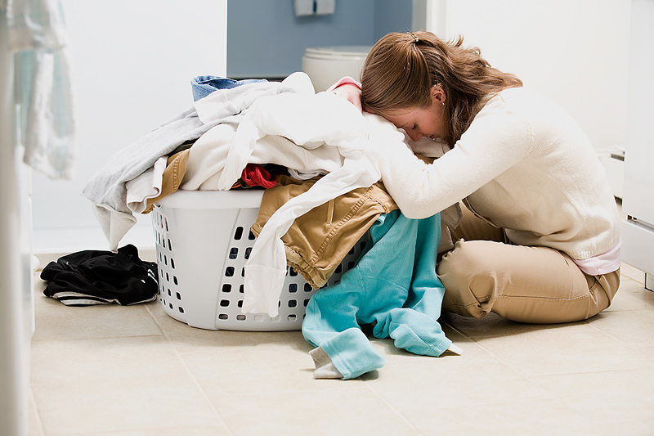
L.F.E.M
Laundry Folding Made Easy
By: Stephen Stenchever

Slide 2
L.F.M.E
Laundry is commonly a weekly task for the typical sanitary human being.
We have a machine to handle cleaning the clothes, we have a machine to dry those clothes, but what about the third step to the equation?
Lets be honest, nobody loves folding clothes, and we all dread it towards the end of every laundry day
Fear no more, your days of laundry folding are over with L.F.M.E!

Slide 3
How does it work?
L.F.M.E is built to work as the functioning programming language for the Laundry Folder Max 3000 (still in prototype phase)
The Language follows styles similar to C++ but with better readability and interpretation
Statements use indents instead of curly brackets (tab/5 spaces)
Variable types do not need to be explicitly stated
Arithmetic will be left associative by default

Slide 4
Input/Output
Input:
  Choice of type of clothing: Shirt/T-Shirt, Pants/Shorts, Sock(2), and Undergarments
  Slot for clothes to be inserted
  Folding mechanism
Output:
  Storage bin where processed (folded) clothes will be stored

Slide 5
Built-in Functions
FeedClothing() – Handles clothes being fed into machine
ArticleType() – Handles determining what type of clothing is inserted
FoldType(article) – Handles the physical folding with input parameter article
FoldingStyle() – Handles what type of folding style is desired
RetrieveClothing() – Handles the retrieval of the folded clothing
CheckStorage() – Checks to make sure that storage bin is not full
RunCycle() – Acts as the Main(), this is where all processing takes place

Slide 6
Syntax
Reserved Words:
  True/False
  F_Style
  A_Type
  F_Type
  StorageBin
  Shirt
  T_shirt
  Socks
  Underwear
  Shorts
  Pants
Variable Types:
  int
  bool
  f_style
  a_type
  f_type
*Note variable types do not need to be explicitly stated*
Logical Operators:
  and (&)
  or (||)
  += (increment by 1)
  -= (decrement by 1)
  is (==)
  =
  > (greater than)
  < (less than)
  # (comment)
Notes:
Note: Variable Types do not need to be explicitly stated

Slide 7
B.N.F.
<RunCycle> ::= <variable assignment><function>|<conditionals> <comments>
<variable assignment> ::= <variable name> (no need to state type)
<variable type> ::= <int> | <bool> | <a_type> <f_type> <f_style>
<variable name> ::= <A-Z> | <a-z> <0-9> | <symbol>
<A_Type> ::= <a_type>
<F_Style> ::= <f_style>
<F_Type> ::= <f_type>
<StorageBin> ::= <TRUE> | <FALSE>
<functions> ::= <built in functions> | <user defined functions>
<built in functions> ::= <FeedClothing> | <ArticleType> | <FoldType> | <FoldingStyle> | <RetrieveClothing> | <CheckStorage>
<FeedClothing> ::= detects when clothes are to be processed
<ArticleType> ::= <A_Type>
<FoldingStyle> ::= <F_Style>
<FoldType> ::= <article> <F_Style>
<RetrieveClothing> ::= takes processed clothing and moves to storage
<CheckStorage> ::= <TRUE> | <FALSE>

Slide 8
More B.N.F.
<user defined functions> ::= <function name> <parameters> <code> <return statement>
<conditionals> ::= <if> | <else> | <while> | <for>
<if> ::= <condition> <TRUE> | <FALSE> if true do something, if false then skip it
<else> ::= do when if is false
<while> ::= <condition> <TRUE> | <FALSE> keep doing while true, if false skip it
<for> ::= do something for a set amount of times
<comments> ::= <#> <OPT comments>
<A-Z> ::= Uppercase alphabetic letters
<a-z> ::= Lowercase alphabetic letters
<0-9> ::= Any digits within the range 0-9 including 0 and 9
<symbol> ::= Any legal ascii symbol that is not a number or letter

Slide 9
Sample Program
RunCycle()
amountToProcess = 5;
amountInBin = CheckStorage(); #True if not full, false if full
a_type article1 = t_shirt;
a_type article2 = t_shirt;
a_type article3 = shirt;
a_type article4 = shorts;
a_type article5 = pants;
while (amountToProcess != 0)
FeedClothing();
ArticleType(A_Type);
FoldingStyle();
FoldType(A_Type);
if (amountInBin != false)
RetrieveClothing();
amountInBin = CheckStorage();
-=amountToProcess; #decrement amountToProcess

Slide 10
Another Sample Program
RunCycle()
amountToProcess = 3;
amountInBin = CheckStorage(); #Lets assume this returns false
a_type article1 = underwear;
a_type article2 = pants;
a_type article 3 = socks;
while (amountToProcess != 0)
FeedClothing();
ArticleType(A_Type);
FoldingStyle();
FoldType(A_Type);
if (amountInBin != false)
RetrieveClothing();
else
cout << “Bin is not empty, please clear it!”;
break;

Slide 11
THANK YOU!
I appreciate your time and I hope all of you are inspired enough by this presentation to go out and spread the word about L.F.M.E.
With your help, we can make the dreaded fear of folding laundry a thing of the past!

Slide 12
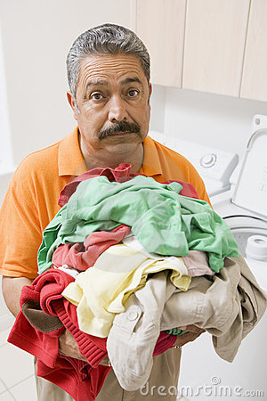
You can be this…

Slide 13

Or you can be this…

