Slide 1
Dahno DRUMP
Programming language

Slide 2
WHY?
I always want to learn drum
Designed for people who can’t read music
but know how to code
Programmer can do all things

Slide 3
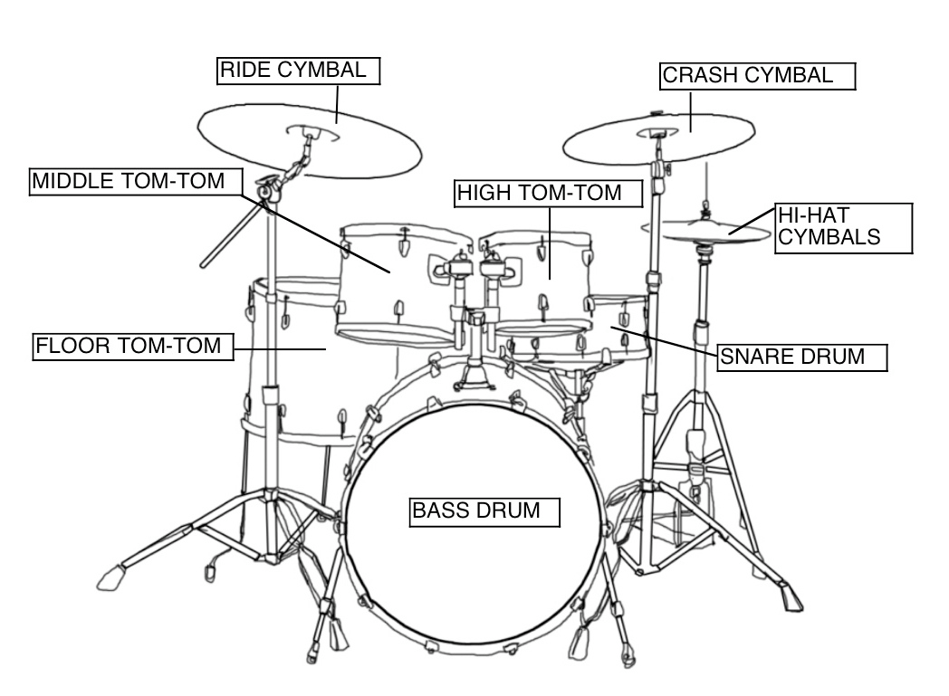
Standard drum set

Slide 4
Input / Output:
Input:
Instrument name ( beat ) * loop counts
Instrument name: Bass / Floor / Snare / High/ Hihat / Crash / Ride
Beat : take input from 1 to 4, indicate frequency in every 4 beats
Loop counts : how many times it’s repeating
Output:
Beautiful drum music

Slide 5
Timing
The tempo of the song you created is controlled by the time signature you enter at the beginning of your program
The clock is set to that speed
Each clock edge is 1 beat

Slide 6
Language Description:
Every function represent 4 beats
Use loop function to make those 4 beats repeat ( * num )
Num = how many time you want to repeat
Not case sensitive
Comments follow by ‘ % ’

Slide 7
Syntax:
Reserved Words:
Bass / Floor / Snare / High/ Hihat / Crash / Ride / Middle
Operators:
*
Variable Types:
Instrument names / Frequency / num

Slide 8
B.N.F
<Main> ::= <functions>|<comments>
<variable name> ::= <A-Z> | <a-z> <0-9>
<functions> ::= <built in functions>
<built in functions> ::= <Snare> | <Hihat> | <Bass> |<Crash> | <Ride> | <Floor> | <High>
<frequency> ::= <0-4>
<comments> ::= % comment content

Slide 9
Examples:
Snare ( 1,2,3,4 ) * 1
Bass ( 1,2,3,4 ) * 2

Slide 10
Crash ( 1,2,3,4 ) * 3
Base ( 1 ) * 3
snare ( 3 ) * 3

Slide 11
Sample Programs:
Main(){
Snare( 3 ,4 ) * 5
Bass( 1 , 3 ) * 10
Hihat( 2,4 ) * 5
}
% it will sound like “donts da donts da”

