Slide 1
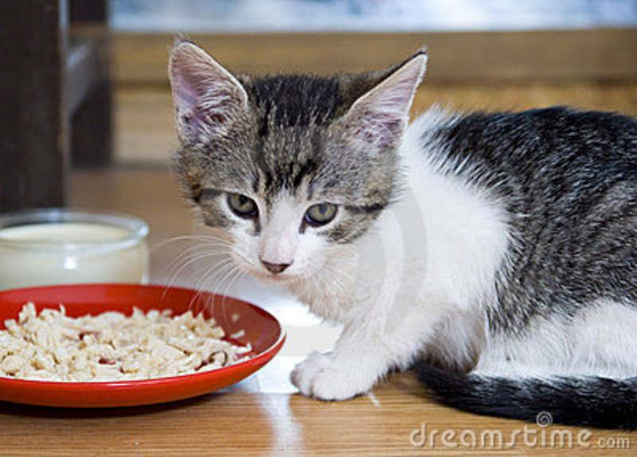
F.U.C.K Feeding Ungrateful Cats and Kittens
By
Katherine Callahan

Slide 2
F.U.C.K
Cats, although adorable, can be annoying creatures that wake you up at very early hours of the morning to feed them
This language would be used to dispense cat food and water into separate dishes
This language could be used to feed your cat at certain preset times during the day or will use a weight based system to detect when the bowls are empty

Slide 3
Language Description
Similar to C++, but implements things from Groovy to make assigning things simpler
Lines do not need to end in a semicolon
Variable names must start with a letter
Language is case sensitive
Left Associative

Slide 4
Input/Output
Input:
Clock running on 24 hour time
Scale to determine if dishes are empty
Multiple trays for food storage
Water piping hookup or bottle input
Output:
Dispensers for food and water

Slide 5
Functions
DispenseFood() -Dispenses food for specified cat
DispenseWater() -Dispenses water for specified cat
CheckEmpty() -Checks if bowl for food/water is empty
SetFeedTime() -Sets times for food/water to be dispensed
SetAmount() -Sets amount of food to be dispensed
SetFoodType() -Sets type of food
SetDish() -Sets dish for food/water to be dispensed to
Main() -Main part of program

Slide 6
Syntax
Reserved Words:
Empty
True
False
FoodType
Dish
FoodAmnt
Time
Variable Types:
int
double
bool
time
CatName
dish
foodType
Operators:
& and
|| or
++ increment by 1
-- decrement by 1
== is equals
= equals
: used in time variable
>= greater than or equal to
<= less than or equal to
~ comment

Slide 7
B.N.F.
<Main> ::= <variable assignment><functions>|<conditionals> <comments>
<variables assignment> ::= <variable types> <variable name>
<variable type> ::= int | double | bool | time | <CatName> | dish | foodType
<variable name> ::= <A-Z> | <a-z> <0-9>
<CatName> ::= <FoodType> <Dish> <FoodAmnt>
<FoodType> ::= <foodType> food tray number
<Dish> ::= <dish> dish number
<FoodAmnt> ::= Amount in cups
<functions> ::= <built in fuctions> | <user created functions>
<built in functions> ::= <DispenseFood> | <DispenseWater> | <CheckEmpty> |
<SetFeedTime> | <SetAmount> | <SetFoodType> | <SetDish>
<DispenseFood> ::= <CatName>
<DispenseWater> ::= dish number
<CheckEmpty> ::= returns true or false
<SetFeedTime>::= time

Slide 8
B.N.F Continued
<SetFoodAmount> ::= CatName.FoodAmnt | Amount in cups
<SetFoodType> ::= CatName.FoodType | <foodType> food tray number
<SetDish> ::= CatName.Dish | <dish> dish number
<user created functions> ::= Function name, parameters, function contents, return
<conditionals> ::= <if> | <while> | <for> | <switch>
<if> ::= condition, do this thing | <else>
<else> ::= do that thing
<while> ::= condition, thing to do
<for> ::= amount to do for, stuff to do
<switch> ::= case 1, case 2, case 3…
<comments> ::= ~ comment content
<A-Z> ::= Uppercase <a-z>
<a-z> ::= If you don’t know the alphabet by now I can’t help you
<0-9> ::= something you really should have learned by this point…

Slide 9
Sample Programs
Main(){
time morning = 06:00
time night = 18:00
foodType cat = 1
dish sfood = 1
dish swater = 2
CatName Sugar = [FoodType: cat, Dish: sfood, FoodAmnt: 1.00]
SetFeedTime(morning)
SetFoodType(Sugar.FoodType)
SetAmount(Sugar.FoodAmnt)
SetDish(Sugar.Dish)
DispenseFood(Sugar)
DispenseWater(swater)
SetFeedTime(night)
DispenseFood(Sugar)
DispenseWater(swater)
}

Slide 10
Sample Programs (cont.)
Main(){
time morning = 08:00
time night = 18:00
foodType cat = 1
foodType kitten = 2
dish cfood = 1
dish cwater = 2
dish sfood = 3
dish swater = 4
CatName Callie = [FoodType: cat, Dish: cfood, FoodAmnt: 0.66]
Catname Spook = [FoodType: kitten, Dish: sfood, FoodAmnt: 0.75]
SetFeedTime(morning)
SetAmount(Callie.FoodAmnt)
SetFoodType(Callie.FoodType)
SetDish(Callie.Dish)
DispenseFood(Callie)
DispenseWater(cwater)
SetAmount(Spook.FoodAmnt)
SetFoodType(Spook.FoodType)
SetDish(Spook.Dish)
DispenseFood(Spook)
DispenseWater(swater)
SetFeedTime(night)
SetAmount(Callie.FoodAmnt)
SetFoodType(Callie.FoodType)
SetDish(Callie.Dish)
DispenseFood(Callie)
DispenseWater(cwater)
SetAmount(Spook.FoodAmnt)
SetFoodType(Spook.FoodType)
SetDish(Spook.Dish)
DispenseFood(Spook)
DispenseWater(swater)
}

Slide 11
Sample Programs(cont.)
Main(){
foodType kitten = 1
dish wfood = 1
dish wwater = 2
CatName Watson = [FoodType: kitten, Dish: wfood, FoodAmnt: 1]
SetAmount(Watson.FoodAmnt)
SetFoodType(Watson.FoodType)
SetDish(Watson.Dish)
while(true){
if(CheckEmpty(wwater) == true){
DispenseWater(wwater)}
~Will dispense water whenever it is empty
if(Time >= 06:00 & Time <= 12:00 & CheckEmpty(wfood) == true){
DispenseFood(Watson)}
if(Time >= 18:00 & Time <= 00:00 & CheckEmpty(wfood) == true){
DispenseFood(Watson)}
}
}

Slide 12
