Slide 1
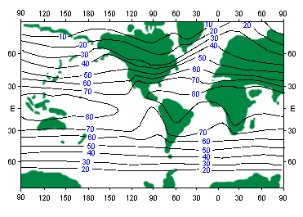
Climate – What makes it work?

Slide 2
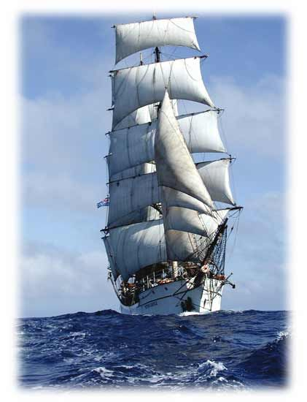
We start in the 1700’s. People sailed across the oceans in tall sailing ships.
They had a very good idea of the prevailing winds. It was their business.
A fellow named Hadley had a theory of why the winds blew the way they did.

Slide 3
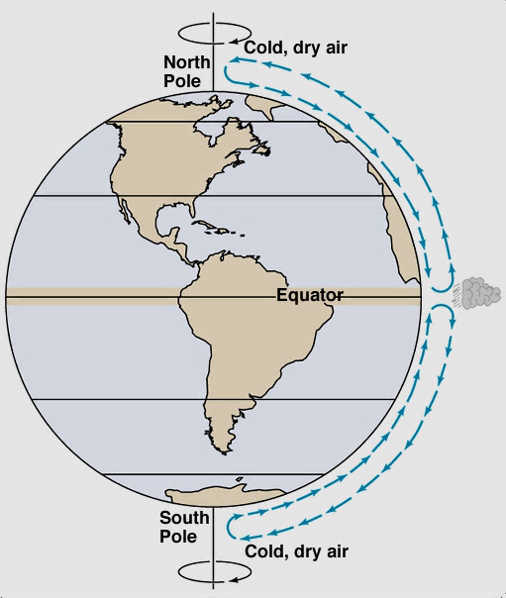
Hadley’s simple idea:
Hot air rises, cold air sinks
<----These are now called
Hadley cells.
At the rising end, you get clouds and precipitation. At the sinking end, you get High pressure and clear skies.

Slide 4
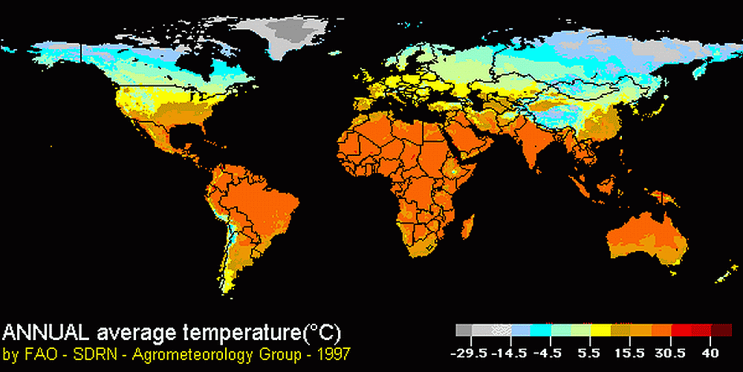
Hadley was right. It’s warmer near the equator.
But the pattern isn’t as simple as that so the atmospheric response is also more complex than Hadley thought.

Slide 5
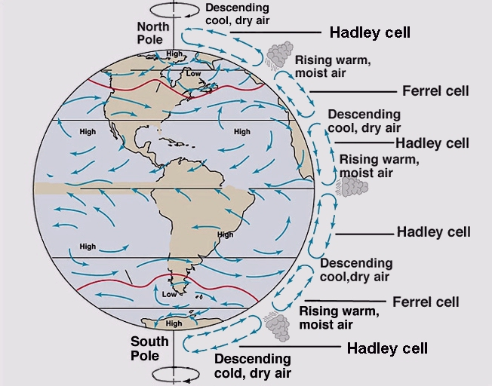
This is a more sophisticated view, called the Three Cell model.

Slide 6
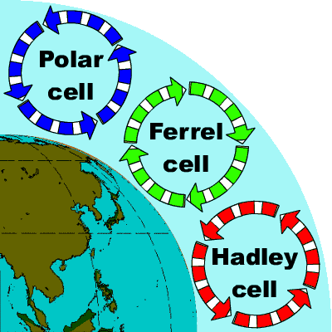

Slide 7
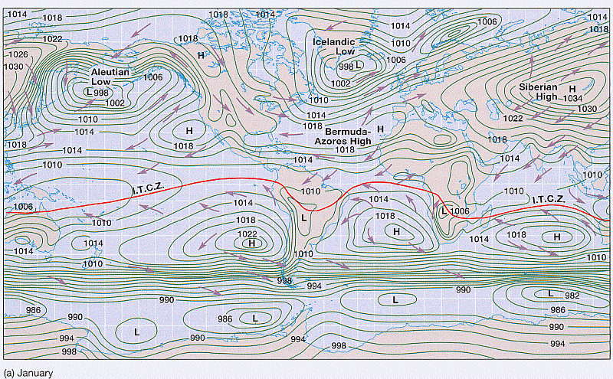
If the air rises near the equator, you get a zone of precipitation. This is called the Intertropical Convergence Zone or ITCZ .

Slide 8
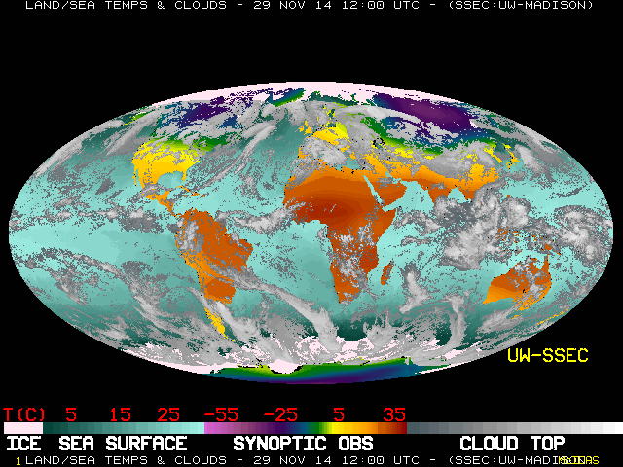
Here is a satellite image. Where is the ITCZ?
Here is the ITCZ

Slide 9
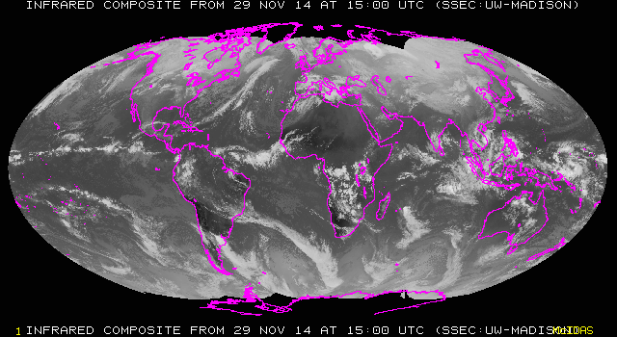
Southeast Asia and Indonesia are here, under the ITCZ clouds

Slide 10
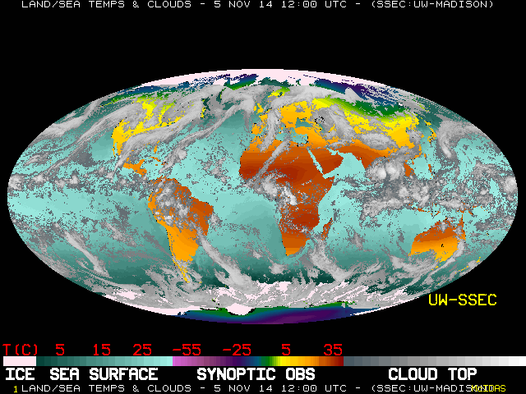
Three weeks of clouds

Slide 11
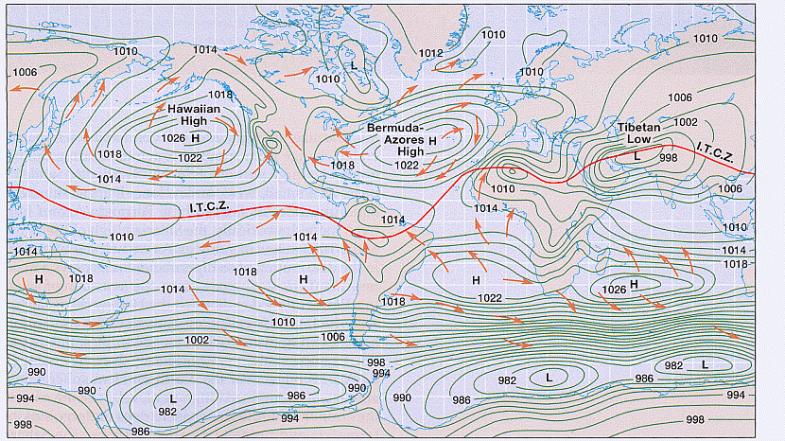
This is the mean surface pressure in July. On either side of the ITCZ are Subtropical Highs. This is where air is sinking in the Hadley cells.

Slide 12
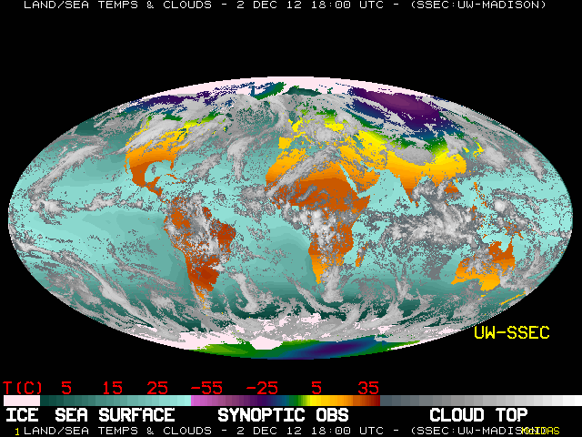
Here’s a December map from 2012. The ITCZ is still there. Always.
The drier areas in the subtropics are the Subtropical Highs
Those are tropical thunderstorms and rain showers.

Slide 13
(Almost) Global Rainfall Pattern

Slide 14
At the poleward end of the 3-cell model you have another area of rising motion, near 60° latitude. This is the latitude of sub-polar lows.

Slide 15
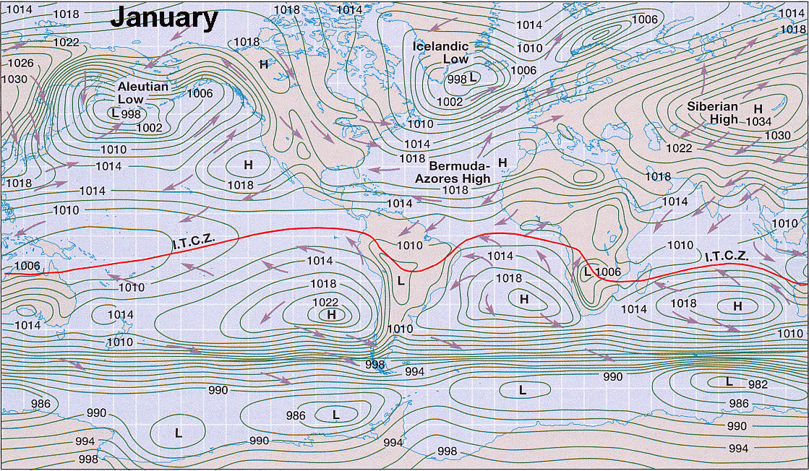
The ITCZ, Subtropical Highs, and Subpolar Lows move and change with the seasons. What happens if they change from year to year?

Slide 16
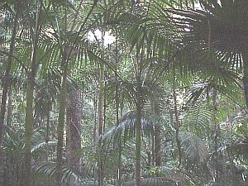
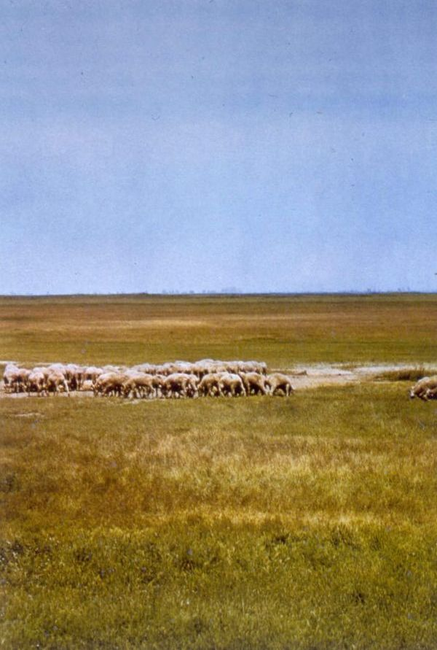
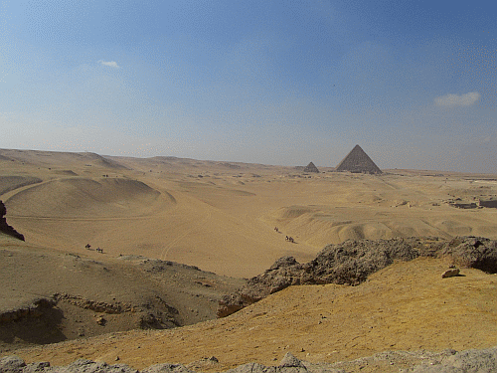
Tropical Rainforest
Desert
Prairie or Steppe (dry)
At low latitudes, the difference is the ITCZ. If it is over you, it rains. If not, it doesn’t (ever?).

Slide 17
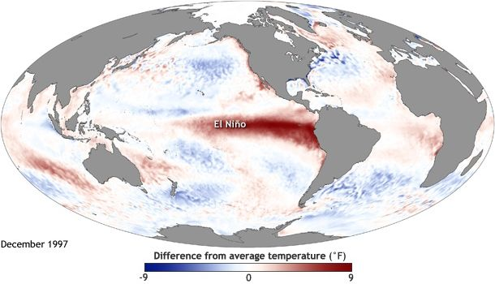
El Niňo

Slide 18
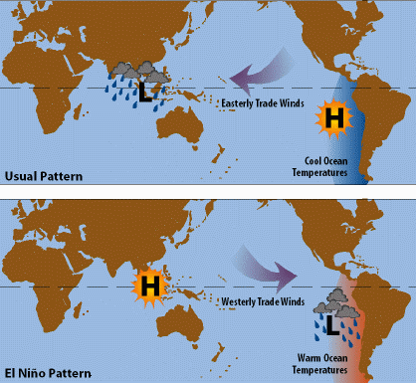
El Nińo: a disruption in the “normal” pattern in the Pacific Ocean.

Slide 19
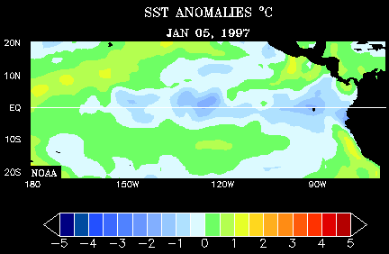
This is the development of the most intense El Nińo ever recorded in 1997-98.
These are anomalies of Sea Surface Temperature (SST)
An anomaly is the difference between the observed and average

Slide 20
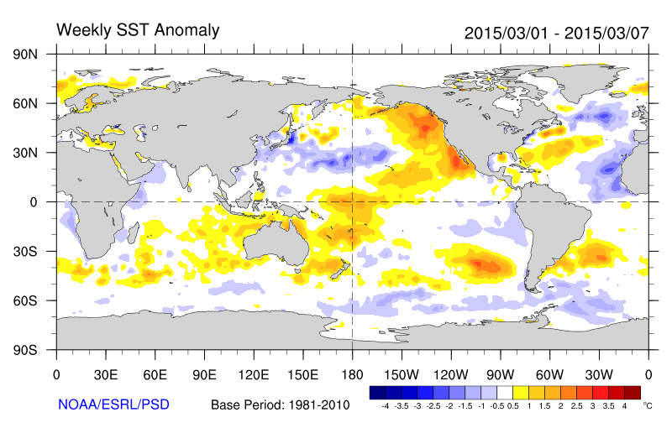
The format has changed but this is the same type of loop of temperature anomalies from March 1, 2015 until the end of November.

Slide 21
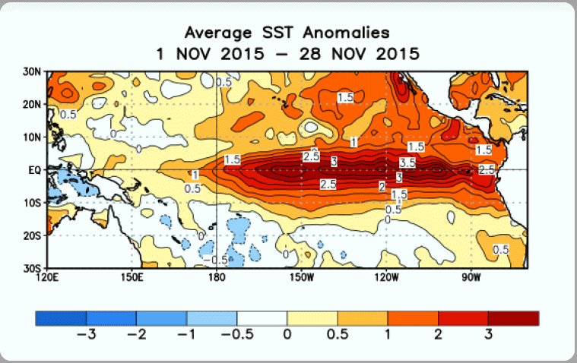
Recent Sea Surface Temperatures (SST) with more detail
How does 2015 compare with 1997-98?

Slide 22
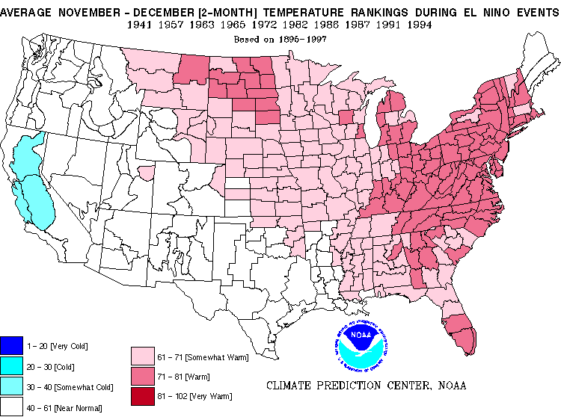
What can we expect? Climatological mean for temperature

Slide 23
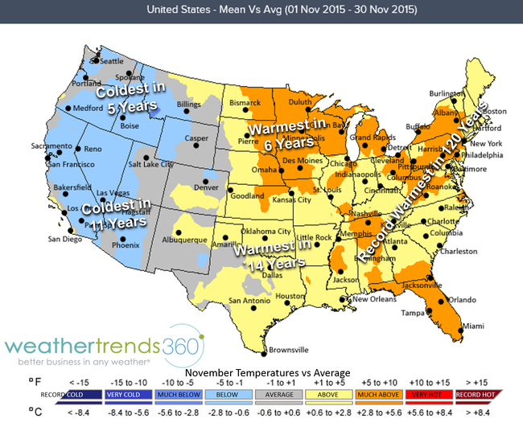
Actual temperature anomalies for Nov 2015
http://www.weathertrends360.com/Blog/Post/November-2015-Weather-Roundup-US-warmest-in-14-wettest-in-11-2960

Slide 24
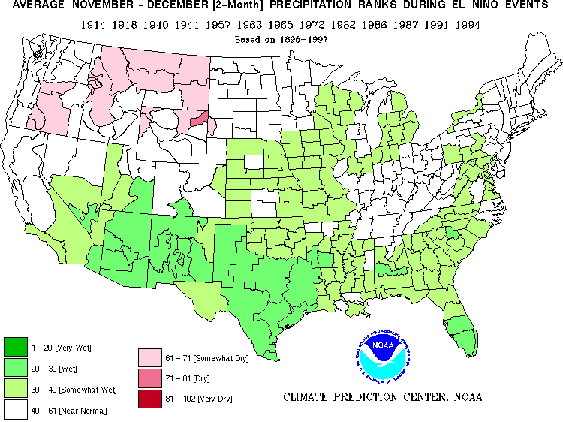
Climatological mean for Precipitation

Slide 25
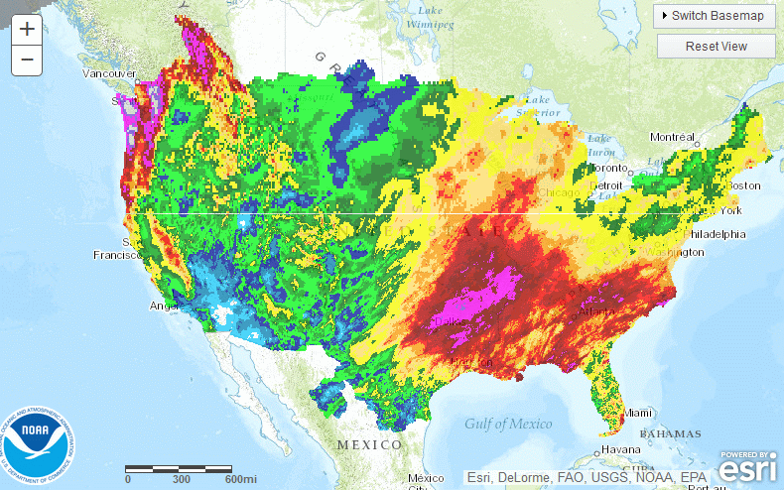
Radar estimated precipitation in Nov 2015
From: http://water.weather.gov/precip/

Slide 26
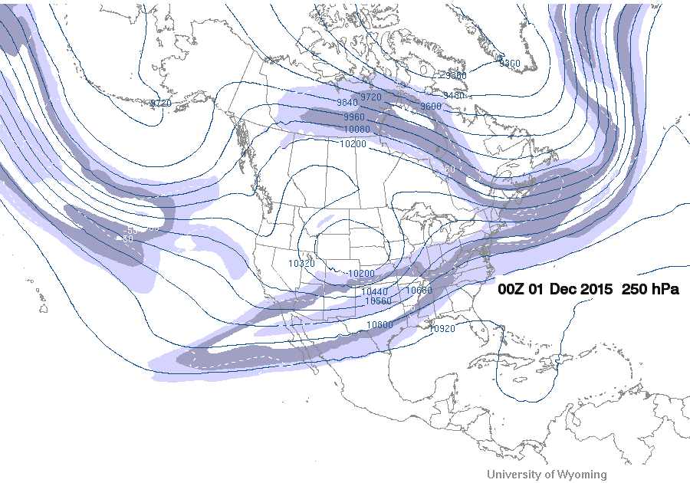
How does El Nino do that?
Cold UA trough
Strong Jet Stream
Strong Jet Stream deepens UA trough
→ cold with heavy rain
UA ridge
Warm Water -> warm air

Slide 27
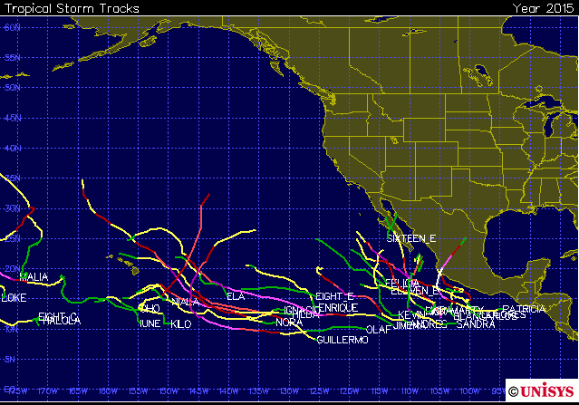
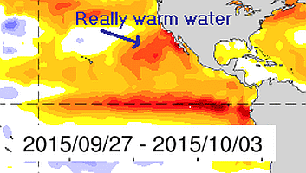
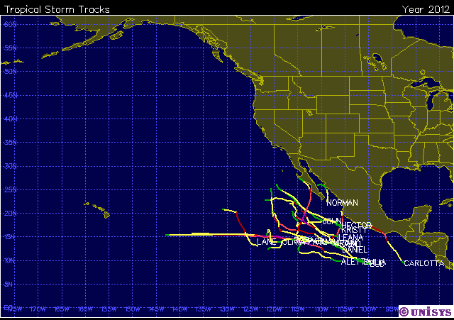
2015
Why?
El Niňo has also had an effect on hurricanes – many more in the Eastern Pacific than in a typical year.
2012

Slide 28
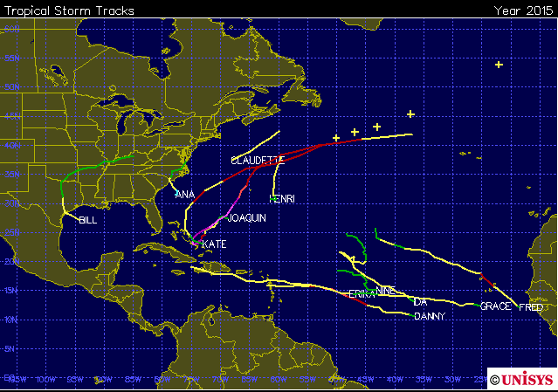
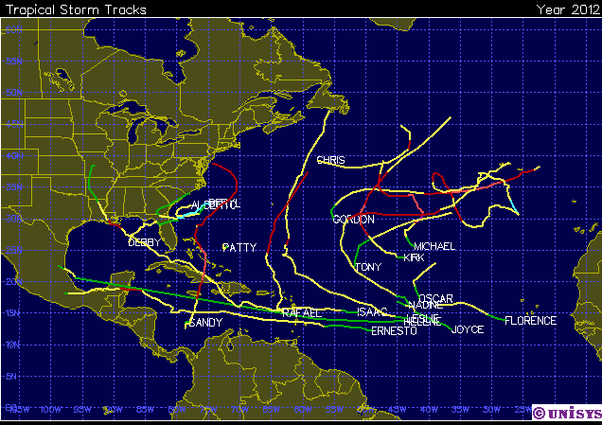
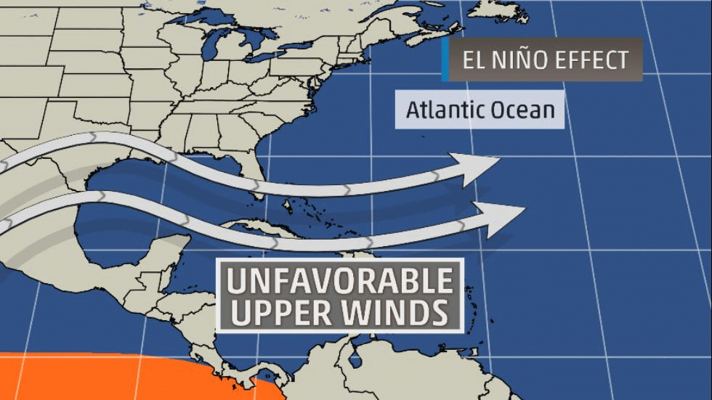
2015
2015 saw fewer tropical cyclones in the Atlantic basin
2012
Why?

Slide 29
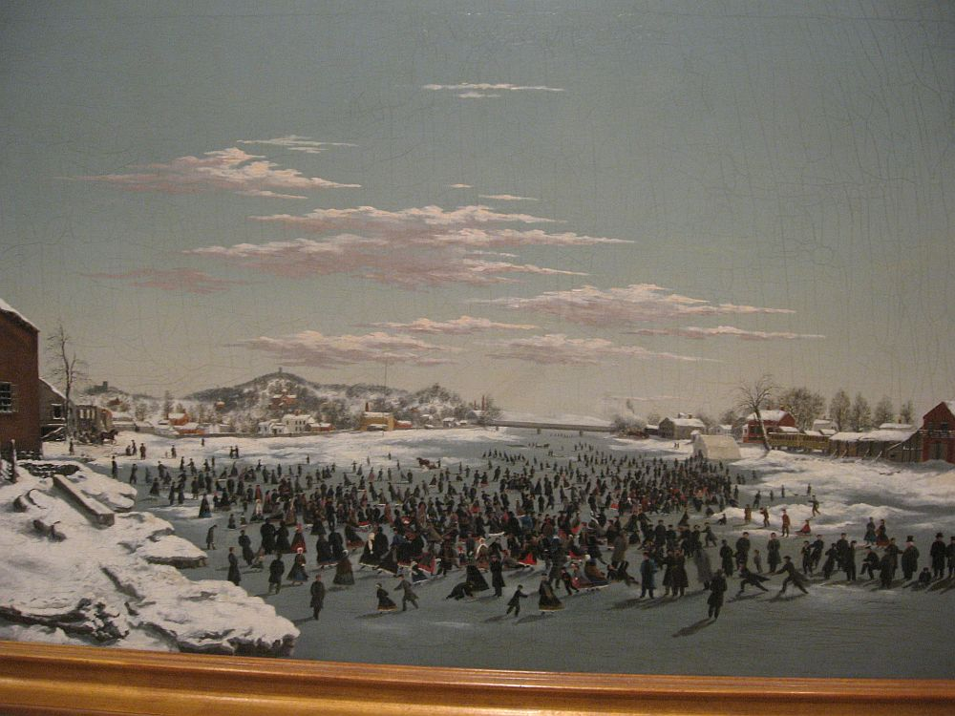
Climate Change
Skating on the Genesee River (Rochester), 1862

Slide 30
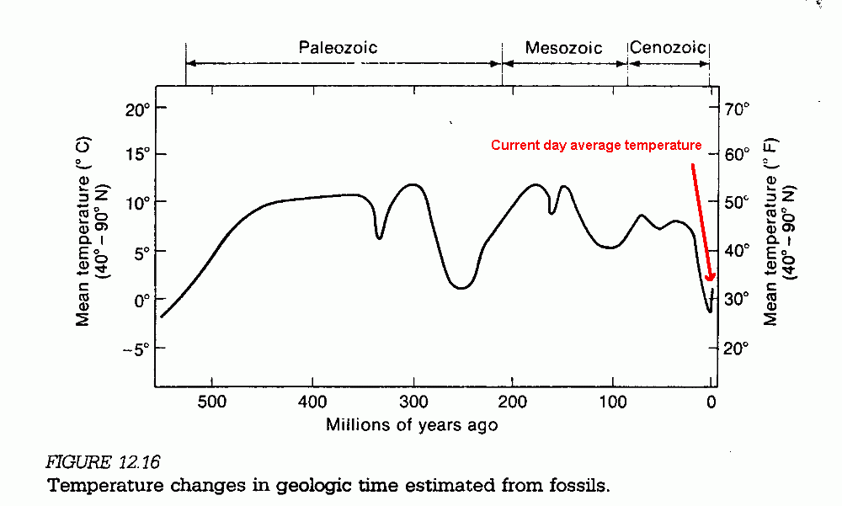
For most of the last half billion years, Earth was a much warmer place than it is now.
Jurassic

Slide 31
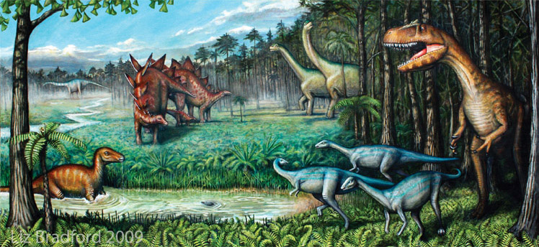
This is what scientists propose the Jurassic probably looked like in North America. It’s certainly much warmer than the current climate.
The Jurassic period was about 175 million years ago.

Slide 32
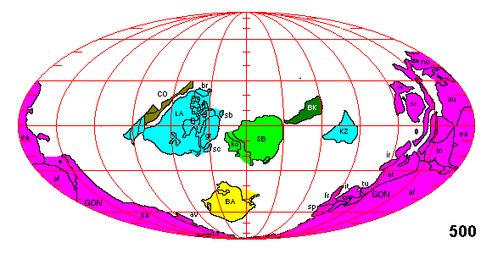
Million years ago
During the last half billion years, the continents have drifted together then apart again. The changes in the ocean shape and currents have had a major effect on climate.
500 million years ago there was more land near the Equator than near the poles. The Northern Hemisphere was almost all water.

Slide 33
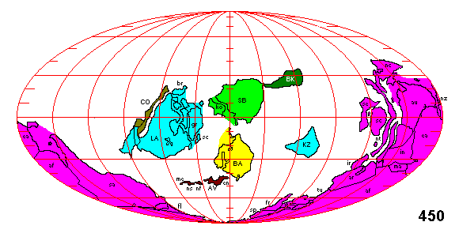
50 million years is a long time. The land masses move slowly but there is a noticeable change from 500 to 450 million years ago.

Slide 34
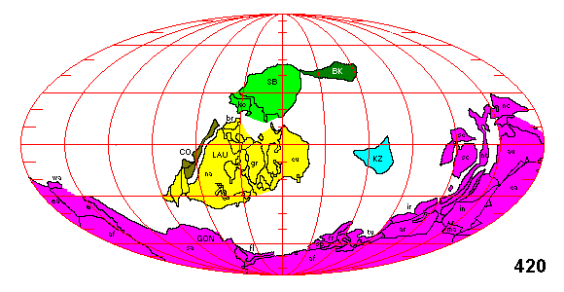
GON is the notation for Gondwana. Do you recognize any now-familiar continental shapes yet?

Slide 35
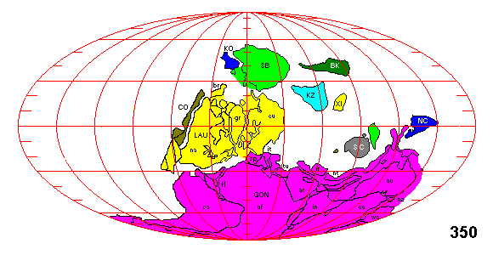
How about at 350 million years ago?

Slide 36
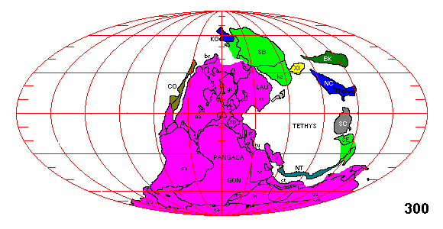
Pangaea (or Pangea) was even bigger than Gondwana. 300 million years ago the Earth was about 10°C warmer than today.

Slide 37
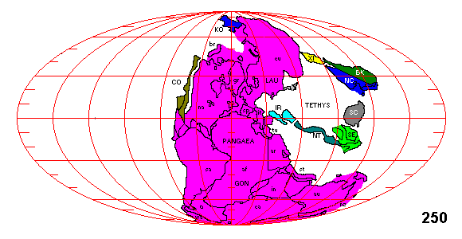
What’s happening to Pangaea?

Slide 38
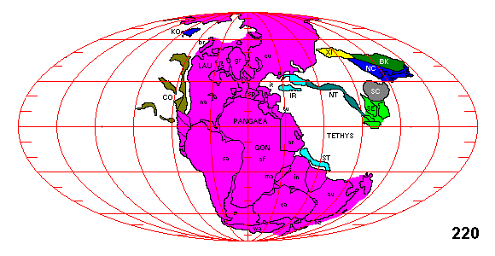
LAU is for Laurentia which eventually forms the Northern Hemispheric continents.

Slide 39
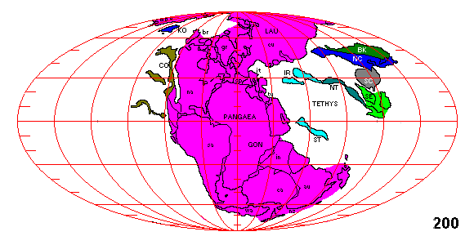
This is getting close to the time of that artist’s conception of the dinosaurs. Actually, they were already the dominant species at 200 million years ago. Large herbivorous dinosaurs need a lot of vegetation so the climate was very warm and humid.
Why was it so warm?

Slide 40
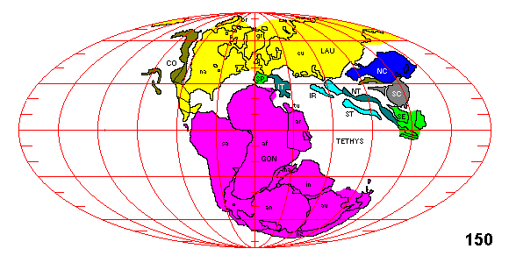
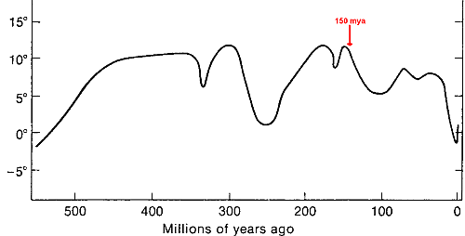
This is when the climate cooled →.
Any ideas why, just from the continents?

Slide 41
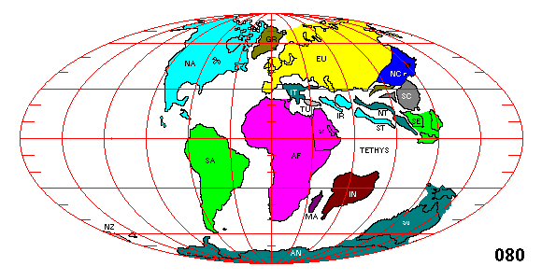
Almost there. Dinosaurs were already declining due to climate change but the biggest change is yet to come.

Slide 42
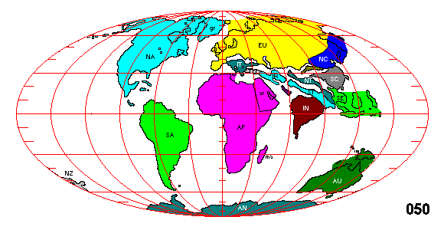
About 65 million years ago, an asteroid strike wiped out the last of the dinosaurs, allowing mammals to flourish. Although the Earth is cooler, there was still no permanent ice (except Antarctica).
What is different about this world from our own?

Slide 43
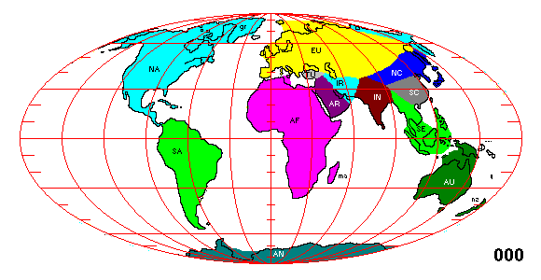
Here it is. Current-day continents. Ice ages began about 3 million years ago. The answer is on this map but it’s not obvious why it works.

Slide 44
Here’s the whole loop in one animation. It has a longer pause near the end when the Ice Ages began.

Slide 45
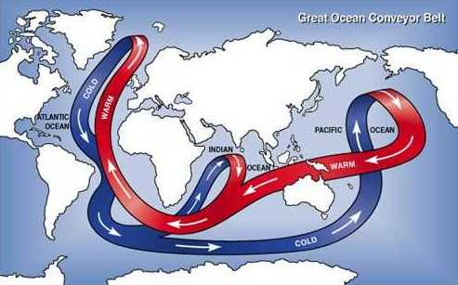
With the Atlantic Ocean separated from the Pacific, ocean currents transport warm water into the North Atlantic. When the currents slow, glaciers form in the high latitudes.

Slide 46
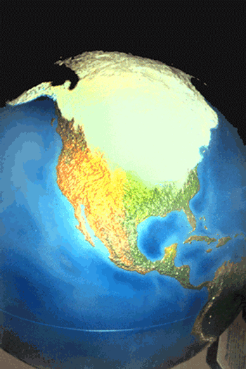
The ice covered 1/3 of the northern hemisphere landmass. Areas just south of the ice were also much colder than they are now.

Slide 47
The glaciers expand and contract over several hundred thousand years. The last glacial expansion is called the “Wisconsin Ice Age.”
Wisconsin

Slide 48
It is not an accident that human brain size has quadrupled during the Ice Ages.

Slide 50
You can’t live on the glacier. It’s ice all year round.

Slide 51
The shear face of this glacier means you can’t even climb onto it. Life in this climate will be tough. Only the smart ones who have social groups will survive.

Slide 52
The average temperature can change very abruptly. 12000 years ago, on our way into the current Interglacial age, it dropped back to Ice Age conditions in one human lifetime.
1000 years later, it bounced back to warm again just as fast. The cold period was the Younger-Dryas.
Younger-Dryas

Slide 53
The Little Ice Age was a cool period which ended around 120 years ago.

Slide 54
Around 1900, the entire world, started to get getting warmer.
As James Burke showed in his video, changing climate means changing living conditions for humans.
(From http://data.giss.nasa.gov/gistemp/graphs_v3/)

Slide 55
In 2012, most of the U.S. was suffering with drought.

Slide 56
As of last year things had improved in the central U.S. but look at California!

Slide 57
Fast-forward to the current situation. Not much improvement for California

Slide 58
In June 2014 it just didn’t rain over parts of 6 southwestern states.

Slide 59
In 2015 things haven’t improved much in southern California. Using the 3-cell model, what does this say for the overall pattern?

Slide 60
The latest version that the CPC has posted is for October

Slide 61
Perhaps the dry subtropical Highs are impacting the southern U.S. more
History shows us that rising global temperatures bring BIG changes in the circulation features.

Slide 62
What happens to the ocean currents if the temperatures in Greenland get warmer and melt the ice?

Slide 63
Here’s the ocean conveyor belt again. Remember from the video, fresh water in the north Atlantic ocean caused the Gulf Stream to stop, allowing glaciers to form in Europe and North America.
Melting ice is fresh water which doesn’t sink. Europe and Asia could get cold enough for glaciers.
If the world warms, will it be just a big heat wave or will it be another Ice Age?
And what happens to us when the climate changes?

Slide 64
Superstorm Sandy
2012
One thing we know from history: when the climate changes, weather events happen that are different from what you had.
Super typhoon Hai-yan 2013
And they are often extreme.

