Slide 1
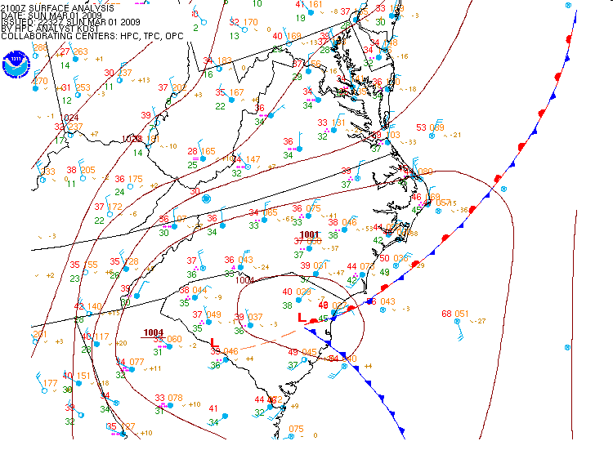
Winds on the Weather Map
Now that we know that upward vertical motion causes clouds and precipitation, how do we get the air moving so it can go up?

Slide 2
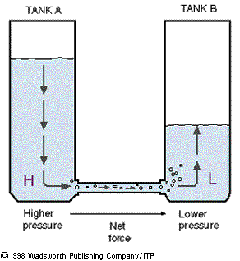
The atmosphere wants to equalize any imbalance in pressure

Slide 3
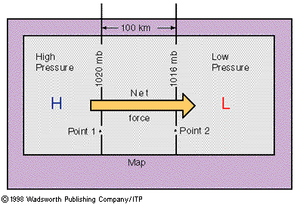
So if there is a pressure difference, there’s a net force.
This is called Pressure Gradient Force. It always goes from the High toward the Low.

Slide 4
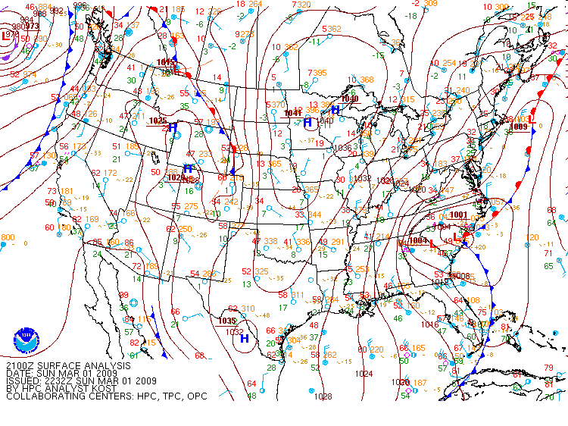
So, which way does the PGF go?
Here’s the High
Why don’t the winds go the same way as the PGF?
PGF
Here’s the Low

Slide 5
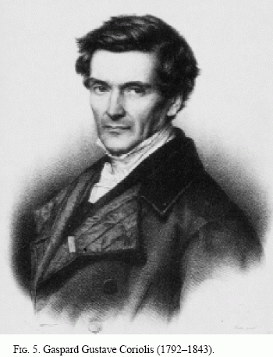
This guy figured it out.

Slide 6
The Earth is rotating quite quickly – once every 24 hours.
The Earth’s circumference is about 25,000 miles, so any spot on the equator goes 25,000 miles around in 24 hours. That’s over 1000 mph!

Slide 7
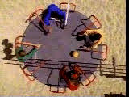
On rotating objects, things move in a weird way, as if some “unknown” force was pushing them sideways.
This playground platform is rotating quite quickly, much like the Earth, when viewed from above one of the poles.

Slide 8
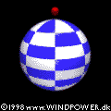
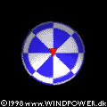
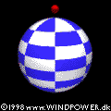
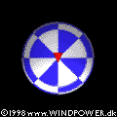
If you were stationary in space, here’s how it looks. The parcel moves in a straight line.
From your perspective on the ground in the northern hemisphere, the Earth doesn’t appear to be rotating. So the parcel appears to be pushed to the right.
We call this mysterious force that appears to push everything sideways Coriolis Force

Slide 9
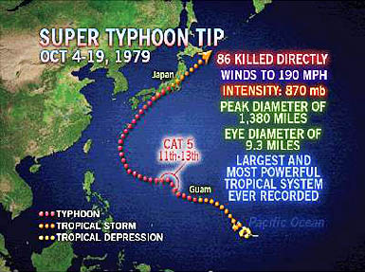
870 mb

Slide 10
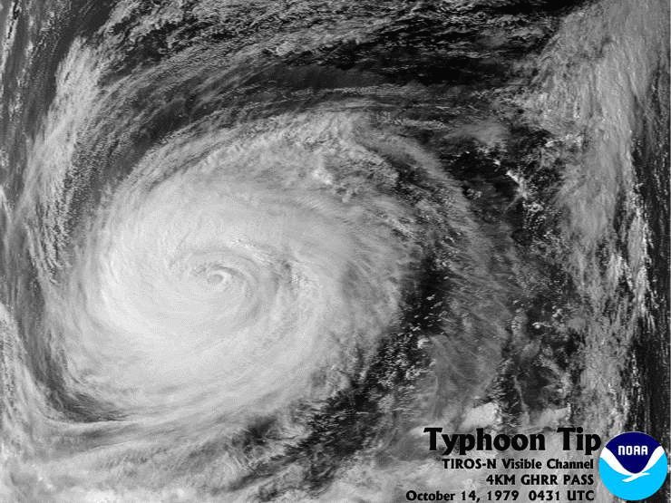
Now add in the Coriolis Force …
PGF

Slide 11
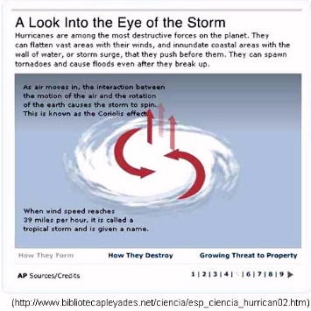
Why do they appear to be curving to the left?

Slide 12
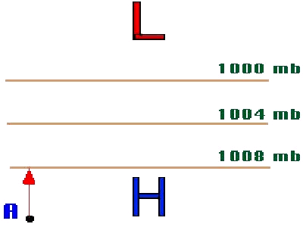
The red arrow is the PGF, the green arrow is the Coriolis force. Blue/purple shows how the parcel moves with those two forces both acting on it.

Slide 13
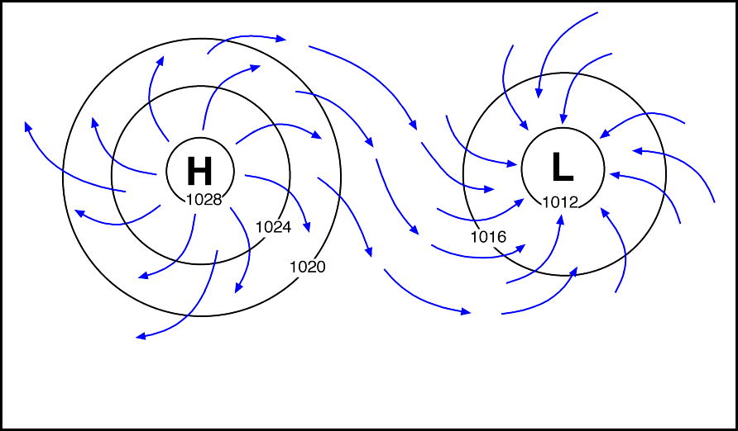
Air parcels on the rotating Earth are pushed by PGF out of Highs and toward Lows. Once they are moving, Coriolis Force acts on them.
In the Northern Hemisphere, parcels flow clockwise around Highs and counter-clockwise around Lows. It’s reversed in the Southern Hemisphere.
.

