Slide 1
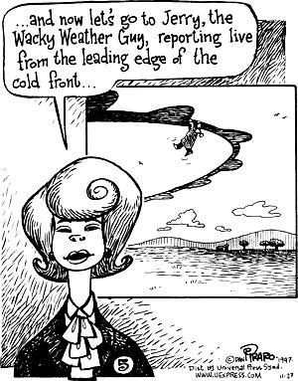
Highs, Lows, Air masses, and Fronts

Slide 2
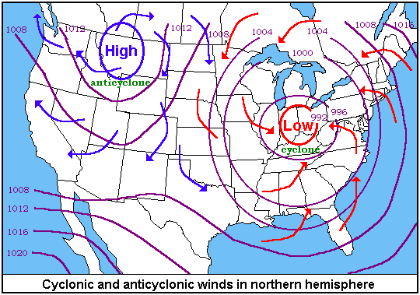
Friction causes the air to spiral inward toward lows while still spinning counter-clockwise. Air spirals out of Highs clockwise.

Slide 3
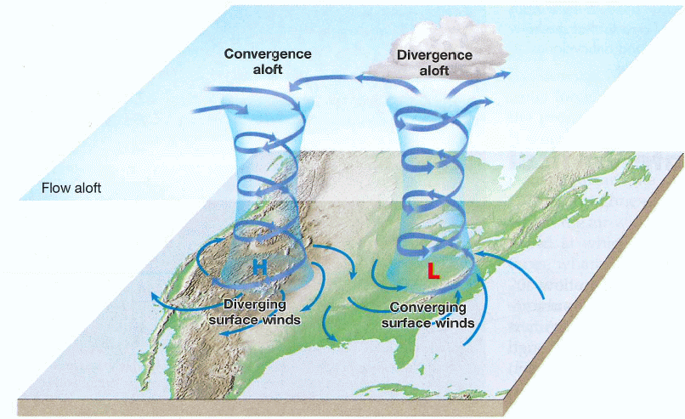
What kind of wind flow?
At the surface of the Earth,
Convergence in Lows means a net airflow in so air must go upward,
Divergence in Highs means a net airflow out so air must go downward.
The opposite happens at the top of the troposphere.

Slide 4
Today’s map

Slide 5
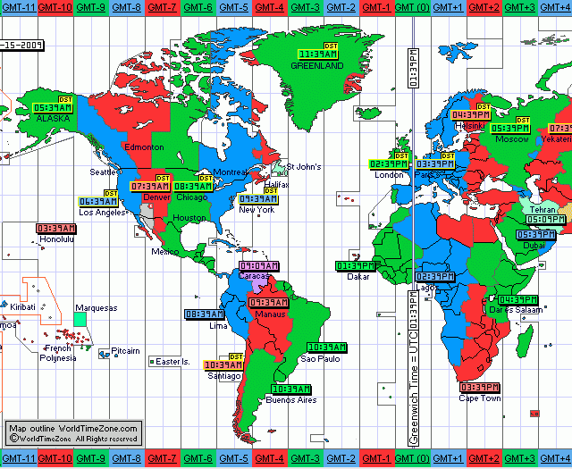
Time on weather maps
We label all weather maps with the Greenwich Mean Time (GMT). This is also called Zulu time, Z for short. Eastern Standard Time is 5 hours behind GMT.

Slide 6
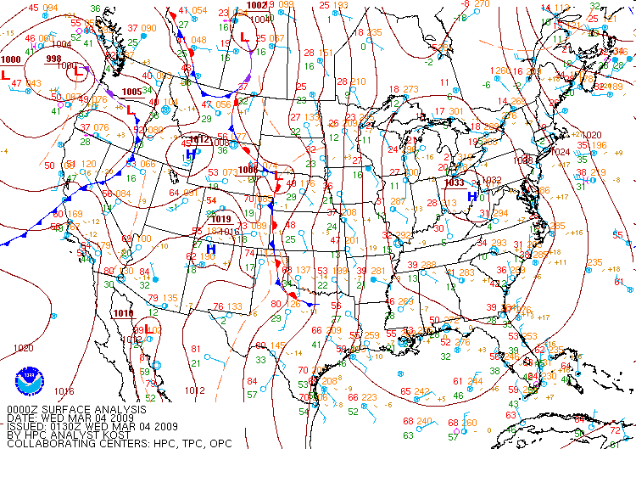
This is the 00Z map. That’s midnight in Greenwich, England. What time is it in Oneonta?

Slide 7
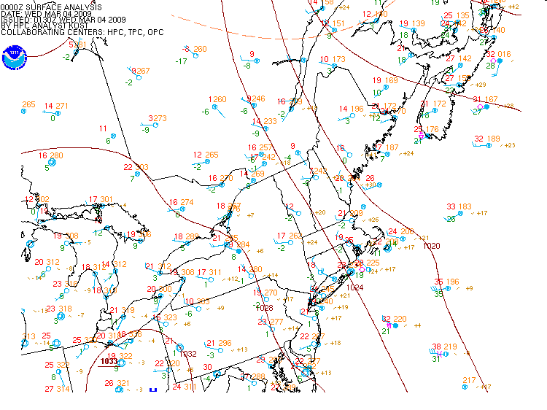
Isobars help to show the pressure gradient
Cold and dry air. Where did it come from?

Slide 8
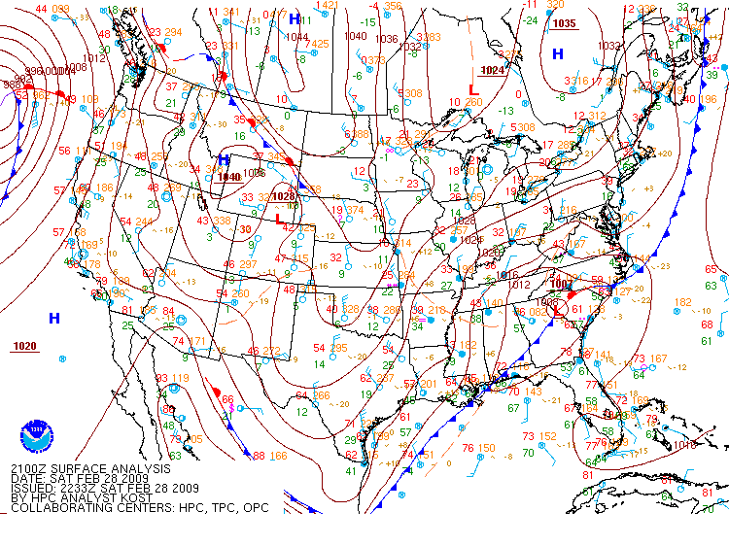
Saturday afternoon at 21Z (4 p.m., eastern time)

Slide 10
The five main air masses
 | Arctic | Polar | Tropical
Continental | cA | cP | cT
Maritime | (does not exist) | mP | mT

Slide 11
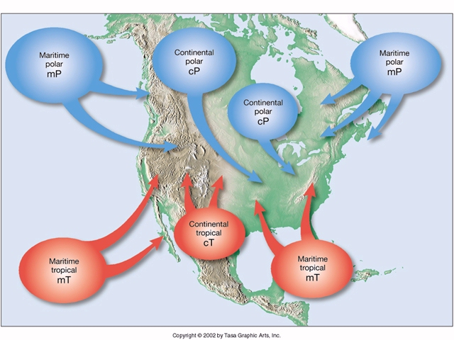
The atmosphere has discrete areas of air with homogeneous characteristics. These are called air masses.

Slide 12
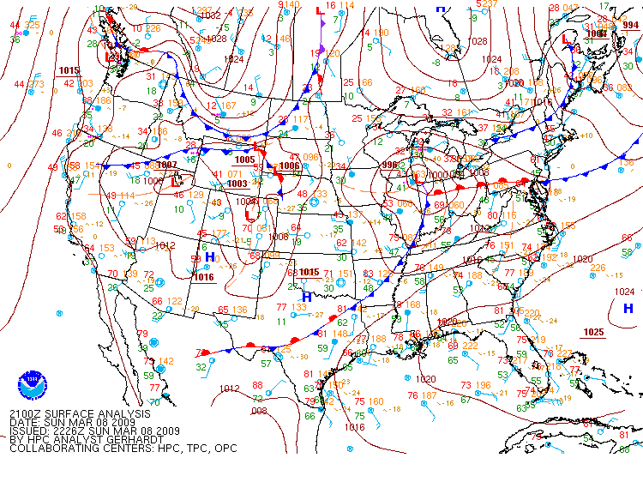
cA
mP
cA
cP
cP
mT
cT
All five main air masses are here. Can you find them?

Slide 13
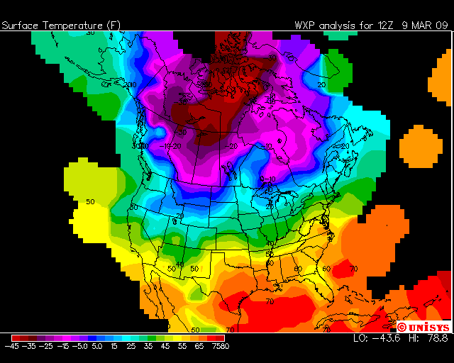
There are places which are very cold, ones which are very warm, with large gradients in between the air masses.

Slide 14
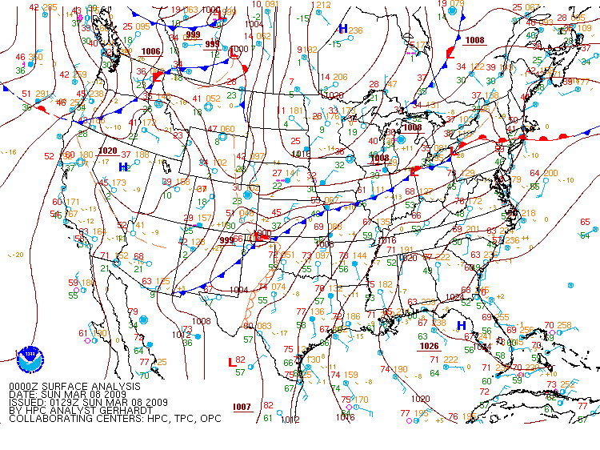
The boundary between air masses is a front

Slide 15
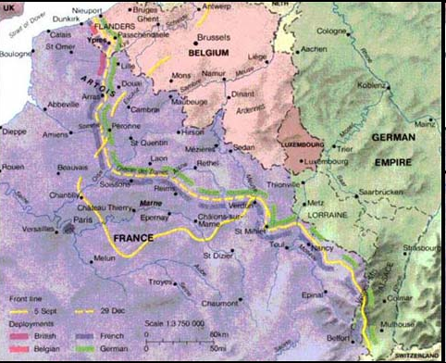
Fronts in meteorology were based on the battle fronts of World War I
The frontal theory was proposed by Vilhelm Bjerknes
To see this, go to www.richthofen.com/ww1sum/

Slide 16
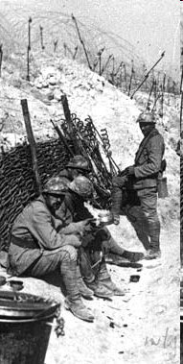
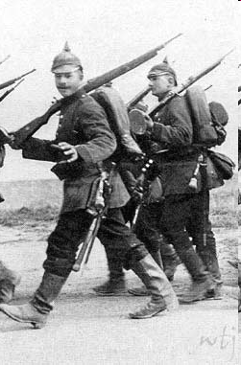
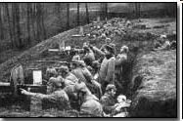
The German uniform of WWI
French infantry
Trenches at the front

Slide 17
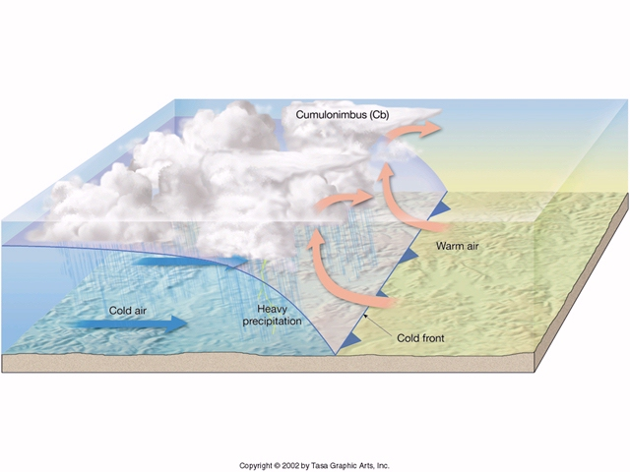
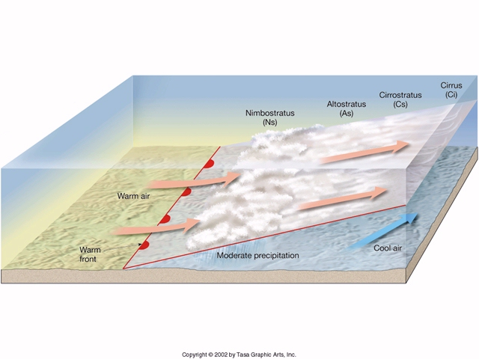
Fronts come in two basic types: Cold fronts and Warm fronts
In the cold front, the cold air mass is advancing
In the warm front, the warm air mass is advancing

Slide 18
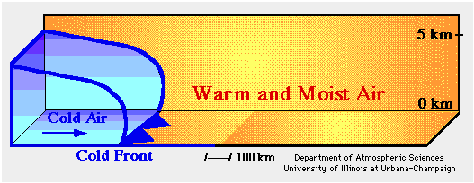
Cold air is heavier and more dense than warm air so the cold air vigorously pushes the warm air up.

Slide 19
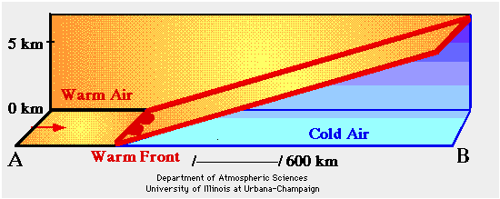
Warm air can’t push underneath the cold (denser) air, so it slides above.

Slide 20
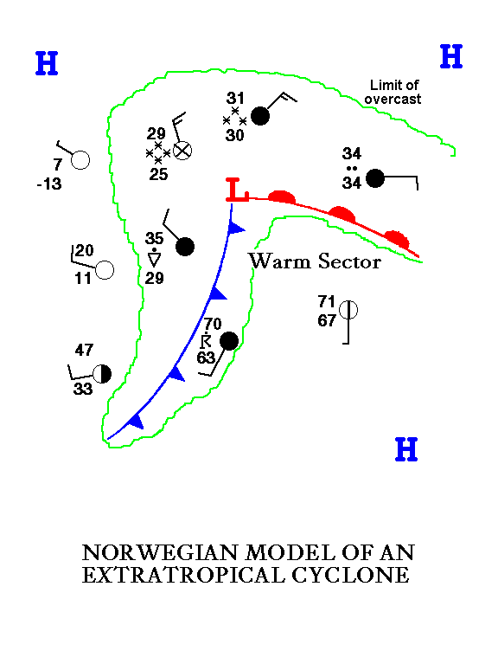
The fronts intersect the Cyclones which have centers of Low pressure.
Vilhelm Bjerknes, who proposed the frontal model, extended it to extratropical cyclones.

Slide 21
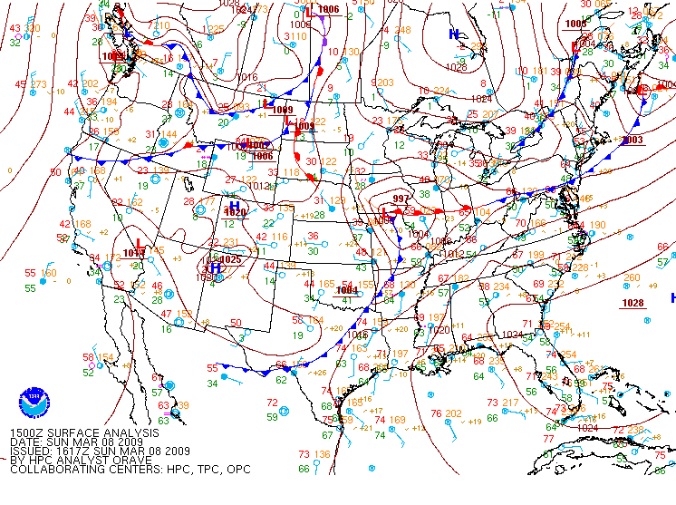
This is a known as a mature cyclone. It has both cold and warm fronts which meet at the Low.

Slide 22
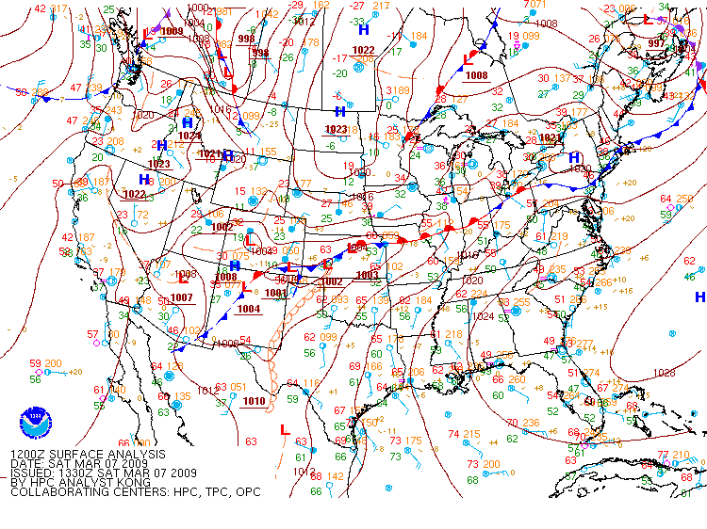
The evolution of a storm from birth to dissipation

Slide 23
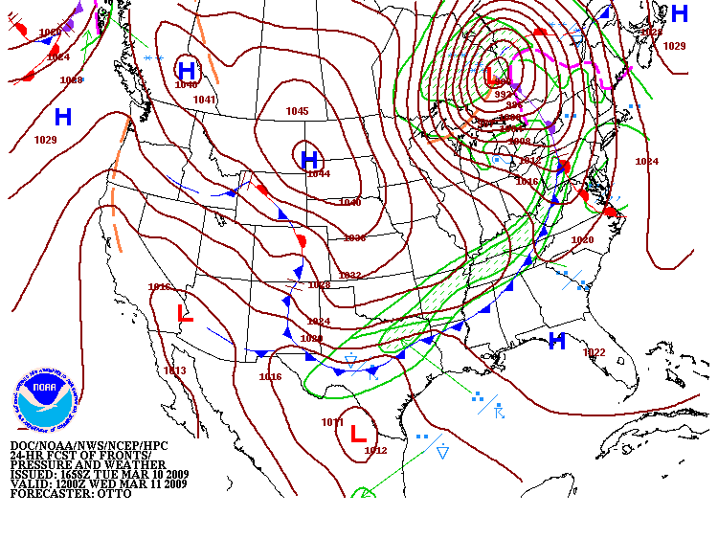
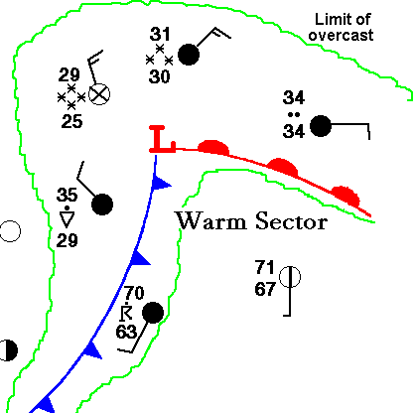
You can use the Norwegian model to make forecasts
Remember, here’s the typical weather in relation to the fronts
This is an actual forecast, known as a surface “prog”

Slide 24
Using the Norwegian model, what would be reasonable forecasts for each city?

Slide 25
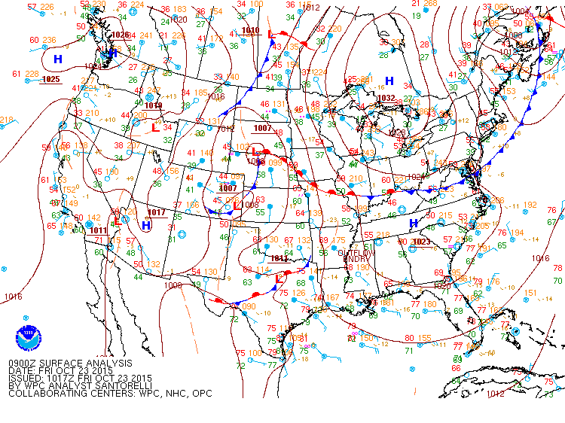
Oneonta
●

