Slide 1
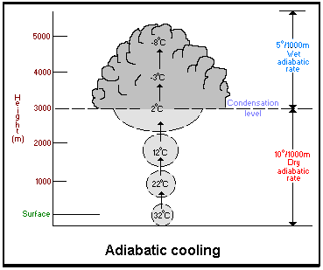
METR 110 Cloud Slide Lectures

Slide 2
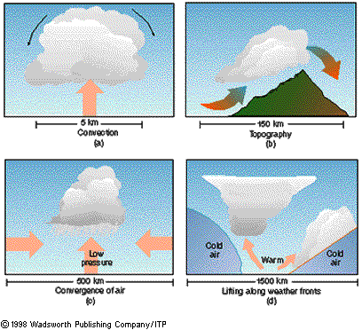
4 Common Ways to Get Upward Vertical Motion to Form Clouds

Slide 3
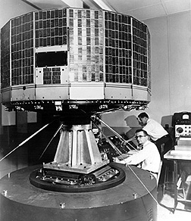
Satellites
TIROS (Television Infrared Observation Satellite), launched in 1960.

Slide 4
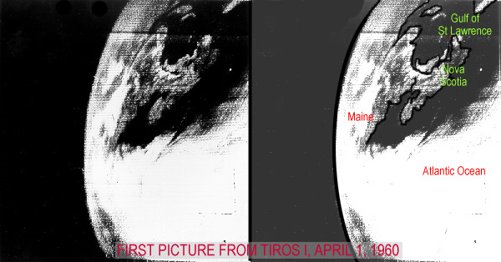
Crude by today’s standards, this was the first time people could see entire cloud systems at once. It changed the weather profession. Now, satellites and Radar are called ‘remote sensing.”

Slide 5
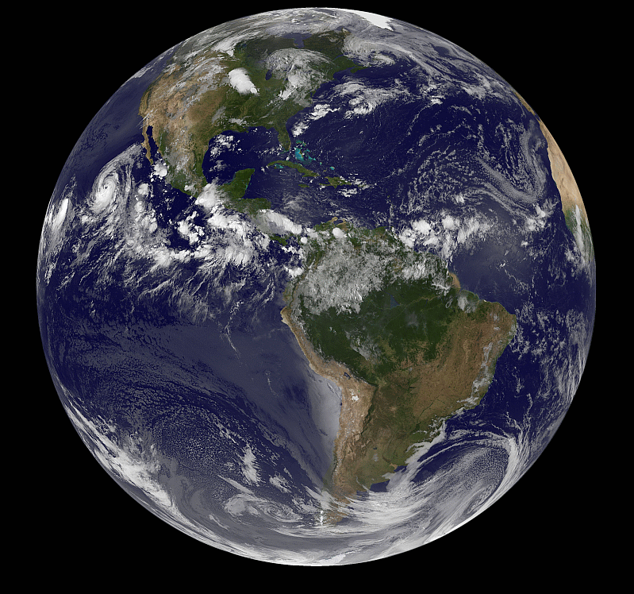
Aug 20, 2014
http://goes.gsfc.nasa.gov/goescolor/goeseast/overview2/color_lrg/latestfull.jpg

Slide 6
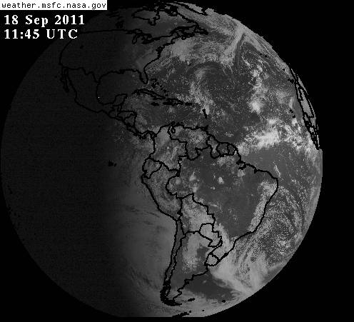
You can see clouds on satellite pictures. This is a full disk visible image.

Slide 7
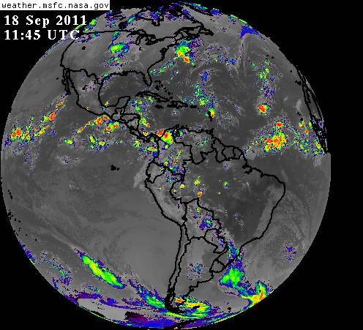
Infrared Image at the same time

Slide 8
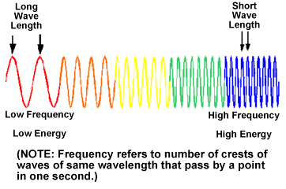
The only difference is the wavelength. People see by visible light but satellite sensors can “see” any type. Infrared (heat) waves are longer than visible.

Slide 9
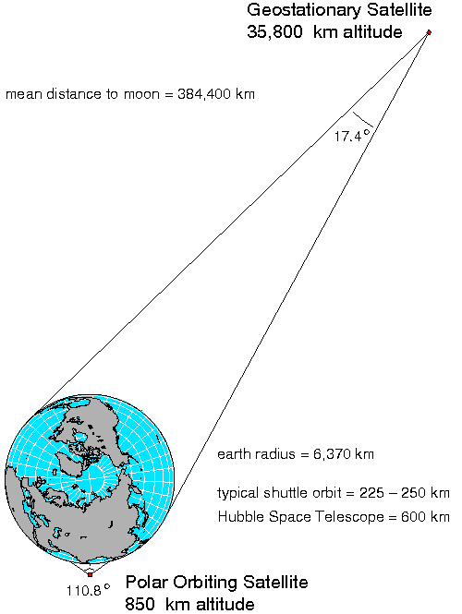
There are two types of satellites, GOES and POES.

Slide 10
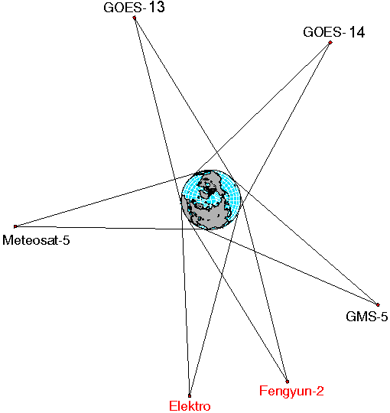
With just a handful of GOES spacecraft, you can see the whole planet.

Slide 11
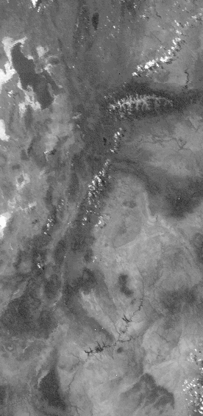
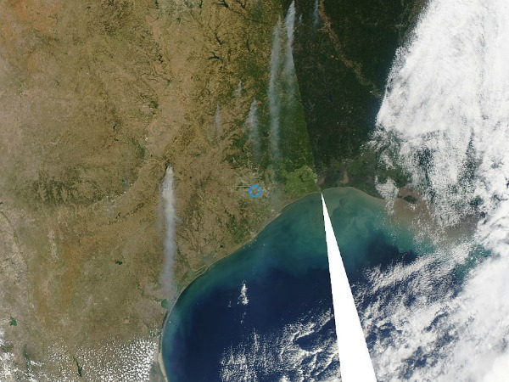
Polar orbiting satellites are much closer to the Earth. They can sense much smaller clouds.
You can also see other phenomena, like smoke from wildfires.
Texas wildfires Sept 2011

Slide 12
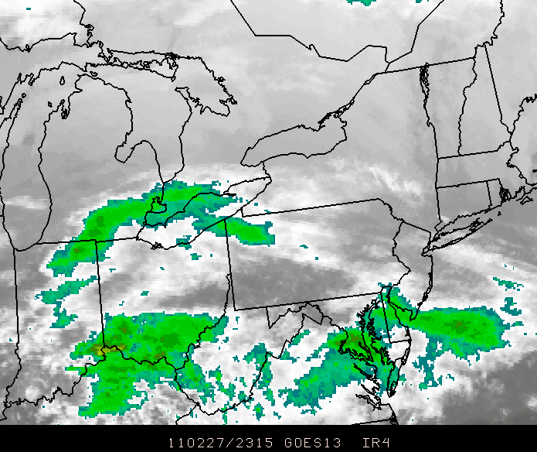
You can depict IR using any colors. The clouds aren’t really green. But these aren’t really clouds, either.

Slide 13
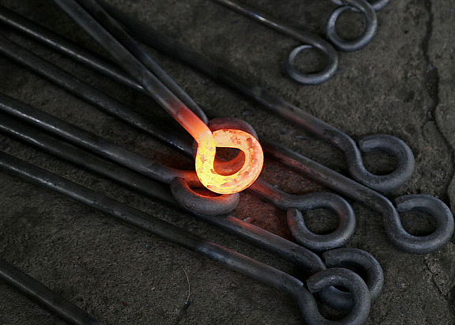
How we see “Clouds” in Infrared. Everything radiates, depending on its temperature. If you get hot enough, you radiate visible light

Slide 14
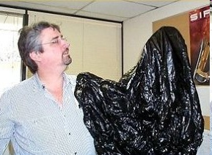
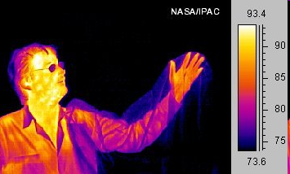
Cool people reflect visible light but actually radiate heat or Infrared.
Visible
Infrared

Slide 15
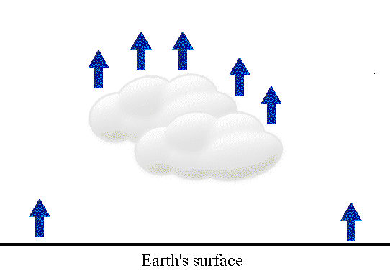
The Earth and the clouds above it all radiate IR. This is what the satellite senses. We can’t see heat so the computer can be told to give the IR radiation “false colors.”

Slide 16
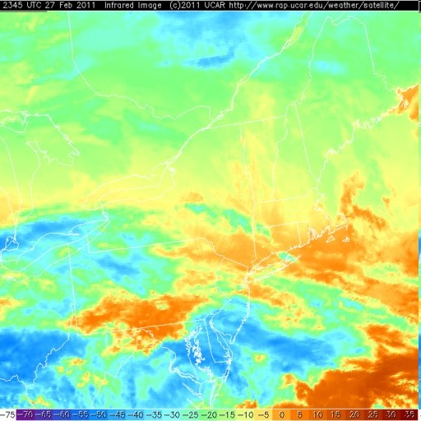
The false color can be quite distracting. It’s better to color clouds shades of grey and the Earth black.

Slide 17
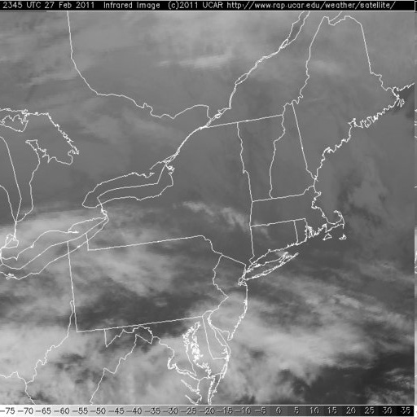
Same image using shades of grey instead of false colors

Slide 18
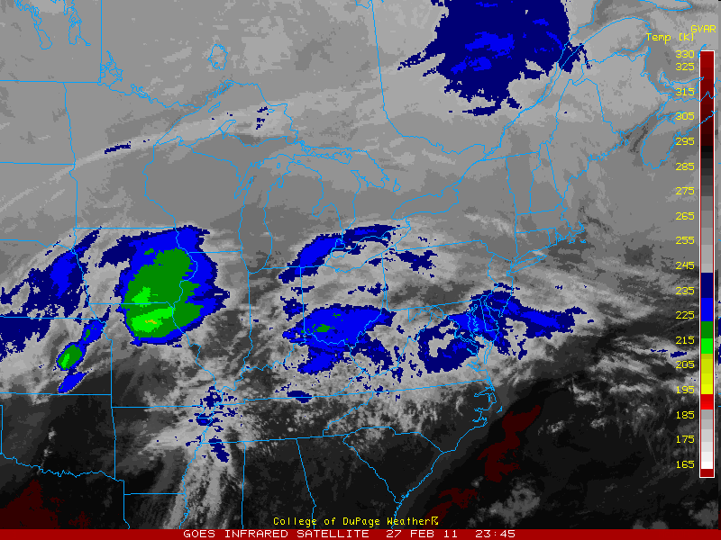
It’s even better if you select certain clouds to enhance with color. The convention in meteorology is to enhance the coldest clouds (remember, IR is heat so we actually sense the temperature of the clouds).

Slide 19
The higher the cloud rises into the troposphere, the colder it gets. This works only because the lapse rate is normal and temperature decreases as you go up.

Slide 20
How do clouds look from our ground-based vantage point?

Slide 21
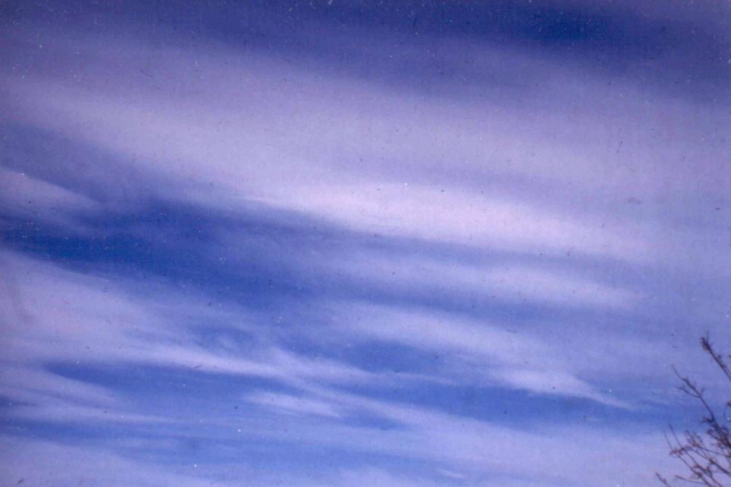
Cirrus (Ci) is the highest cloud, composed of ice crystals

Slide 22
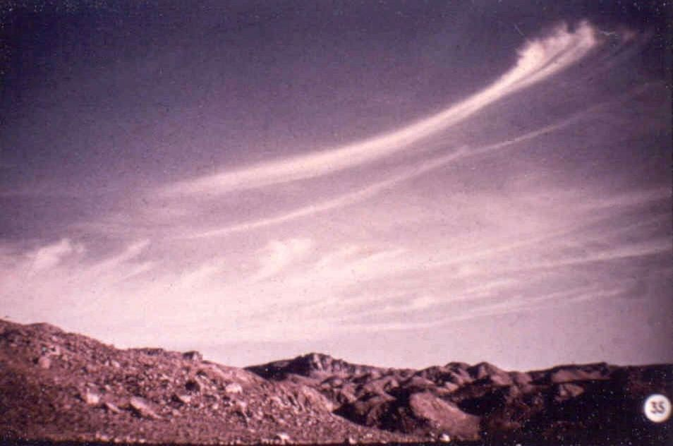
Cirrus (also called Mare’s Tails)

Slide 23
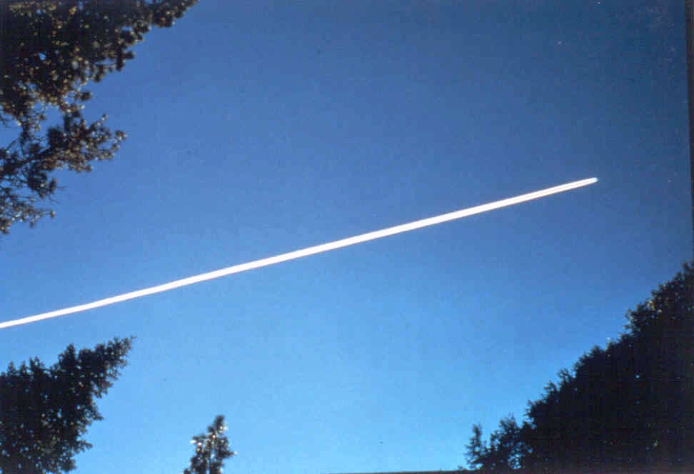
Contrail (condensation trail)

Slide 24
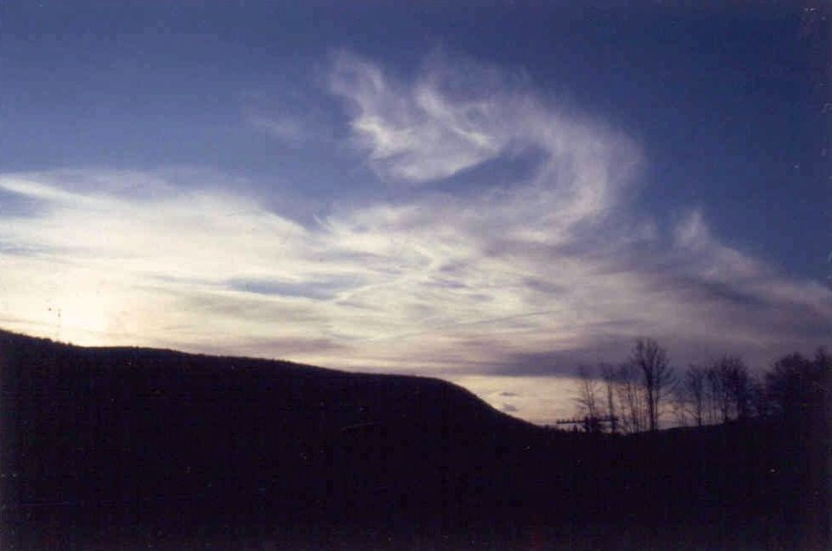
Cirrus with contrails at sunset

Slide 25
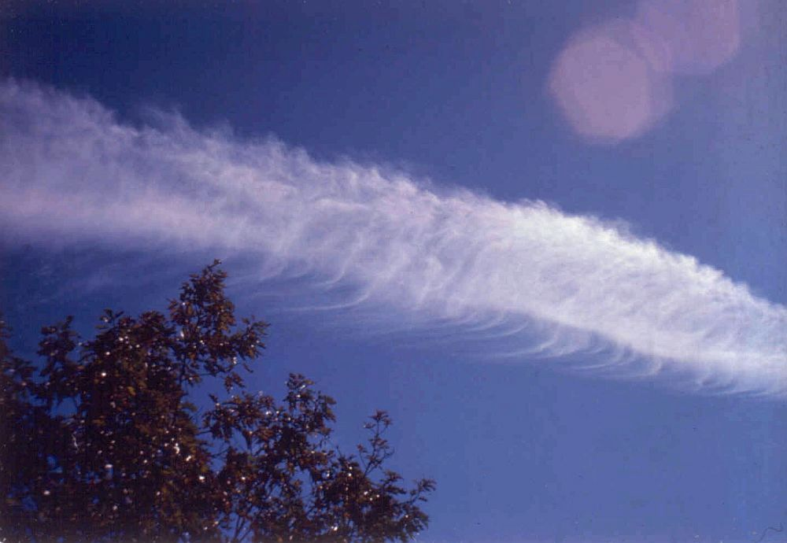
Contrail with ice crystals falling out like mini-mare’s tails.

Slide 26
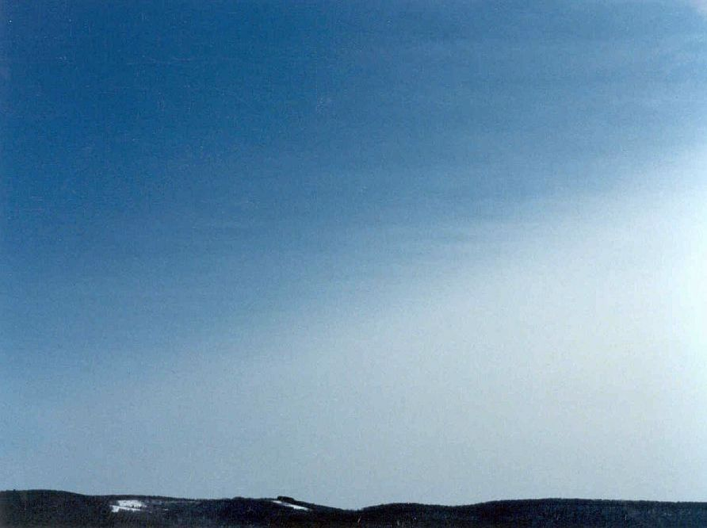
Approaching Cirrostratus (Cs) overcast

Slide 27
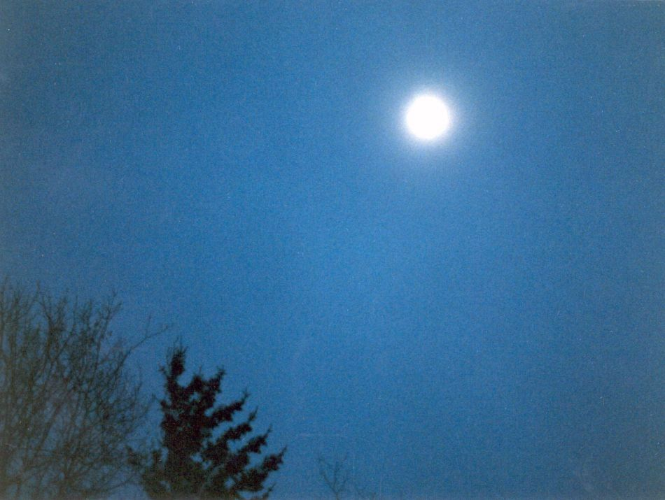
Moon shining through thin Cs

Slide 28
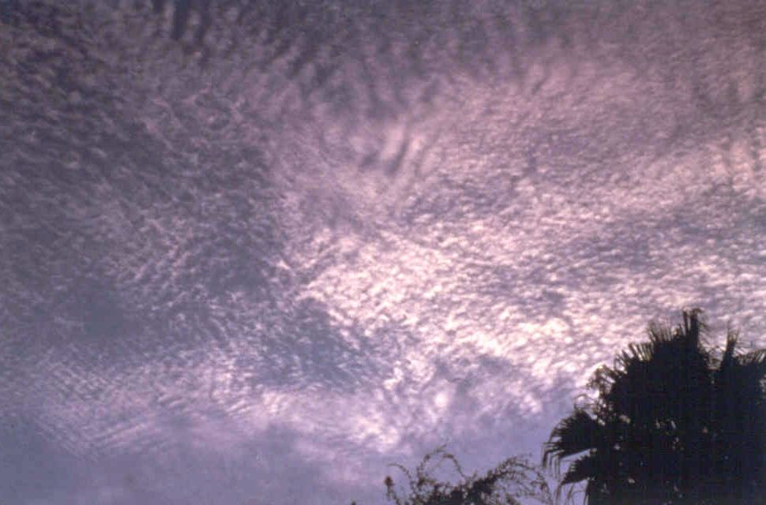
Cirrocumulus (Cc)

Slide 29
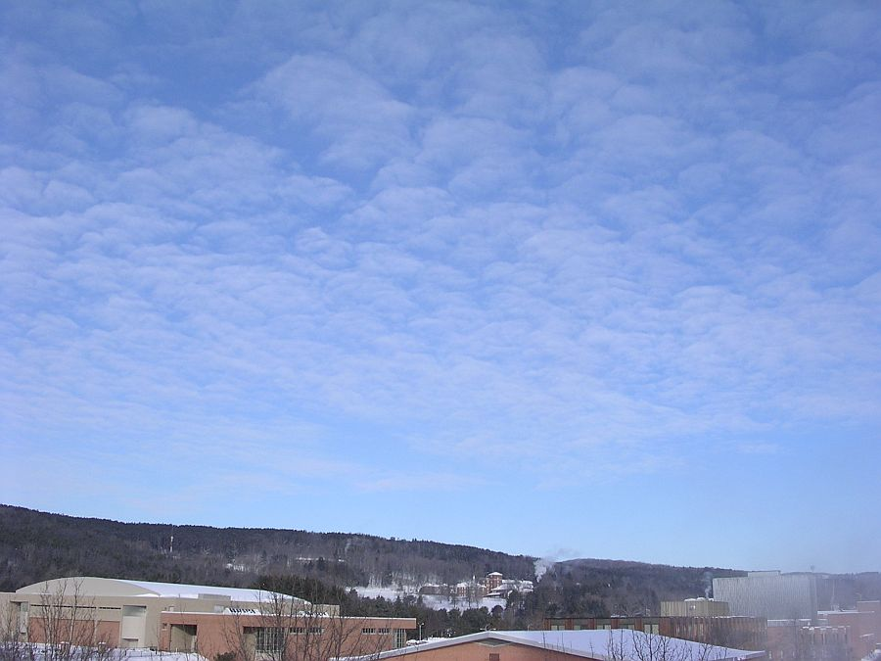
Altocumulus (Ac) means vertical motion in the middle troposphere

Slide 30
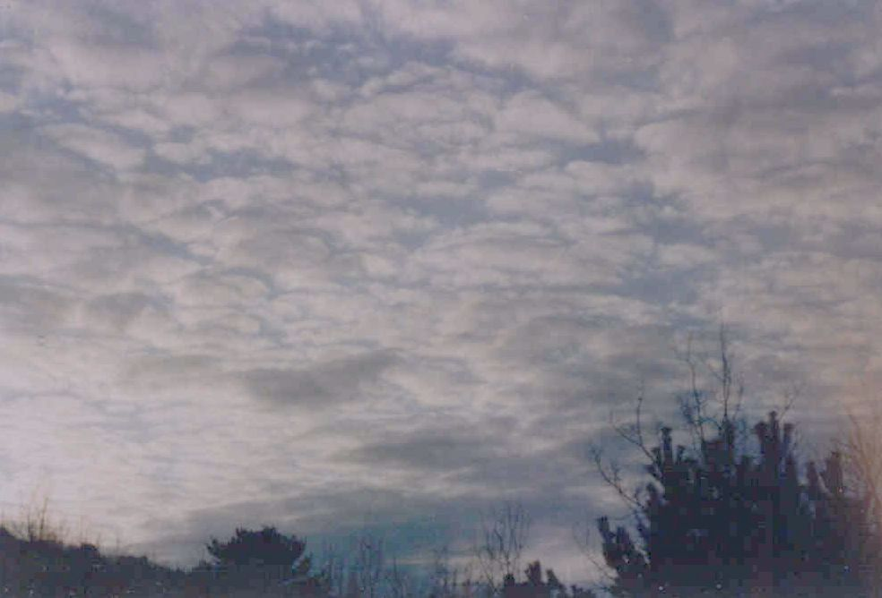
Ac from an approaching warm front

Slide 31
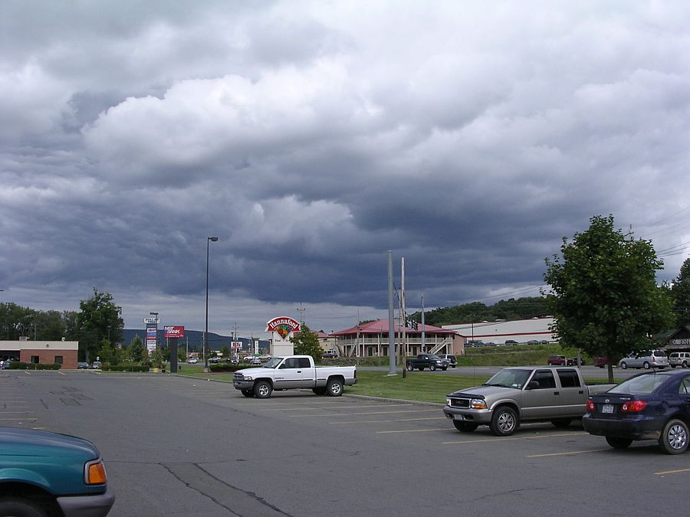
Stratoculumus (Sc) are low, with distinctly rounded shapes

Slide 32
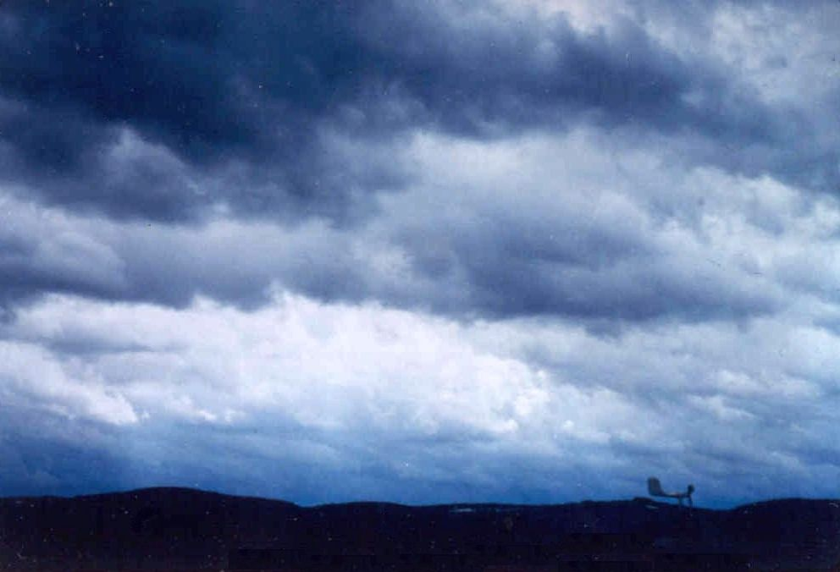
Sc is a common wintertime cloud

Slide 33
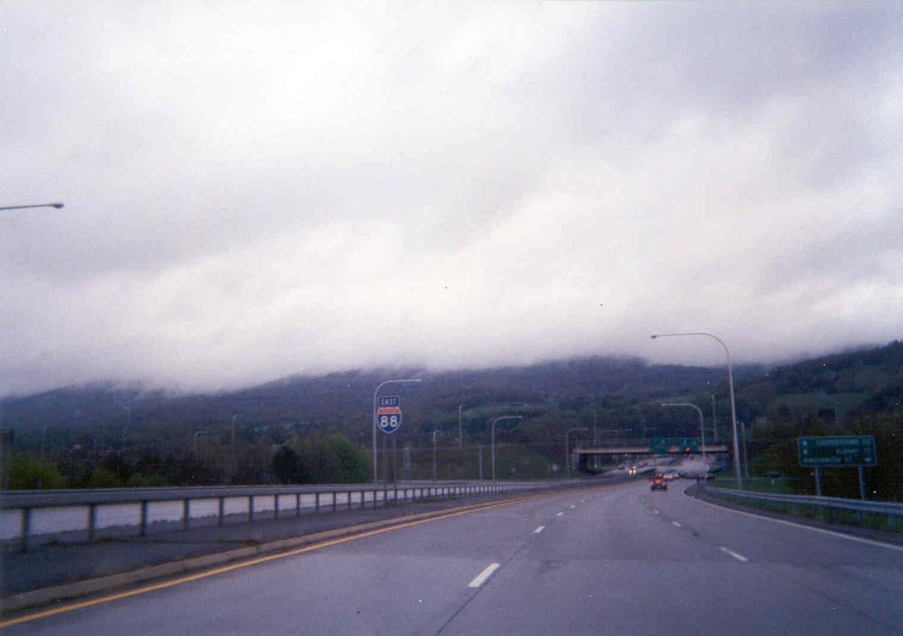
Stratus (St) is a low, grey, smooth cloud

Slide 34
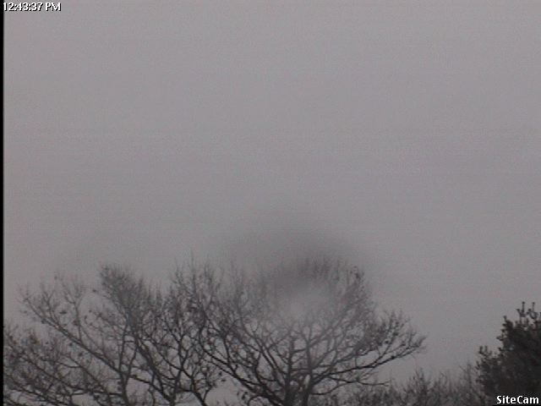
Thick St is dark grey and often induces depression in humans

Slide 35
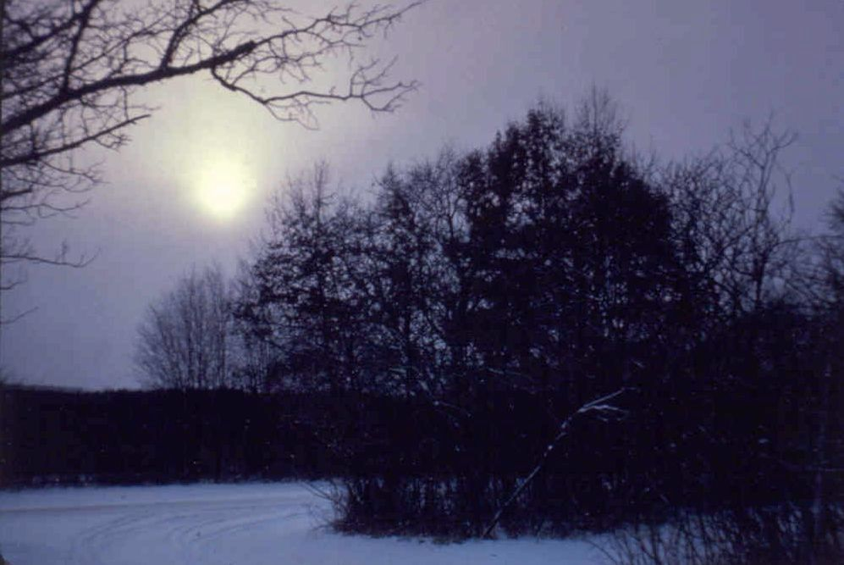
The sun can shine through thin St. This is also a winter cloud (notice the snow on the ground)

Slide 36
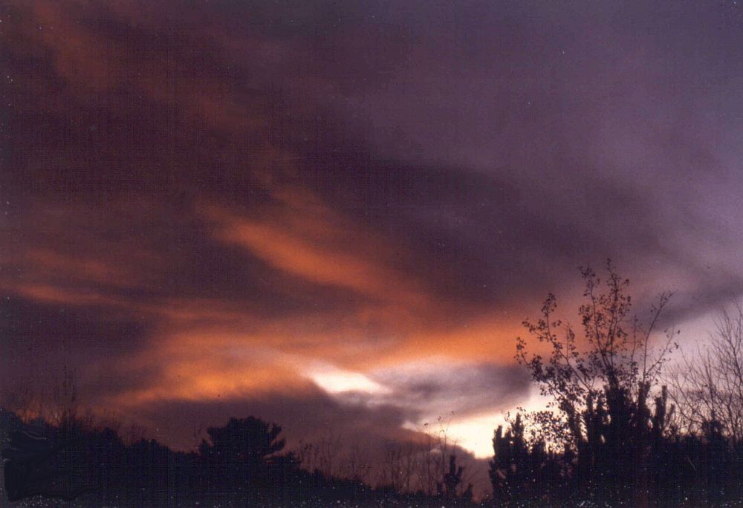
A setting sun shining on the underside of St or Sc is very colorful.

Slide 37
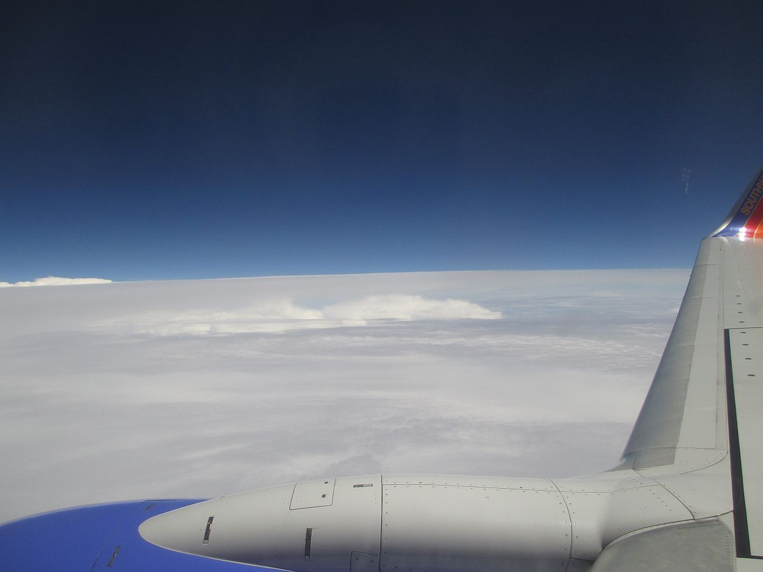
Stratosphere
(warm, no vertical motion)
Flying over a Stratus overcast
Tropopause
Troposphere

Slide 38
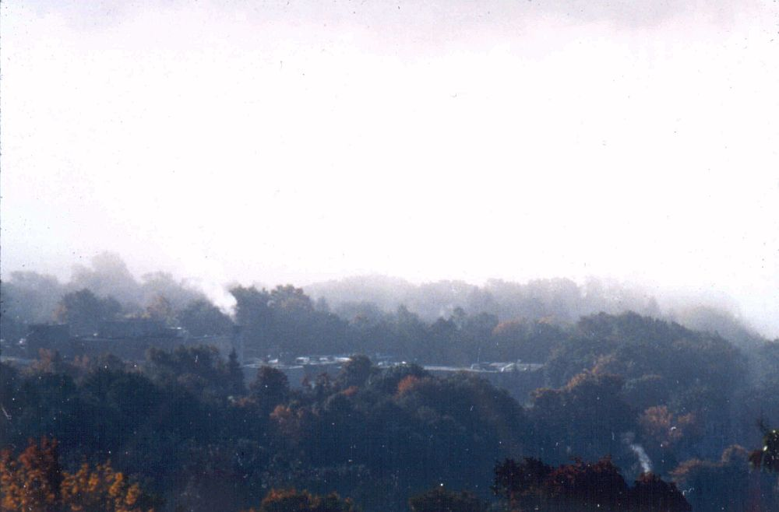
Lower than low clouds, fog is not a “cloud on the ground.” This is radiation fog.

Slide 39
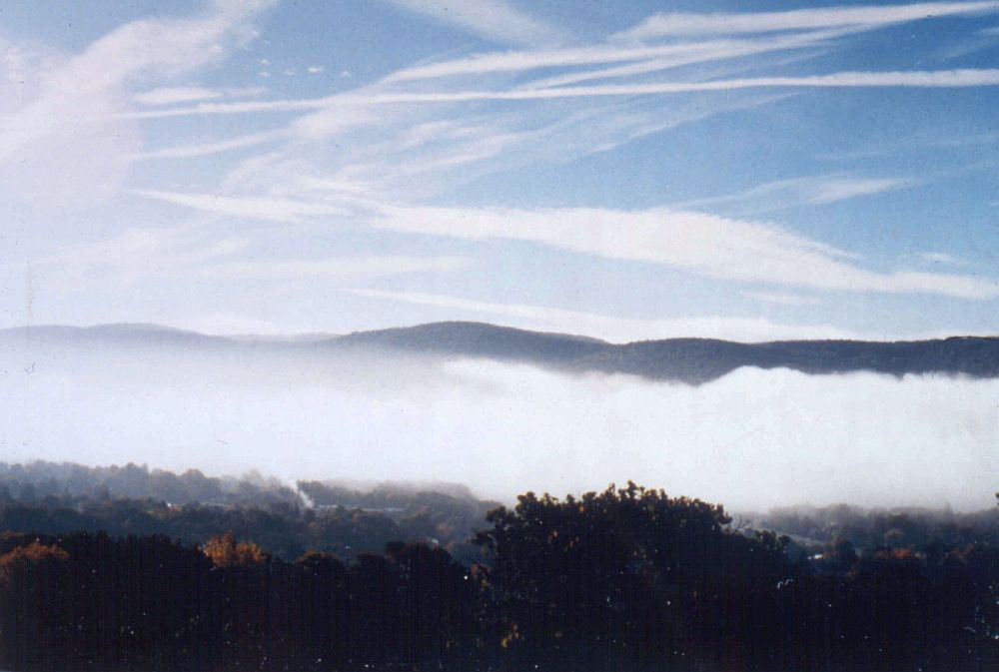
This is the same fog as in the previous slide. It’s a valley fog over Oneonta

Slide 40
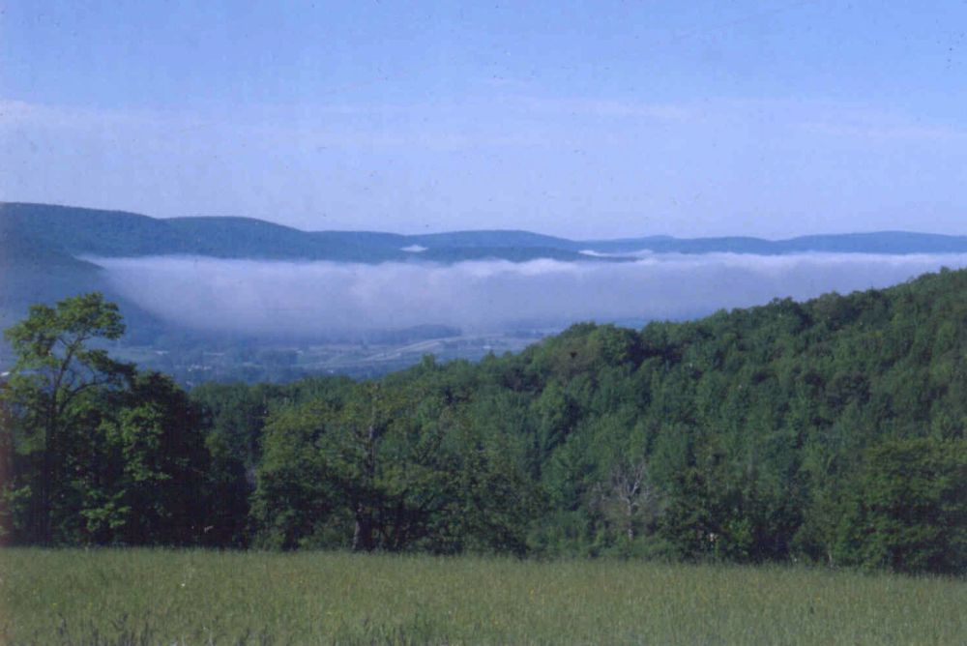
Radiation fog in the valleys of southern New York State

Slide 41
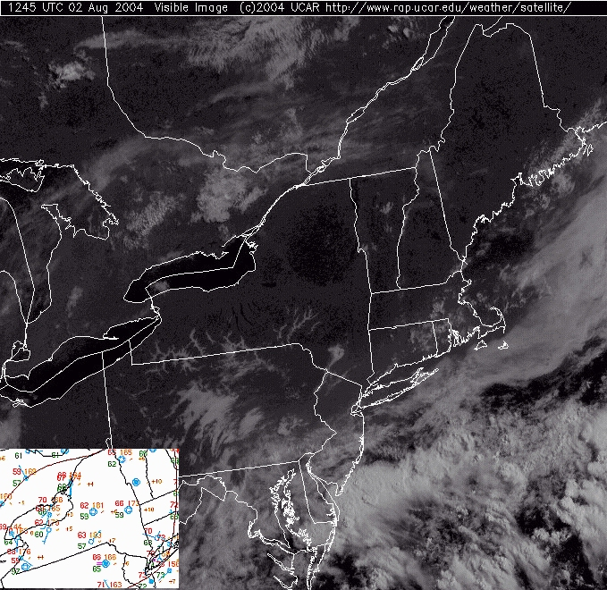
Radiation fog in the valleys of southern New York State and Pennsylvania.

Slide 42
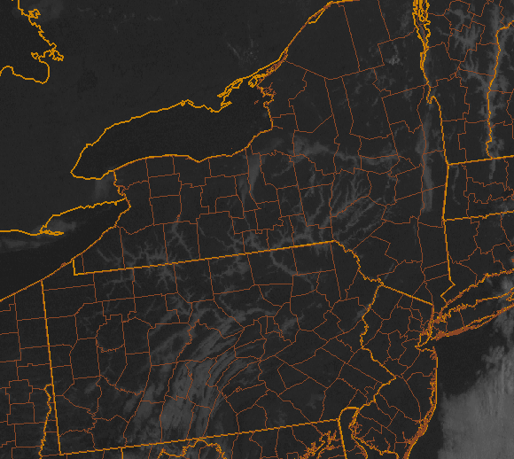
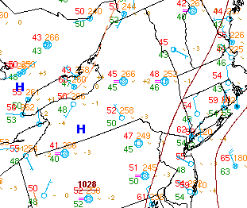

Slide 43
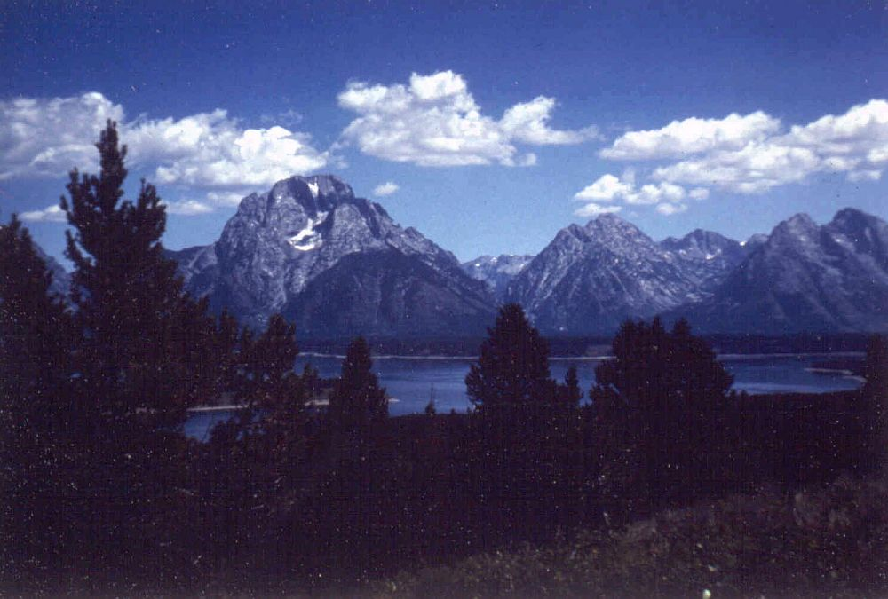
Cumulus (Cu) clouds are very common in summer (here over the Tetons)

Slide 44
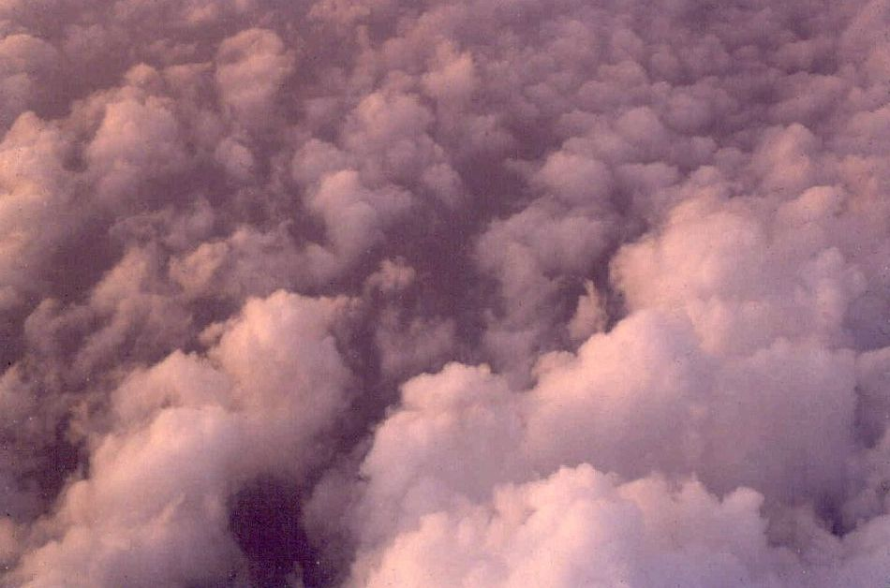
Cu are vertically growing clouds.

Slide 45
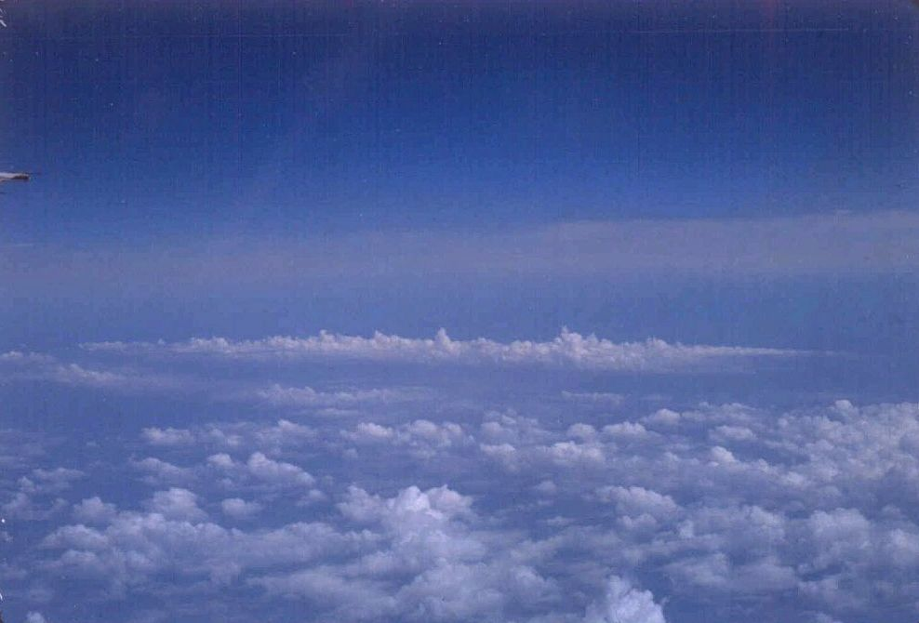
Most Cu don’t grow much and are called fair-weather cumulus.

Slide 46
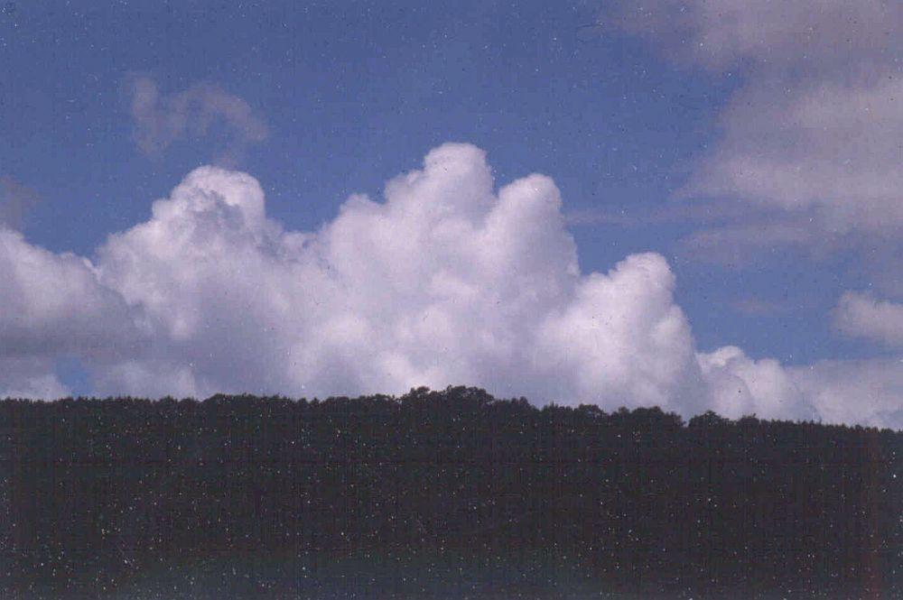
Some Cu grow very tall – 15, 000 to 30,000 feet and up. These are called towering cumulus (Tcu) and are summertime clouds.

Slide 47
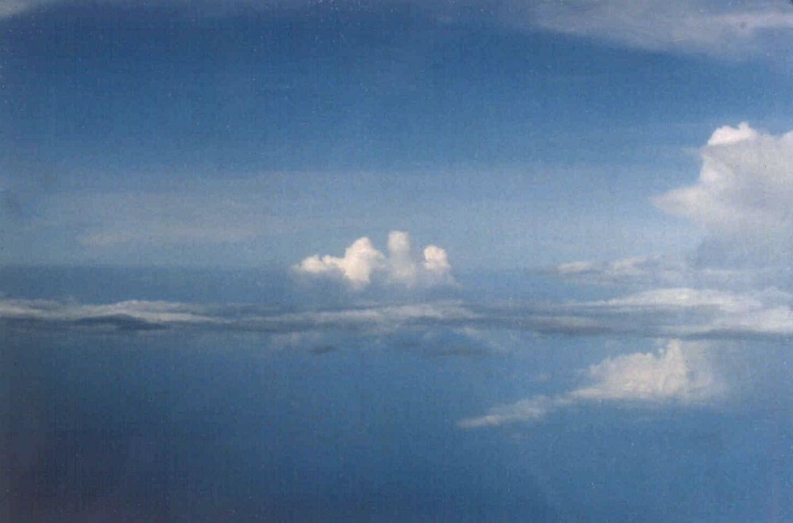
Tcu versus St. Cumulus grow vertically. Stratus grow horizontally. Notice the very tall cloud on the right. It’s a thunderstorm.

Slide 48
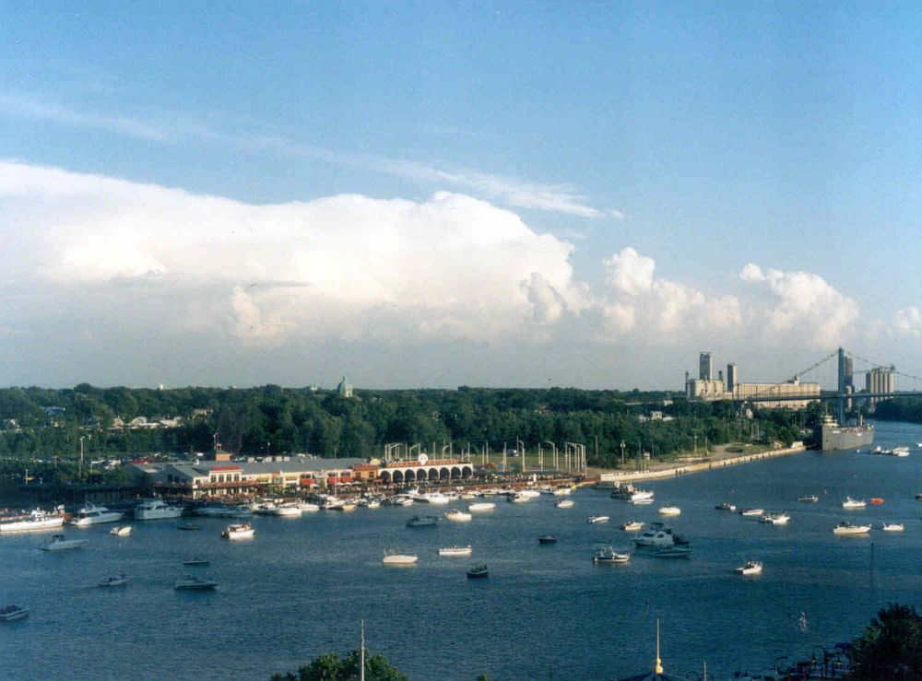
The meteorological name for a thunderstorm is Cumulonimbus (Cb).

Slide 49
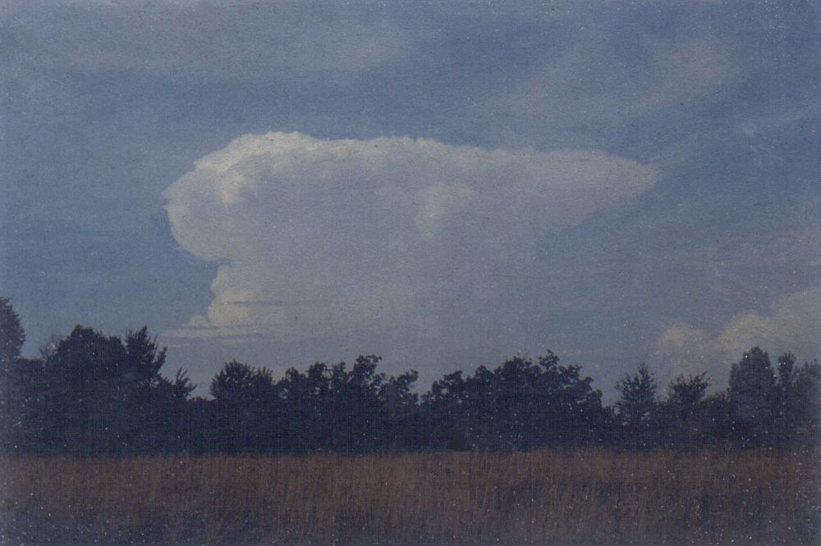
Cb have a distinctive shape, like a blacksmith’s anvil. This one is producing a tornado over a small Wisconsin town at the time of the picture.

Slide 50
A significant threat from thunderstorms is cloud-to-ground lightning.

Slide 51
Lightning doesn’t always reach the ground. It goes sideways and upwards, too.

Slide 52
Some optical effects: This is a halo with sundogs.

Slide 53
From the NOAA photo library. This was taken in Antarctica.

Slide 54
This is a “Glory”. Note the shadow of the airplane in the middle of the halo effect.

Slide 55
Mirage: the “water” on the road isn’t really there.

Slide 56
A more common optical effect. Notice the second rainbow (very faint).

Slide 57
A better view of a double rainbow. The colors reverse in the second bow.

Slide 58
Very close rainbow in the desert southwest.
Can you ever get to the end of one (and find a pot of gold)?

Slide 59
Very close rainbows even happen in Oneonta! Look for them at low sun, either early morning or late afternoon, while it is raining.
Keep your camera handy for shots like this.

Slide 60
Remember to look up!
The End

