Slide 1
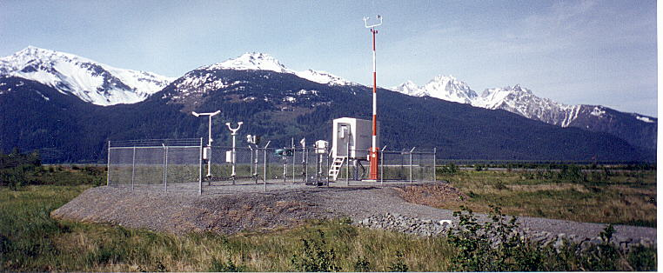
ASOS – Automated Surface Observing System

Slide 2
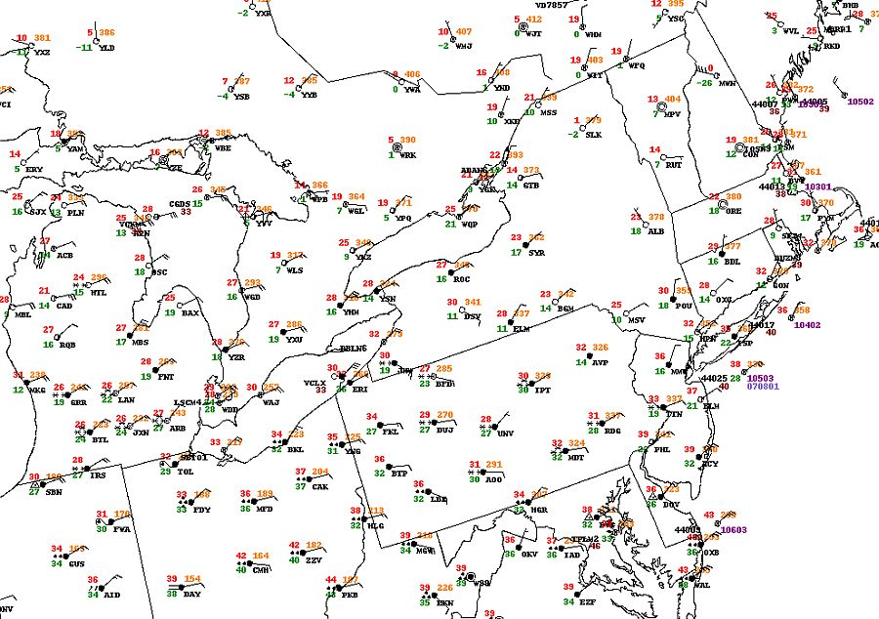
All models start with initial conditions. The most important initial conditions are from the ground.
Why automate the surface observation?
You have a lot of them!

Slide 3
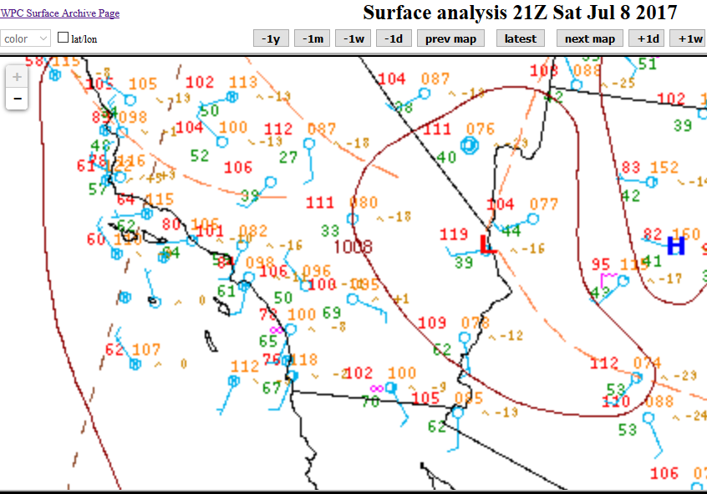
Also, some of the stations are in places where NOBODY wants to live.

Slide 4
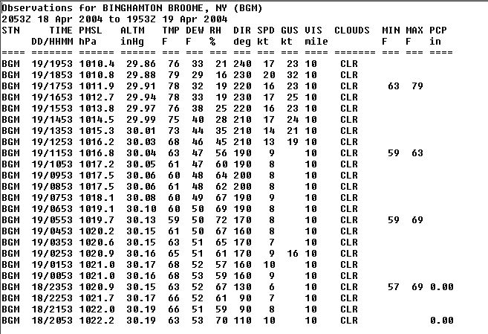
Normally surface observations are taken every hour. When the weather is complex, this is not enough. Can one person take multiple special observations 24/7? Machines can do that.

Slide 5
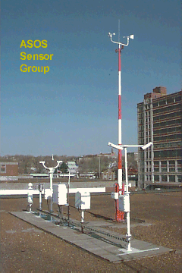
Automation also means fewer paychecks for the Federal Government.
Also, no health insurance payments. No sick days. No unions. No strikes.
Machines work every day of the year. No holidays. No vacations.
Does this mean fewer meteorologists are employed by the NWS?
Not necessarily. It means your NWS job will be forecasting, not doing grunt work.

Slide 6
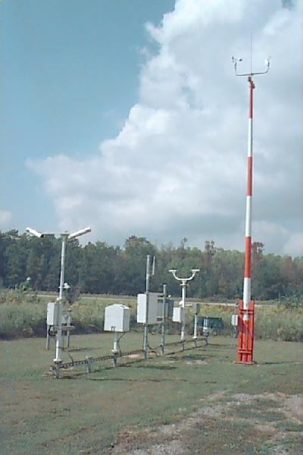
A typical “small airport” ASOS setup.
ASOS is not a single observing machine. It is a suite of sensors attached to a computer system.

Slide 7
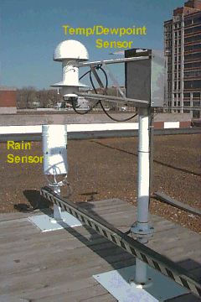
The sensors

Slide 8
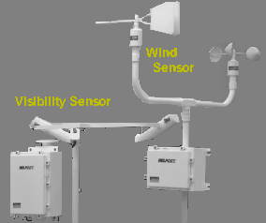
Some are very familiar. Some are ingenious

Slide 9
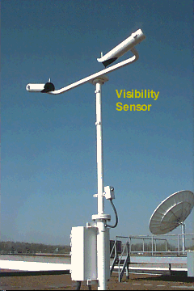
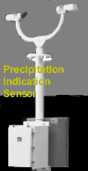
Both the Visibiity and Precipitation Indication Sensor operate on the same type of principle: Atmospheric meteors obscure a beam between emitter and receiver.

Slide 10
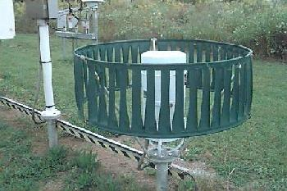
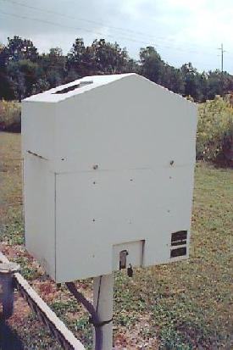
Cloud Height Sensor
ASOS sometimes does not sense weather the same way people do.
Shielded rain guage

Slide 11
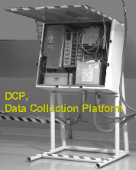
The sensors feed into one central collection platform.
What happens when the power is off?
How about when an ASOS array is hit by lightning?

Slide 12
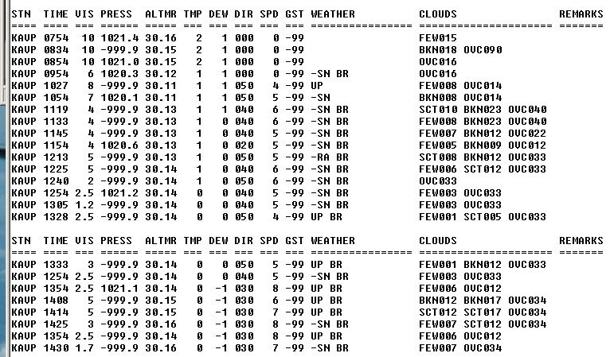
ASOS limitations
Unknown Precipitation (UP) is reported when the sensor is confused.

Slide 13
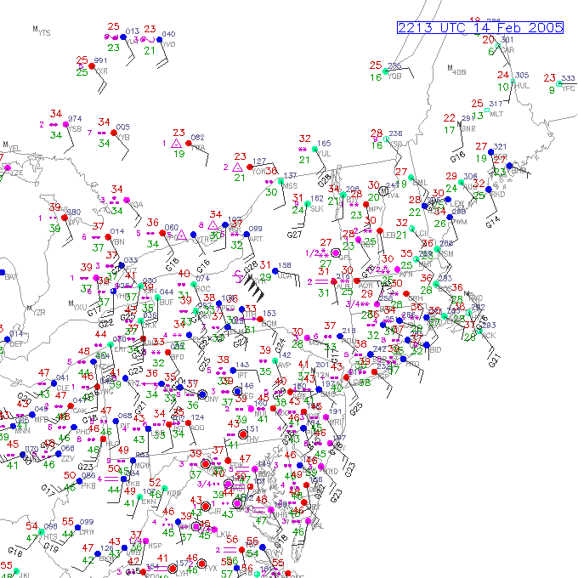
Quality control by people is a must.
Machines may report anything, even absurd observations. People can use judgement.

Slide 14
KMYP is Monarch, CO

Slide 15
It’s a blizzard!

Slide 16
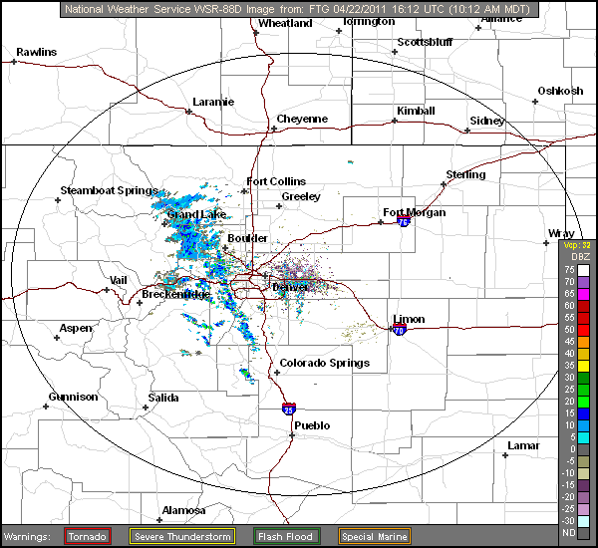
Not much on Radar but Monarch is in the mountains. Maybe it’s blocked.

Slide 17
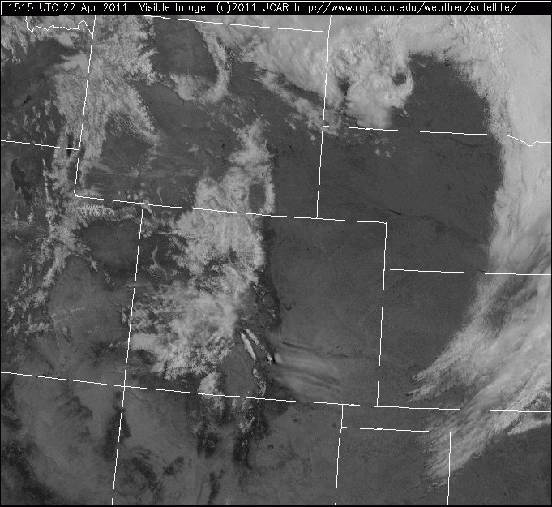
Just small clouds, even in the mountains.
Lesson: ASOS is an array of machines. When in doubt, always check other sources.
Let’s check one more.

Slide 18
It’s a ski area, up at 12,000 feet and it sure looks like it’s been snowing.
But this is not 0.0 miles visibility in moderate snow with 26 knot sustained winds and gusts to 42. Someone forgot to service the ASOS.

Slide 19
A thunderstorm at 31°F? Neighboring obs are freezing rain. Maybe somebody sent in the wrong code. What other data source could we check to verify a thunderstorm?
←CG strokes!
(click)

Slide 20
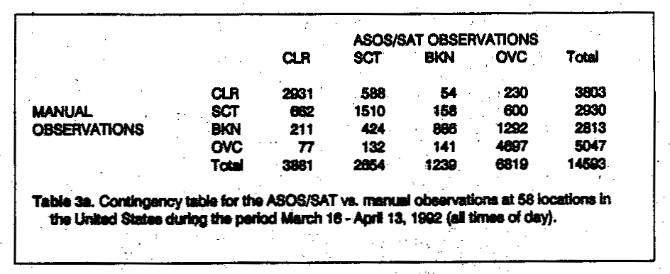
Testing the Cloud Sensor during ASOS deployment.
This is a contingency table. If the ASOS observations exactly match the manual obs (done by a human), all numbers would appear on the main diagonal.

Slide 21
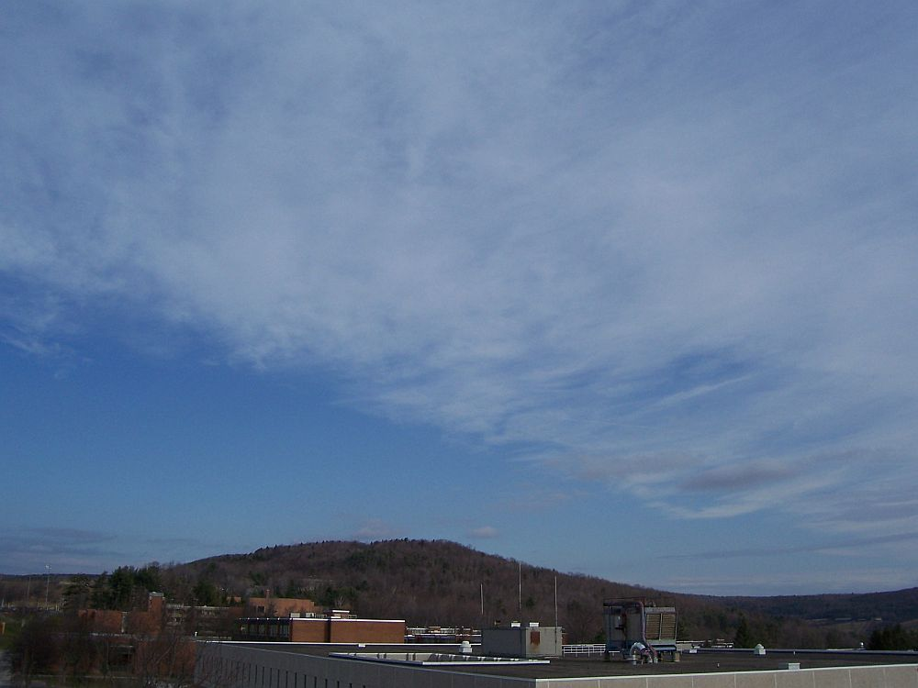
The cloud height sensor cannot sense clouds above 12,000 feet. So ASOS doesn’t see Cirrus clouds.

Slide 22
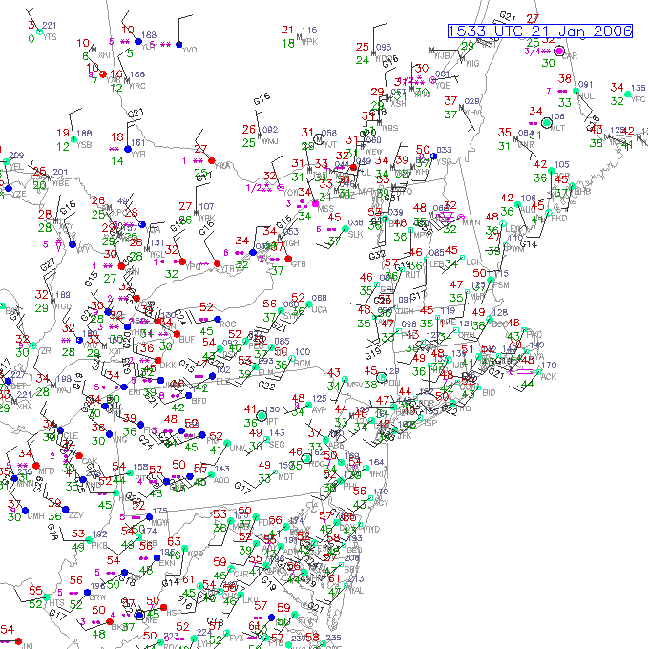
Clear skies being reported in central NY

Slide 23
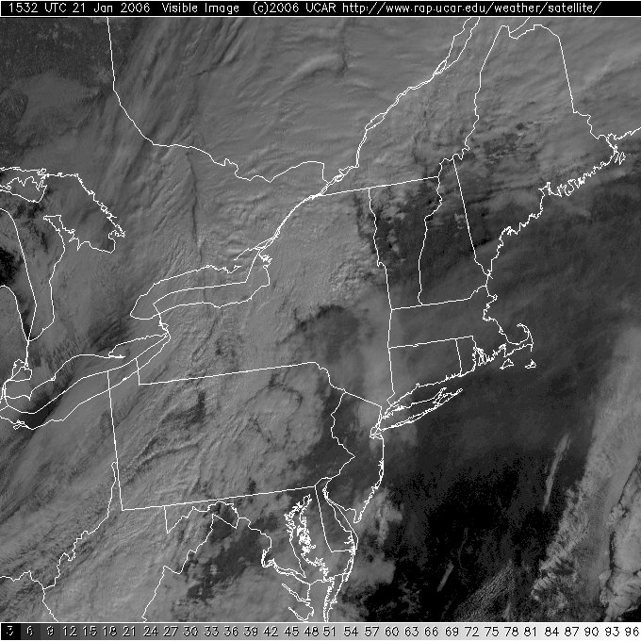
ASOS will report the thicker, lower clouds but not those over Oneonta.

Slide 24
Other problem observations
Thunderstorms - the sensor is based on lightning detection.
Tornadoes – will probably never be detectable by machines.
Hail – hailpads could be a solution here.
Mixed Precipitation – usually reported as UP
Blowing snow, blowing dust
Water equivalent of snow on the ground

Slide 25
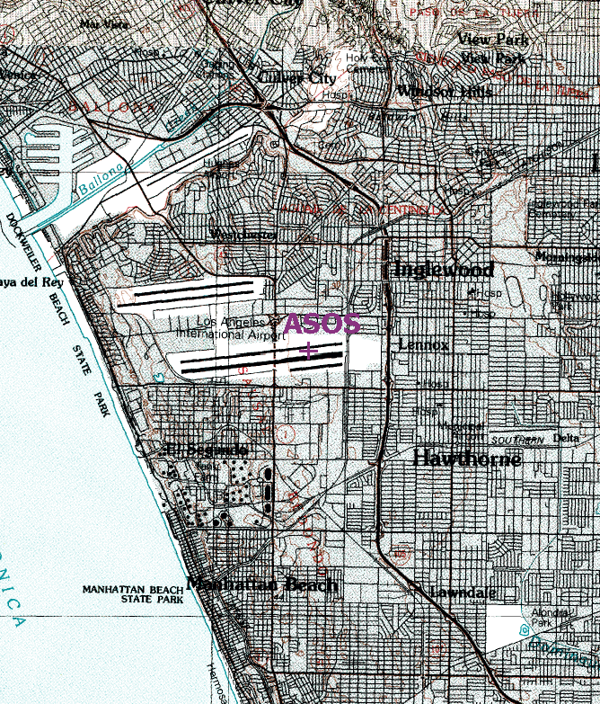
The KLAX ASOS array is located between the runways.
Could this arrangement cause any bogus observations?

Slide 26
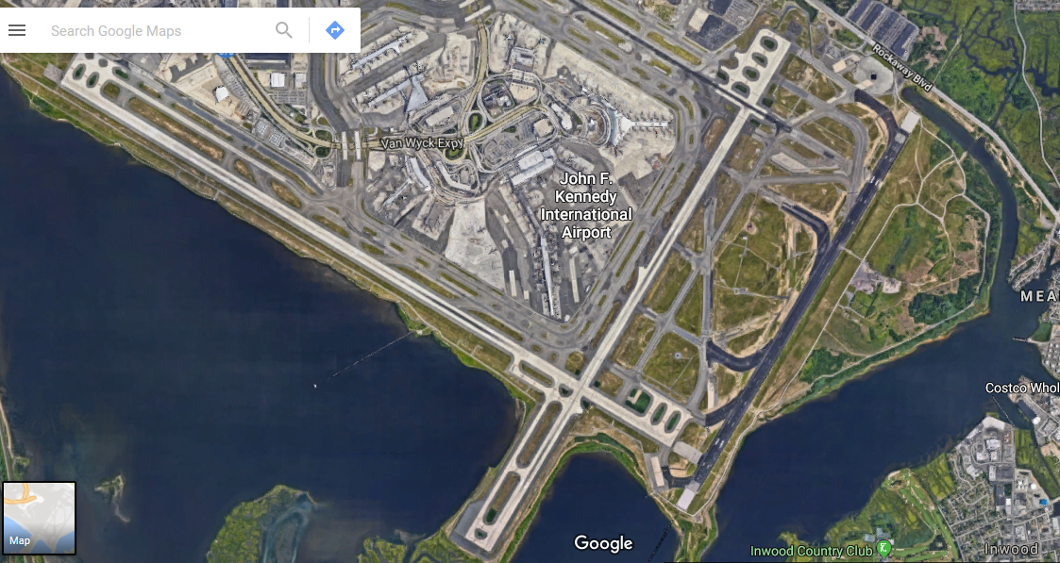
Google Earth image of KJFK
Where would you put the ASOS array to balance ease of access with quality of the data?

Slide 27
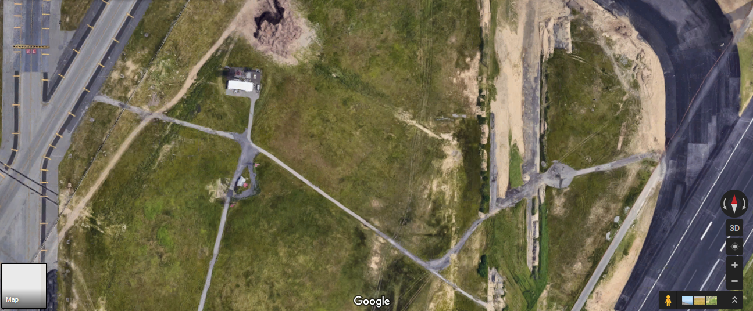
Maintenance bldg
ASOS
Terminal
Old taxiway
Taxiway
Service Road
Look closer
Even closer
Old taxiway
ASOS

Slide 28
If KBTV is really right next to the runway,
it could be a problem
What’s this?

Slide 29
Looks like an ASOS array in a good spot

Slide 30
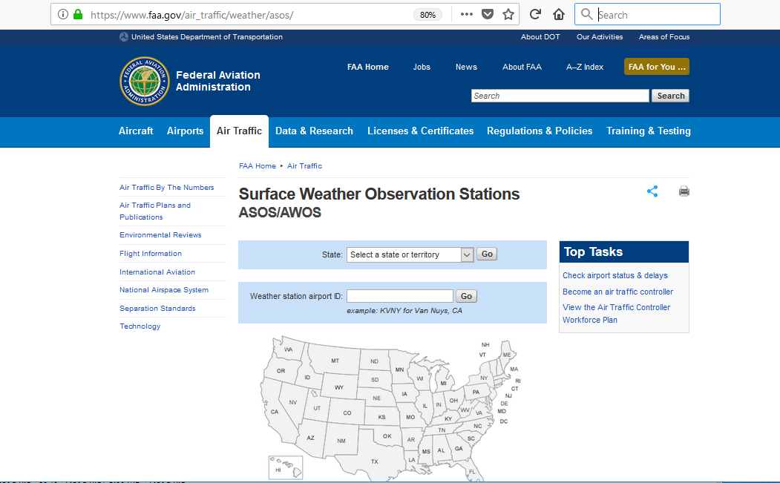
Almost every single observation is now done by the automated system
Find them at https://www.faa.gov/air_traffic/weather/asos/

Slide 31
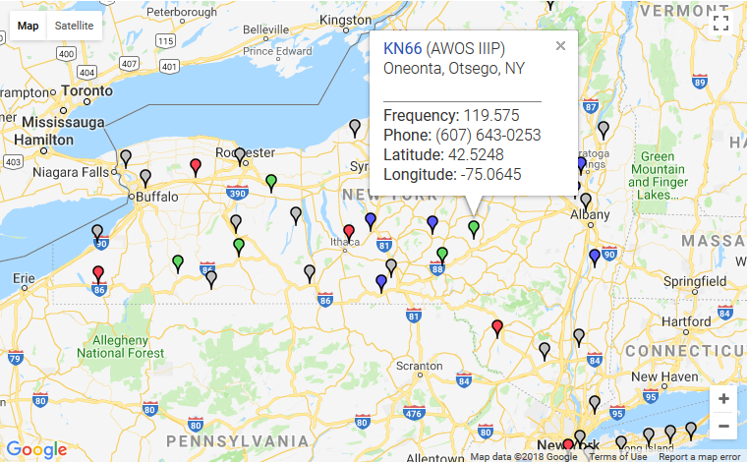
Oneonta is on the map! But it’s AWOS, not ASOS. That’s an aviation site, maintained by the FAA. ASOS balloons are grey.

Slide 32
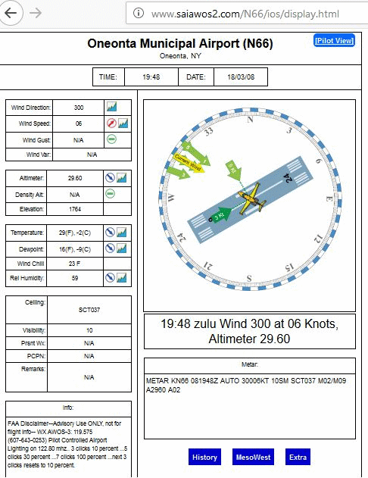
Oneonta does have an airport and an automated weather observing system (AWOS).

Slide 33
Summary
ASOS is not perfect. It requires a person to double-check the observations.
Also, the machines need to be located in accessible locations for maintenance.
Will meteorologists ever be obsolete?
NEVER! Meteorologists will be needed to adapt to new situations. Machines can’t do that. Meteorologists invent new sensors and ways to do observations.

