Slide 1
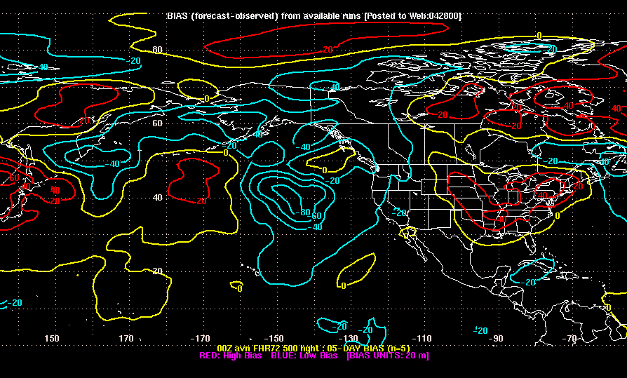
Numerical Forecast Models
For more info: http://www.meted.ucar.edu/nwp/model_structure/

Slide 2
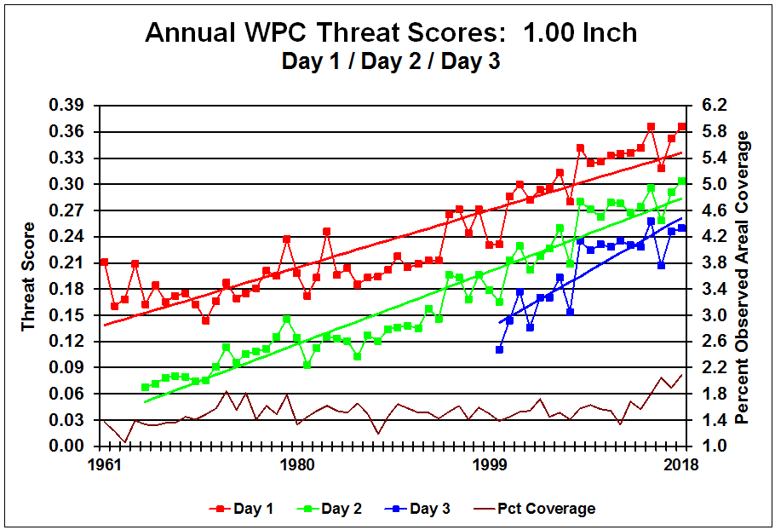
Clearly forecast skill is improving. This must be due to computer forecast models.
Source: https://www.wpc.ncep.noaa.gov/html/hpcverif.shtml

Slide 3
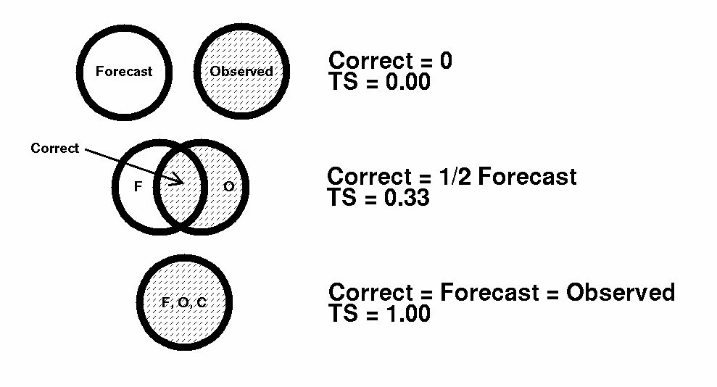
The Threat Score is a measure of how well the pattern verified.
TS = Correct / (Forecast + Observed - Correct)
From http://www.wpc.ncep.noaa.gov/html/scorcomp.shtml

Slide 4
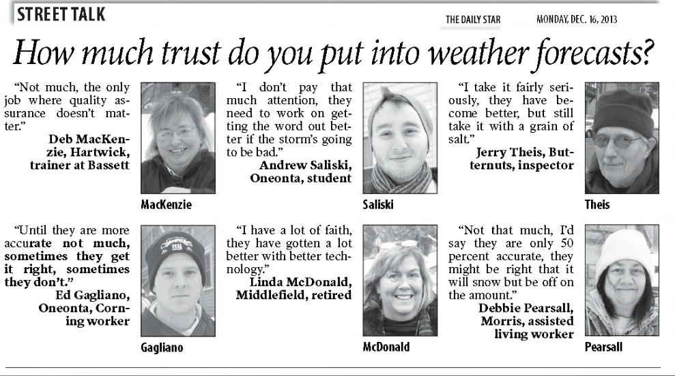
The perception of the general public is that weather forecasting is inaccurate.
So you can be graded 50% on your professional performance by an “assisted living worker”?

Slide 5

And… She’s right!

Slide 6
Some of the Models
WRF-NMM Weather Research and Forecasting Non-Hydrostatic Mesoscale Model (currently North American Mesoscale or NAM)
GFS Global Forecast System (NCEP- http://mag.ncep.noaa.gov/)
HRRR High Resolution Rapid Refresh (NCEP) Short range forecasting model
RAP Rapid Refresh (NCEP) Also short range
ECMWF European Centre for Medium-Range Weather Forecasts, a.k.a. the “Euro” It does short range, too. www.ecmwf.int/
RDPS Regional Deterministic Prediction System (Canada) www.weatheroffice.gc.ca/model_forecast/index_e.html
Eta (formerly the core model of the NAM) Discontinued
Many more – individuals, universities, and government agencies have their own! You too can write a model.

Slide 7
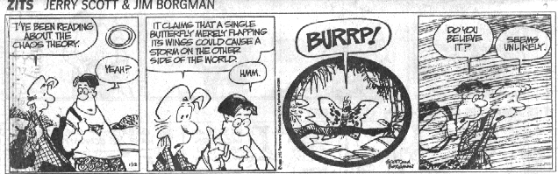
Did Lorenz (famous theoretical meteorologist) really say that?
So, if the atmosphere behaves that way, how do models predict its behavior?

Slide 8
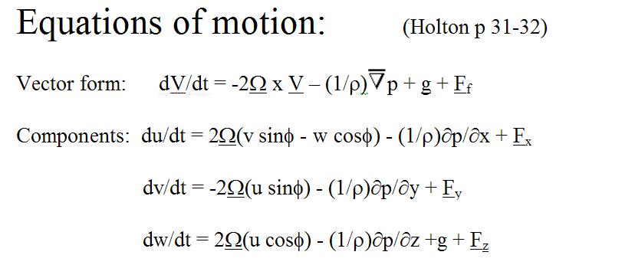
We need a mathematical framework that can be used to make forecasts. Here it is:
We’d like to solve these equations, so we know the wind at any future time. Unfortunately, we don’t know how to do it.

Slide 9
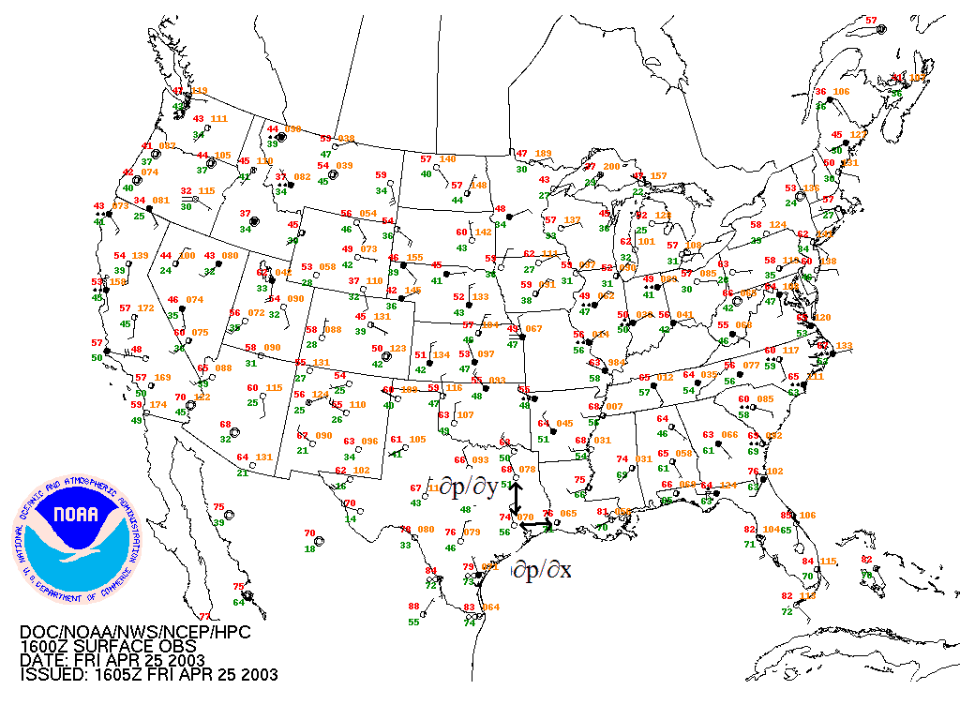
So we approximate and use computers. You only have observations at specific places (stations)
Convert derivatives to finite differences

Slide 10
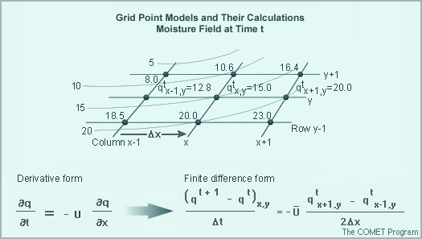
Models work by approximating the equations using finite differences on a model “grid.” (exception: spectral models)
∆x is the grid interval in the west-east direction. ∆y is south-north. ∆t is time.

Slide 11
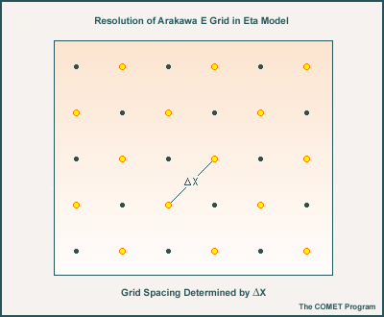
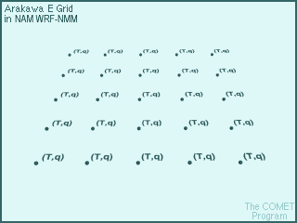
The NAM-WRF, sometimes called the NMM (Non-hydrostatic Mesoscale Model) has a staggered grid and 12-km resolution.

Slide 12
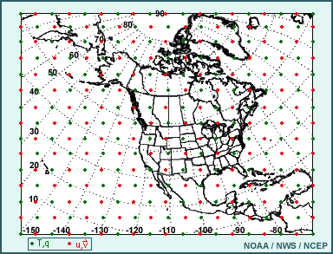
You solve the finite difference equations for the points on a map. Depending on your computer size, you may only get a limited number of grid points.
The limited area where your model is defined is called the “Domain”

Slide 13
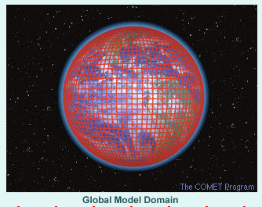
For a global model, the entire Earth is the Domain

Slide 14
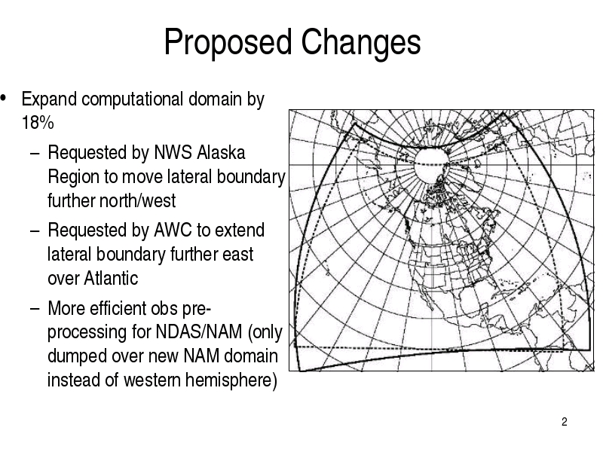
The WRF model which is the basis for the North American Mesoscale model has a domain centered on - guess which continent.
(March 2008)

Slide 15
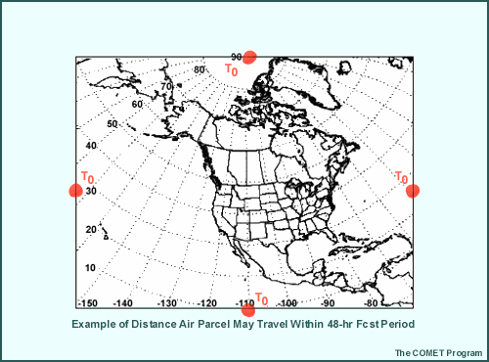
If your domain is not global, you have artificial “boundaries”. Since these don’t exist in the real atmosphere, any effects from these boundaries are computational. The effects propagate into the interior as fast as air parcels move.

Slide 16
Once you define a domain, you need boundary conditions. The real Earth has topography. Your lower boundary must have mountains!
32-km Eta model terrain

Slide 17
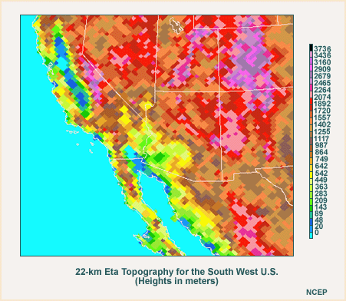
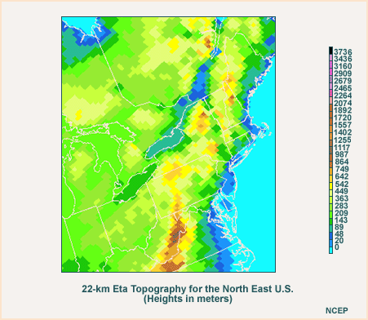
Here’s a closer look at the Southwest and Northeast U.S. terrain in the 22 km Eta (22 km horizontal grid spacing). What do you think?
(Remember the butterfly!)

Slide 18
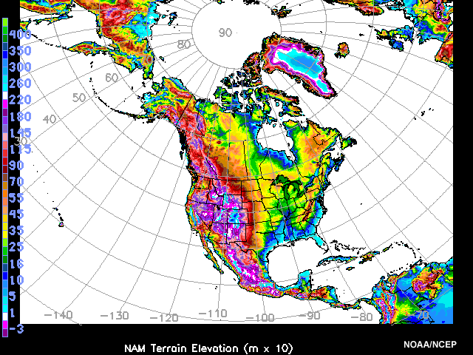
The NAM-WRF model terrain

Slide 19
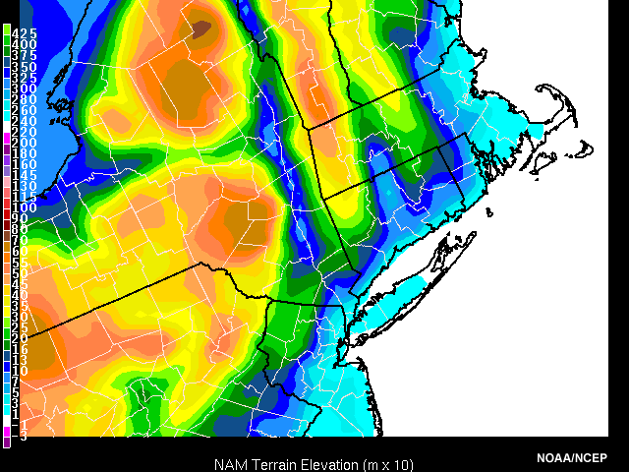
“Box 47” view of eastern NY in the NAM-WRF

Slide 20
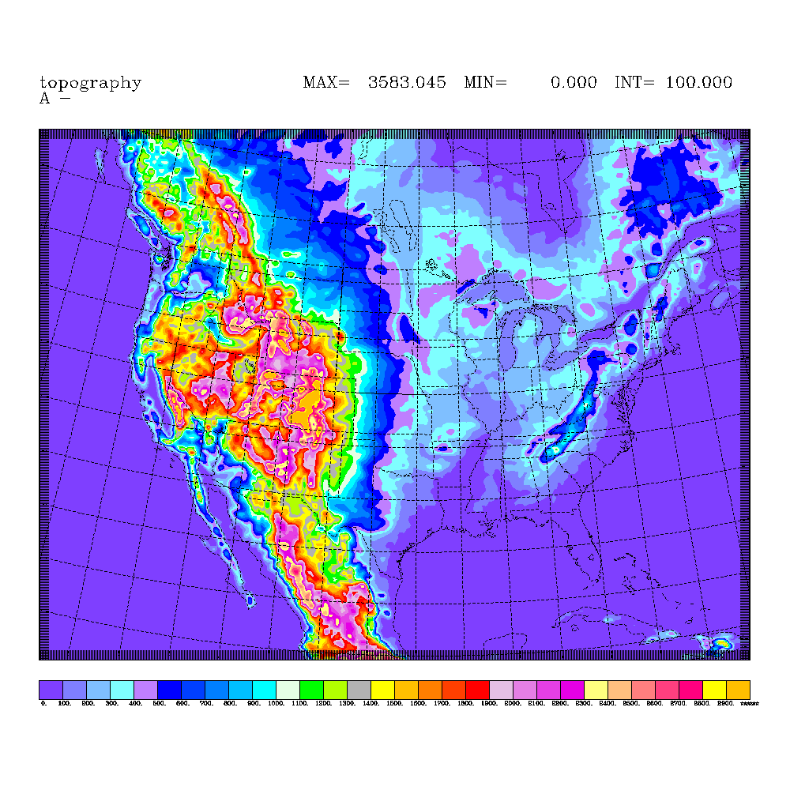
Topography in the Rapid Refresh Model (RAP)
Carried over from the 13 km Rapid Update Cycle (RUC) model (http://ruc.noaa.gov) The RAP replaced the RUC on May 1, 2012 (http://rapidrefresh.noaa.gov/)

Slide 21
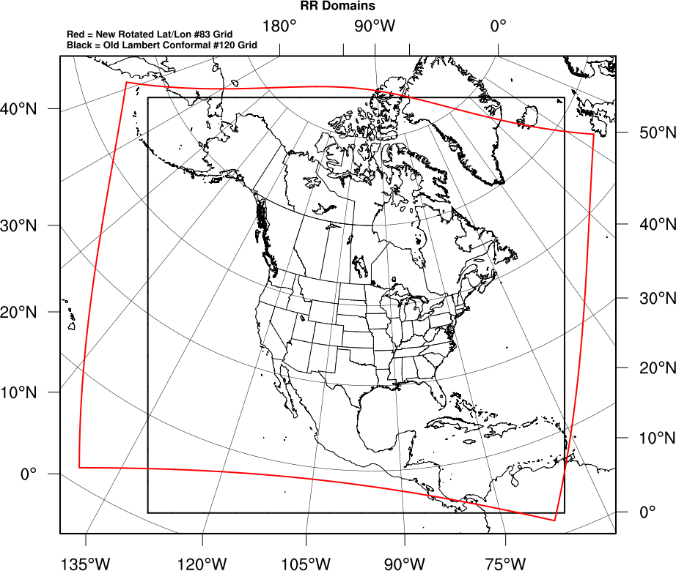
RAP domains
Notes:
21

Slide 22
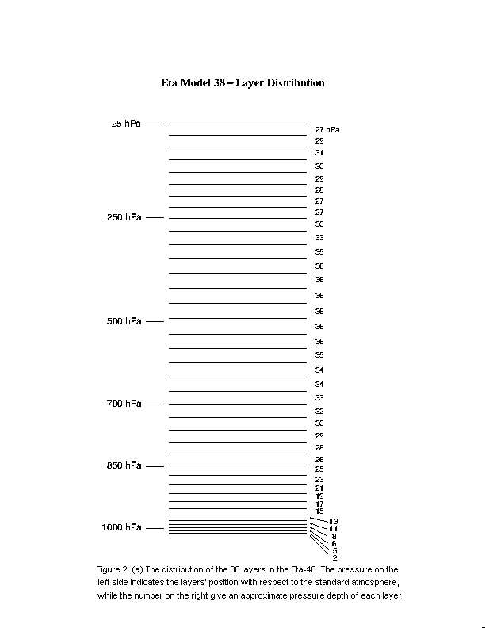
Atmospheric models are three dimensional. You also need a vertical grid.
Resolution in the vertical is much better than in the horizontal. But is it good enough?

Slide 23
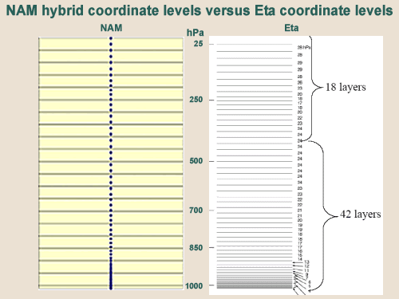
The NAM-WRF has 60 vertical layers, as did the NAM-Eta. The top level in the NAM-WRF is 2 mb instead of the 25 mb Eta top level.

Slide 24
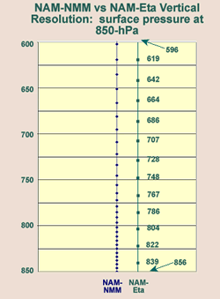
The NAM-WRF uses a vertical coordinate that is proportional to the surface pressure. So elevated terrain has very thin layers near the ground no matter how high it is. The old Eta had thin layers only near 1000 mb leading to errors in the western U.S.
The vertical resolution is lowest near 500 mb and increases again near 250 mb for better depiction of jet stream shears.

Slide 25
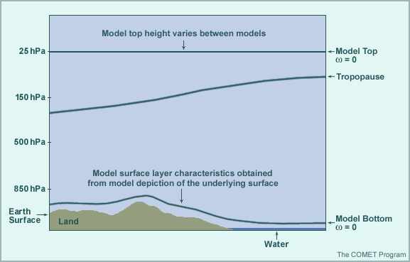
Models have top and bottom boundaries. The real atmosphere doesn’t so how you program these affects model performance. Many models use nondimensional (sigma) coordinates (P/P_{ref})

Slide 26
Horizontal Resolution
At each grid point, you have seven finite difference equations, each with multiple mathematical operations.
If your horizontal grid resolution is 12 km, how many 12 x 12 km boxes would you need for the entire world?
A: Earth’s radius ~ 6370 km, Area of a sphere = 4πr² so the Earth’s area is approximately 5.1 x 10⁸ km²
12km x 12km = 144 km² so you need 3,541,003 boxes!
You also have 60 levels of grid points so multiply that answer by 60 to get 2.12 x 10⁸ boxes!!!
But you only need that kind of resolution in a limited area, like North America.
One solution is to use a wider spacing for most of the world, but a very fine spacing in your area of interest. That’s called Nesting Grid Modeling. The NAM-WRF is a nested grid model

Slide 27
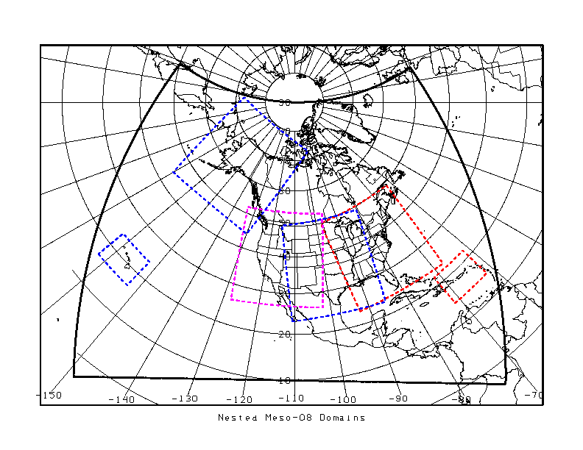
Here are the NAM-WRF model’s nested grid domains

Slide 28
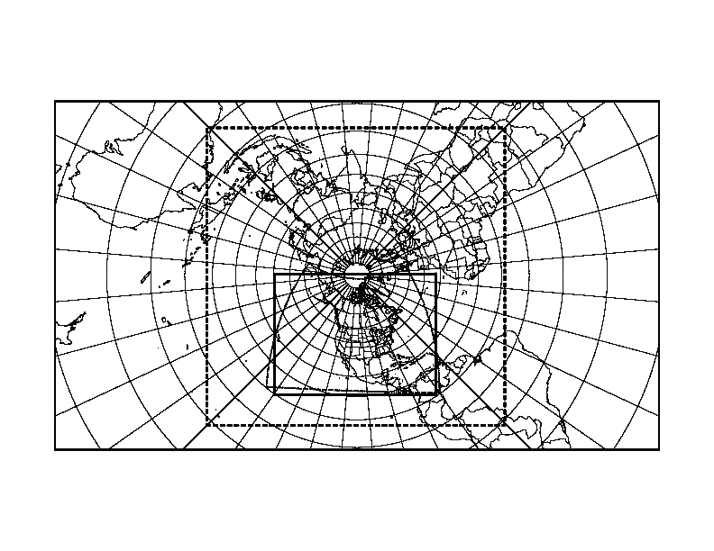
The first nested grid model was the NGM (nested grid model!) It had three grids, A, B, and C. The A grid was the entire world.
A
B
C

Slide 29
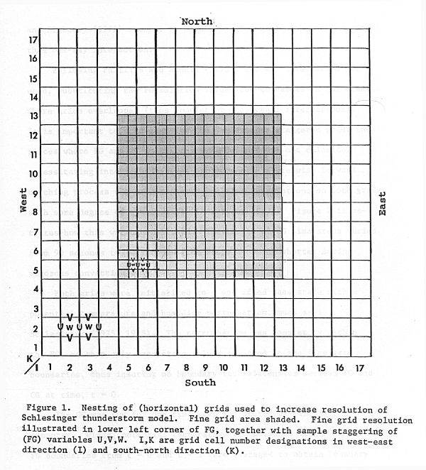
When you nest a model, you run the model equations for each grid, with different grid spacings.
It takes at least three times as much computer time.

Slide 30
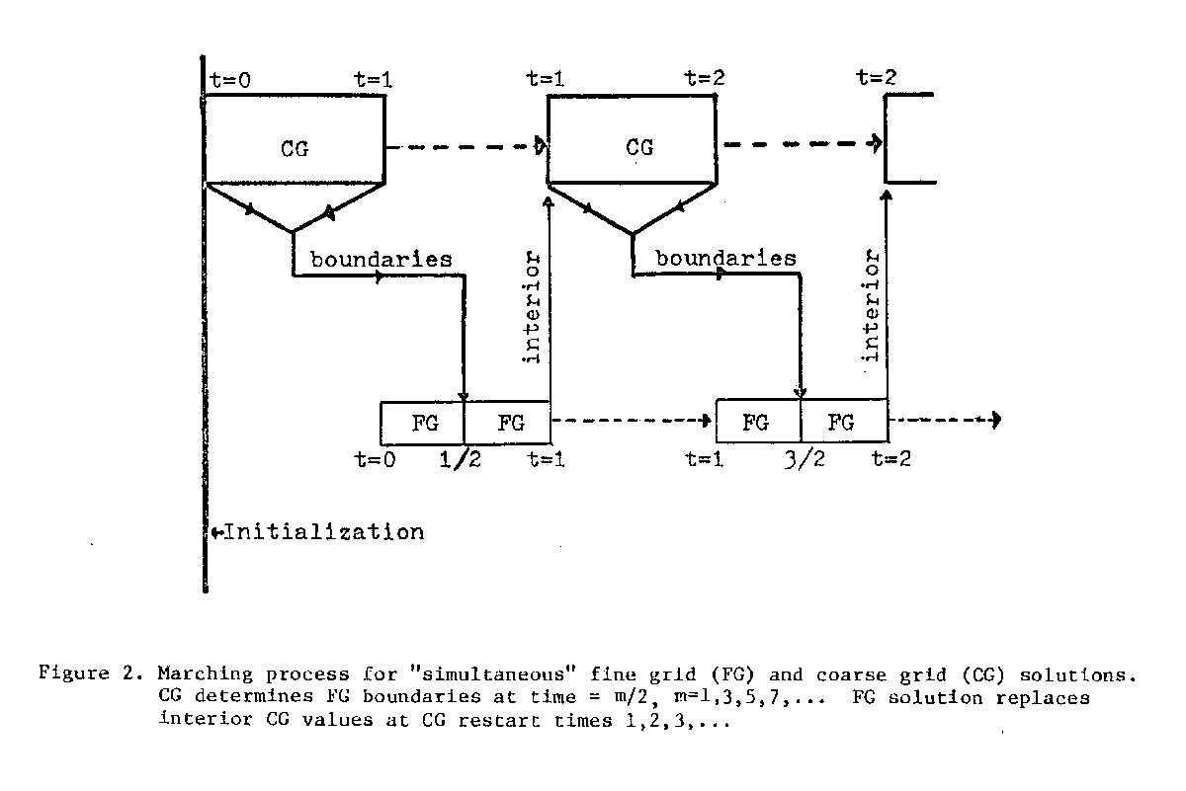
Two-way interaction is now the standard

Slide 31
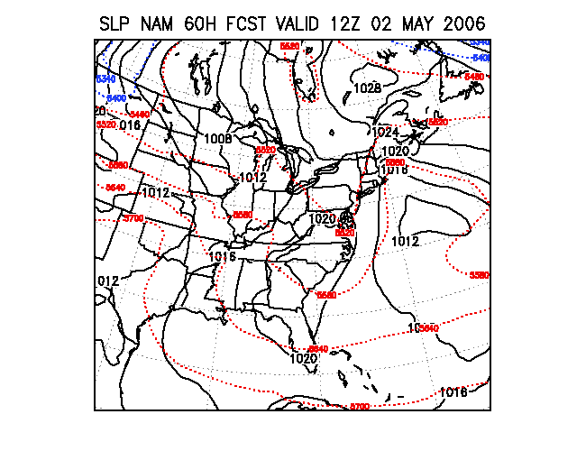
Nested Grid modeling allows the forecaster to “zoom in” on the local forecast region
How far in can we zoom? What are the modeling considerations?
With more calculations come more errors. Smaller grids need more calculations.

Slide 32
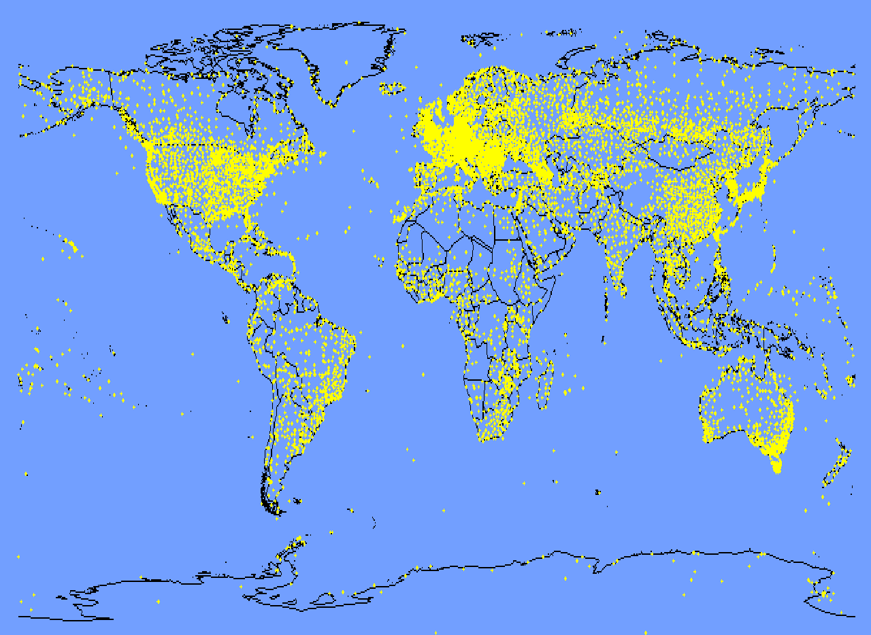
Initialization. How do we start the model?
A: Somehow we need to assess the atmosphere’s true initial state. Right down to each butterfly.
Any butterflies missed?

Slide 33
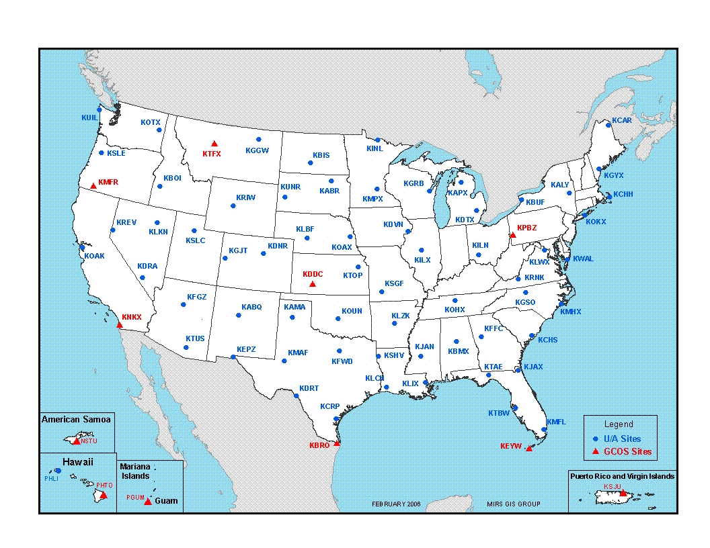
The models are 3-dimensional so you need data from above the surface. This is the most dense upper air network in the world.

Slide 34
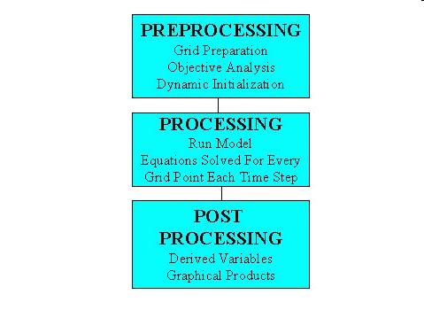
Every Model operates on a “framework” or procedure. The NAM would be like this:
This part would be the WRF →

Slide 35
Parameterization
If the weather element you are trying to forecast is smaller than a grid box or one wave in a spectral model, your model can’t handle it. Even with a grid spacing of 12 km, your model won’t predict individual cumulus clouds.
Real weather depends on very small-scale (called sub-grid scale) processes such as cloud or even raindrop formation. Models must forecast these processes correctly. Do you have to forecast each raindrop?
To include sub-grid scale processes, we build in computer subroutines called parameterization schemes.

Slide 36
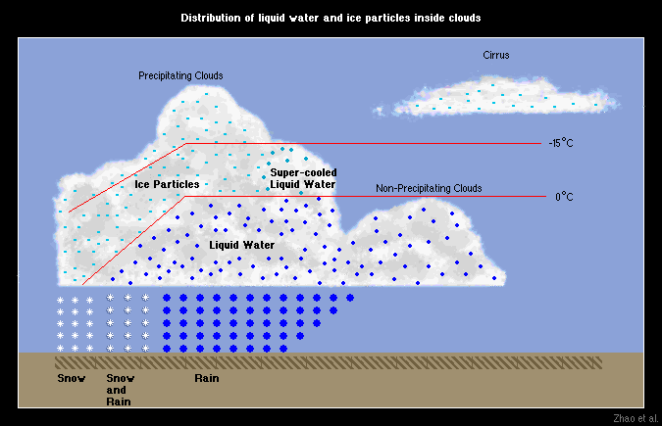
Clouds in the WRF model consist of liquid droplets or ice particles (depending on temperature of cloud and cloud top)

Slide 37
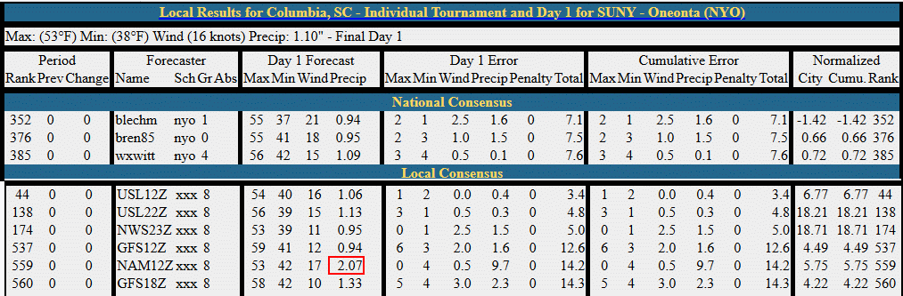
Sometimes a model will be way off, compared to the others. Likely this was a parameterization error. How does it happen?

Slide 38
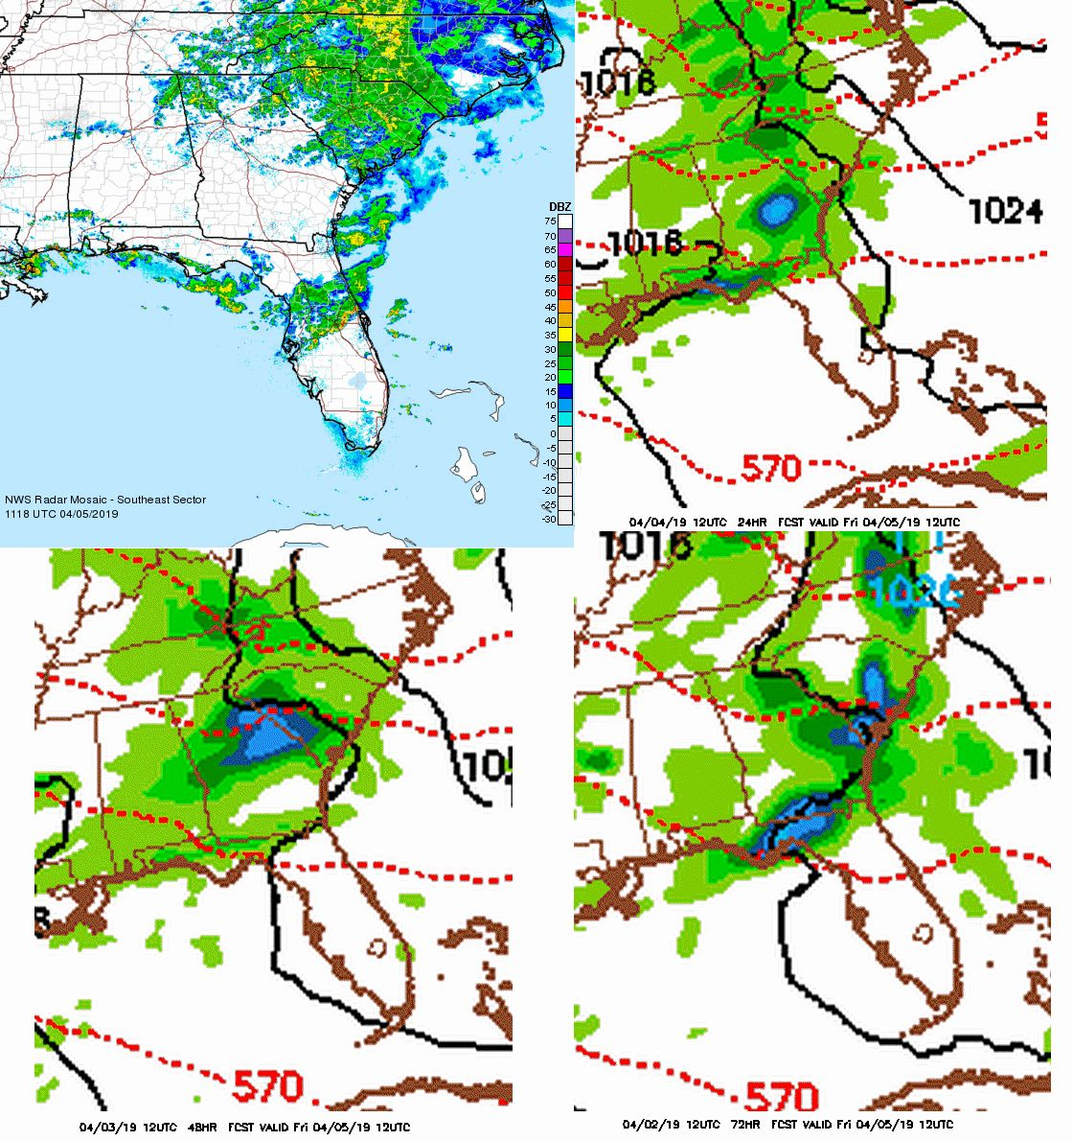

Easterly winds causing problems with the NAM convection forecast April 5, 2019
Radar
1118Z
24 hrs
48 hrs
72 hrs

Slide 39
Sub-grid scale processes requiring parameterization:
Friction (includes turbulence and ground )
Convection
Deep convection = thunderstorms
Shallow convection = cumulus clouds
Cloud droplet formation
Ice crystal formation
Raindrop formation
Cloud electrification
Atmospheric aerosols

Slide 40
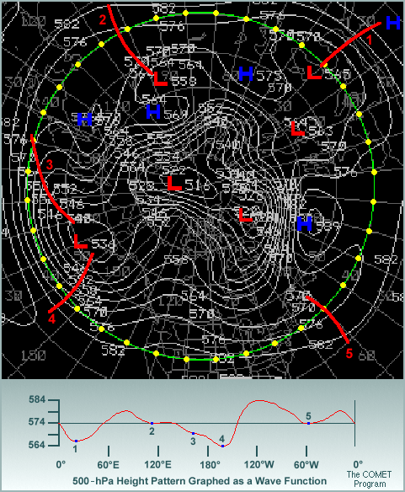
Spectral Models
Instead of solving for the variables (u,v,w, etc.) at grid points, some models solve for wave solutions.
The GFS is a spectral model
The highest resolution since 2011 is 1534 waves (approx 13 km at the equator)
The current description of the GFS spectral model is at https://www.emc.ncep.noaa.gov/GFS/doc.php

Slide 41
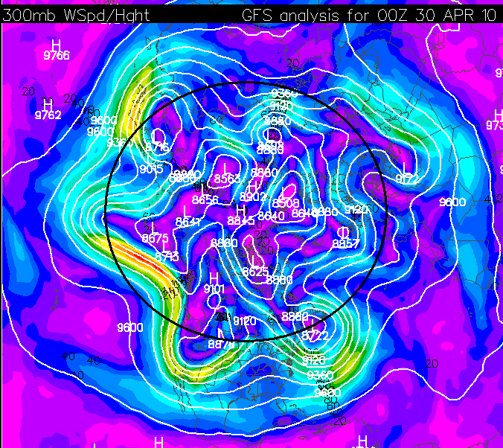
Good wave example. How many are around the 45°N latitude circle? (very approximately shown in black)

Slide 42
Comparing a northern hemispheric spectral simulation (left) with a low resolution grid-point version of the same simulation (right).

Slide 43
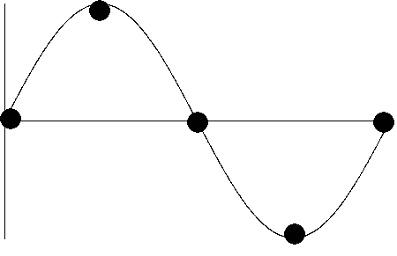
Question: To resolve the equivalent of today’s waves, how fine a resolution would a grid point model need?
To resolve a single wave, you need, at a minimum, 5 grid points.
What might be the wavelength of a typical hemispheric wave pattern of seven waves?

Slide 44
What might be the wavelength of a typical hemispheric wave pattern of seven waves?
Take the circumference of the 45°N latitude circle. C = 2πr where r is the radius of that circle. In this case r = a sin 45° where a is the Earth’s radius.
So, r ~ 4500 km and C ~ 28300 km.
With 7 waves, the average wavelength is around 4000 km (2500 miles). So your points must be a minimum of 800 km or 500 miles apart.
Question: Suppose you wanted to resolve smaller features, say 20 km in width? How many waves would you need?
28,000 km/20 = 1400 waves
Would you ever want to resolve more?

Slide 45
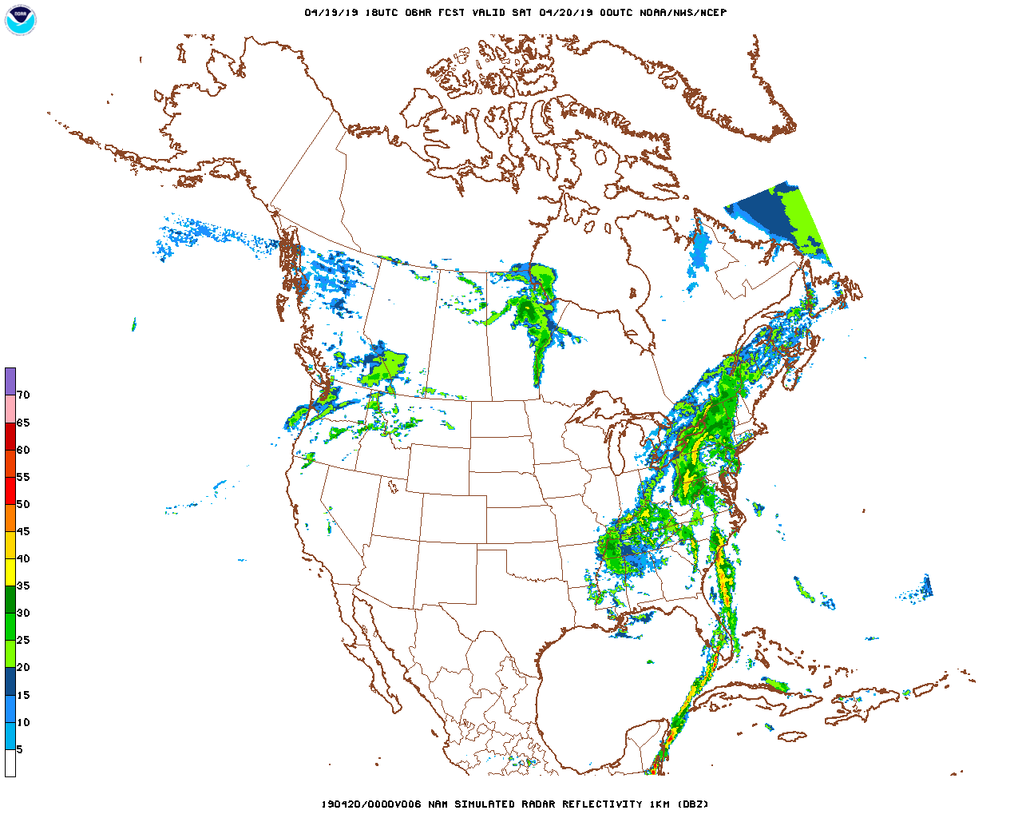
This is the simulated radar from the NAM-WRF since the GFS doesn’t have a display of simulated radar. It looks like individual thunderstorm cells can be forecast. What resolution would we need for this?

Slide 46
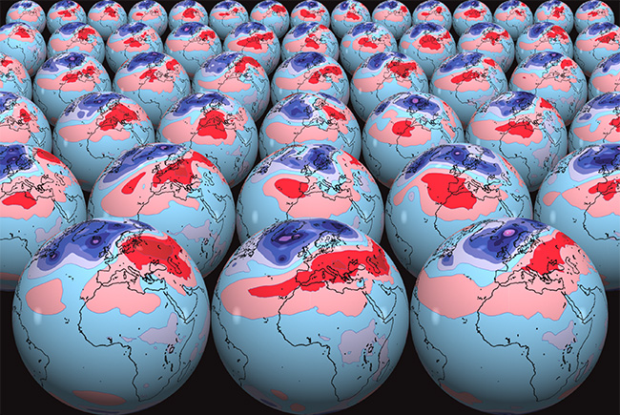
Ensemble Forecasting
What is ensemble weather forecasting?
An ensemble weather forecast is a set of forecasts that present the range of future weather possibilities. Multiple simulations are run, each with a slight variation of its initial conditions and with slightly perturbed weather models.
From https://www.ecmwf.int/en/about/media-centre/fact-sheet-ensemble-weather-forecasting

Slide 47
Where to find products:
https://www.esrl.noaa.gov/psd/map/images/ens/ens.html (still active but will be discontinued)
https://mag.ncep.noaa.gov/model-guidance-model-area.php (look for SREF and NAEFS)
https://www.spc.noaa.gov/exper/sref/
https://www.emc.ncep.noaa.gov (environmental modeling center)
http://weatheroffice.ec.gc.ca/ensemble/index_e.html (Canada)
http://cms.met.psu.edu/sref/ PSU eyewall
Really old tutorial:
www.wpc.ncep.noaa.gov/ensembletraining/

Slide 48
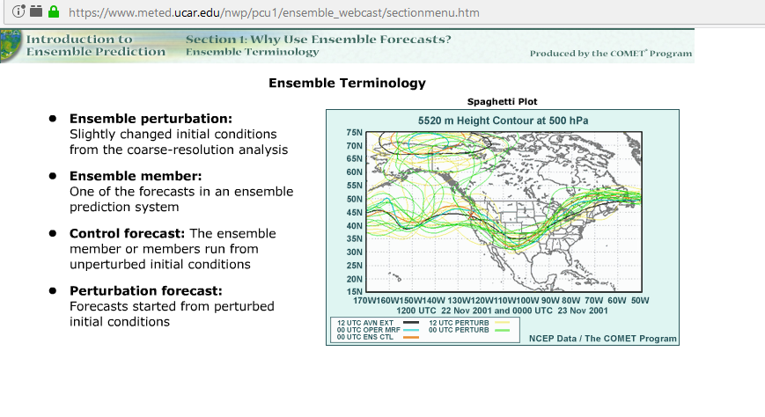

Slide 49
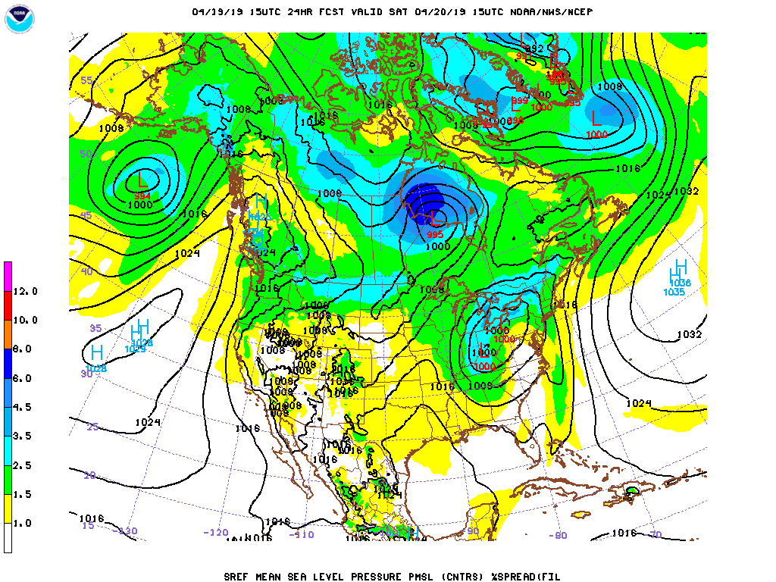
.
Typical ensemble forecast of MSLP from the mag page SREF. You get the mean and spread of the members (shaded)

Slide 50
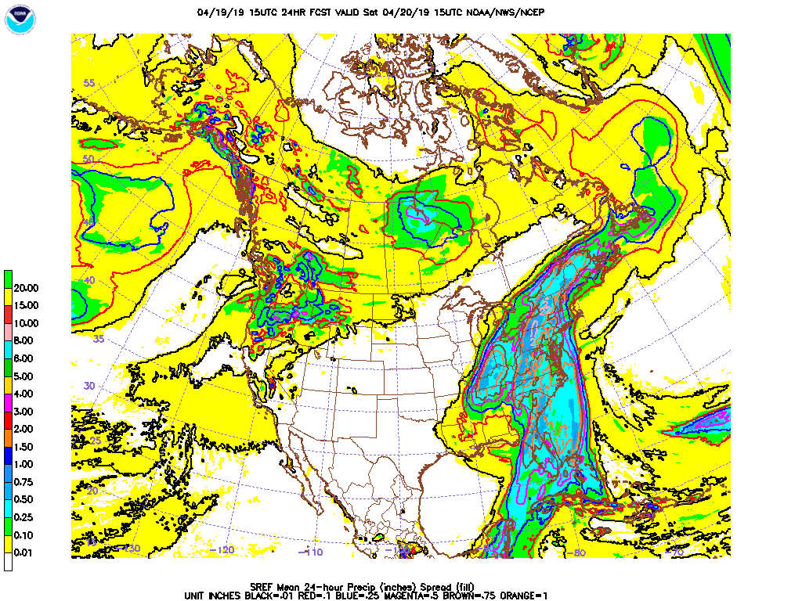
This is available on the Model Analysis and Guidance site (https://mag.ncep.noaa.gov/)

Slide 51
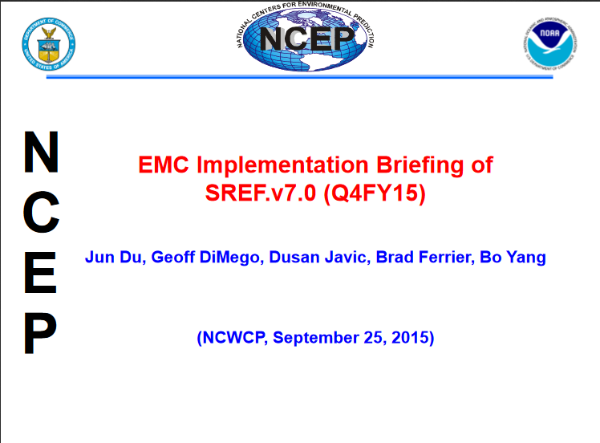

Slide 52
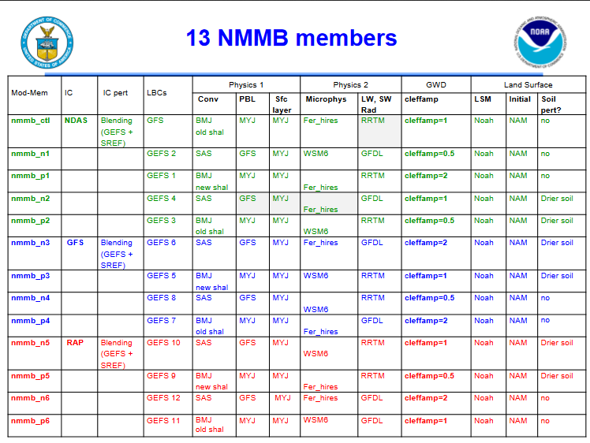
(Non-hydrostatic Multiscale Model Grid B)

Slide 53
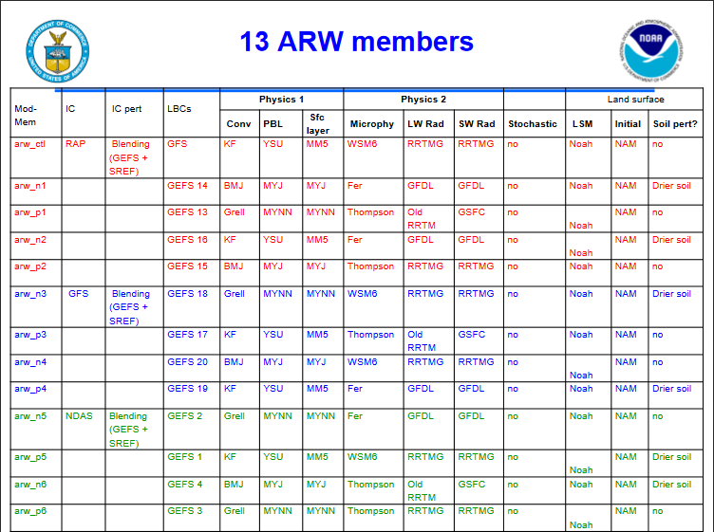
(Advanced Research WRF)

Slide 55
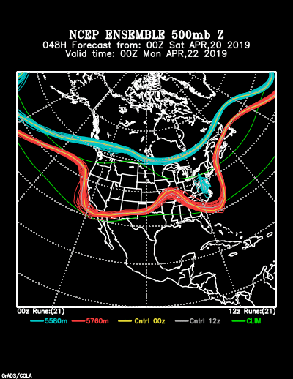
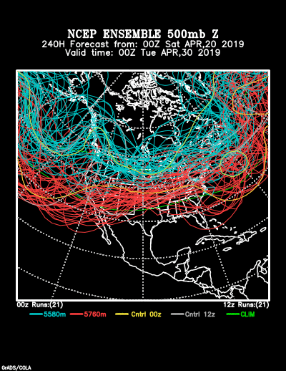
“Spaghetti Plots” Take two 500 mb contours and show all the ensemble members. At 48 hours there’s not much spread. At 240 hours it’s spaghetti!
htFrom https://www.esrl.noaa.gov/psd/map/images/ens/ens.html#nh

Slide 56
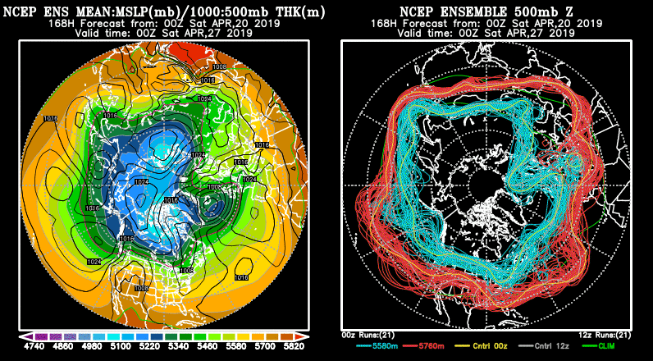
So what good is it? If you take the ensemble mean, that forecast beats all individual member forecasts over the long term.

Slide 57
Class assignment
Each student takes a model:
NAM
GFS
HRRR
GEFS (Mean-Spread)
SREF
Go to the mag site (https://mag.ncep.noaa.gov/model-guidance-model-area.php) Find the latest run Oneonta 2 m max temperature for today and the total precipitation 12Z to 00Z. Write your model’s numbers on the whiteboard.
Your professor will report the verifications on Monday.

