Slide 1
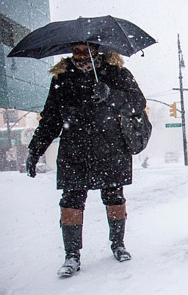
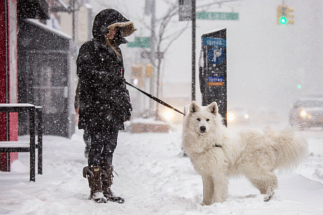
The Coastal Snowstorm of Jan 4, 2018
METR 361 presentation

Slide 2
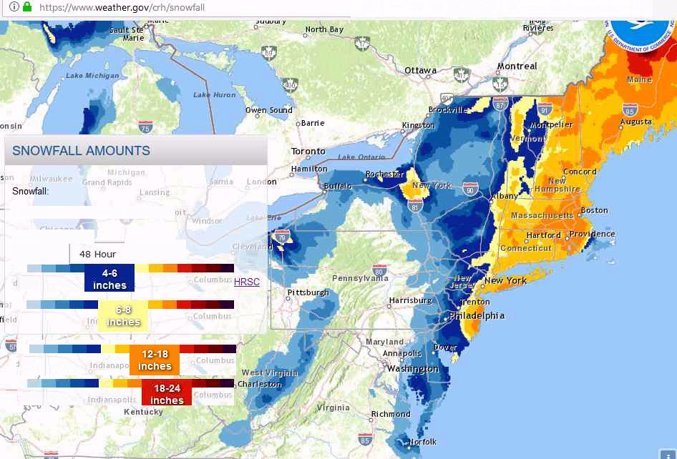

Slide 3
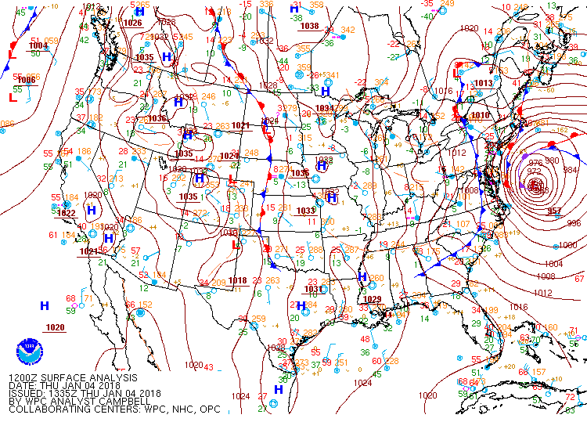

Slide 4
Surface Map animation
Watch for:
• Low appears to begin in the Florida Strait
• Low develops and moves north along east coast ~ 100 miles offshore.
• Second low moves southeastward from Great Lakes (Clipper)
• Cold air mass follows and is incorporated into the coastal Low.

Slide 5
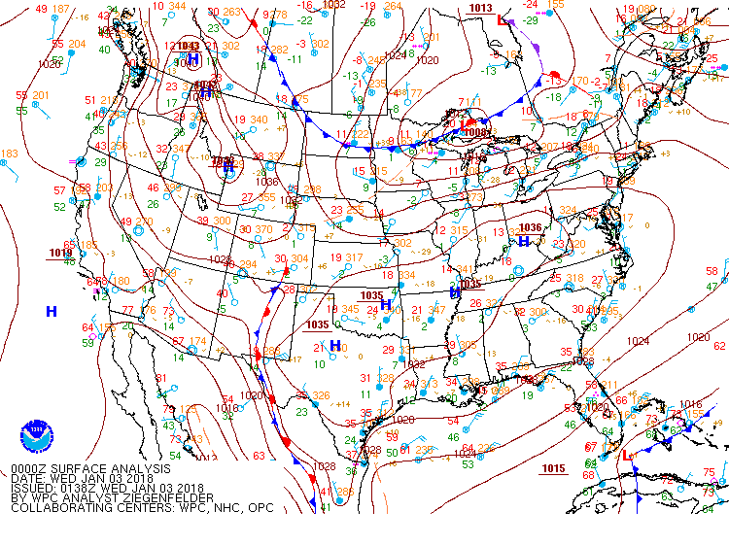
US surface Loop

Slide 6
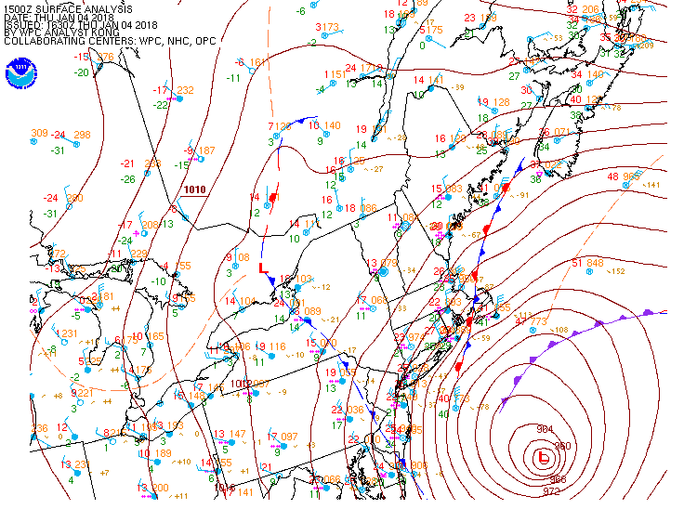

Slide 7
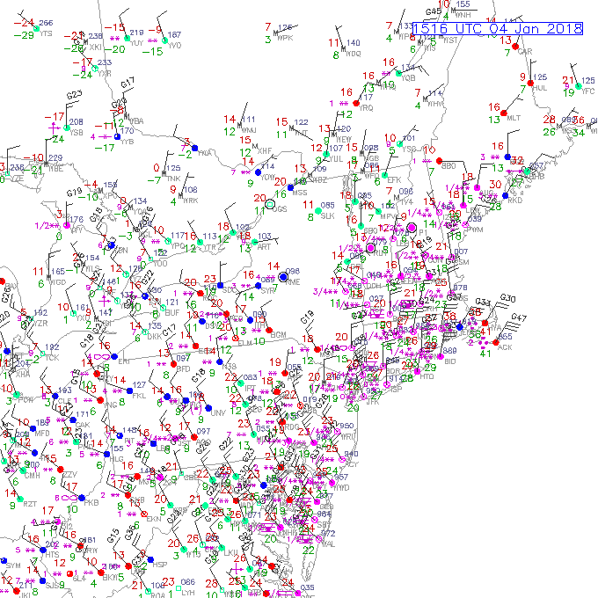

Slide 8
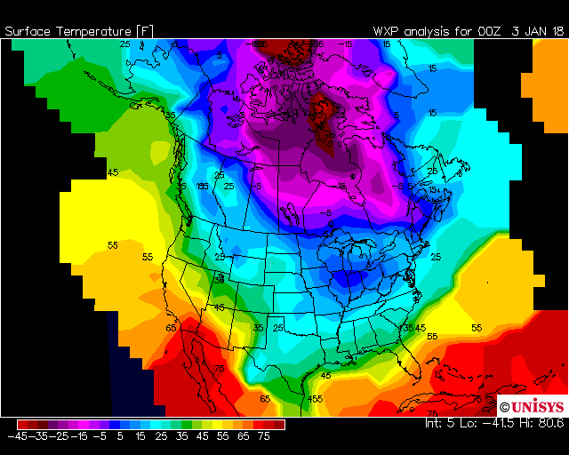
Loop of 00Z temperature color bands

Slide 9
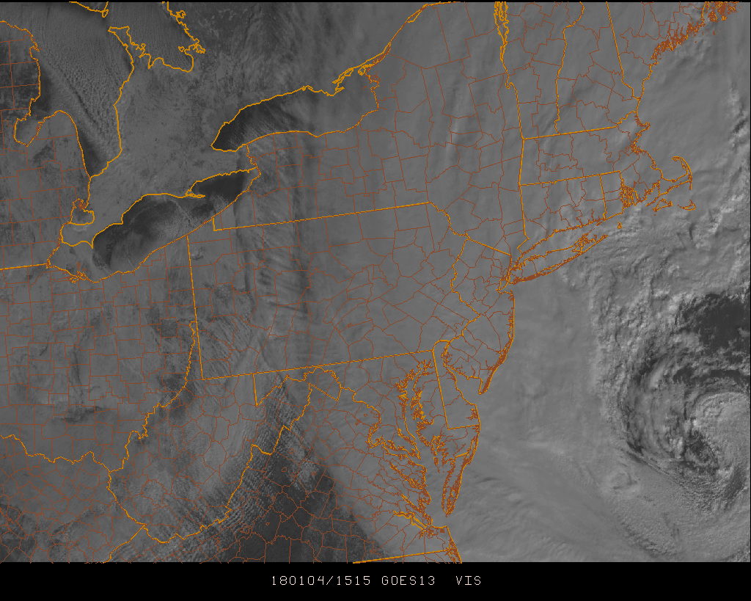
15Z Jan 4, 2018 Visible Satellite image
Snow cover (no clouds)
Edge of cloud shield

Slide 10
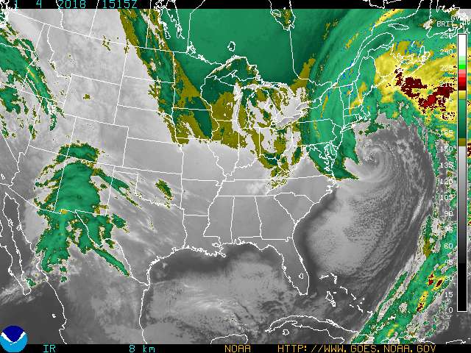

Slide 11
Features to notice in Satellite Loop
• Very cold air in Canada shown by color enhancement
• Clouds in Utah on Jan 1 move southeast
• Alberta Clipper enters image on Jan 2 (not a classic feature of Nor’easters)
• On Jan 3, enhancements off FL, GA, and SC coast become stronger and then organize
• “Jump” late on Jan 2 due to data loss
• Dry tongue becomes pronounced and wraps around center as the Low occludes

Slide 12
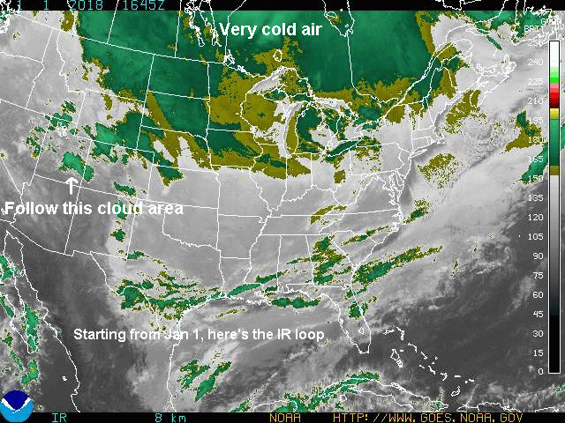

Slide 14
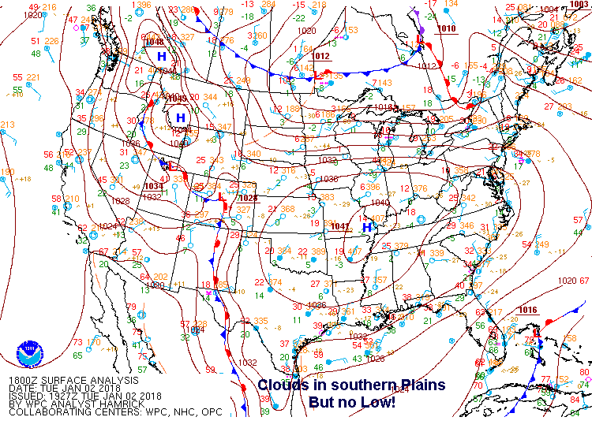

Slide 15
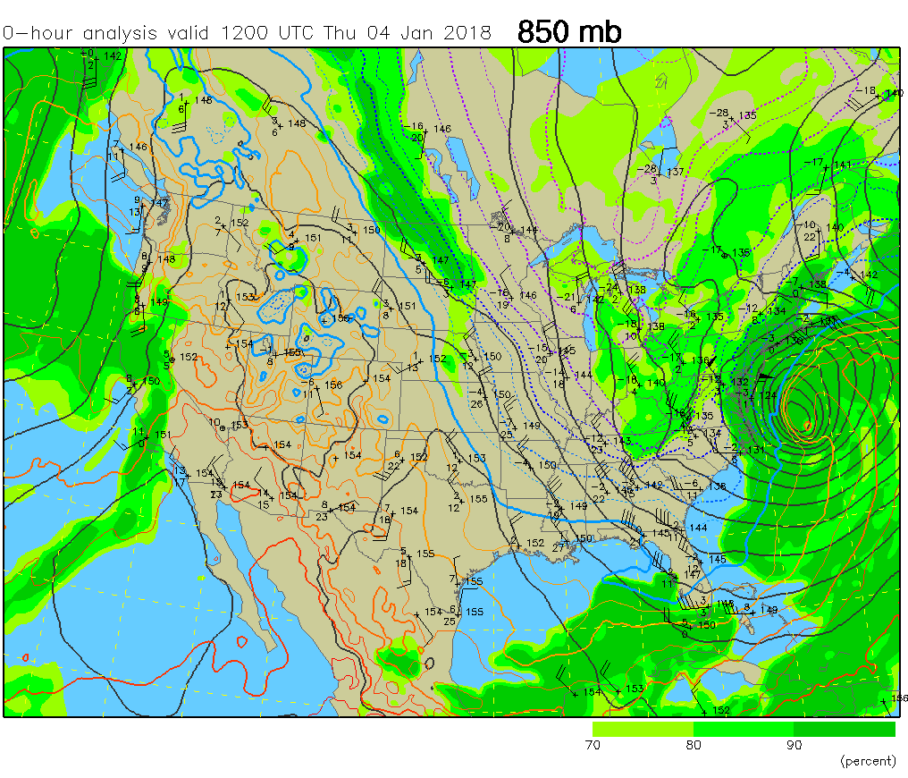

Slide 16
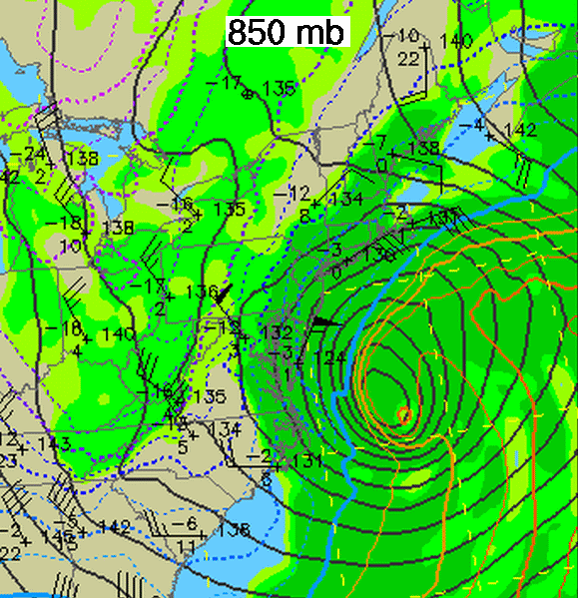

Slide 17
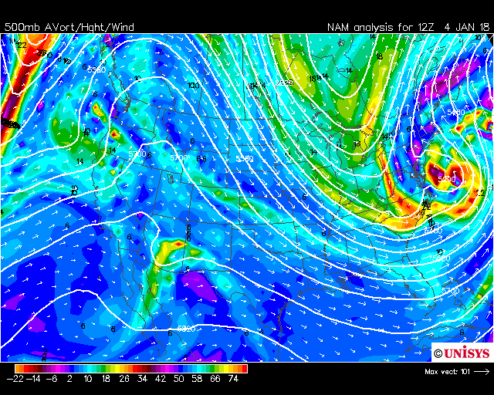
500 mb

Slide 18
500 mb Heights and Vorticity
• Long wave trough over eastern U.S. stays in place
• Short wave trough in British Columbia with Avort ~ 33 x 10⁻⁵ sec⁻¹
• Second short wave in Alberta at 00Z Jan 2 is the Alberta Clipper
• Avort in southern stream becomes enhanced on Jan 3 when the short wave (S/W) moves offshore.
• After Nor’easter the long wave (L/W) amplitude is significantly stronger than on Jan 1

Slide 19
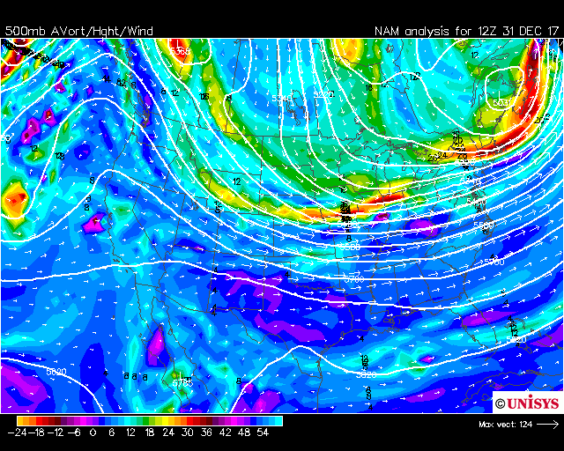
500 mb

Slide 20
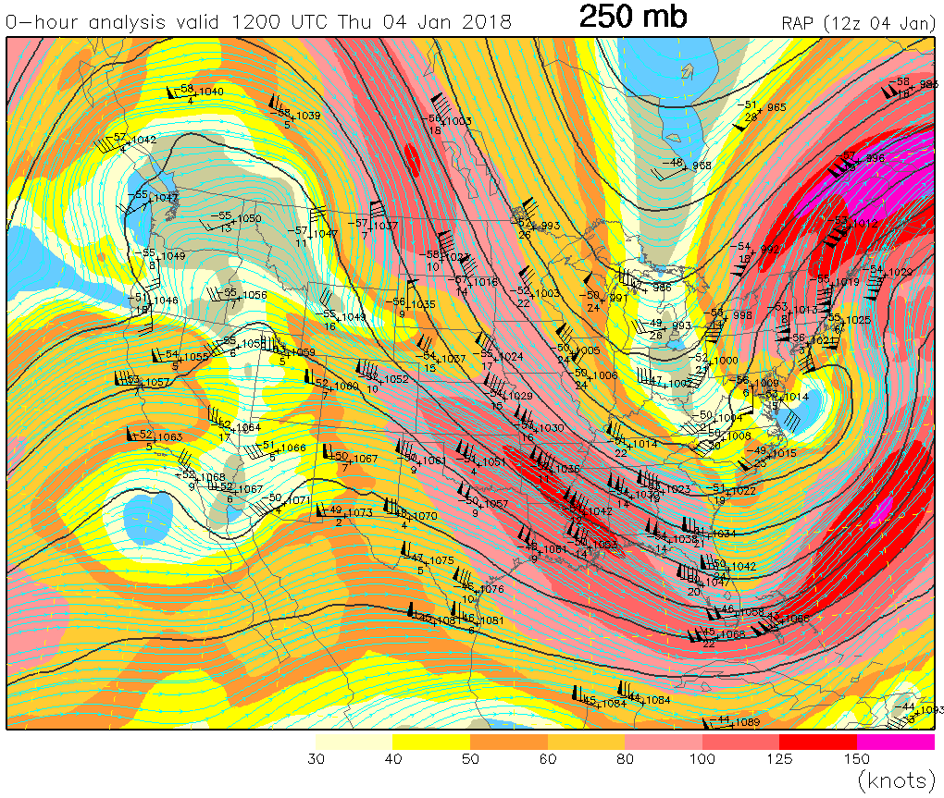

Slide 21
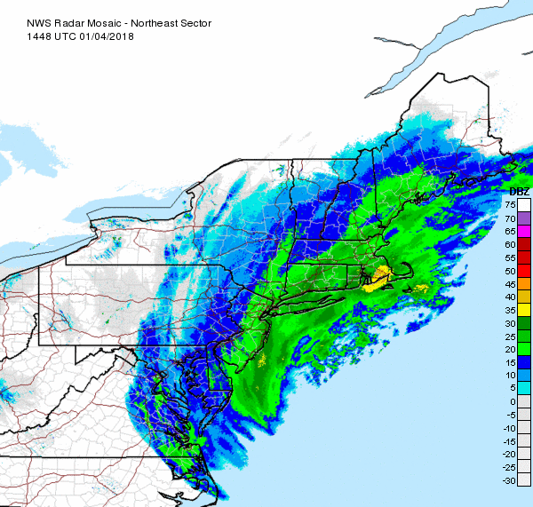
Radar

Slide 23
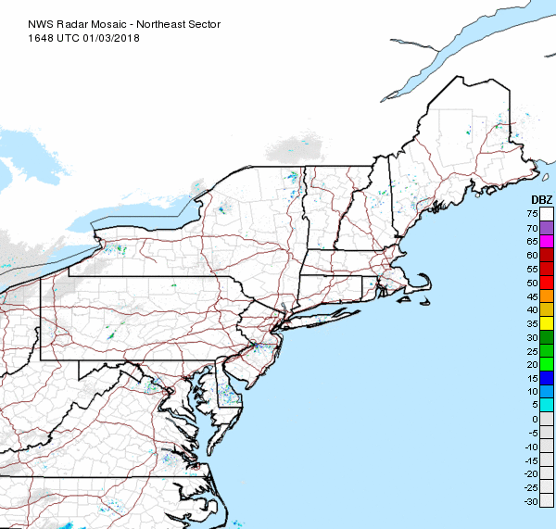
Radar

Slide 24
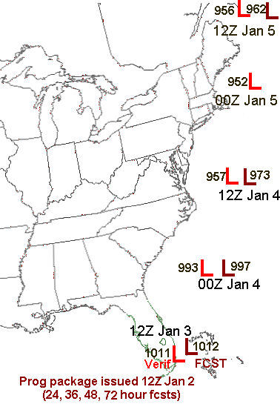
Forecasts vs Verifications

Slide 25
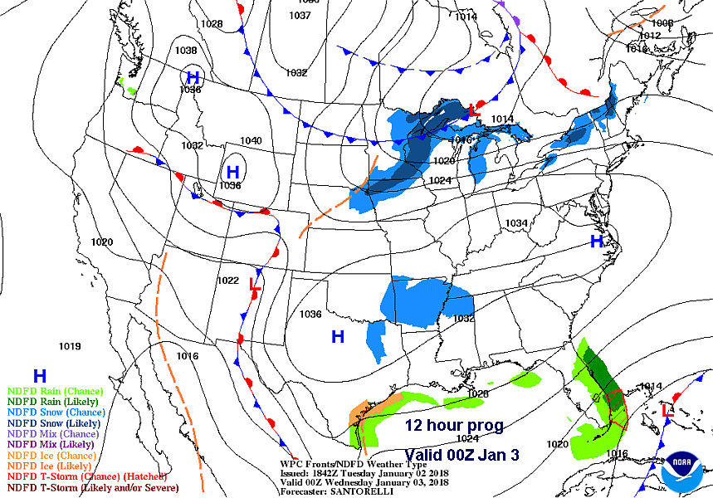
Prog package from
12Z Jan 2

Slide 26
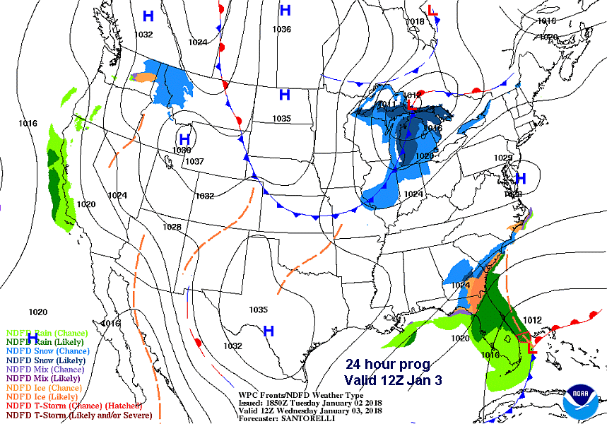

Slide 27
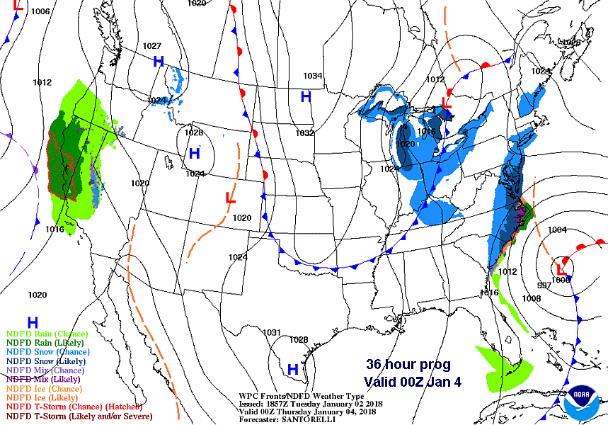

Slide 28
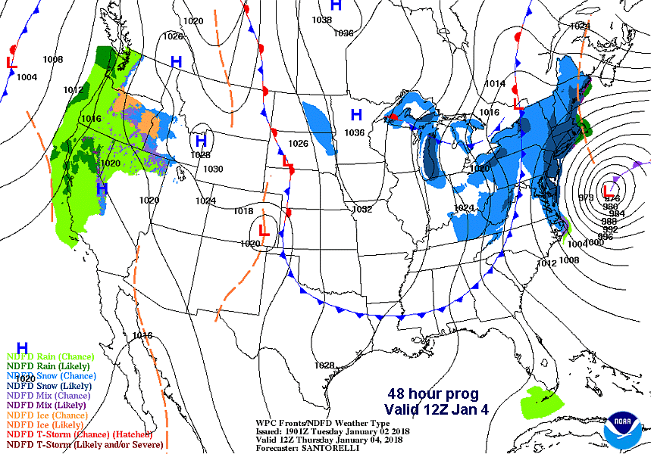

Slide 30
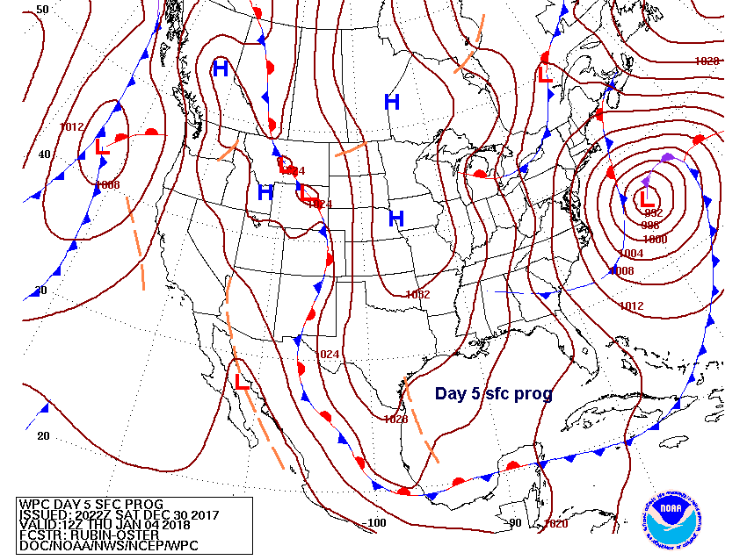
All progs verifying
at 12Z on Jan 4

Slide 31
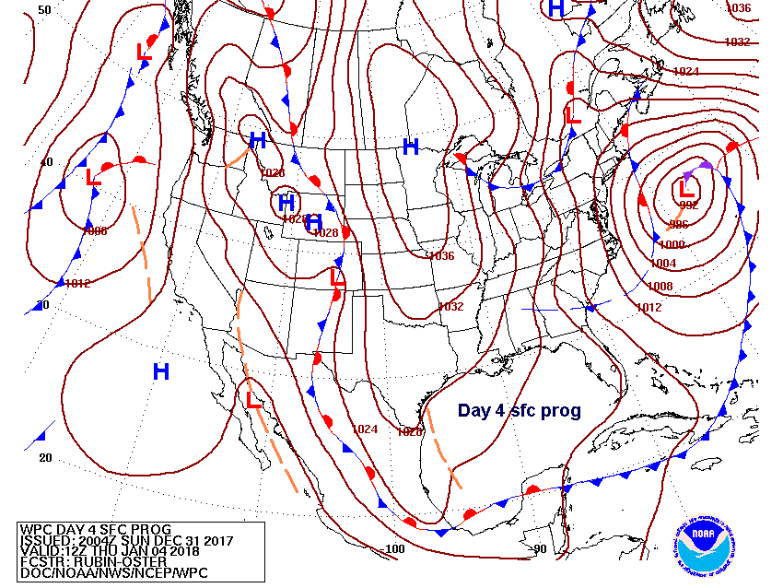
All progs verifying
at 12Z on Jan 4

Slide 32
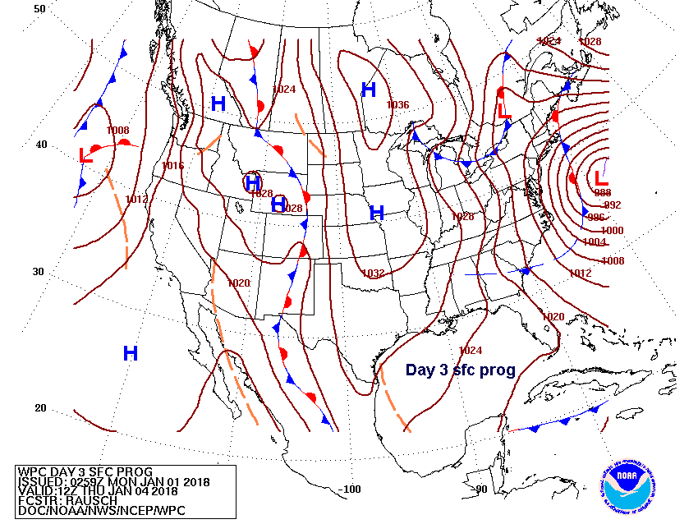
All progs verifying
at 12Z on Jan 4

Slide 33
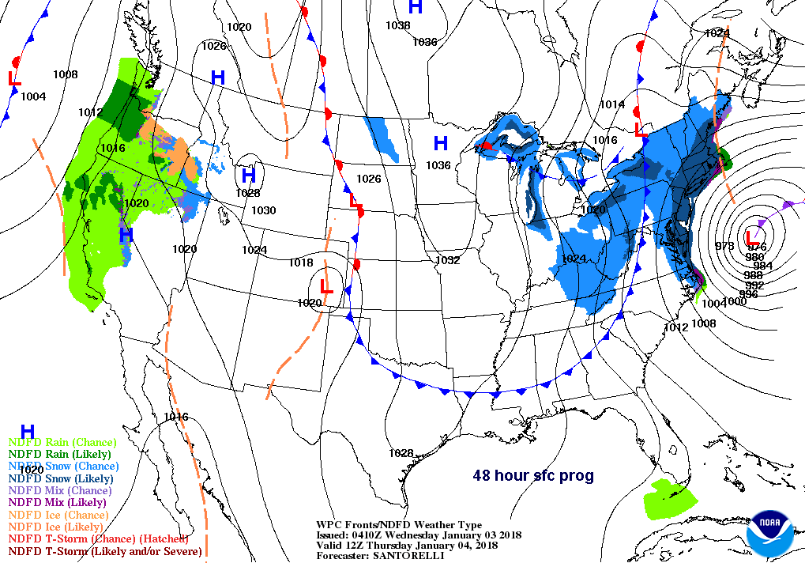
All progs verifying
at 12Z on Jan 4

Slide 34
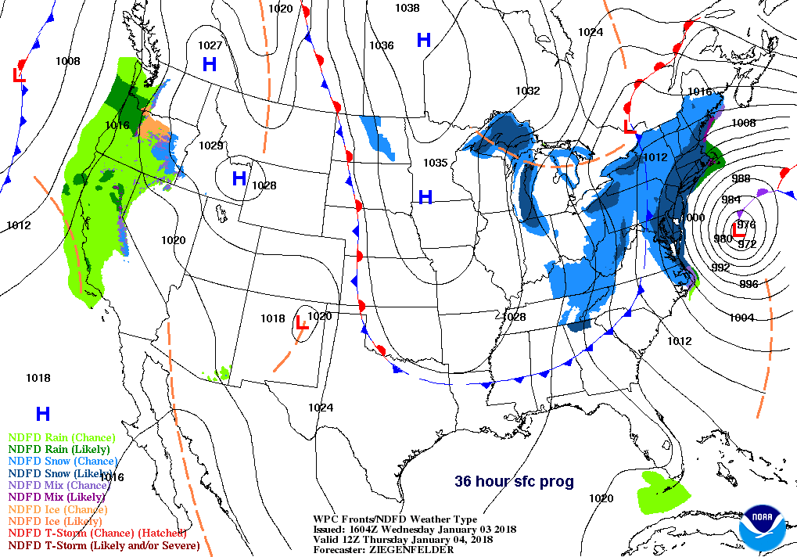
All progs verifying
at 12Z on Jan 4

Slide 35
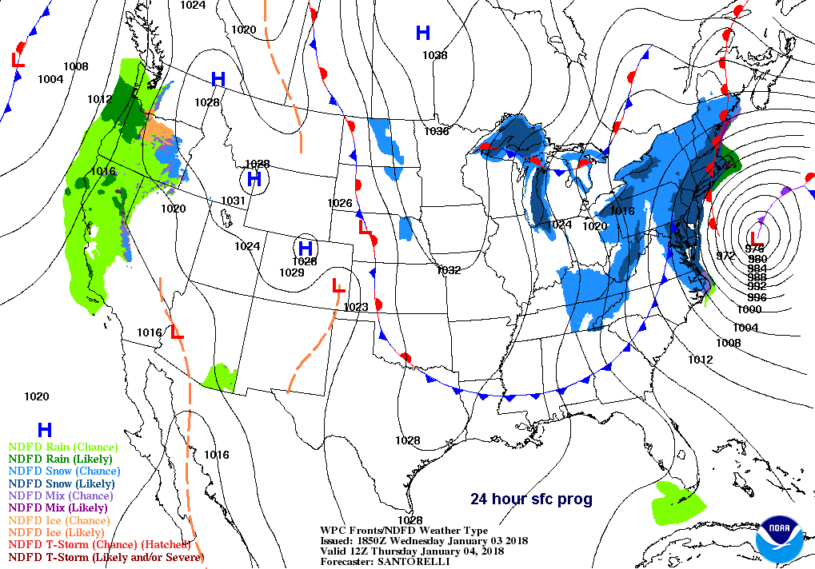
All progs verifying
at 12Z on Jan 4

Slide 36
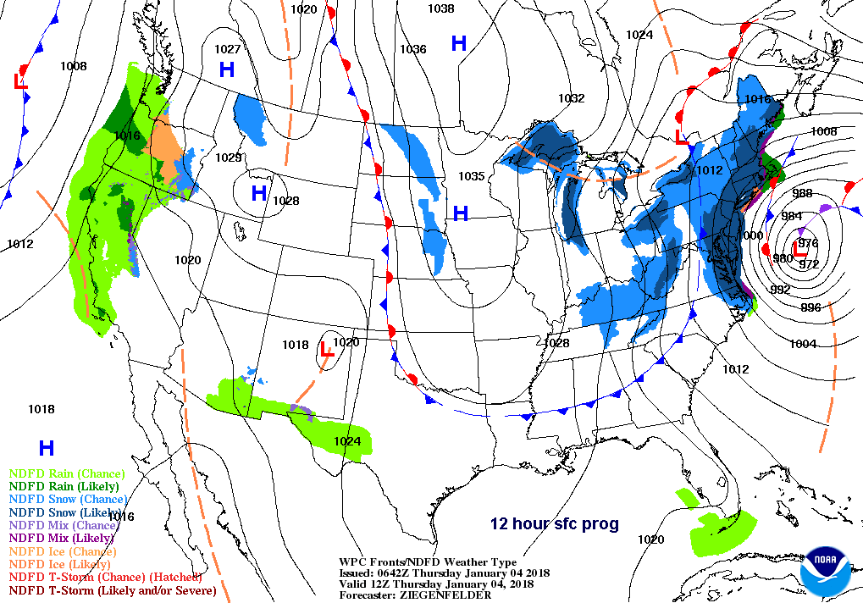
All progs verifying
at 12Z on Jan 4

Slide 37
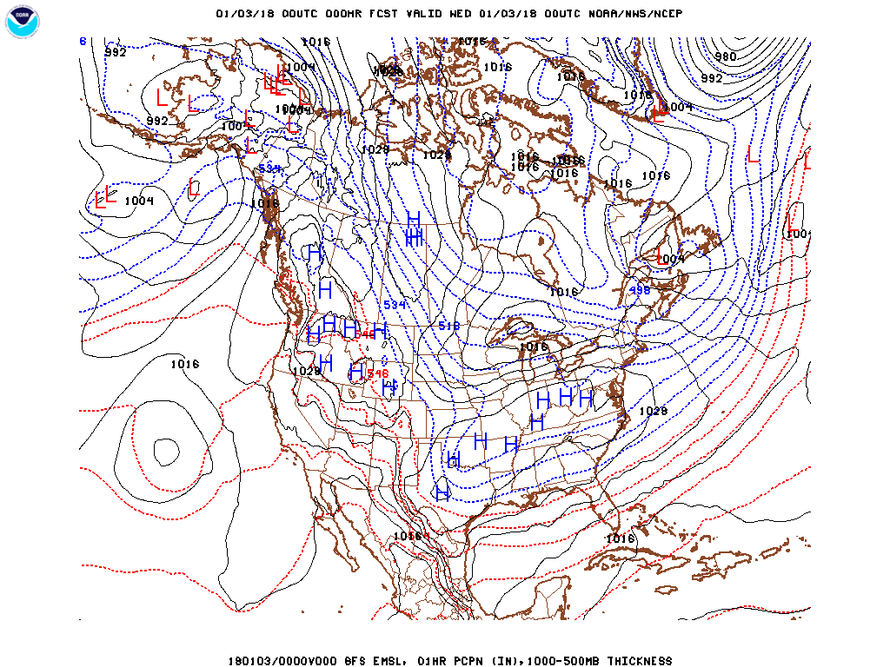
GFS MSLP loop

Slide 38
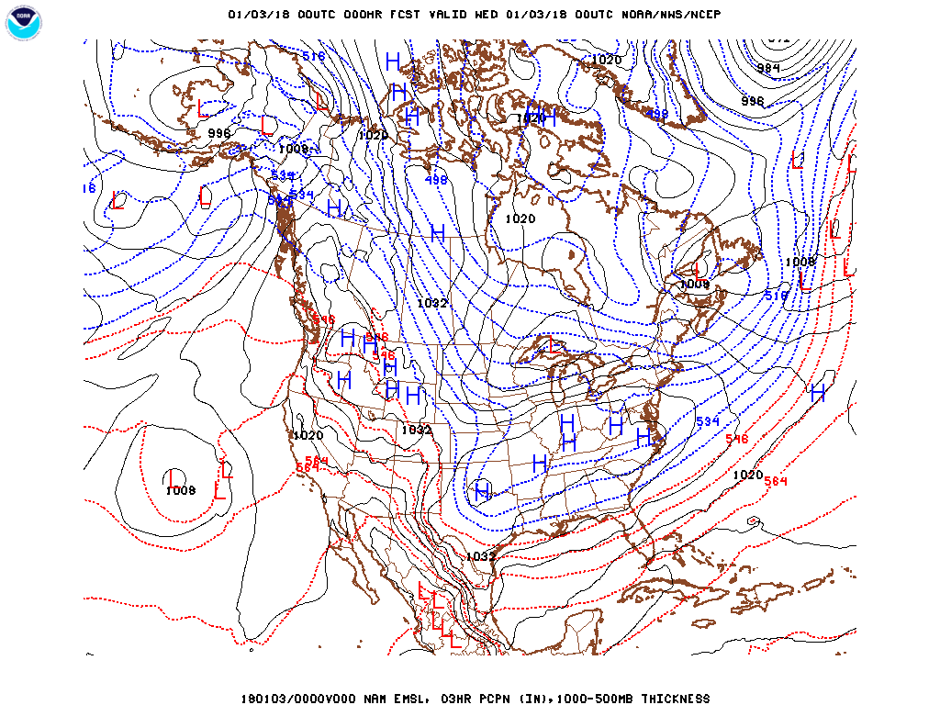
NAM MSLP loop

Slide 39
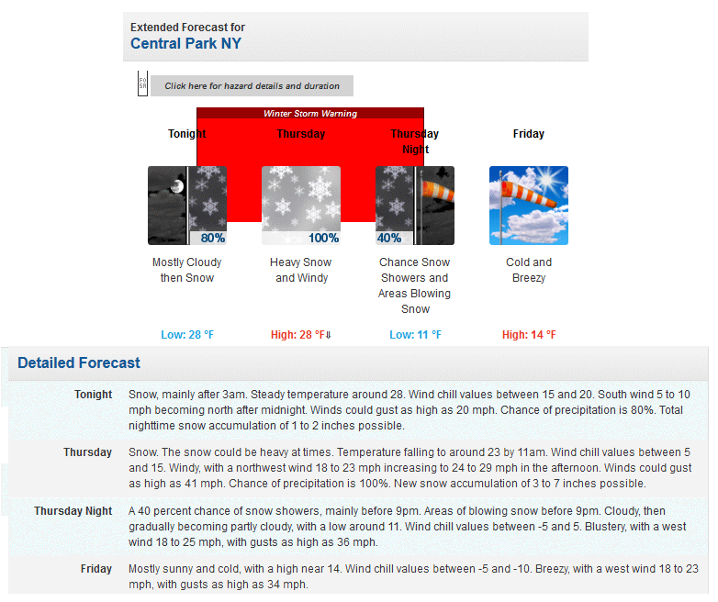

Slide 40
Conclusions
• The storm of Jan 4, 2018 was a good example of a coastal cyclone, a.k.a., a Nor’easter.
• Snowfall was heaviest in Maine, but New York and Boston received 12-18”. Boston also had coastal flooding which froze after storm passage when Arctic Air arrived. Heavy snow did not penetrate far inland.
• The surface cyclone appeared to form on a cold front south of Florida
• An upper air short wave could be followed from British Columbia southeastward until it interacted with the front.
• The cyclone tracked north-northeast, roughly parallel to the U.S. east coast, producing snowfall from eastern Virginia to Maine.

Slide 41
Conclusions (continued)
• In part due to an Alberta Clipper interacting with the coastal cyclone, extreme Arctic Air with High Pressure brought temperatures below freezing to areas right on the coast.
• Driving the cold air southeast was associated with an amplification of the upper air long wave trough.
• Forecasts were generally accurate 2-3 days in advance, although the coastal storm tracked about 50 miles (80 km) west of the (prog) forecast track, causing snowfall totals in coastal metropolitan areas to be greater than forecast.
• GFS and NAM precipitation forecasts in those coastal areas were underforecast but manual adjustments by NWS forecasters resulted in only slight errors in official forecasts. In general, the public was well warned.

