Slide 1
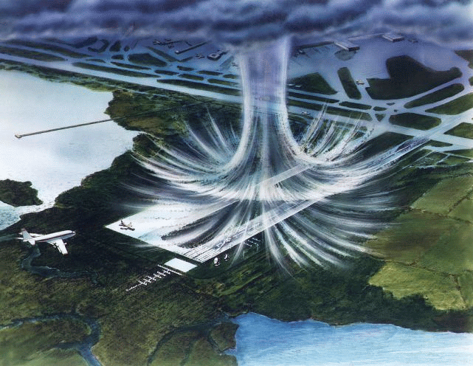
Downbursts, a.k.a., straight-line wind

Slide 2
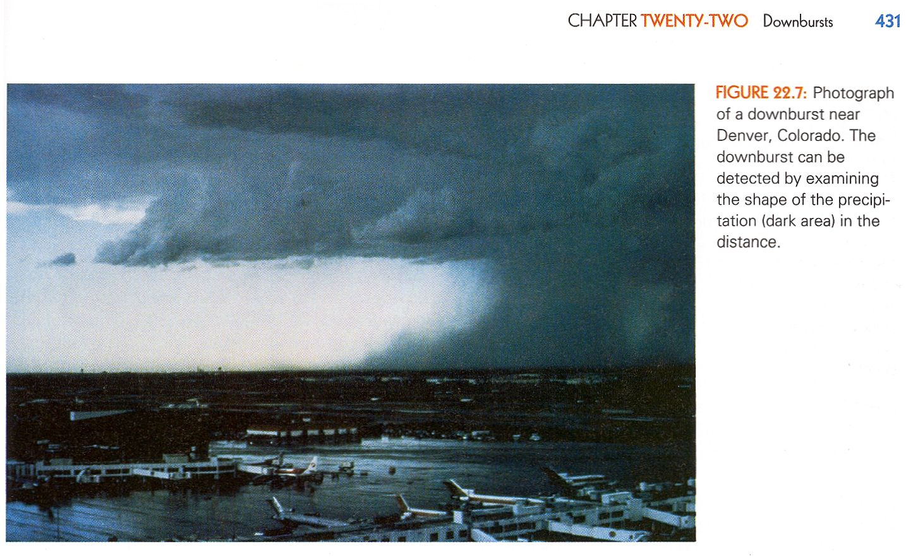
Definition from the AMS Glossary of Meteorology:
An area of strong, often damaging winds produced by one or more convective downdrafts over an area from less than 1 to 400 km in horizontal dimensions.
From Rauber, et al., “Severe & Hazardous Weather”, fourth edition:
“… convective downdrafts…” Downbursts come from thunderstorms. Always.

Slide 3
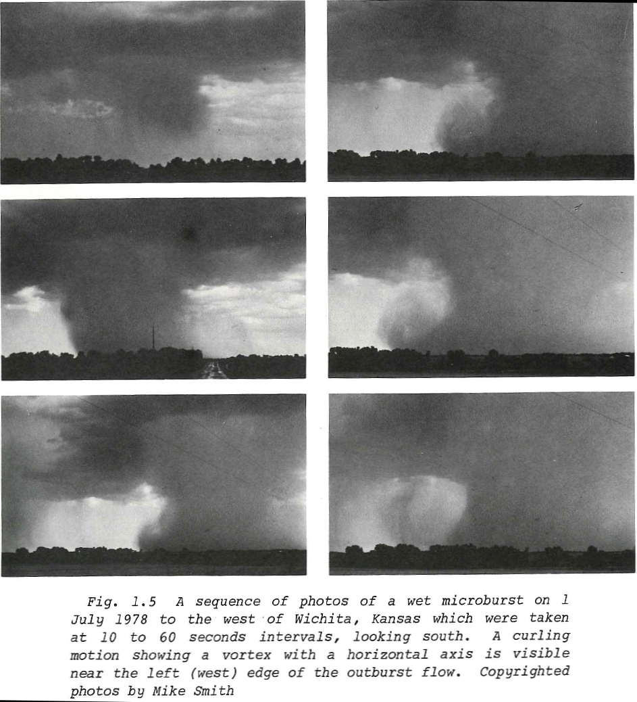
This is what it looks like when you can see it. Downbursts are only visible when there is rain in them.
Called a “Wet Downburst”
Microburst: A downburst that covers an area less than 4 km along a side with peak winds that last 2–5 minutes (AMS glossary)
From T.T. Fujita, “The Downburst”, 1985.

Slide 4
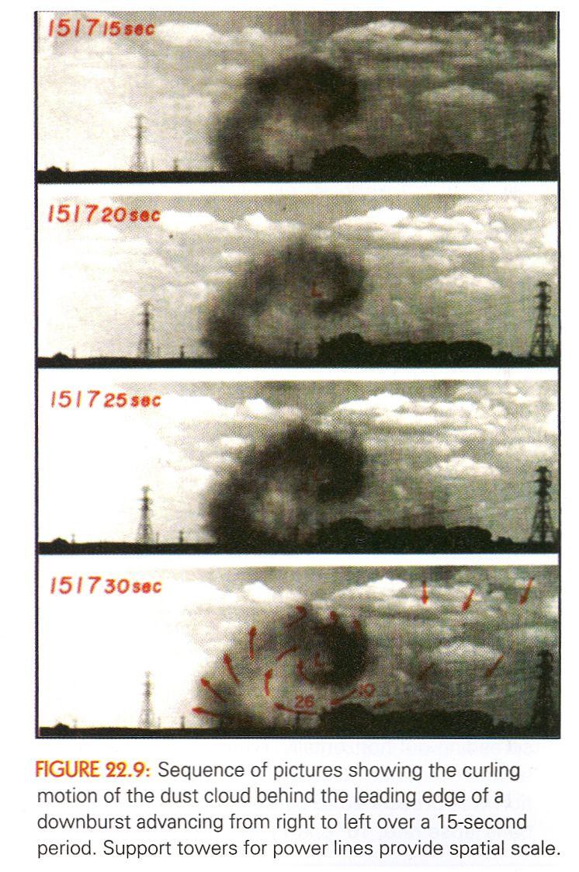
Again, from Rauber, et al., “Severe & Hazardous Weather”, fourth edition:
This is a closeup of just the curling part of a wet downburst, as seen with a camera from the ground.

Slide 5
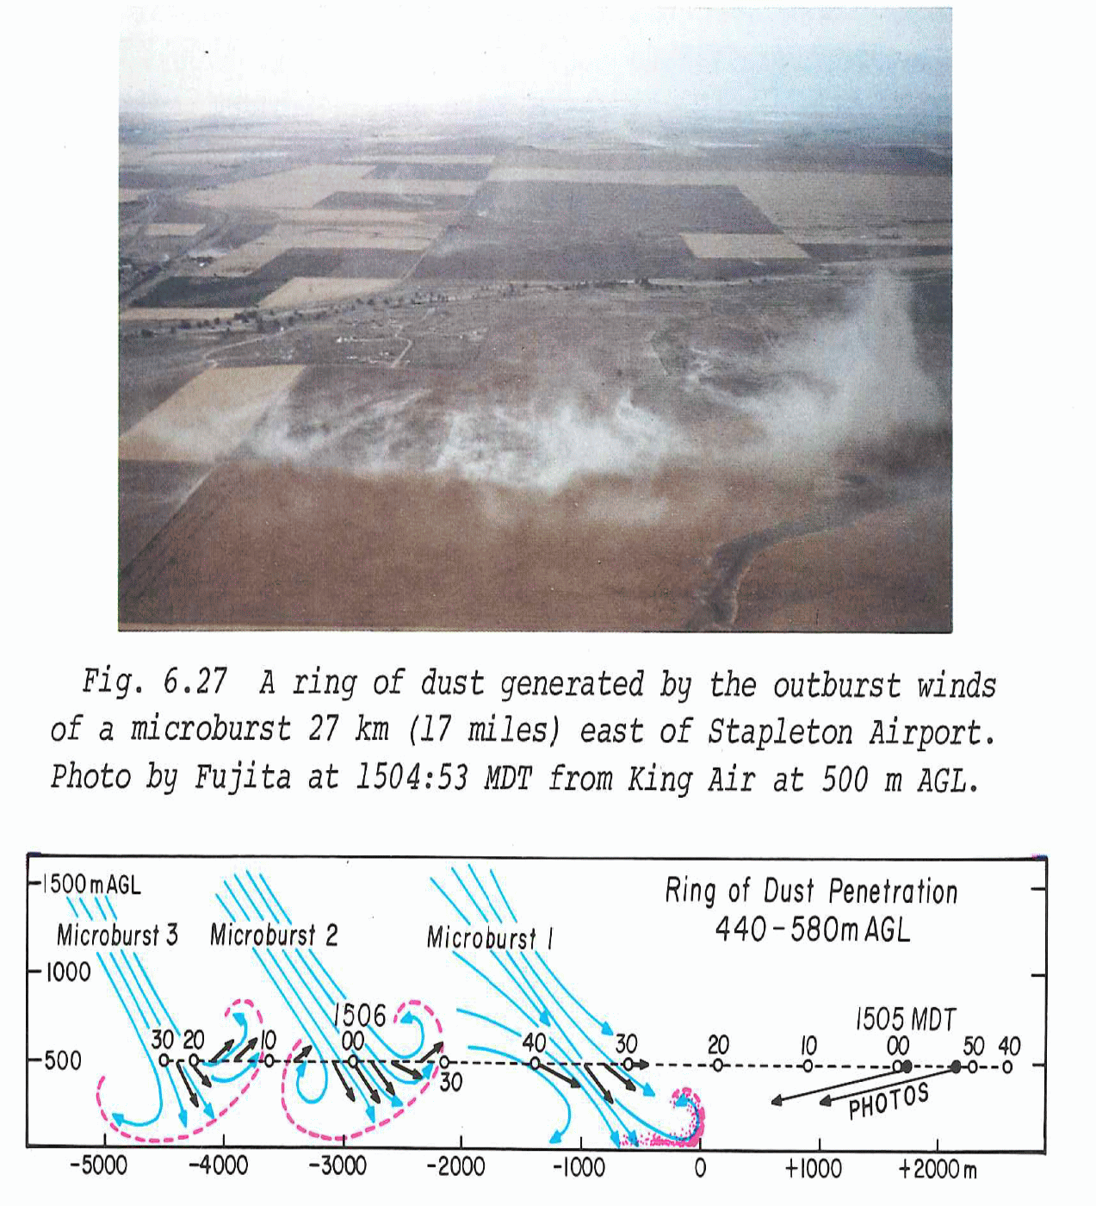
Downbursts can also be dry, i.e., no rain in the downdraft. Dry downbursts tend to be in the High Plains where humidity is low (see Fig. 6.27 from Denver).
When pilots can’t see the downburst, it’s even more dangerous. Doppler Radar can detect these since there is dust.

Slide 6
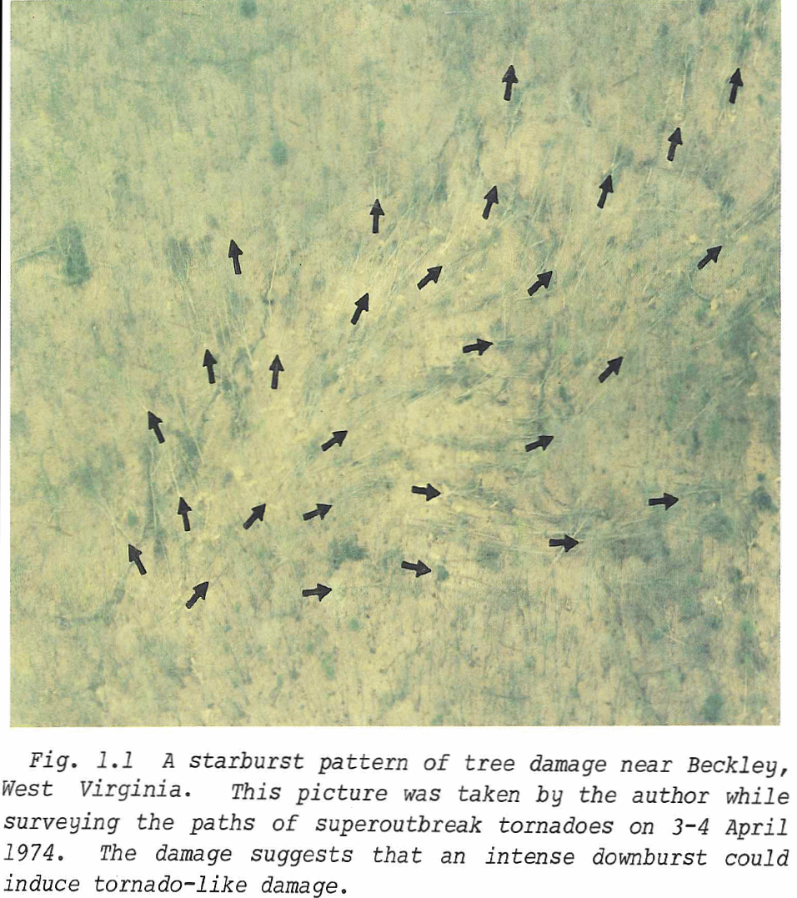
In 1974 Dr. Fujita was doing aerial surveys of damage from the first Superoutbreak of tornadoes when he noticed the pattern shown here:
The wind can reach EF2 speed (up to 137 mph).
NWS survey teams look for the damage pattern. If it is curving around itself, that’s tornado damage. If the pattern is the divergence you see in Fig. 1.1, that’s a downburst, reported as simply Wind.
From T.T. Fujita, “The Downburst”, 1985.

Slide 7
https://www.youtube.com/watch?v=BQ5lgOJWyc0
https://www.youtube.com/watch?v=a_G2KRzha7o
https://www.youtube.com/watch?v=AZeT8ihpvM0
https://www.youtube.com/watch?v=7LLJt7_NTRI

Slide 8
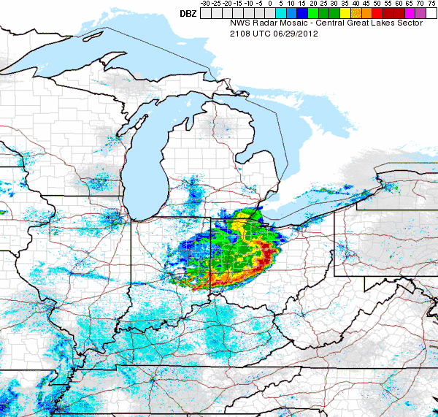
When the precipitation in a downburst spreads out at the ground it creates a bow-like echo. This is often called a Derecho (AMS: A widespread convectively induced straight-line windstorm. Specifically, the term is defined as any family of downburst clusters produced by an extratropical mesoscale convective system.)

Slide 9
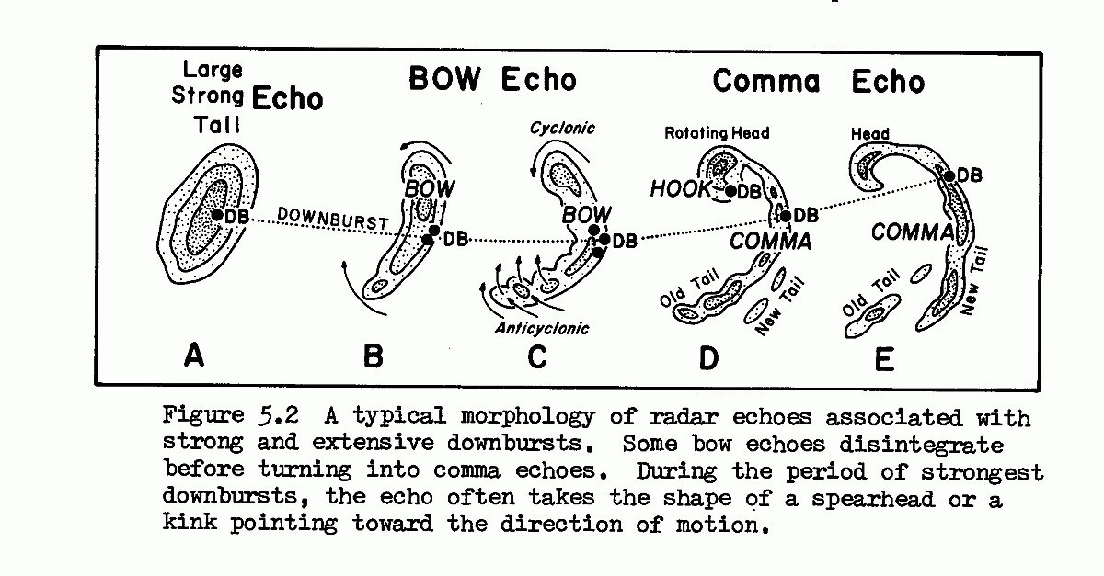
Dr. T. Fujita of the University of Chicago first identified downbursts. This figure is from his May 1978 report: Manual of Downburst identification for Project Nimrod, SMRP Research paper No. 156.

Slide 10
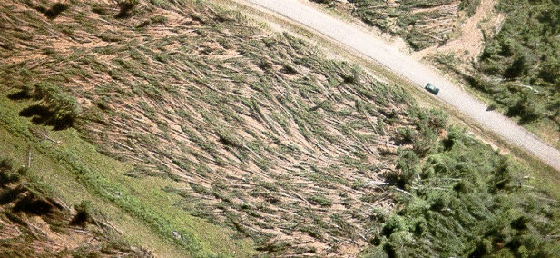
He wasn’t making this up. It was based on observation, like this radar evolution from northern Wisconsin in 1977:
Downbursts like that one cause whole stands of trees to blow down:

Slide 11
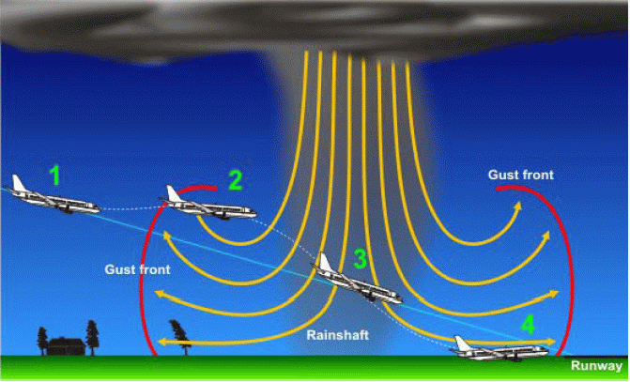
In addition to normal ground damage and injuries, downbursts pose a special hazard to aviation.
(show delta 191a and b.flv)

Slide 12
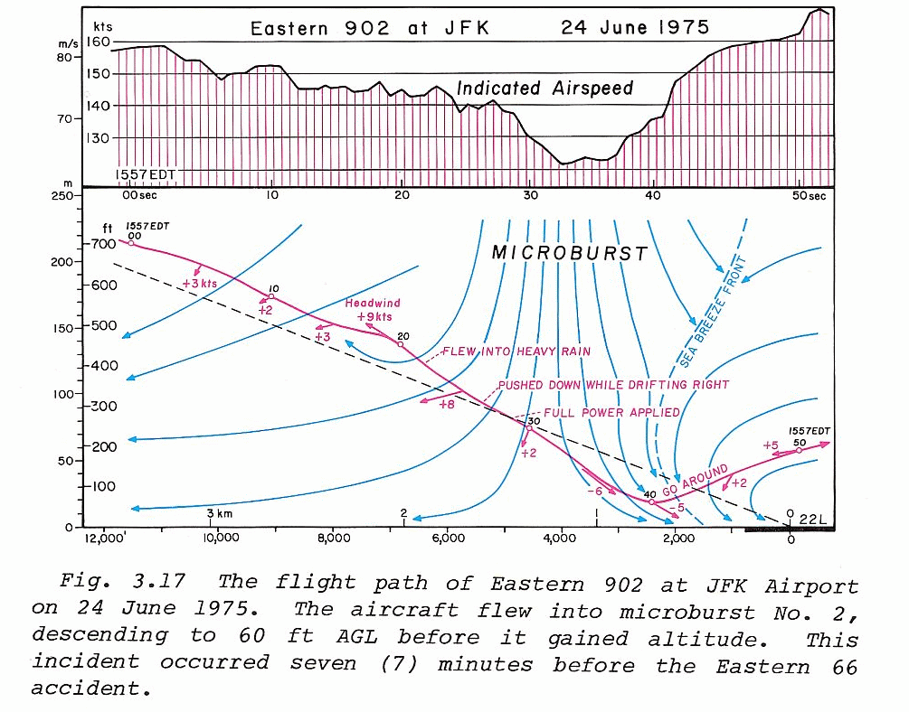
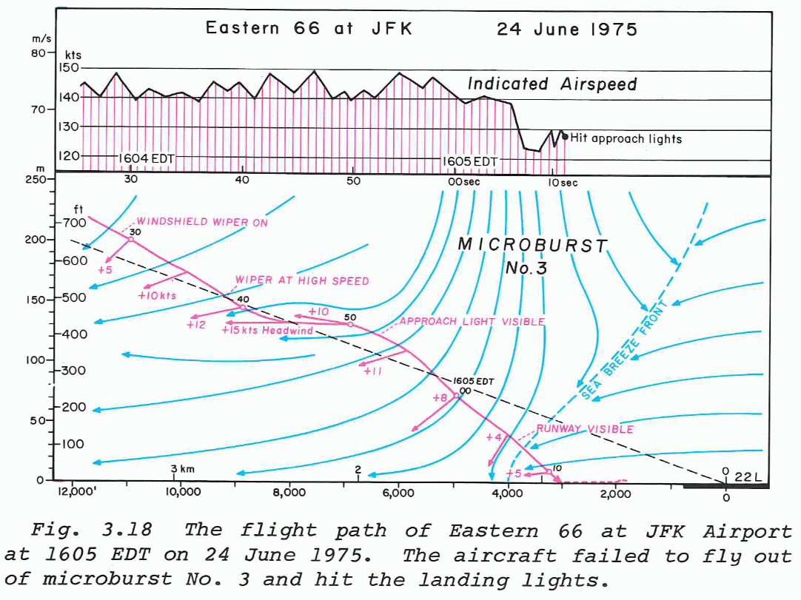
Flying into a downburst or microburst means compromising the lift of the aircraft. If you don’t have enough power to climb out of it, you hit the ground at too steep an angle and short of the runway. The usual result is death. In 1975, nobody except Dr. Fujita even knew that downbursts existed. They simply called it “wind shear.”

Slide 13
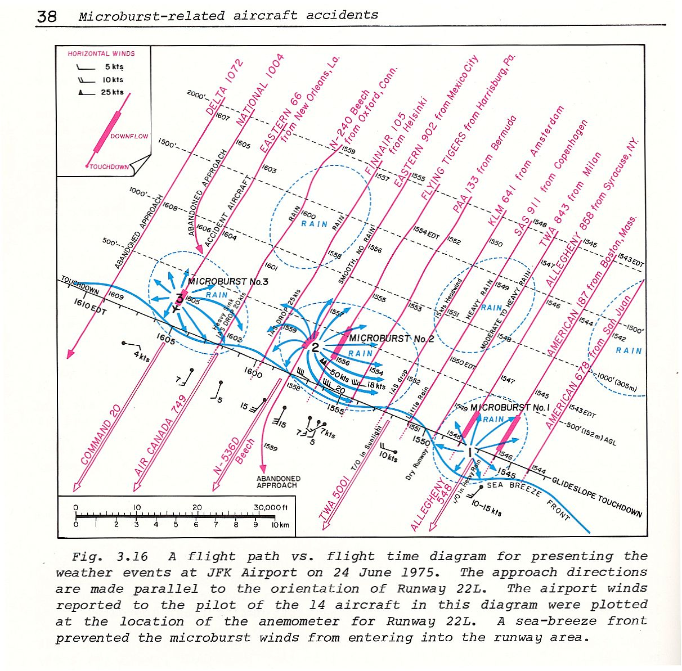

Slide 14
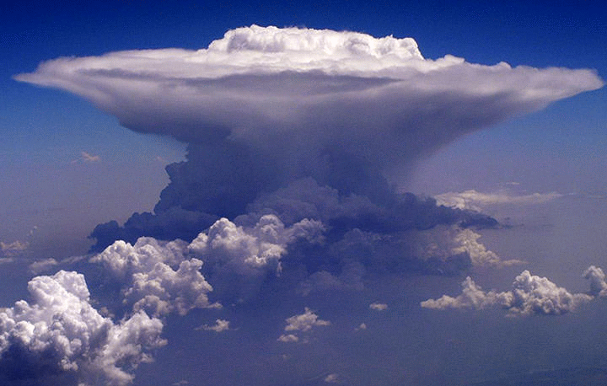
Forecasting Downbursts and Microbursts

Slide 15
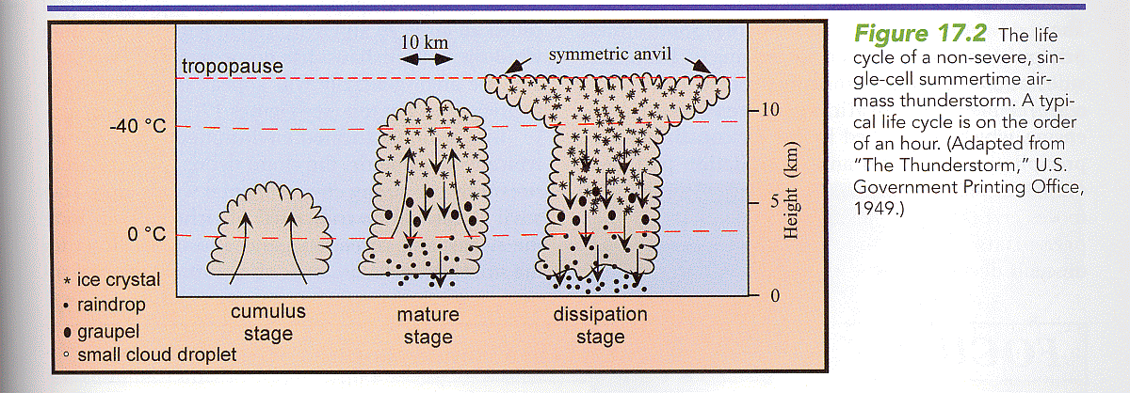
From Rauber et al.
All thunderstorms develop downdrafts. Why do those downdrafts intensify?
Clue: This is the life cycle of a non-severe thunderstorm. What is different about severe thunderstorms?

Slide 16
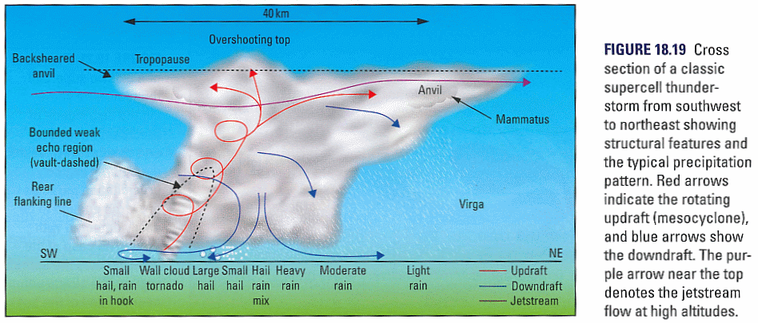
From Rauber et al.
Do you see what is different from ordinary thunderstorms in this supercell drawing?
It’s not the tornado or the rotating updraft. Those are symptoms (of what?).

Slide 17
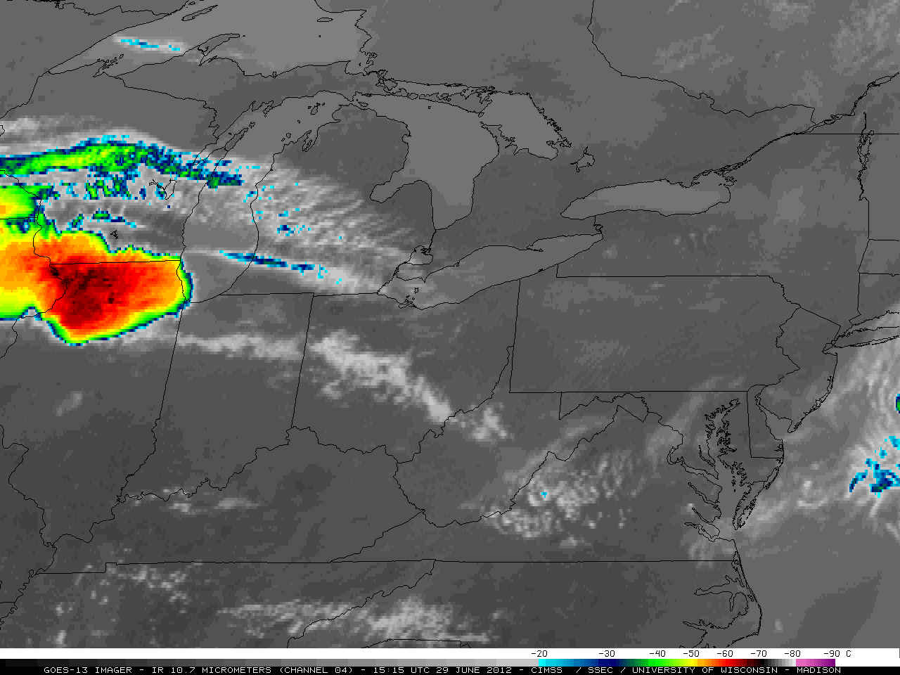
Very powerful derecho June 29-30, 2012

Slide 18
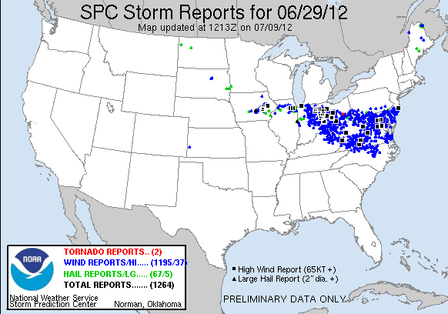
Almost entirely a straight-line wind event (downbursts)

Slide 19
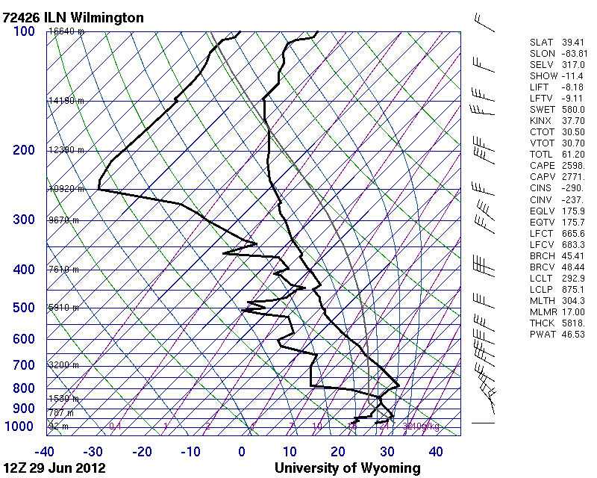
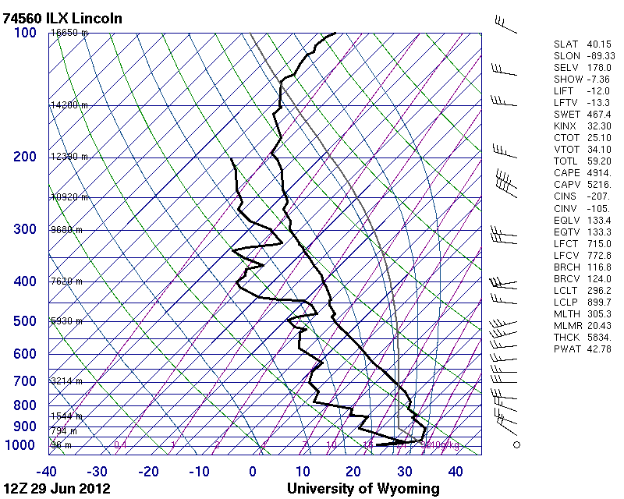
It started in the Midwest, early on June 29, 2012. Here are two morning soundings. What is common to both?

Slide 20
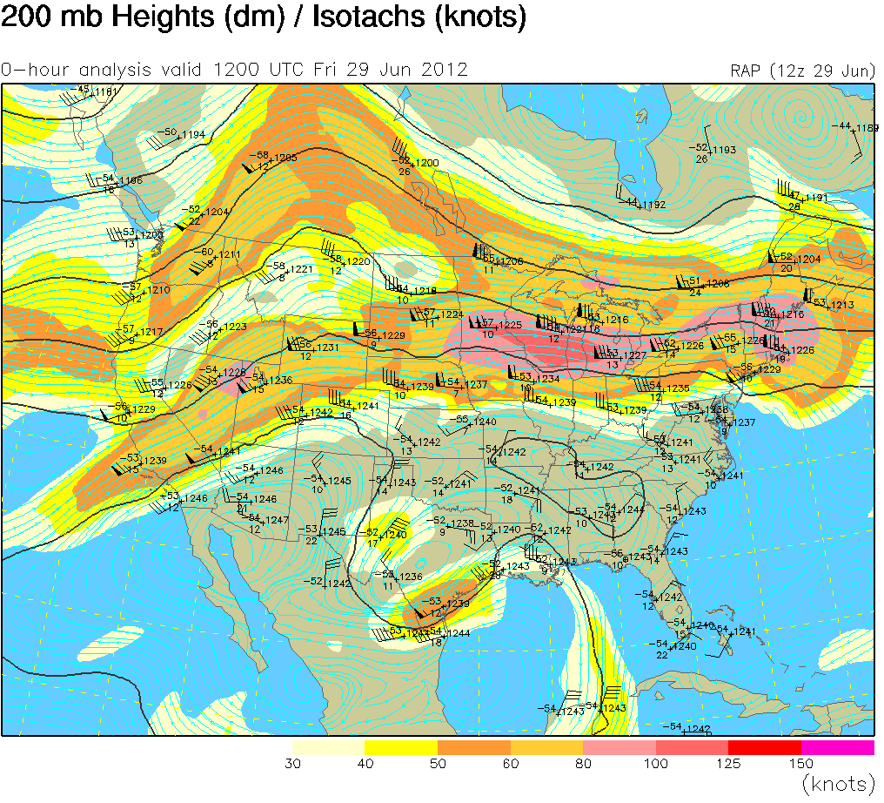

Slide 21
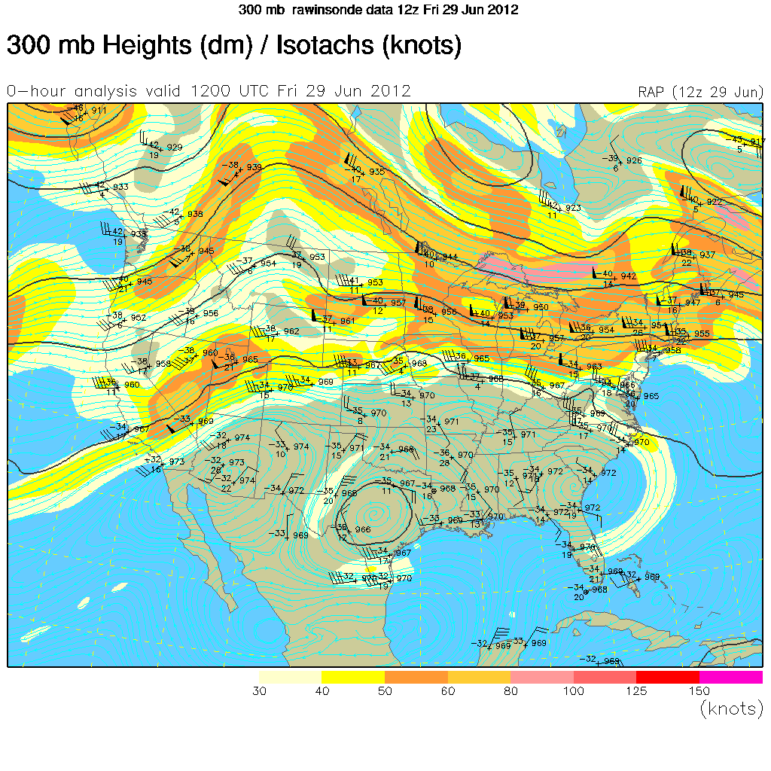

Slide 22
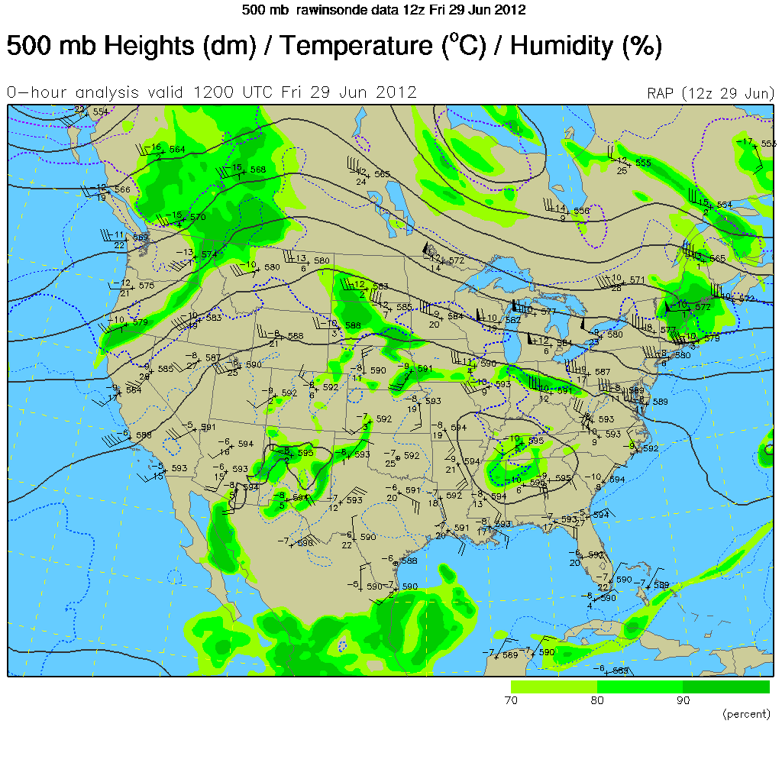

Slide 23
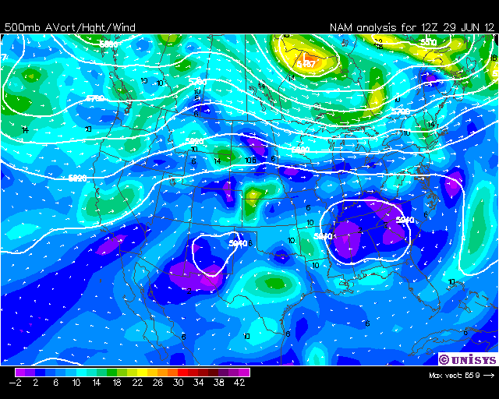

Slide 24
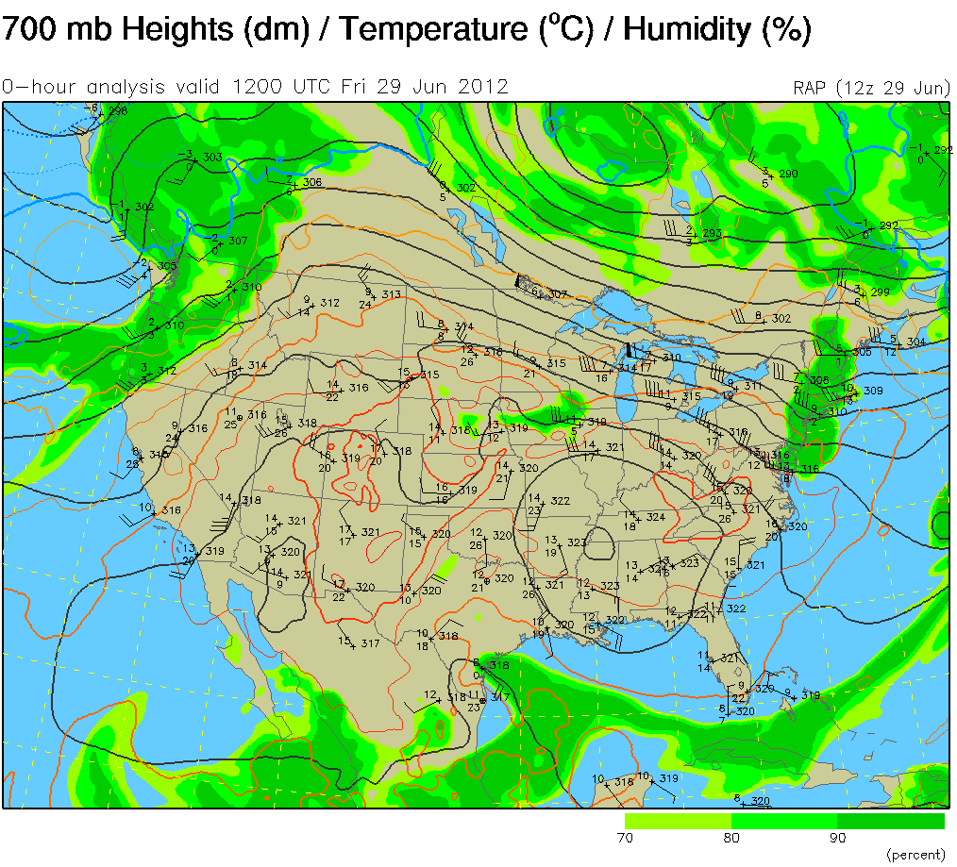

Slide 25
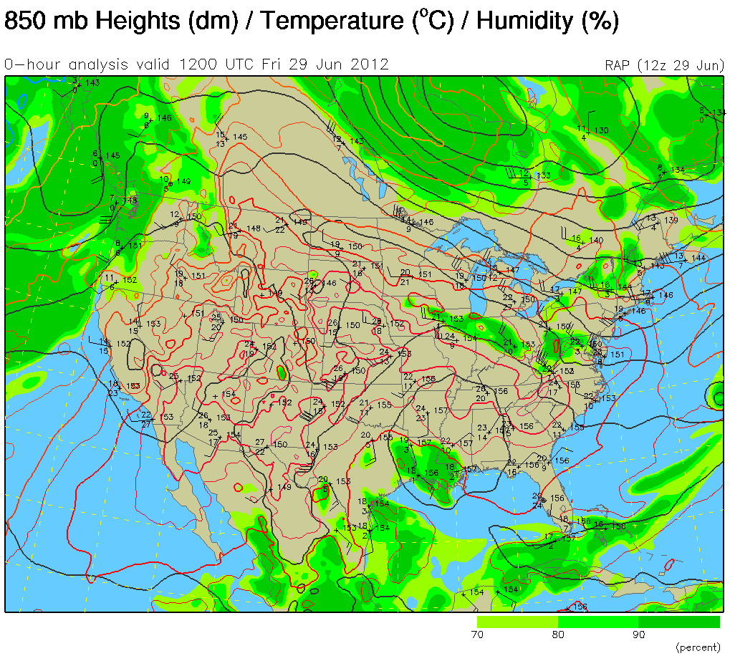

Slide 26
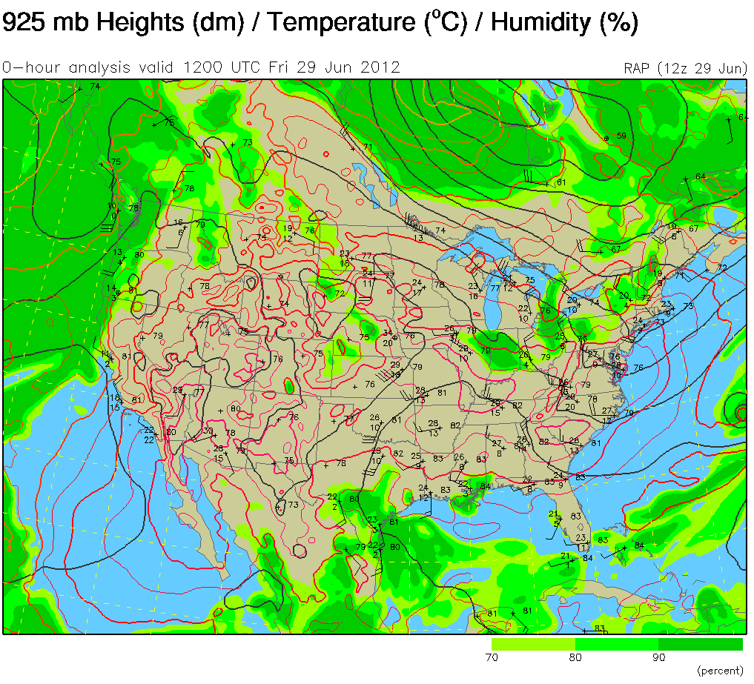

Slide 27
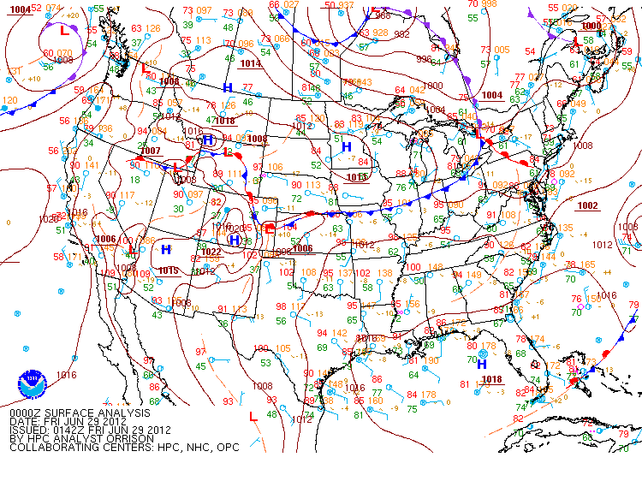

Slide 28
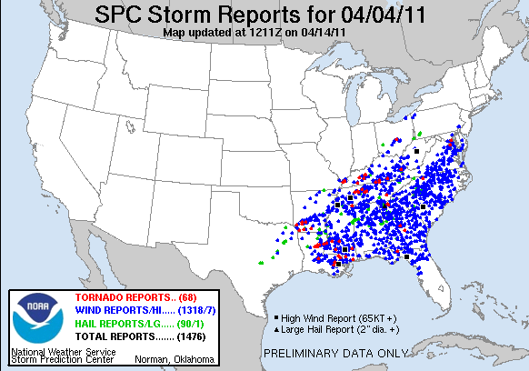
Here’s another prolific downburst case but this one also has tornadoes
(but not due to one Derecho)

Slide 29
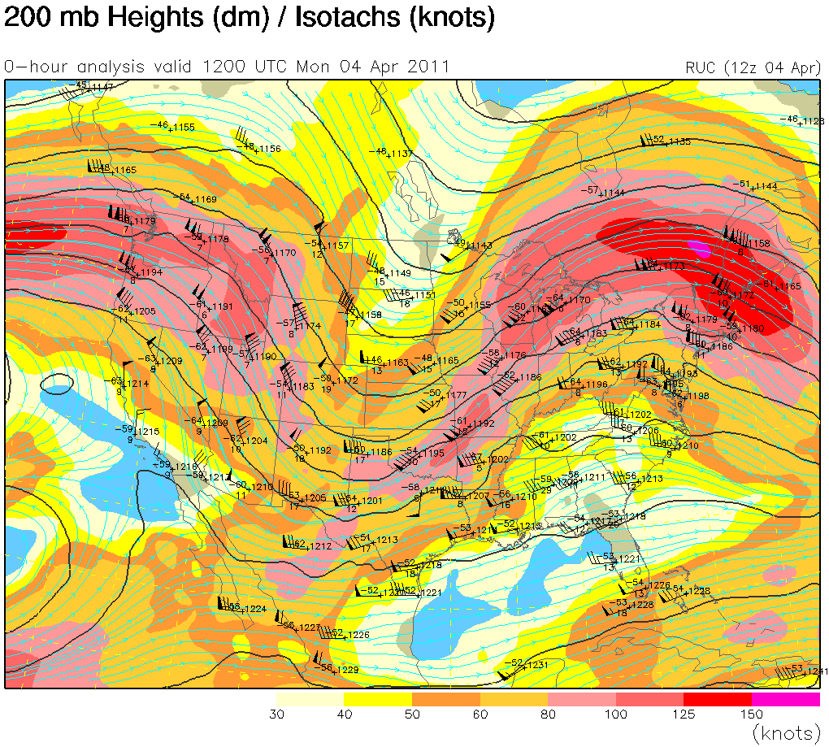

Slide 30
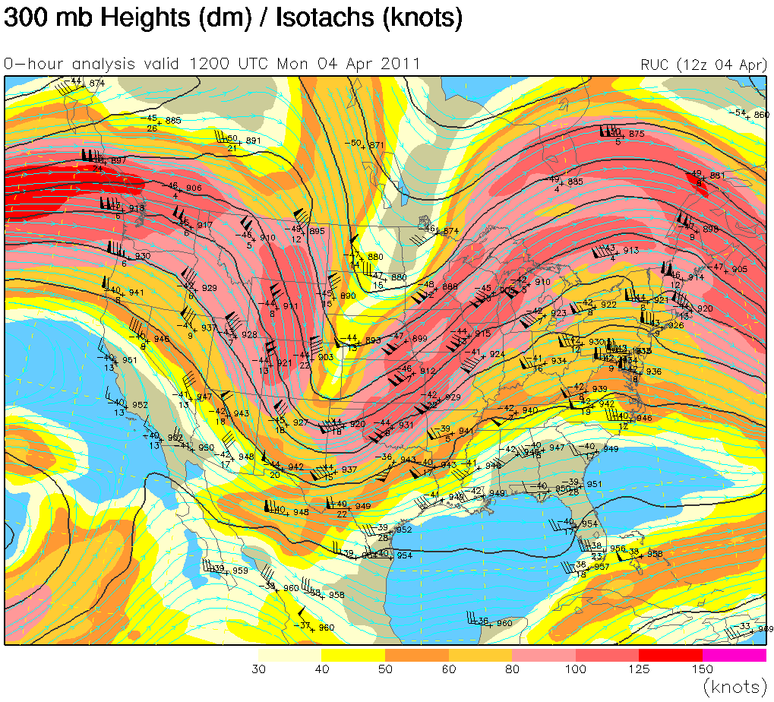

Slide 31
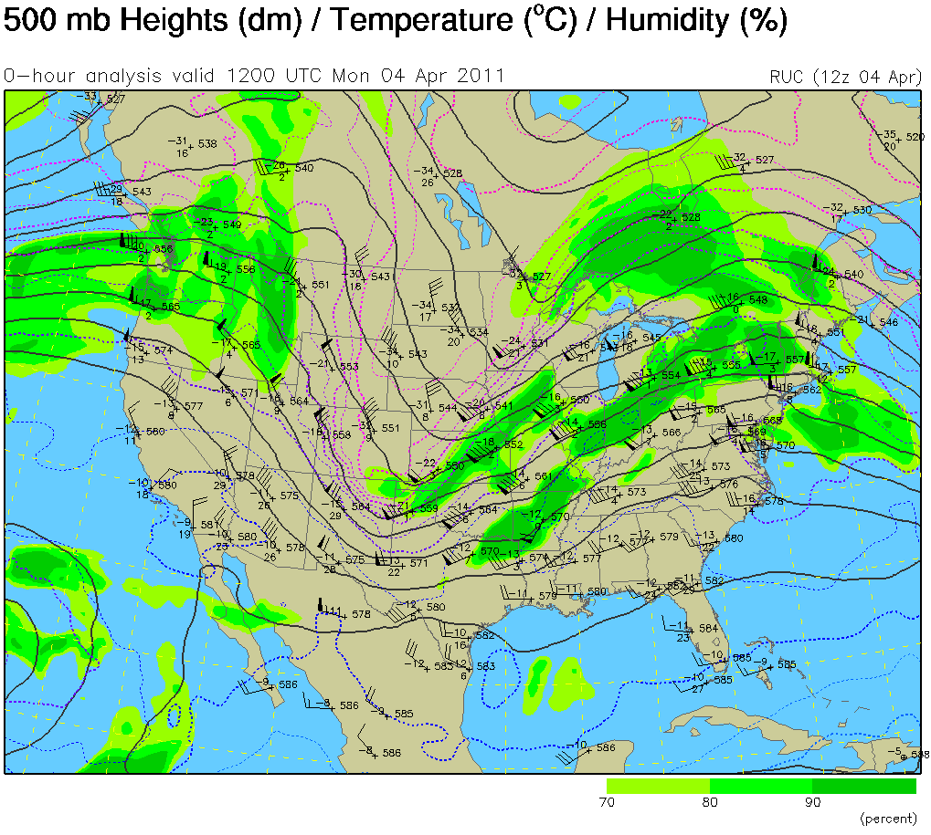

Slide 32
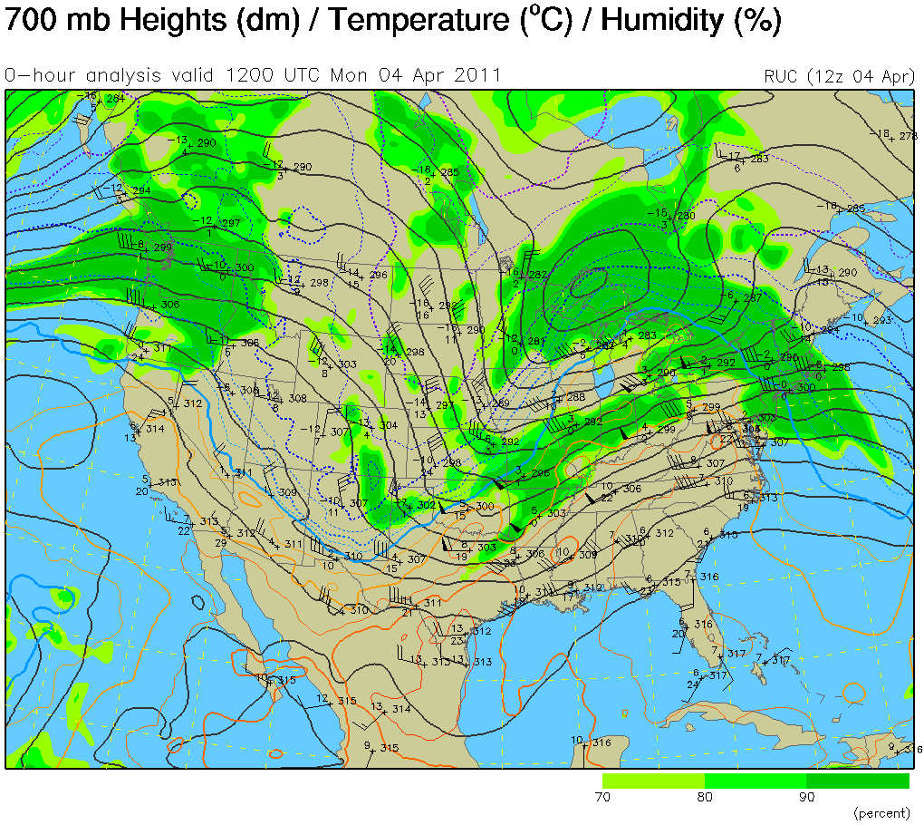

Slide 33
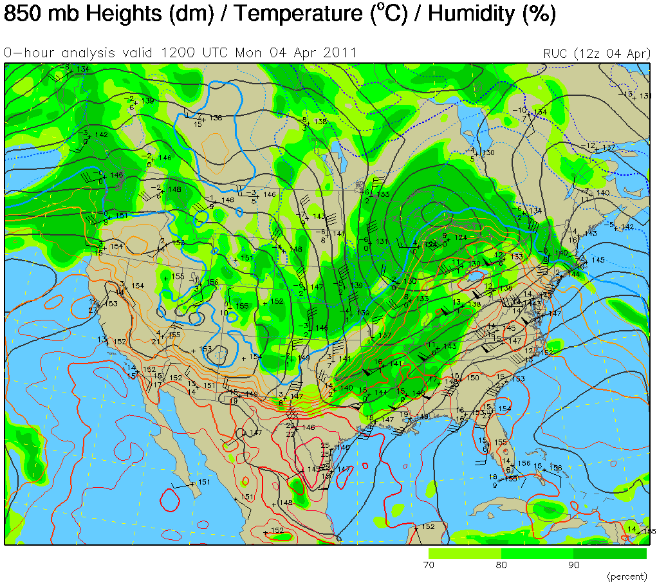

Slide 34
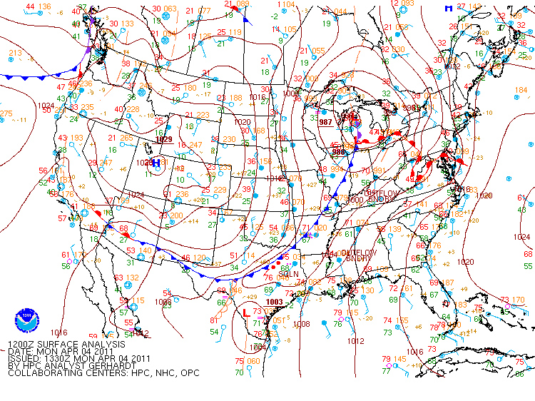

Slide 35
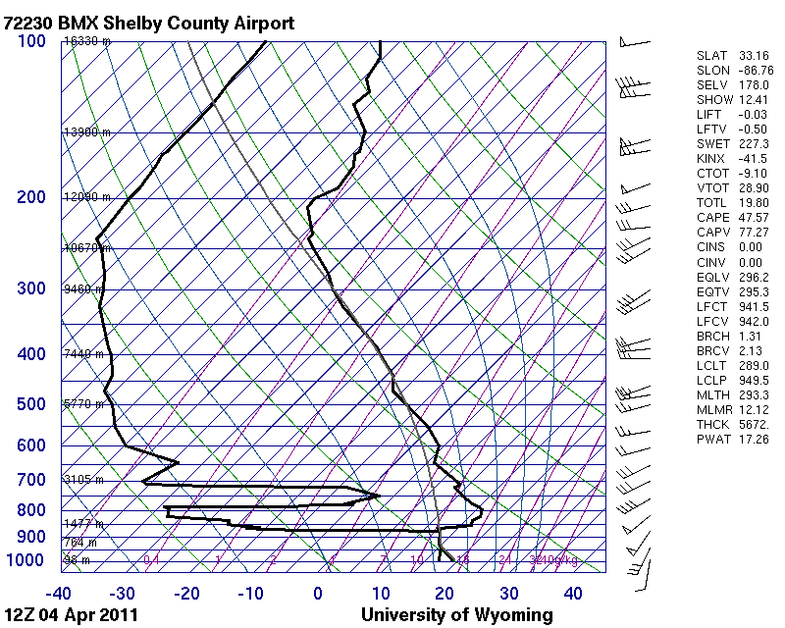

Slide 36
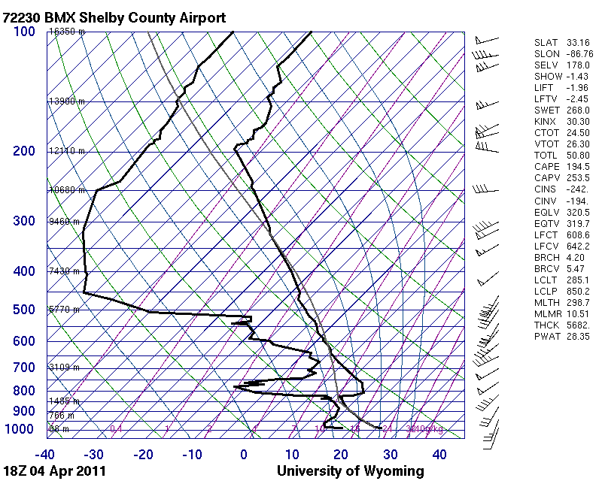

Slide 37
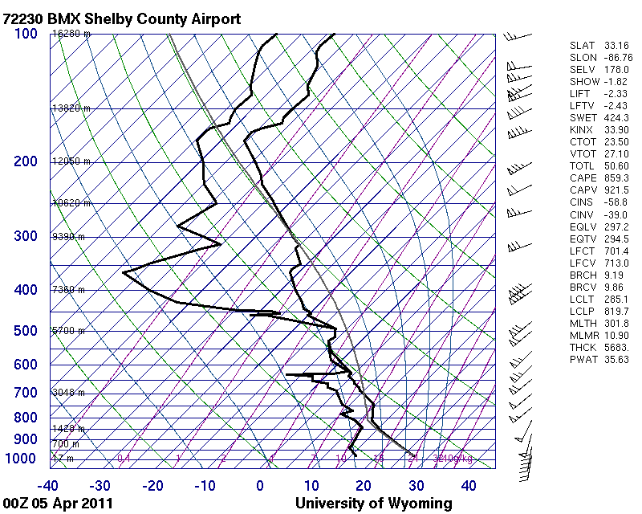

Slide 38
Summary:
Synoptic conditions can look very favorable for severe thunderstorms or hardly favorable at all!
The environment must be unstable so thunderstorms will form.
Mid-tropospheric dry air is a key. That air will be entrained into thunderstorms, causing increased evaporative cooling in the middle of the storm. The heavier air will accelerate down and out of the storm.
If the wind shear is uni-directional, rotation of the updraft will not occur. Only straight-line outflow (downburst).

