Slide 1
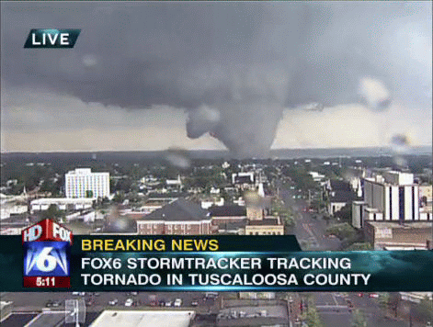
Severe Thunderstorm forecasting

Slide 2
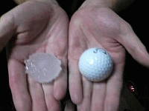
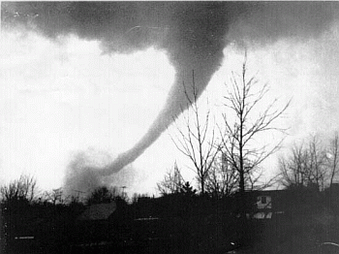
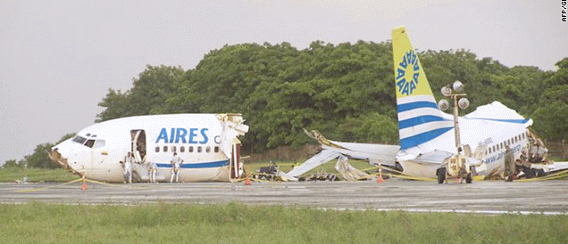
From www.spc.noaa.gov/faq/#4.2, SPC defines a thunderstorm as severe if it has one of more of the following:
a. Hail at least 1 inch in diameter (quarter size)
b. Wind gusts to 58 mph or greater (50 knots)
c. Any tornado
The website goes on to say: “… Although lightning can be deadly, the NWS doesn't use it to define a severe thunderstorm. If it did, every thunderstorm would be severe, by definition. Also, excessive rainfall may lead to deadly flash flooding, but heavy rain is not a severe criterion either. The flood threat is handled through a separate set of watches and warnings from your local NWS forecast office.

Slide 3
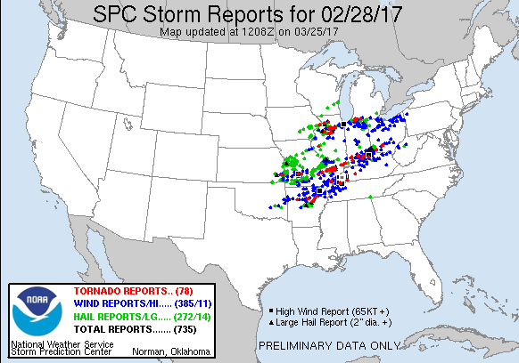
Storm reports from the Storm Prediction Center are color coded:
Each dot is a reported location. There were 78 tornado reports, not 78 tornadoes.
Red for tornadoes, green for hail, blue for straight-line winds
These are preliminary reports. They can and do change as more information comes in (such as the NWS damage surveys). For final reports, consult Storm Data.

Slide 4
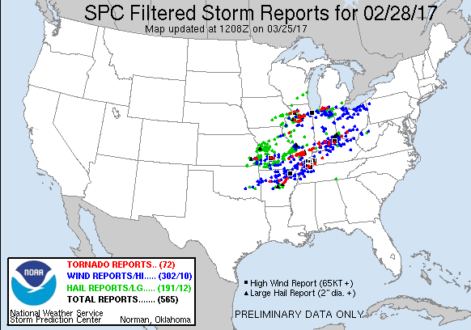
SPC now filters the reports to try to eliminate duplicates. Also, see their web page for the GoogleMaps version (you can zoom in!)
Notice there were 72 filtered tornado reports
This is from www.spc.noaa.gov/climo/reports/yesterday.html

Slide 5
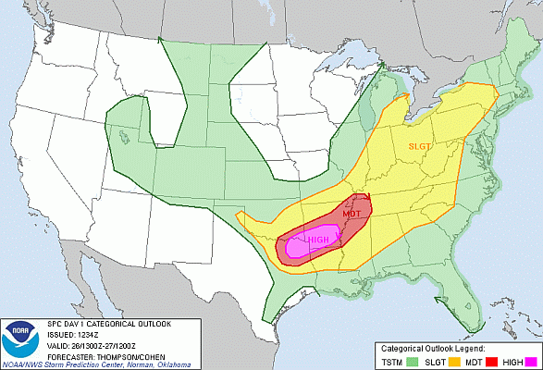
The warning system consists of three parts
1. Convective outlook (just for us, not for the general public)
The convective outlook is issued early in the day and again in the afternoon. We get convective outlooks for today (day 1), tomorrow (day 2), and the day after tomorrow (day 3).

Slide 6
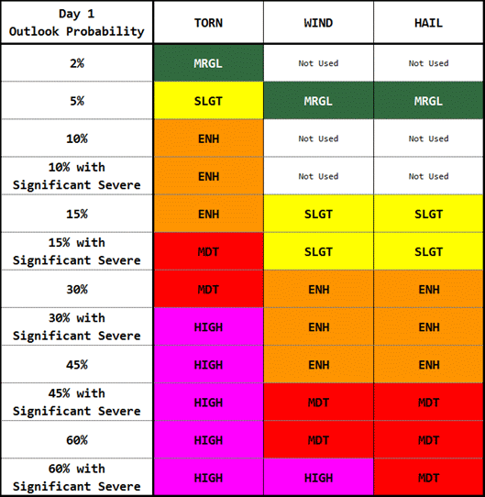
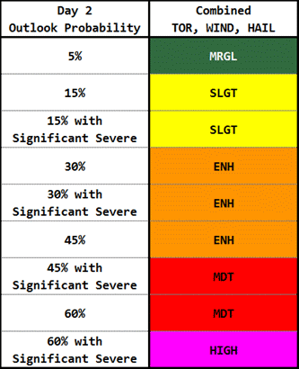
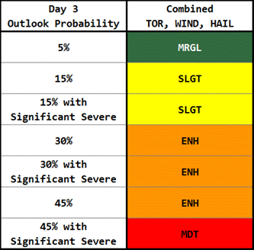
There are 6 categories, general (nonsevere) thunderstorms, Marginal risk, Enhanced risk, Slight risk, Moderate risk, and High risk. The High risk category is rarely used but when it is, that’s a seriously bad situation!

Slide 7
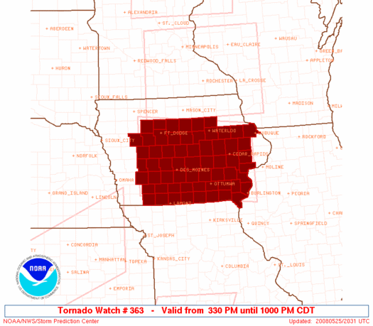
2. Severe thunderstorm and tornado watches.
Watches are announced for the general public. They are meant to put people on guard. Usually, watches are issued before any severe weather is seen, but sometimes they are issued after the first reports are received. A watch covers all or most of a middle-sized state.
Watches come in two varieties: 1. Severe Thunderstorm 2. Tornado

Slide 8
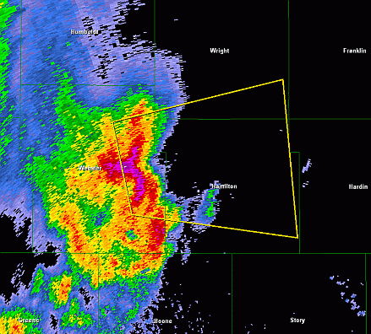
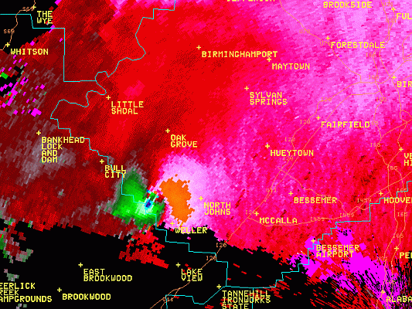
3. Warnings. These are issued when severe weather is spotted or indicated by radial velocity on Doppler Radar.
Warnings come in two varieties, just like watches:
1. Severe Thunderstorm
2. Tornado
This radar signature triggers a tornado warning:
Warnings may have significant (10-20 minute) lead time or no lead time, depending on the situation. Warnings trigger TV and radio announcements and NOAA weather radio broadcasts.
Or a storm spotter could see a funnel.

Slide 9
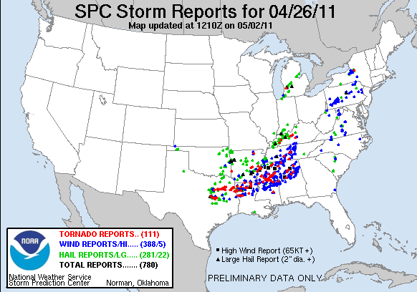
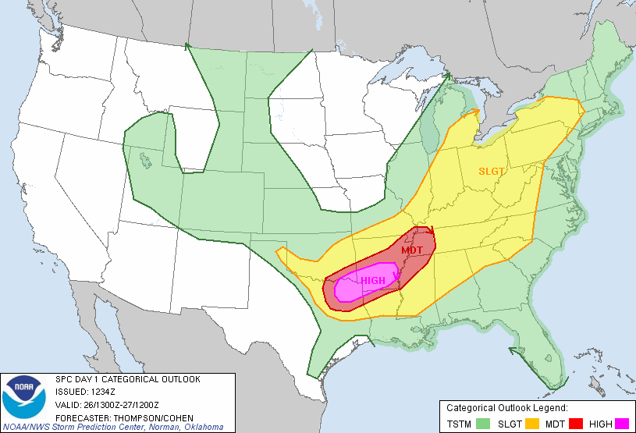
The Pre-storm Environment
What to look for in the morning. Remember, things may change by afternoon!
Here’s a powerful case from 2011. It’s the day before the Superoutbreak:
The SPC forecasters were impressed with the setup in this case. They predicted severe weather all the way north to Michigan and New York.

Slide 10
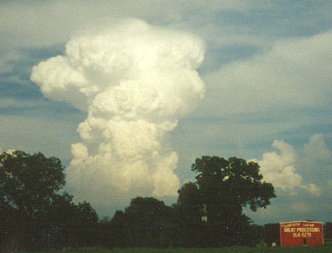
Ingredients for deep moist convection (Doswell, 1987):
1) Moisture 2) Instability 3) Lift
We look for the synoptic conditions which increase any or all of those three.

Slide 11
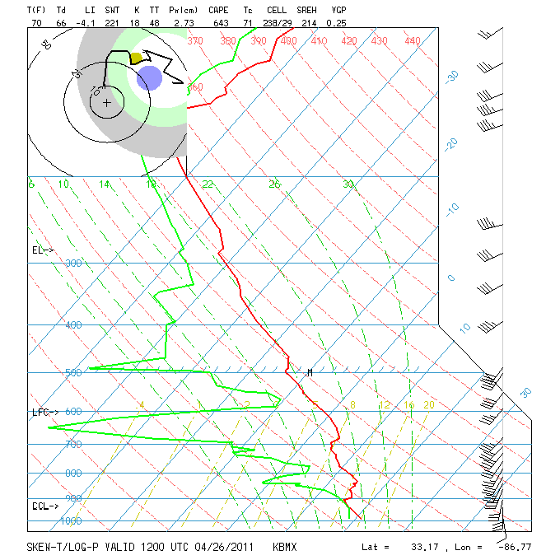
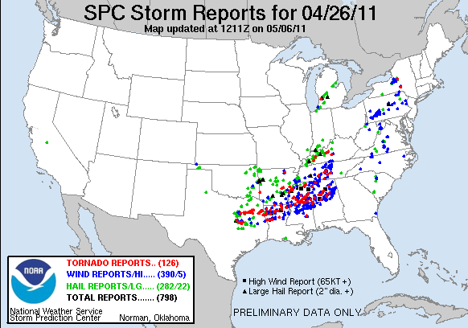
This is the morning sounding at Birmingham, AL on April 26, 2011. Later that day there were many severe thunderstorms.
Soundings provide information helpful for severe forecasting

Slide 12
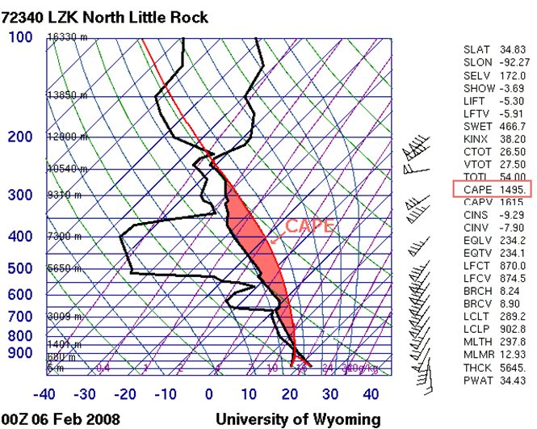
Parcel Instability
C.A.P.E.: Convective Available Potential Energy. From the AMS Glossary of Meteorology: On a thermodynamic diagram this is called positive area, and can be seen as the region between the lifted parcel process curve and the environmental sounding, from the parcel's level of free convection to its level of neutral buoyancy. Measured in joules/kilogram

Slide 13
CAPE definitions (http://www.spc.noaa.gov/misc/acronyms.html)
MUCAPE: Most unstable CAPE
Lifts most unstable parcel in lowest 300 mb.
Useful in non-surface based (elevated) CAPE.
SBCAPE: Surface-based CAPE
Lift surface parcel.
Usually identical to MUCAPE in the afternoon.
MLCAPE: Mean-mixed CAPE
Parcel lifted using mean temp/moisture (lowest 100mb).
Most representative for diurnal development when boundary layer is well mixed.
DCAPE: Downward CAPE
a.k.a. CINH.

Slide 14
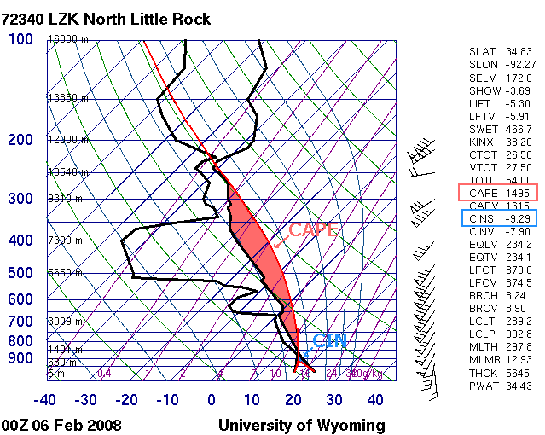
Convective Inhibition (CIN or CINH)

Slide 15
CIN: Convective Inhibition. Again, from the AMS Glossary of Meteorology, for an air parcel possessing positive CAPE, the CIN represents the negative area on a thermodynamic diagram.
In this closeup of the KLZK sounding from 00Z, April 26, 2011, the CIN is the small light blue area to the left (colder) of the black temperature sounding. CIN is also j/kg but it is negative and means downward (negative) buoyancy.

Slide 16
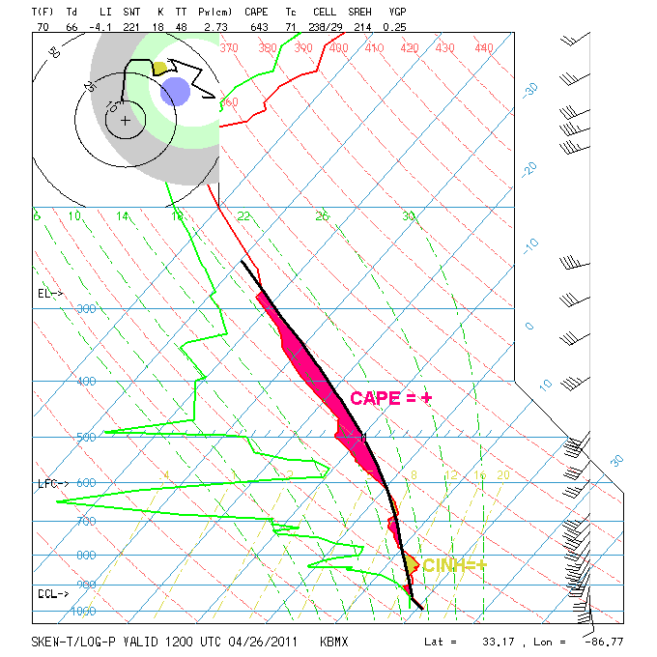

Slide 17
More on instability
CAPE is hard for people to calculate just on seeing a sounding. So, we have some easier ways such as the Lifted Index (LI). To find the LI, first lift a parcel to its LCL:
To find the LCL, lift from the temperature along a dry adiabat, here shown in red, until your line meets the mixing ratio line from the same parcel, here shown in purple. Above the LCL, you must lift along the wet or moist adiabat, also shown in red.
.

Slide 18
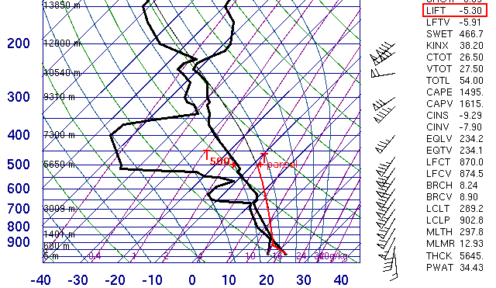
LI = T₅₀₀ – T_{lifted parcel}
Other indices (SWEAT, K, Total-Totals) will be covered in lab

Slide 19
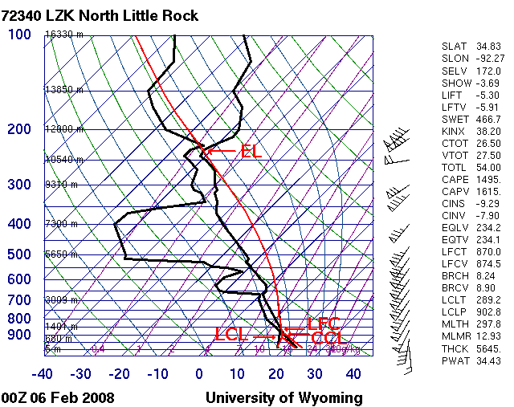
Other important levels are the Convective Condensation Level or CCL , the Level of Free Convection (LFC), and the Equilibrium Level (EL)
The EL is simply where buoyancy becomes negative in the upper troposphere. It’s the level of the top of the anvil (some clouds overshoot the EL).

Slide 20
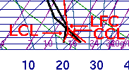
If a parcel reaches its LCL and keeps rising, probably by being forced upward since it’s usually in a CIN area, it might cross the temperature sounding and become warmer than the environmental air. Where that occurs is the LFC.
The CCL is the level where air heated to its Convective Temperature meets the surface mixing ratio and saturates. It’s the level where clouds become cumuloform.
Hint: Go to http://www.theweatherprediction.com/habyhints/320/

Slide 21
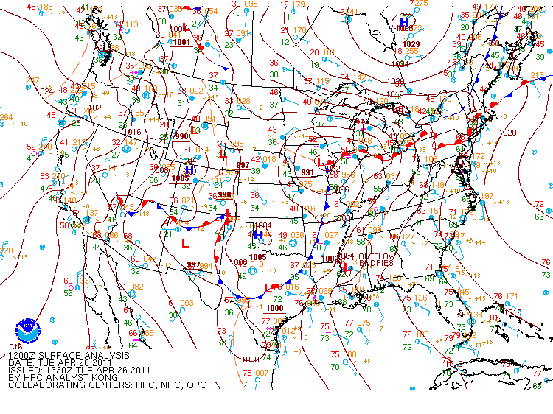
The MSLP or surface chart. Find the conditions that favored severe thunderstorms.

Slide 22
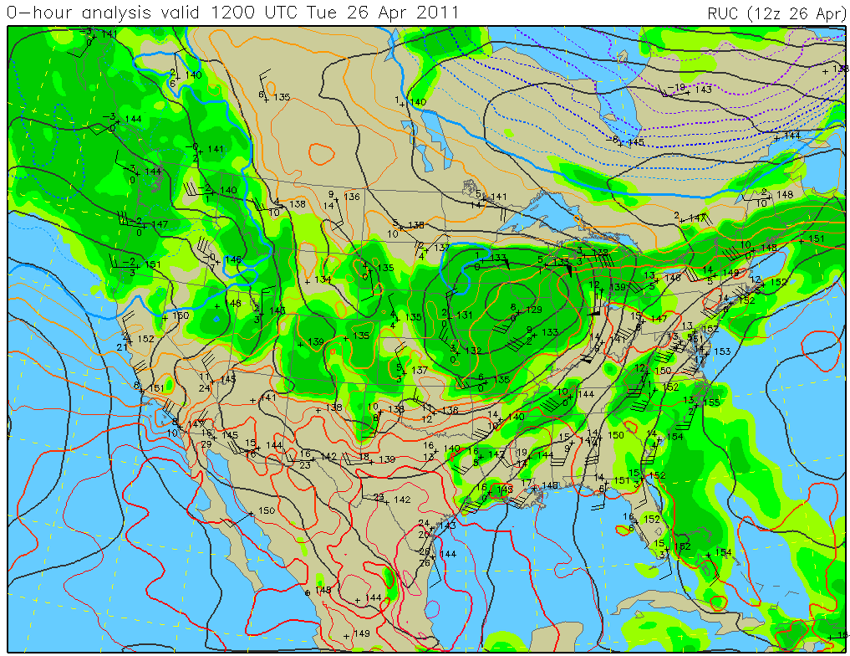
Low-level (850 or 925 hPa) warm air advection is favorable. So is low-level moisture advection or just high absolute humidity. Wind?
850 hPa

Slide 23
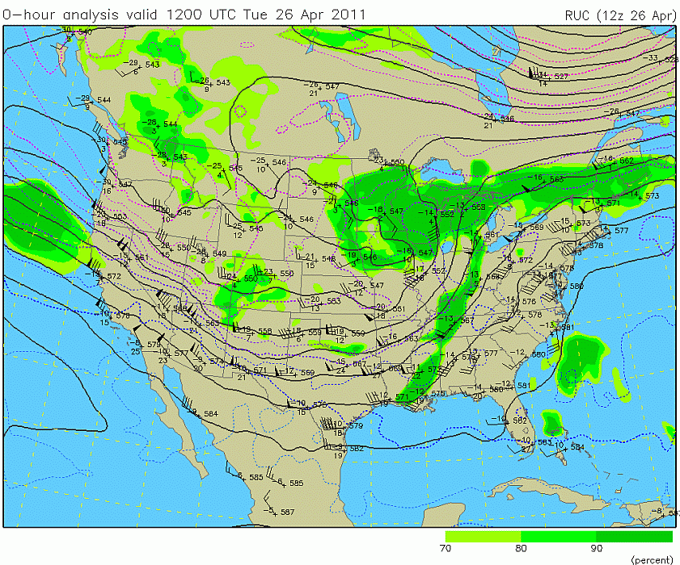
At the 500 hPa mid-troposphere level, look for an amplified trough and difluent winds.
500 hPa

Slide 24
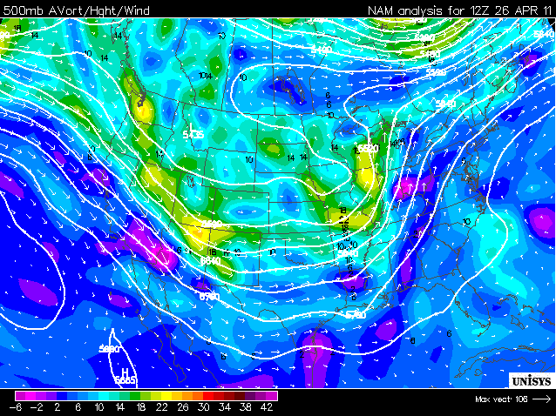
Vorticity advection supports the cyclone and fronts but is not directly related to most severe thunderstorms.

Slide 25
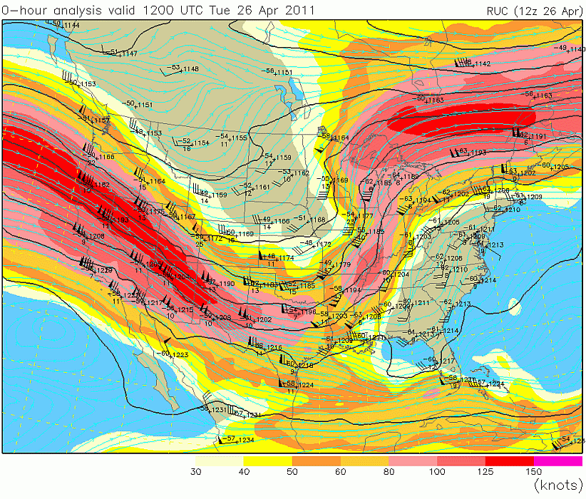
In the upper troposphere (200 and 300 hPa), it’s all about the jets.
200 hPa

Slide 26
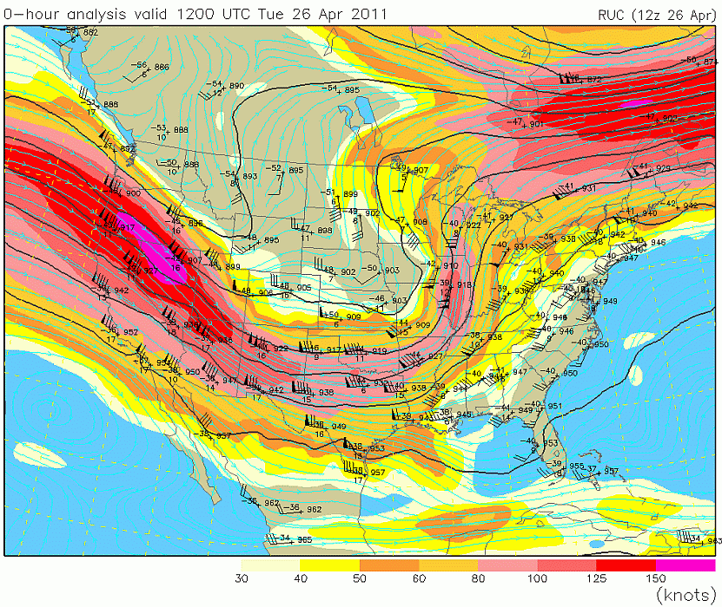
How is this map different from the 200 hPa map?
300 hPa

Slide 27
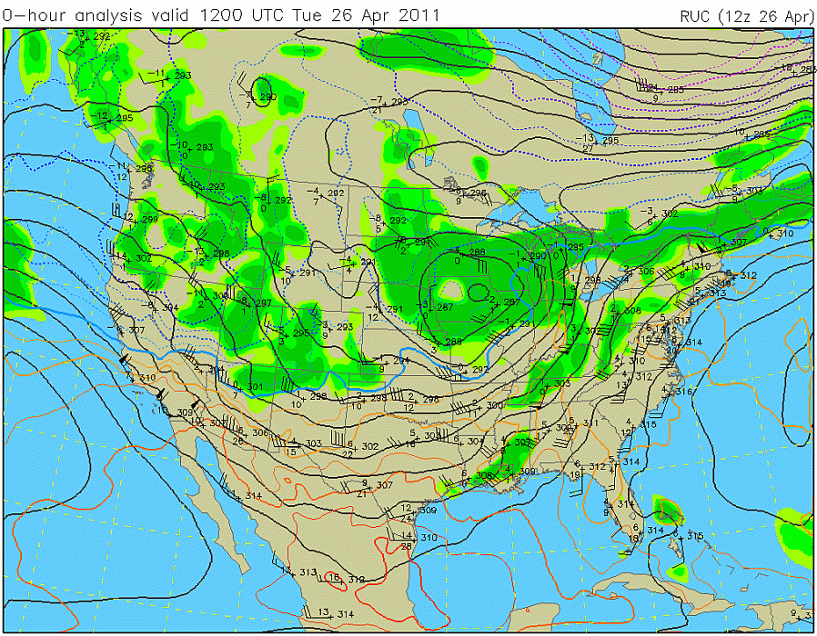
700 hPa is a special map. Here’s one from this case at the same time as the others. Notice anything that seems odd?

Slide 28
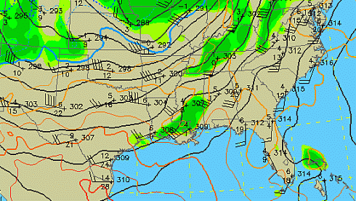
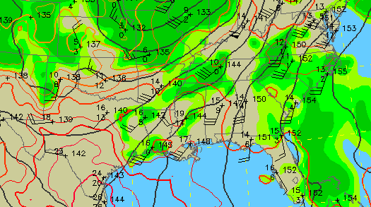
How about a comparison with 850 hPa?
dry air advection
dry air advection
700 hPa
850 hPa
moisture advection

Slide 29
Convective Instability is what happens when lifting a layer of air makes the entire layer absolutely unstable. Here’s how you do it:
Start with a 200 mb layer which is humid on the bottom but very dry on top.
Lift the entire layer 300 mb. The bottom and top cool at different rates.
Lift the top of the layer from 700 to 400 mb
Look at the resulting lapse rate!
Lift the bottom of the layer from 900 to 600 mb
Dry at 700 mb
Humid at 900 mb
This will always work if you have dry air over humid air. You just have to lift the entire layer far enough. It will be very powerfully destabilized.

Slide 30
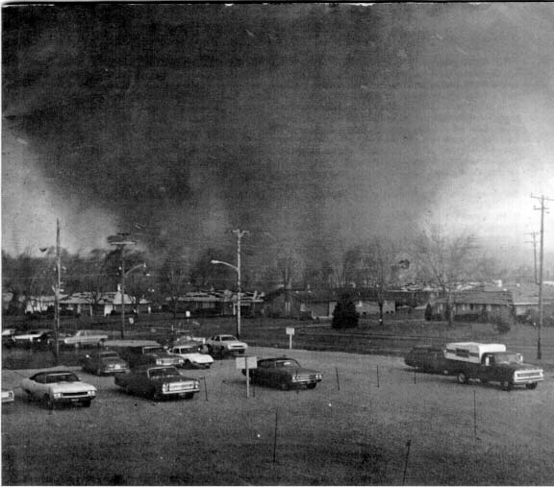
The 1974 Superoutbreak

Slide 31
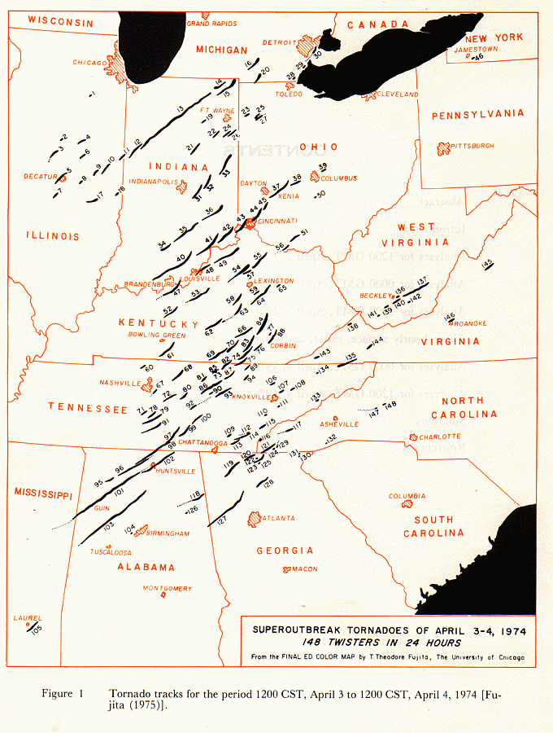

Slide 32
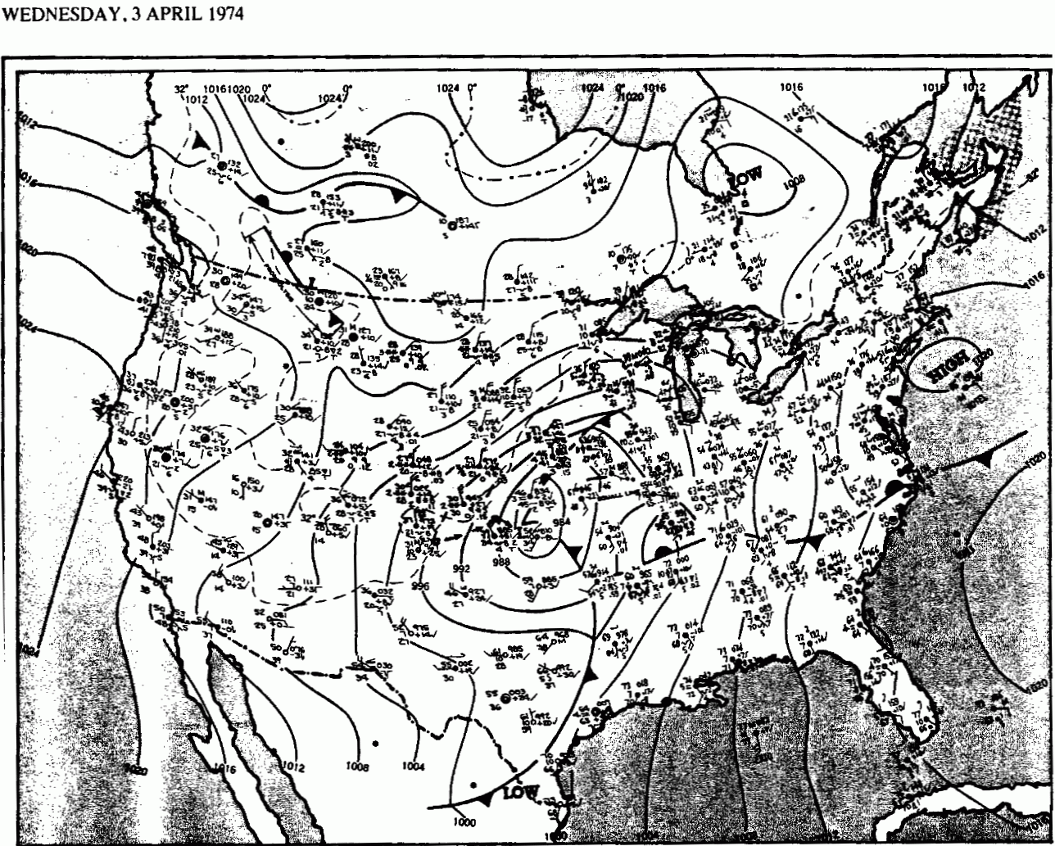
From the daily weather map series
1200 UTC

Slide 33
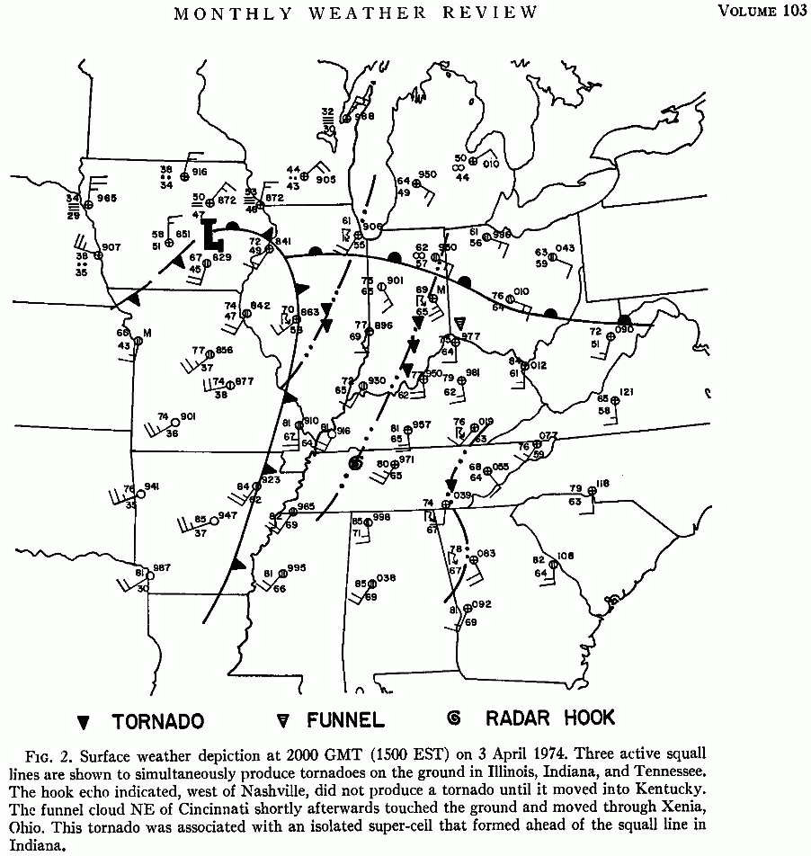
From a 1975 article by Agee, Church, Morris, and Snow. Note the time of this map is 20 UTC.

Slide 34
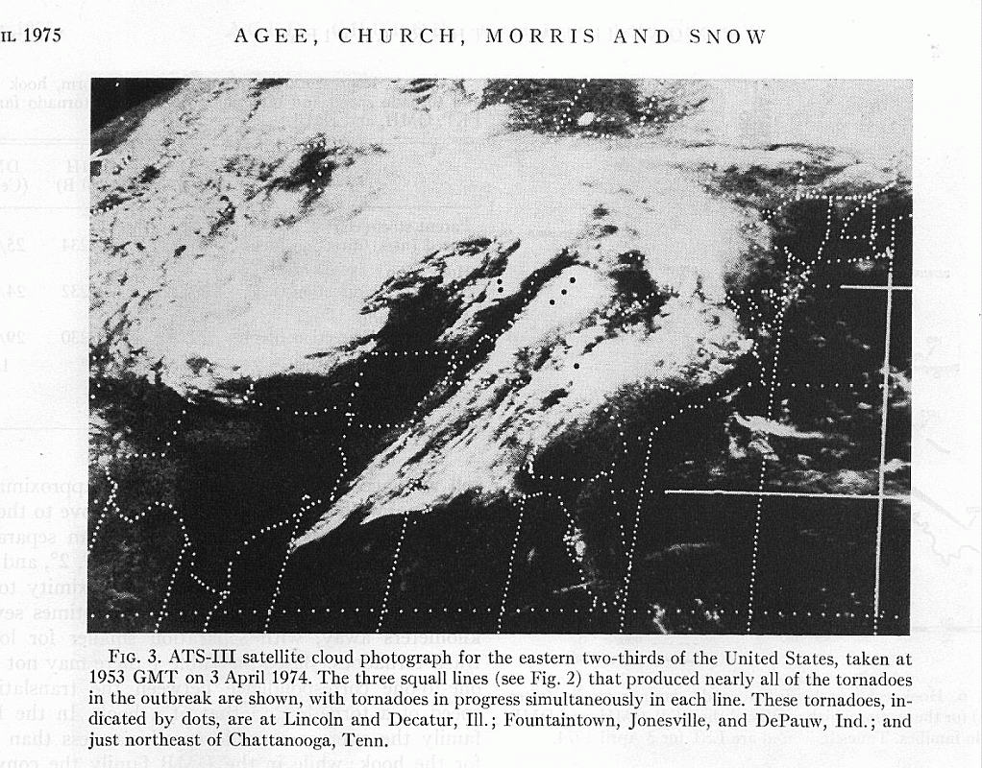

Slide 35
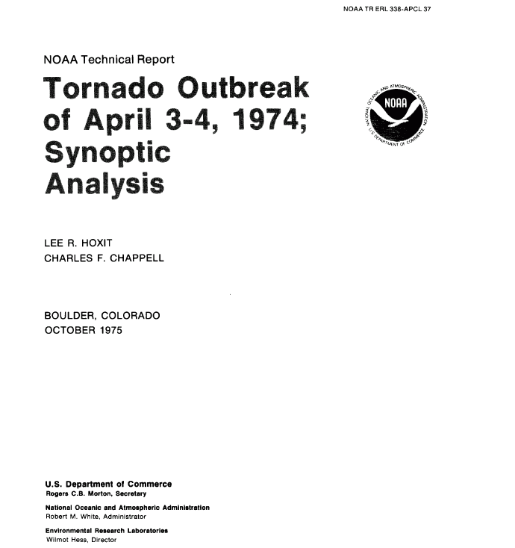
The remainder of the figures in this presentation are from this technical report.

Slide 36
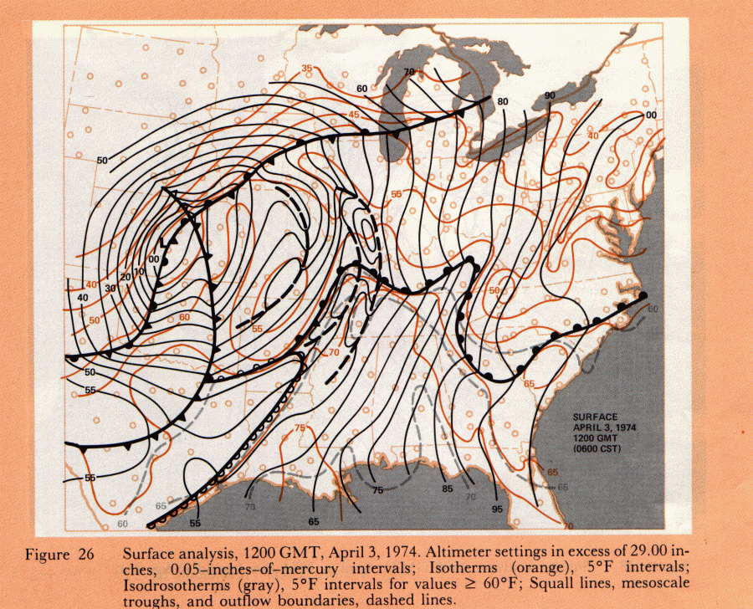

Slide 37
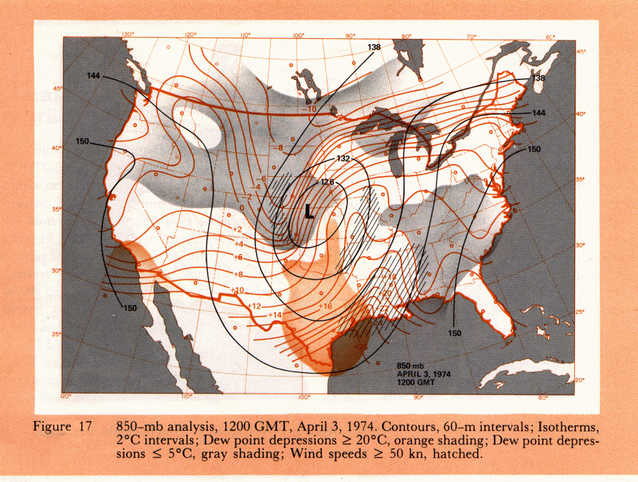

Slide 38
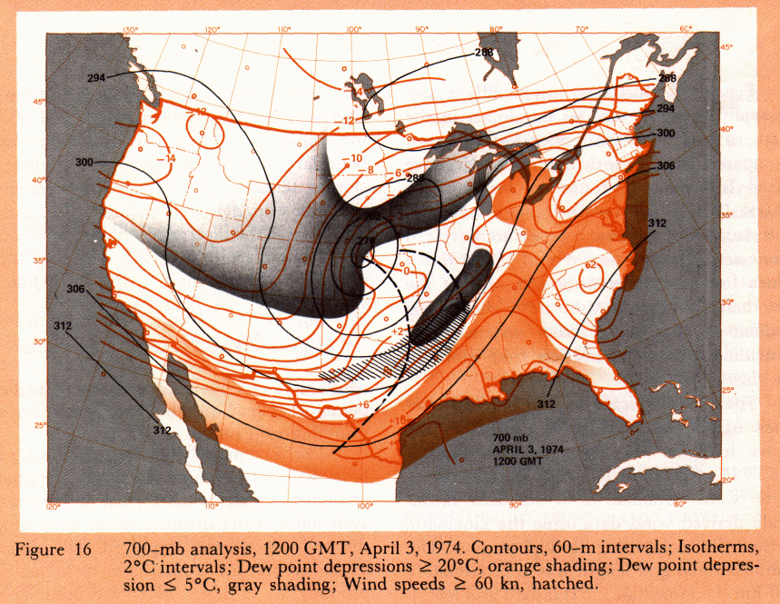

Slide 39
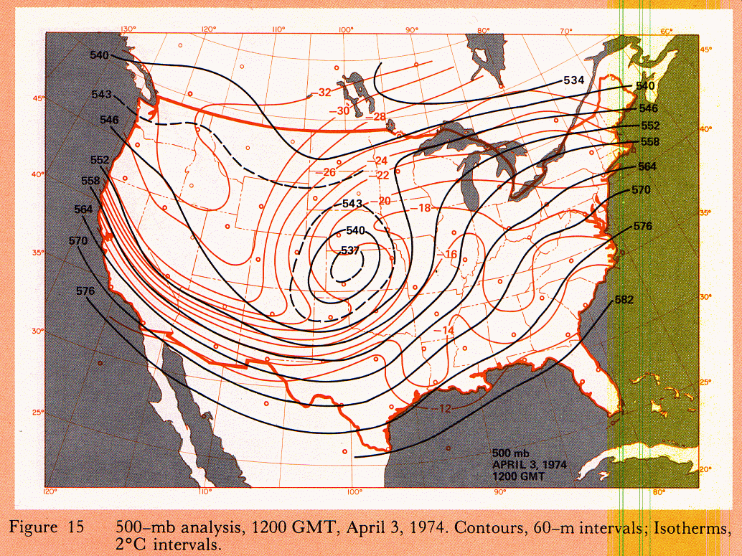

Slide 40
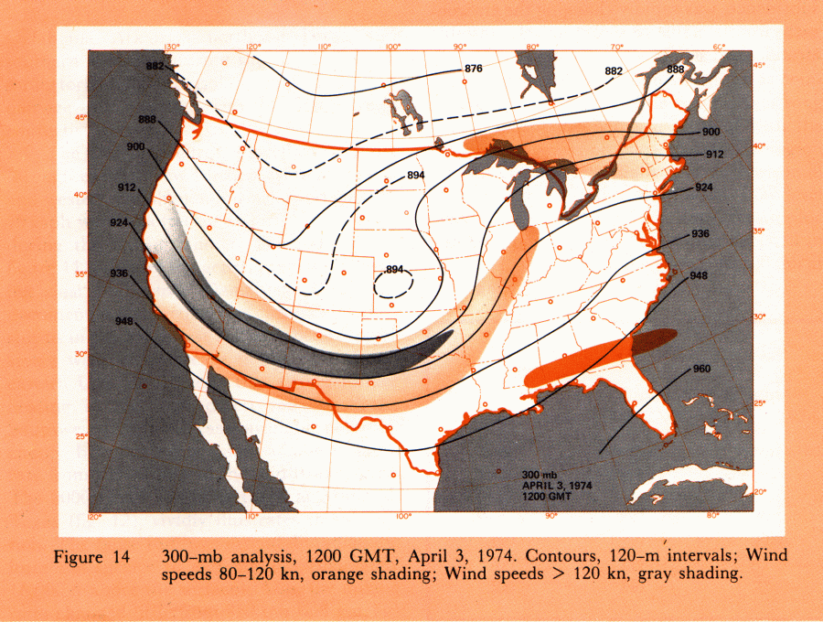

Slide 41
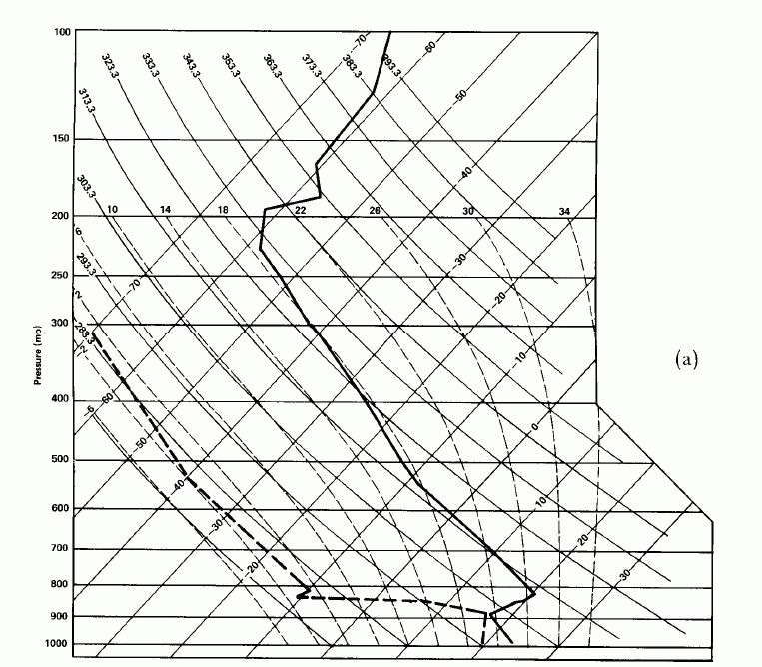
Jackson, MS sounding, April 3, 1974 12 UTC

Slide 42
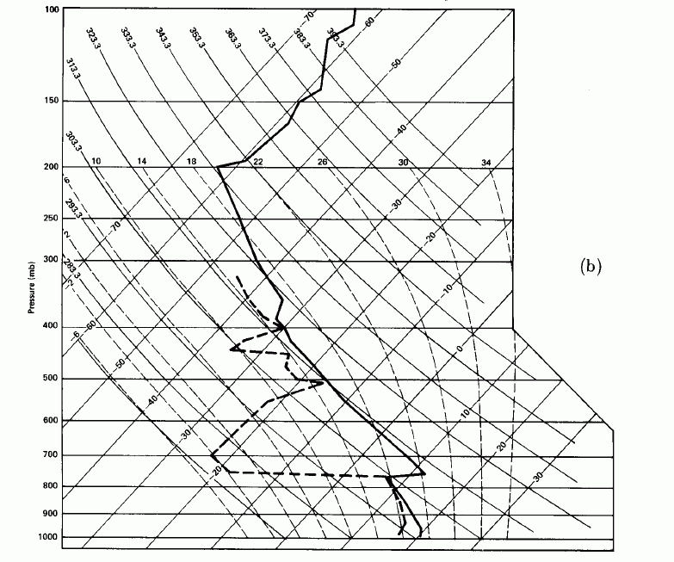
Nashville, TN sounding, April 3, 1974 12 UTC
Notice how both these soundings have an elevated inversion. It’s called a lid or cap.

Slide 43
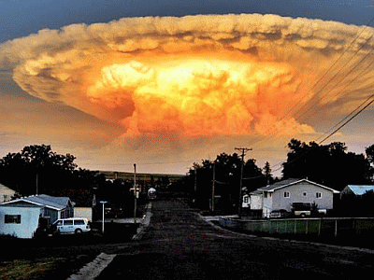
The lid means that air parcels rising from the surface have CIN. They are negatively buoyant and will not rise above the capping inversion.
This prevents cumulus clouds from becoming thunderstorms early in the day, allowing more sunshine and building more instability by heating of lower layers.
When parcel get hot enough, usually when they reach the Convective Temperature, they break through the lid explosively, rather than gradually. External forcing mechanisms, like fronts or drylines, can push parcels through the lid, producing the same violent upward cloud growth.
You can get severe thunderstorms without a cap, but usually the most intense storms start in a capped environment.

Slide 44
What happens if the temperature rises to here?

Slide 45
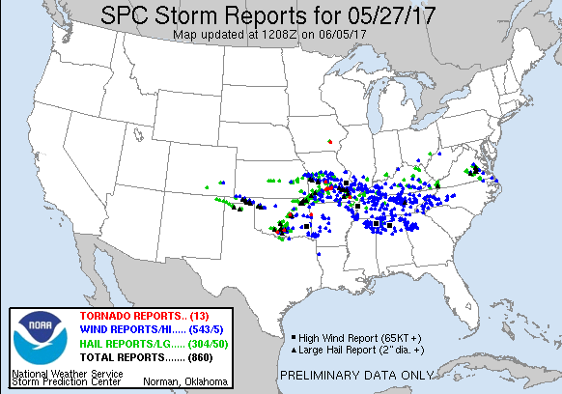
That’s when you get this
Next: Severe Thunderstorm Summary PowerPoint

