Slide 1
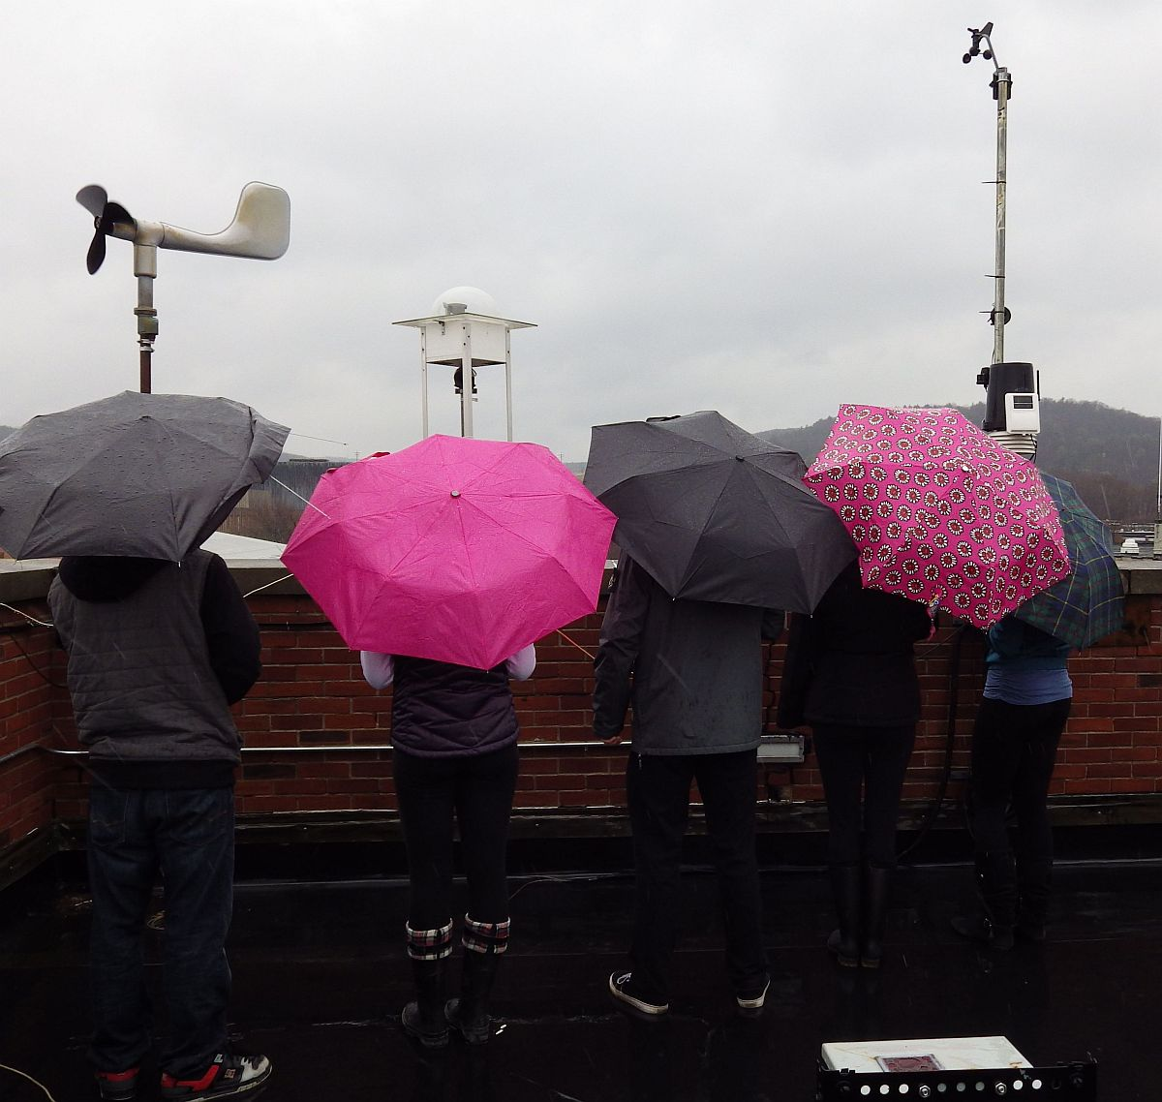
Oneonta Weather

Slide 2
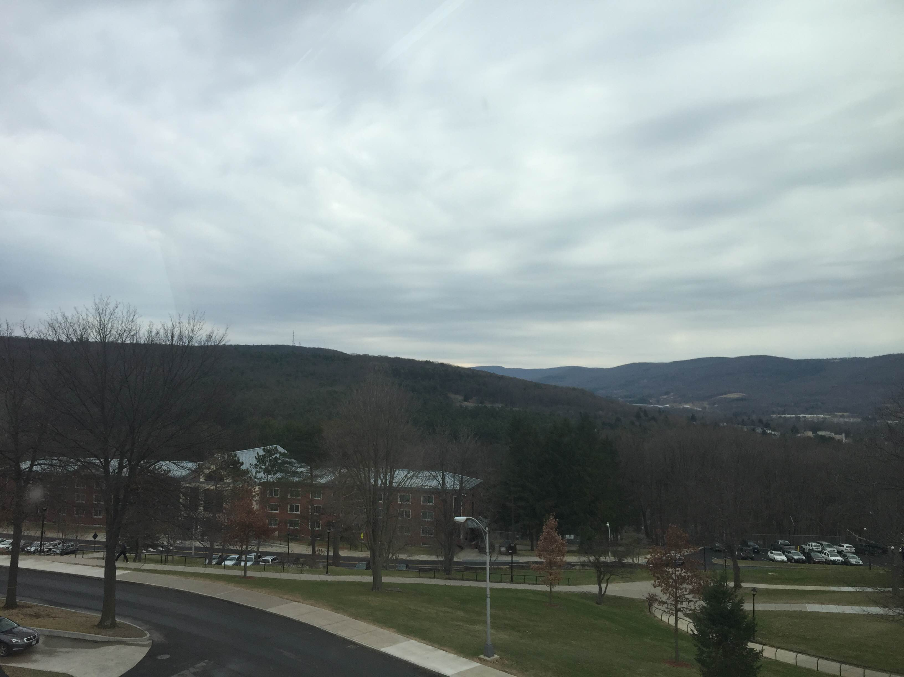
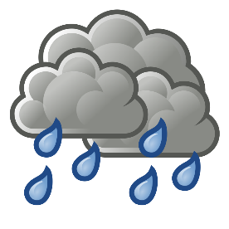
51°
1009.2 mb
W 8 mph
0.03”

Slide 3
Almanac – Mar 23, 2016
High: (Avg 43)
69° (2012)
Low: (Avg 25)
10° (1972)
Record Precip:
1.05” (1977)
Record Snow:
6” (1967)
Sunrise: 6:47 am
Sunset: 7:15 pm

Slide 4
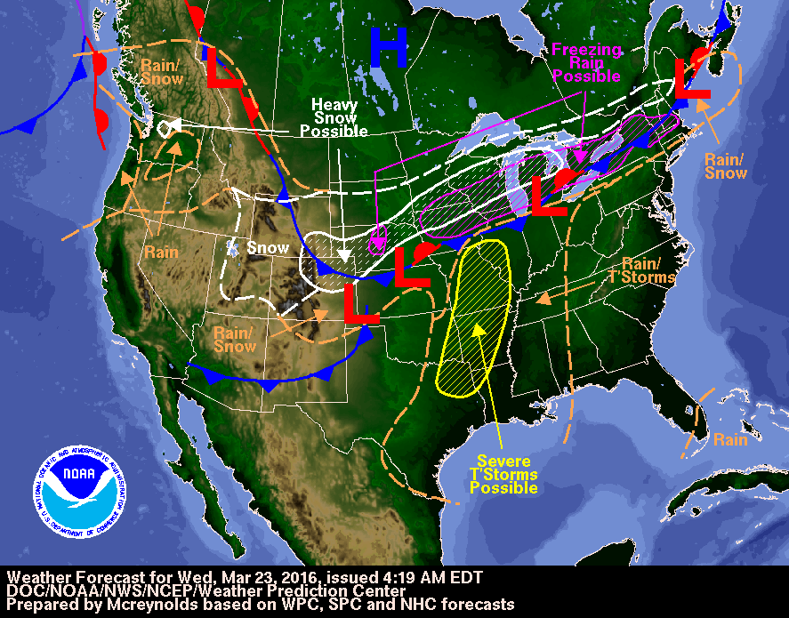

Slide 5
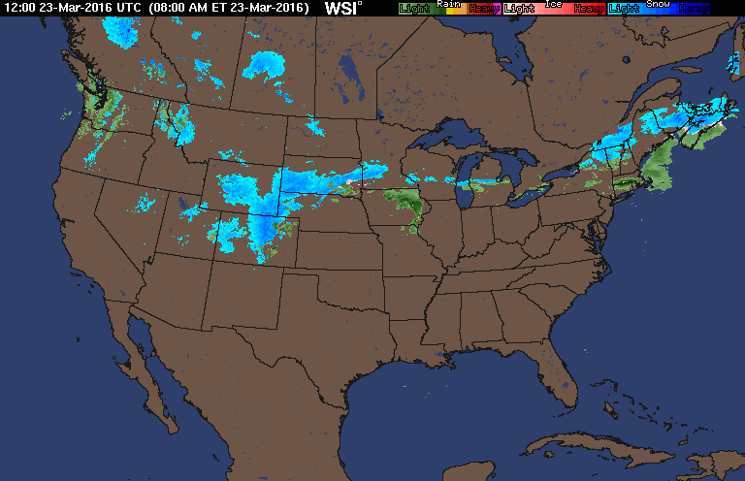

Slide 6
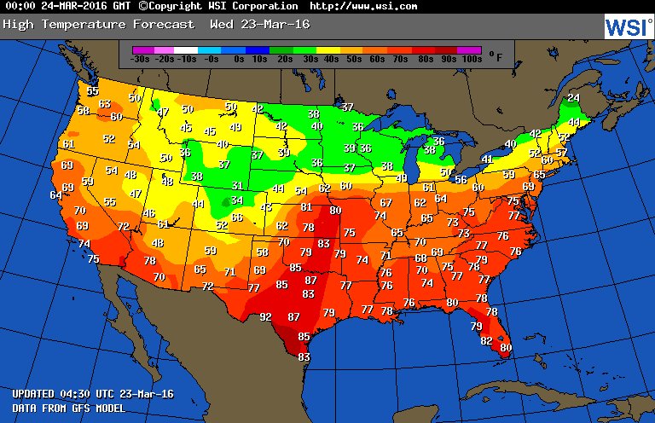

Slide 7
Tonight
40°
Rain Showers
East Wind
Light and Variable

Slide 8
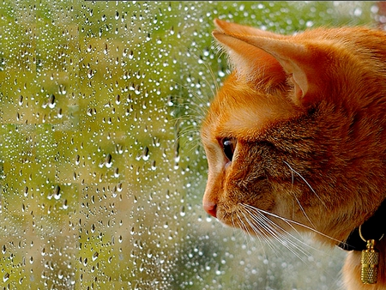
Tomorrow
59°
Morning Showers
Tomorrow Night
46°
Rain Showers Likely

Slide 9
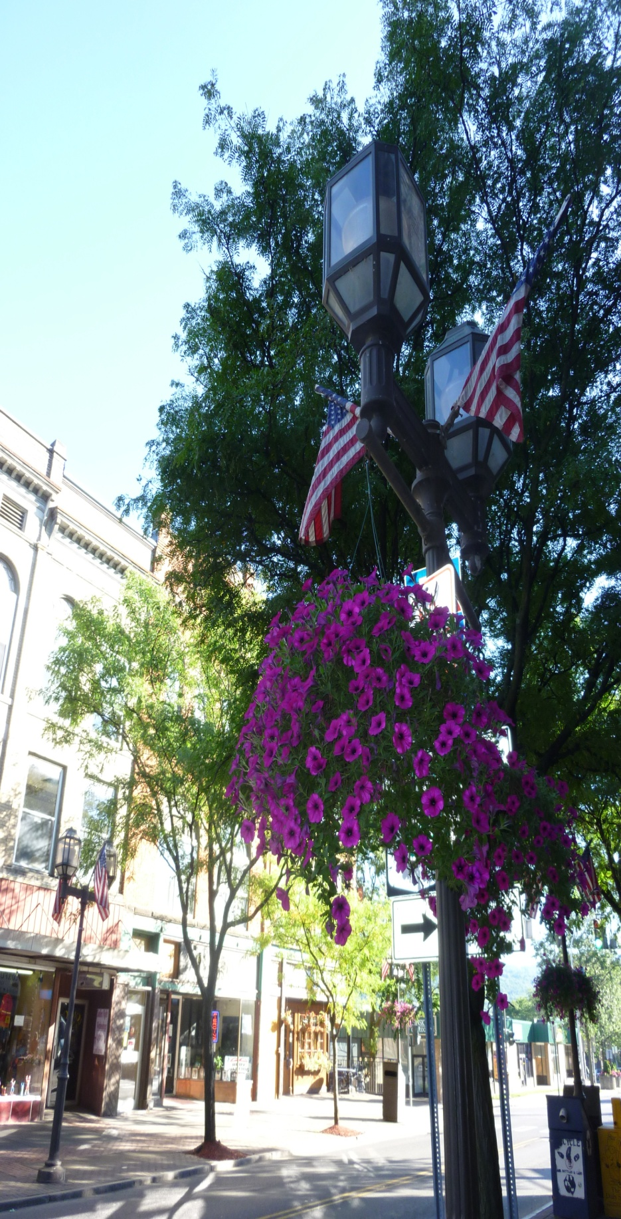
FIVE DAY FORECAST
ONEONTA, NY WEATHER
FRI
SAT
SUN
MON
TUE
Rain Showers
Mostly
Sunny
Partly Sunny
Chance Showers
Partly Sunny
HIGHS
52
54
61
50
46
28
32
40
32
31
LOWS

Slide 10
