Slide 1
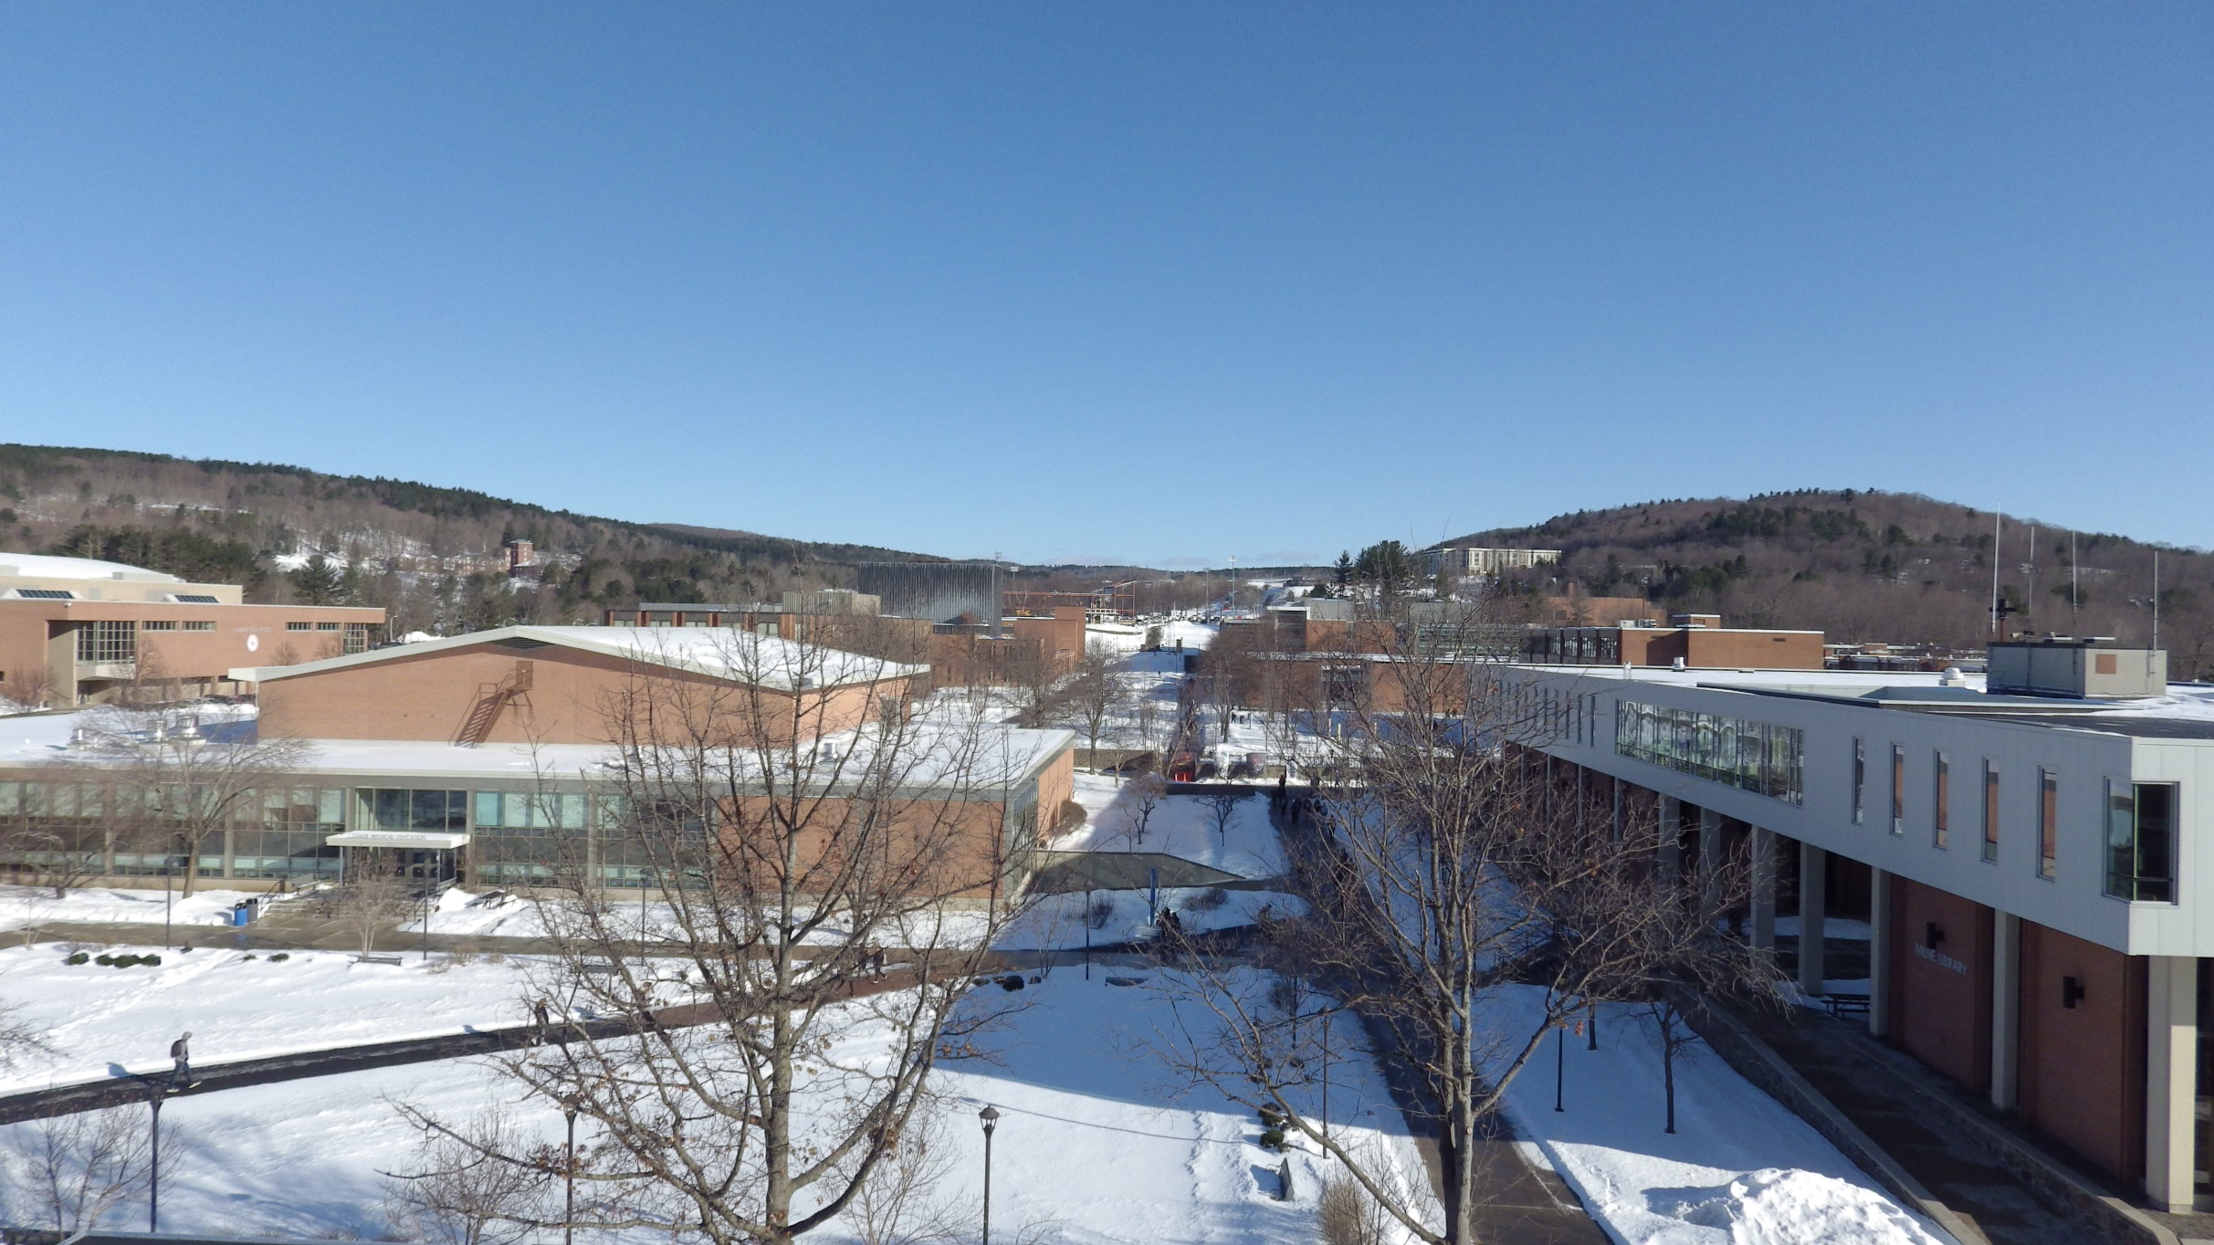
Oneonta Weather

Slide 2
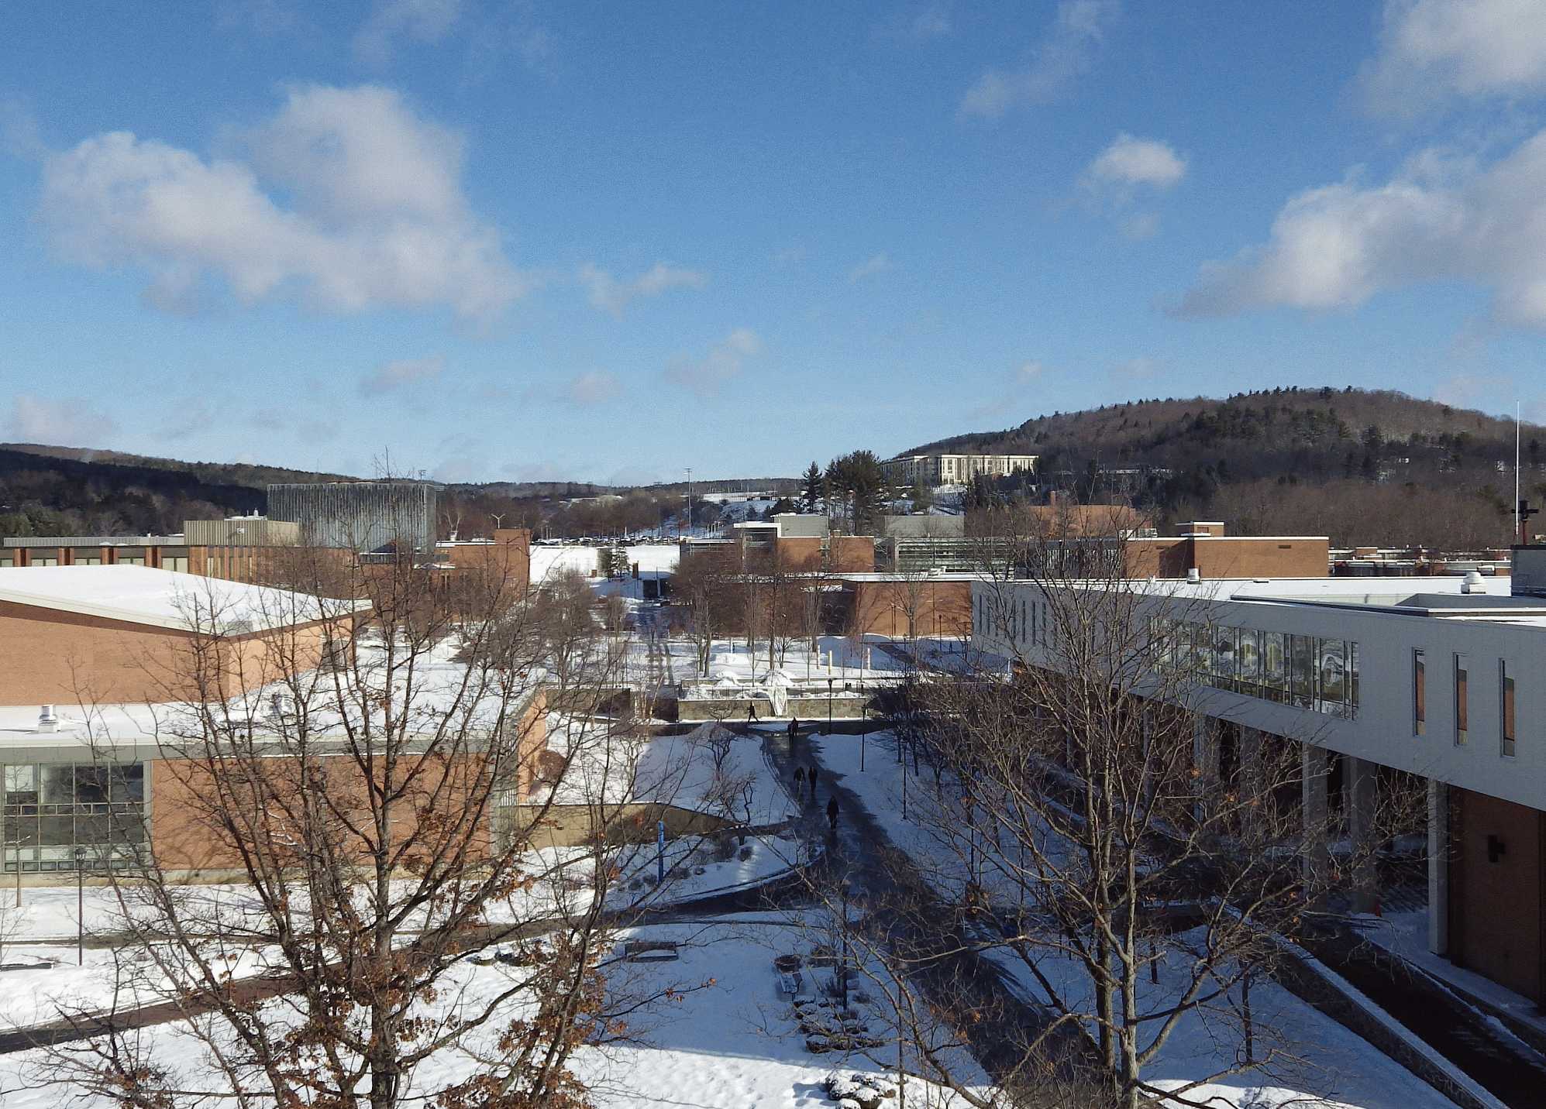
18°
1028.1 mb
NW 17 mph
Trace of snow

Slide 3
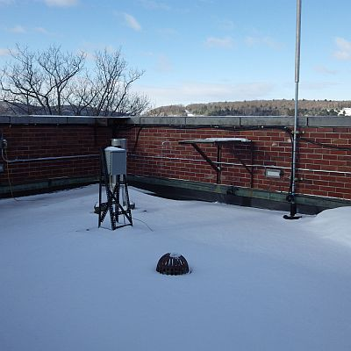
Almanac – Mar 22, 2017
High: (Avg 41)
76° (2012)
Low: (Avg 24)
2° (1976)
Record Precip:
1.59” (2010)
Record Snow:
16.4” (1977, 2-day event total 28.4”)
Sunrise: 7:00 am
Sunset: 7:15 pm

Slide 4
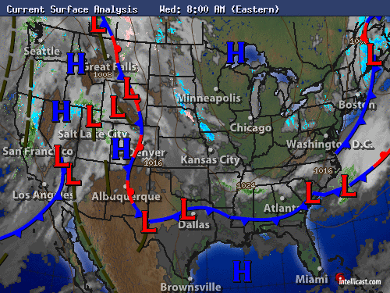

Slide 5
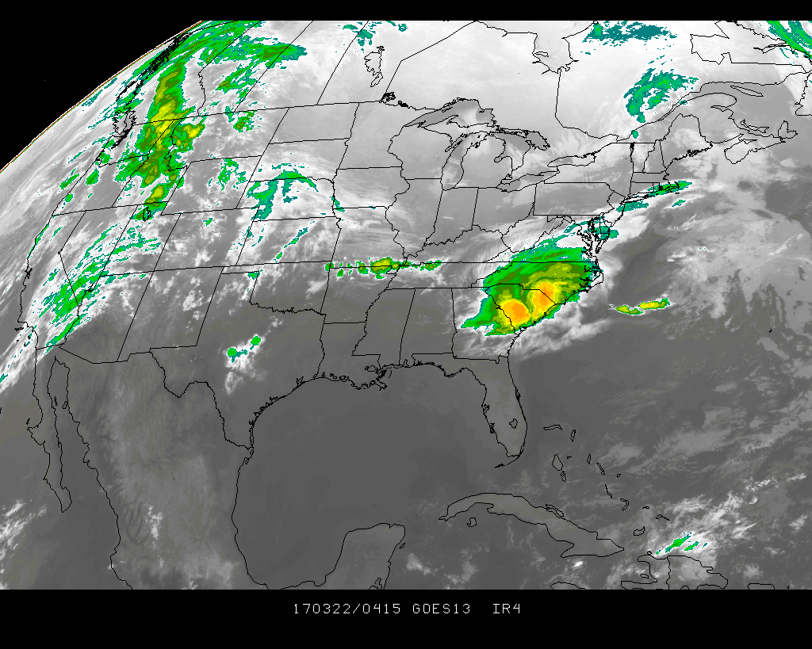

Slide 6
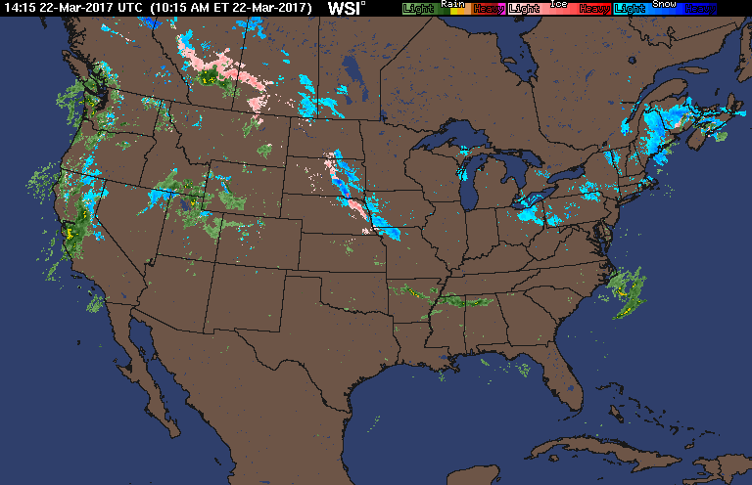
U.S. Radar Loop

Slide 7
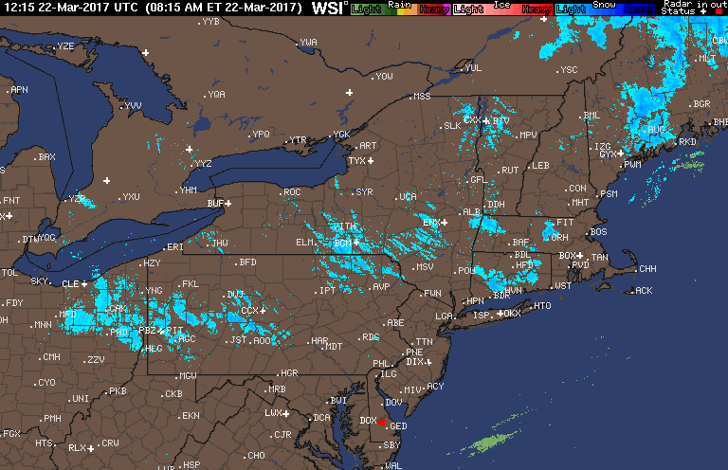
Northeast Radar Loop

Slide 8
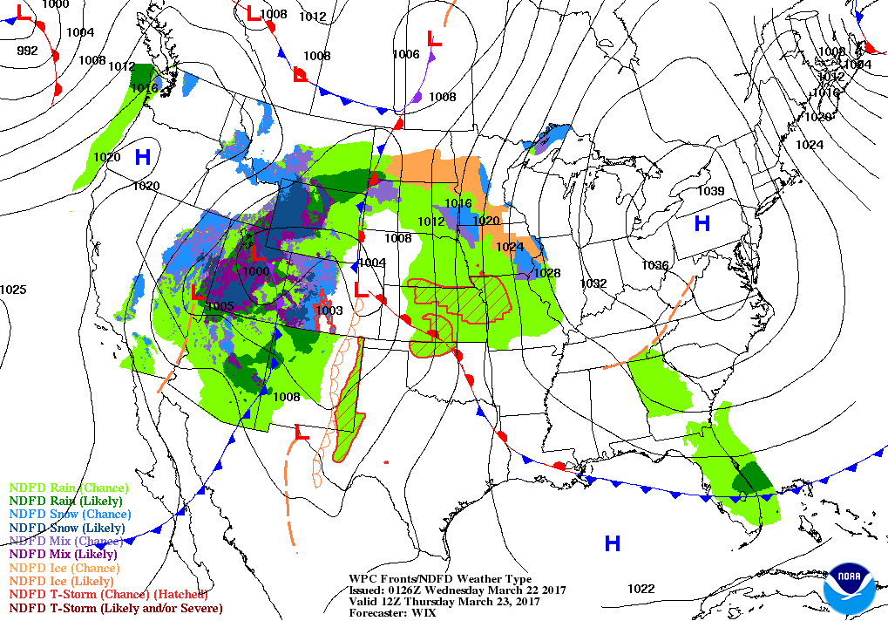
Forecast

Slide 9
Tonight
4°
Wind Chill -2!
NW wind 6-10 mph
Today’s High: 18 °

Slide 10
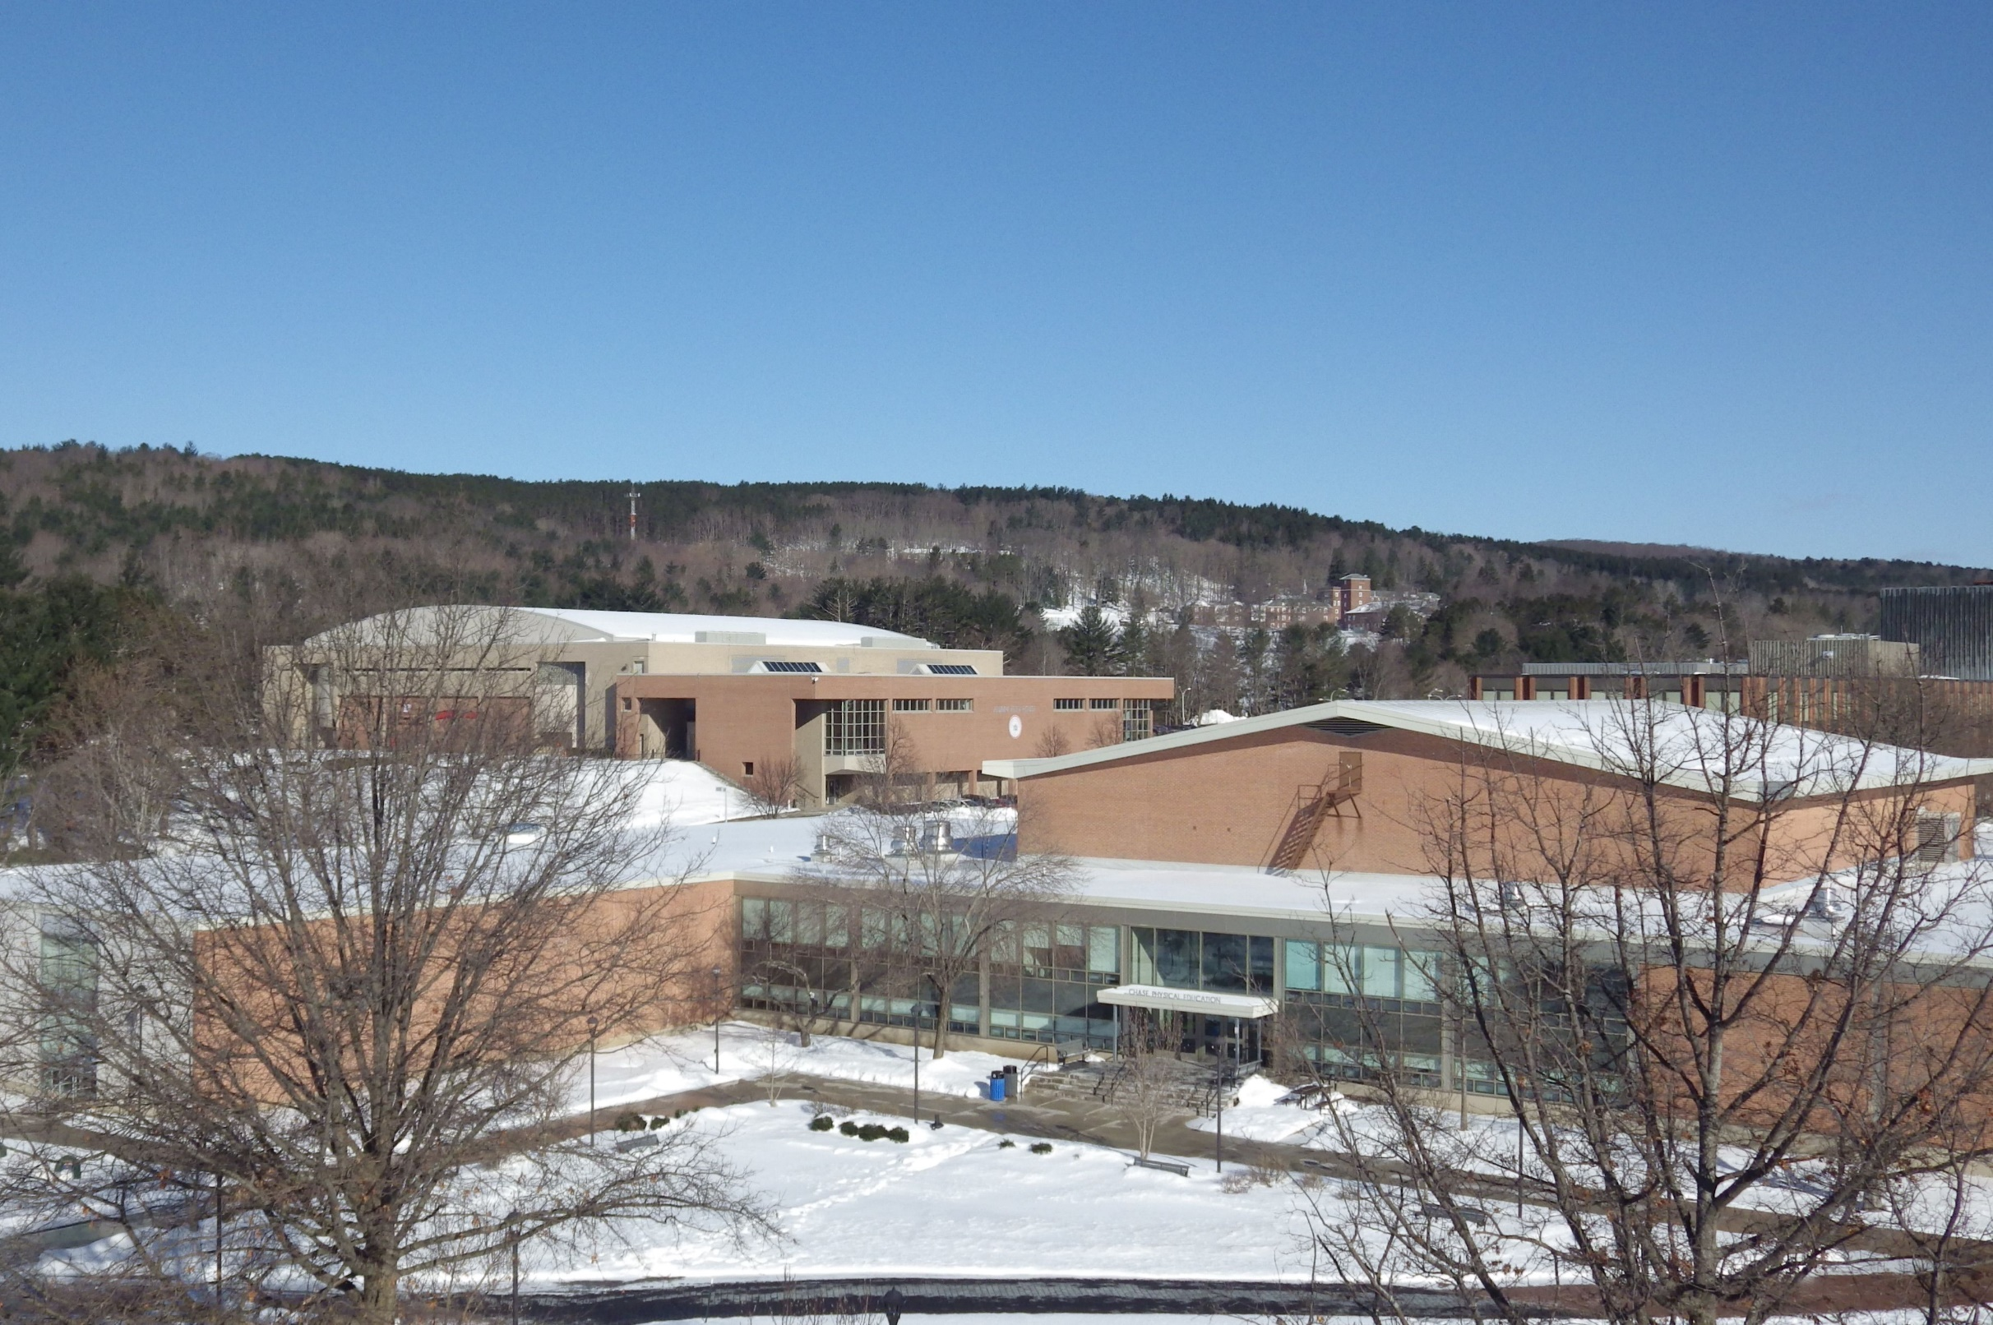
Tomorrow
30°
Sunny and warmer but still below normal
Tomorrow Night
21°

Slide 11
FIVE DAY FORECAST
ONEONTA, NY WEATHER
Wed
Thu
Fri
Sat
Sun
Cold
Mostly Sunny after cold start
Snow to Rain
Showers
Rain likely
HIGHS
18
30
40
48
41
4
22
37
30
LOWS

Slide 12
