Slide 1
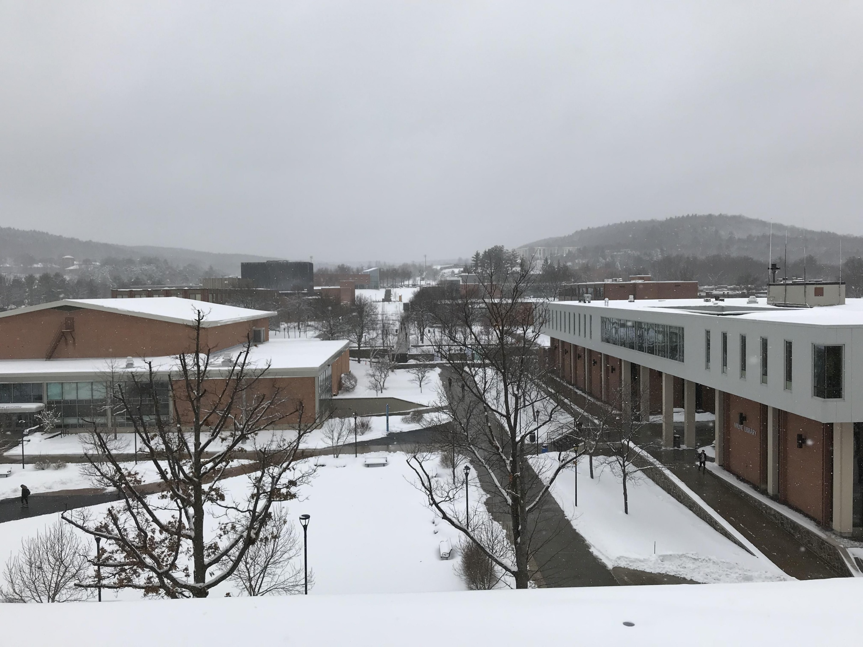
Oneonta Weather

Slide 2
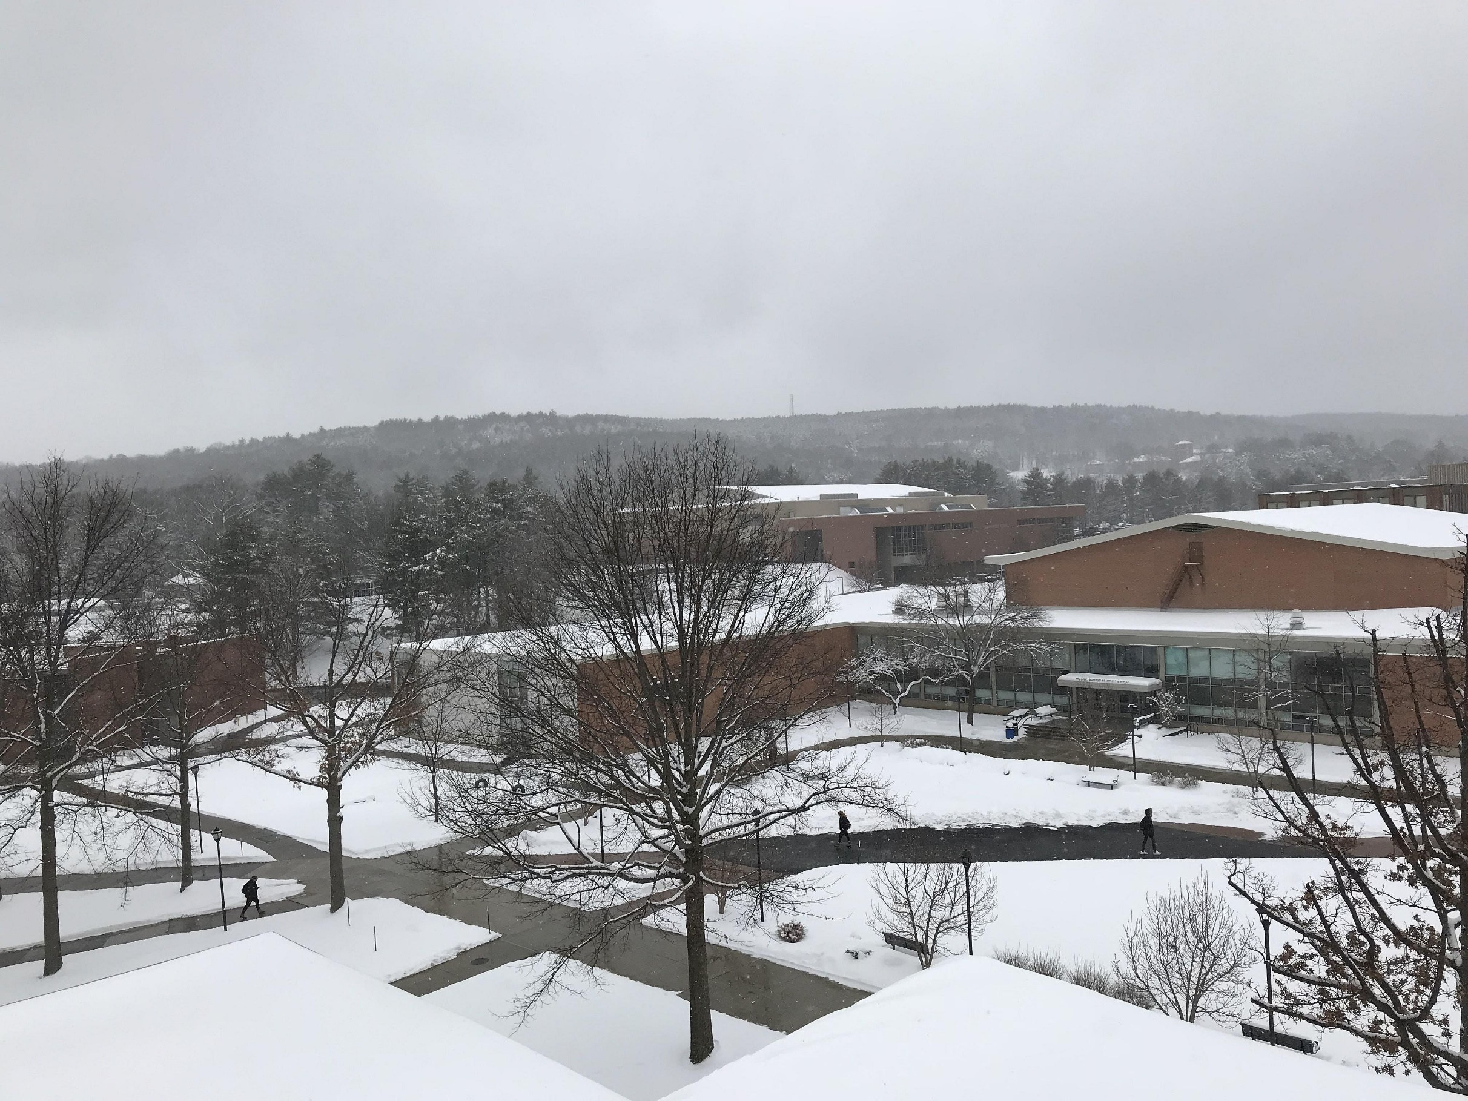
30°
1008 mb
W 11 mph
Light snow
flurries

Slide 3
Tonight
24°
West Wind at 11 mph
Snow Showers

Slide 4
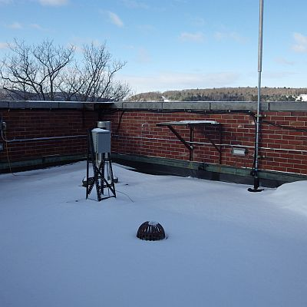
Almanac – March 14, 2018
High: (Avg 43)
77° (1990)
Low: (Avg 17)
4° (1993)
Record Precip:
0.86” (1980)
Record Snow:
24.0” (2017)
Sunrise: 7:14 am
Sunset: 7:07 pm
Mar 13: 19.5” (1993)

Slide 5
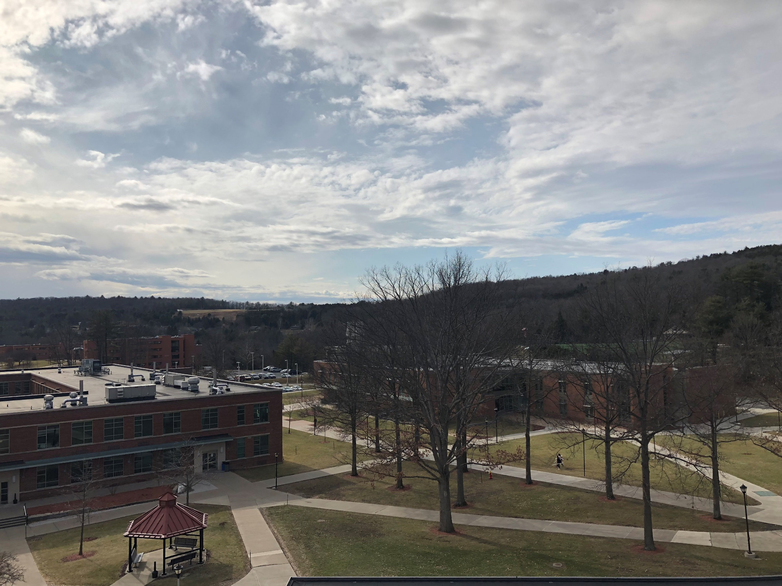
Tomorrow
33°
Chance of Flurries
Tomorrow Night
21°
Flurries, cold, and windy

Slide 6
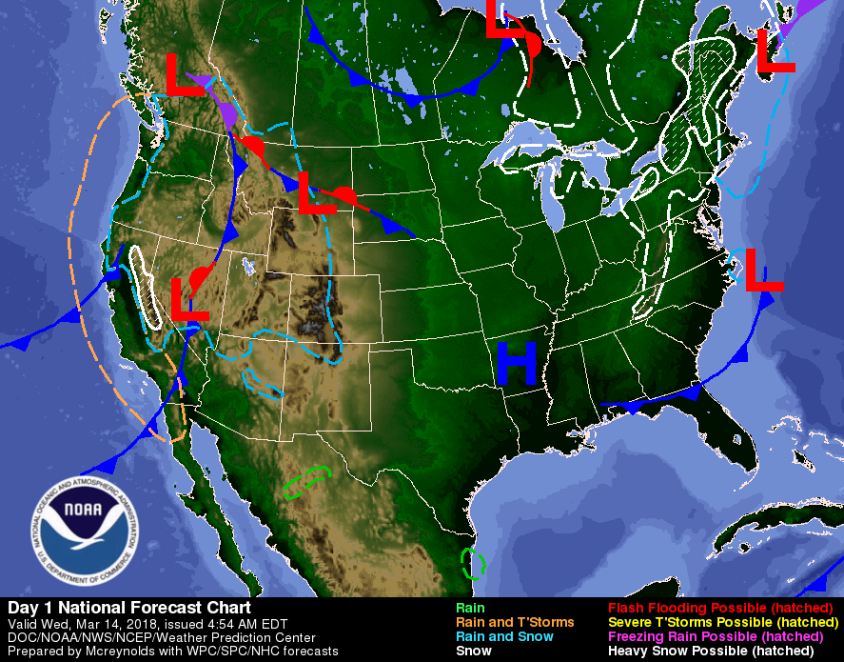

Slide 7
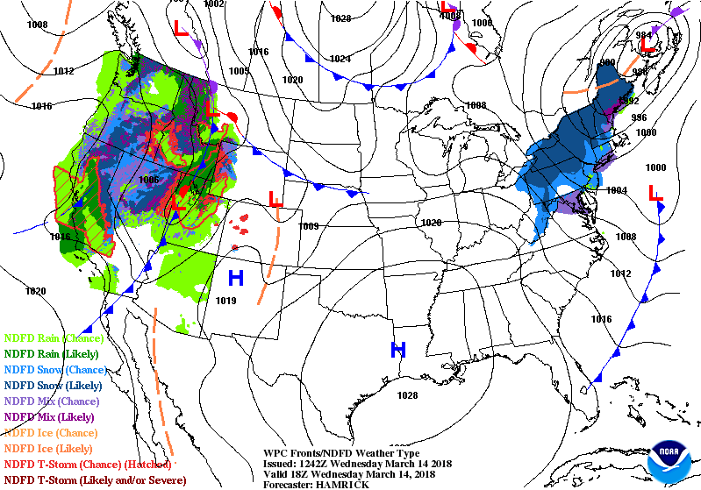

Slide 8
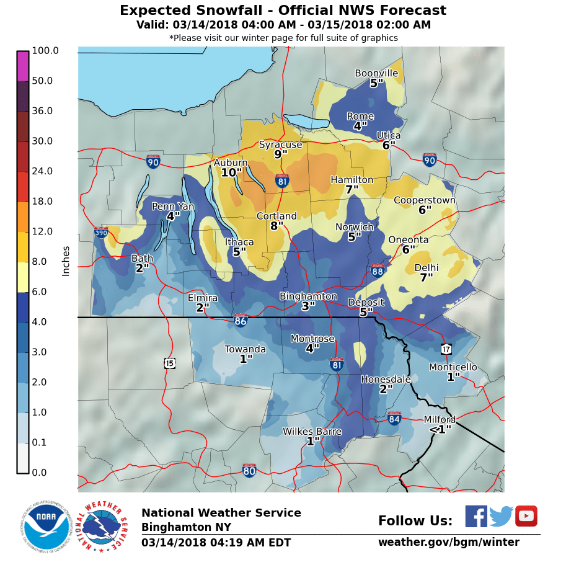
Forecast Prog

Slide 9
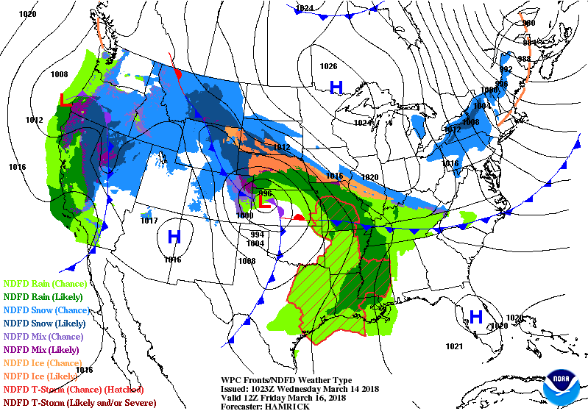
U.S. Radar Loop

Slide 10
March Madness
Spring, where u at?

Slide 11
FIVE DAY FORECAST
ONEONTA, NY WEATHER
Wed
Thu
Fri
Sat
Sun
Snow
Windy
Flurries
Mostly Cloudy
Partly Cloudy
Cold
Mostly Sunny
HIGHS
31
33
27
30
33
22
21
15
19
LOWS

Slide 12
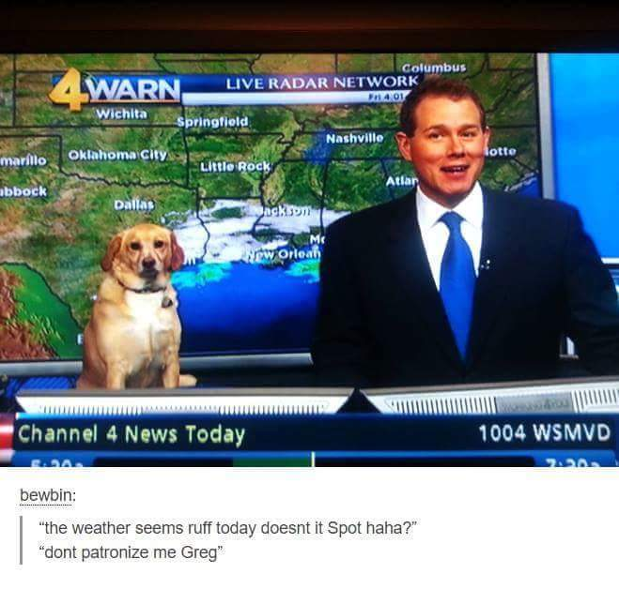
Meteorologist Greg
Meteorologist Spot

