Slide 1
Oneonta Weather

Slide 2
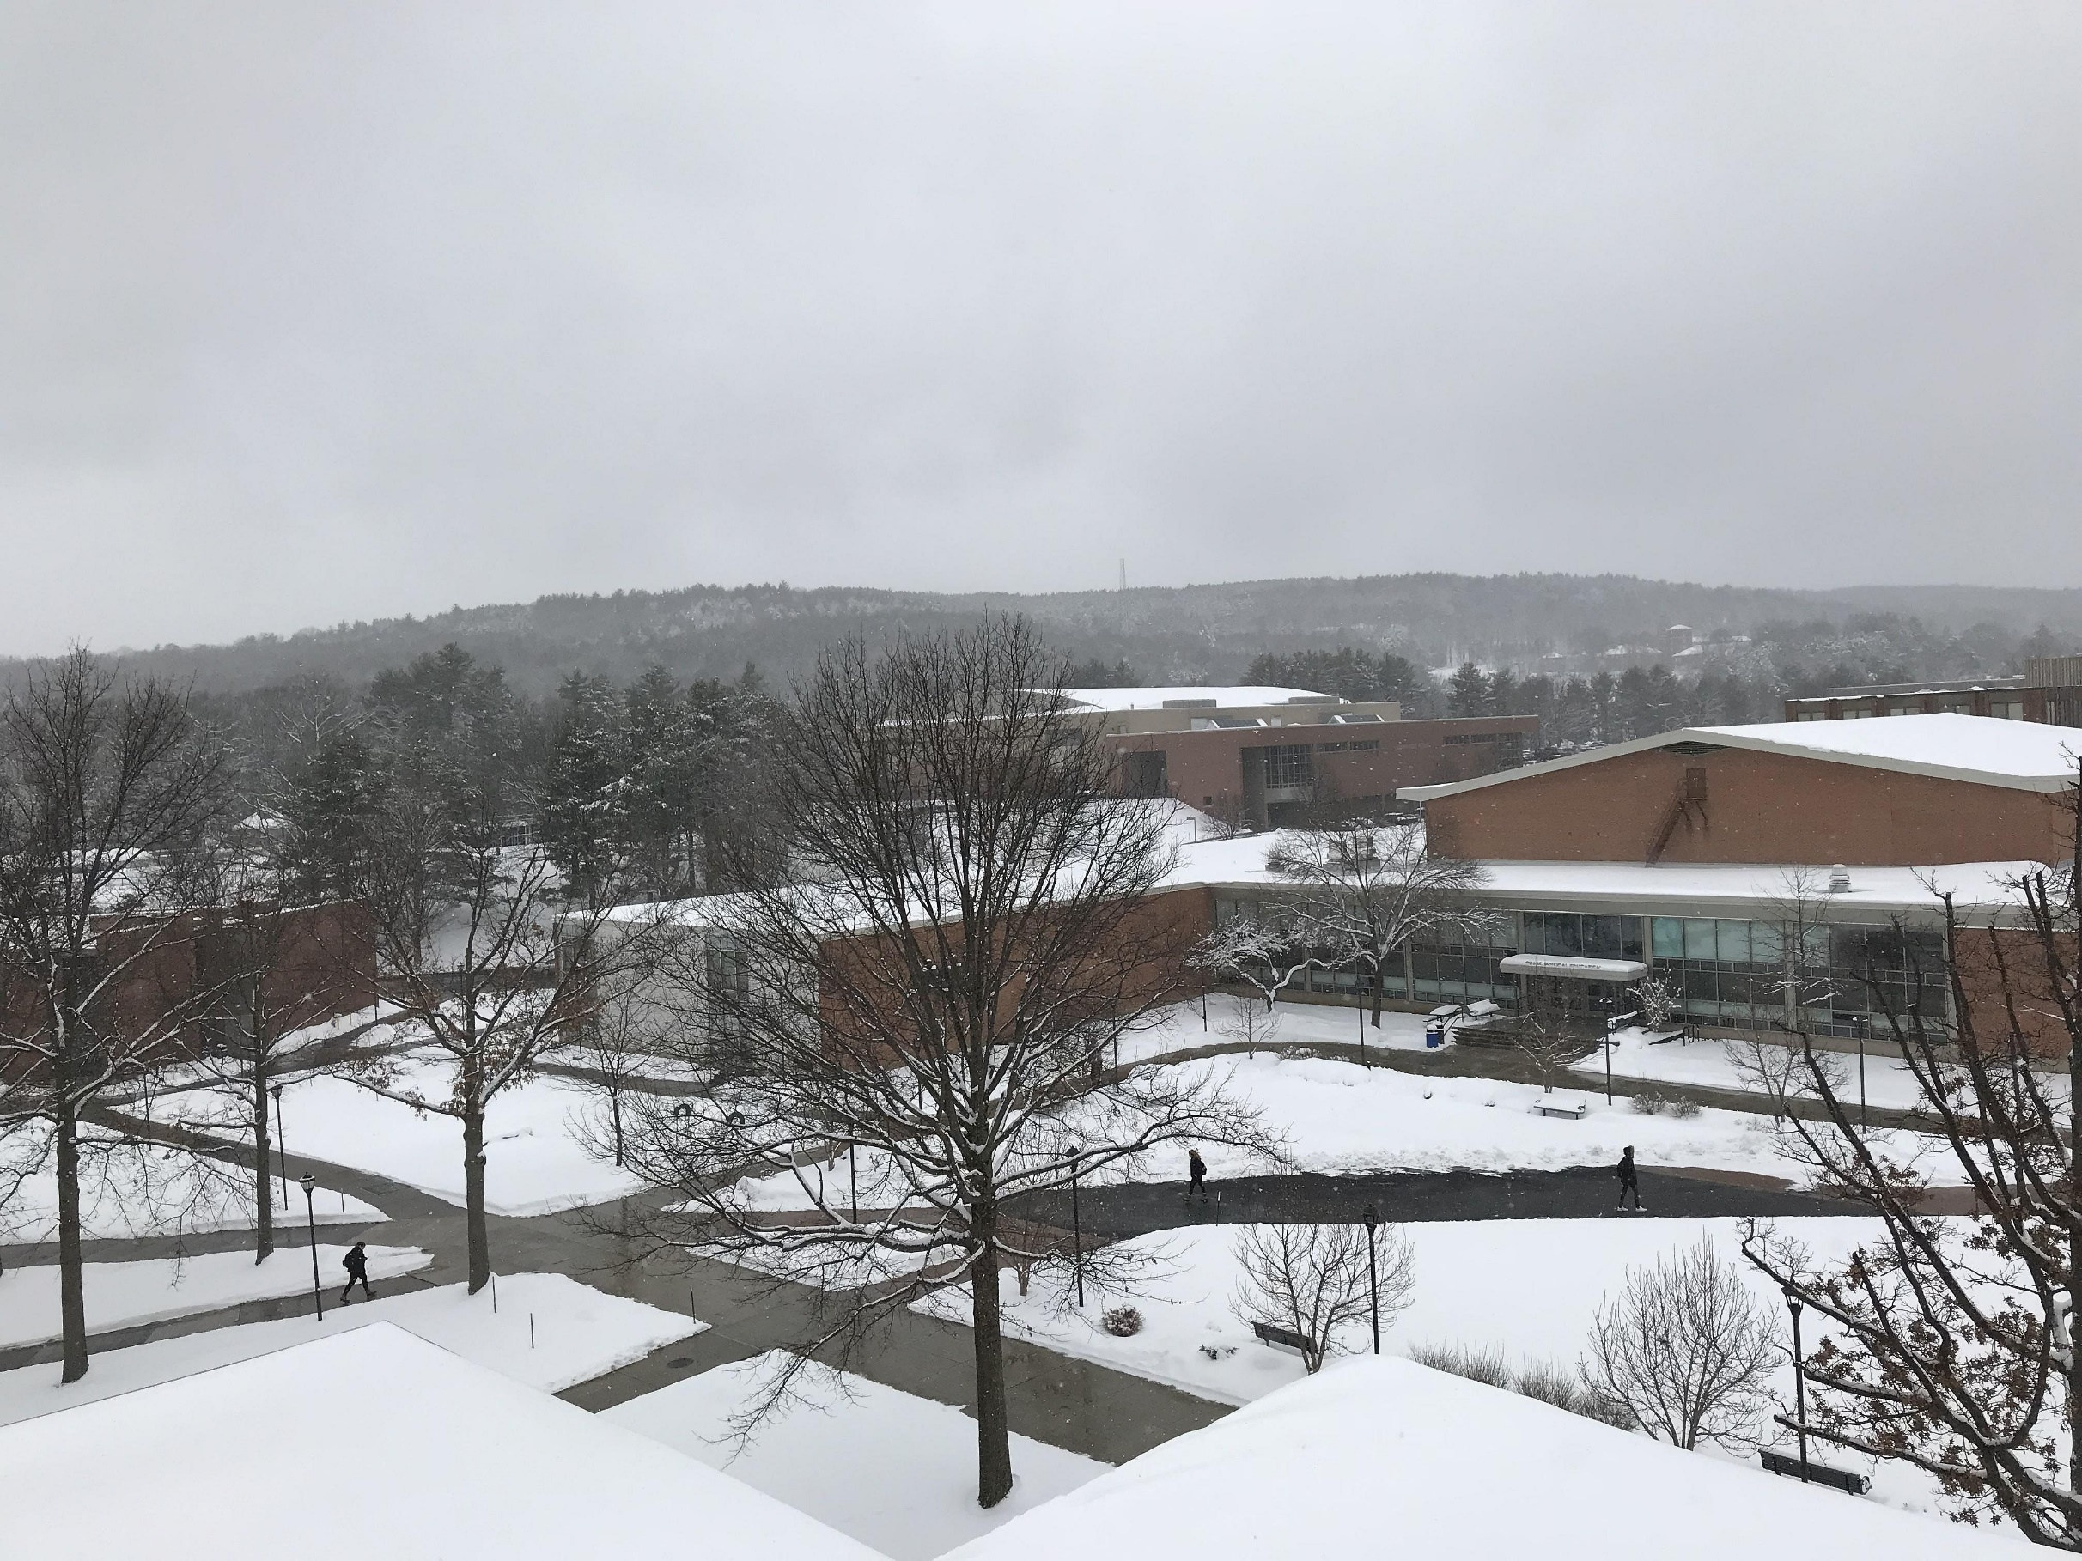
°
mph

Slide 3
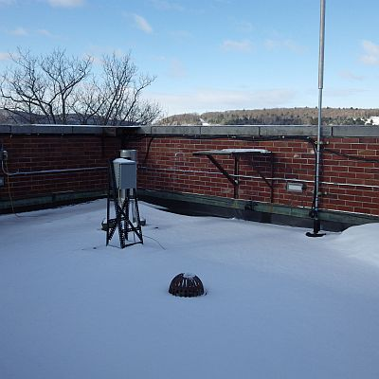
Almanac – Feb 27, 2019
High: (Avg 36)
64° (1997)
Low: (Avg 16)
-26° (1963)
Record Precip:
0.91” (2000)
Record Snow:
2.0” (1969)
Sunrise: 6:39 am
Sunset: 5:47 pm

Slide 4
Tonight
13°
Snow: 3 more inches

Slide 5
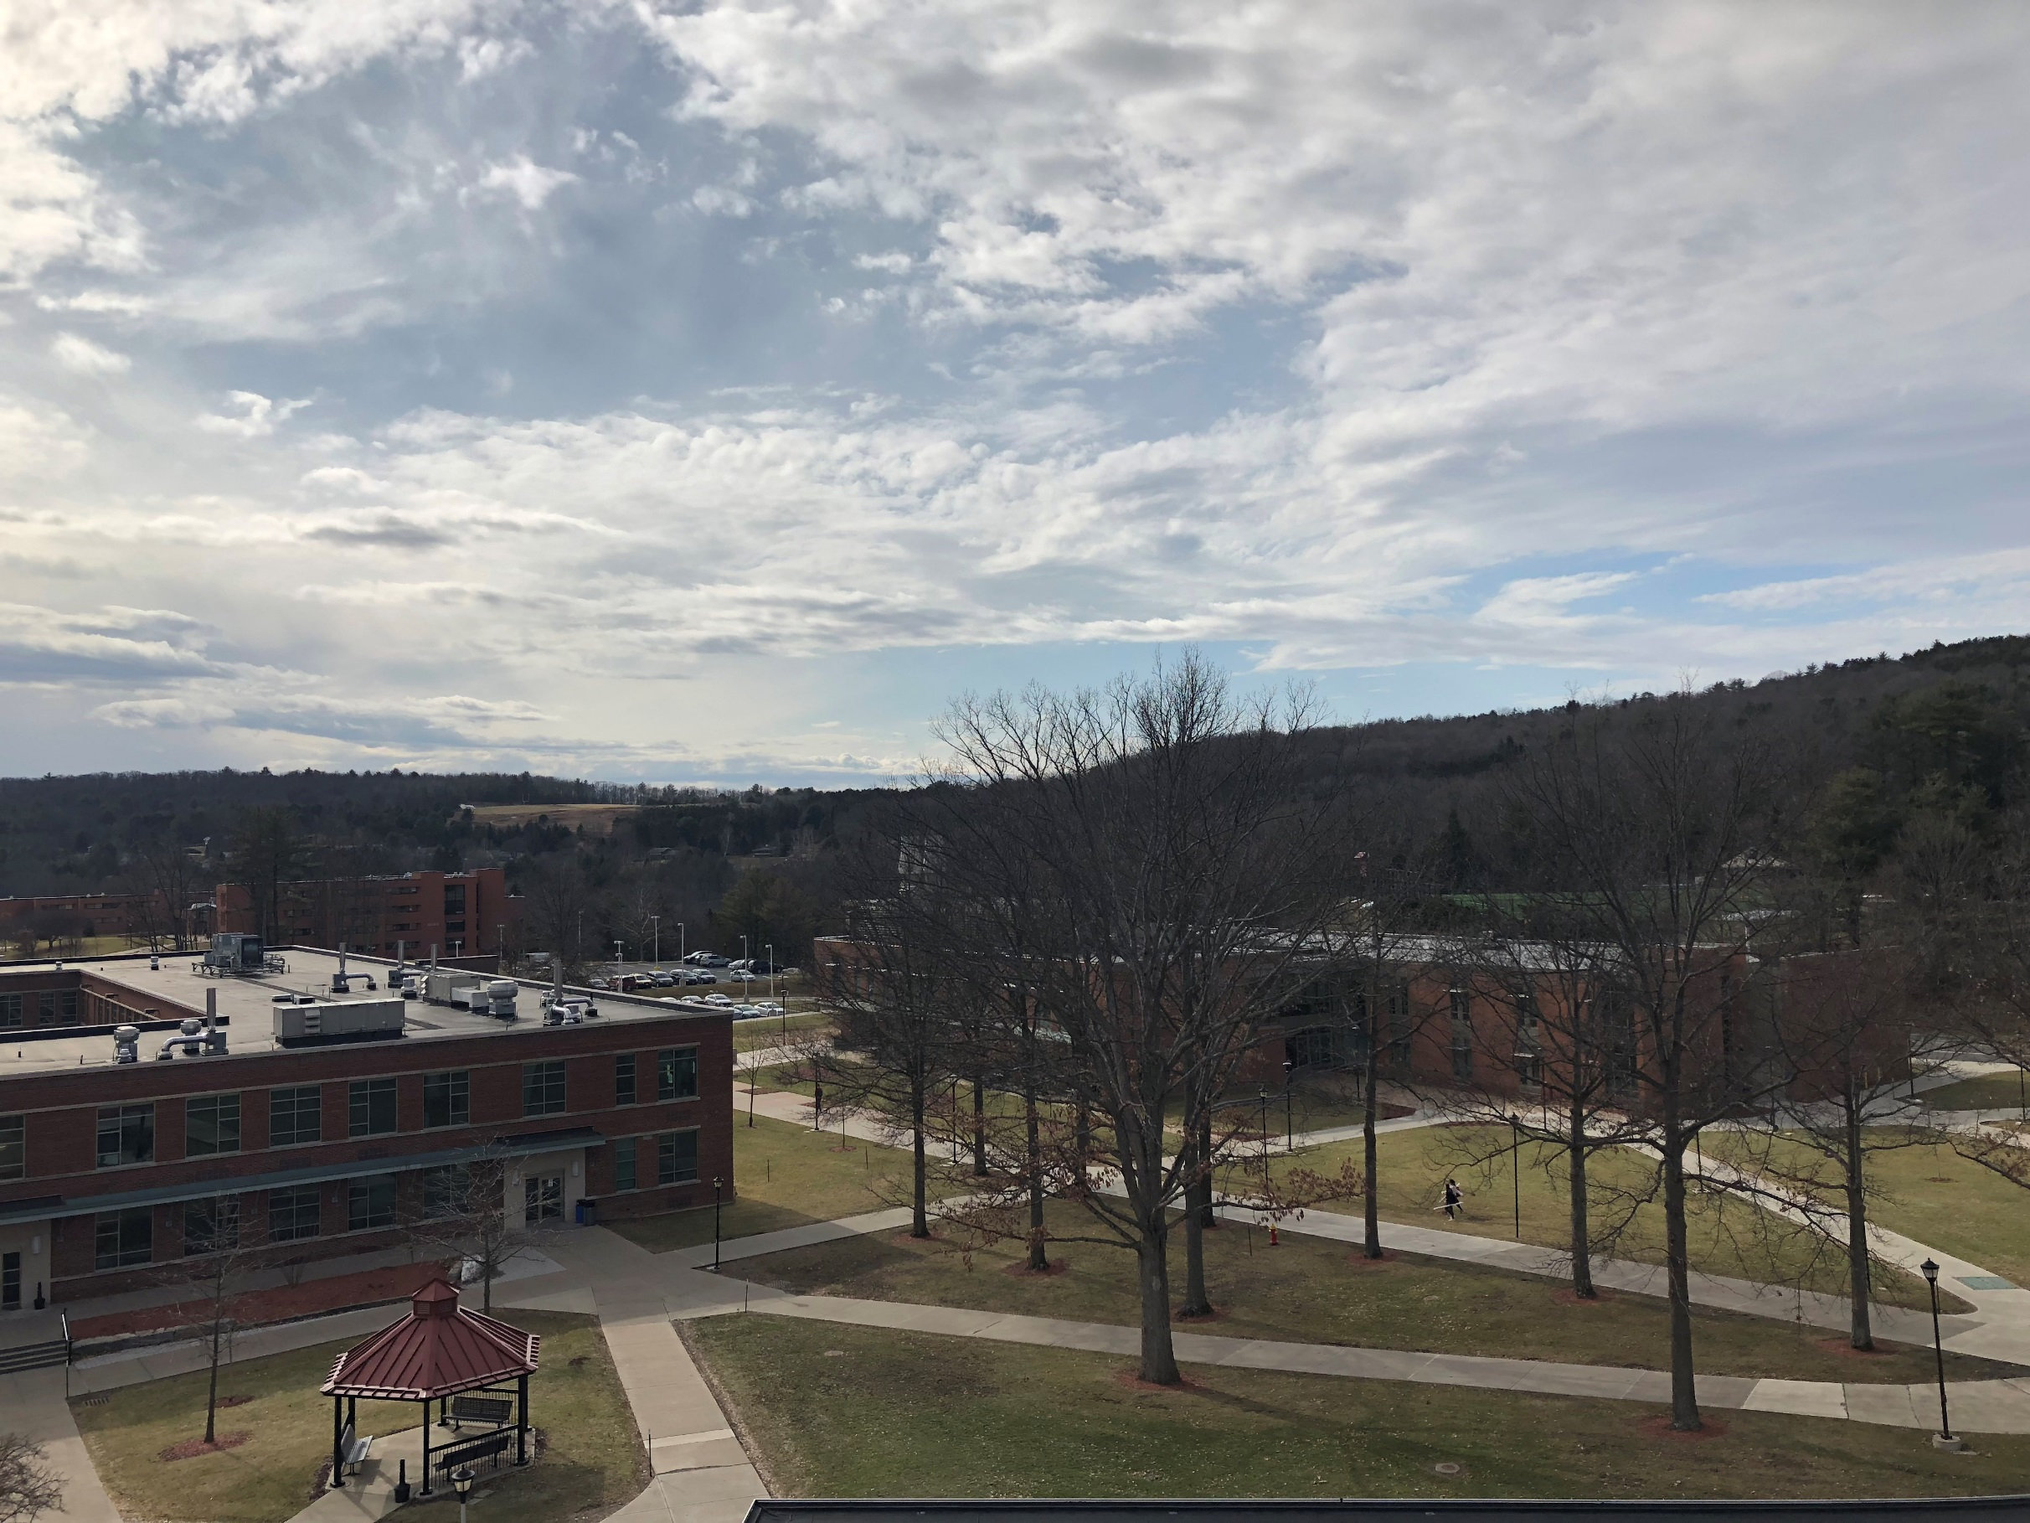
Tomorrow
26°
Partly Sunny
Tomorrow Night
12°
Mostly cloudy

Slide 11
FIVE DAY FORECAST
ONEONTA, NY WEATHER
Wed
Thu
Fri
Sat
Sun
5” total
Ending overnight
Partly Sunny
Partly Sunny
Snow changing to rain
Chance of snow
HIGHS
19
26
35
38
30
13
12
23
15
LOWS

