Slide 1
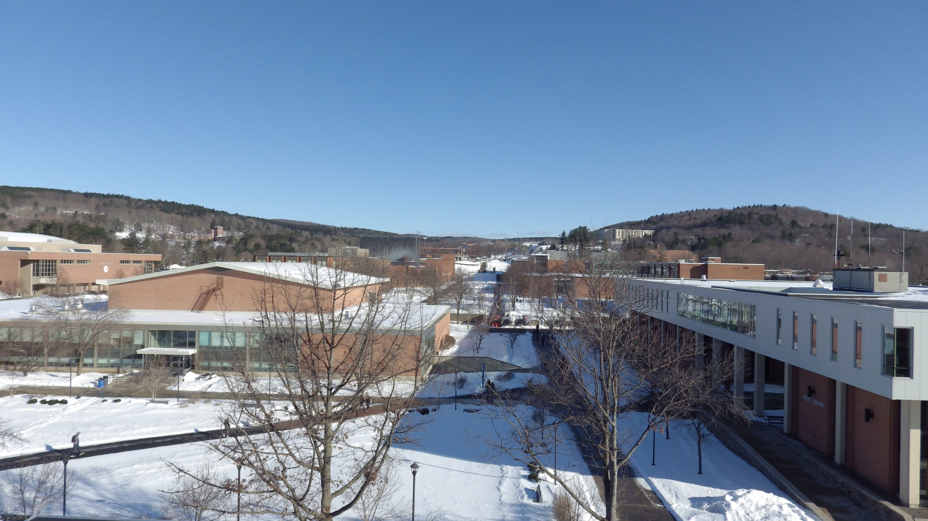
Oneonta Weather

Slide 2
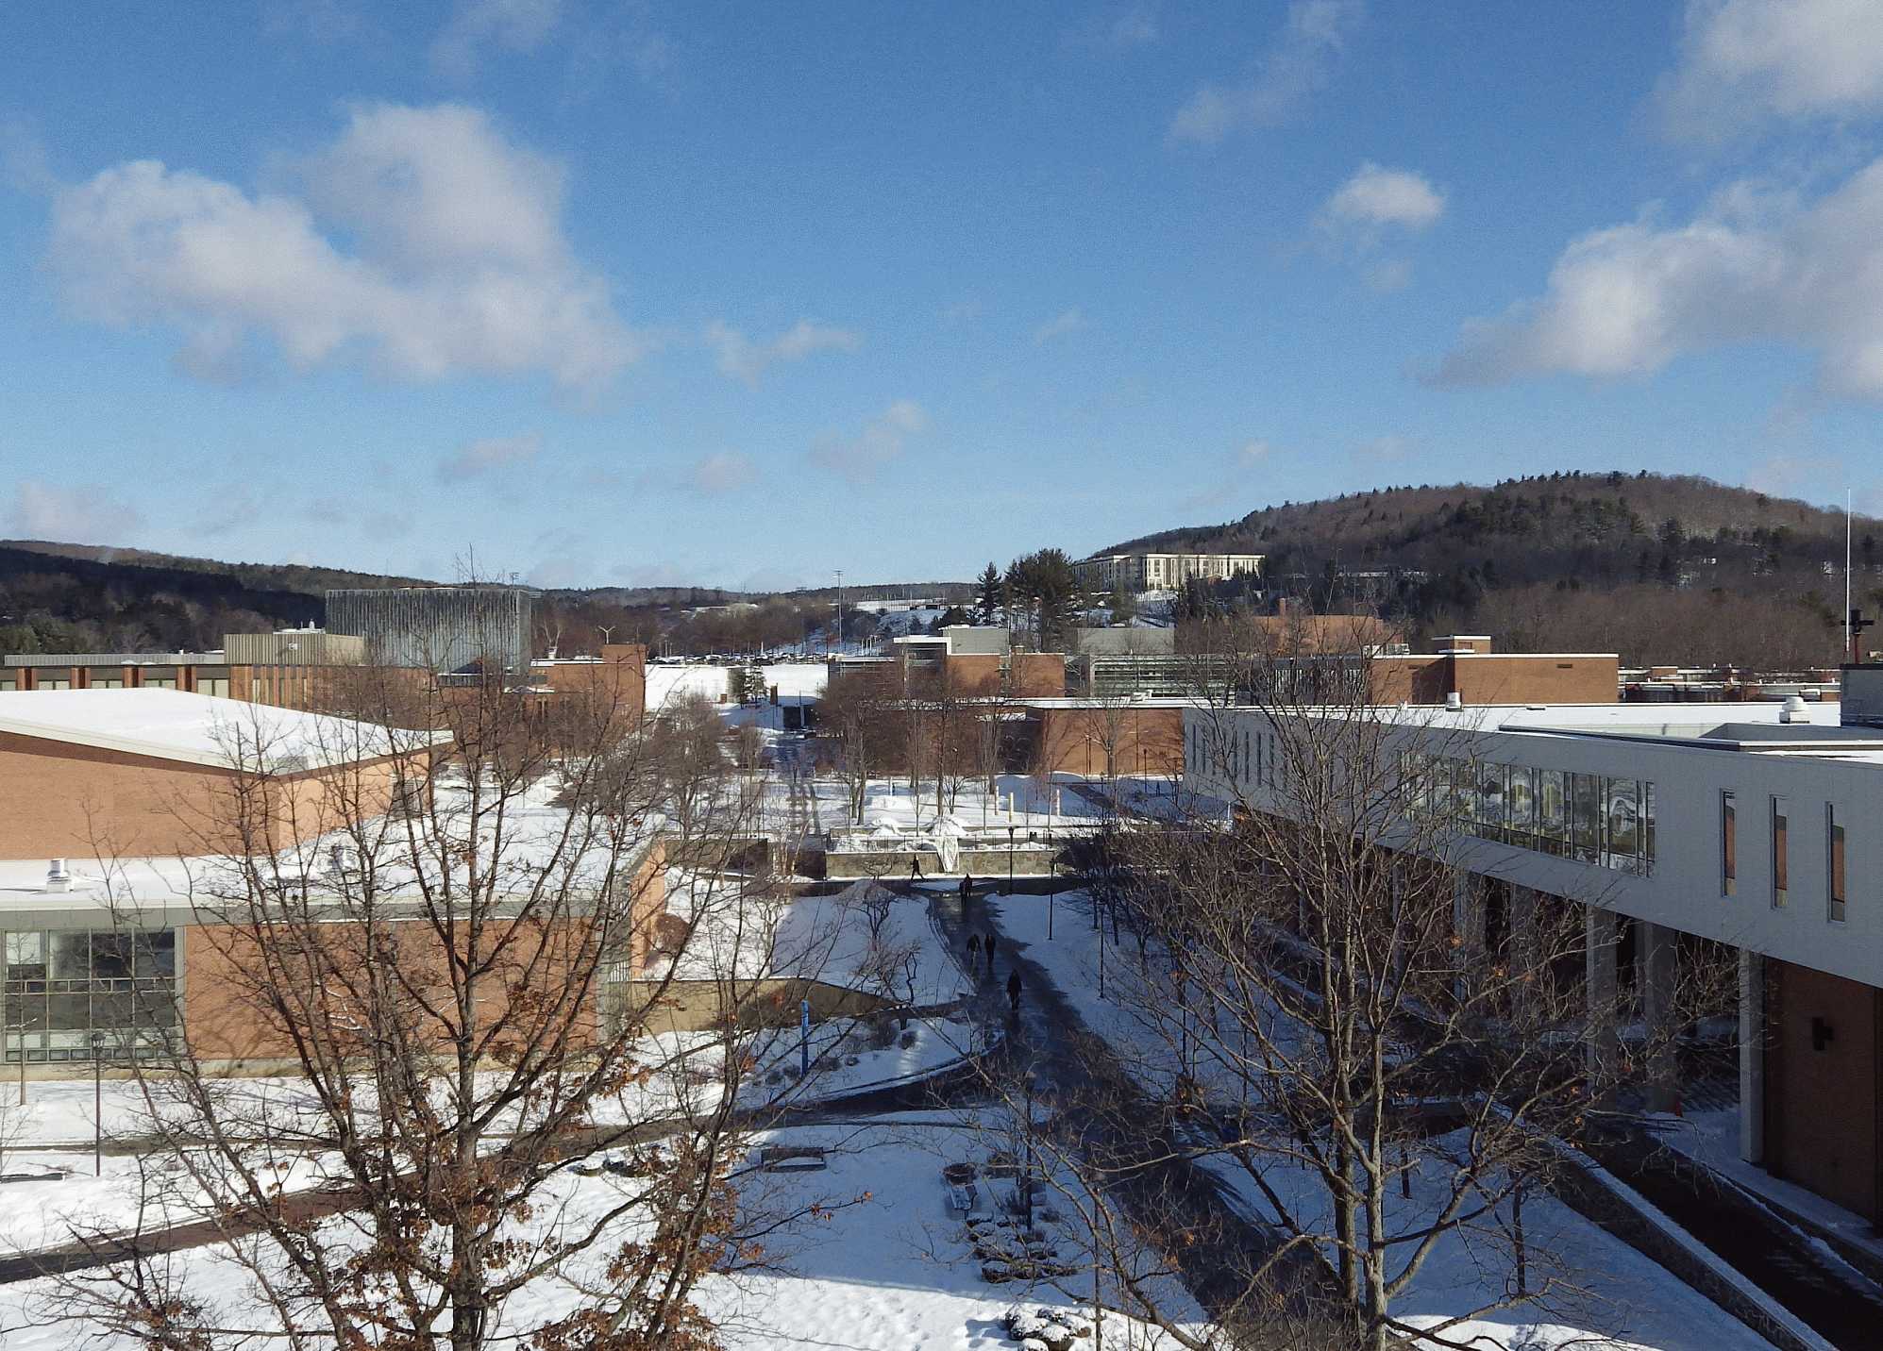
42°
1026 mb
S 5 mph
None

Slide 3
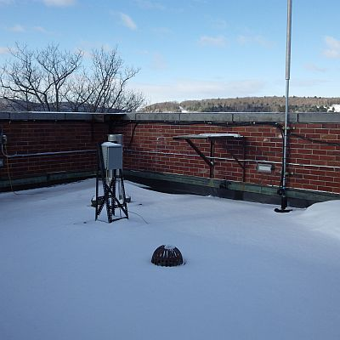
Almanac – March 13, 2019
High: (Avg 43)
71° (1990)
Low: (Avg 17)
4° (1960)
Record Precip:
1.25” (2006)
Record Snow:
19.5” (1993)
Sunrise: 7:15 am
Sunset: 7:03 pm
(The Superstorm of ‘93)

Slide 6
U.S. Radar Loop

Slide 7
Northeast Radar Loop

Slide 8
Forecast Prog

Slide 9
Tonight
32°
Mostly Cloudy

Slide 10
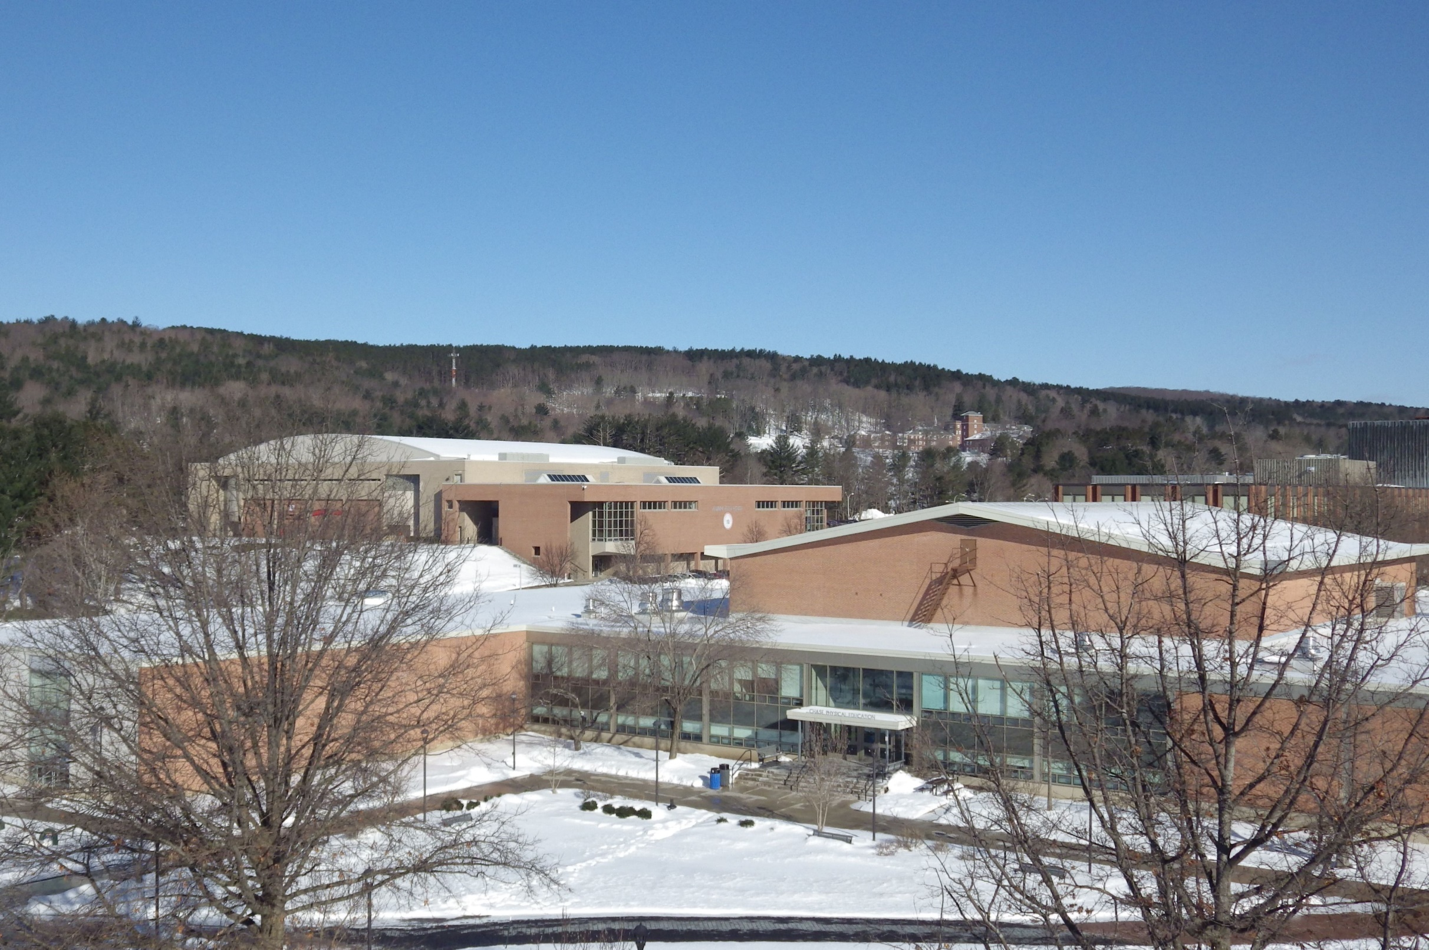
Tomorrow
42°
A chance of showers
Tomorrow Night
32°
Mostly Cloudy

Slide 11
FIVE DAY FORECAST
ONEONTA, NY WEATHER
Wed
Thu
Fri
Sat
Sun
Sunny with increasing clouds
Mostly Cloudy
Showers Likely
Rain and Snow Showers
Mostly Sunny
HIGHS
42
53
59
37
33
32
45
32
19
LOWS

