Slide 1
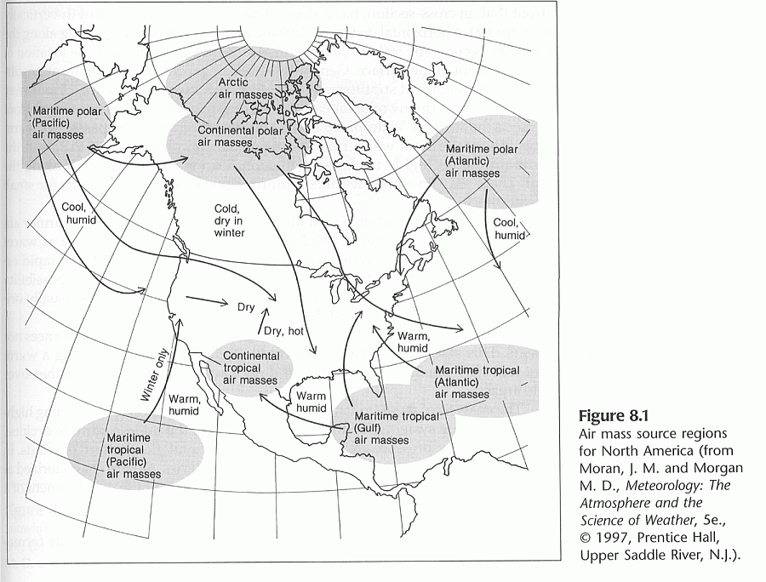

Slide 2
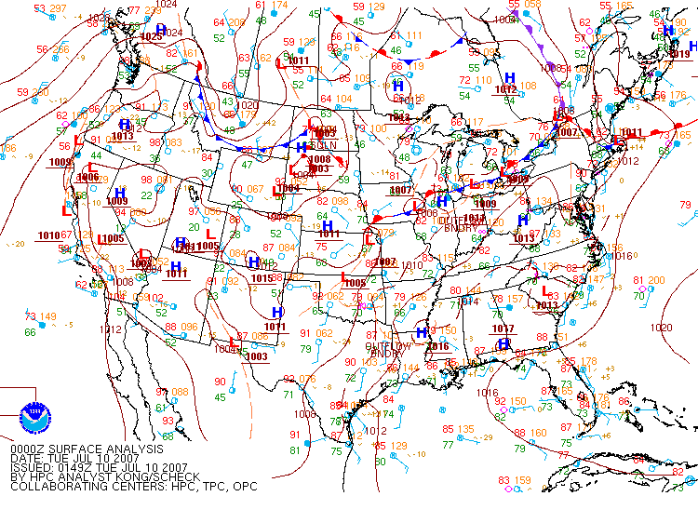
Much cooler cP air mass over the northern midwest
mT air mass over NY
Normal cT air mass over desert
Summertime Air mass example

Slide 3
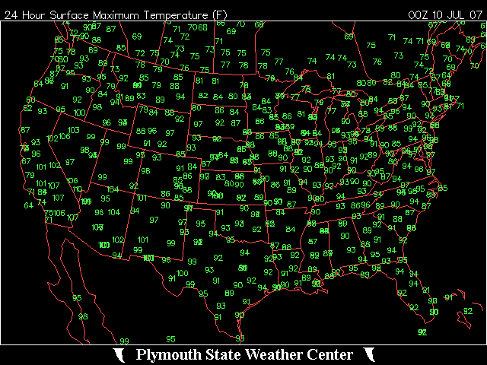

Slide 4
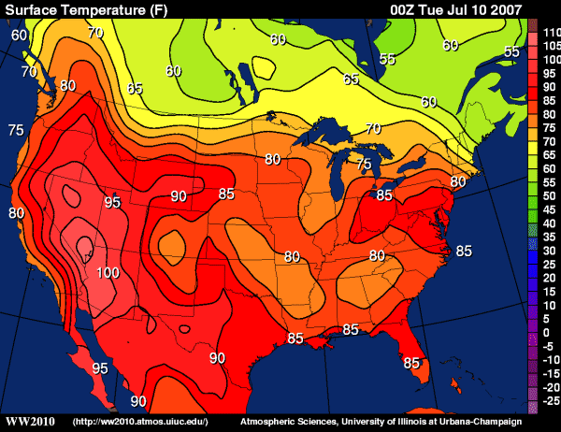

Slide 5
Soundings
Notice differences in surface T, T_{d}, tropopause height and temperature. Also, APX has a frontal inversion separating the air masses.
cP
mT

Slide 6
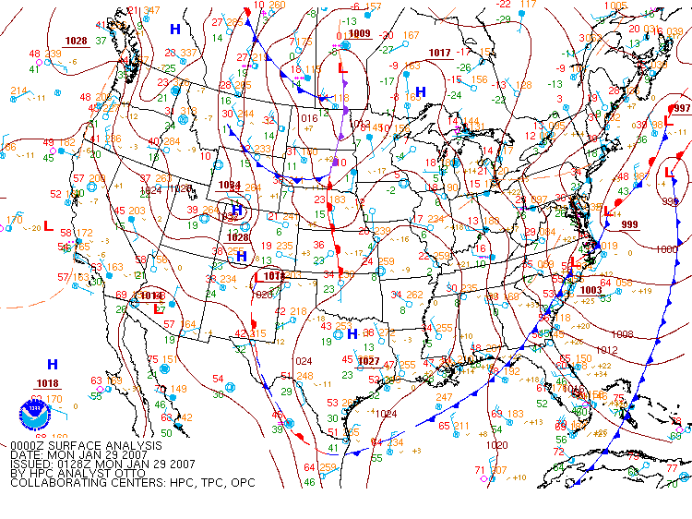
cA air mass from Canada to the Gulf coast
Despite the wind, probably still mT in south Florida
Wintertime Air mass example

Slide 7
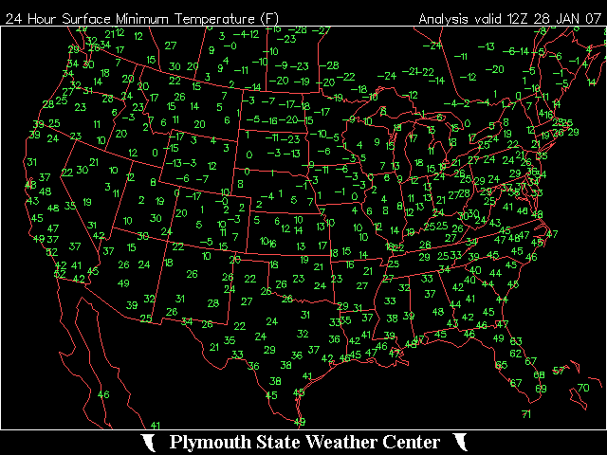

Slide 8
Soundings
Davenport, IA
Key West, FL
cA
mT

Slide 9
More Soundings
Tucson, AZ
Albany, NY
cT
mP

Slide 10
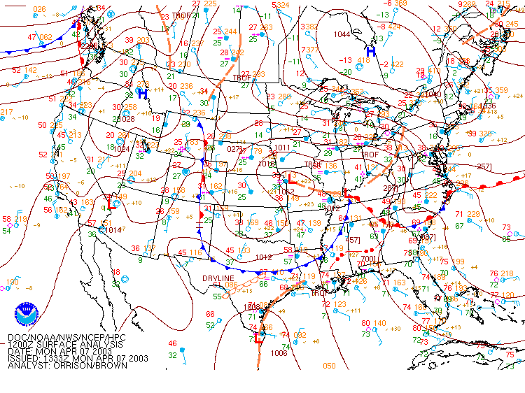
Cold Air Damming of Arctic Air Masses
(April 7, 2003)

Slide 11
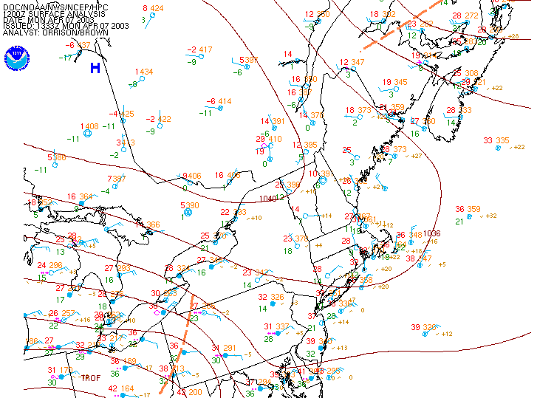
cA air mass
Northeast winds on the east side of the High

Slide 12
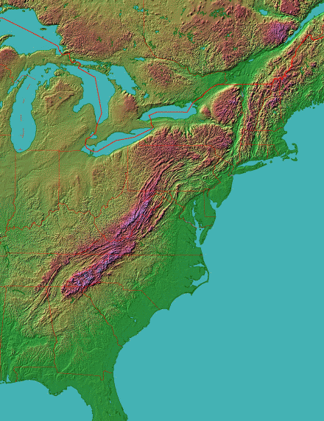
Northeast winds will drive air toward the Appalachian Mountains. That barrier is the “dam”
(map from the Johns Hopkins University Applied Physics Laboratory, fermi.jhuapl.edu/states/)

Slide 13
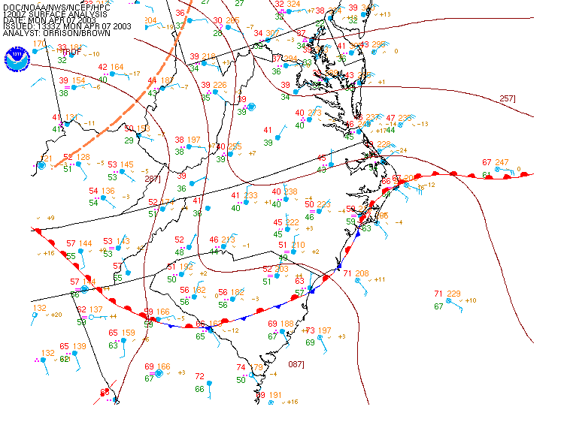
IAD
Air is “dammed” up against the mountains. The mT air to the south can’t displace it.

Slide 14
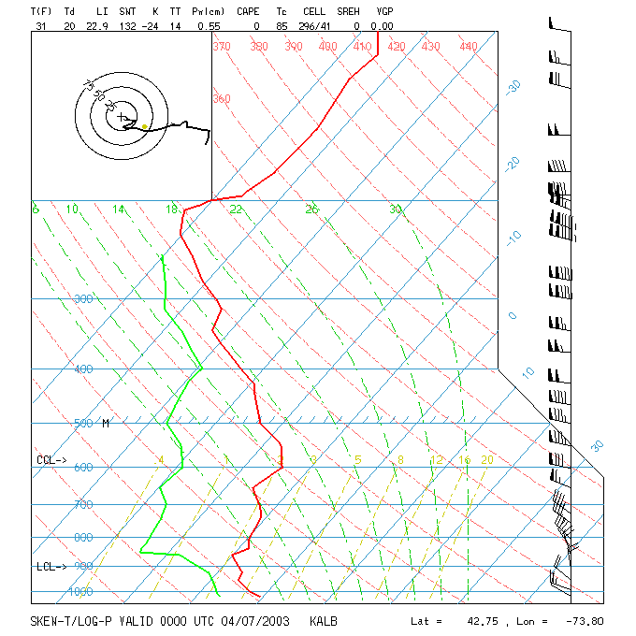
Not much happening at Albany other than the cold surface air.

Slide 15
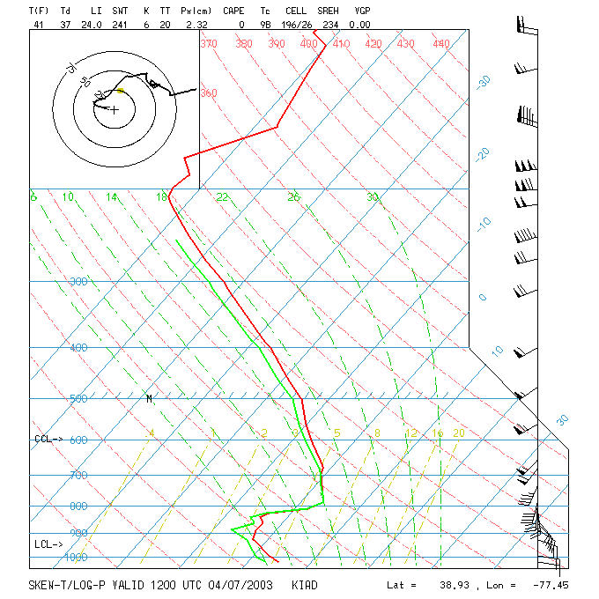
Dulles (IAD), however, shows two distinct air masses, cA from the surface to 800 mb, much warmer aloft, possibly mT)

Slide 16
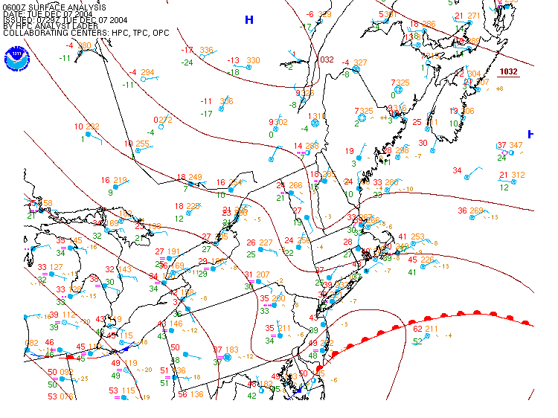
Another cold air damming case
(Dec 7, 2004)
As the air “piles up” a pressure ridge forms

Slide 17
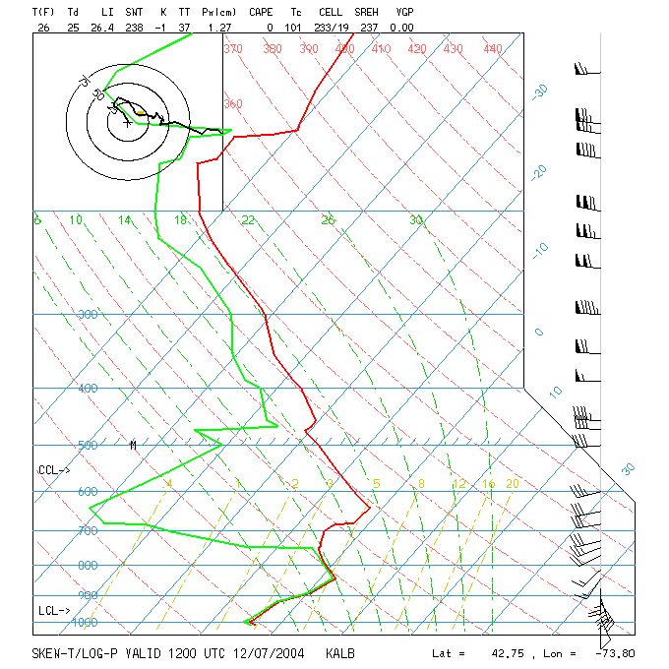
Albany is showing cold low-level temperatures with warmer temperatures aloft. The low-level winds are from the southeast.
Given this sounding, what weather do you expect at Albany? Be as specific as you can.

Slide 18
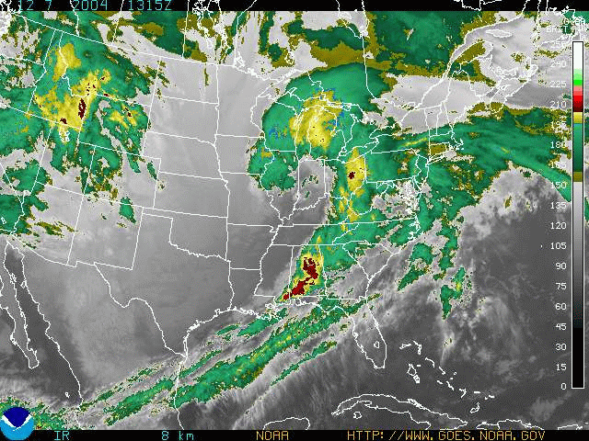
It was definitely cloudy. Here’s the IR satellite image from that morning:
Do you recognize the shape of the clouds? It’s the Norwegian Cyclone Model!

Slide 19
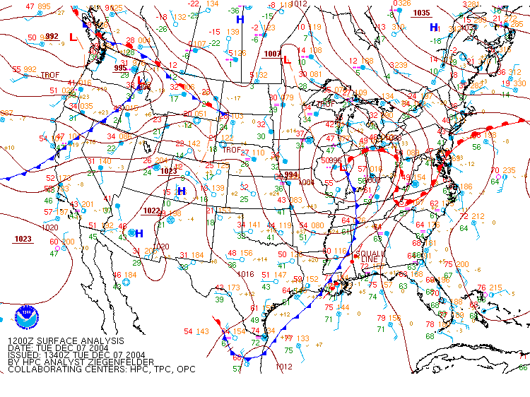
Albany is in the cold air associated with the High in Quebec. That accounts for the SE surface wind veering to west with warm air aloft.

Slide 20
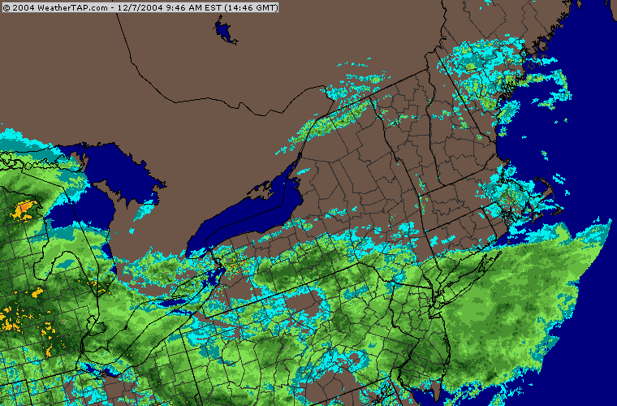
Precipitation in the ridge north of the warm front due to vertical motion over the mP air mass. This could be freezing precipitation, depending on surface conditions.

Slide 21
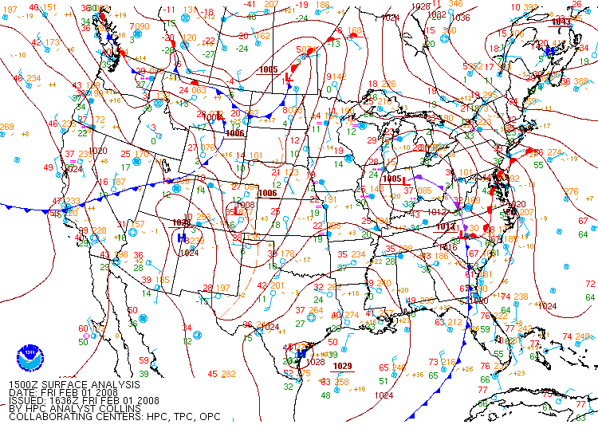
Another case. Do you think this looks like cold air damming?

Slide 22
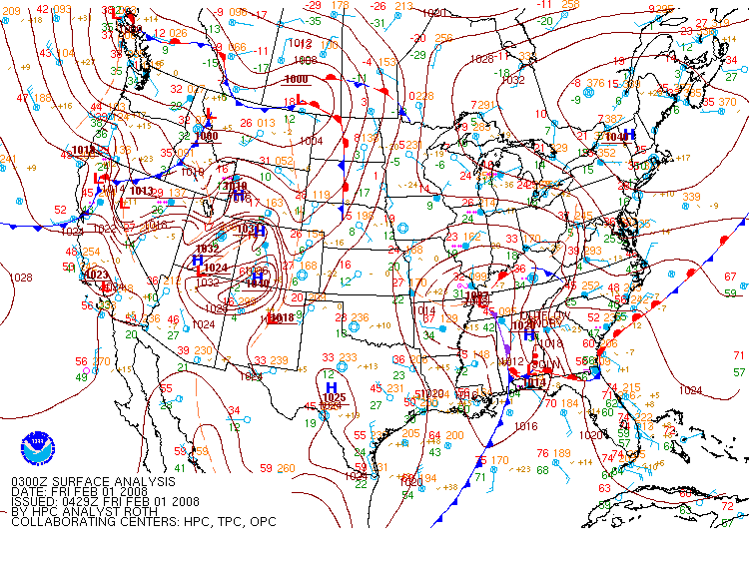
The damming occurs overnight, leaving NY and PA with low-level cold air.

Slide 23
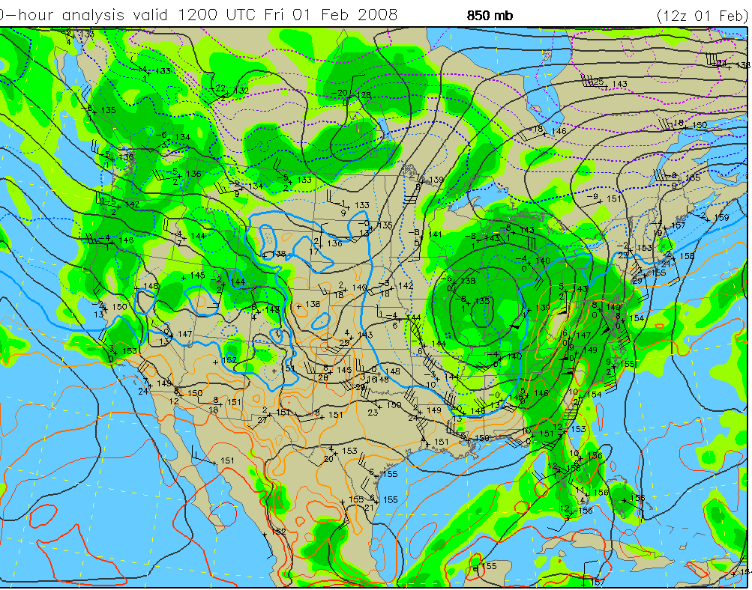
Strong warm air advection at 850 mb

Slide 24
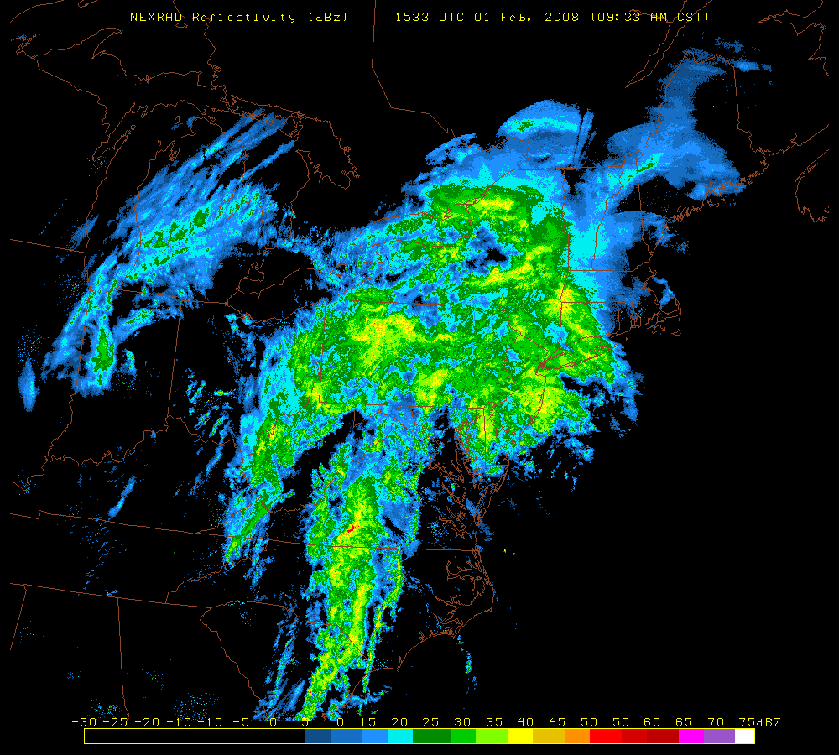
Radar

Slide 25
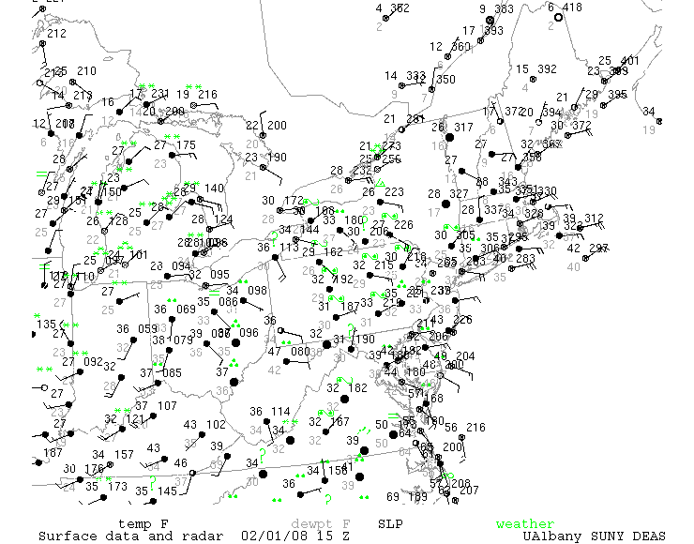
The result is a widespread area of heavy freezing rain.
Easterly winds, cold surface temperatures, warm air overrunning precipitation. This is cold-air damming.

Slide 26
Next: Guidance

