Slide 1
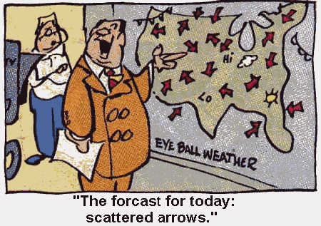
Fronts

Slide 2
Definition (Glossary of Meteorology)
Front: …generally the interface or transition zone between two air masses of different density
Air Mass: …a widespread body of air that is approximately homogeneous in its horizontal extent, particularly with reference to temperature and moisture distribution…

Slide 3
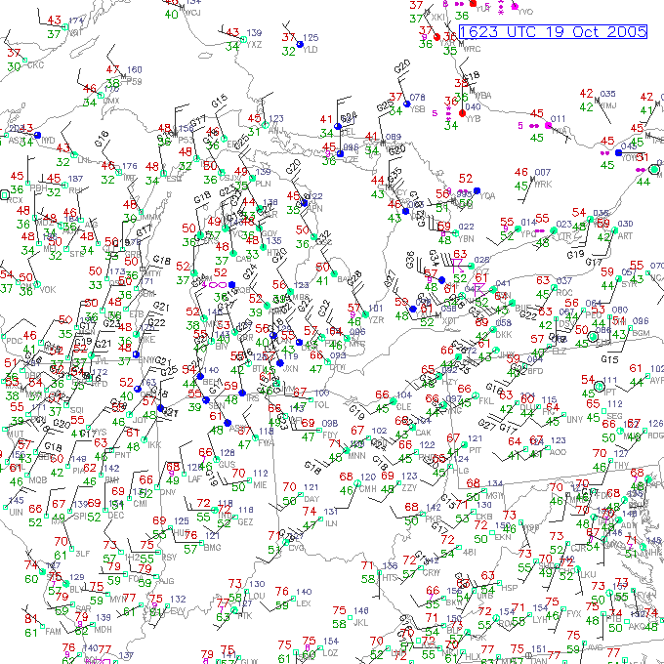
Where’s the front? (easy question)
What kind of front is on this map? (tougher question)
How can you tell from the data what kind of front it is? (really tough question – or maybe not so tough)

Slide 4
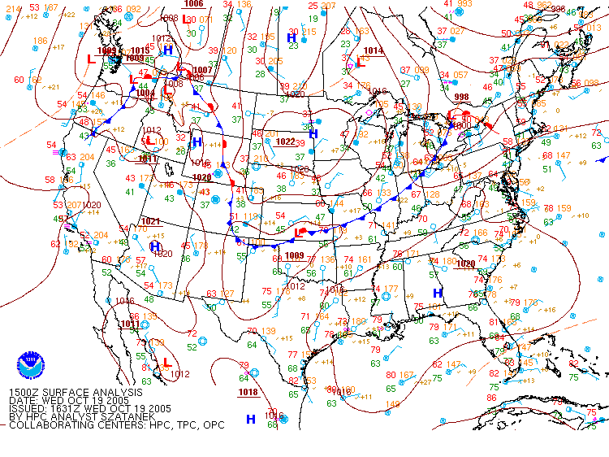

Slide 5
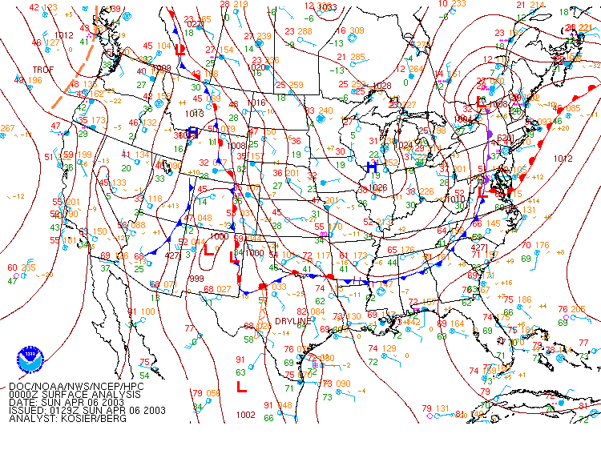
This map has every major kind of front analyzed somewhere on it.
What are the frontal types and their symbols?

Slide 6
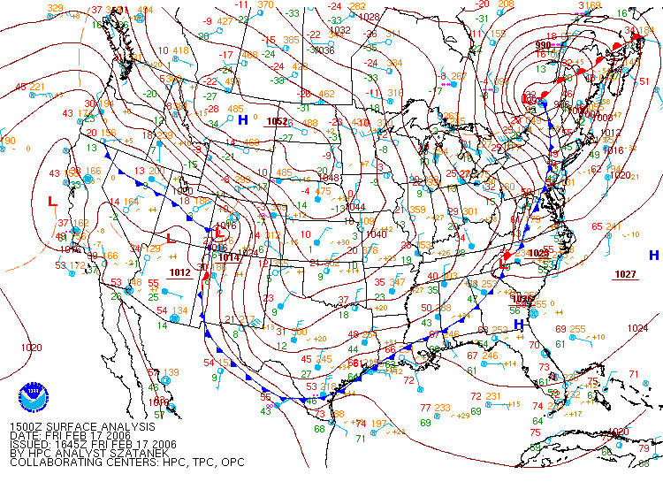
Example of a very powerful front. What makes it strong? (Use the data and the definition : a “transition zone between two air masses of different density”)

Slide 7
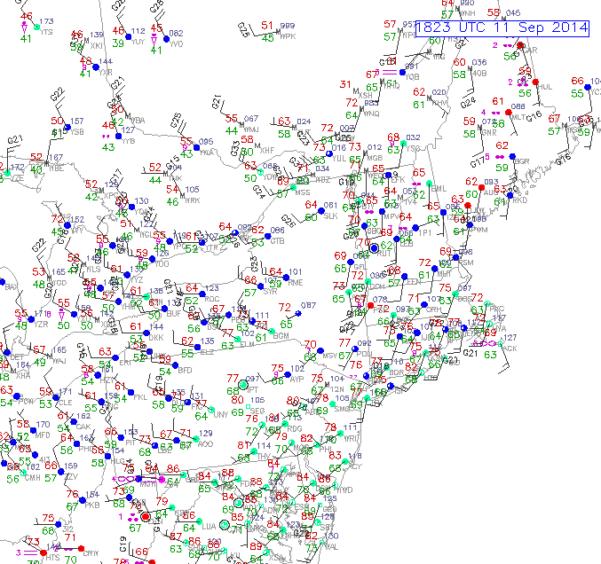
Where is the front on this one?

Slide 8
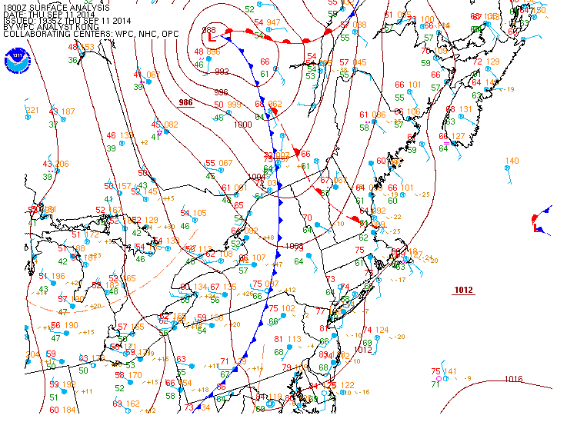
Why does this warm front have gaps?
Moderate cold front

Slide 9
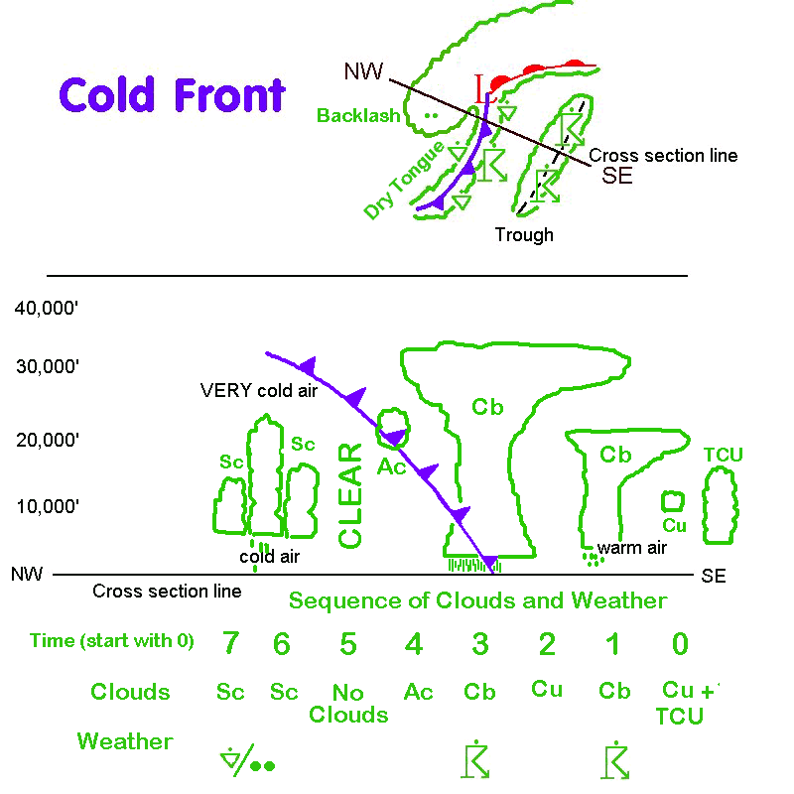
Typical symbols on a weather map. Note the cross section goes through the cold front.
Viewed along the cross section, these are typical clouds and precip types.
At a station, this is the sequence you’d expect with this cold frontal passage (front moving east to west)

Slide 10
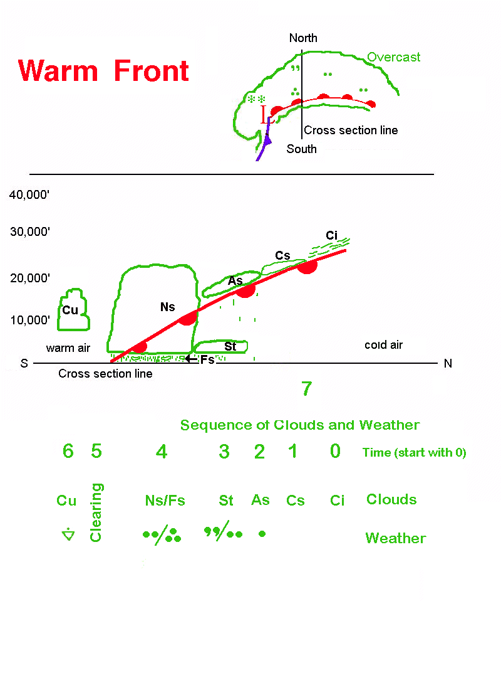
Similar to the cold front, this is a typical weather map for a warm front.
Warm front cross sections have stratoform clouds and steady precip.
Here’s a typical weather sequence if the front is moving from south to north.
(Show time lapse FromClrtoLowovcst

Slide 11
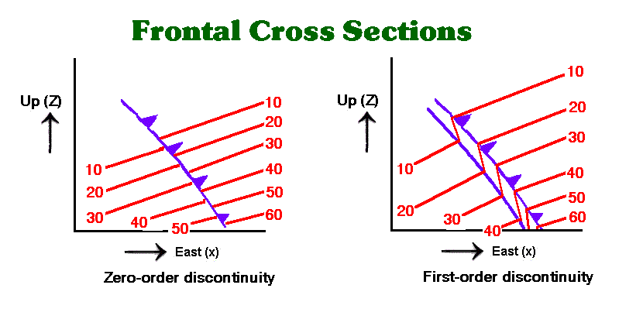
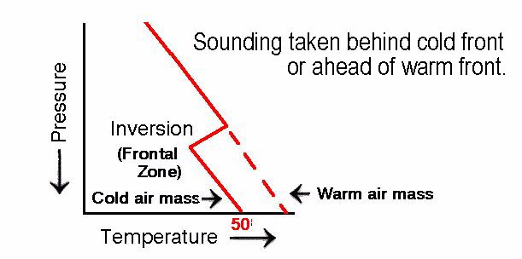
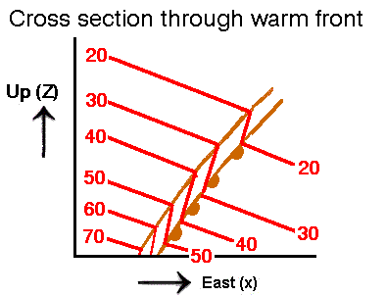
Doesn’t exist in the real atmosphere
Much more realistic

Slide 12
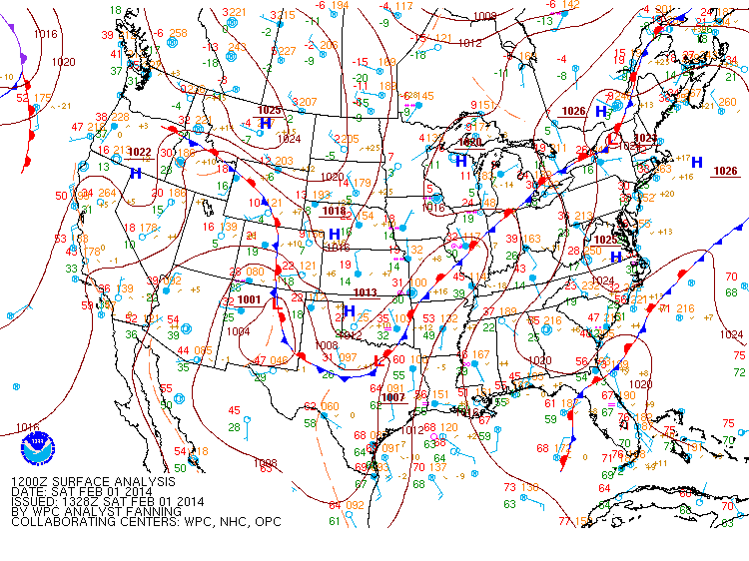
All fronts are located in troughs of low pressure. This is because of the converging winds necessary to create the air mass change.

Slide 13
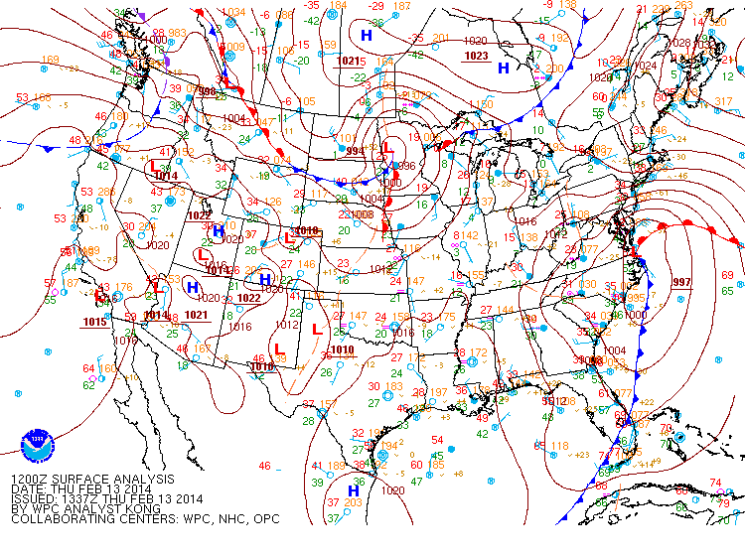
Because of their convergent winds, Lows will have fronts. Highs will not. You can have Lows without fronts and fronts without Lows.
The dashed orange lines are pressure troughs. They could become fronts if they strengthen.

Slide 14
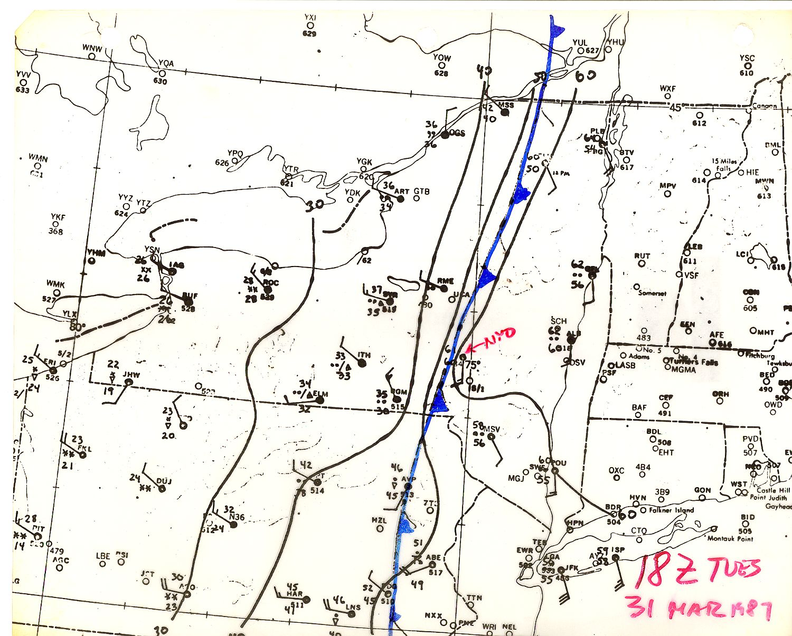
Spectacular front passes Oneonta 18Z on Mar 31, 1987.

Slide 15
Here’s the temperature drop.
At what time did that cold front reach Oneonta?

Slide 16
Dewpoint trace
Same time, of course

Slide 17
Before you see the pressure trace, what do you expect to see, given what you know now about fronts?
Rapid pressure rise after front passes
Pressure falls before front arrives

Slide 18
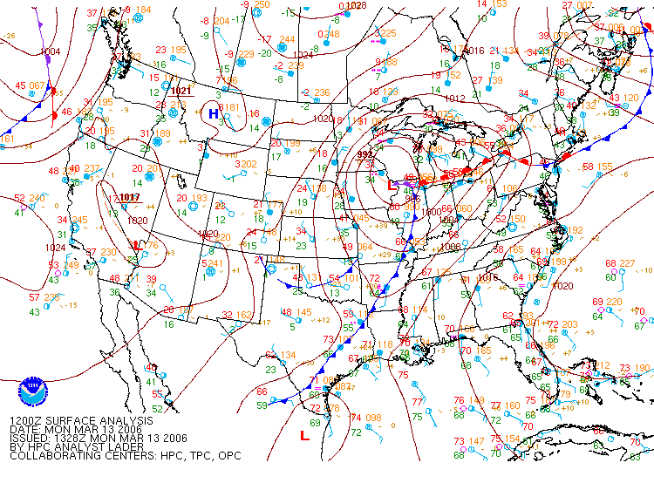
This is not as powerful a front as Mar 13, 1987. It’s typical of a strong situation.

Slide 19
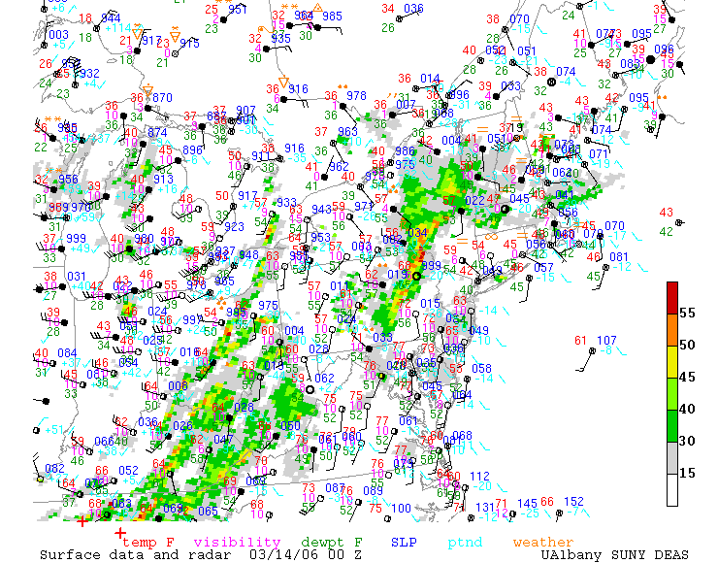
At 00Z there is a squall line preceding the front. Note the high temperatures and south winds.

Slide 20
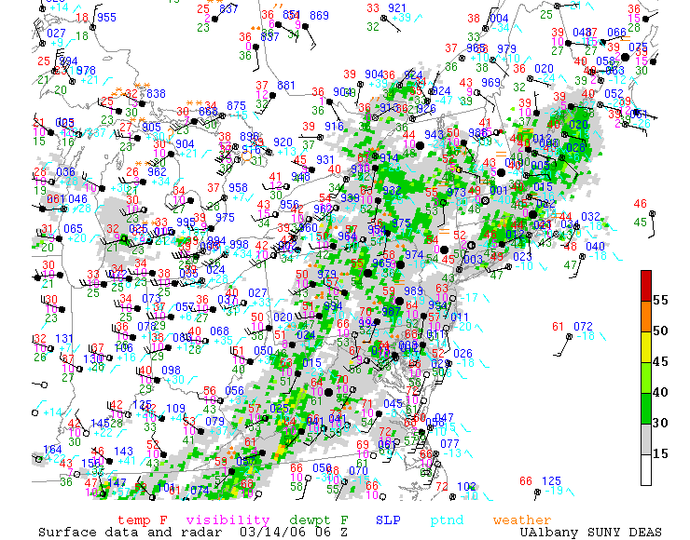
At 06Z, frontal passage is occurring in central NY with showers (on radar) but temperatures haven’t fallen yet.

Slide 21
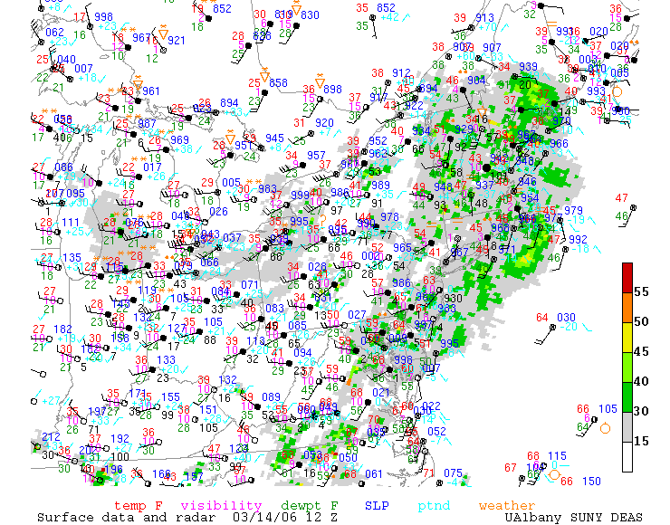
By 12Z, winds have shifted and the temperature is falling.

Slide 22
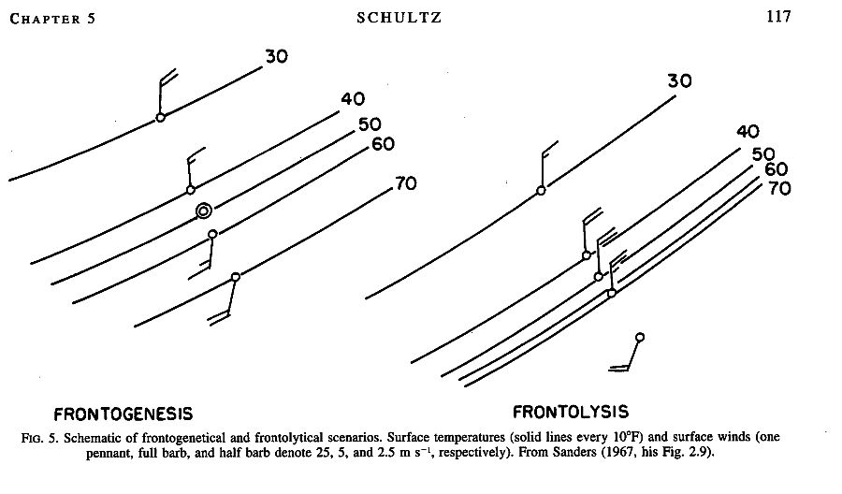

Slide 23
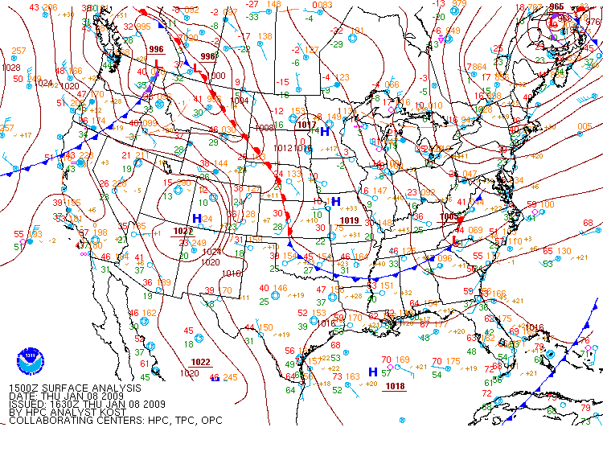
Frontolysis as the front gets near the Gulf of Mexico. Step through this.

Slide 24
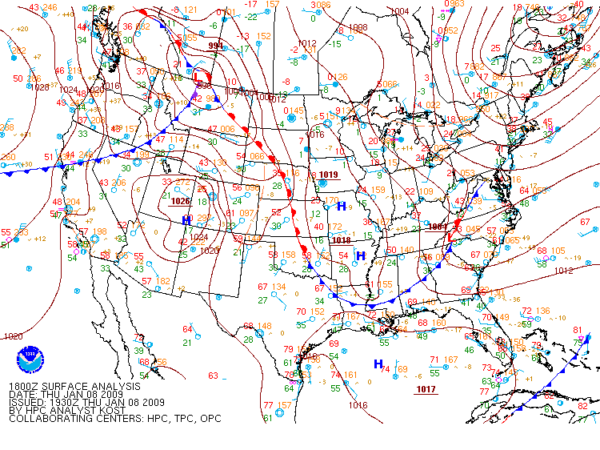

Slide 25
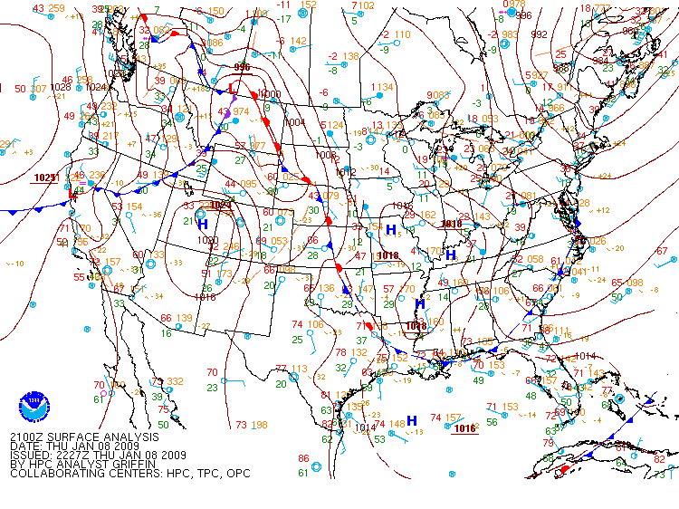

Slide 26
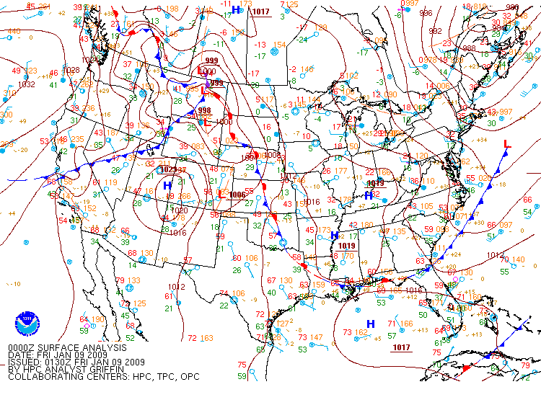

Slide 27
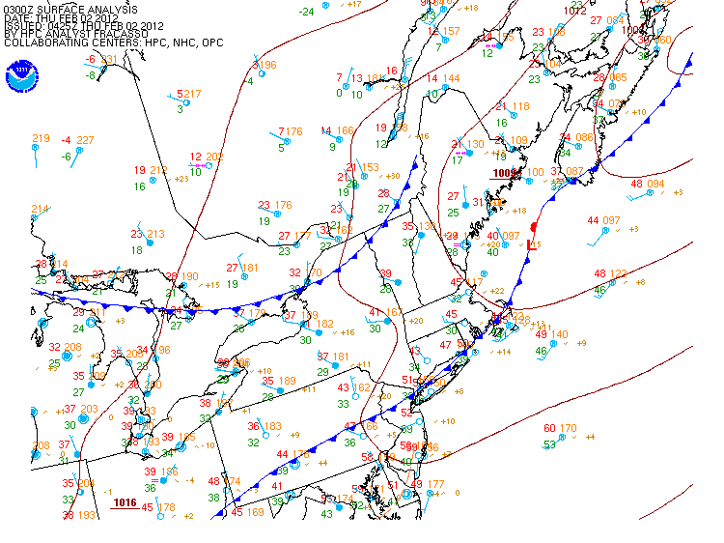
This front undergoes frontolysis and becomes a pressure trough.
The Norwegian Cyclone model didn’t account for this but it happens and has effects on the weather

Slide 28
(Based, in part, on Margules)

Slide 32
Next: Stability

