Slide 1
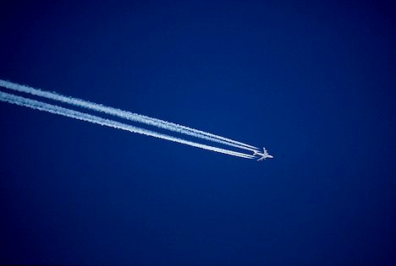
Jet Streams

Slide 2
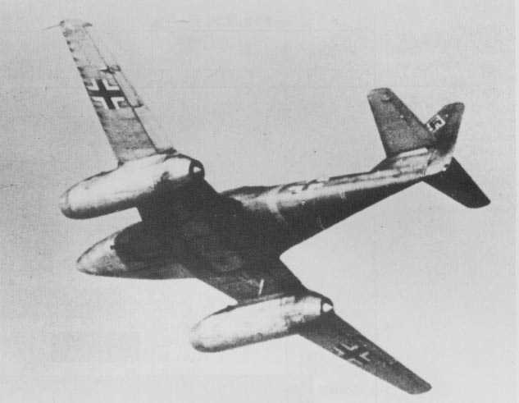
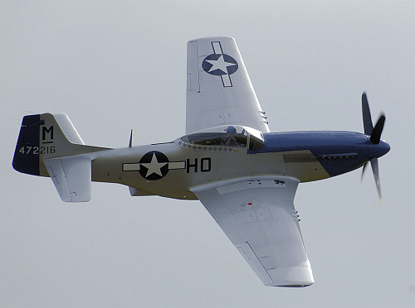
During World War II, allied pilots encountered high speed winds in the upper air. They named those winds after the fastest planes they came up against: fighters equipped with jet engines.
U.S. P-51 Mustang
Top speed: 425 mph
German Messerschmidt 262
Top speed: 540 mph

Slide 3
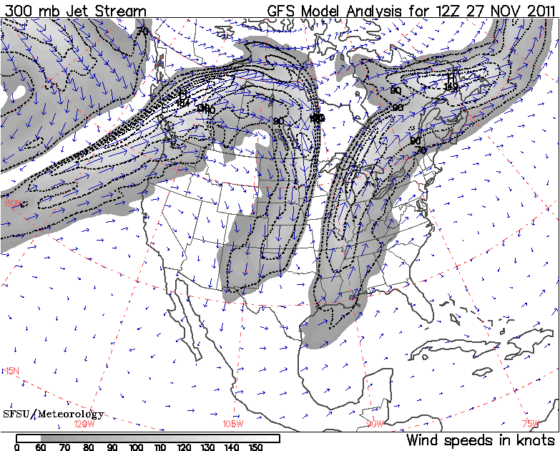
From the AMS Glossary of Meteorology (http://amsglossary.allenpress.com/glossary):
jet stream—Relatively strong winds concentrated within a narrow stream in the atmosphere.
While this term may be applied to any such stream regardless of direction (including vertical), it is coming more and more to mean only a quasi-horizontal jet stream of maximum winds embedded in the midlatitude westerlies, and concentrated in the high troposphere …

Slide 4
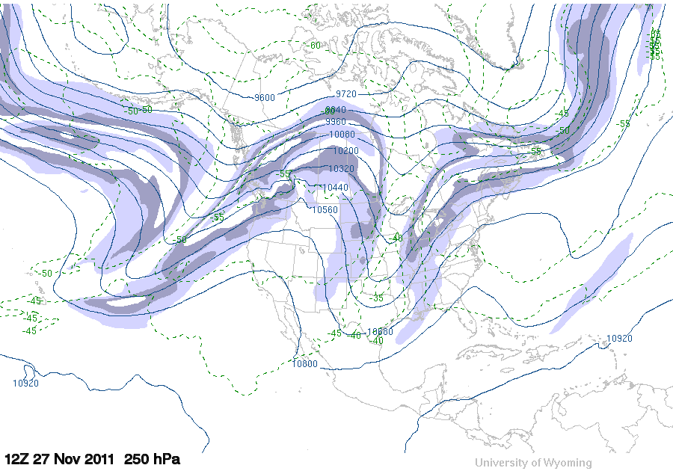
The jet stream is a localized wind maximum concentrated in a narrow area
Isotachs like these show the jet streams correctly.

Slide 5
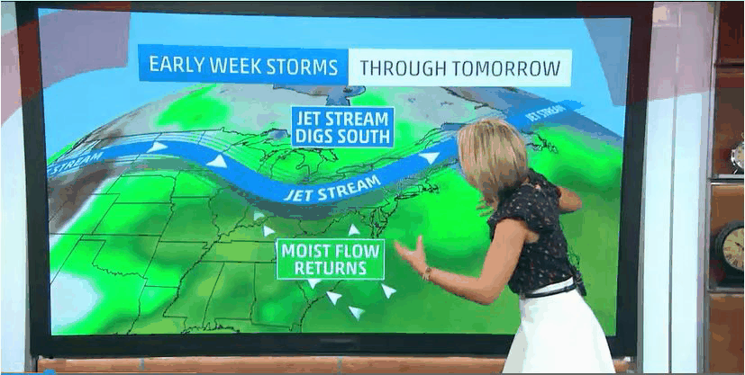
Often, the media shows the jet as an unbroken snaking line across the whole map. This is not the jet stream for that day.

Slide 6
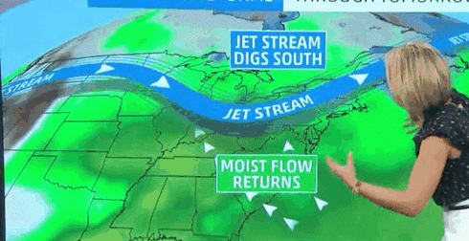
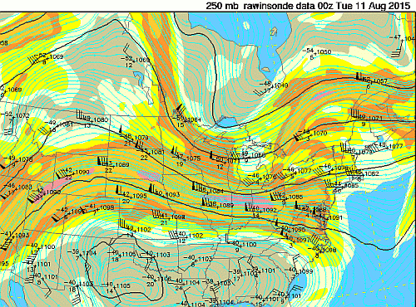
See the difference?
These continuous lines are just the height contours
Here’s the Jet (wind maximum)

Slide 7
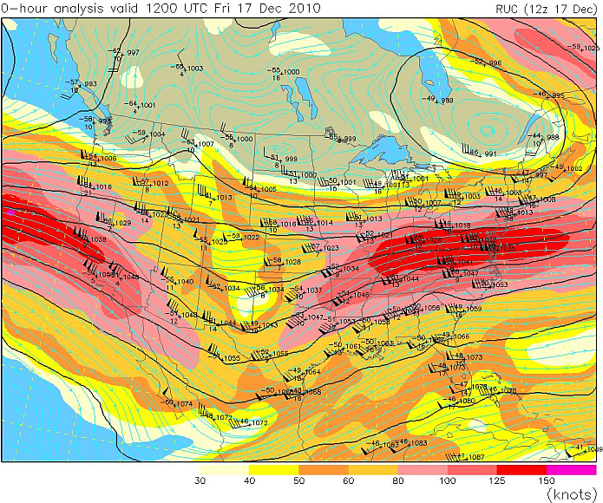
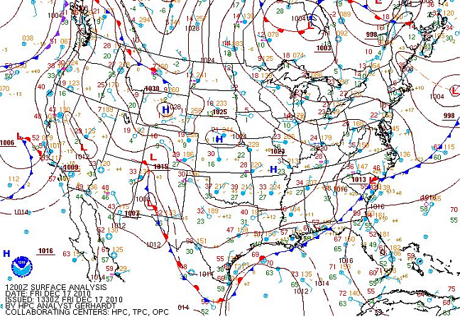
Jet stream example – Zonal flow aloft

Slide 8
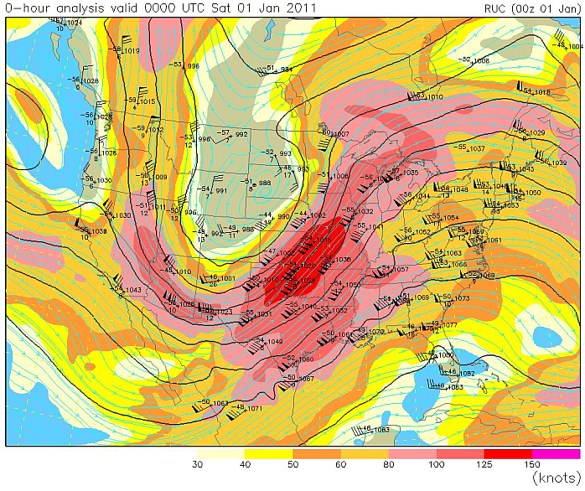
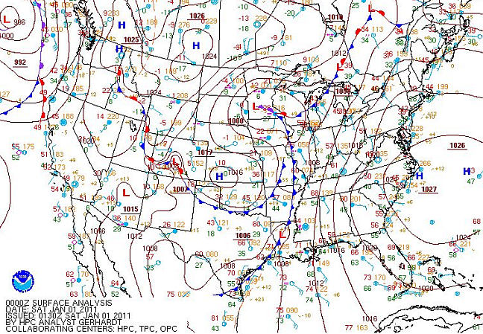
Jet stream example – Meridional flow aloft
The Jet stream is where the (meteorological) action is.

Slide 9
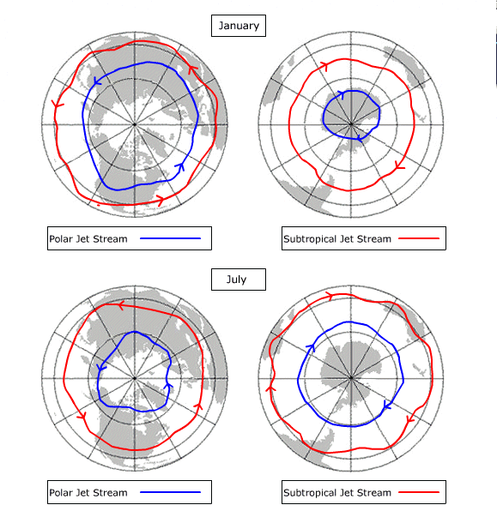
You can show a line for the mean position of the jet stream.
There are two main types of jets – the Polar Jet and the Subtropical Jet. Their average position migrates poleward during summer.

Slide 10
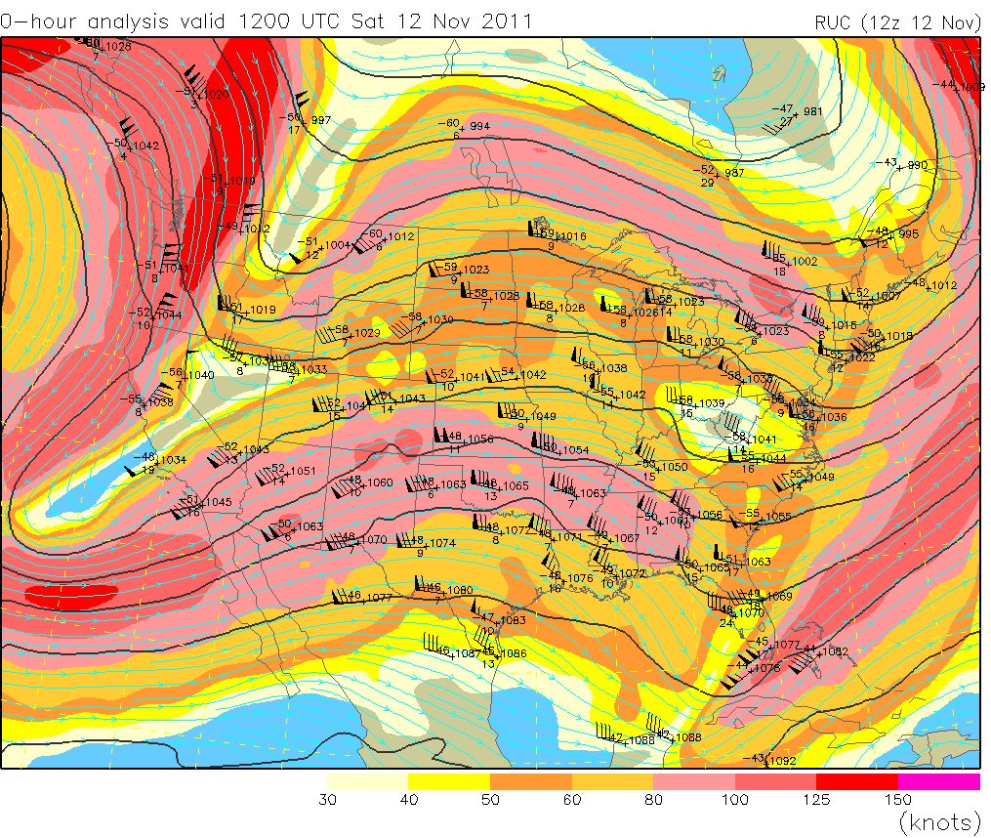
Two jets over N. America. The northern jet is Polar and the southern jet is Subtropical.

Slide 11
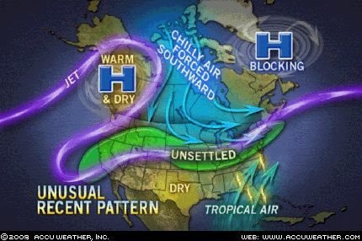
If the Accuweather folks wanted to highlight the fact that the jet was causing unsettled weather in the U.S. heartland they should not have used this purple line.
But the jet DOES separate air masses so this was at least good to show that.
Why is it “unsettled” only in one place on the purple line?
That’s something this image isn’t telling you. So what DOES it mean?

Slide 12
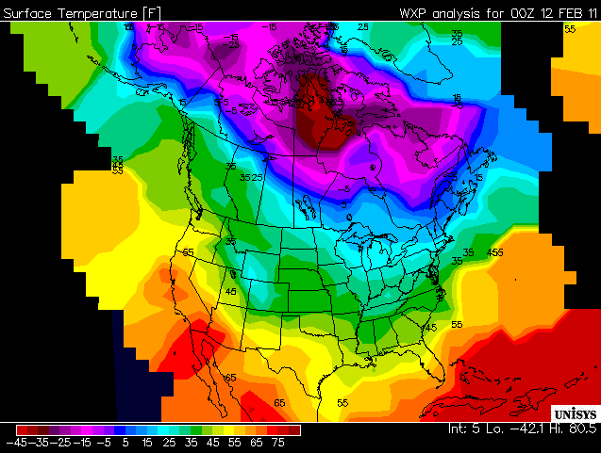
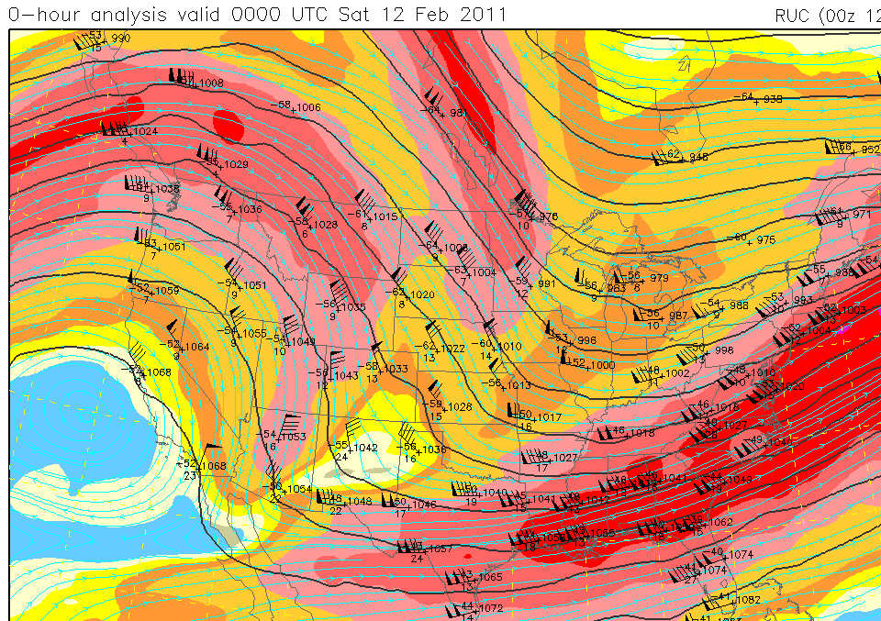
The surface temperature gradients seem to fit with the upper tropospheric jets!
How does that work?

Slide 13
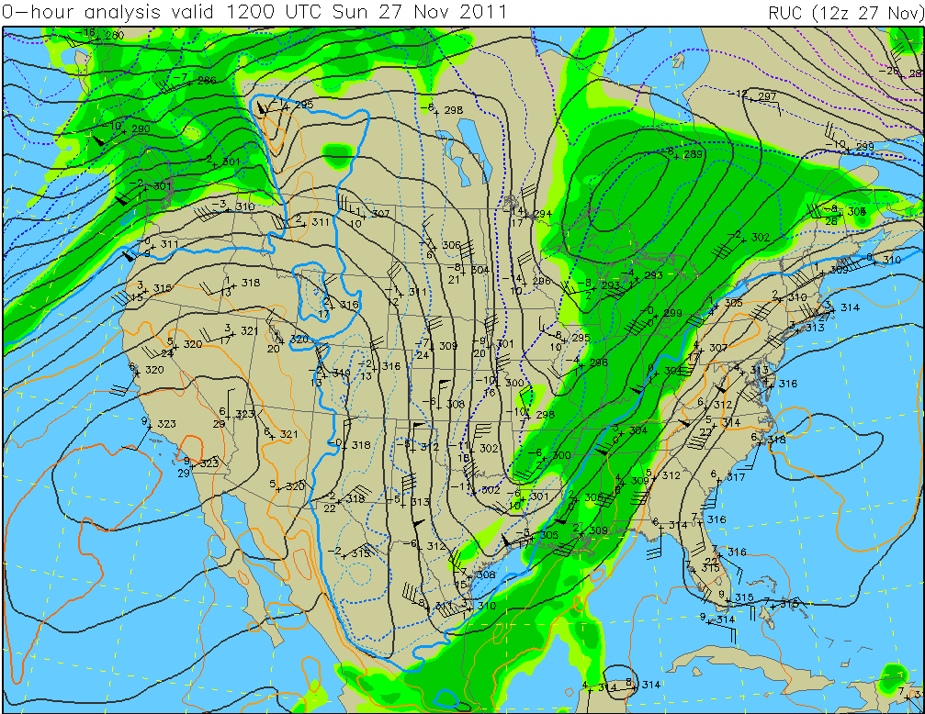
Troughs and Ridges in the upper air are cold and warm. At 700 mb you can see the isotherms show that. (Remember the hypsometric eq)

Slide 14
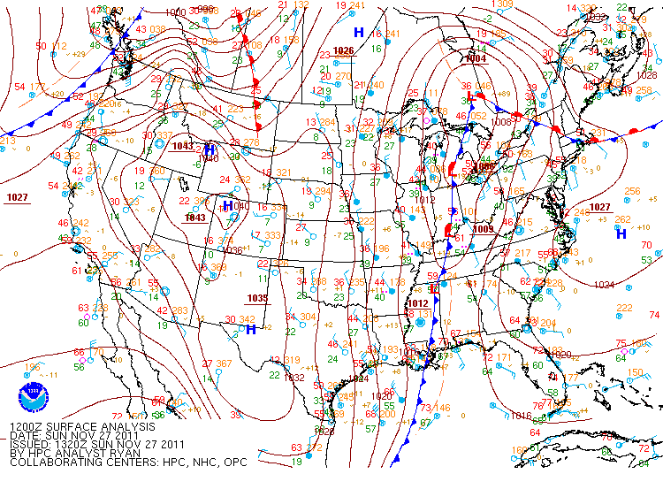
Surface temperatures match the 700 mb temperatures because the troughs and ridges are just the upward extensions of the surface features.

Slide 15
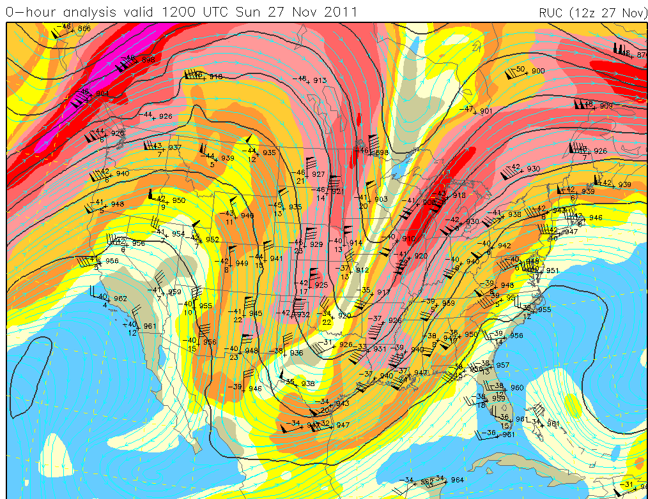
The temperature pattern goes all the way up to the tropopause.
Since ρ = P/RT,
if P is constant, the height (temperature) gradient creates a density gradient. Wind is the result.

Slide 16
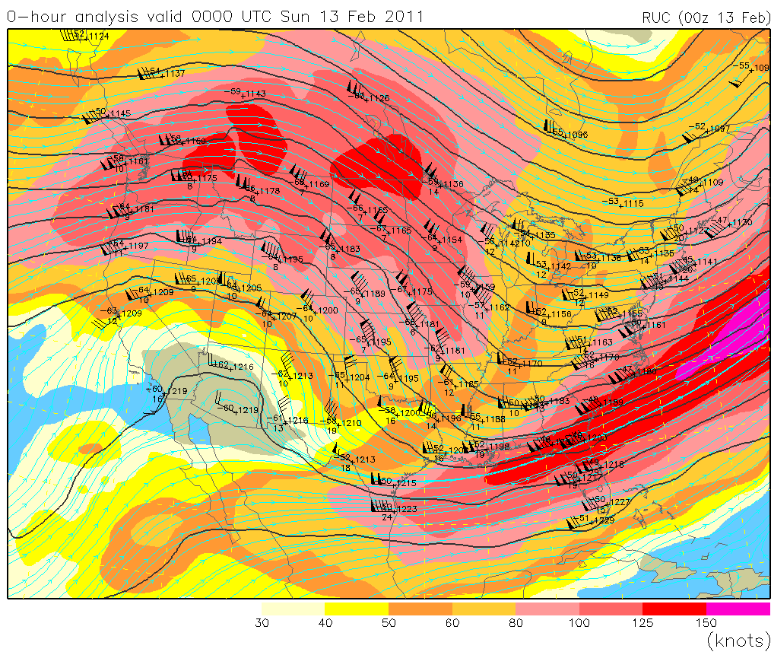
The Subtropical Jet is best seen at 200 mb

Slide 17
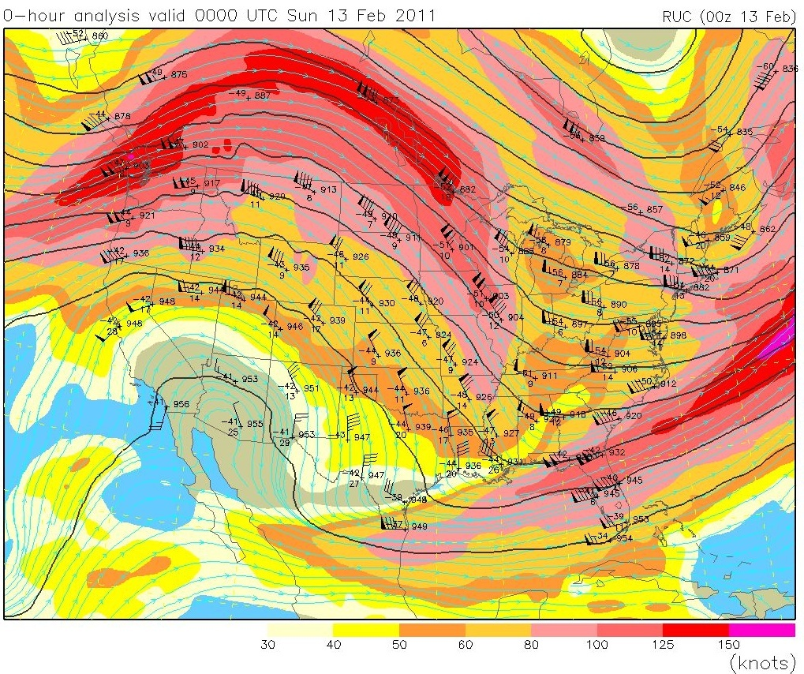
In contrast, the Polar Jet is most easily seen at a lower elevation, here at 300 mb.

Slide 18
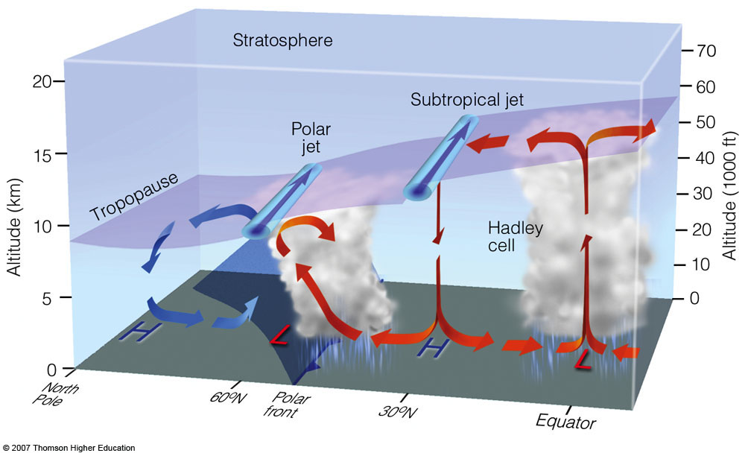
Here’s a schematic showing the relative positions of the two types of jet streams

Slide 19
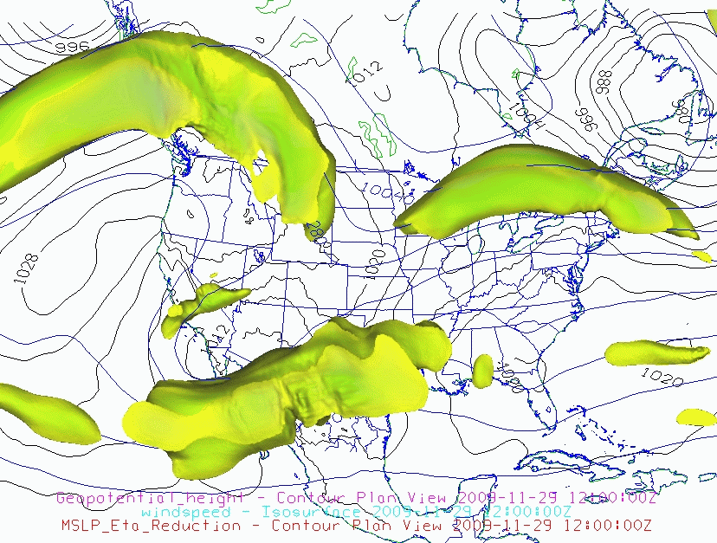
Jet Streams are Three-Dimensional
Polar Jet Streams
Subtropical Jet Stream

Slide 21
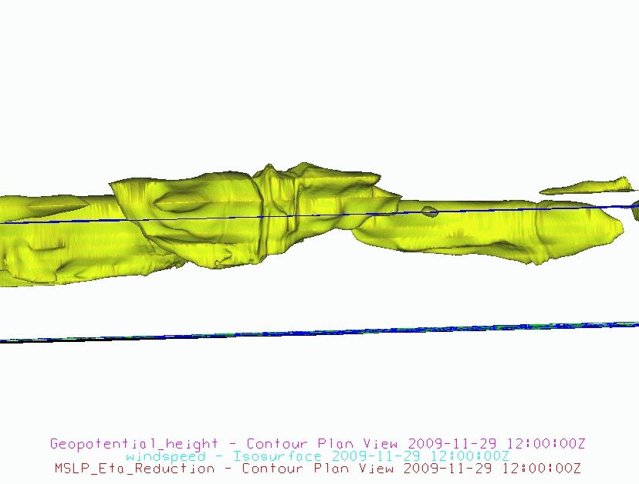
The Subtropical Jet is a little higher in elevation due to the larger Thickness in a warmer part of the atmosphere (that’s why we look for it at 200 mb, while we look for the Polar Jet at 300 mb)

Slide 22
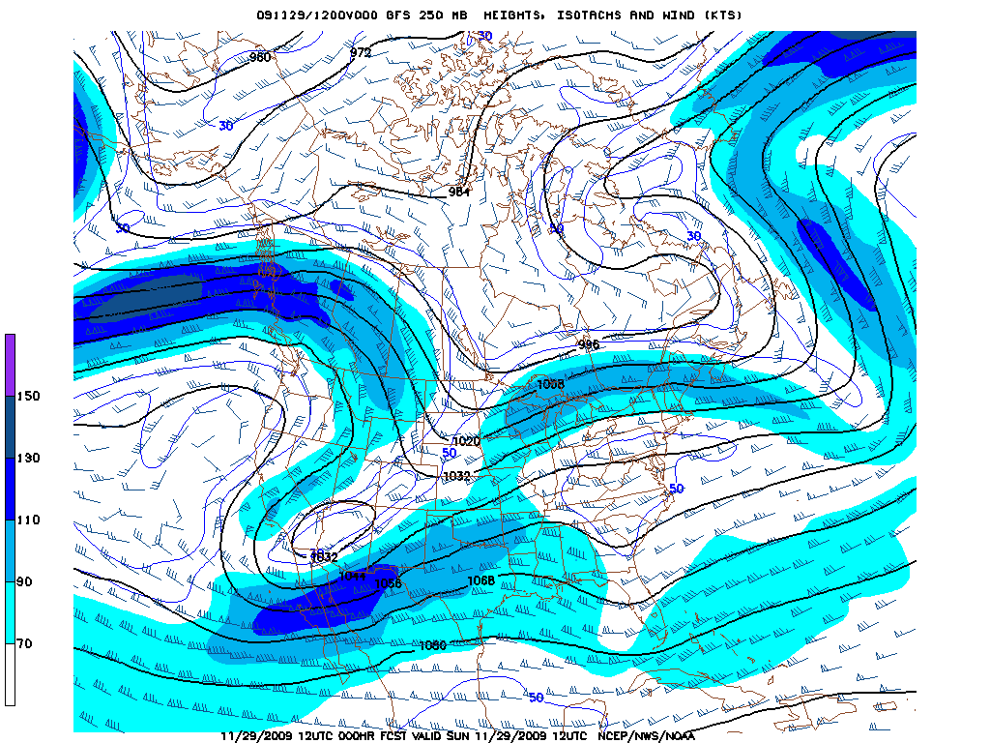
A more conventional view of the same jet streams. 250 mb is a compromise level which shows some of all upper tropospheric jets.

Slide 23
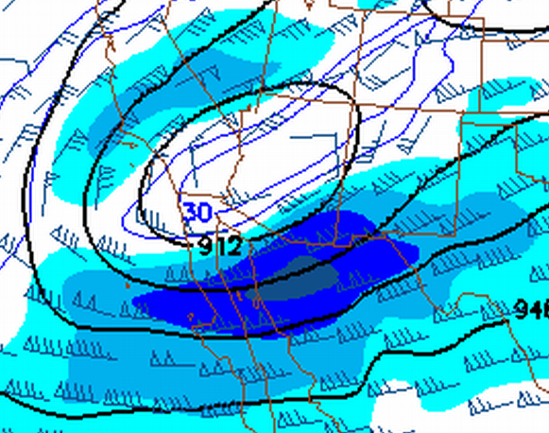
J
The maximum wind in a Jet Stream is called the Jet Streak

Slide 24
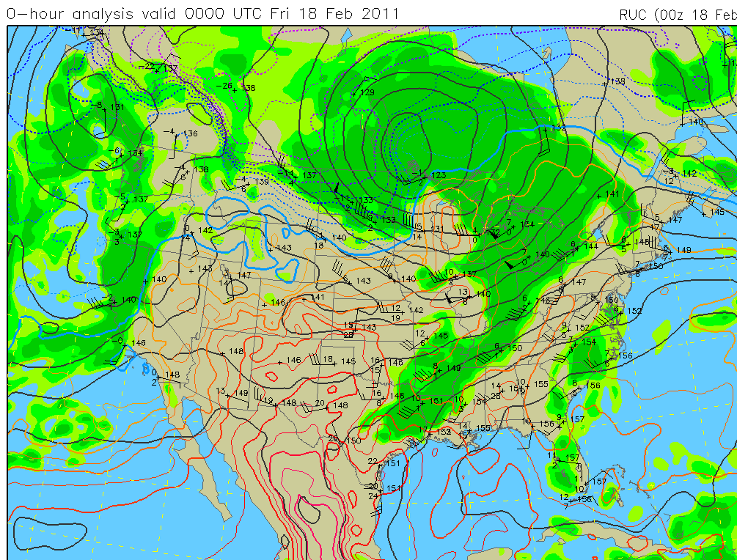
The main part of the definition of a jet (“relatively strong winds concentrated within a narrow stream in the atmosphere”) does not require that the jet be in the upper troposphere.
LLJ
LLJ
LLJ
When it is in the lower troposphere (850 mb), it is a Low Level Jet. 50 knots is usually a good value to use to identify the LLJ but don’t get hung up on it.

Slide 25
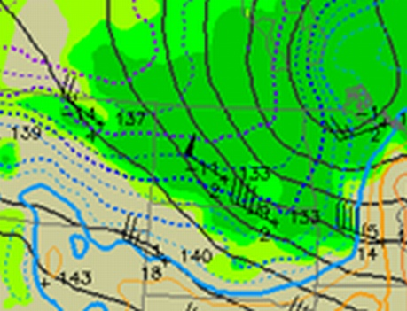
If the cold advection is occurring, it’s a descending Jet
If the descending Jet is at 850 mb, some of that momentum will reach the ground. This calls for a high-wind forecast.

Slide 26
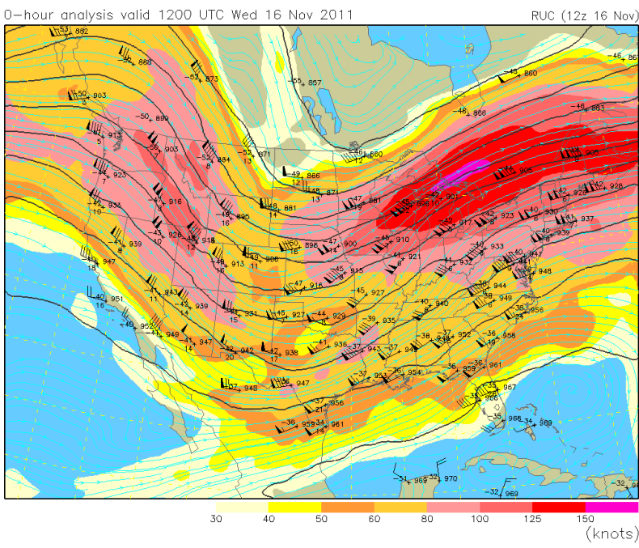
KGRB
Jets create PVA/NVA

Slide 27
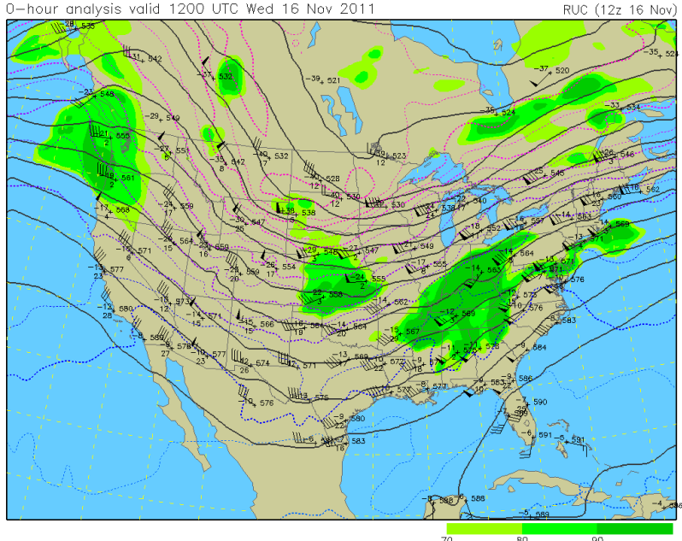
Here is the 500 mb jet streak at KGRB

Slide 28
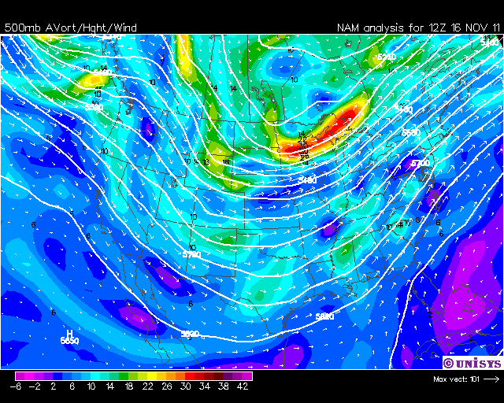
vortmax
J
vortmin
On either side of the jet streak, there is a maximum and a minimum of vorticity.

Slide 29
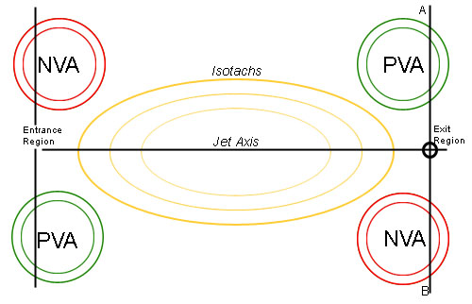
With wind blowing from Entrance to Exit regions, the vorticity is being advected so you get areas of PVA and NVA in this pattern:
Vorticity maximum
Vorticity minimum

Slide 30
Geostrophic and Ageostrophic wind
Departures from Geostrophic are highly exaggerated

Slide 31
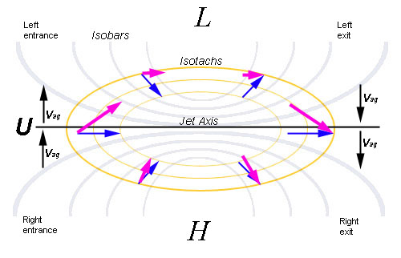
Another view
V (total wind)
V (total wind)
V_{ag}
V_{ag}
V_{g}
V_{g}

Slide 32
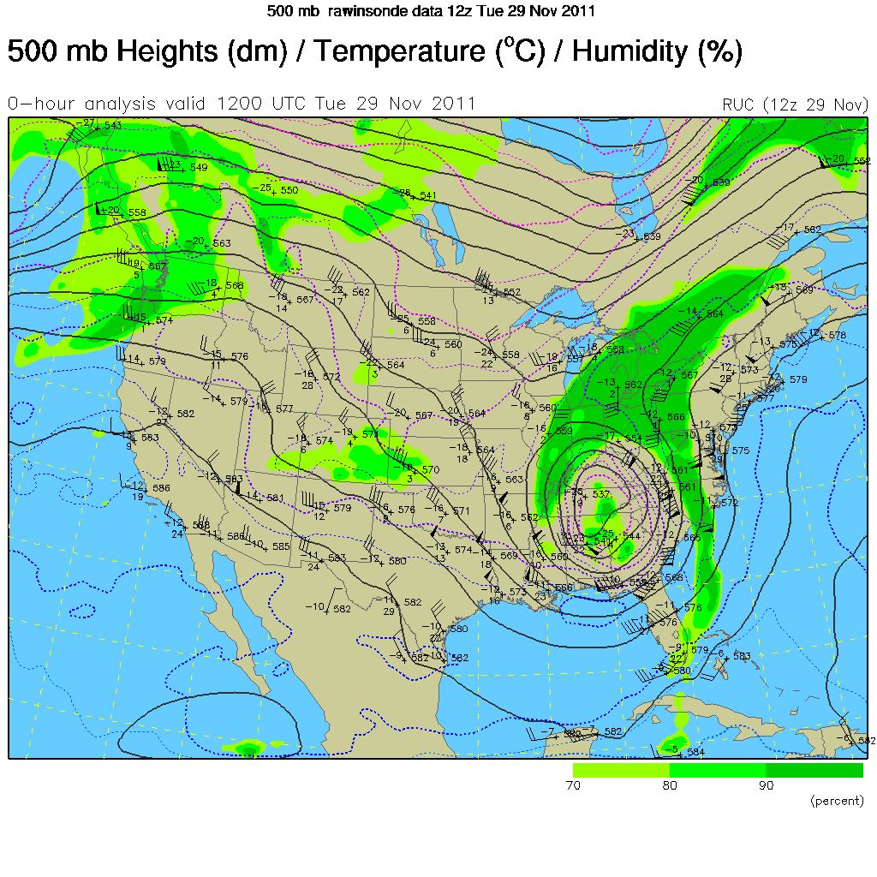

Slide 33
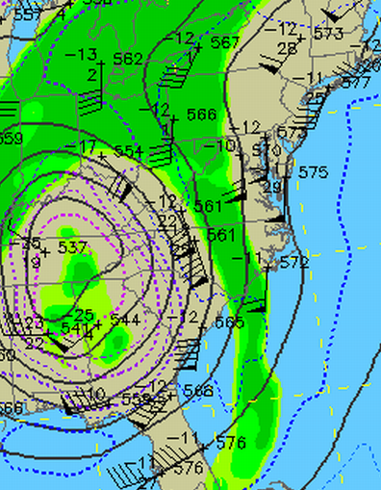
Exit region
Winds cross the height lines! Geostrophic winds shouldn’t do that. So these have an ageostrophic component.
Entrance region

Slide 34
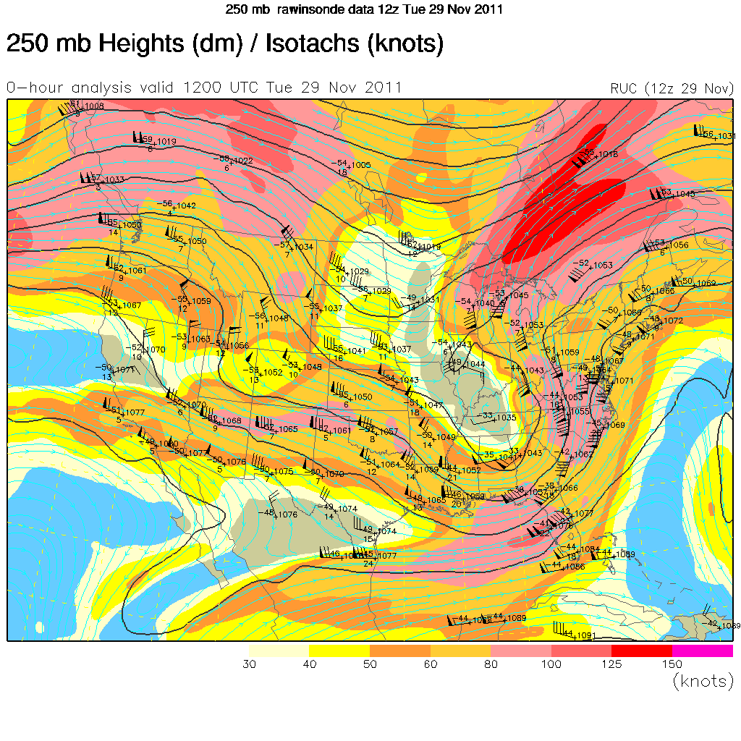
Notice how the streamlines cross the height lines
V_{ag}
V_{ag}

Slide 35
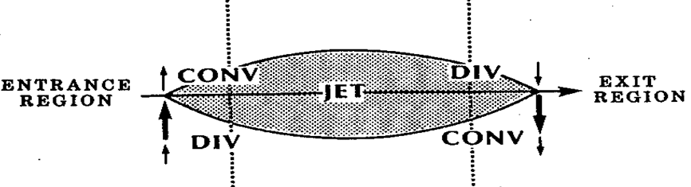
So, where you have NVA there is Convergence. Where you have PVA there is Divergence.
Convergence at the top of the troposphere means downward vertical motion. Divergence at the top of the troposphere means upward vertical motion.
NVA
PVA
PVA
NVA

Slide 36
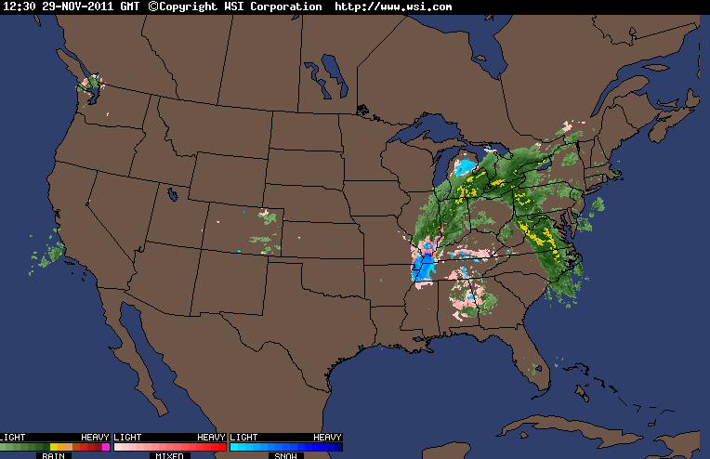
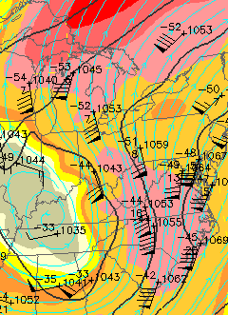
NVA
PVA
NVA
PVA
NVA
PVA

Slide 37
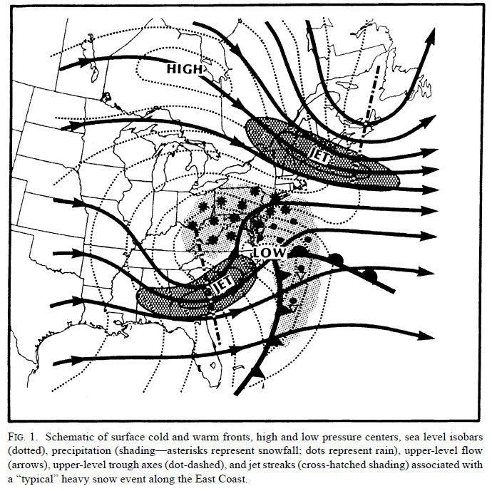
From Uccelini and Kocin (1987) The interaction of jet streak circulations during heavy snow events along the east coast of the United States. Wea. Forecasting, 2, 289-308

Slide 38
Three-dimensional schematic of jet-related circulation patterns during East Coast snowstorms. The
transverse circulations are associated with diffluent exit and confluent entrance regions of jet streaks embedded,
respectively, at the base of troughs moving across the Ohio and Tennessee valleys and across southeastern
Canada. Surface low and high pressure systems, isobars, and frontal positions are also indicated.

Slide 39
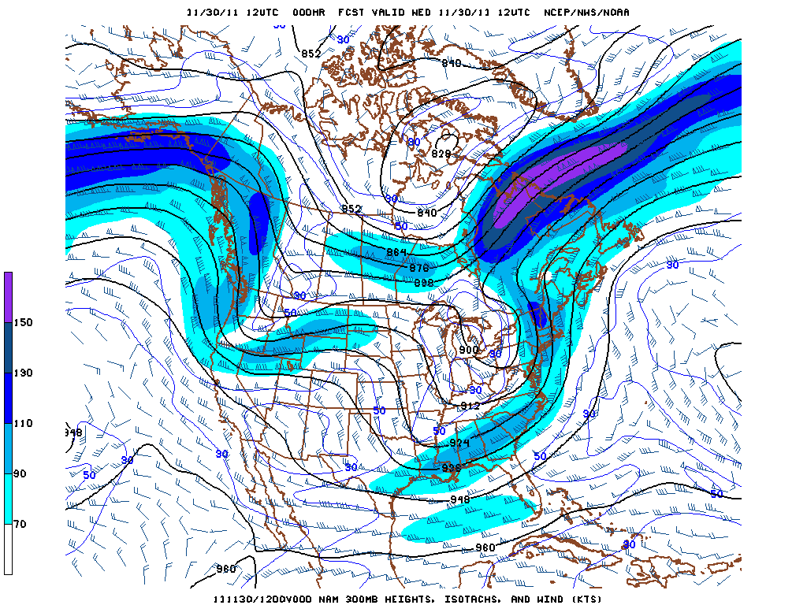
The jet streams will also change the pattern itself.
V_{ag}
V_{ag}
Run Nov29300mbLoop

Slide 40
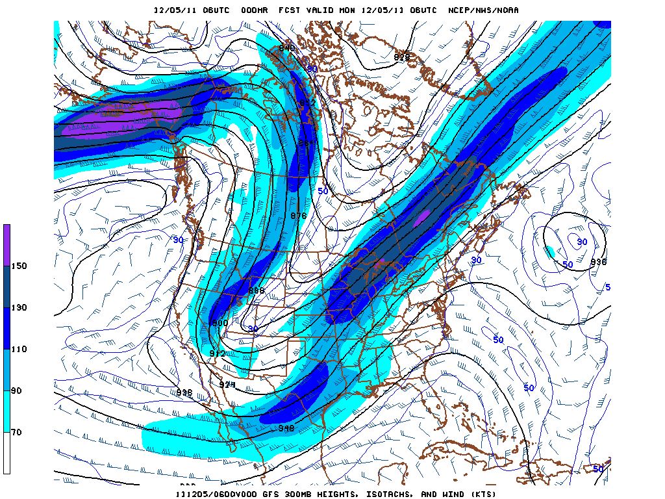
GFS 300 mb forecast, initialized 06Z Dec 5, 2011

Slide 41
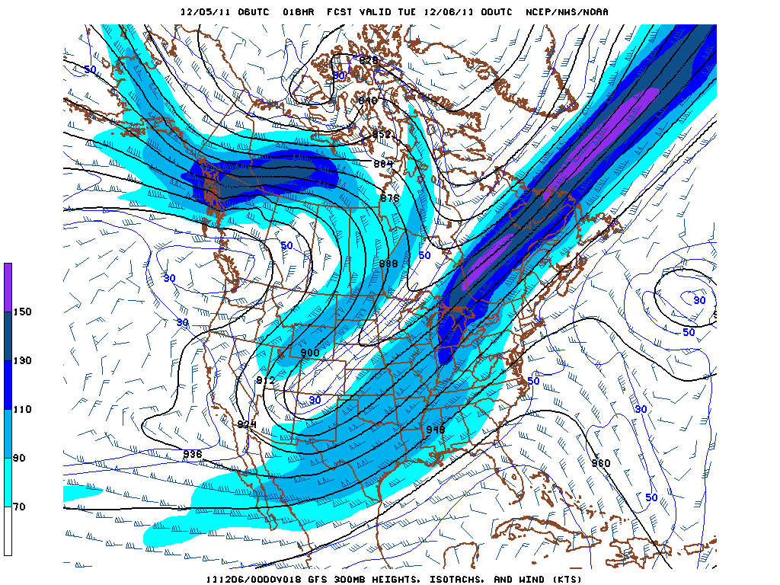
18 hour forecast
V_{ag} in Exit Region
V_{ag} in Entrance Region

Slide 42
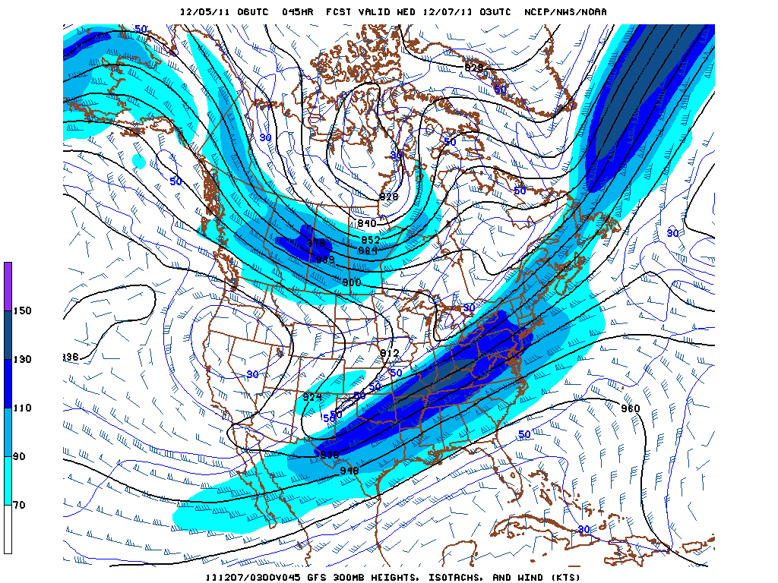
Changes in the trough due to Ageostrophic airflow

Slide 43
Summary of Jet Stream Effects
1. Jet streams are areas of relatively high-speed winds. They occur where PGF is enhanced by different air densities resulting from temperature gradients (fronts)
2. Jets create vorticity maximum and minima through horizontal wind shear. It follows that PVA and NVA occur upstream and downstream of both max and min.
3. Air in the entrance region is accelerated into the Jet. Air in the exit region is decelerated. This leads to ageostrophic motions across the entrance and exit region. Upper air convergence in left entrance and right exit regions leads to downward vertical motion. Upper air divergence in right entrance and left exit regions leads to upward vertical motion.
4. Since air flows across the isoheights, the convergence areas gain air parcels leading to height rises (ridging). The divergence areas lose air parcels, leading to height falls (troughing).

