Slide 1
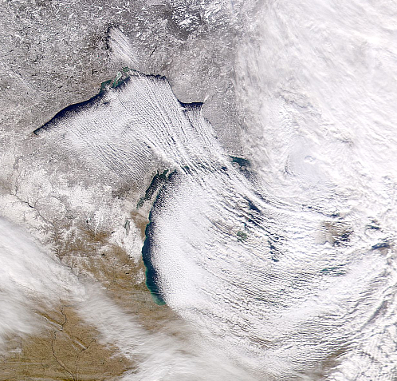
Lake Effect
December 5, 2000

Slide 2
From a presentation by Greg Byrd (COMET program and former SUNY-Oneonta professor)

Slide 3
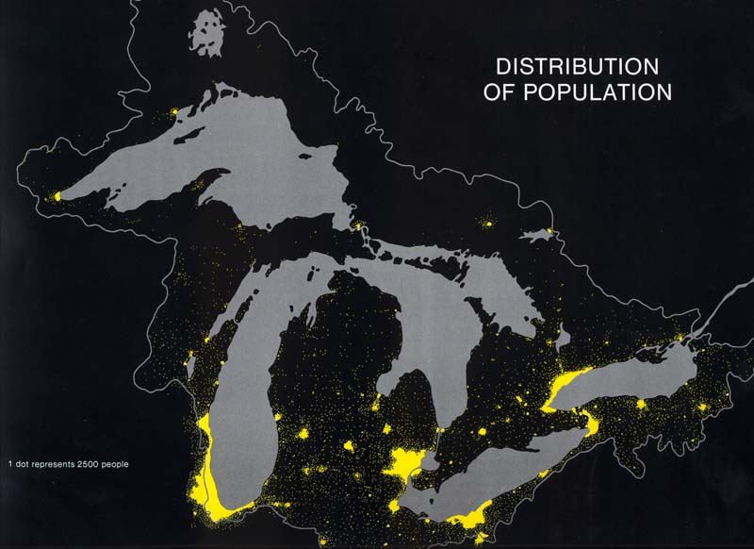
Considering the number of people living on or near the Great Lakes, it is obvious that meteorologists must understand how lake effect happens.

Slide 4
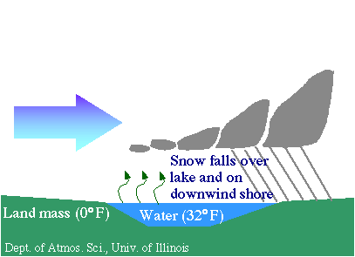
A Very basic schematic on the mechanics of lake effect snow.

Slide 5
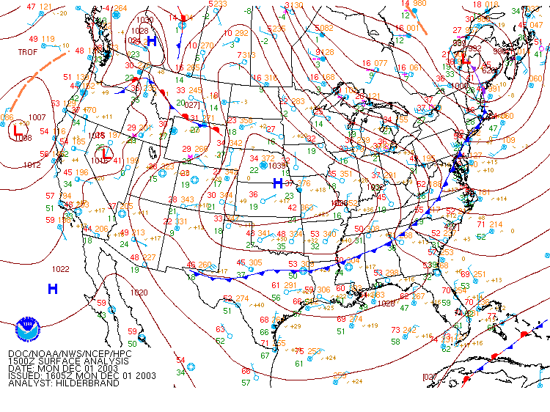
Lake Effect starts once the storm has passed. Look between the Low and the incoming cold High.

Slide 6
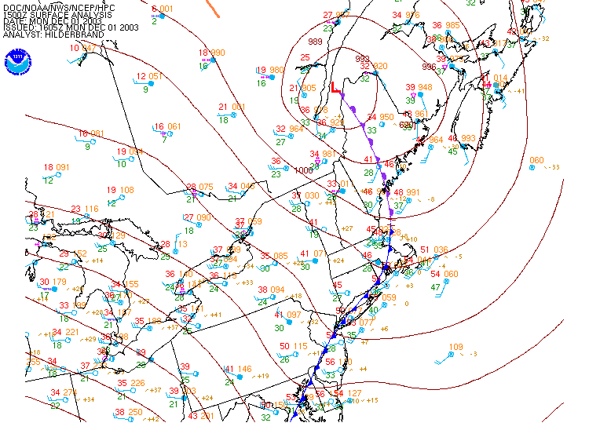
Necessary conditions include cold air temperatures and winds flowing over the warmer lake(s).

Slide 7
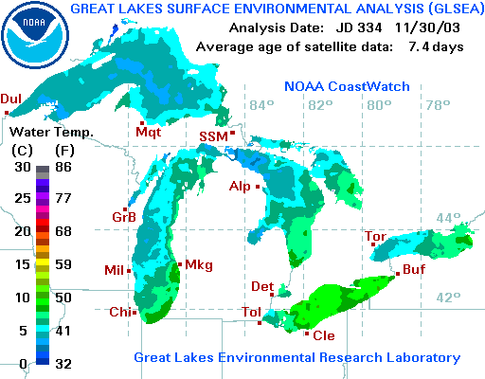
The lake water temperatures are much warmer than the air passing over.
https://coastwatch.glerl.noaa.gov/

Slide 8
Air passing over the lakes will have a very unstable layer to 850 mb.

Slide 9
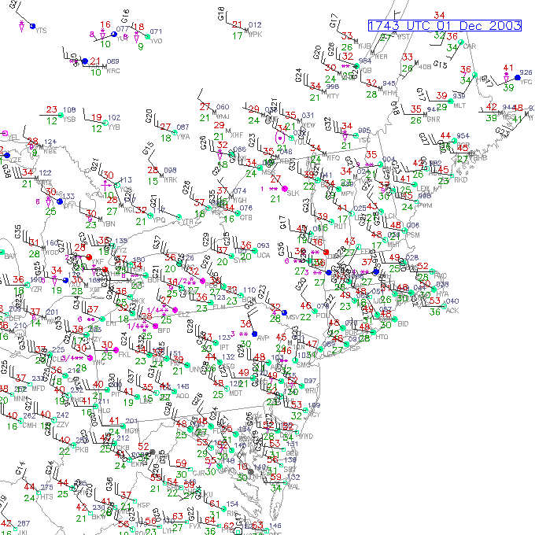
The result can be heavy snow which is quite localized.

Slide 10
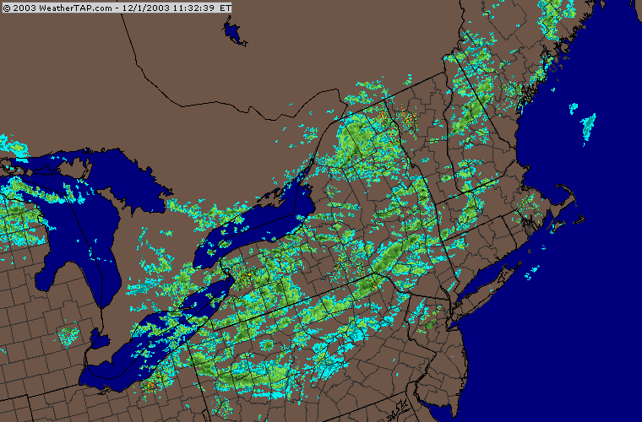
This is not all lake effect, but a lot of it is, even upwind of Lakes Ontario and Erie (downwind of Lake Huron and Georgian Bay)

Slide 11
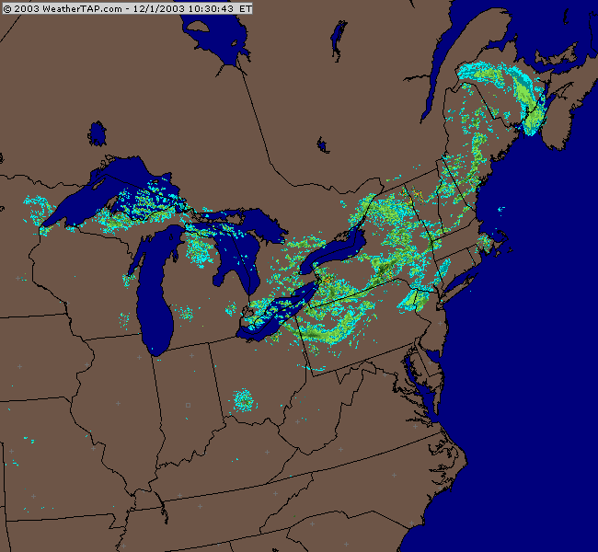
Lake effect occurs with all the Great Lakes and many smaller lakes, too.

Slide 12
Observations for BINGHAMTON BROOME, NY (BGM)
1453Z 1 Dec 2003 to 1353Z 2 Dec 2003
STN TIME PMSL ALTM TMP DEW RH DIR SPD GUS VIS CLOUDS Weather MIN MAX P01 PCP
DD/HHMM hPa inHg F F % deg kt kt mile F F in in
==== ======= ====== ====== === === === === === === ==== ======= ======= ======= ============ === === ==== ====
BGM 02/1353 1021.1 30.08 20 17 88 320 16 22 1 FEW009 BKN019 OVC025 S-F 0.00
BGM 02/1253 1020.3 30.06 20 18 92 300 10 1 X008 S-F 0.01
BGM 02/1153 1019.4 30.03 21 20 96 320 12 17 1/4 BKN003 OVC010 S+IF 21 25 0.02 0.03
BGM 02/1053 1018.4 30.00 22 18 84 270 13 22 3 BKN029 OVC060 S-F 0.00
BGM 02/0953 1018.3 30.01 23 17 78 280 12 10 FEW020 SCT044 OVC080 0.00
BGM 02/0853 1018.3 30.01 22 19 88 300 11 8 SCT018 BKN030 OVC090 S- 0.00 0.01
BGM 02/0753 1018.1 30.00 24 20 84 300 14 20 3 SCT017 BKN029 OVC070 S-F 0.01
BGM 02/0653 1016.9 29.97 25 17 71 280 16 23 10 BKN030
BGM 02/0553 1015.9 29.94 25 18 74 300 15 21 10 FEW023 SCT028 SCT033 24 26 0.00 0.00
BGM 02/0453 1016.2 29.95 25 22 88 270 10 9 FEW017 BKN023 OVC049 S- 0.00
BGM 02/0353 1016.2 29.95 25 24 96 270 12 1 SCT010 BKN016 OVC033 S-F 0.00
BGM 02/0253 1015.7 29.95 25 21 85 230 9 10 FEW030 BKN038 BKN070
BGM 02/0153 1016.6 29.97 24 20 84 230 8 10 CLR
BGM 02/0053 1016.8 29.98 26 20 77 260 12 10 CLR
BGM 01/2353 1016.9 29.98 26 22 84 270 11 18 10 SCT060 BKN080 25 34 0.00 0.01
BGM 01/2253 1016.1 29.96 25 24 96 270 11 3 SCT003 SCT012 BKN018 S-F 0.00
BGM 01/2153 1015.3 29.94 28 21 75 270 10 9 FEW027 BKN040 OVC060 0.00
BGM 01/2053 1014.2 29.91 30 19 63 280 11 21 10 FEW033 0.00 0.01
BGM 01/1953 1013.2 29.88 27 25 92 310 12 20 1/2 BKN006 BKN015 OVC037 SIF 0.00
BGM 01/1853 1012.3 29.85 28 27 96 300 14 35 1/4 SCT001 BKN018 BKN034 S+IF 0.01
BGM 01/1753 1011.1 29.82 33 20 58 300 14 24 10 BKN045 BKN050 30 38 0.02
BGM 01/1653 1011.0 29.82 32 23 69 290 16 25 10 FEW029 SCT070 0.00
BGM 01/1553 1010.9 29.81 30 30 100 310 15 30 1/4 SCT003 BKN015 BKN028 S+IF 0.02
BGM 01/1453 1009.4 29.77 38 24 57 280 17 21 10 SCT037 BKN045
Snow can be intense (S+) but the liquid equivalent is usually low

Slide 13
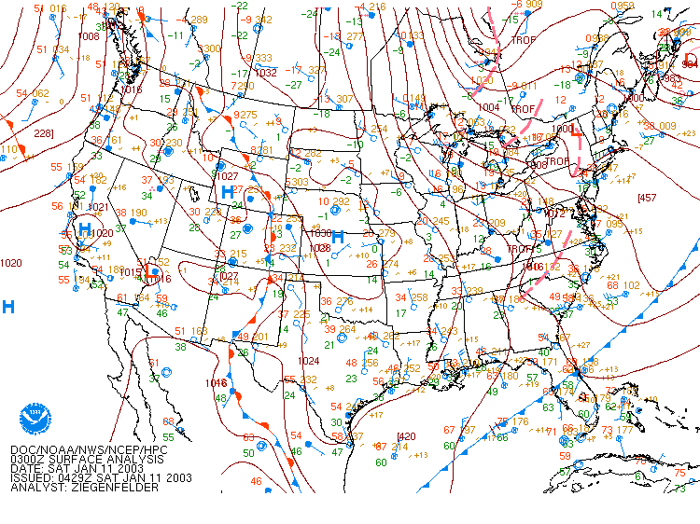
Jan 11-15, repeated lake effect events over several days

Slide 14
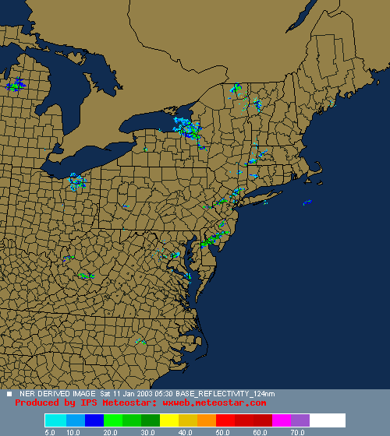

Slide 15
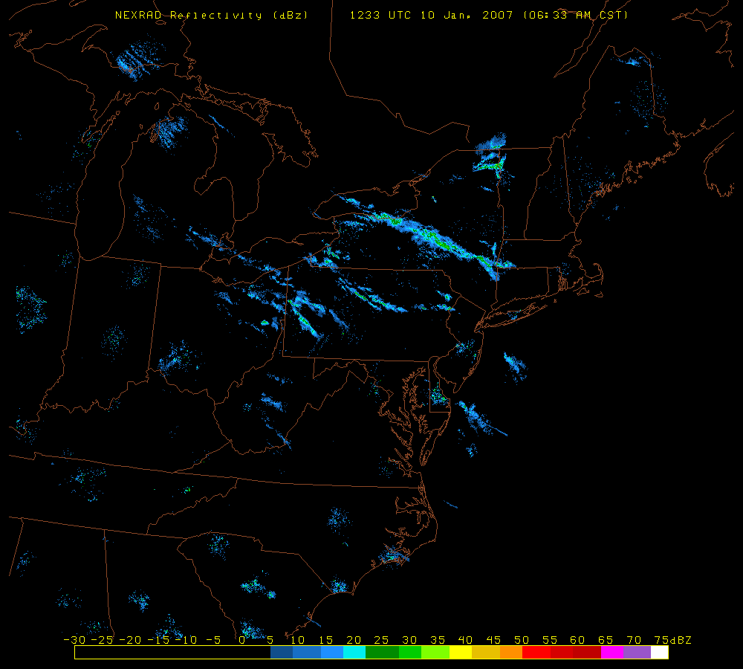
Lake Effect bands can be very long. On Jan 10, 2007, a band from Lake Ontario reached Connecticut and Massachusetts.
This air had a fetch over Lake Huron before it reached Lake Ontario.

Slide 16
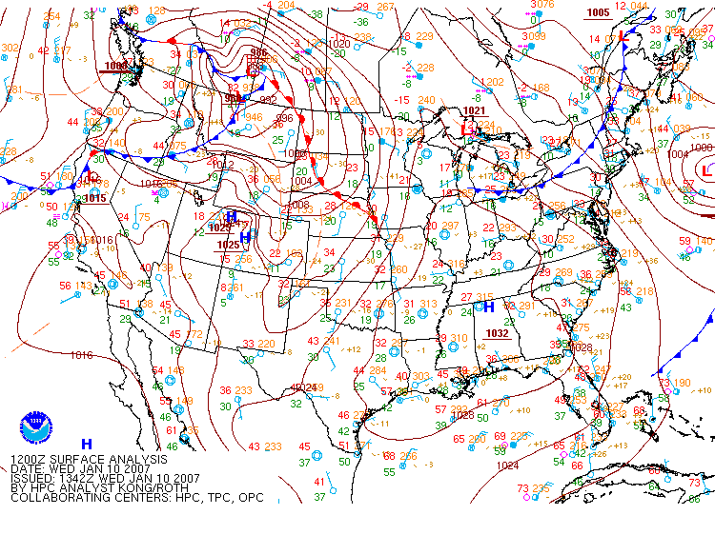
Notice the strong northwest winds from Georgian Bay. The cold front enhanced the lift as well.

Slide 17
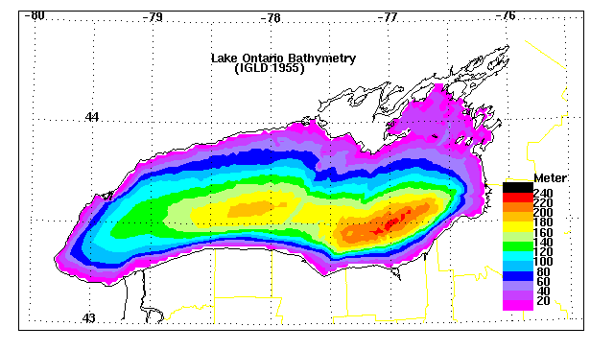
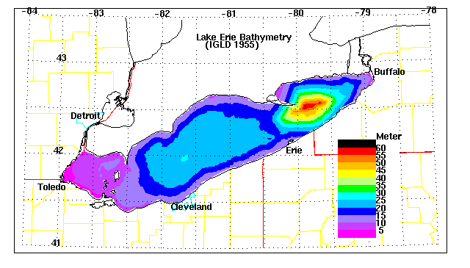
The water temperatures of Lakes Erie and Ontario can be very different due to their bathymetry. Lake Erie is a much more shallow lake than any of the other Great Lakes.

Slide 18
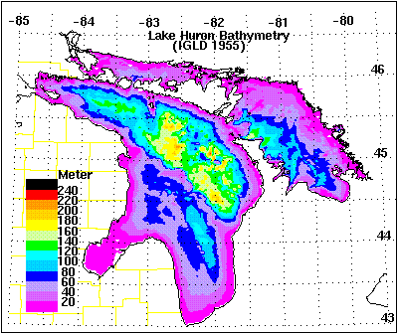
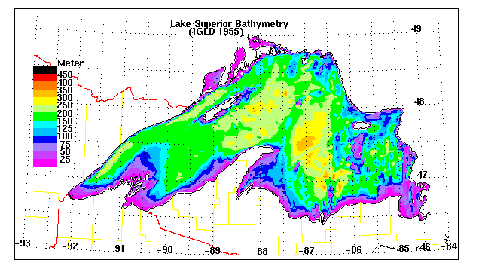
Note the scales are all different.

Slide 19
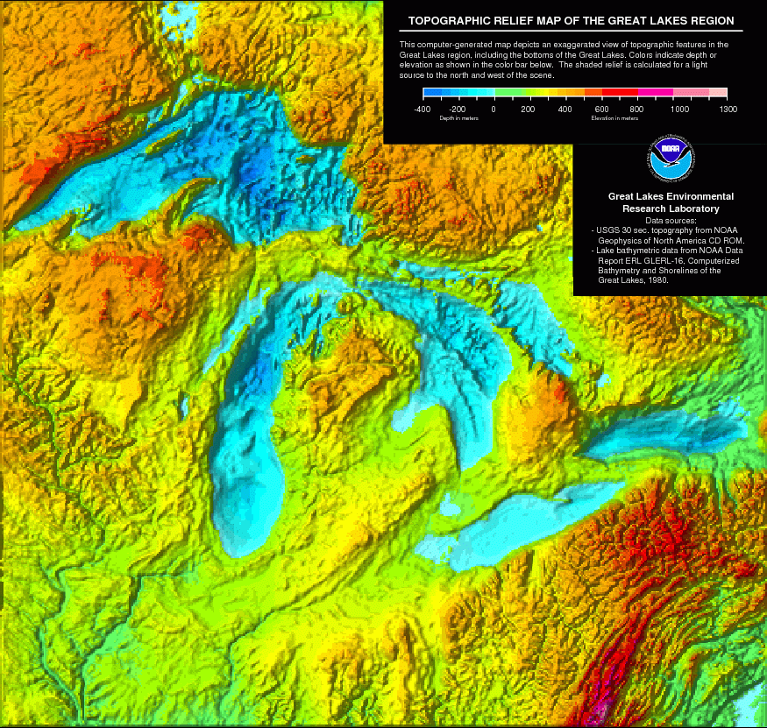

Slide 20
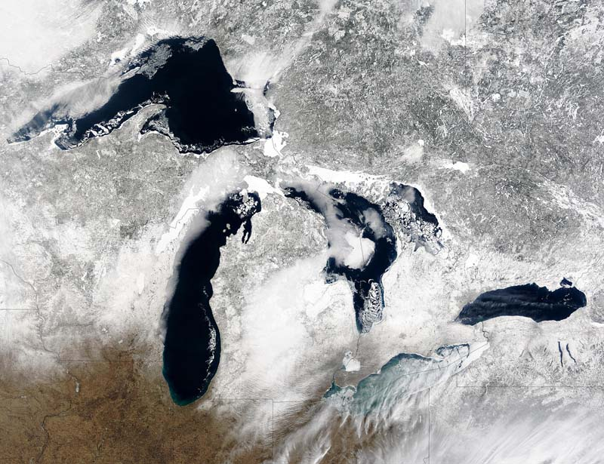
Shallow Lake Erie freezes over in late winter. None of the others do.
When that happens, lake effect is greatly reduced.

Slide 21
Going back to Greg Byrd’s presentation:

Slide 24
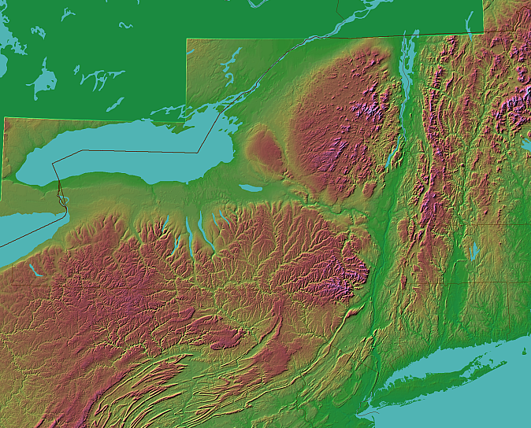
Fetches from north to south and west to east take air over higher terrain in NY state after leaving Lake Ontario. The extra upward vertical motion gives places like theTug Hill Plateau much heavier snowfalls.
Tug Hill Plateau →

Slide 26
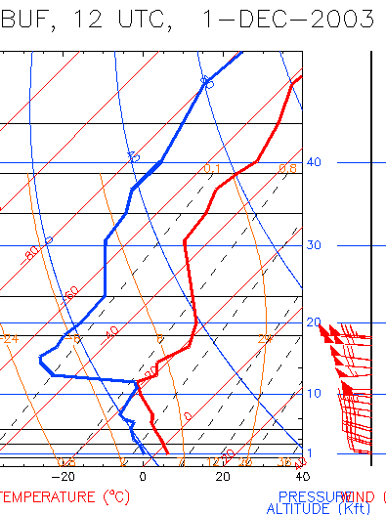
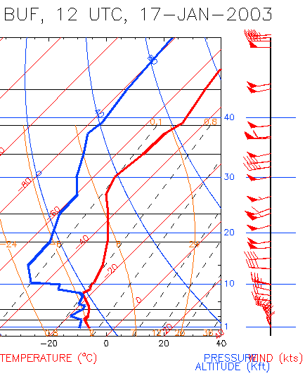
Sfc-700 mb directional wind shear < 30 °
Sfc-700 mb directional wind shear >30 °

Slide 27
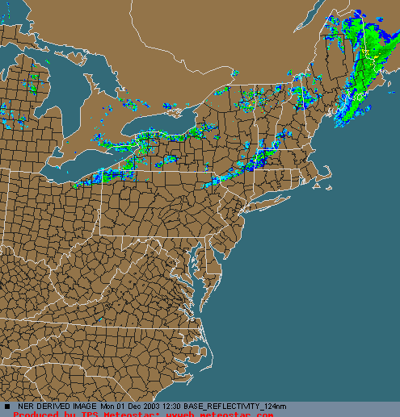
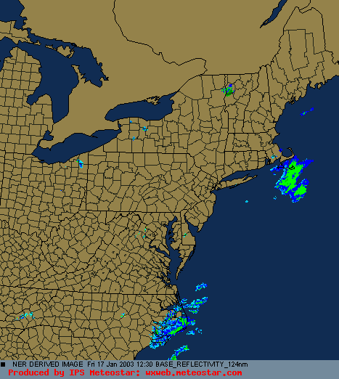
Dec 1, 2003. Weak dir wind shear, well developed lake effect bands
Jan 17, 2003. Strong dir wind shear, weak or nonexistent lake effect bands

Slide 30
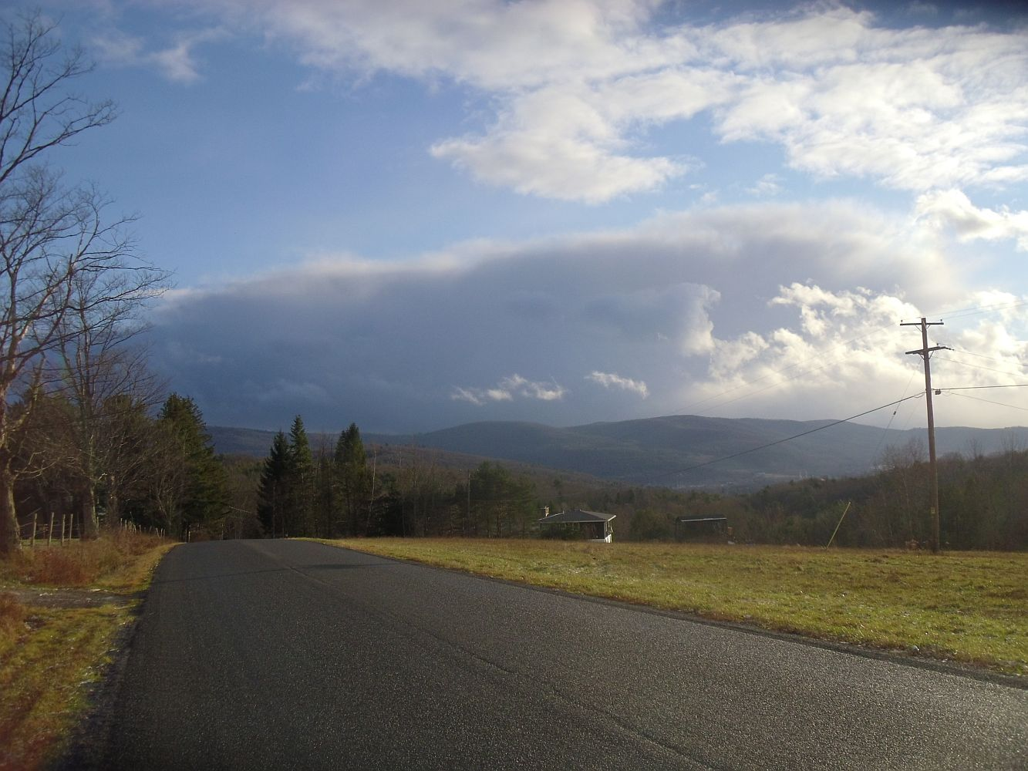
This is what Lake Effect squalls look like from in our area. Looking south over the Susquehanna valley in November.

Slide 31
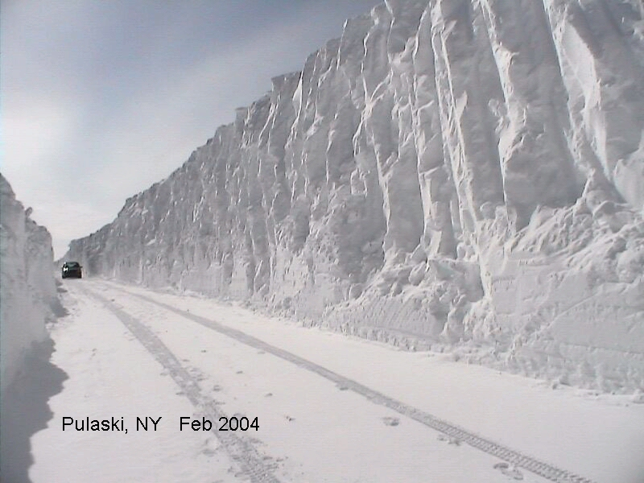

Slide 32
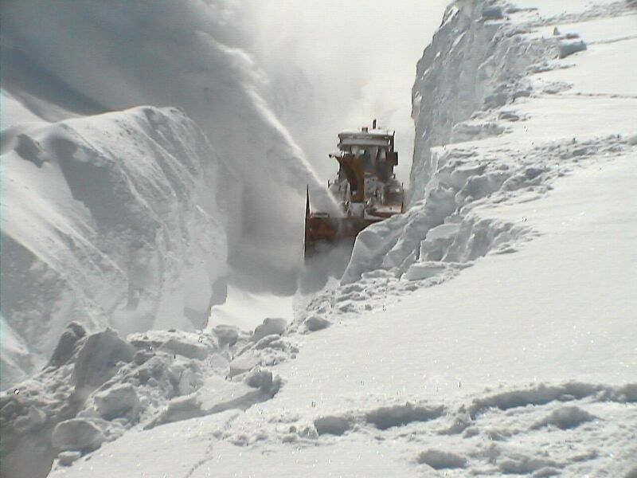
The importance of a good lake effect snow forecast can’t be understated!

