Slide 1
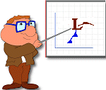
Norwegian Cyclone Model Review
Vilhelm and Jacob Bjerknes; Halvor Solberg
Bergen Geophysical Institute ~1920

Slide 2
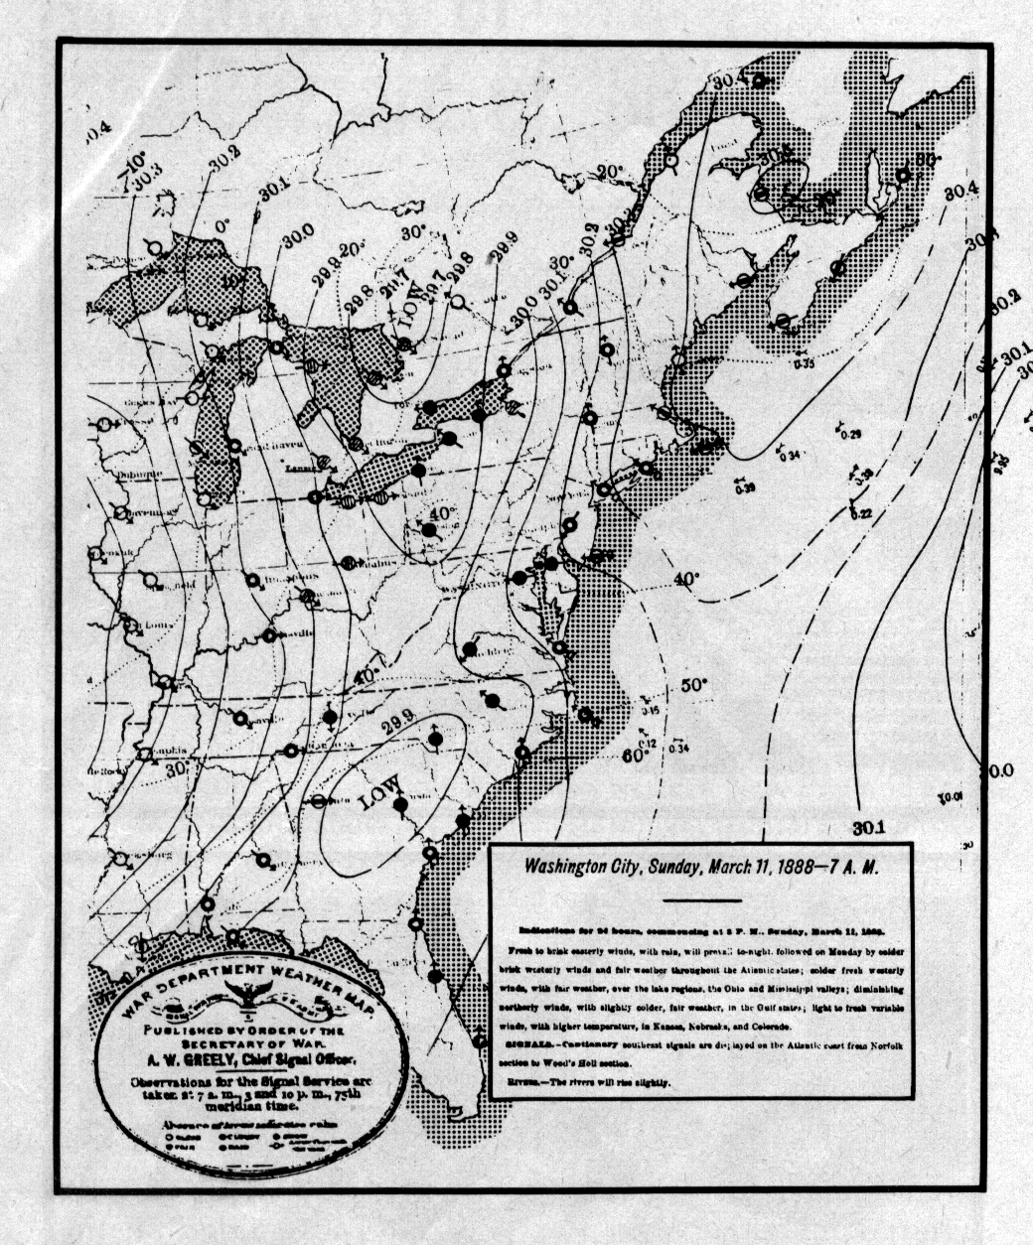
Before Bjerknes, maps had no fronts.
There were Highs and Lows and even isobars.
So the big breakthrough of the Norwegian Model was fronts. How did they come up with that idea?

Slide 3
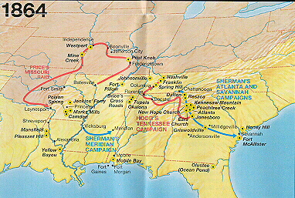
In war, up to the 20th century armies were small and wandered around the countryside looking for enemies to fight.

Slide 4
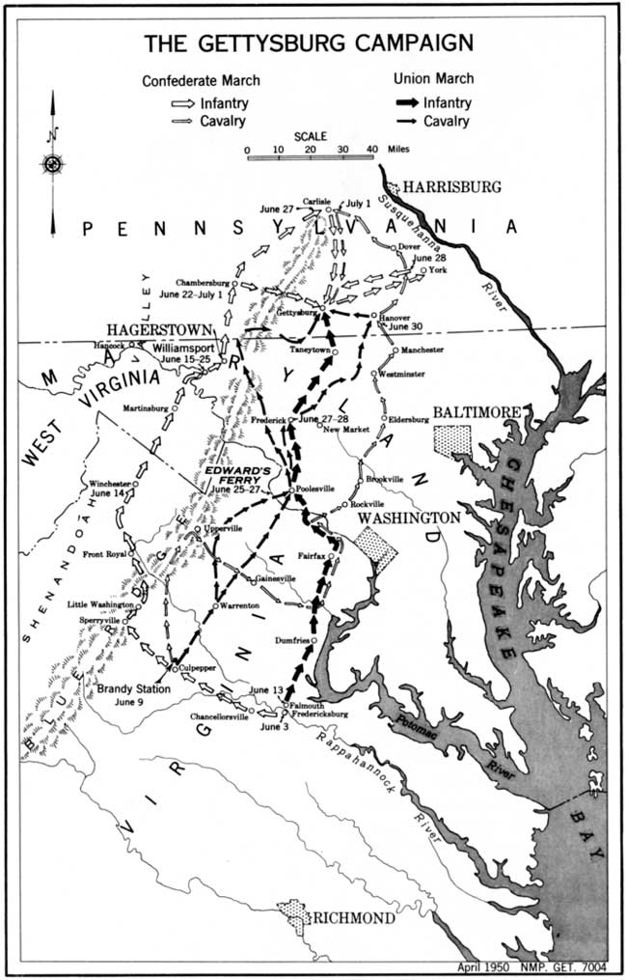
The battle of Gettysburg was a good example. The Confederate Army was moving through southern Pennsylvania near Washington D.C. When they spotted the Union army, they attacked from the north!

Slide 5
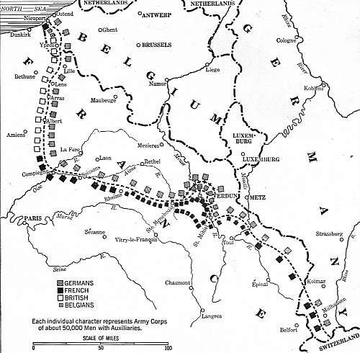
Fronts were a military concept during World War I when armies grew large enough to occupy whole regions
This is the western front. All troops on the German side are alike. Notice how the allies also group together. The big changes occur across the front.

Slide 6
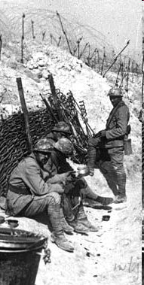
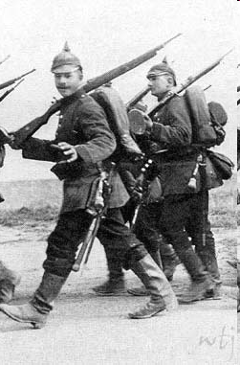
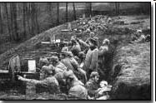
The German uniform of WWI
French infantry
Trenches at the front

Slide 7
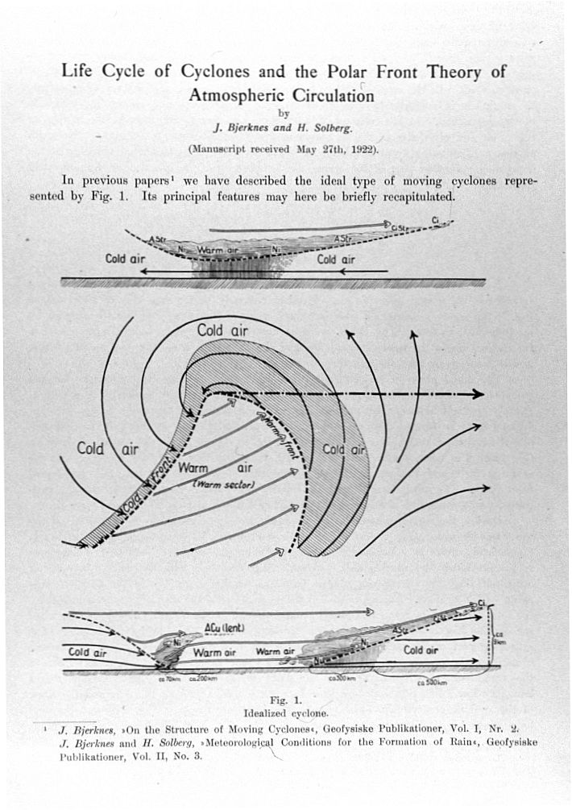
Building on his father’s concepts, Jacob Bjerknes and his co-worker Halvor Solverg proposed a structure.
The storm doesn’t look precisely the way we draw them now but the main features are there.

Slide 8
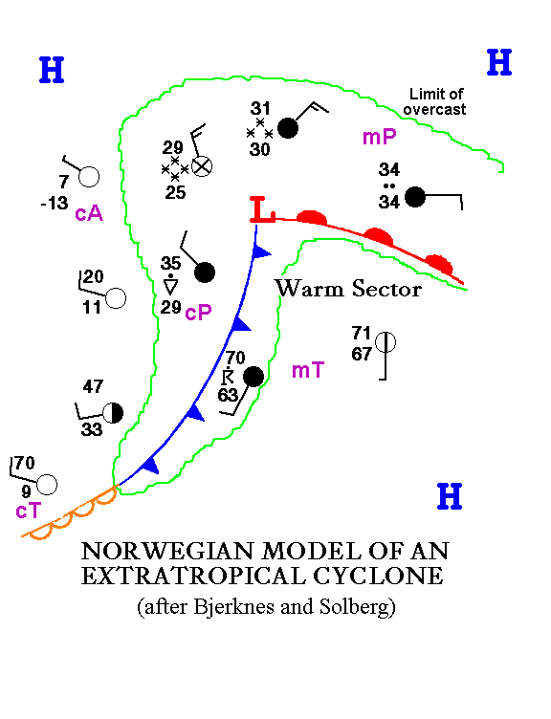
This is how we plot the features of a typical cyclone.
Station data is exaggerated to show the contrasts. Air mass types and the approximate extent of the region of overcast skies are also shown.

Slide 9
Question for the class:
They had maps in 1888. They had weather observers. They had telegraphs and could get data from across the country.
Why was the development of the Norwegian model of an extratropical cyclone such an important breakthrough for meteorologists? (It was so good, we still use the model today)

Slide 10
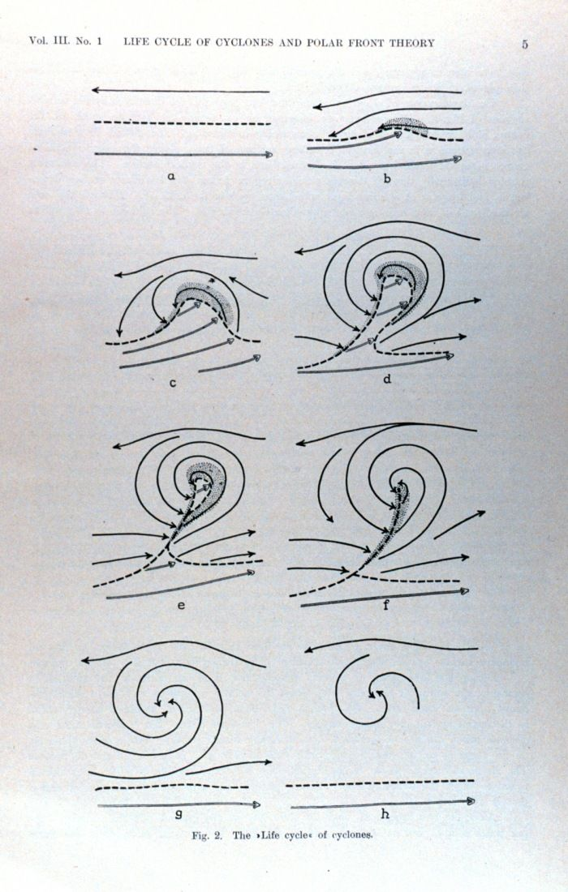
Bjerknes and Solberg also proposed that the cyclones went through a common evolution of stages.
In the next slide, a loop of surface maps shows a storm going through those stages. Watch the Low which starts in western Kansas.
You should also check the temperatures in the air masses. Maybe the schematic wasn’t so exaggerated after all.

Slide 11
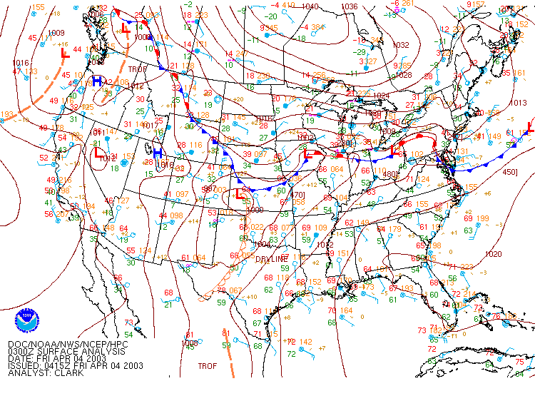

Slide 12
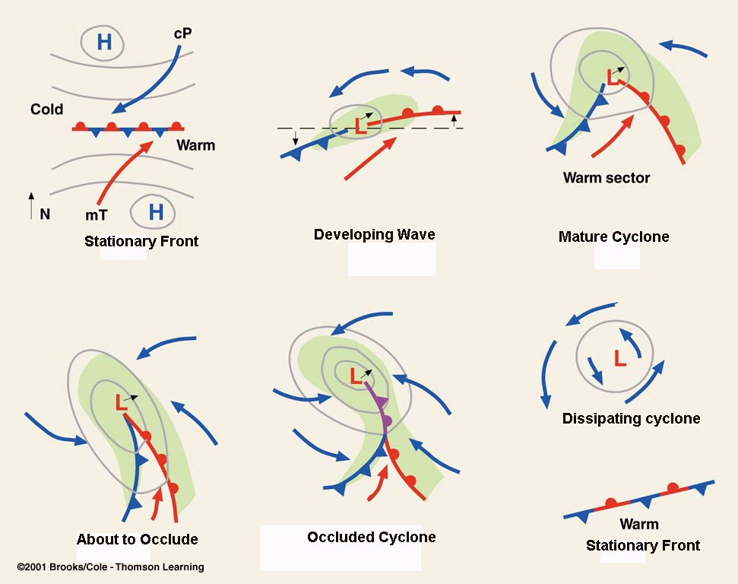
Stages of the typical Extratropical Cyclone

Slide 13
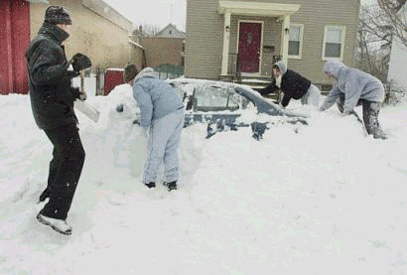
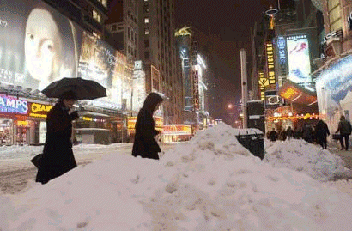
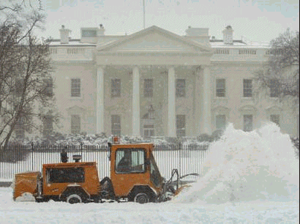
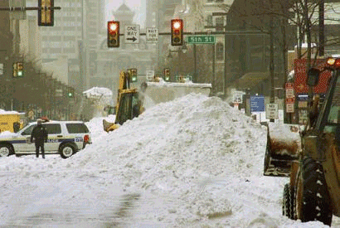
The President’s Day Storm of 2003
Rutgers U
Times Square
Philadephia
The White House

Slide 14
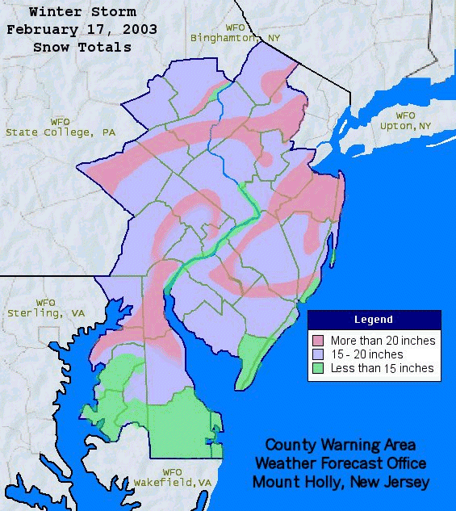

Slide 15
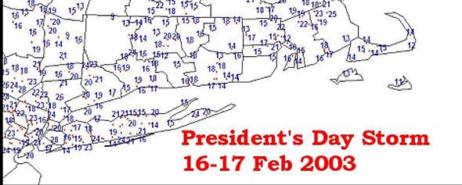

Slide 16
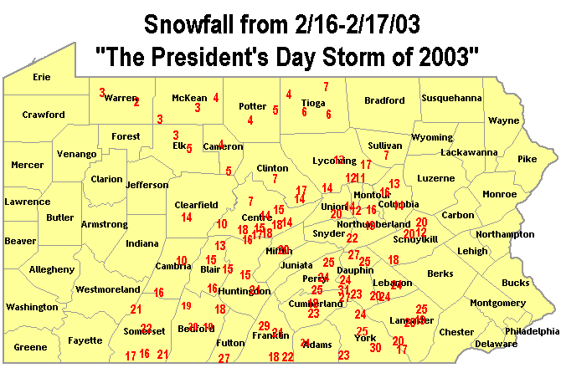

Slide 17
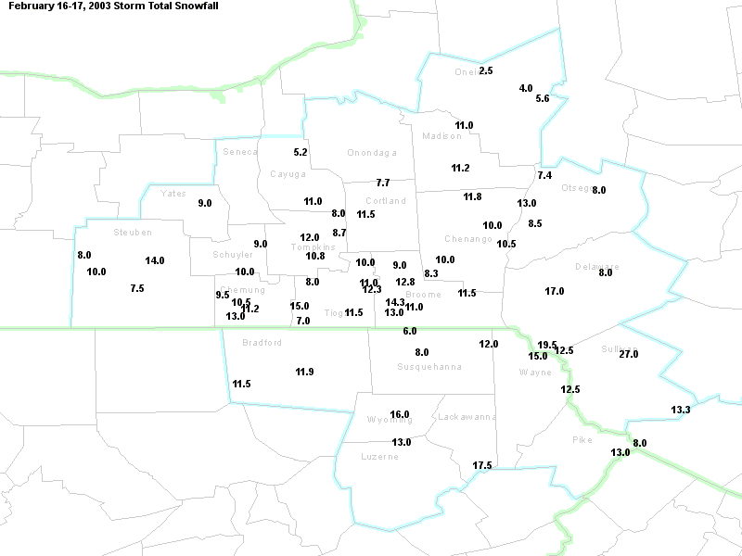
NYO8.5

Slide 18
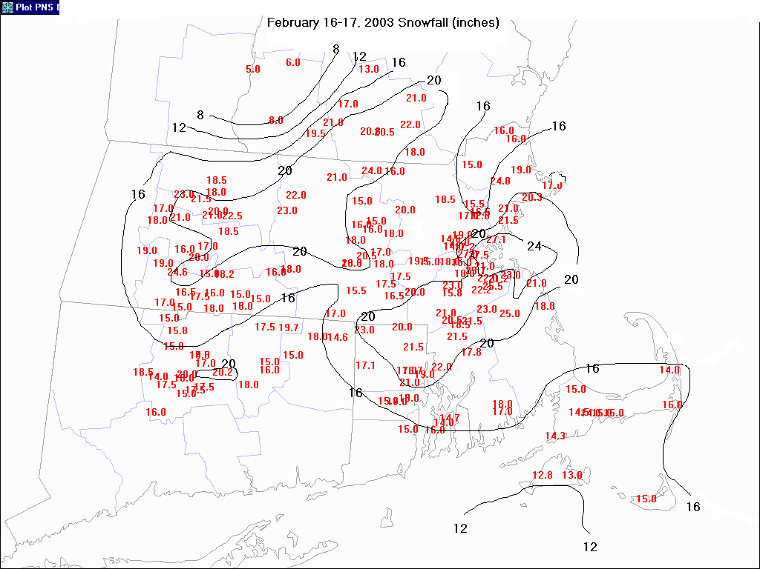

Slide 19
Surface Map Loop for Feb 15-18, 2003
To watch for:
Developing waves in Arkansas
Mature cyclone
New Low forms offshore by Carolinas
Arctic air mass with High over New England

Slide 20
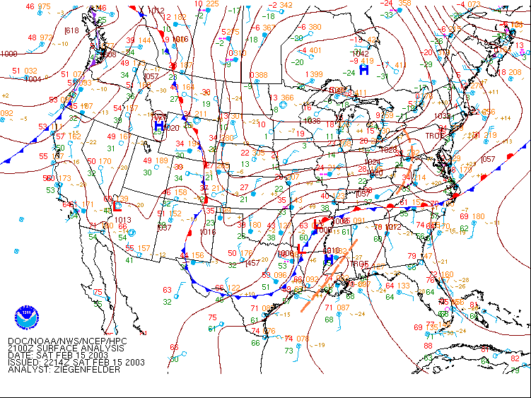
Coastal Low forms
Mature Cyclone
Developing Waves

Slide 21
Satellite Loop
Bjerknes didn’t have one. If he had, he would have seen some characteristic features which show what kind of weather is occurring.
To watch for:
The cloud shield of the warm front is spread out
The cold front has a narrow strip of cloud
Development of “Dry Tongue” behind system.
Backlash means clouds behind the system

Slide 22
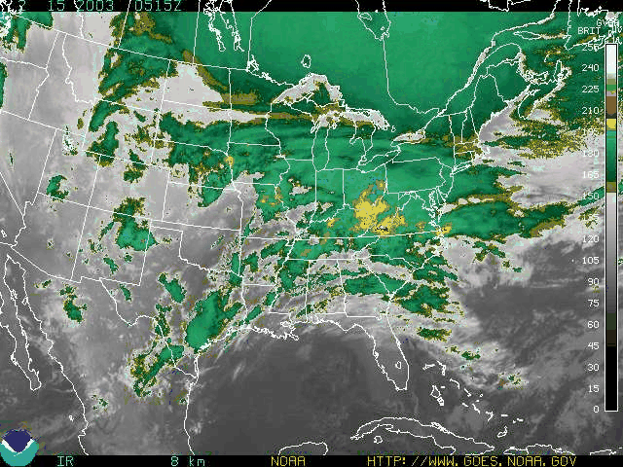
Warm front cloud shield
Backlash
Dry Tongue
Cold front cloud shield

Slide 23
Upper Air
This is another asset that didn’t exist in the early 20th century.
Watch the following loop of 300 mb maps.
The solid lines are height lines (like isobars)
The blue shading shows the wind speeds
How does this loop help us to forecast the track of the surface storm?

Slide 24
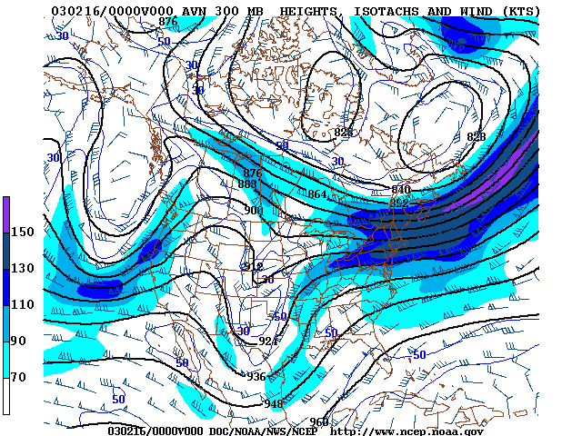

Slide 25
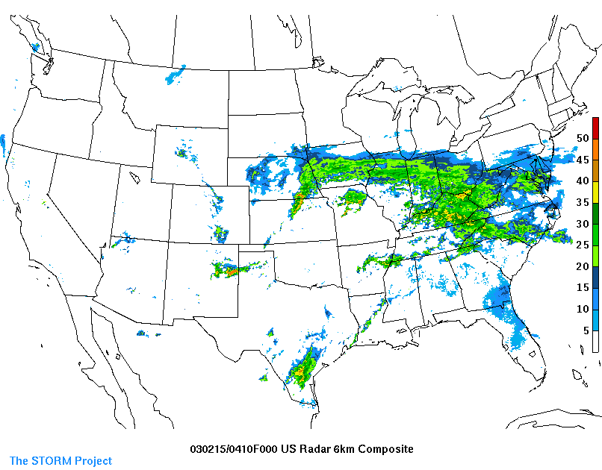
Radar Loop
In the Radar loop you can identify more characteristic features of the Norwegian Model.
What is this?

Slide 26
So, what does this case tell us about the Norwegian Model?
Every extratropical cyclone in the U.S. has certain features in common (besides the obvious):
Fronts:
stratiform precipitation shield with warm front
cumuloform precipitation with cold front
Cyclone goes through life cycle from wave on front to dissipating
But every extratropical cyclone is different in some way
You must forecast each on a case-by-case basis
Use as many data sources (maps, numbers, etc.) as you can.
Next we examine the fronts themselves in more detail

