Slide 1
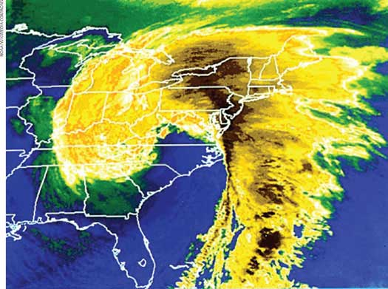
Potential Vorticity

Slide 2
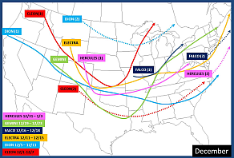
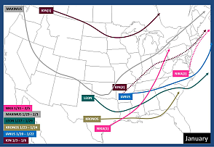
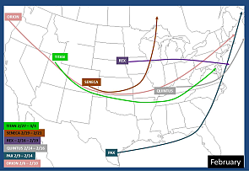
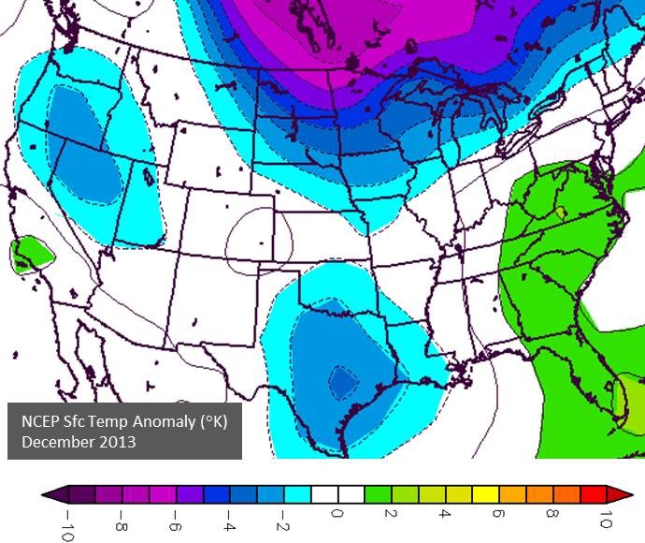
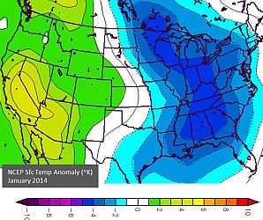
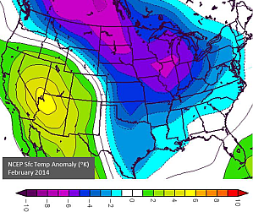
From Tom Niziol’s blog at wunderground.com, the winter storm tracks for Dec 2013-Feb 2014. What patterns do you notice?
The storms seem to begin in particular regions and they all curve toward the northeast.
Could it be related to this:
With respect to where they originate, Jan and Feb fit but Dec doesn’t. We need more.

Slide 3
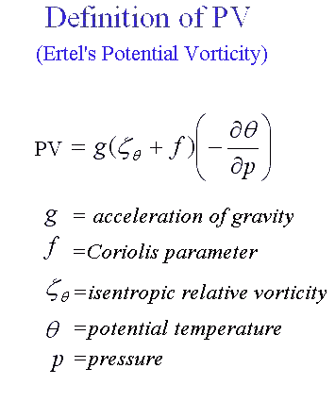
Here’s more:
Key fact:
PV is conserved so the right-hand side doesn’t change.

Slide 4
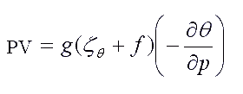
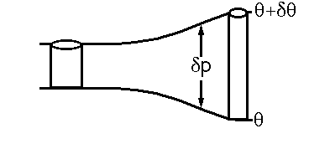
If PV is conserved, what happens when you change one part of the expression on the right?
Case 1: Change ∂p
∂p has changed
∂θ has not changed. g can’t change.
For west-east motions, f doesn’t change. The only quantity left to balance the change in ∂p is … (you know this)
ζ Relative Vorticity

Slide 5
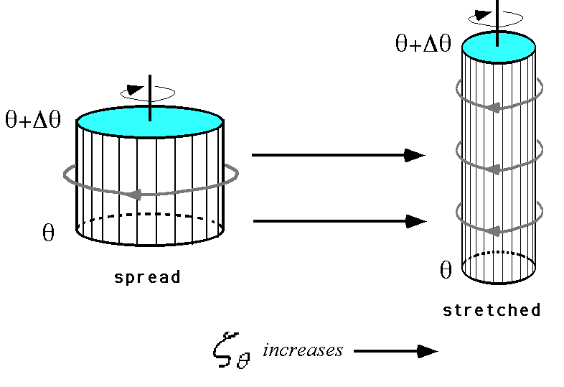

Slide 6
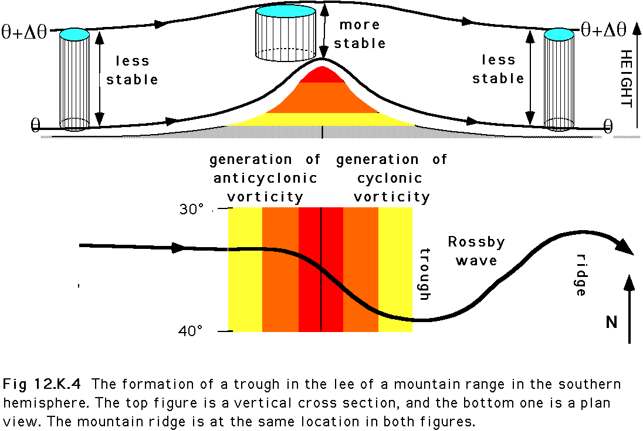

Slide 7
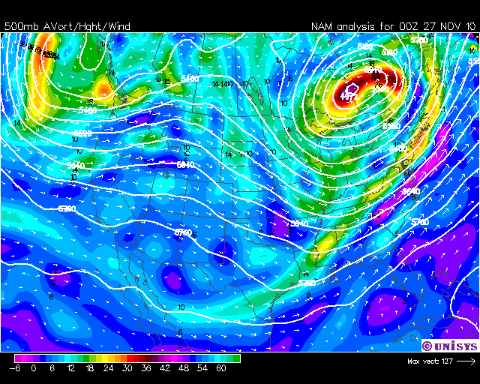
Example from Nov, 2010. Watch the absolute vorticity in the western trough.
As its absolute vorticity increases, the trough amplifies.

Slide 8
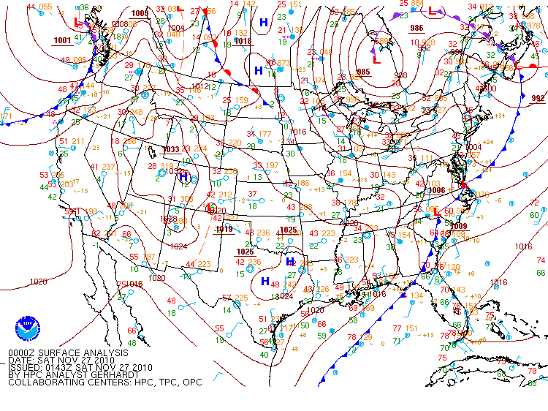
Low approaches the western mountains.
New Low moves into midwest
New Low forms

Slide 9
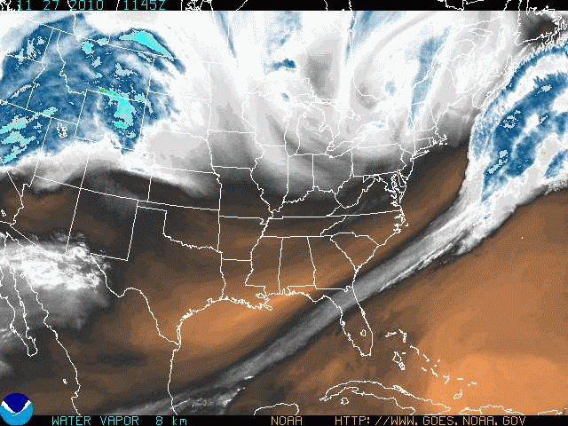
The Water Vapor loop shows the formation of upper air circulation over Colorado. This is called a Lee-side Cyclogenesis

Slide 10
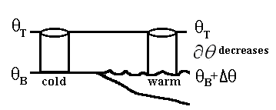
Case 2: Change ∂θ
∂p has not changed. As always, g can’t change. For west-east motions, f doesn’t change.
∂θ has changed. Since the water is warm, the column θ difference decreases.
But if ∂θ alone decreases, the absolute vorticity must increase to maintain constant PV.

Slide 11
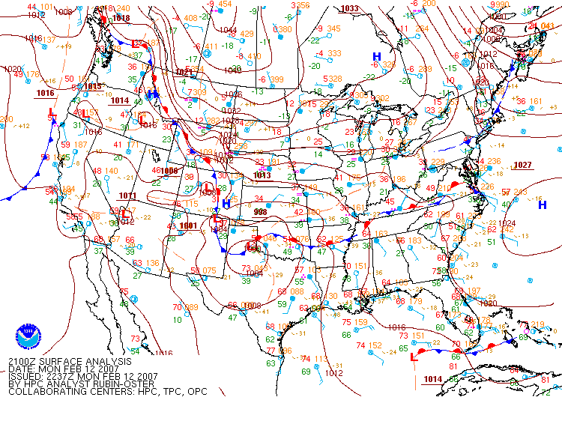
Case: Valentine’s Day storm of 2007 (we have seen the upper air maps already)

Slide 12
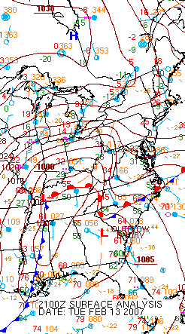
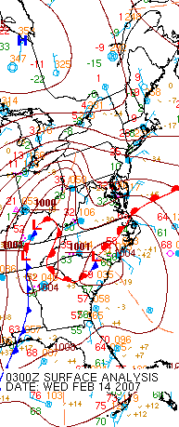
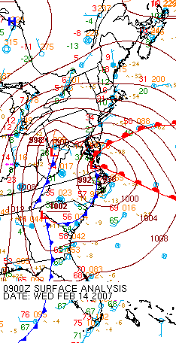
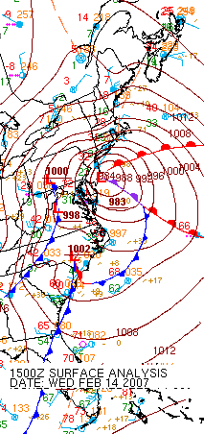
The first Low (Ohio Valley) dies. A new low begins near the coast. This is again cyclogenesis. The coastal Low becomes the storm (so, if you were naming them, what do you do during the 18-24 hours when there are two?)

Slide 13
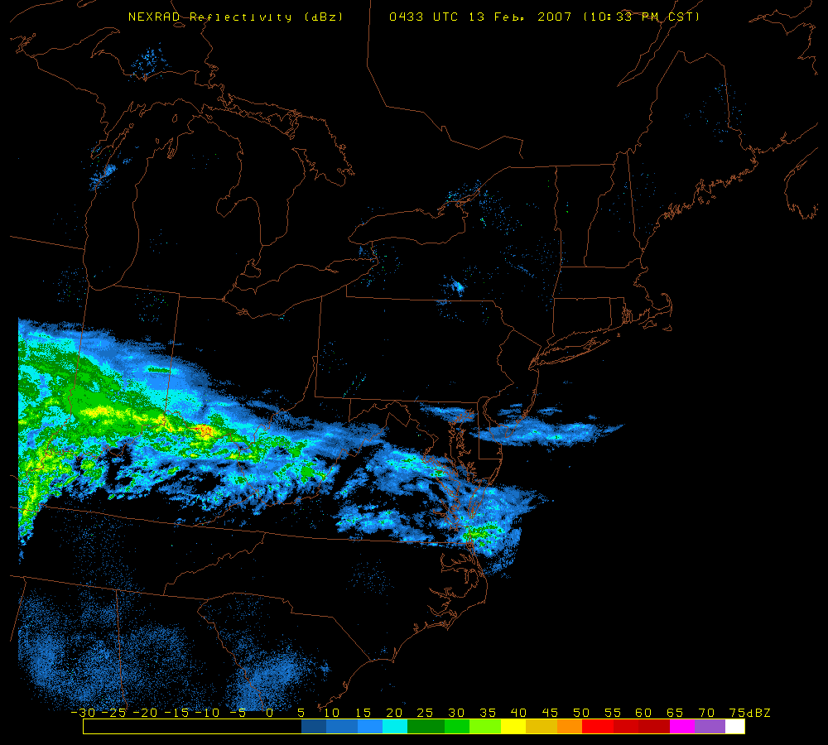
Can you see when the coastal storm takes over from the Ohio Valley storm?

Slide 14
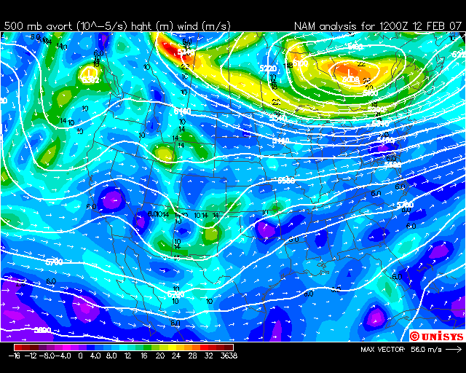
From a weak leeside trough to a powerful coastal trough with absolute
-5 -1
vorticity around 32 x 10 s .

Slide 15
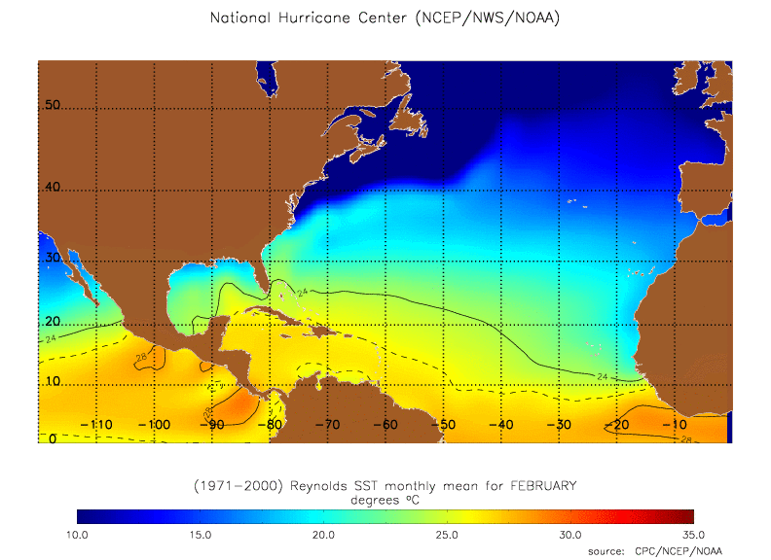
Why did it happen?

Slide 16
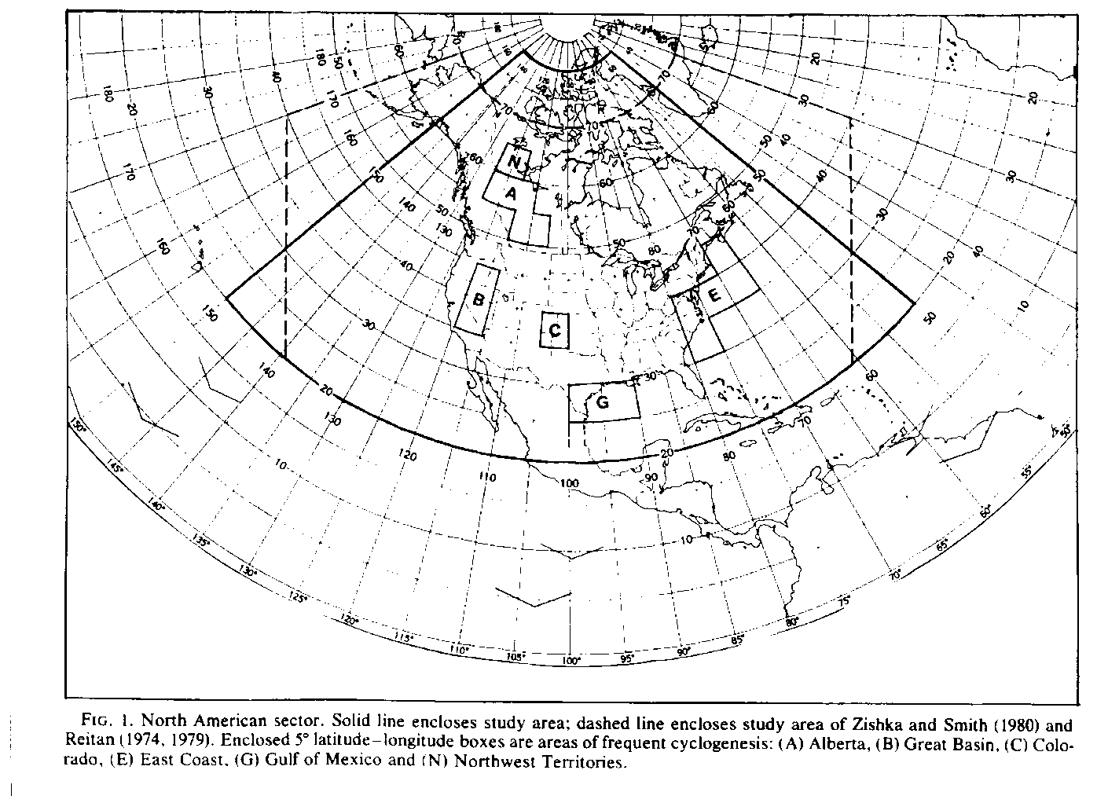
Cyclogenesis regions

Slide 17
Summary of Cyclogenesis
Potential Vorticity: g[(f + ζ)*(-∂θ/∂p)] = constant
As -∂θ/∂p goes down, f + ζ goes up. As -∂θ/∂p goes up, f + ζ goes down.
As absolute vorticity (f + ζ) increases, upper air troughs become more cyclonic. Deepening troughs are said to be “digging.”
Preferred cyclogenesis areas in all cases ∆θ/∆p decreases, f + ζ increases
Colorado, in the lee of the U.S. Rockies. ∆p increases
Alberta, in the lee of the Canadian Rockies ∆p increases
Gulf of Mexico ∆θ decreases
East coast, especially off Cape Hatteras ∆θ decreases
East coast in the coastal plain (lee of Appalachians) ∆p increases

