Slide 1
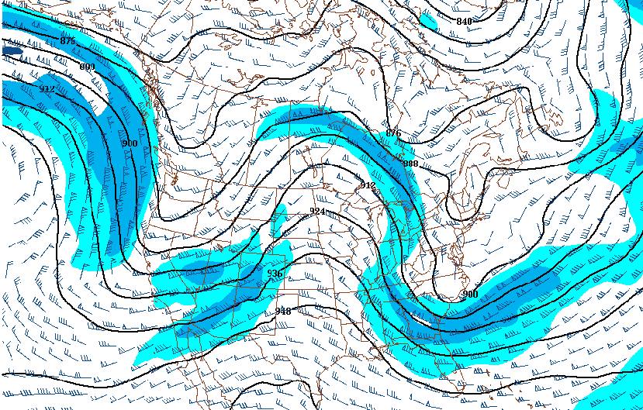
Rossby Waves (waves in the upper air westerlies)

Slide 2
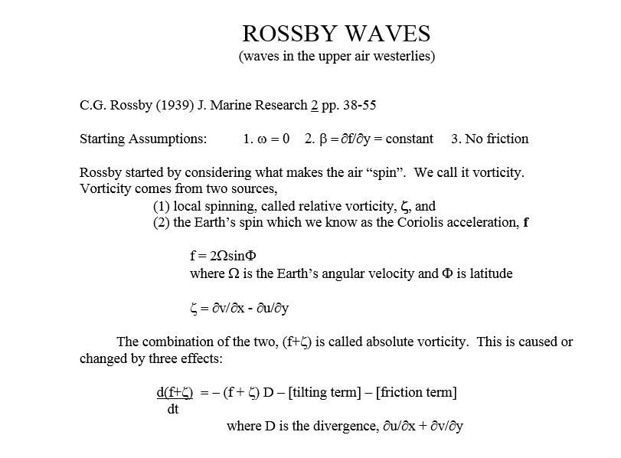

Slide 3
Coriolis is easy. The spin about a vertical axis is the greatest at the poles. It is zero at the Equator.
How is this guy (Olaf) going to turn?
How about this guy? (Sergio) Doesn’t he turn?
Can you see why?
To describe turn about the vertical axis, use f = 2ΩsinΦ

Slide 4
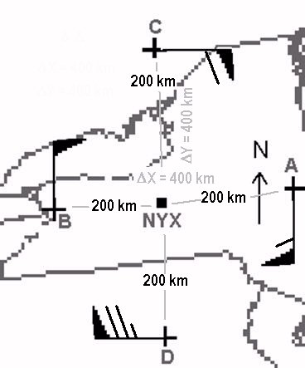
To see relative vorticity, it helps to actually calculate some:
With winds like these, what kind of vorticity do you have?
Your choices are:
Cyclonic (+) or Anticyclonic (-)
What is the Relative Vorticity (ζ) at KNYX?

Slide 5
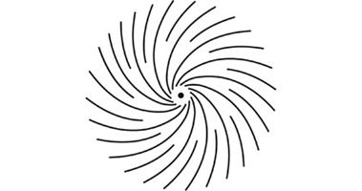
Reminders:
ζ ~ Δv/Δx - Δu/Δy
1 knot = 0.5144 m s⁻¹
400 km = 4 x 10⁵ m
So, ζ = (56.6 m s⁻¹/4 x 10⁵ m) – (-69.4 m s⁻¹/4 x 10⁵ m)
= 14.15 x 10⁻⁵s⁻¹ + 17.35 x 10⁻⁵s⁻¹ = 31.5 x 10⁻⁵s⁻¹
It’s positive and therefore cyclonic. Didn’t it look cyclonic or counter-clockwise in the Northern Hemisphere?

Slide 6
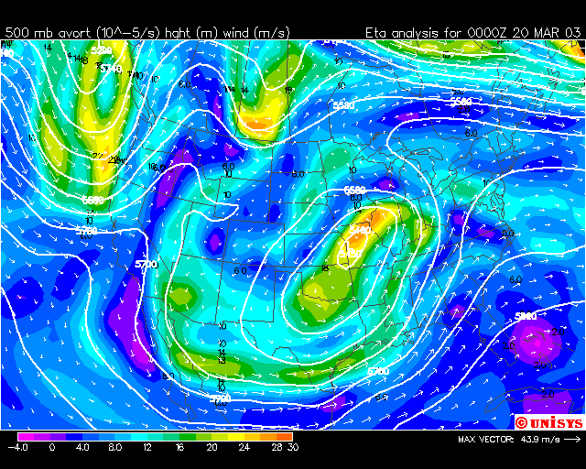
We have maps of absolute vorticity:

Slide 7
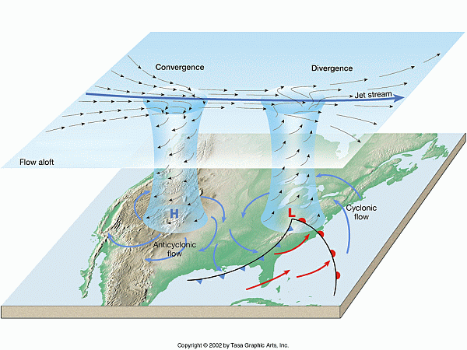
Now back to Rossby:
We assume friction is very small in the upper air. Also, tilting is very small on the synoptic scale (more about that next semester).
Rossby also assumed no vertical motion (w = 0). That stifles divergence so D = 0.
`
This is called “Conservation of Absolute Vorticity”

Slide 8
Conservation of Absolute Vorticity
Constant absolute vorticity trajectories naturally go in wavelike patterns

Slide 9
In addition to the fact that the atmosphere must consist of waves, Rossby used the conservation of Absolute Vorticity to show that the speed of those waves can be calculated. We won’t derive that here. Take METR 350 to see how it works.
The Rossby wave equation can help us understand how weather systems move.
What is the difference between wave speed (c) and wind speed (U)?

Slide 10
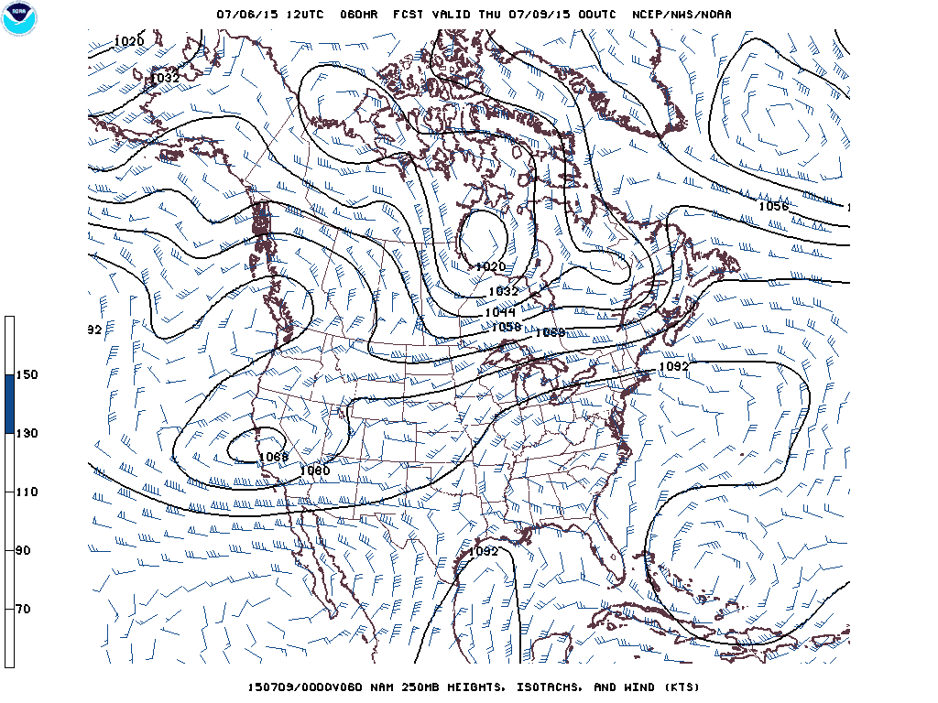
Watch this wave trough
The trough finishes here, 1000 nm east and 24 hours later
So the trough moves at a speed of 42 nm/hour (knots) even though the winds in the trough are much greater than that, up to 95 knots! So, c ~ 42 knots but we can estimate U ~ 70 knots.

Slide 11
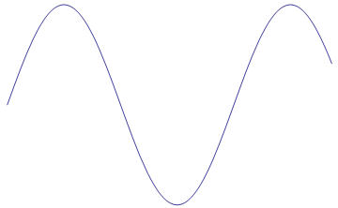
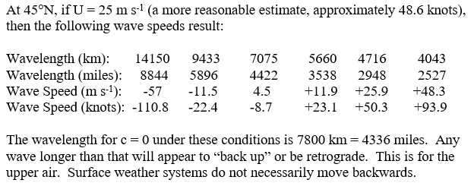
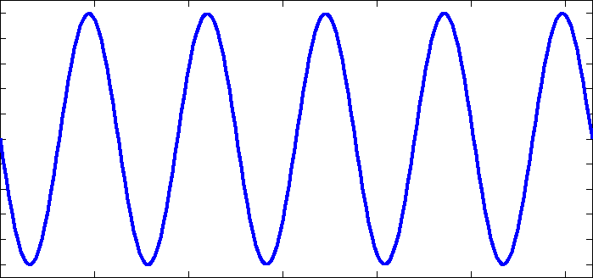

Slide 12
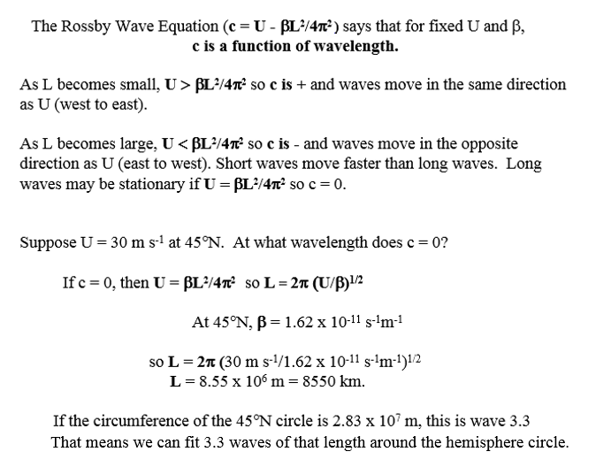

Slide 13
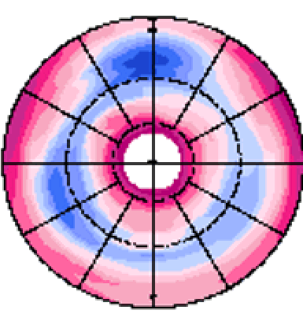
This is a simple wave 3 simulation.
The colors are wind speed. Notice the three blue maxima (jet streams)in the troughs.

Slide 14
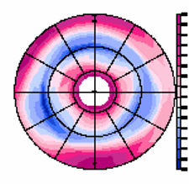
Animating …

Slide 15
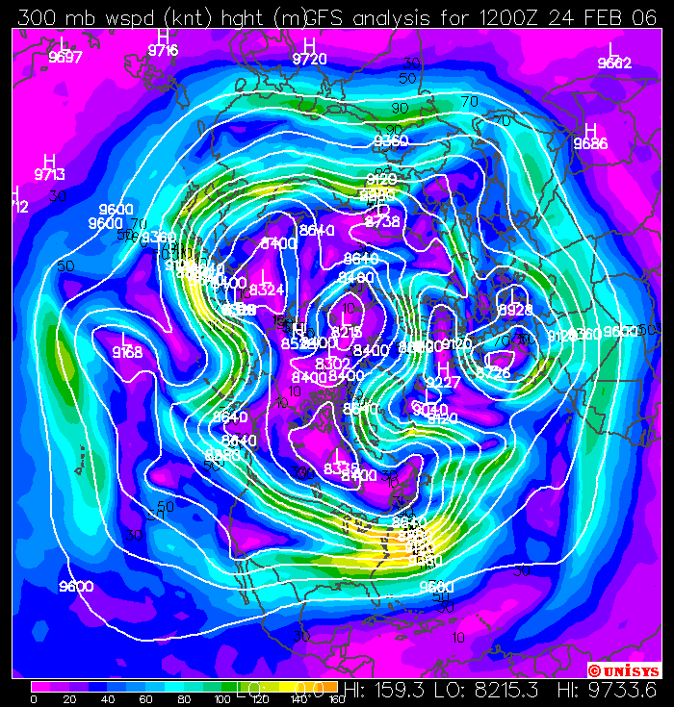
Real upper air patterns are quite a bit more complex.
In this actual hemispheric loop from 2006 the colors represent wind speed with white height contours showing the troughs and ridges.
Do you see wave 3? How about wave 2? 8?
Which waves are progressive? Why are they progressive?

Slide 16
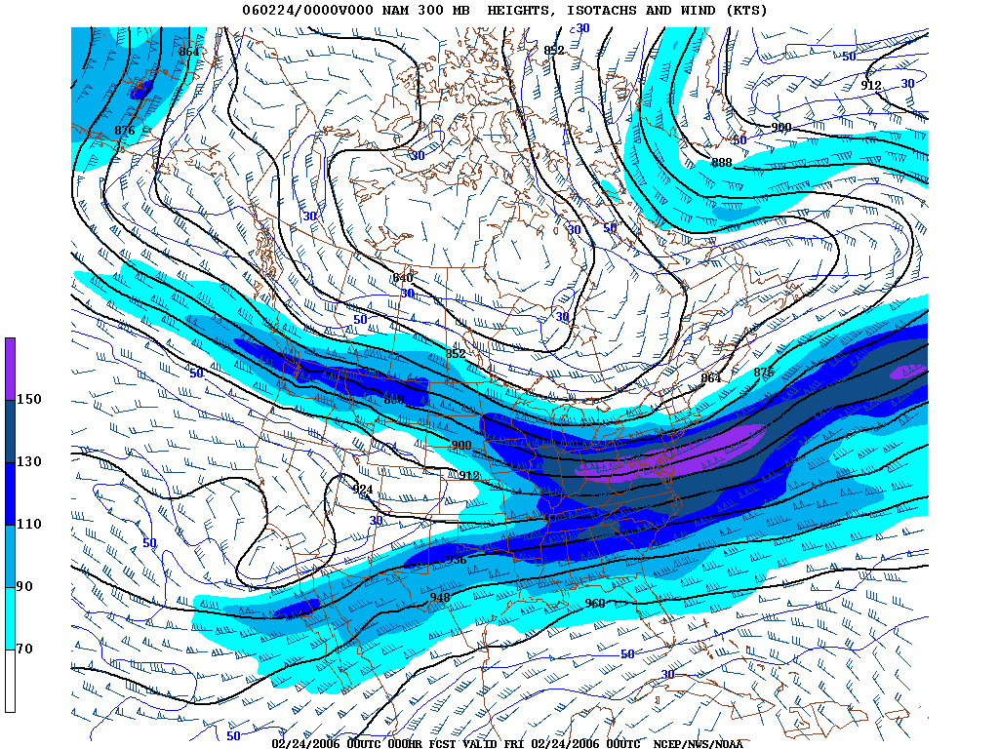
This is the 300 mb flow over North America at that time.

Slide 17
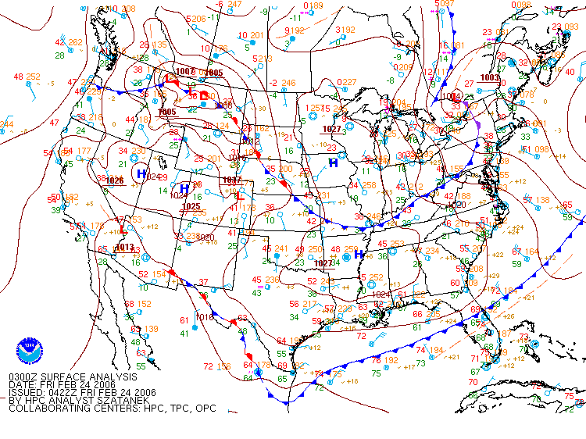
This is the corresponding surface loop.

Slide 18
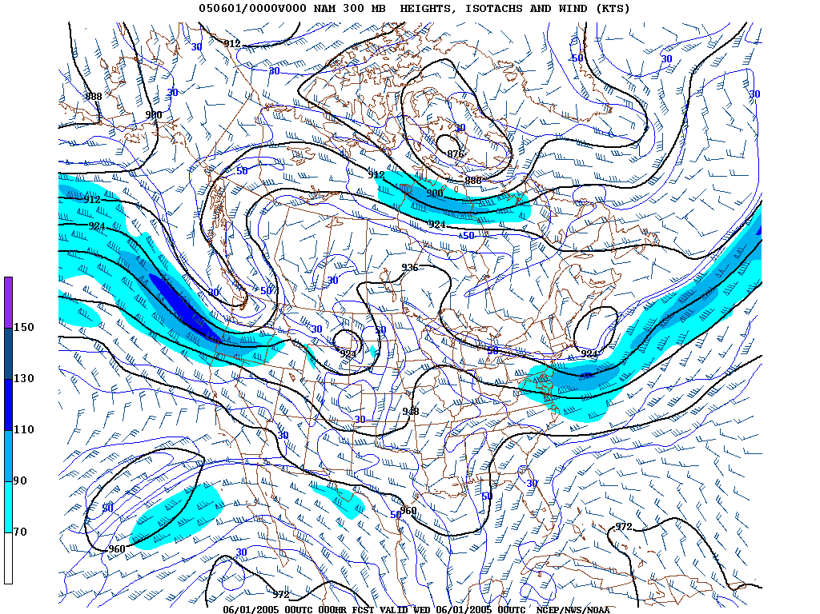
Here’s a loop from June, 2005. Short waves move into the long wave which stays mostly stationary. Around June 18, an Omega Block forms

Slide 19
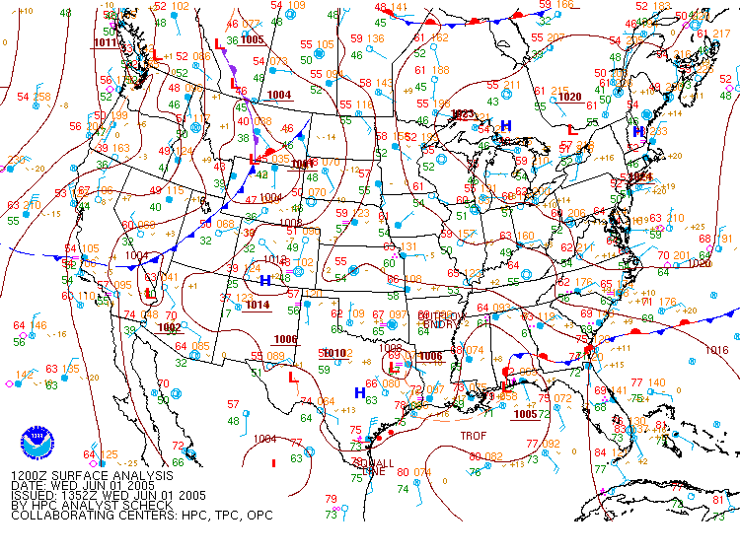
This is the surface during June 2005. While surface Lows move with the short waves, a tendency for unsettled weather persists under the western trough.

Slide 20
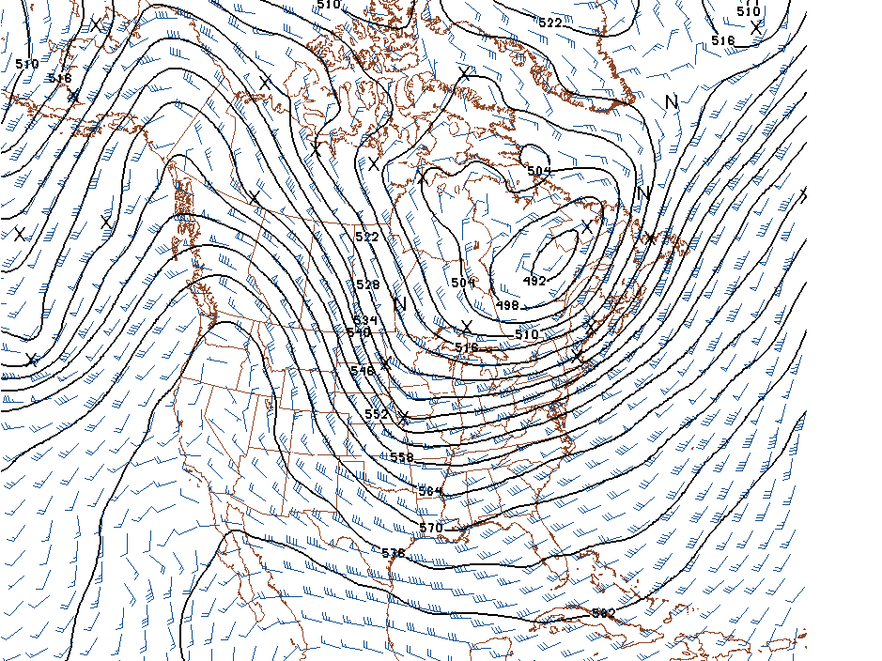
Class assignment
As seen on the 300 mb wave loop, the upper air pattern over North America is often one complete wave. Usually there is a ridge over the west and a trough in the eastern half of the nation. That is a pattern that recurs more often than any other.
If the wave over North America is centered at 45ºN, what wave number is that? What is the wave speed? Use the Rossby Wave Equation.

