Slide 1
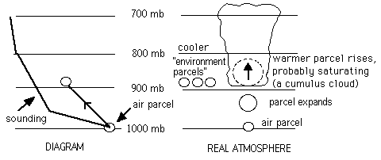
Stability

Slide 2
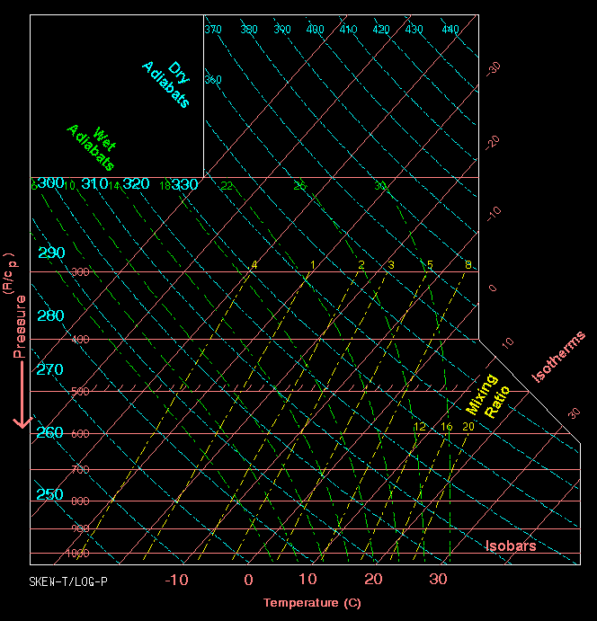
For these lectures, you will need to review the Skew-T/Log P diagram.
The setup of this diagram is shown here.
Isotherms are pink slanting lines.
Dry adiabats are blue and slightly curved.
Wet or moist adiabats are curved green lines.
Mixing ratios are straight, slanting yellow lines.

Slide 3
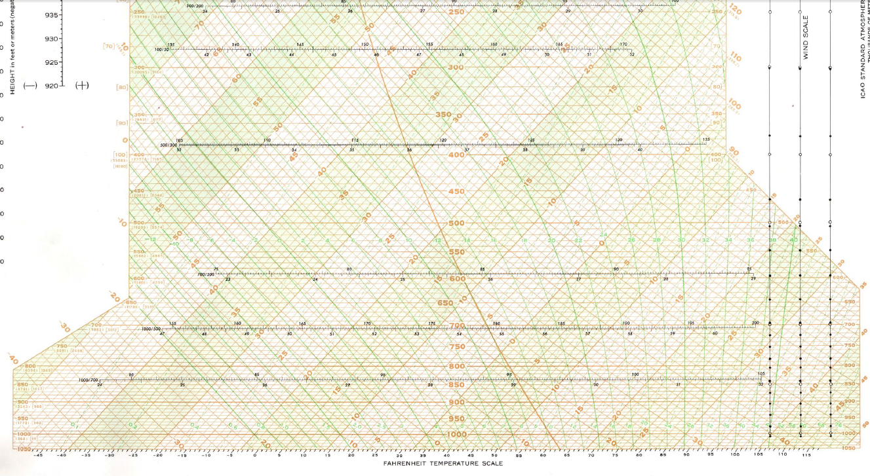
For this lecture, we’ll use the black background Skew-T Log P and we’ll also see examples on simple diagrams used on the web, but for labs you will draw on the big ones. The lines are the same for all Skew-Ts

Slide 5
When a parcel rises it follows an adiabat, dry if the parcel is unsaturated, wet if it saturates. These lapse rates probably aren’t coincident with the sounding.
If the parcel is warmer than the air at its new level, it is buoyant and rises (instability).
The soundings change, the adiabats don’t. So stability depends on the sounding and which adiabat the parcel follows.

Slide 6
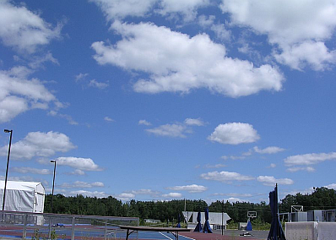
Remember the primary assumptions of parcel theory:
1. The parcel doesn’t mix with its environment
2. No compensating motions

Slide 7
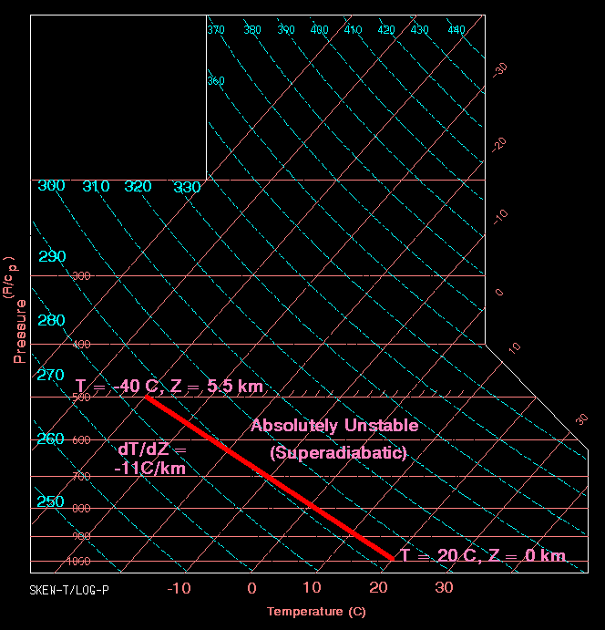
This is a sounding whose slope is greater than the dry adiabatic. So the lapse rate is less than -10°C/Km. That makes the sounding automatically unstable, called Absolutely Unstable.
No matter which adiabat the parcel follows, if lifted, it will be warmer than this sounding (try it!)
This is also known as being superadiabatic (or “super”).

Slide 8
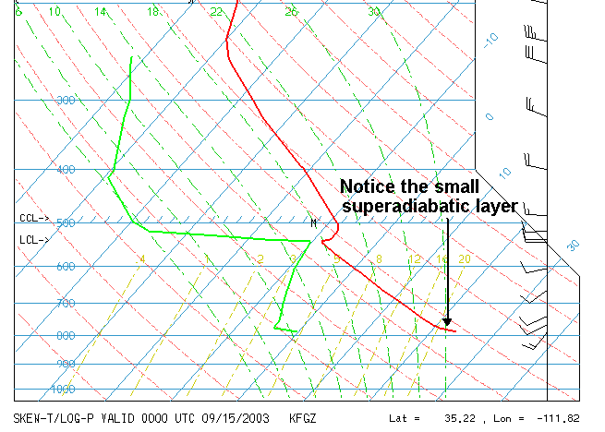

Slide 9
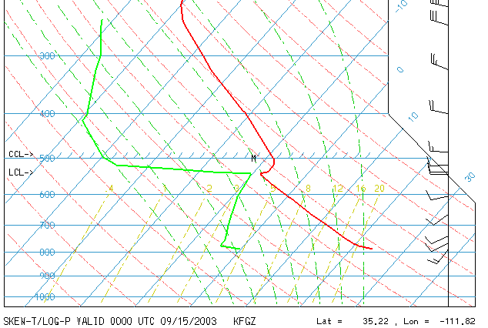
Questions for the class to answer
1. What caused the superadiabatic layer in the previous diagram? Similarly, why is the temperature sounding so slanted from 770 hPa to 540 hPa?
2. Why do the red and green sounding lines start at 795 hPa?
3. If there will be clouds at this place, what kind would they be?

Slide 10
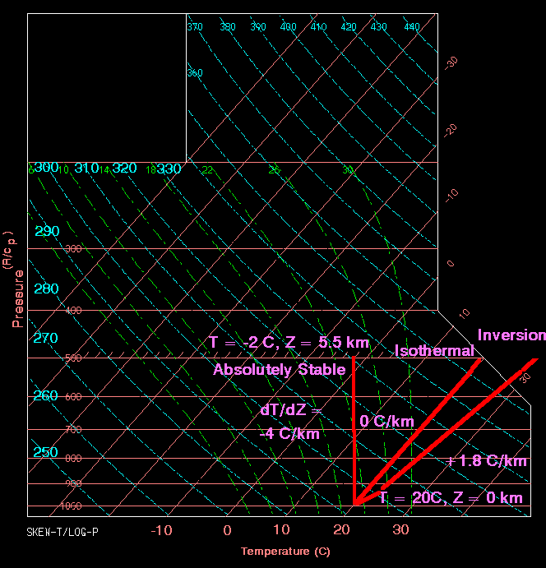
This is the Absolutely Stable type. Any lapse rate greater than the moist adiabatic (-6.5°C/Km) will be stable no matter which adiabat a lifted parcel follows.
The lapse rate can even be negative. It is still stable!

Slide 11
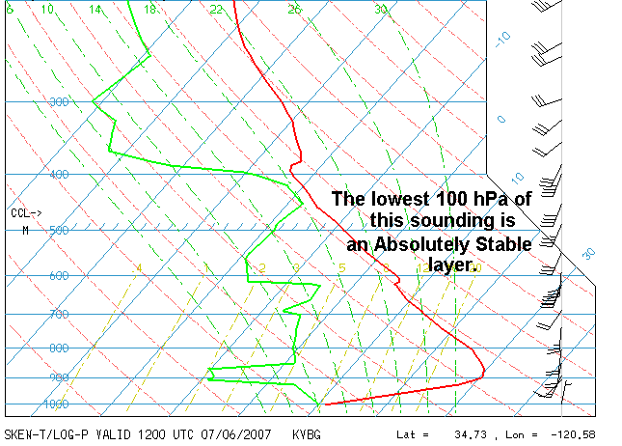

Slide 12
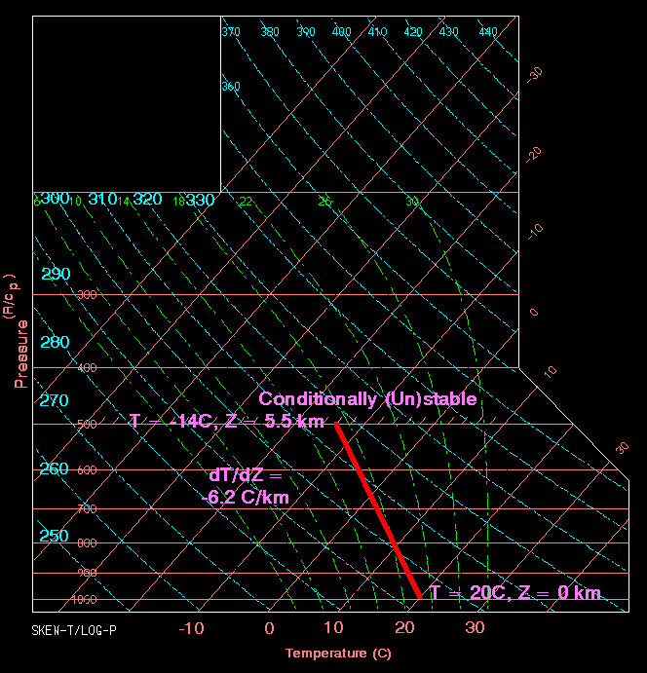
This is the most interesting case. When the lapse rate is between dry and moist adiabatic, the atmosphere is Conditionally stable (or unstable).
The condition is saturation. Saturated parcels rise along the wet adiabat and are unstable. Unsaturated parcels rise along the dry adiabat and are stable.

Slide 14
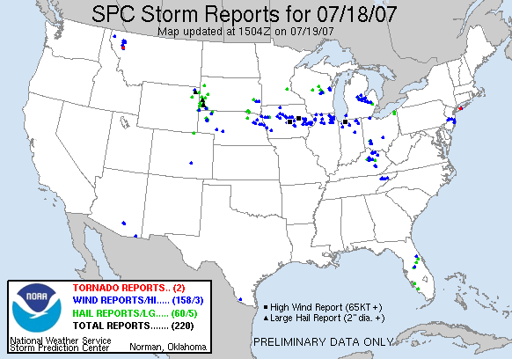
Davenport, IA
Example of the effect of strong instability on thunderstorms

Slide 16
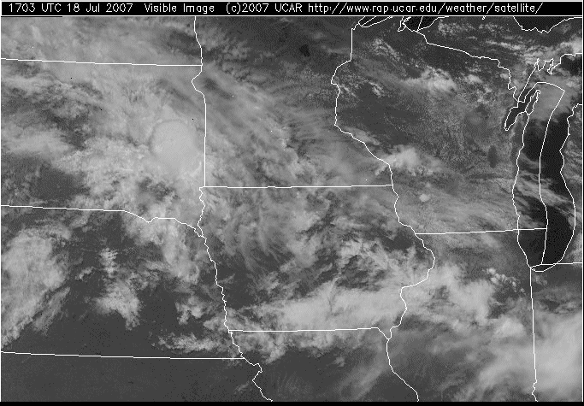
Visible loop of severe thunderstorms in Iowa on July 18, 2007

Slide 17
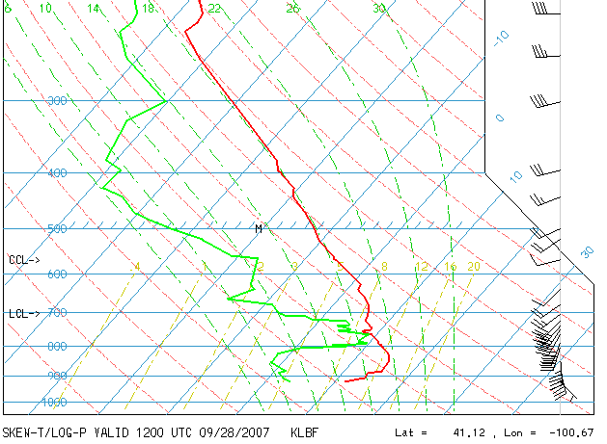
So, lapse rates come in three varieties:
Absolutely Stable
Absolutely Unstable
Conditionally stable (or unstable)
A sounding may exhibit any of these lapse rates and often more than one.

