Slide 1
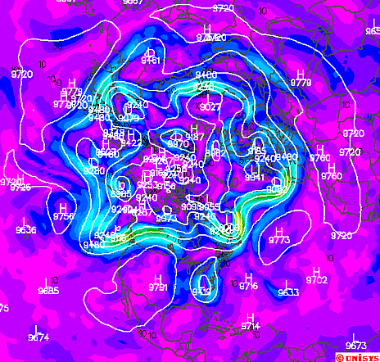
Upper Air

Slide 2
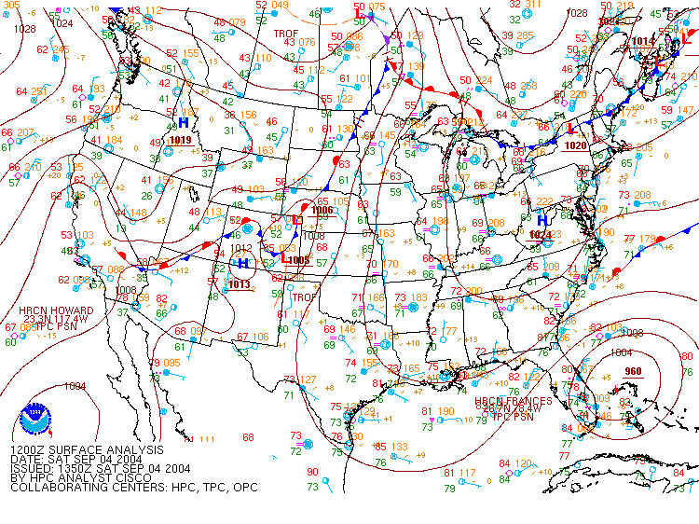
Using just the surface is like diagnosing a sick person using only an examination of the soles of the feet.

Slide 3
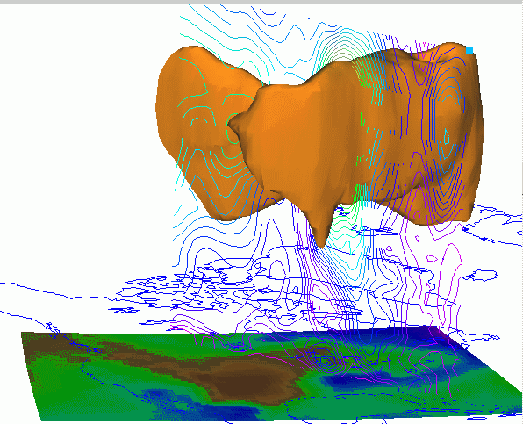
The atmosphere is three-dimensional
And important stuff (like the jet stream shown here) are not seen directly on a surface map.

Slide 4
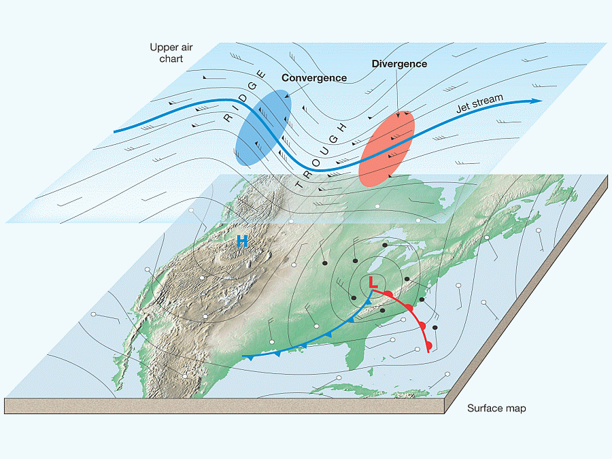
3-D views are amazing, but almost all analysis is done using 2-D map views of upper air pressure surfaces.

Slide 5
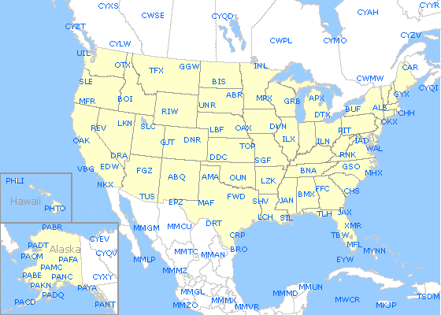
The upper air network is much more sparse than at the surface. Data also can be input via aircraft observations or special radiosondes.

Slide 6
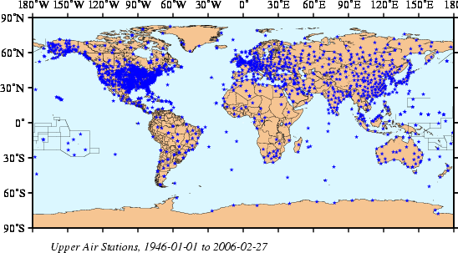
While the U.S. radiosonde station network looked a bit thin, it is much better than most of the world. Only Europe has a comparable density of stations.

Slide 7
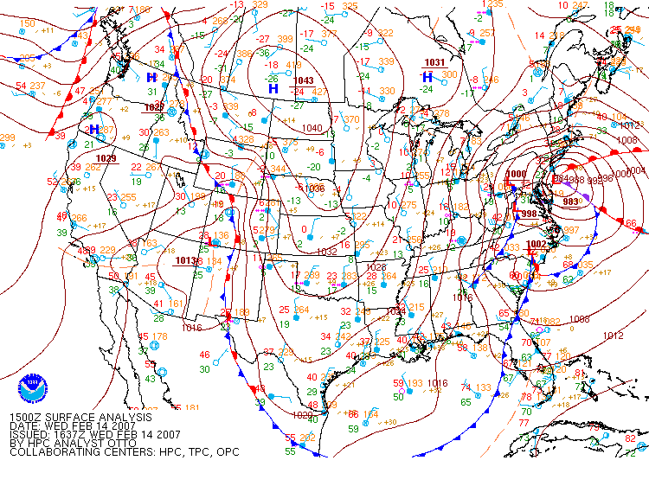
Here’s an interesting case: the Valentine’s Day storm of 2007
983 mb is deep, but not the most intense coastal cyclone at all.

Slide 8
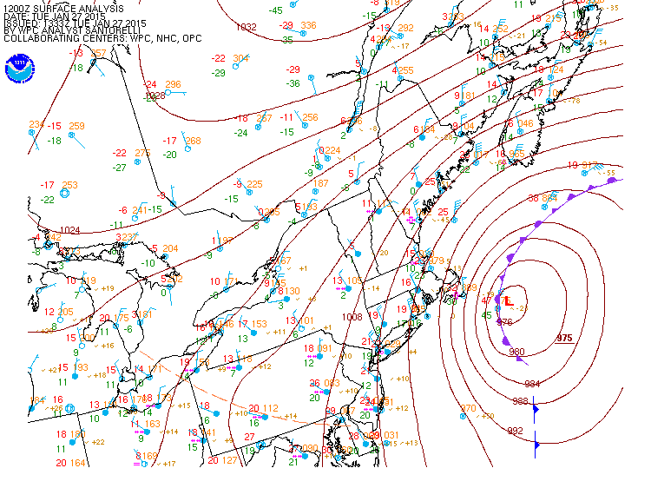
The northeast blizzard of 2015 was 975 mb. NYC got about 10”. Parts of LI got over 20”. Eastern Massachusetts got over 30”

Slide 9
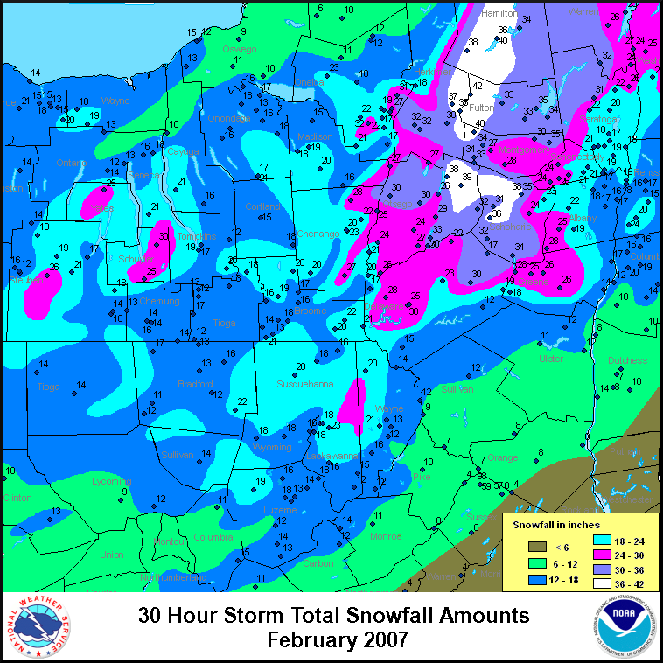
In the 2007 Valentine’s Day storm, some of the snow totals in New York were similar to the 2015 blizzard in New England.
Oneonta’s 30 inches set the record for any storm.
This storm had more features than just the surface Low.

Slide 10
At 850 mb, the storm center is over the Chesapeake Bay (remember where it was at the surface? Click it)
All pressures are 850 mb and the height of the surface (above sea level) is reported in decameters (dm). Temperatures are in Celsius degrees.
The black lines are isoheights (contours), not isobars.
Isotherms are colored.
L

Slide 11
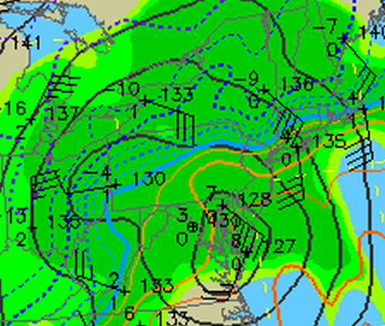
Here’s a closeup of the storm at 850 mb. A more modern unit for a millibar is called a hectopascal, hPa. So this is the 850 hPa surface.
What is happening over New York? Use all the information shown.

Slide 12
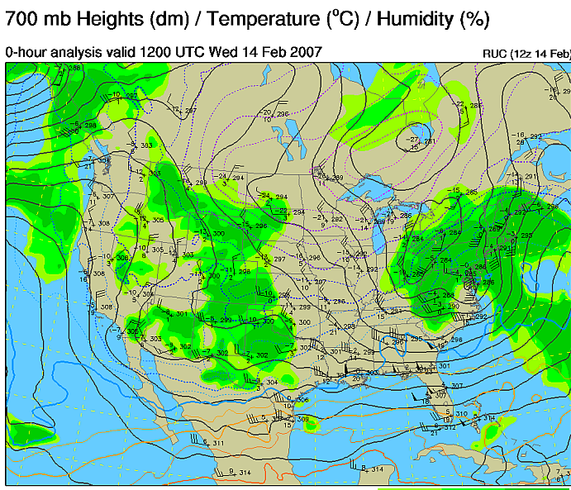
At 700 hPa, the closed low is hardly there, but the trough covers half the continent.
700 hPa is around (~) 300 dm (~10000 feet)

Slide 13
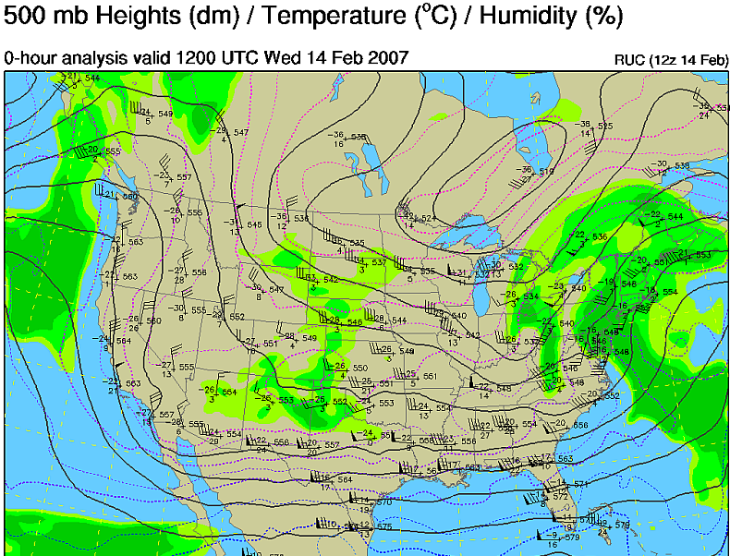
No closed Low here!
500 hPa is around half the atmosphere. It tends to be at 550 dm (~18000 ft)

Slide 14
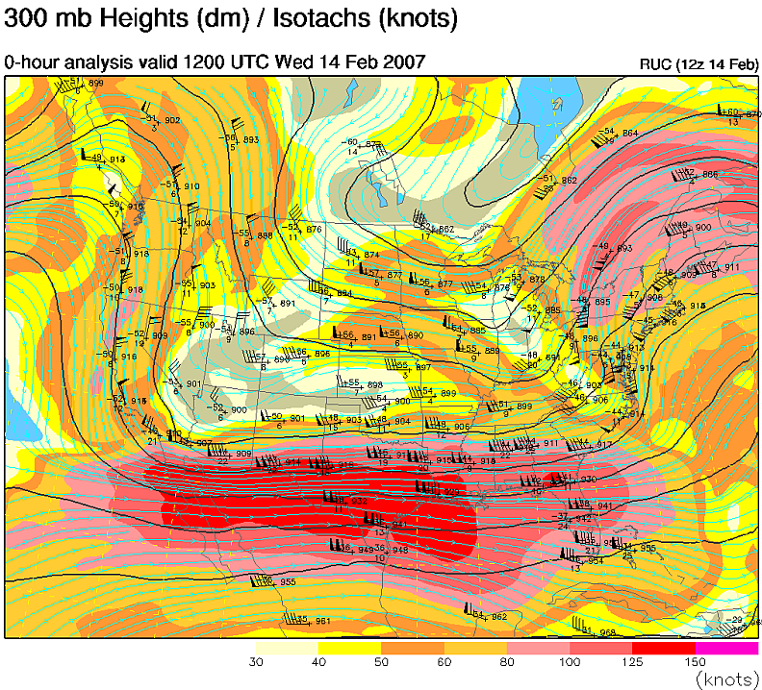
Upper air maps are at standard or mandatory levels. The next level up from 500 hPa is 300 hPa.
At 300hPa, RH is no longer an important factor. Wind speed is.
The maximum observed wind is 140 knots (161 mph) at LCH. But that isn’t the maximum wind in the system.

Slide 15
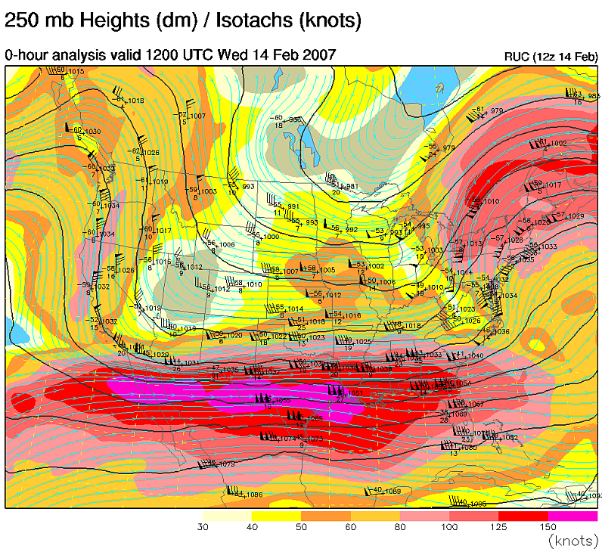
At 250 hPa the max windspeed is probably over 150 kt (172.5 mph).
This level is near the tropopause.

Slide 16
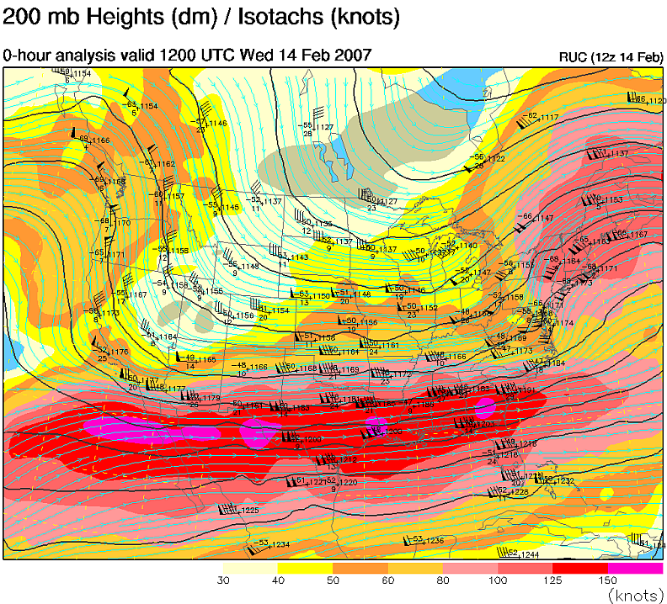
200 hPa heights are well over 1100 dm (35750 ft) and are in the stratosphere.
Notice the trough pattern is almost identical from 500 hPa on up.

Slide 17
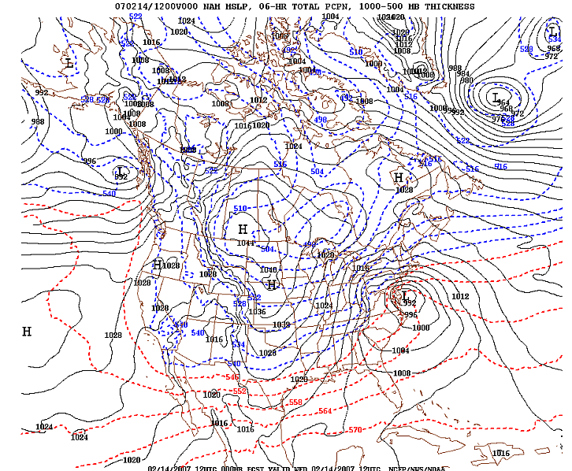
Thickness is a concept often used with upper air maps. It is simply the difference in heights between two constant height surfaces.
The most commonly used value is the 1000-500 mb thickness.
The red and blue dashed lines are the values of 1000-500 mb thickness

Slide 18
Thickness is related to Temperature via the Hypsometric Formula
The difference between levels, Z₁-Z_{o} is the thickness of the layer from P₁ to P₀:
Hypsometric Formula Other than constants,
the thickness depends on the
∆Z = (RT/g) ln(P_{o}/P₁) mean temperature of the layer!
We often take the levels to be 1000 hPa and 500 hPa, but any two levels can be used.

Slide 19
Example: What is the 1000-500 mb thickness if the mean temperature is -7°C?
R = 287 m² s⁻² k⁻¹, g = 9.8 m s⁻², T = -7°C = 266K, P₀ = 1000 hPa, P₁ = 500 hPa
∆Z = (RT/g) ln(P_{o}/P₁)
∆Z = (287 m² s⁻² K⁻¹ x 266K/9.8 m s⁻²) ln 2
∆Z = 5399.6 m which is approximately 540 decameters (540 dm)

Slide 20
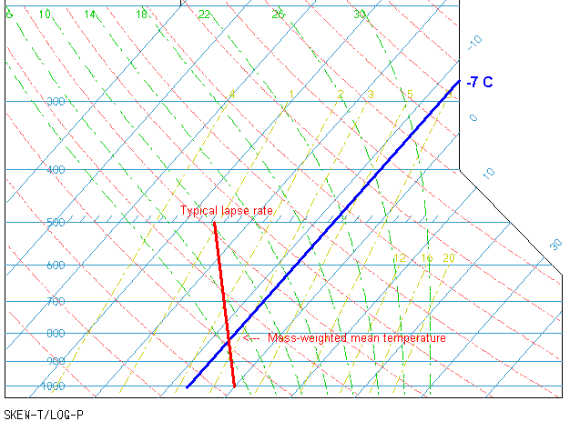
In typical situations when the mean temperature is -7°C, the surface is at or close to 0°C. This is often the deciding factor between rain and snow.
Be careful! Your “typical” lapse rate has a lot to say about it. In the warm season, it is different and 540 dm thickness does NOT always mean 0°C.
Here the 500 hPa temperature is -16°C so the lapse rate is ~ 3°C/km)

Slide 21
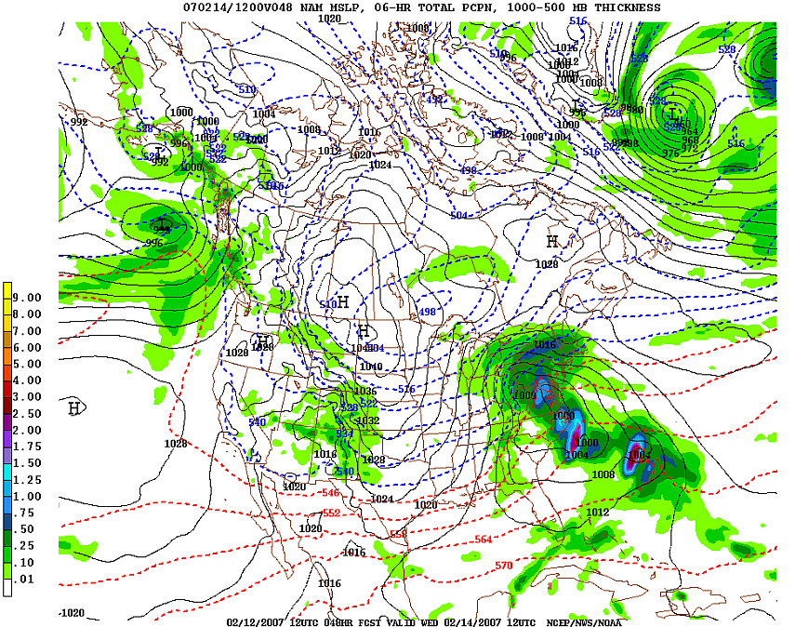
For places near sea level, the rain/snow line is where the thickness lines change color, at 540 dm.

Slide 22
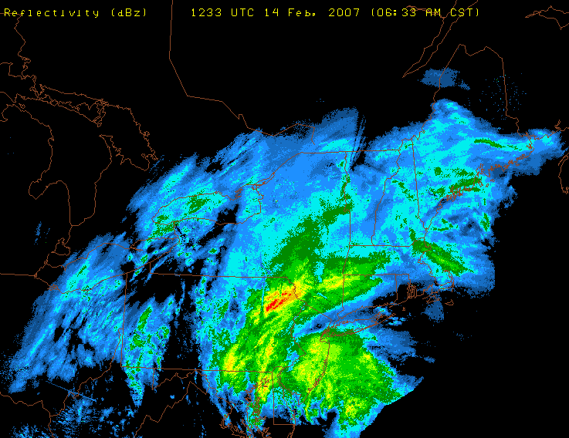
Radar showed heavy precipitation in central NY and eastern PA, but also in NJ and in NYC.

Slide 23
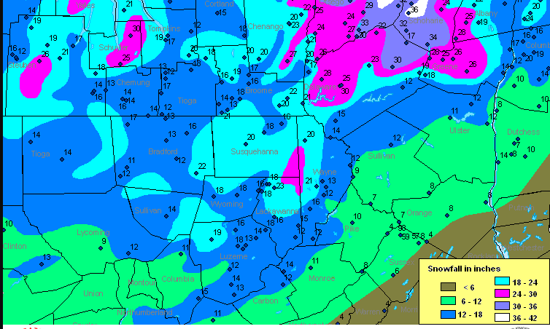
South of the 540 dm thickness, the snowfall amounts drop off dramatically. Probably most of their precipitation was rain, with a few inches at the end of the storm as the cold air moved in.

Slide 24
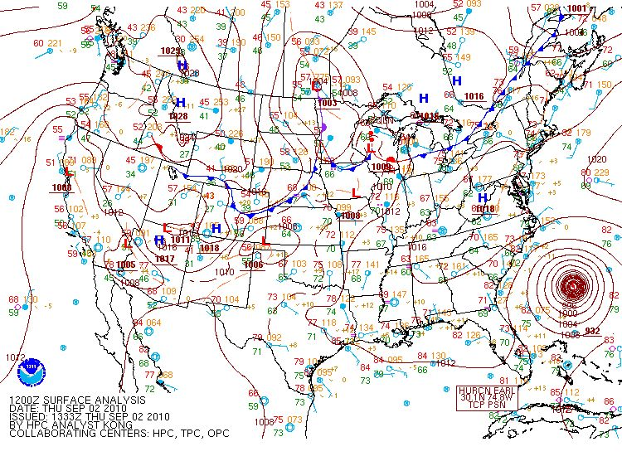
How about a tropical situation? What does the upper air look like?

Slide 30
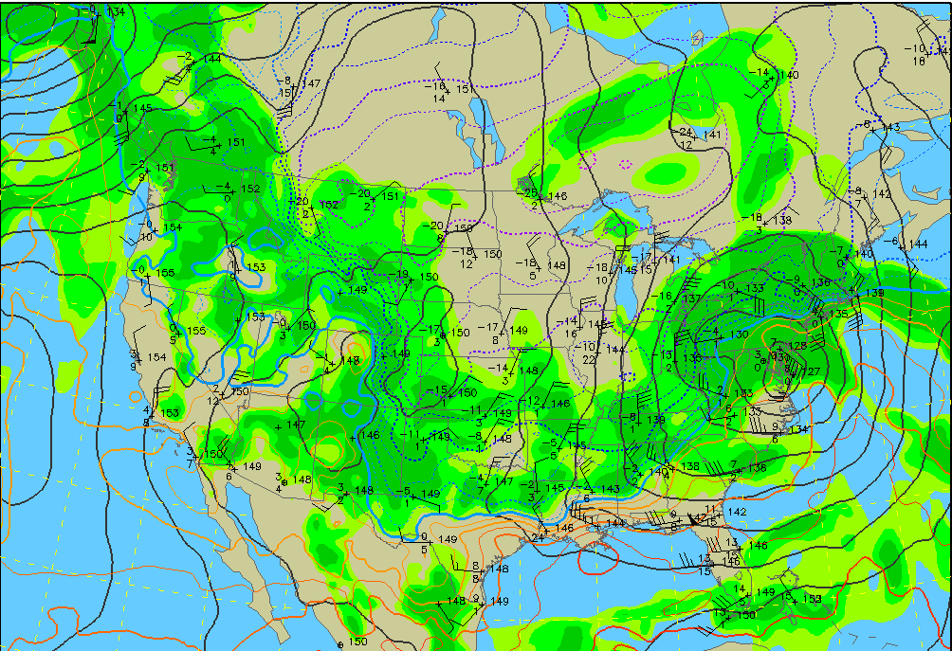
Did you notice? The overall pattern did not change much from 500 hPa to 300 hPa to 200 hPa. That is typical for the upper troposphere. Look at the black height contours.
What is the biggest atmospheric difference between this chart and the three above?
Compare the patterns above with the 850 hPa pattern

Slide 31
Next: Air Masses, after Exam 1

