Slide 1
What causes vertical motion?
In confined fluids, vertical motion is always accompanied by rotation. For example (click):

Slide 2
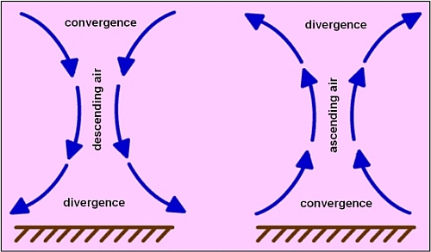
In the atmosphere, convergence at the surface leads to upward vertical motion and divergence aloft.

Slide 3
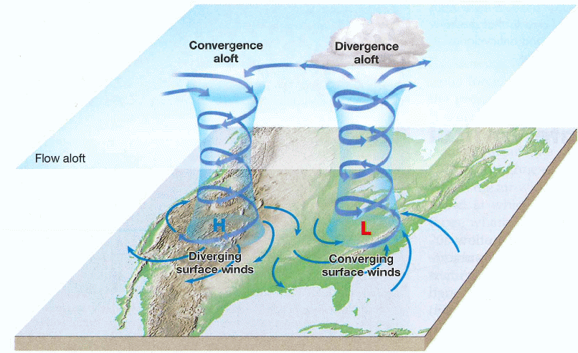
But you only get surface convergence and divergence with Low and High pressure systems.
Coriolis Force makes the converging (diverging) winds turn cyclonically (anti-cyclonically)
By the way, Coriolis is NOT the main reason toilets swirl. It’s how the water jets are aimed that determines the direction of rotation.

Slide 4
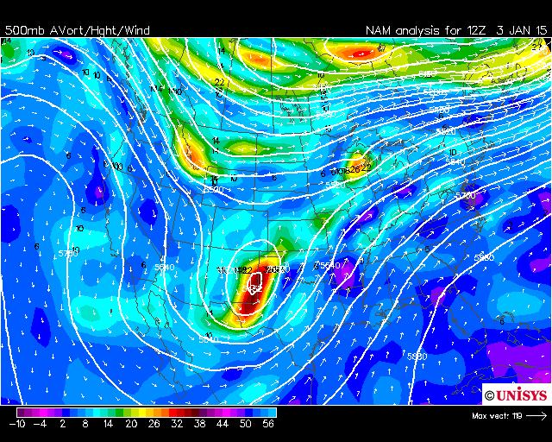
Upward motion is always accompanied by cyclonic rotation so we look for vorticity:
This is a maximum in the Absolute Vorticity (often called a “vortmax”)

Slide 5
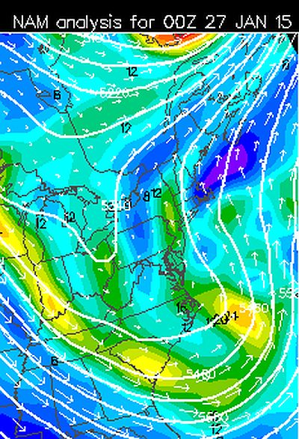
It turns out that the vertical motion is associated with the change in vorticity, not the vorticity itself.
PVA
Vortmax
NVA
When cyclonic vorticity is being advected, i.e., moved by the wind, we call it Positive Vorticity Advection or PVA.
Of course, when anti-cyclonic vorticity is being advected, we call it Negative Vorticity Advection or NVA.

Slide 6
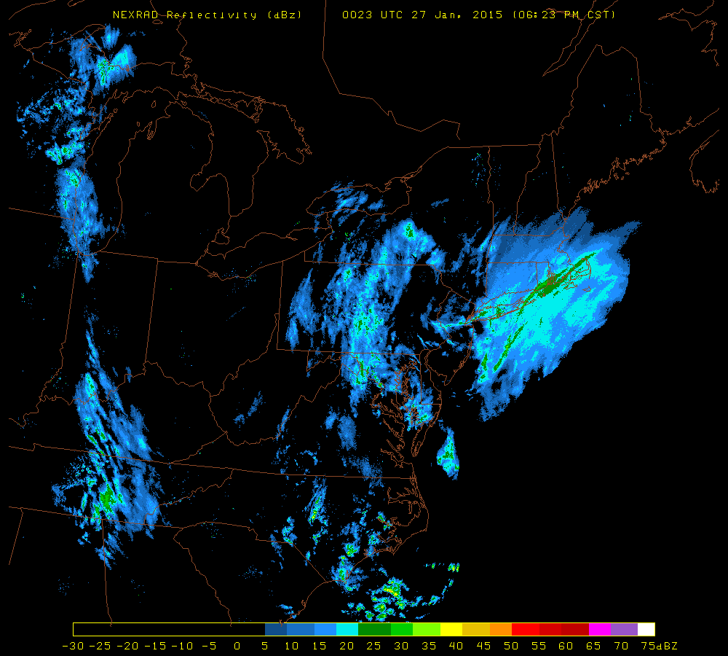
PVA here with echoes
Vortmax is here. No echoes
NVA is here. Why echoes?

Slide 7
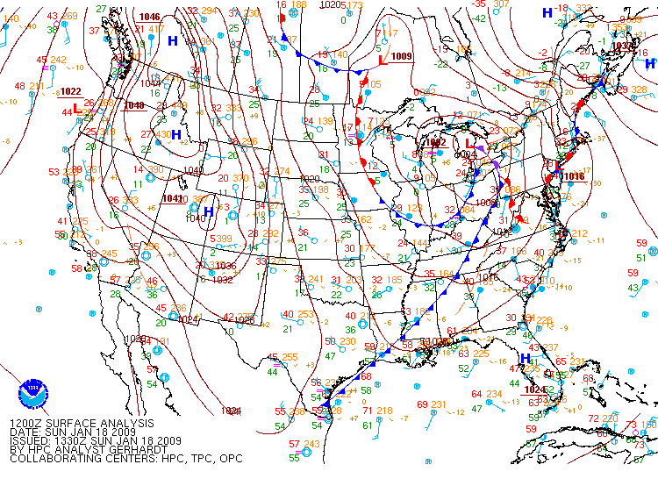
Another example: January 18, 2009

Slide 8
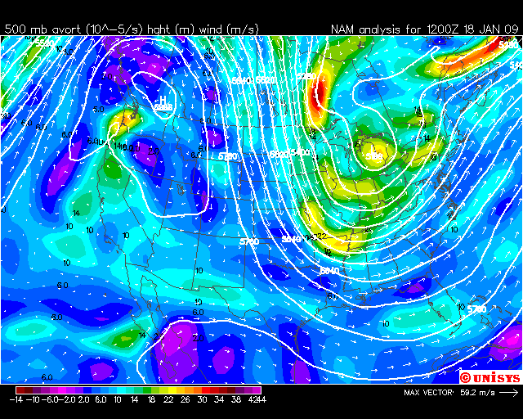
Here’s the 500 mb map with absolute vorticity.

Slide 9
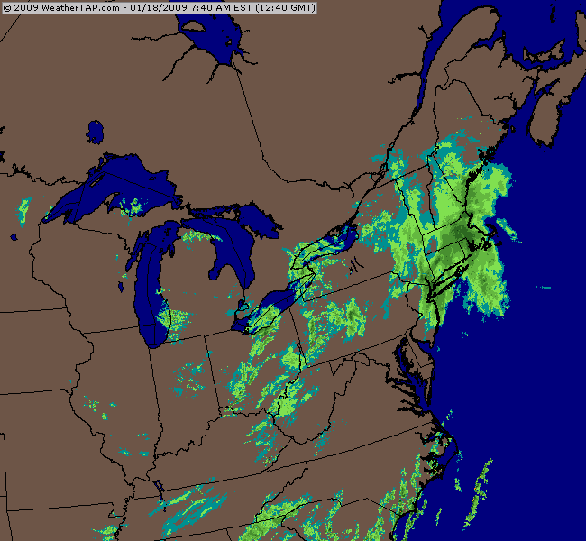
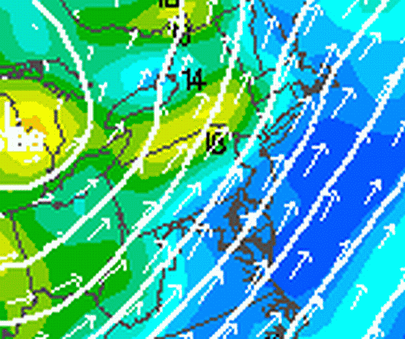
Close up view of the absolute vorticity
The echoes appear where vorticity is low, but PVA is strong
Northeast Radar Loop

Slide 10
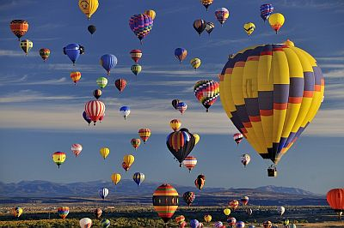
PVA is not the sole contributor to vertical motion
What else causes air to rise (and sink)?
Hint
Instability. The hot air is lighter than the cool air so it rises.
What else?

Slide 11
What’s happening here?
In a Lava Lamp™ the red goo is heated.

Slide 12
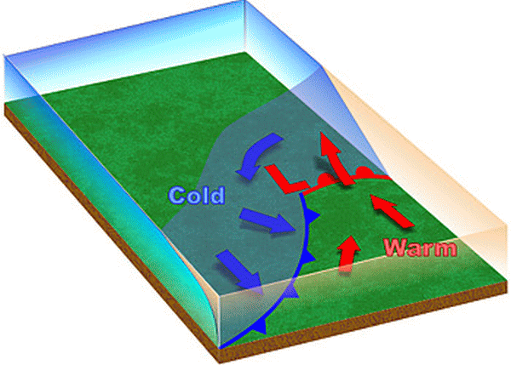
This one isn’t as intuitive as the others.
Air in the warm sector is being advected to the cooler air.

Slide 13
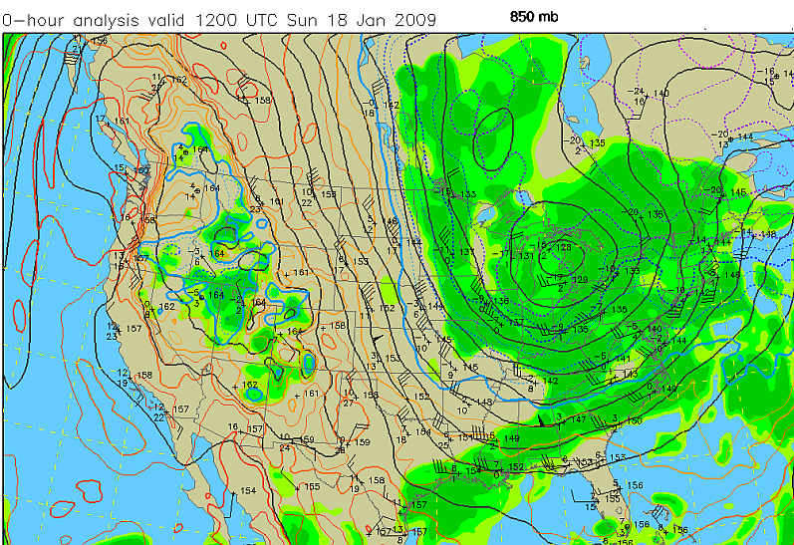
You look for warm advection at 850 mb. This map for the last example shows strong warm advection in New England.

Slide 14
Front along the New England coast.

Slide 15
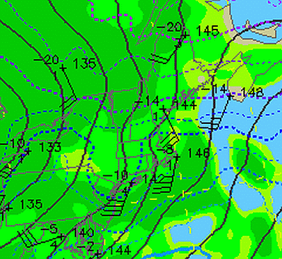
When winds blow across isotherms, there is temperature advection.
Notice the wind at Chatham, MA, at 35 knots from the SSW
The temperature is -8°C. Temperatures downstream are 6 degrees cooler.
New England is cold, but has significant warm advection over the cool air north of the coastal front. This is sometimes called overrunning.

Slide 16
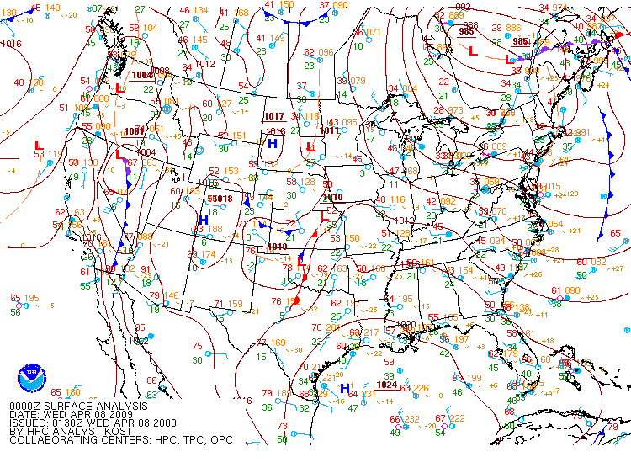
Sometimes there is no warm advection (or PVA) but upward vertical motion still happens. Here’s an example:

Slide 17
Post-cold frontal passage, there is low-level cold advection (supports downward vertical motion)

Slide 18
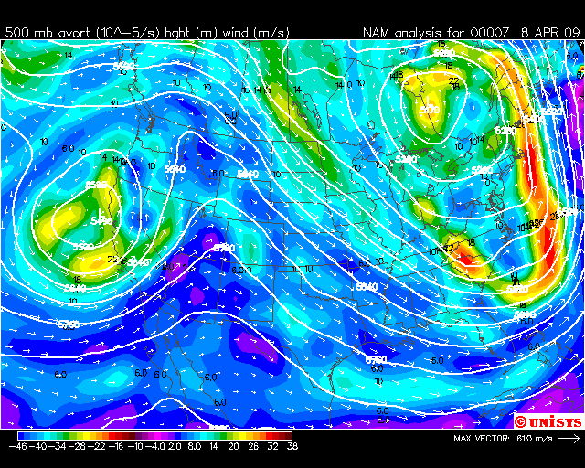
There is PVA east of New England and well south in the Carolinas.

Slide 19
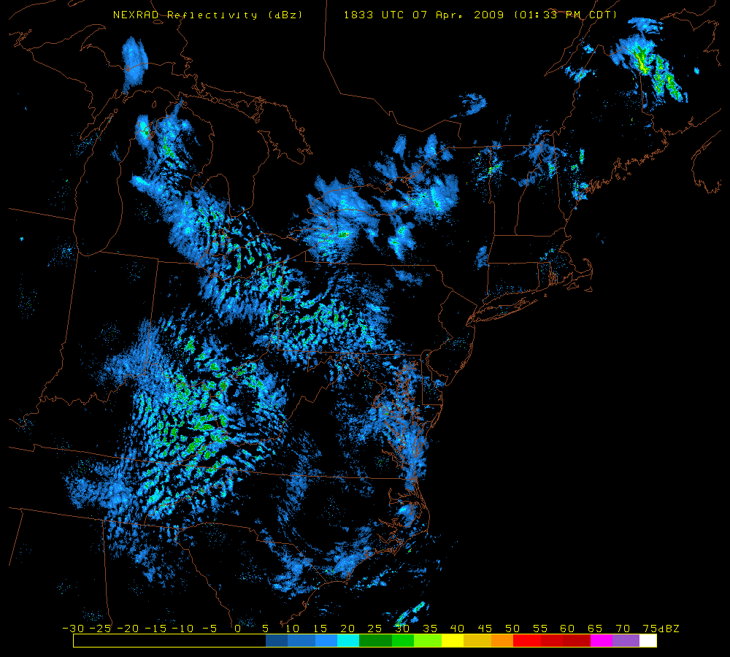
Widespread light convection is due to the very cold air aloft causing static instability.

Slide 20
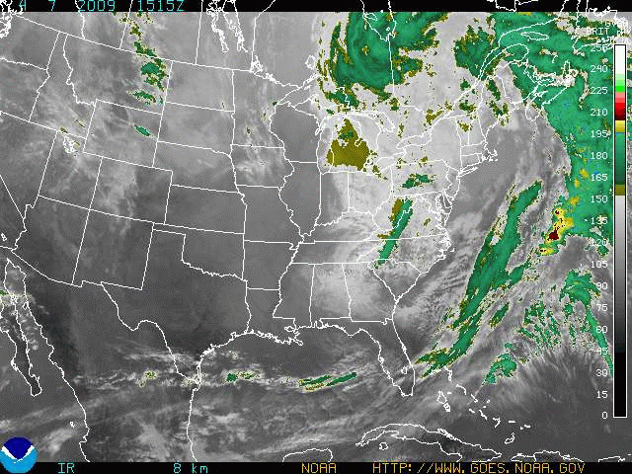
The low clouds behind the dry tongue are due to the convection. This is backlash.

Slide 21
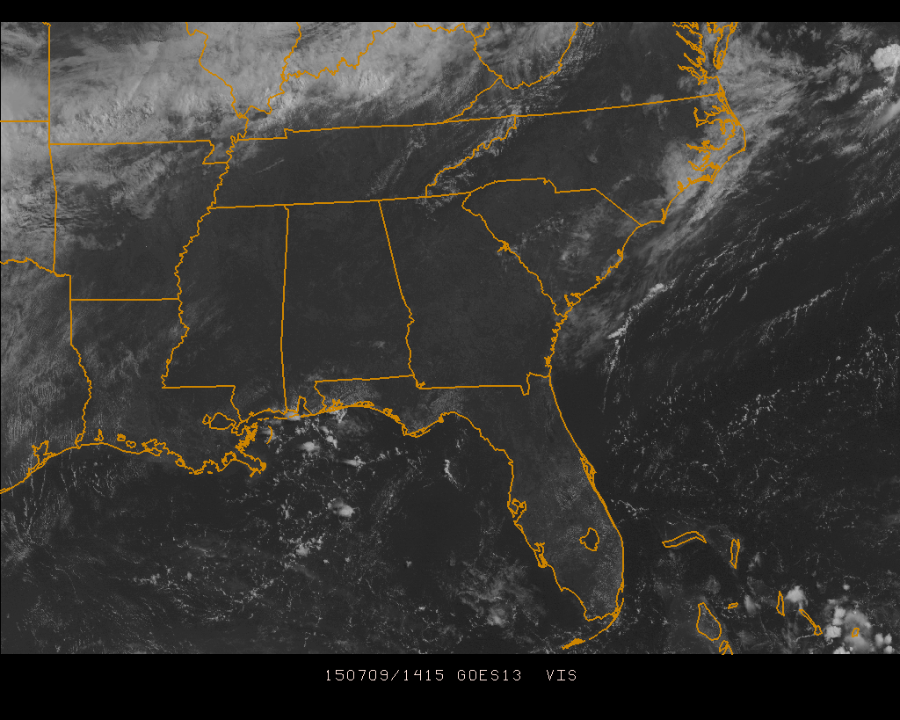
Here’s a gorgeous day in the Southeastern U.S., absolutely clear skies in many parts of Florida, Georgia, Alabama, and Mississippi.

Slide 22
During the day, cumulus clouds form and by 1945Z, scattered heavy thundershowers dot the southeast from Florida to Mississippi.`

Slide 23
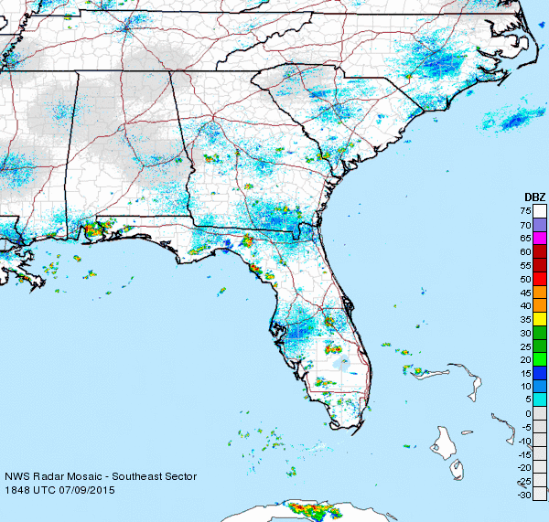
Radar confirms the storms are intense (50 DBZ+), but quite local.
What caused this vertical motion?

Slide 24
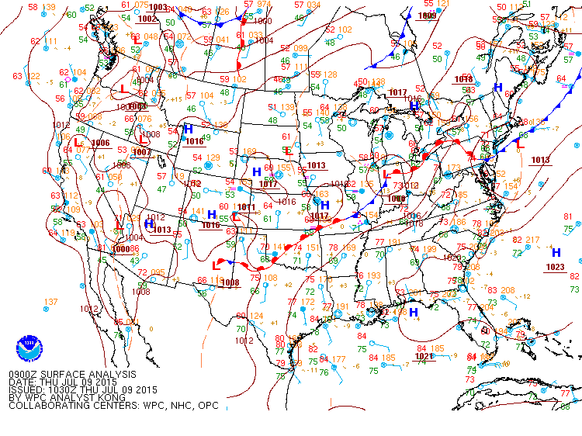
No fronts, just High pressure over the southeast.

Slide 25
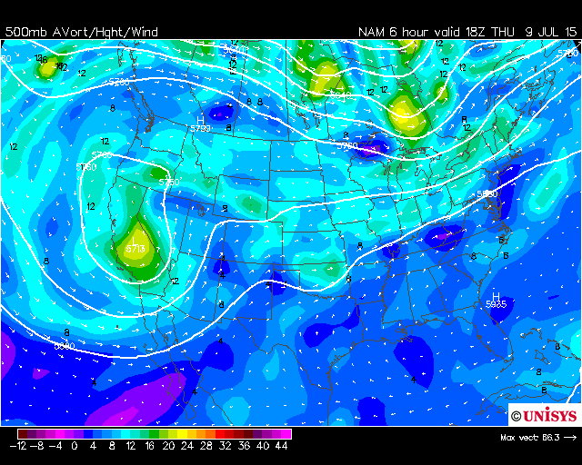
Low Absolute Vorticity and almost no advection of vorticity

Slide 26
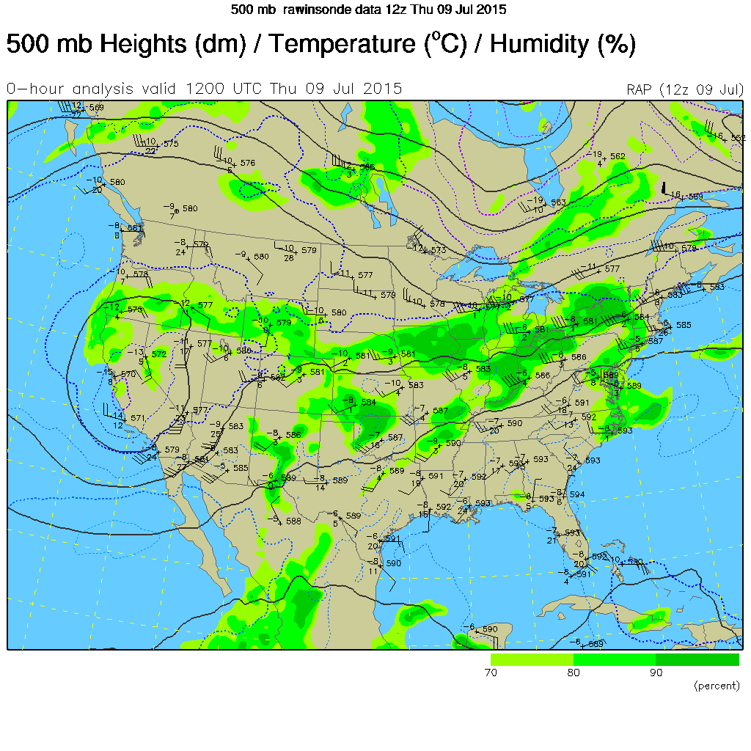
Relatively warm upper air temperatures, around -7 C so the column is probably stable.

Slide 27
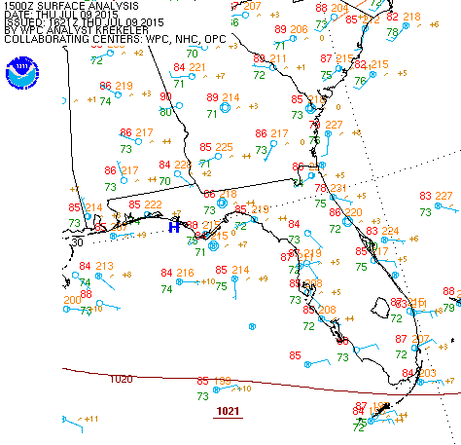
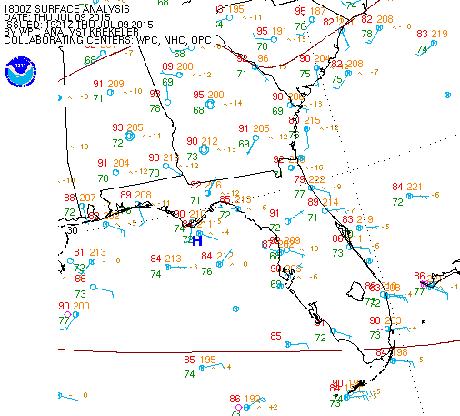
These observations suggest the mechanism for upward vertical motion. Don’t overthink this.
So this was a simple case of afternoon heating of very humid air. You can count on thunderstorms but you won’t know exactly where they will form.

Slide 28
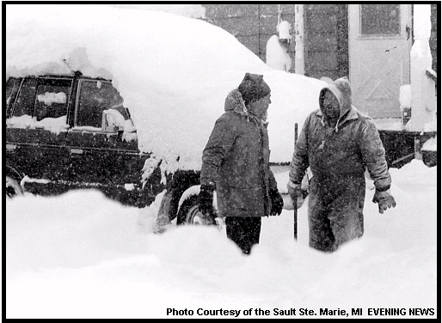
Next: Lake Effect

Slide 30
Next: A useful concept for predicting when the conditions for vertical motion will change and help create new storms.

