Slide 1
Announcements
Quote of the day:
Willard Gibbs is, in my opinion, one of the most original and important creative minds in the field of science America has produced.
—Albert Einstein
If you don’t have a clicker with you, sign in after class
Chapter 19 Homework- Finish it!
Exam #1:
This FRIDAY!
Covers Chapter 5, 8.4, and 19 (through page 9-14)
Study guide posted on course web site

Slide 2
Gibbs’ Free Energy
Gibbs’ Free Energy: ΔG = ΔH - TΔS
(All variables are in terms of the system)
When ΔG is negative, reaction is favored.
When ΔG is positive, reaction is disfavored.
When calculating ΔG, be careful with enthalpy units!

Slide 3
At 25°C, is this reaction spontaneous?
N₂(g) + 3 H₂(g) → 2 NH₃(g)

Slide 4
ΔG = ΔH - TΔS
2 Fe₂O₃(s) + 3 C(s) → 4 Fe(s) + 3 CO₂(g)
ΔH = +468 kJ ΔS = +561 J/K
What is ΔG at 25 ºC and at 1000 ºC?

Slide 5
Temperature Domains and Reaction Favorability
ΔH
+
-
+
ΔS
-

Slide 6
2 Fe₂O₃(s) + 3 C(s) → 4 Fe(s) + 3 CO₂(g)
ΔH = +468 kJ
ΔS = +561 J/K
In what temperature range will this reaction be favored?
High or low?
What temperature?

Slide 7
At what temperature is this reaction spontaneous? (favored) CaCO₃(s) → CaO(s) + CO₂(g) ΔH° = +178 kJ ΔS° = +161 J/K
High temperatures
Low temperatures
All temperatures
No temperatures

Slide 8
At what temperature is this reaction spontaneous? (favored) C(s) + 2H₂(g) → CH₄ (g) ΔH° = -74.80 kJ ΔS° = -80.08 J/K
High temperatures
Low temperatures
All temperatures
No temperatures

Slide 9
At what temperatures is this reaction spontaneous? (favored) N₂(g) + 2O₂(g) → 2NO₂(g) ΔH° = +66.36 kJ ΔS° = -121.77 J/K
High temperatures
Low temperatures
All temperatures
No temperatures

Slide 10
Free Energy vs. Temperature
 | Reaction 1 | Reaction 2 | Reaction 3
ΔH | 468.00 | -80.08 | -625
ΔS | 0.56 | 0.07 | -0.65
T | ΔG | ΔG | ΔG
550 | 159.45 | ΔG | -267.50
575 | 145.43 | -118.58 | -251.25
600 | 131.40 | -120.33 | -235.00
625 | 117.38 | -122.08 | -218.75
650 | 103.35 | -123.83 | -202.50
675 | 89.33 | -125.58 | -186.25
700 | 75.30 | -127.33 | -170.00
725 | 61.28 | -129.08 | -153.75
750 | 47.25 | -130.83 | -137.50
775 | 33.23 | -132.58 | -121.25
800 | 19.20 | -134.33 | -105.00
825 | 5.17 | -136.08 | -88.75
850 | -8.85 | -137.83 | -72.50
875 | -22.88 | -139.58 | -56.25
900 | -36.90 | -141.33 | -40.00
925 | -50.93 | -143.08 | -23.75
950 | -64.95 | -144.83 | -7.50
975 | -78.98 | -146.58 | 8.75
1000 | -93.00 | -148.33 | 25.00
1025 | -107.03 | -150.08 | 41.25
1050 | -121.05 | -151.83 | 57.50
1075 | -135.08 | -153.58 | 73.75
1100 | -149.10 | -155.33 | 90.00
1125 | -163.13 | -157.08 | 106.25
1150 | -177.15 | -158.83 | 122.50
1175 | -191.18 | -160.58 | 138.75
1200 | -205.20 | -162.33 | 155.00
1225 | -219.23 | -164.08 | 171.25
1250 | -233.25 | -165.83 | 187.50

Slide 11
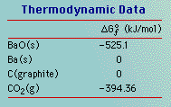
Free Energy of Formation: Only used at 25 ºC
2 BaO(s) + C(s) → 2 Ba(s) + CO₂(g)

Slide 12
Exam #1 Review

Slide 13
Exam #1 Review

Slide 14
Exam #1 Review

Slide 15
Exam #1 Review

Slide 16
Chapter 11
Intermolecular Forces and the Liquid State

Slide 17
Review: Bonding
When atoms stick together, that’s bonding.

Slide 18
Why do Covalent Bonds Form?
Electrons on one
atom attracted to
nucleus of other
atom
Nucleus on each atom repels other nucleus
Electron on each atom repels other electron
If new attractions > new repulsions, then a bond forms

Slide 19
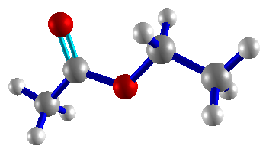
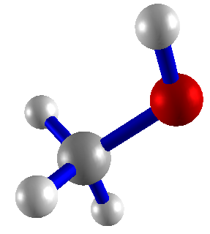
Determining Molecular Geometry
Valence Lewis Electron-Pair Molecular
Electrons Structure Geometry Geometry

Slide 20
Chapter 11 Properties of Liquids and Solids
Formula → Lewis Structure → Electron Geometry →
Molecular Geometry → Polarity →
Intermolecular Forces → Properties

Slide 21
What happens when water boils. Draw pictures.
Bonding vs. Intermolecular Forces (IMFs):
Where do IMFs come from?

Slide 22
Types of forces between molecules: Intermolecular Forces (IMFs)

Slide 23
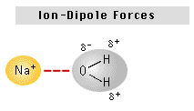
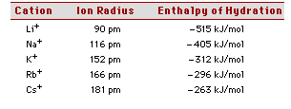
Ion-Dipole Forces: Between dissolved ions and polar molecules
Enthalpy of hydration:
Trends:

Slide 24
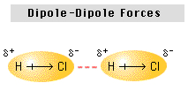
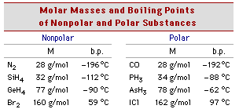
Dipole-Dipole Forces: Between polar molecules
Trends:

Slide 25
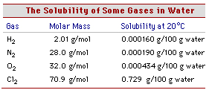
Dipole-Induced Dipole Forces: Between polar and nonpolar molecules
Trends:

Slide 26
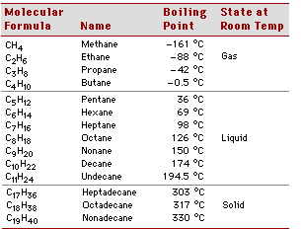
Induced Dipole-Induced Dipole Forces: Between nonpolar molecules
Trends:

Slide 27
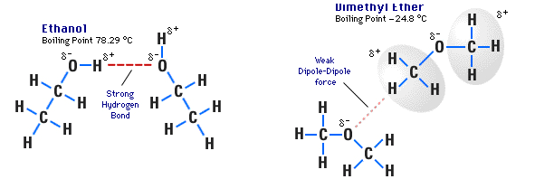
Hydrogen Bonding: Molecules with F-H, O-H, or N-H bonds

Slide 29
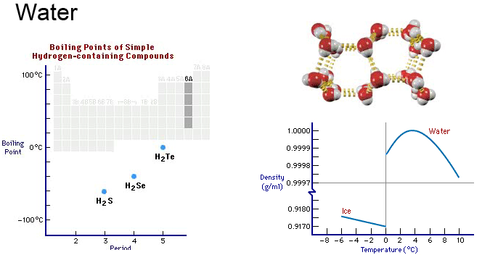
Hydrogen Bonding: Properties of water

Slide 30
Hydrogen Bonding: Properties of water

Slide 31
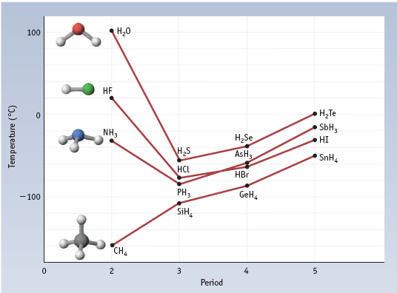
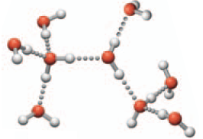
More on Boiling Points and Hydrogen Bonding

Slide 32
Identifying IMFs

Slide 33
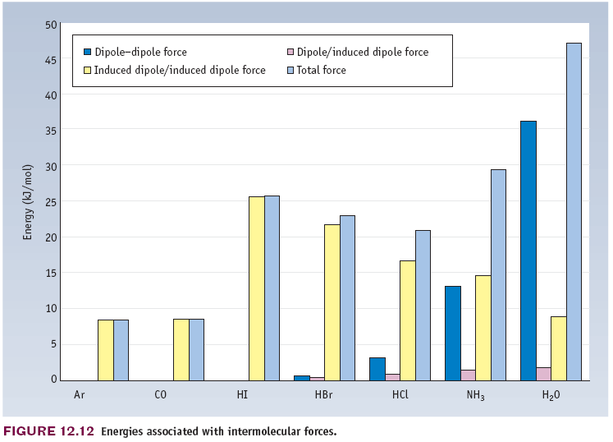
Relative Contributions of Different IMFs

Slide 34
Properties of Liquids
Vapor Pressure (volatility)
Boiling Point
Enthalpy of Vaporization
Viscosity
Surface Tension

Slide 35
Molecular interpretation of vapor pressure and boiling.
Enthalpy of vaporization:

Slide 36
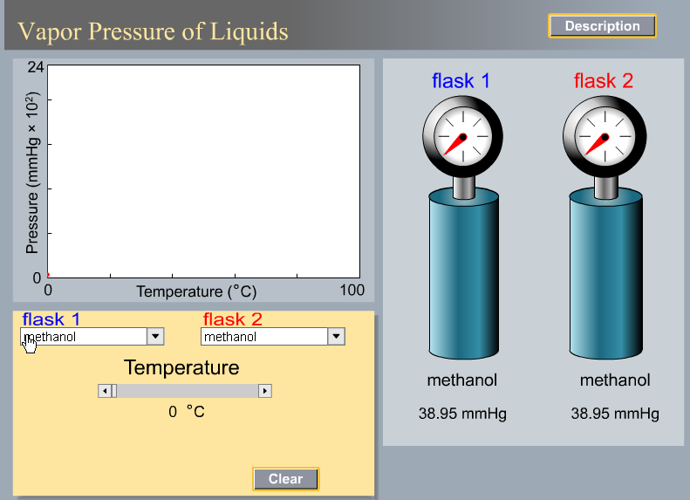

Slide 37
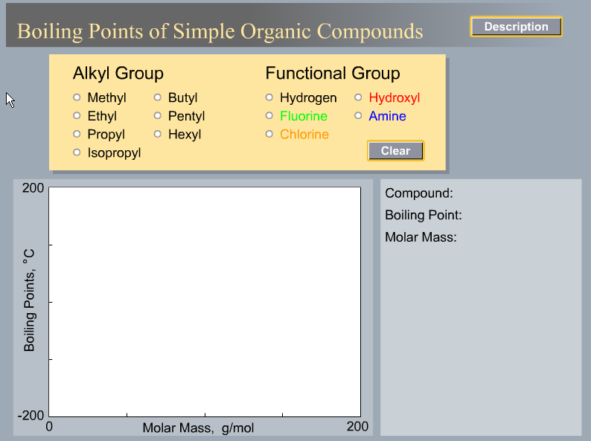

Slide 38
Clausius-Clapyron Equation: Vapor Pressure, ΔH_{vap}, and T

Slide 39
Graphical Method of Determining Enthalpy of Vaporization

Slide 40
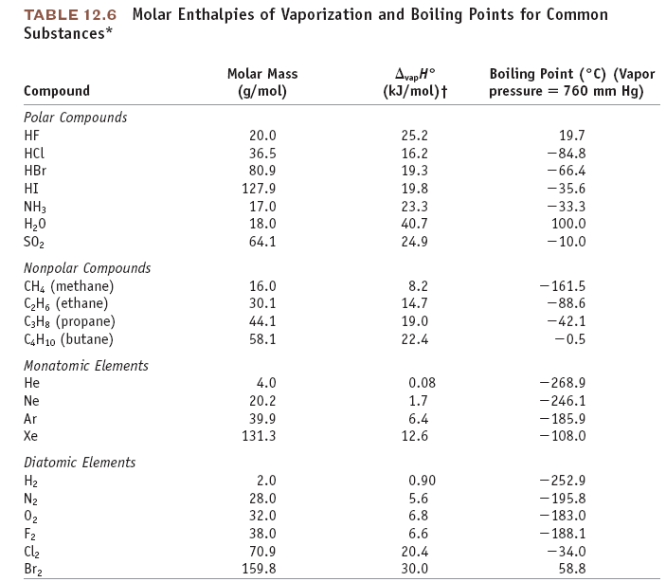

Slide 41
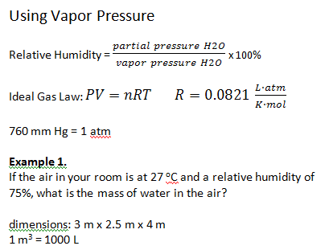

Slide 42
Example 2.
What is the mass of water in the air in this lecture hall?
14 m x 5 m x 17 m
T = 22 ºC
Humidity = 43%

Slide 43
Example 3.
A 1-L flask of air is at 30 ºC and relative humidity of 68%. The flask is put
in a freezer and the temperature decreases to 5 ºC. What happens?

Slide 44
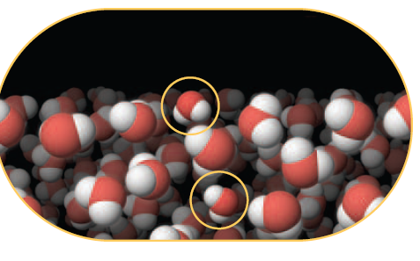
Surface Tension

