Slide 1
Announcements
If you don’t have a clicker with you, sign in after class
This week: Chapter 11 Intermolecular Forces (OWL homework due 2/28)
Exam #1 Results:
Average: 68

Slide 2
Chapter 11
Intermolecular Forces and the Liquid State

Slide 3
Formula → Lewis Structure → Electron Geometry
Molecular Geometry → Polarity
Intermolecular Forces → Properties

Slide 4
What happens when water boils? Draw a picture.
Bonding vs. Intermolecular Forces
Where do IMF’s come from?

Slide 5
Types of Forces Between Molecules Intermolecular Forces (IMF’s)

Slide 6
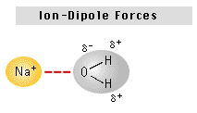
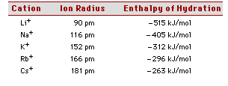
Ion-Dipole Forces: Between dissolved ions and polar molecules
Enthalpy of hydration:
Trends:

Slide 7
Which would have the highest ΔH_{hyd}?
Li⁺
Na⁺
K⁺
Ca²⁺
Al³⁺

Slide 8
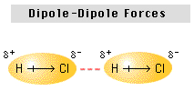
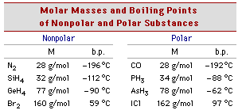
Dipole-Dipole Forces: Between polar molecules
Trends:

Slide 9
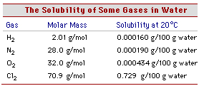
Dipole- Induced Dipole Forces: Between polar and nonpolar molecules
Trends:

Slide 10
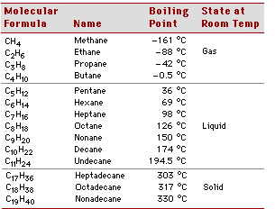
Induced Dipole- Induced Dipole Forces: Between nonpolar molecules
Trends:

Slide 11
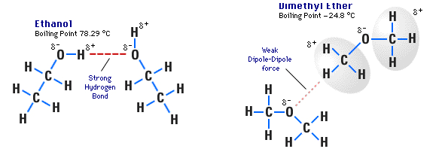
Hydrogen Bonds: Between Molecules with F-H, O-H, or N-H bonds
Trends:
C₂H₆O

Slide 12
Which has strongest IMF?
F₂
Cl₂
Br₂
I₂

Slide 13
Which has the strongest IMF?
CH₃CH₃
CH₃OH

Slide 15
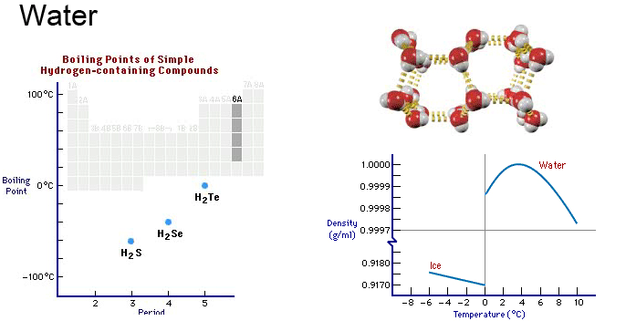
Hydrogen Bonding: Properties of water

Slide 16
Hydrogen Bonding: Properties of water

Slide 17
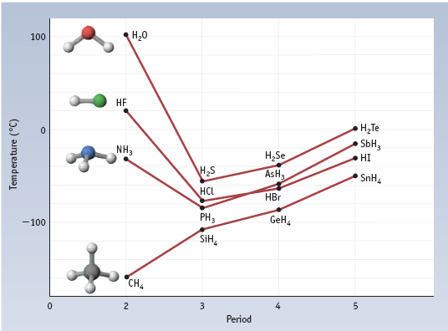
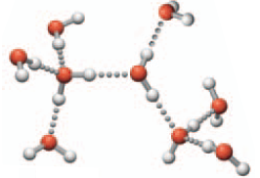
More on Boiling Points and Hydrogen Bonding

Slide 18
Identifying IMFs

Slide 19
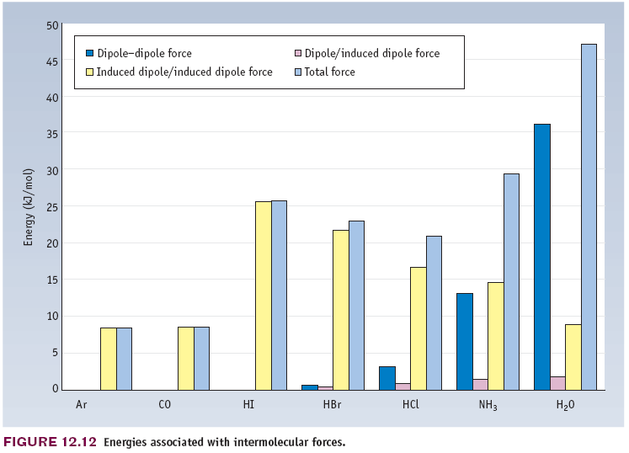
Relative Contributions of Different IMFs

Slide 20
Properties of Liquids
Vapor Pressure (volatility)
Boiling Point
Enthalpy of Vaporization
Viscosity
Surface Tension

Slide 21
Molecular interpretation of vapor pressure and boiling.
Enthalpy of vaporization:

Slide 22
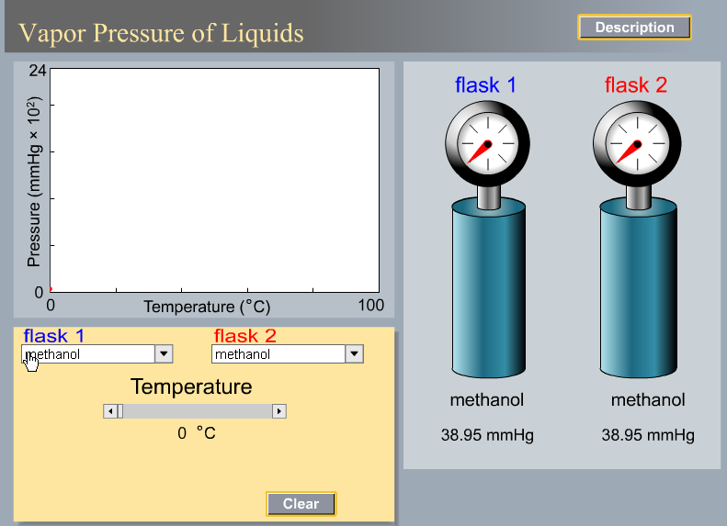

Slide 23
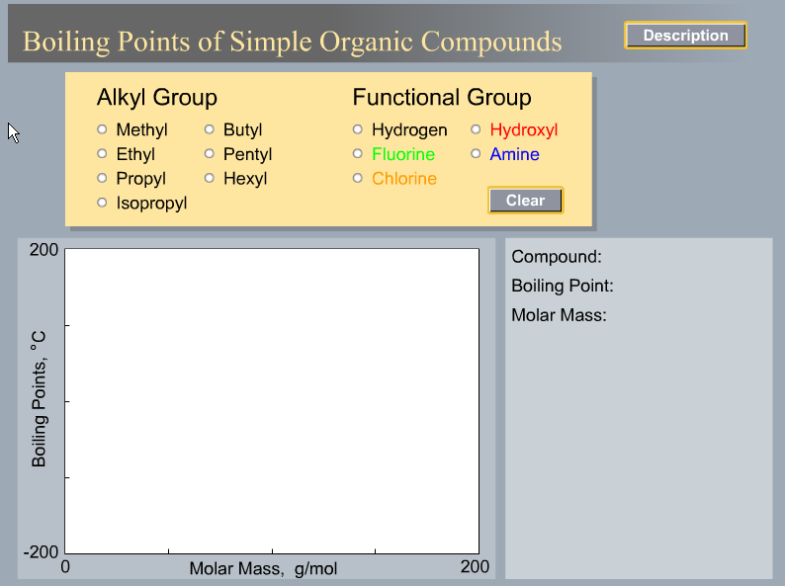

Slide 24
Clausius-Clapyron Equation: Vapor Pressure, ΔH_{vap}, and T

Slide 25
Graphical Method of Determining Enthalpy of Vaporization

Slide 26
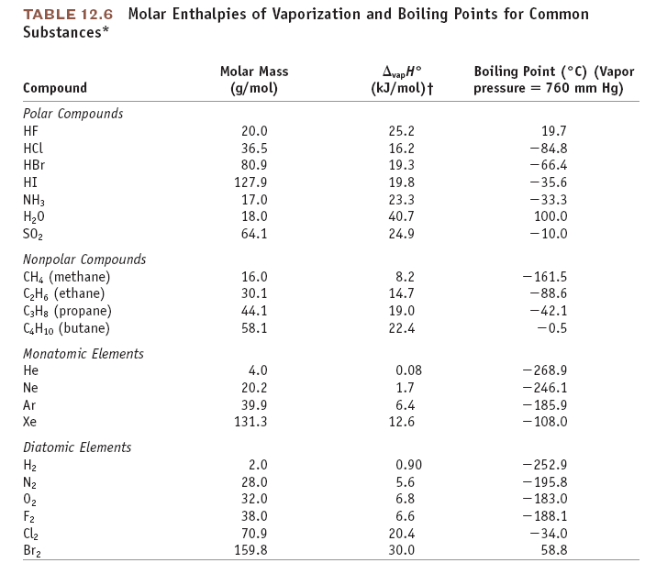

Slide 27
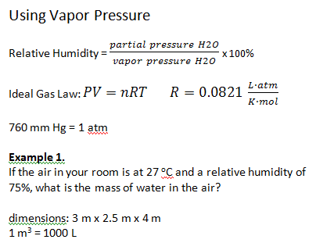

Slide 28
Example 2.
What is the mass of water in the air in this lecture hall?
14 m x 5 m x 17 m
T = 22 ºC
Humidity = 43%

Slide 29
Example 3.
A 1-L flask of air is at 30 ºC and relative humidity of 68%. The flask is put
in a freezer and the temperature decreases to 5 ºC. What happens?

Slide 30
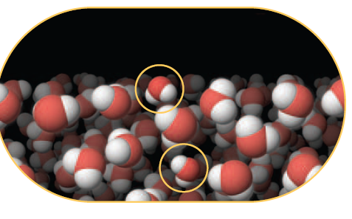
Surface Tension

