Slide 1
Announcements
If you don’t have a clicker with you, sign in after class
Check OWL announcements for information on exam makeups

Slide 2
Intermolecular Forces
Ion-dipole
Dipole-Dipole
Dipole-Induced dipole
Induced dipole-Induced dipole
Hydrogen Bonding

Slide 3
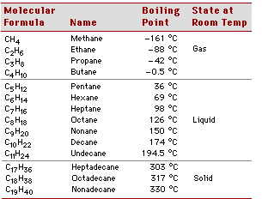
Induced Dipole- Induced Dipole Forces: Between nonpolar molecules
Trends:

Slide 4
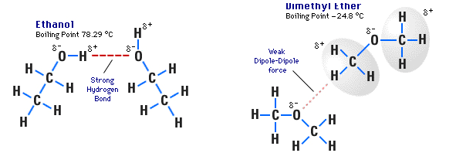
Hydrogen Bonds: Between Molecules with F-H, O-H, or N-H bonds
Trends:
C₂H₆O

Slide 5
Which has strongest IMF?
F₂
Cl₂
Br₂
I₂

Slide 6
Which has the strongest IMF?
CH₃CH₃
CH₃OH

Slide 7
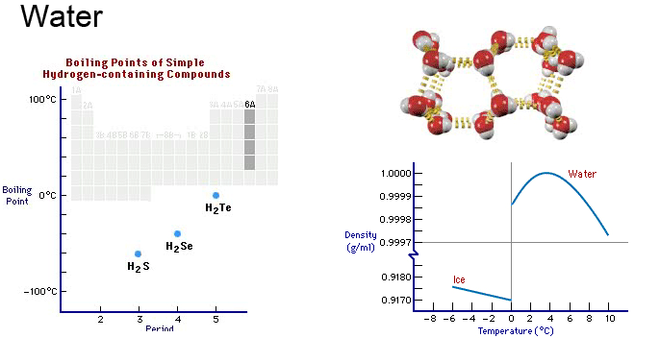
Hydrogen Bonding & The Unusual Properties of Water

Slide 8
Hydrogen Bonding & The Unusual Properties of Water

Slide 9
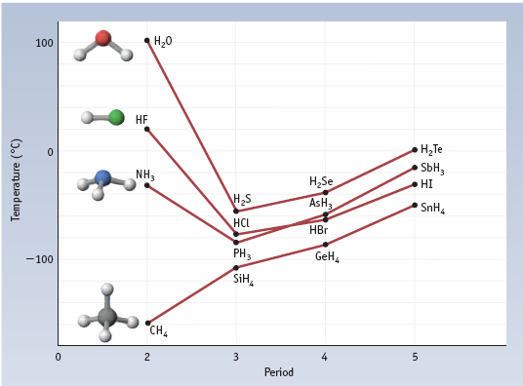
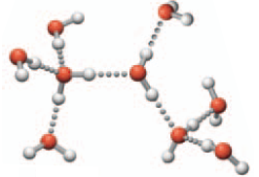
Boiling Points and Hydrogen Bonding

Slide 10
Identifying IMF’s

Slide 11
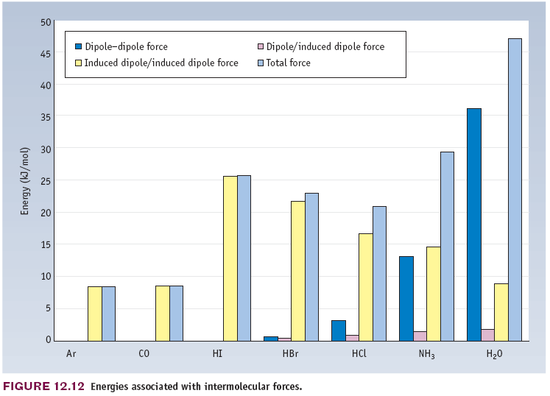
Relative Contributions of Different IMFs

Slide 12
What are the most important IMF’s in propane?
Induced-dipole
Dipole-dipole
Hydrogen bonding

Slide 13
What are the most important IMF’s in methanol?
Induced-dipole
Dipole-dipole
Hydrogen bonding

Slide 14
What are the most important IMF’s in octanol?
Induced-dipole
Dipole-dipole
Hydrogen bonding

Slide 15
Properties of Liquids
Vapor Pressure (volatility)
Boiling Point
Enthalpy of Vaporization
Viscosity
Surface Tension

Slide 16
Molecular interpretation of vapor pressure and boiling.
Enthalpy of vaporization:

Slide 17
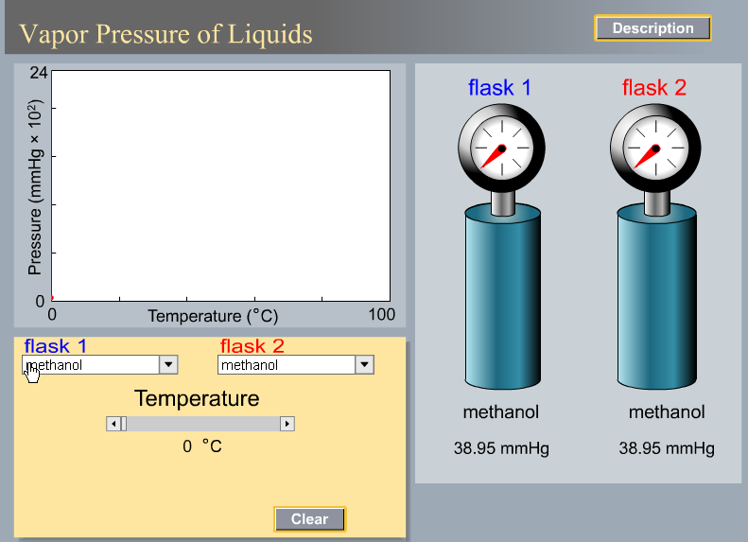

Slide 19
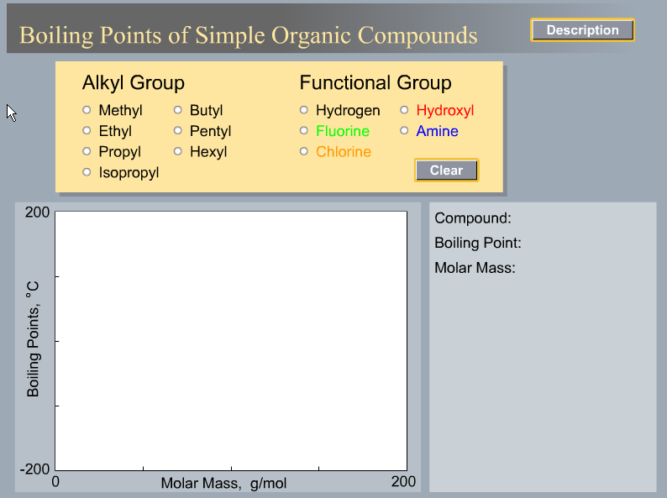

Slide 20
Clausius-Clapyron Equation: Vapor Pressure, ΔH_{vap}, and T

Slide 21
Graphical Method of Determining Enthalpy of Vaporization

Slide 22
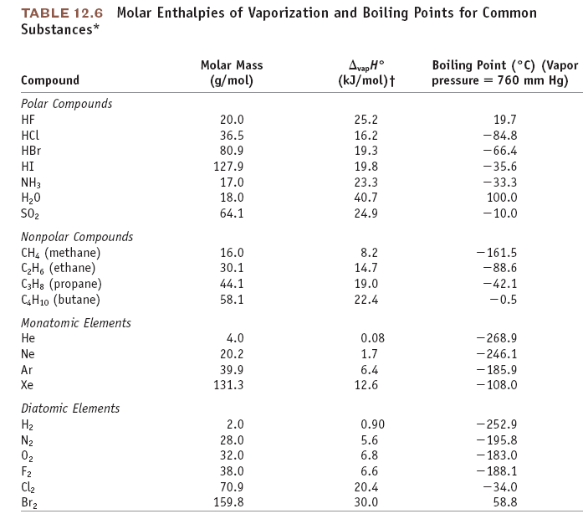

Slide 23
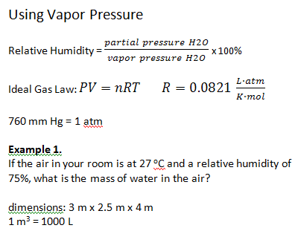

Slide 24
Example 2.
What is the mass of water in the air in this lecture hall?
14 m x 5 m x 17 m
T = 22 ºC
Humidity = 43%

Slide 25
Example 3.
A 1-L flask of air is at 30 ºC and relative humidity of 68%. The flask is put
in a freezer and the temperature decreases to 5 ºC. What happens?

Slide 26
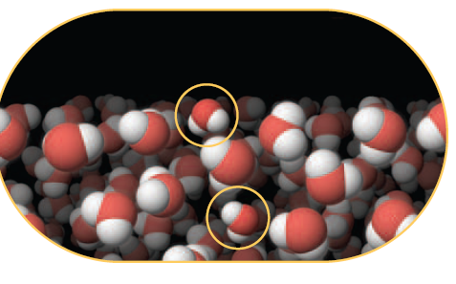
Surface Tension

