Slide 1
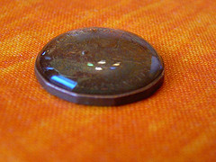
Announcements
We are finishing Chapter 11 today
See me after class to pick up your graded exam if you took a makeup exam

Slide 2
Intermolecular Forces
Polar
Dipole-dipole
Hydrogen Bonding
Induced dipole (dispersion)
Nonpolar
Hydrogen Bonding
Induced dipole (dispersion)
Not Hydrogen Bonding
Induced dipole
(dispersion)
Dipole-dipole
All molecules

Slide 3
Properties of Liquids
IMF’s | Vapor Pressure (Volatility) | Boiling Point | ΔH_{vap} | Surface Tension | Viscosity
Strong
Weak

Slide 4
Which compound will have the highest boiling point?
CH₄
C₆H₁₄
C₂₀H₄₂
C₃₀H₆₂

Slide 5
Which compound will have a higher vapor pressure at room temperature?
PF₃
CF₄

Slide 6
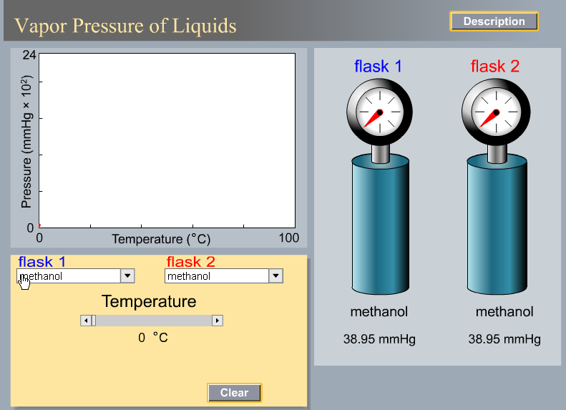

Slide 7
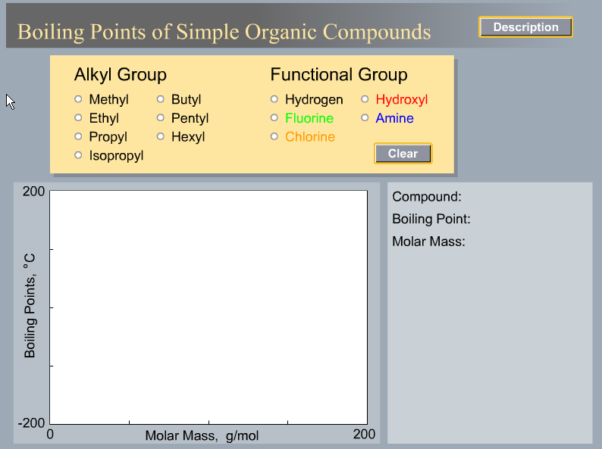

Slide 8
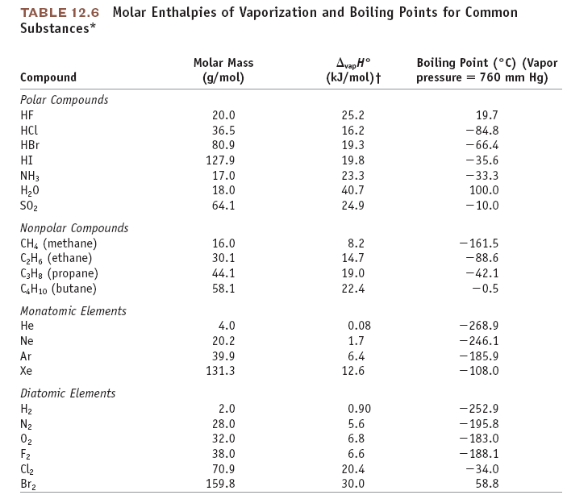

Slide 9
Clausius-Clapyron Equation: Vapor Pressure, ΔH_{vap}, and T

Slide 10
Graphical Method of Determining Enthalpy of Vaporization

Slide 11
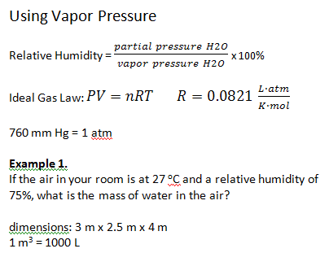

Slide 12
Try this at home, answer next class
What is the mass of water in the air in this lecture hall?
Room Dimensions: 14 m x 5 m x 17 m
Temperature =
Humidity =

Slide 13
Another (more complicated) Example: A 1-L flask of air is at 30 ºC and relative humidity of 68%. The flask is put in a freezer and the temperature decreases to 5 ºC. What happens?

Slide 14
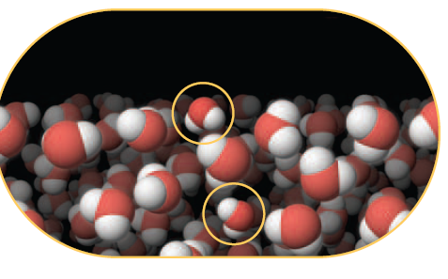
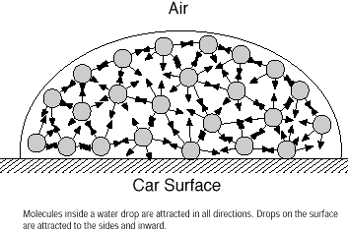
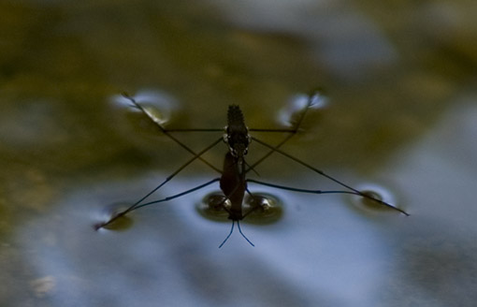
Surface Tension

Slide 15
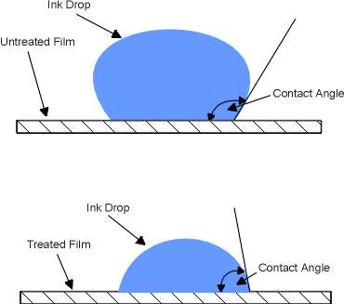
Reducing Surface Tension
Contact Angle
Surfactants

Slide 16
Surface Tension in Space (Microgravity)
Contained fluids
Fluids in Freefall
http://www.nasa.gov/mov/231408main_084_Fluid_Physics.mov

Slide 17
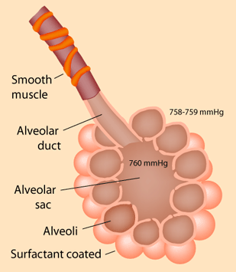
Surface Tension in the Body
Inflation of the alveoli in the lungs is facilitated by a surface-tension reducing surfactant
Reference: http://hyperphysics.phy-astr.gsu.edu/Hbase/ptens2.html#alv

Slide 18
Why does the big paper clip sink?
Because the force of gravity pulling down on the clip is greater than surface tension
Because the force of gravity pulling down on the clip is less than surface tension
Because the paper clip is hydrophobic
Because the paper clip is hydrophillic

Slide 19
What makes the little paper clip sink?
The detergent reduces the water-water IMF’s and thus reduces the surface tension of the water
The detergent increases the water-water IMF’s and thus reduces the surface tension of the water
The detergent reduces the water-water IMF’s and thus increases the surface tension of the water
The detergent increases the water-water IMF’s and thus increases the surface tension of the water

Slide 20
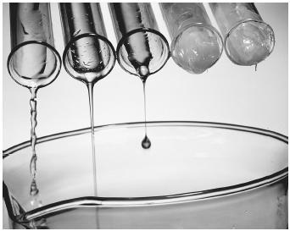
Viscosity
Fluid flow and IMF’s

Slide 21
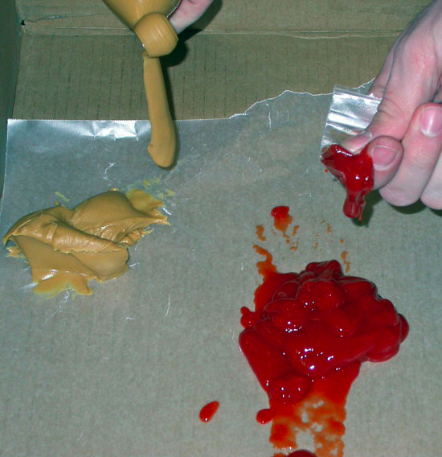
Viscosity and Volcanoes
peanut butter (silica-rich, rhyolitic magma)
vs.
ketchup (silica-poor, basaltic magma)
Conclusion:
During eruptions basaltic magmas will erupt better since they require less pressures acting upon them, while rhyolitic magmas will hardly erupt at all due to their highly viscous nature which requires excess pressures to cause an eruption.

