Slide 1
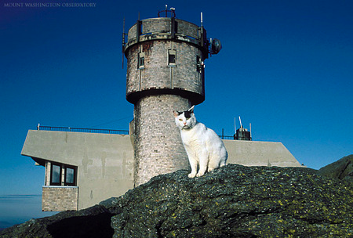
Chapter 11- We’re really going to finish it today!
Mt. Washington
Observatory
A Detailed Exam #1 Answer Key is on the web site

Slide 2
Gas Chromatography Lab

Slide 3
Colligative Properties Lab
Equations you need:
The numbers you need (and how to obtain them):

Slide 4
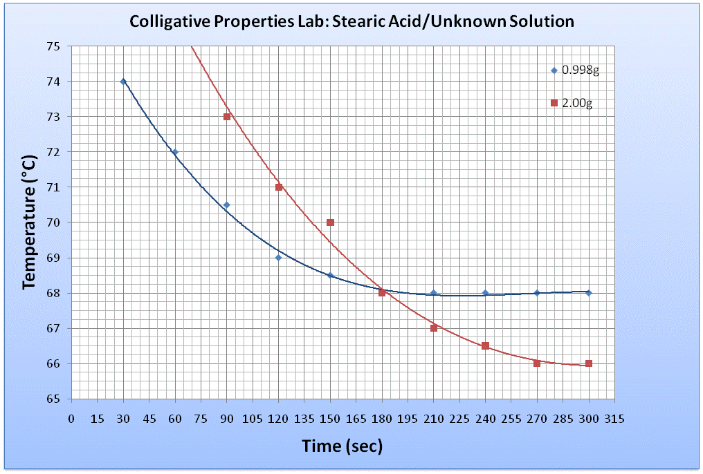
Colligative Properties Lab
Time (sec) | Temperature (°C)
 | Stearic Acid 1 | Stearic Acid 2 | Unknown Solution 1g | Unknown Solution 2g
30 | 80 | 79 | 74 | 79
60 | 75 | 75.5 | 72 | 76
90 | 73 | 72 | 70.5 | 73
120 | 72 | 71 | 69 | 71
150 | 71 | 70.5 | 68.5 | 70
180 | 70.5 | 70 | 68 | 68
210 | 70 | 70 | 68 | 67
240 | 70 | 70 | 68 | 66.5
270 | 70 | 70 | 68 | 66
300 | 70 | 70 | 68 | 66

Slide 5
Try this at home, answer next class
What is the mass of water in the air in this lecture hall?
Room Dimensions: 14 m x 5 m x 17 m
Temperature = 20°C
Humidity = 40%
Vapor P of water at 20°C= 17.5mmHg

Slide 6
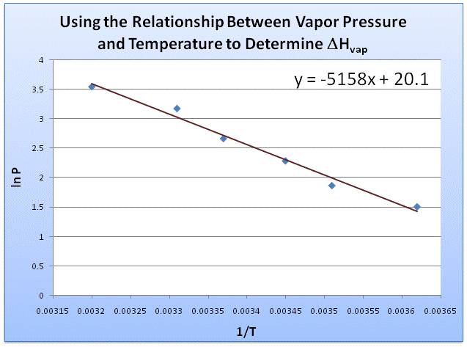
Graphical Method of Determining Enthalpy of Vaporization

Slide 7
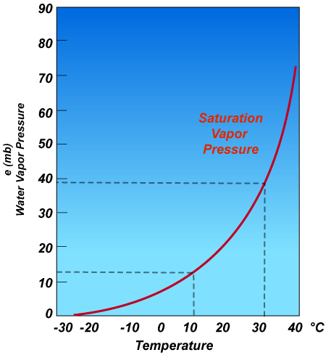
Another (more complicated) Example: A 1-L flask of air is at 30 ºC and relative humidity of 68%. The flask is put in a freezer and the temperature decreases to 5 ºC. What happens?

Slide 8
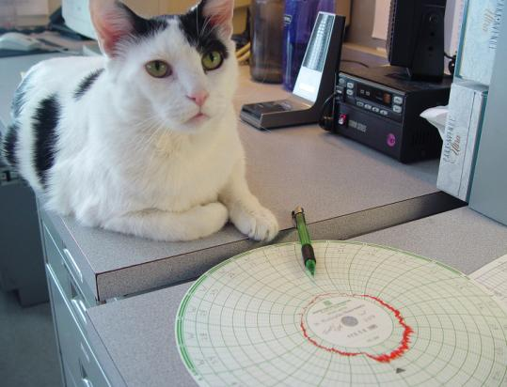
At what temperature does water boil at the Mt. Washington weather observatory?
For Water:
ΔH_{vap}=40.65 kJ/mol R= 8.314 J/mol K
Normal T_{bp}= 373 K
Pressure at summit of Mt. Washington = 0.79atm = 600.96mmHg
Answer:
According to my calculations, it’s 93.6°C

Slide 9
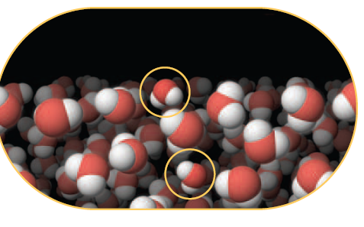
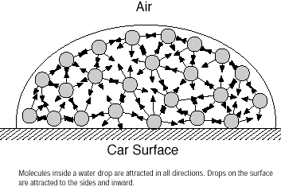
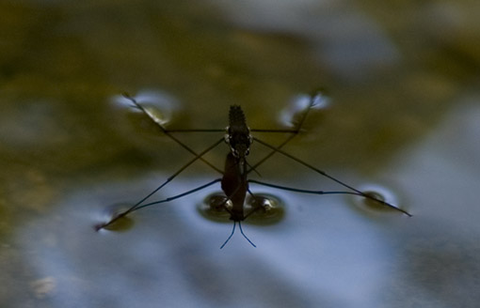
Surface Tension

Slide 10
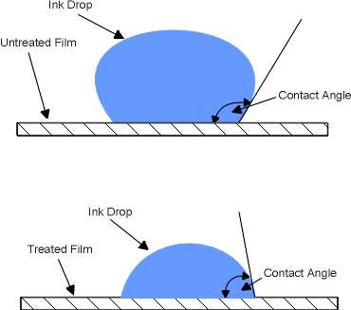
Reducing Surface Tension
Contact Angle
Surfactants

Slide 11
Surface Tension in Space (Microgravity)
Contained fluids
Fluids in Freefall
http://www.nasa.gov/mov/231408main_084_Fluid_Physics.mov

Slide 12
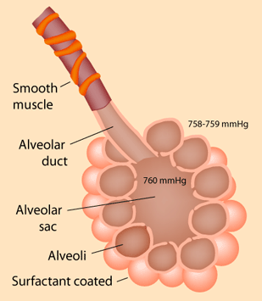
Surface Tension in the Body
Inflation of the alveoli in the lungs is facilitated by a surface-tension reducing surfactant
Reference: http://hyperphysics.phy-astr.gsu.edu/Hbase/ptens2.html#alv

Slide 13
Why does the big paper clip sink?
The paper clip is hydrophobic
The paper clip is hydrophillic
The force of gravity pulling down on the clip is greater than surface tension
The force of gravity pulling down on the clip is less than surface tension

Slide 14
What makes the little paper clip sink?
The detergent reduces the water-water IMF’s and thus reduces the surface tension of the water
The detergent increases the water-water IMF’s and thus reduces the surface tension of the water
The detergent reduces the water-water IMF’s and thus increases the surface tension of the water
The detergent increases the water-water IMF’s and thus increases the surface tension of the water

Slide 15
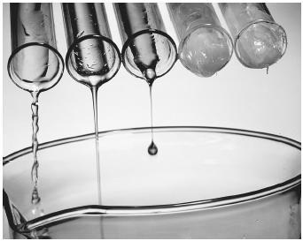
Viscosity
Fluid flow and IMF’s

Slide 16
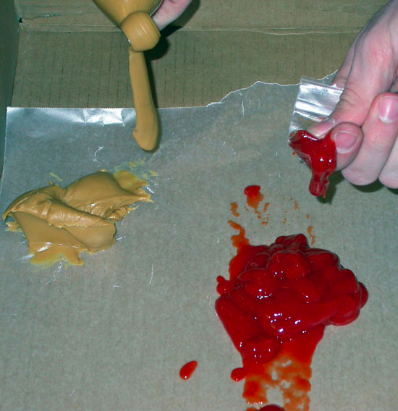
Viscosity and Volcanoes
peanut butter (silica-rich, rhyolitic magma)
vs.
ketchup (silica-poor, basaltic magma)
Conclusion:
During eruptions basaltic magmas will erupt better since they require less pressure acting upon them, while rhyolitic magmas will hardly erupt at all due to their highly viscous nature which requires excess pressures to cause an eruption.

