Slide 1
Solids
New OWL Homework has been posted
This week’s lab- Separation of Metal Ions

Slide 2
Unit Cells, Dimensions and Measurements:
Ca metal:
Face centered cubic unit cell
Density = 1.54 g/cm³
What is the radius of a Ca atom?

Slide 3
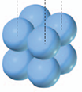
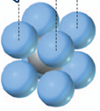
What fraction of a unit cell is filled with atoms?
Simple cubic cell
Face centered cubic cell

Slide 4
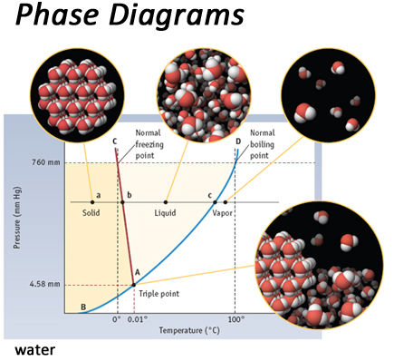
Phase Diagrams

Slide 5
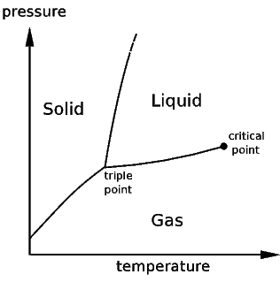
Phase Changes

Slide 6
Freeze-dried Food

Slide 7
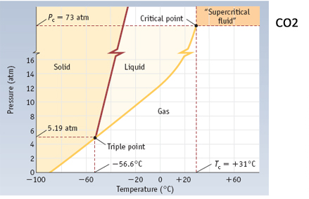
Carbon Dioxide

Slide 8
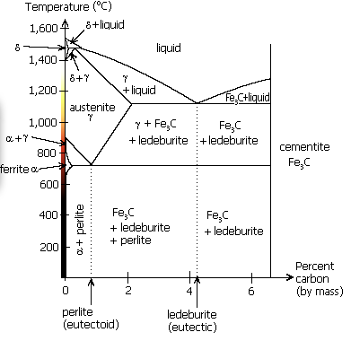
Multiple Solid Forms

Slide 9
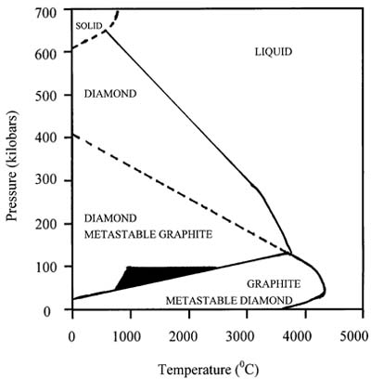
Forms of Carbon

Slide 10
What form will carbon take if I move from Point A to Point B?
Graphite
Diamond
B
A

Slide 11
What form will carbon take if I move from Point A to Point B to Point C?
Graphite
Diamond
B
A
C

Slide 12
The End

Slide 13
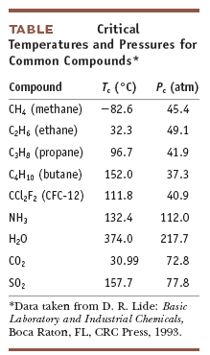
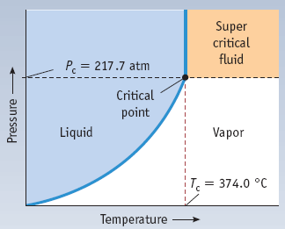
Supercritical Fluids

