Slide 1
Chapter 13- Solutions
Friday is the last day to contact me about Exam #1

Slide 2
Where we are in the big picture…

Slide 3
Chapter 13: Solutions
Solutions
Solvent
Solute
Dissolving depends on

Slide 4
What we’ll cover:
Definitions
Control of Solubility
Things that affect solubility
Concentration units
Colligative properties

Slide 5
Definitions
Solubility

Slide 6
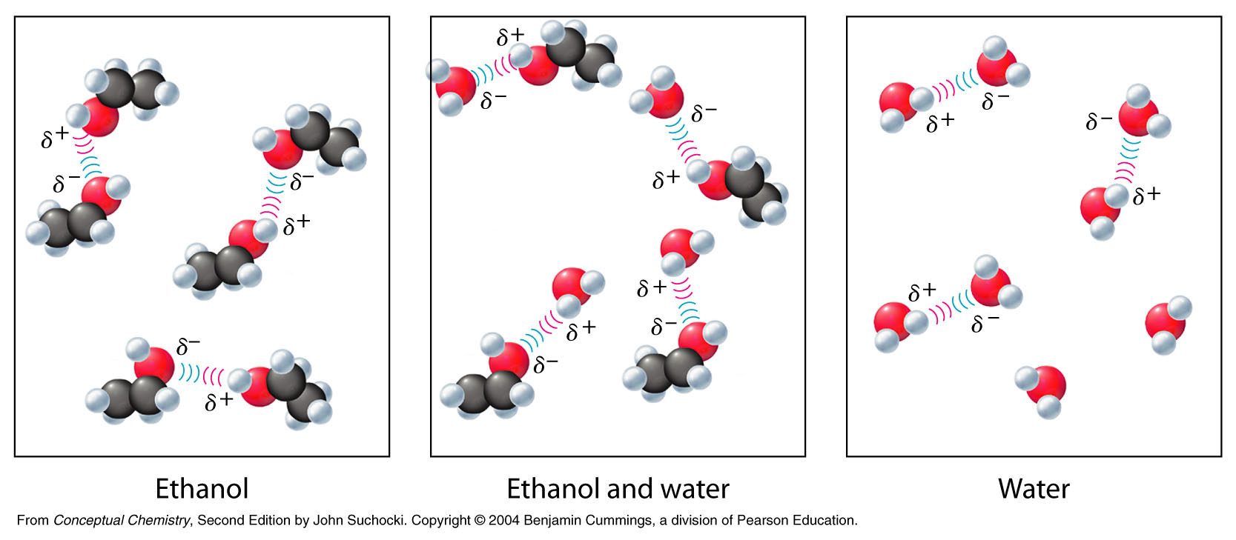
Solubility
Soluble
Examples
    Sugar: 200 g in 100 mL water at 20 ºC
    Ethanol: infinitely soluble in water
    Gases: infinitely soluble in one another

Slide 7
Definitions
Solubility
Saturated
Unsaturated
Supersaturated
Concentration

Slide 8
What controls solubility?
Rule of thumb: “like dissolves like”
Example: Oil and water don’t mix.

Slide 9
Which will be the least soluble in water?
CH₃OH
CH₃CH₃
NH₃

Slide 10
Please make your selection...
Choice One
Choice Two
Choice Three

Slide 11
Which will be the least soluble in water?
CH₃OH
CH₃CH₂CH₂OH
CH₃CH₂CH₂CH₂CH₂OH

Slide 12
How does thermodynamics control things?
Enthalpy (ΔH)
    Stronger bonds and IMF’s are favored
    Enthalpy is negative if the forces in the solution are stronger than when the solute and solvent are separate
Entropy (ΔS)
    Freedom of movement is favored
    Depends on both the solute and the solvent

Slide 13
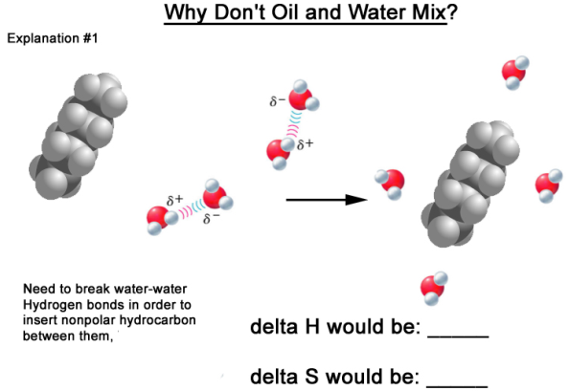
Why don’t oil and water mix- Idea #1

Slide 14
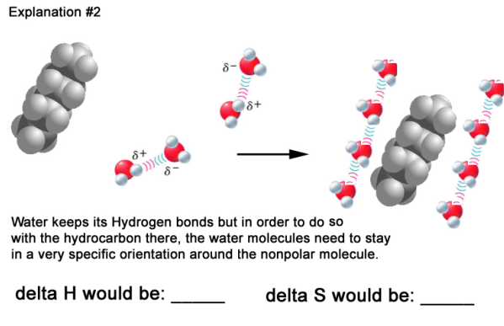
Why oil and water don’t mix- Idea #2

Slide 15
Which prevents oil from mixing with water?
Enthalpy (the water wants to keep its hydrogen bonds)
Entropy (the water doesn’t want to adopt an ordered arrangement)

Slide 16
Enthalpy, Entropy, and Solubility

Slide 17
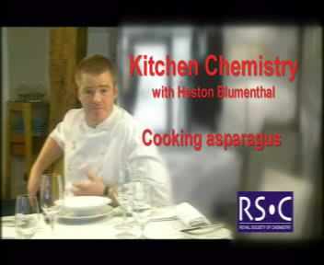
Kitchen Chemistry

Slide 18
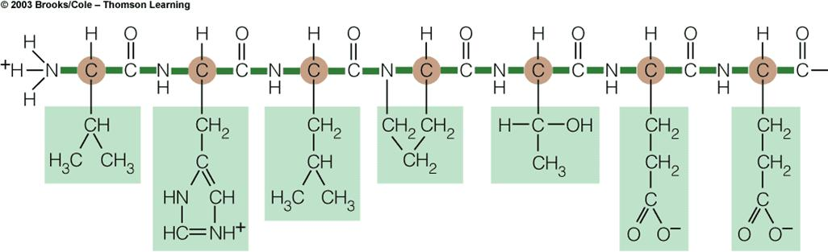
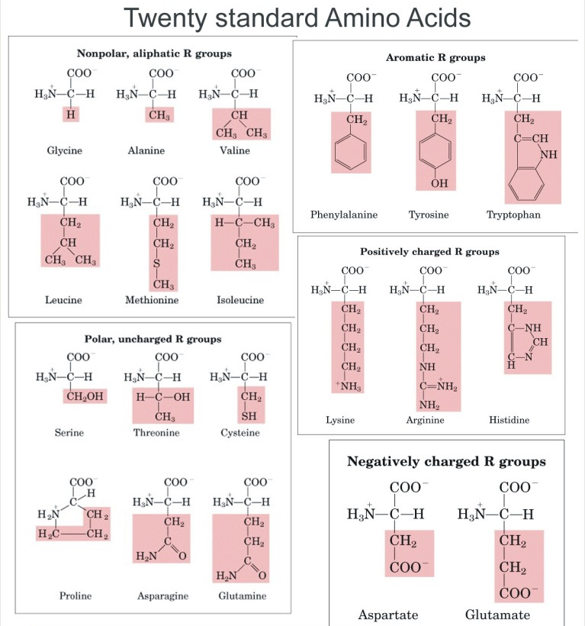
Protein Folding

Slide 19
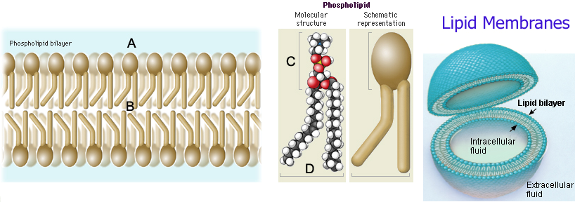
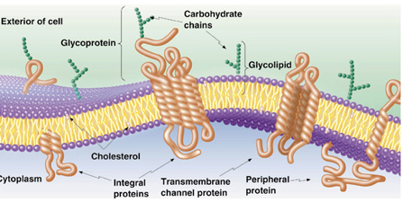
Lipids and Membranes
Surfactants
Self-assembly

