Slide 1
Announcements
Reminder- Exam #3 is on Friday (April 23rd)
Review session: Wednesday, April 21st @ 5:00pm

Slide 2
How to determine if a proposed reaction mechanism is “reasonable” H₂ + 2ICl → 2HCl + I₂
Proposed mechanism 1:
Step 1:
H₂ + ICl → HI + HCl (slow)
Step 2:
ICl + HCl → HI + Cl₂
Sum
Rate
Step 1
Step 2
Overall
Proposed mechanism 2:
Step 1:
H₂ + ICl → HCl + HI (slow)
Step 2:
HI+ ICl → HCl + I₂
Sum
Rate
Step 1
Step 2
Overall

Slide 3
Most reactions go in both directions (↔)
Individual elementary steps are reversible
Thus, overall reaction is, in theory, reversible
Example:
Microscopic reversibility

Slide 4
Simulation- The Equilibrium State

Slide 5
Rate laws can be written for both the forward and reverse reaction

Slide 6
At equilibrium, the forward and backward reaction rates are equal
Equilibrium: when Rate_{forward} = Rate_{backward}

Slide 7
Rules for writing equilibrium constant expressions
Products over reactants
Stoichiometric coefficient = exponent
Don’t include solvent or solids

Slide 8
What is the equilibrium expression for CO₂(g) + Cl₂(g) ↔ COCl₂(g)

Slide 9
What is K for the reaction Br₂(g) + Cl₂(g) ↔ 2BrCl(g)? Equilibrium concentrations are: [Br₂]= 2.3 x 10⁻³M [Cl₂]= 1.2 x 10⁻²M [BrCl]= 1.4 x 10⁻²M

Slide 10
What is the reaction described by
H₂ + Cl₂ ↔ 2HCl
2H₂ + 2Cl₂ ↔ 2HCl
H₂ + Cl₂ ↔ HCl
2H₂ + 2Cl₂ ↔ 2HCl

Slide 11
What happens to K when you “reverse” a reaction?
When you reverse a reaction, K is inversed

Slide 12
What happens to K when you multiply a reaction by a number?
When you multiply a reaction by a number, K is raised to that power

Slide 13
What happens to the overall K when you add two reactions?
Cu(OH)₂(s) ⇔ Cu²⁺(aq) + 2 OH⁻(aq) K₁ = 1.6x 10⁻¹⁹
Cu²⁺(aq) + 4 NH₃(aq) ⇔ Cu(NH₃)₄²⁺(aq) K₂ = 1.2 x 10¹²
Cu(OH)₂(s) + 4 NH₃(aq) ⇔ Cu(NH₃)₄²⁺(aq) + 2 OH⁻(aq) K = ?
When you add two reactions, multiply the K’s together

Slide 17
Cu(NH₃)₄²⁺(aq) ⇔ Cu²⁺(aq) + 4 NH₃(aq) K = 8.5 x 10⁻¹³ If [Cu²⁺] = 1.0 x 10⁻⁶ , [NH₃] = 1.0 x 10⁻³, [Cu(NH₃)₄²⁺], then …
It is at equilibrium
Reaction goes forwards
Reaction goes backwards

Slide 18
Equilibrium Calculations: Your Pathway to Happiness
Write the equilibrium expression
Determine Q
if Q = K, it’s at equilibrium
if Q < K, reactants go to form products
if Q > K, products go to form reactants
Call the amount reacting “x”
Solve for x in the equilibrium expression
Use x to determine equilibrium concentrations

Slide 19
Given these initial concentrations, what will the final
concentrations be when equilibrium is reached?

Slide 20
K in terms of pressure: K_{p} vs. K_{c}
K_{p} = K_{c}(RT)^{Δn}
Δn = change in numbers of moles of gas
2 NH₃(g) N₂(g) + 3 H₂(g) K_{c} = 5.8 x 10⁵
K_{p} =

Slide 21
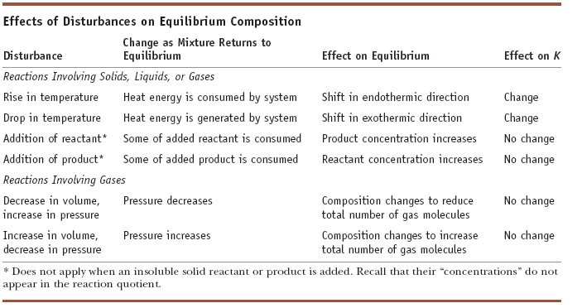

Slide 22
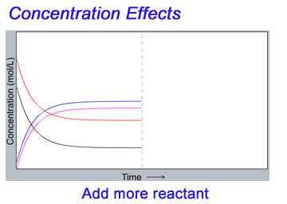

Slide 23
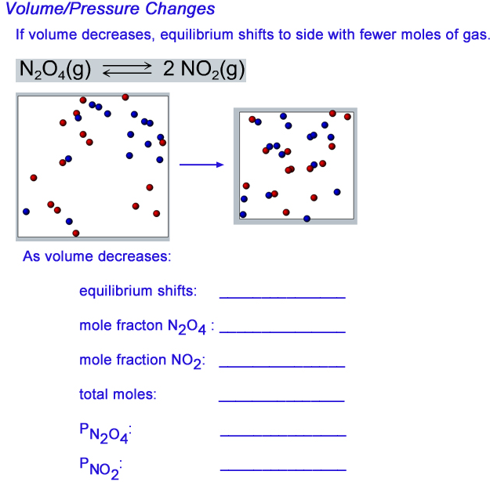

Slide 25
LeChatelier’s Principle: Doing the math
1-Liter flask contains 0.50 mol butane and 1.25 mol isobutane (at equilibrium).
0.50 mol butane are added. What happens, and what is the result?

