Slide 1
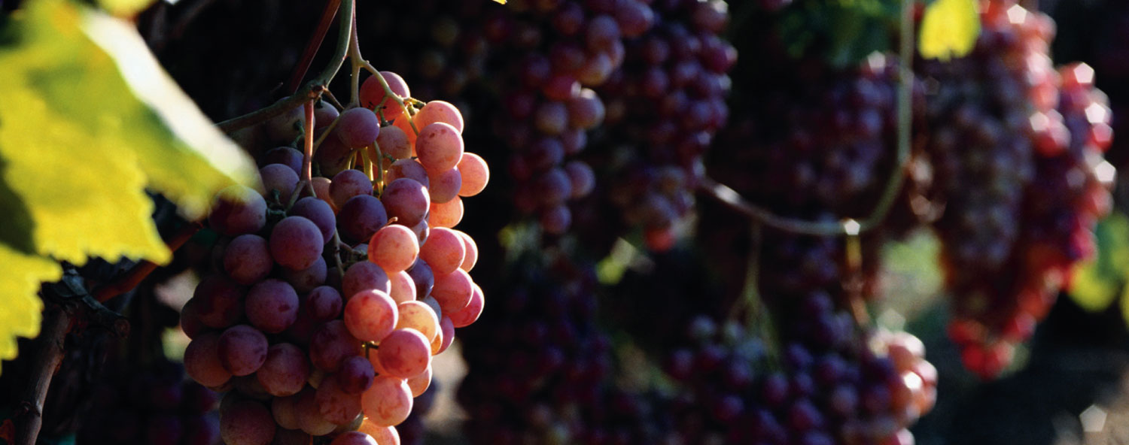
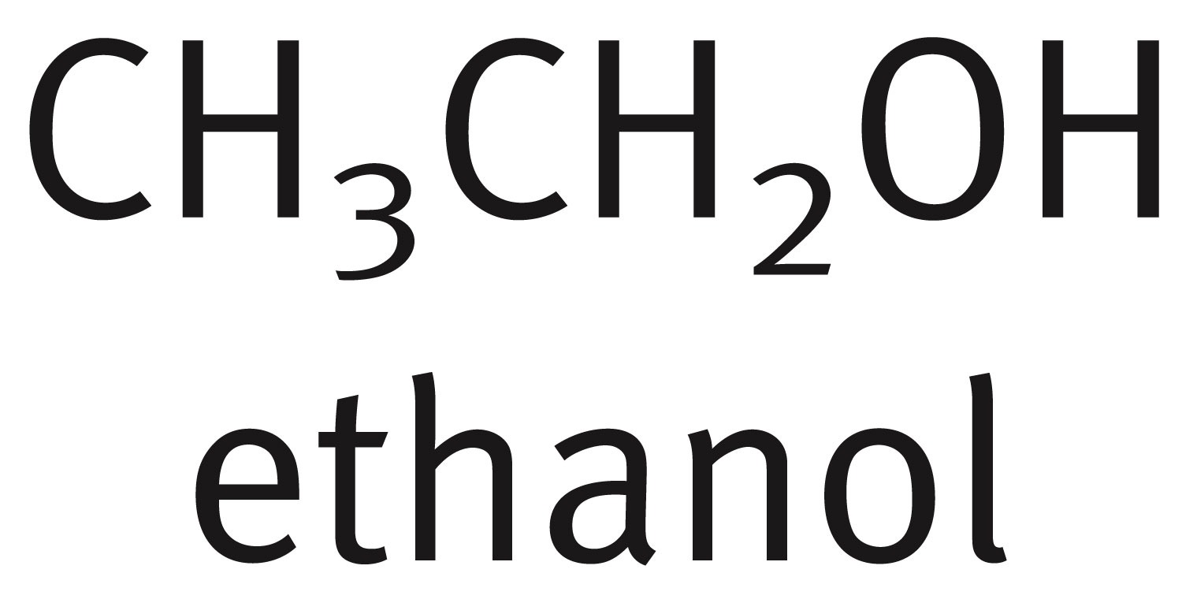
Chapter 7: Alcohols, Phenols and Thiols

Slide 2
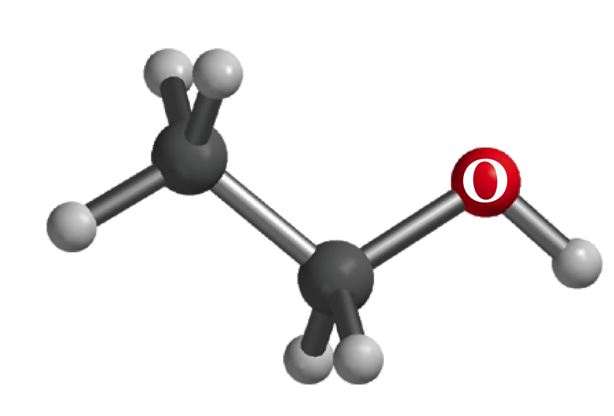
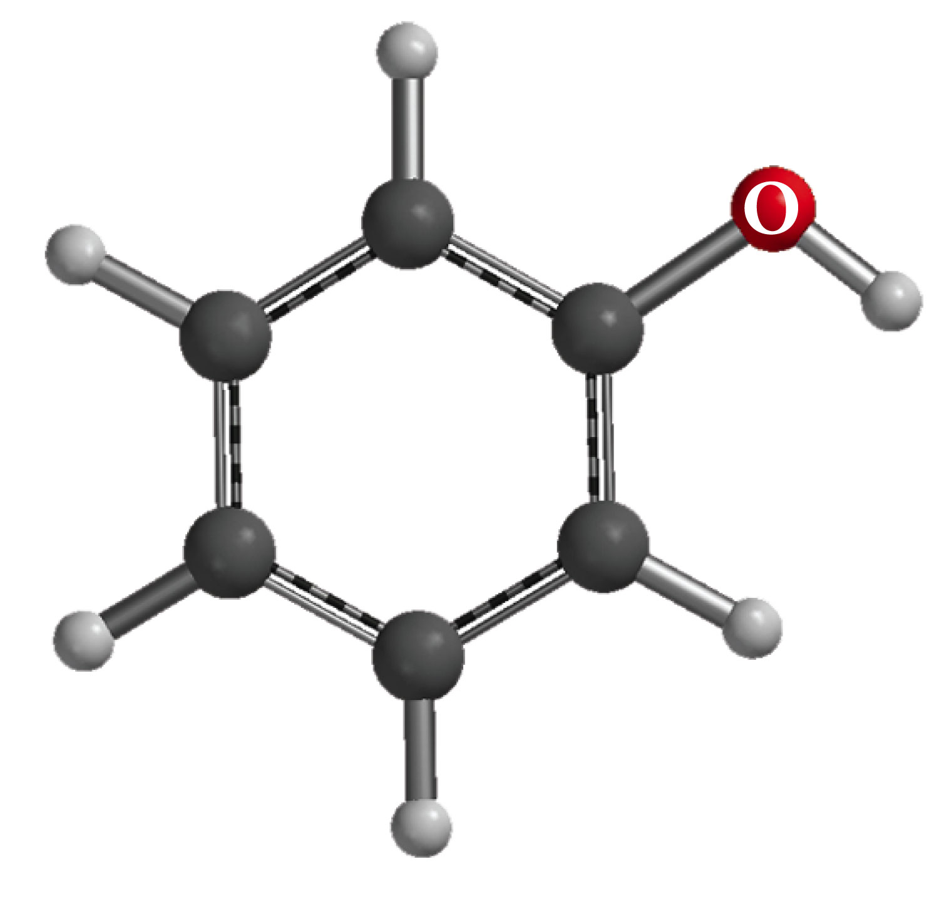
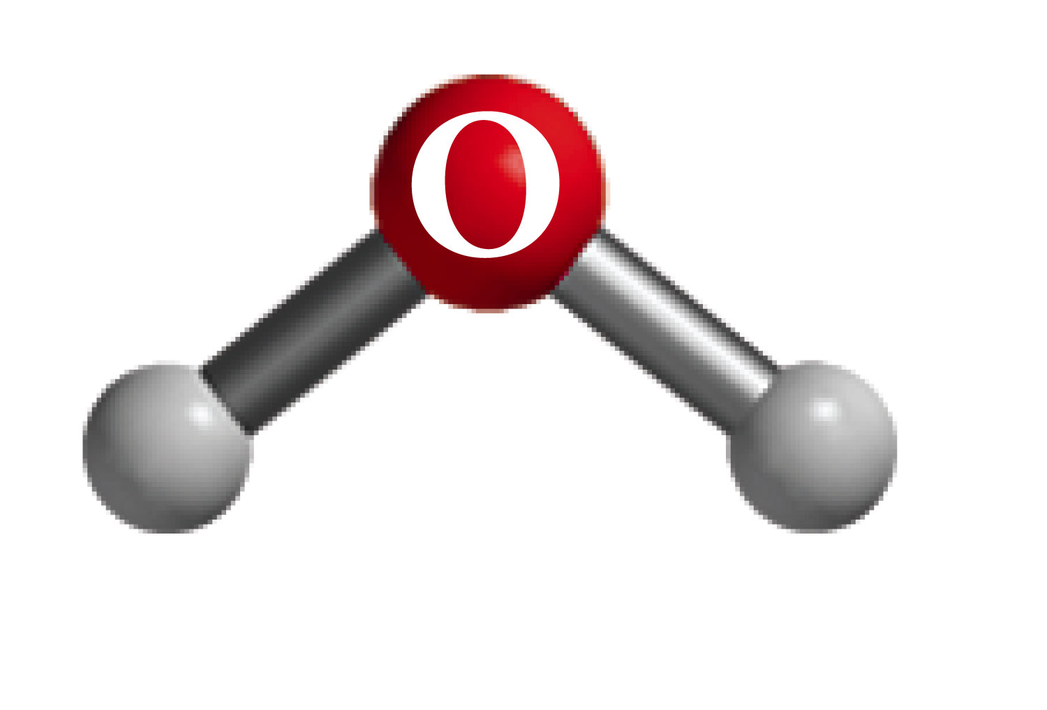
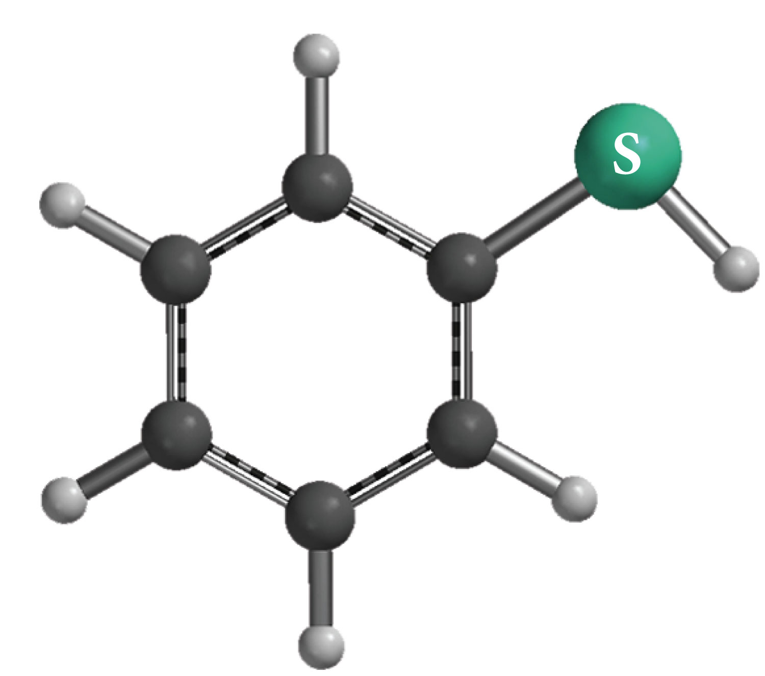
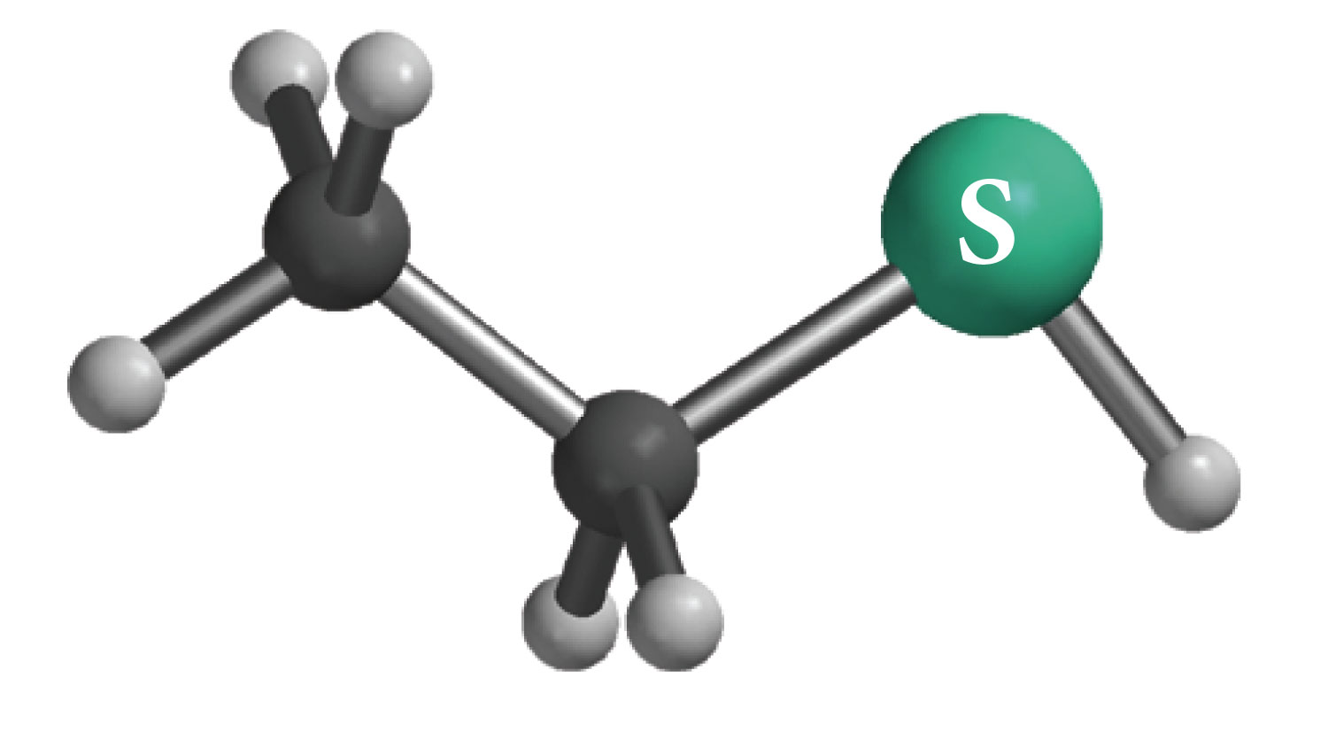

Slide 3
Nomenclature of Alcohols
In the IUPAC system, the hydroxyl group in alcohols is indicated by the ending –ol. In common names, the separate word alcohol is placed after the name of the alkyl group.

Slide 5
Industrial Alcohols

Slide 6
Classification of Alcohols

Slide 7
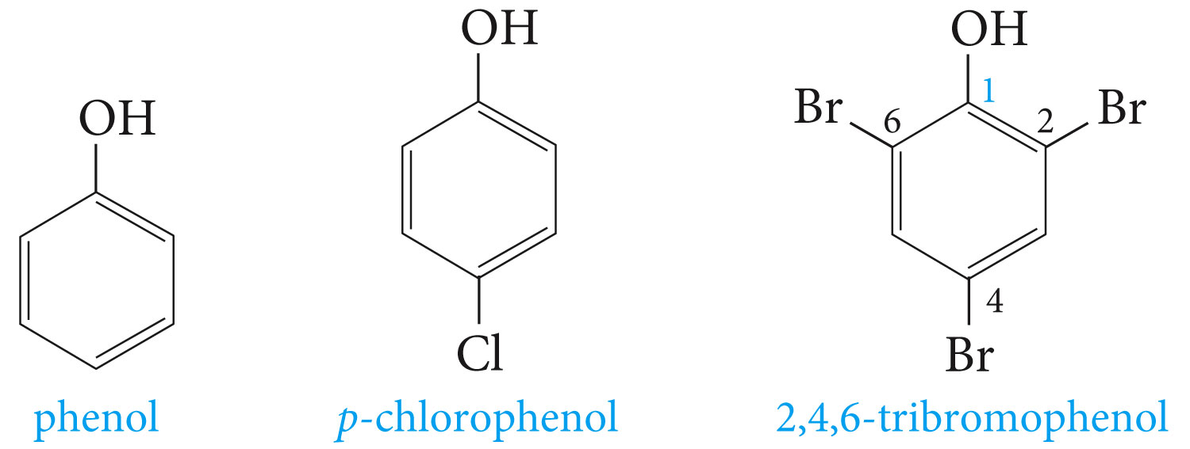
Nomenclature of Phenols

Slide 8
The hydroxyl group is named as a substituent when it occurs in the same molecule with carboxylic acid, aldehyde, or ketone functionalities, which have priority in naming. Examples are

Slide 9
Hydrogen bonding in Alcohols and Phenols

Slide 10
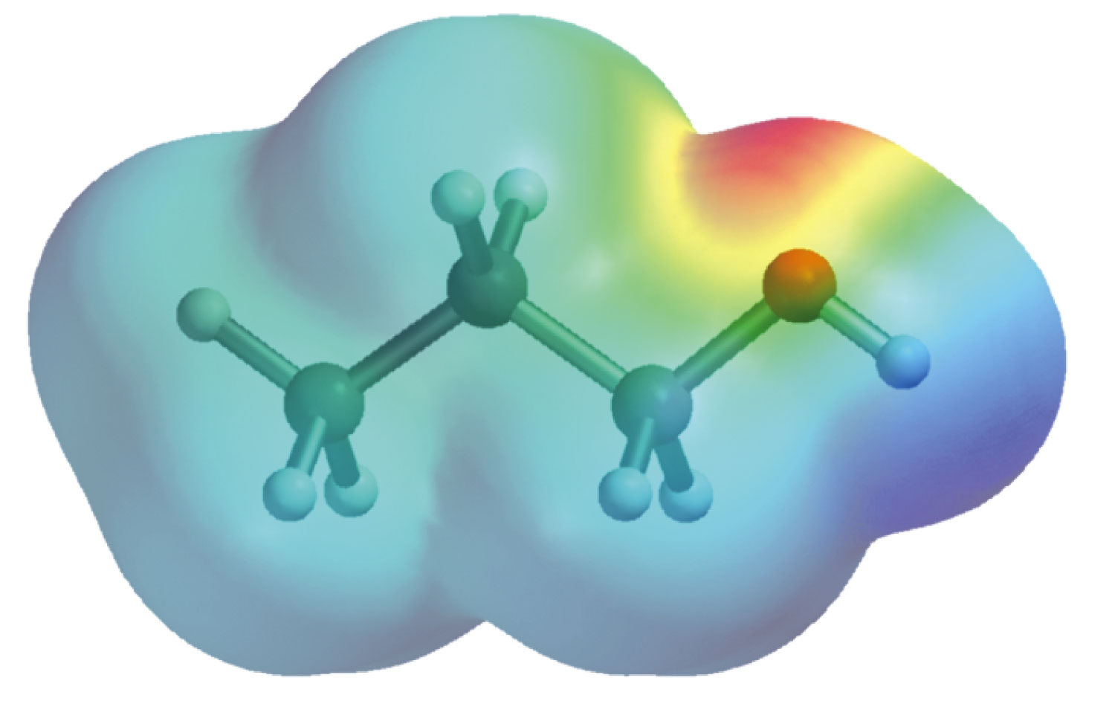
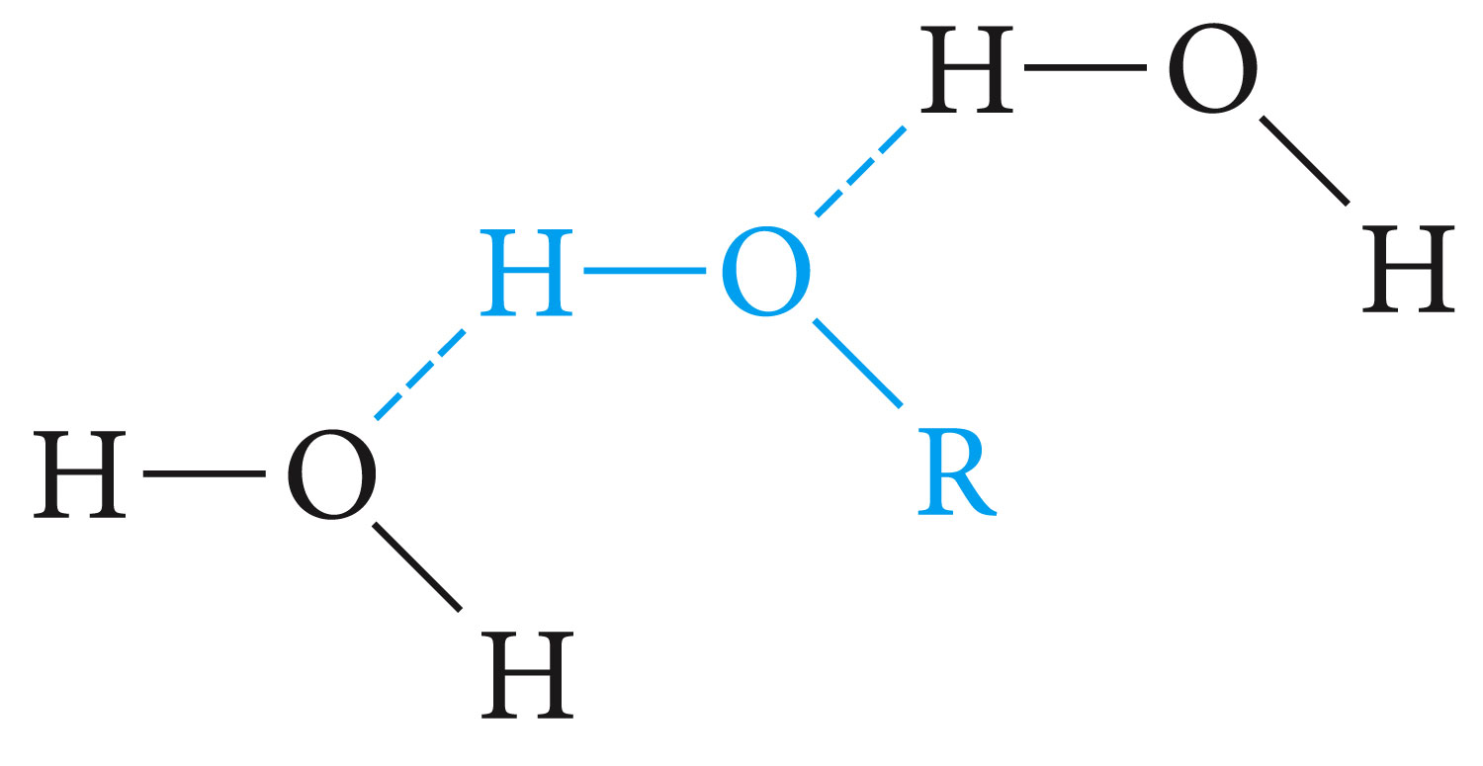
Electronic potential map for 1-propanol
The lower-molecular-weight alcohols can readily replace water molecules in the hydrogen-bonded network. This accounts for the complete miscibility of such alcohols with water.

Slide 11
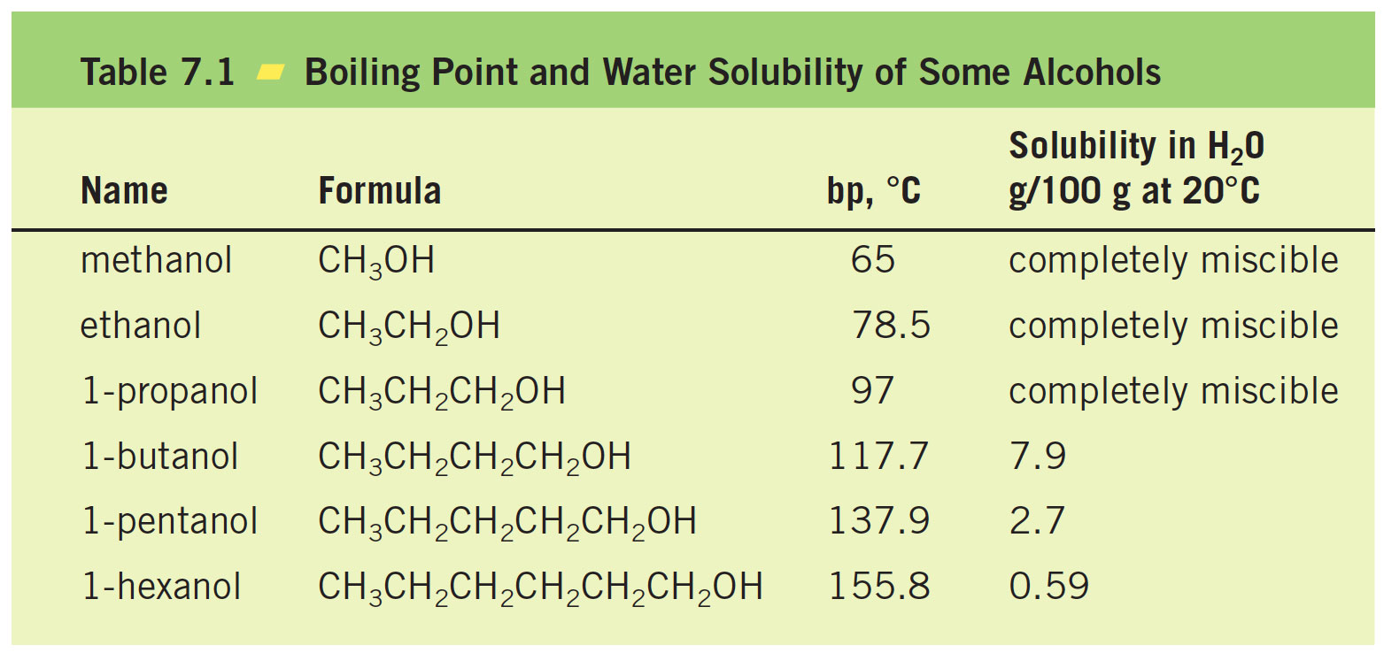

Slide 12
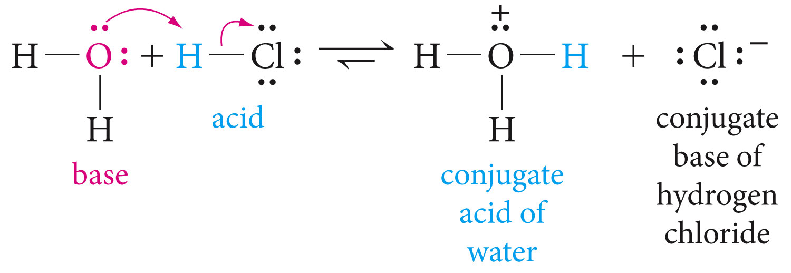
Review of Acidity and Basicity
Bronsted-Lowry definition, Acid proton donor, and base proton acceptor

Slide 13
The Acidity of Alcohols and Phenols
Phenols are much stronger acids than alcohols mainly because the corresponding phenoxide ions are stabilized by resonance. The negative charge of an alkoxide ion is concentrated on the oxygen atom, while the negative charge on the phenoxide ion can be delocalized to the ortho and para ring positions through resonance

Slide 14
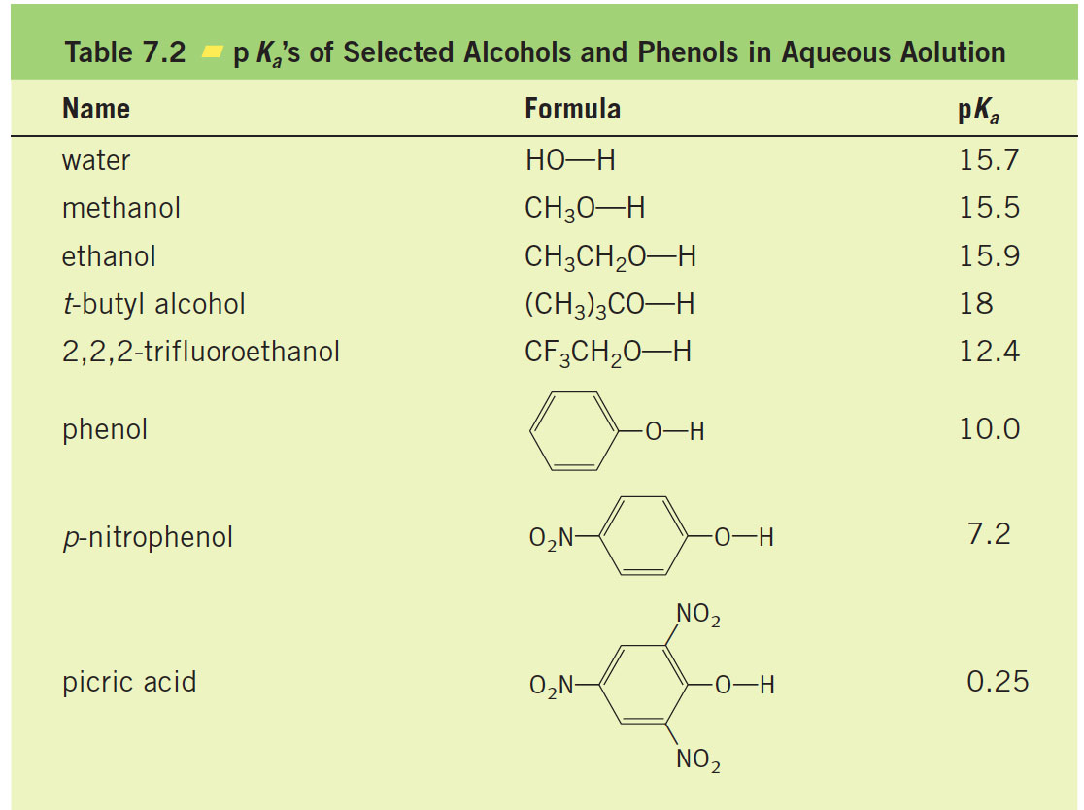

Slide 15
Stabilization by inductive effect

Slide 16
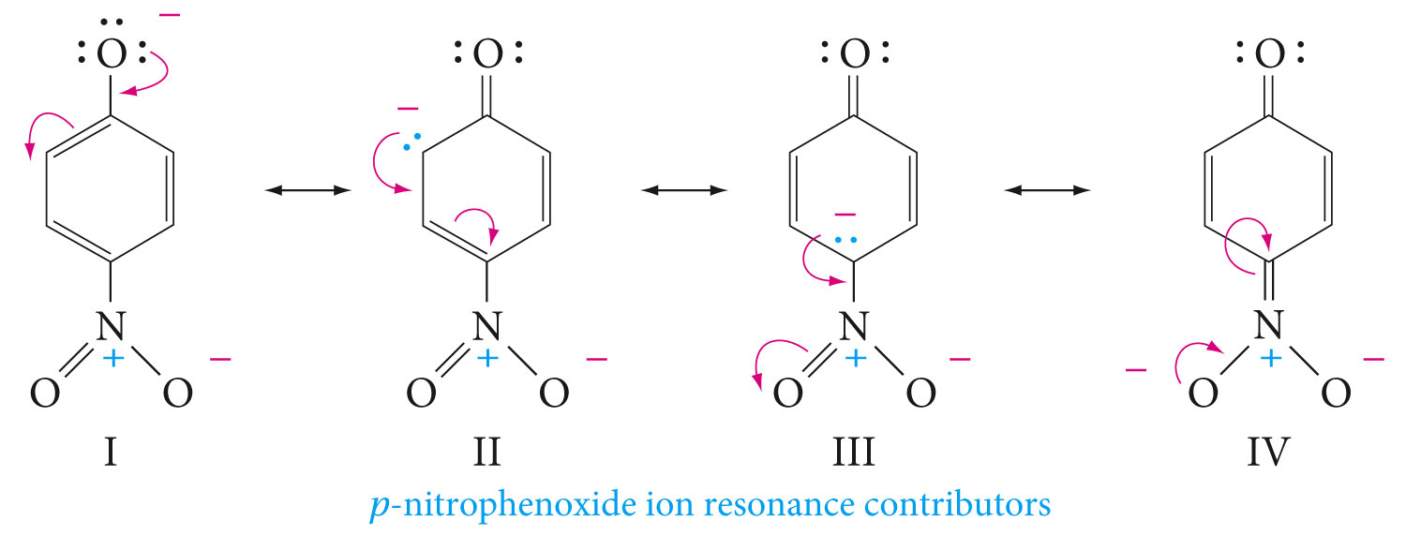
Electron-withdrawing groups increase acidity by stabilizing the conjugate base, while electron-donating groups decrease acidity because they destabilize the conjugate base.

Slide 17
Dehydration of Alcohols to Alkenes

Slide 20
Sometimes a single alcohol gives two or more alkenes

Slide 21
The Reaction of Alcohols with Hydrogen Halides

Slide 23
Reaction occurs by an S_{N}2 mechanism when the alcohol is protonated by an acid.

Slide 24
Other Ways to Prepare Alkyl Halides from Alcohols

Slide 25
A Comparison of Alcohols and Phenols
Phenyl cations are energetically unstable and are difficult to form. Phenols can also never undergo displacement by the S_{N}2 mechanism

Slide 26
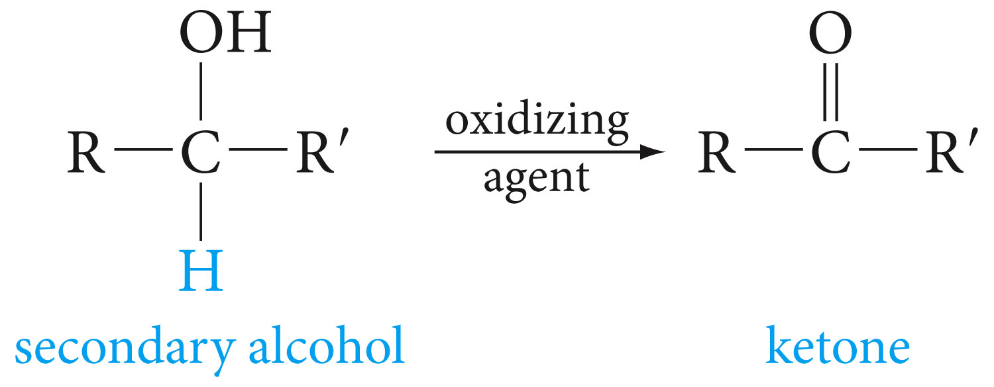
Oxidation of Alcohols to Aldehydes, Ketones, and Carboxylic Acids

Slide 27
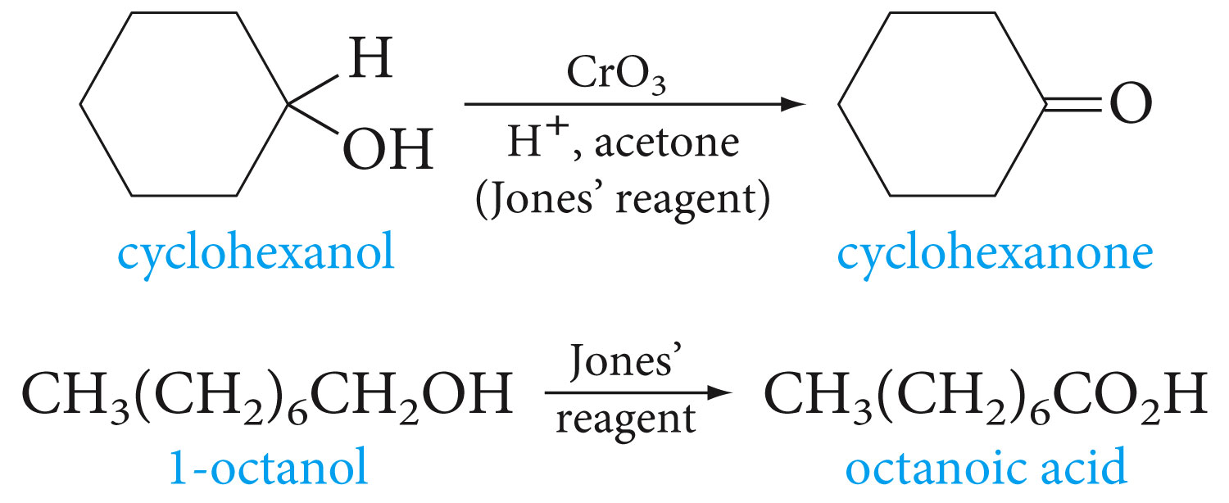

Slide 28
With primary alcohols, oxidation can be stopped at the aldehyde stage by special reagents, such as Pyridinium Chlorochromate (PCC)

Slide 29
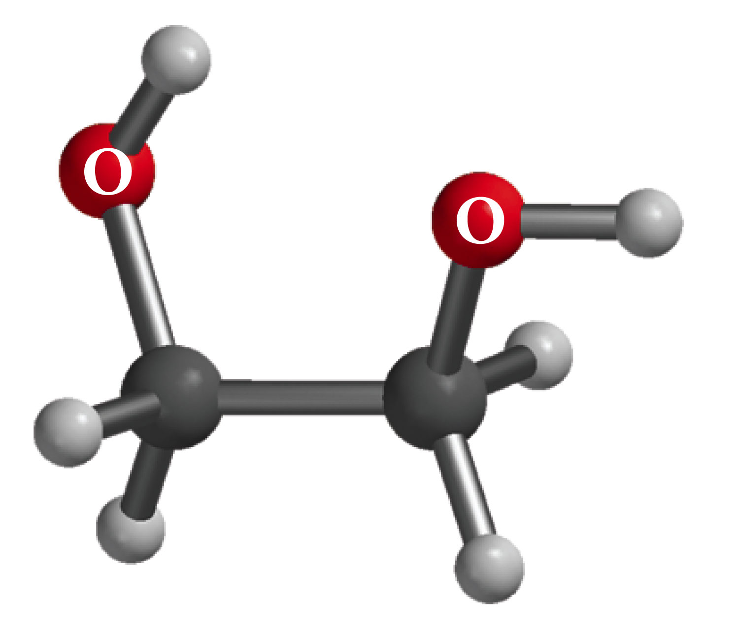
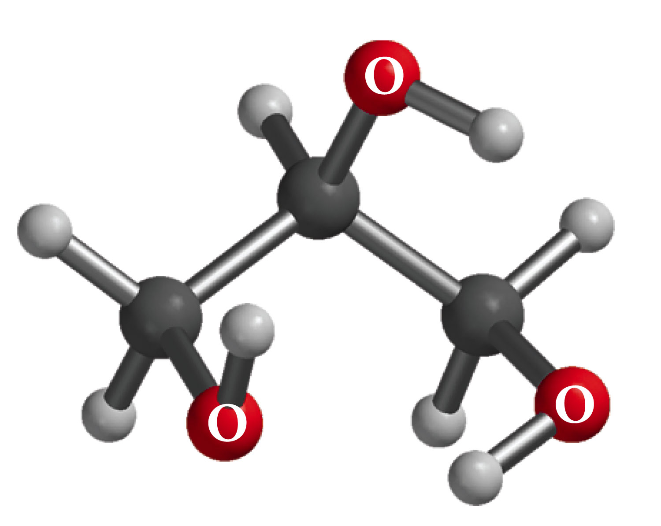
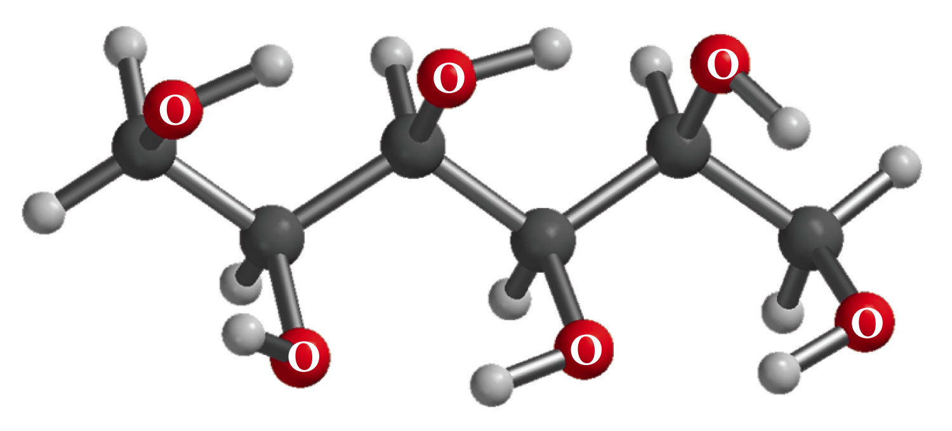
Alcohols with More Than One Hydroxyl Group
Ethylene glycol
(1,2-ethanediol)
bp 198 ⁰C
Glycerol (glycerine)
1,2,3-propanetriol
bp 290 ⁰C
Sorbitol
1,2,3,4,5,6-hexanehexaol
Mp 110-112 ⁰C

Slide 30
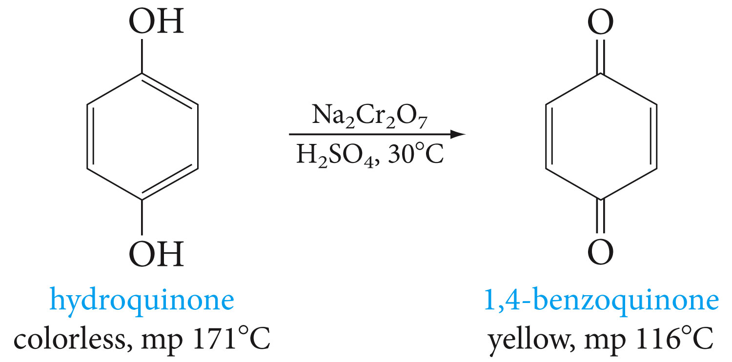

Slide 31
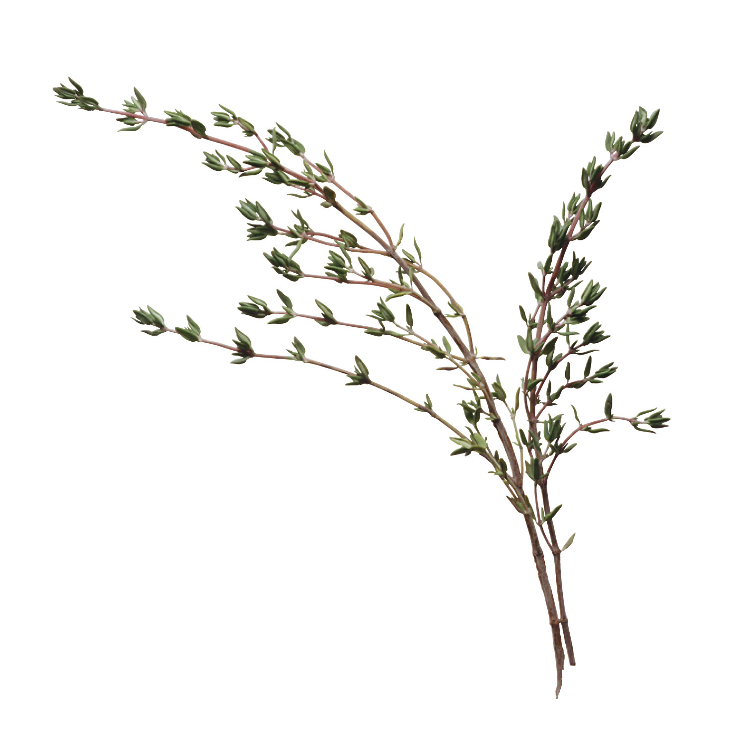
Thymol is an antibacterial oil obtained from thyme (Thymus vulgaris). The IUPAC name of this compound is 2-isopropyl-5-methylphenol. Draw the structure of thymol.

Slide 32
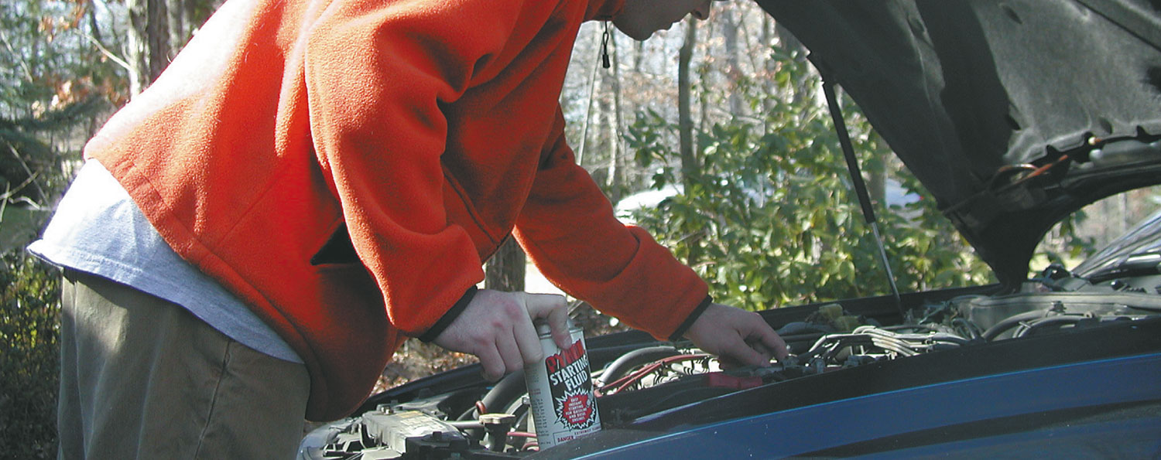
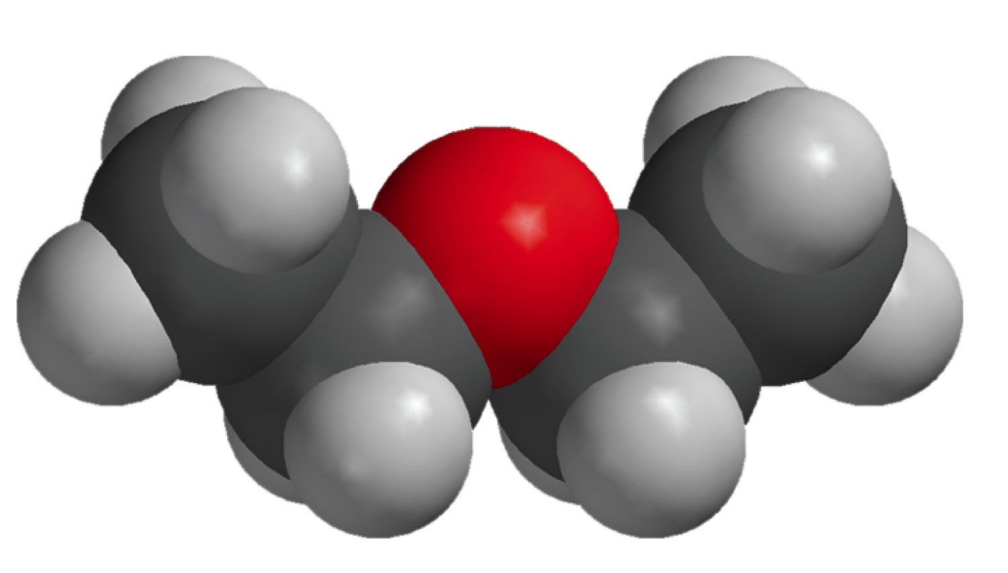
Chapter 8: Ethers and Epoxides
Diethyl ether in starting fluid

Slide 33
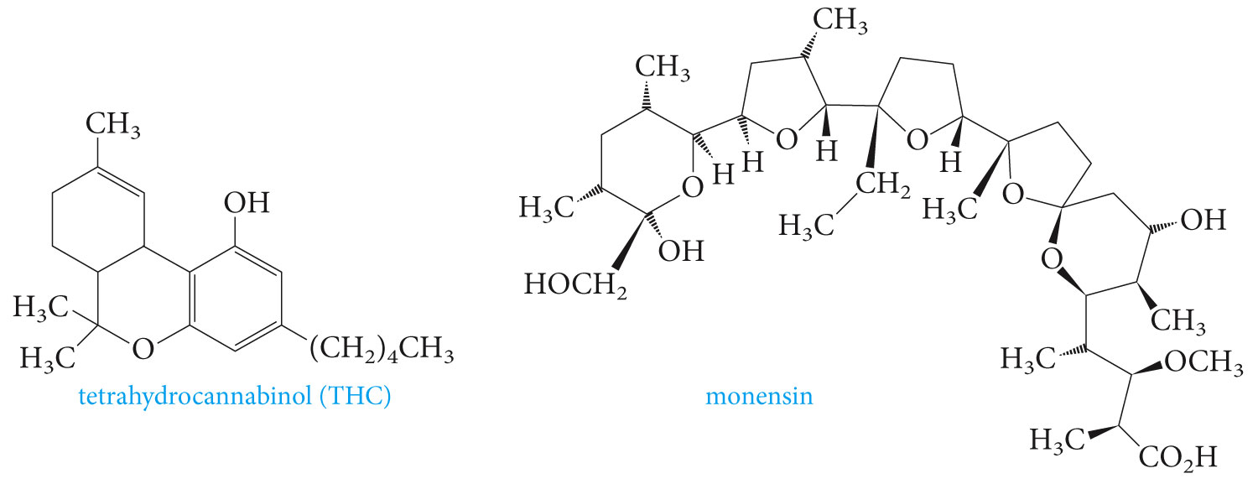
Examples of compounds with ether groups

Slide 34
Nomenclature of Ethers

Slide 35
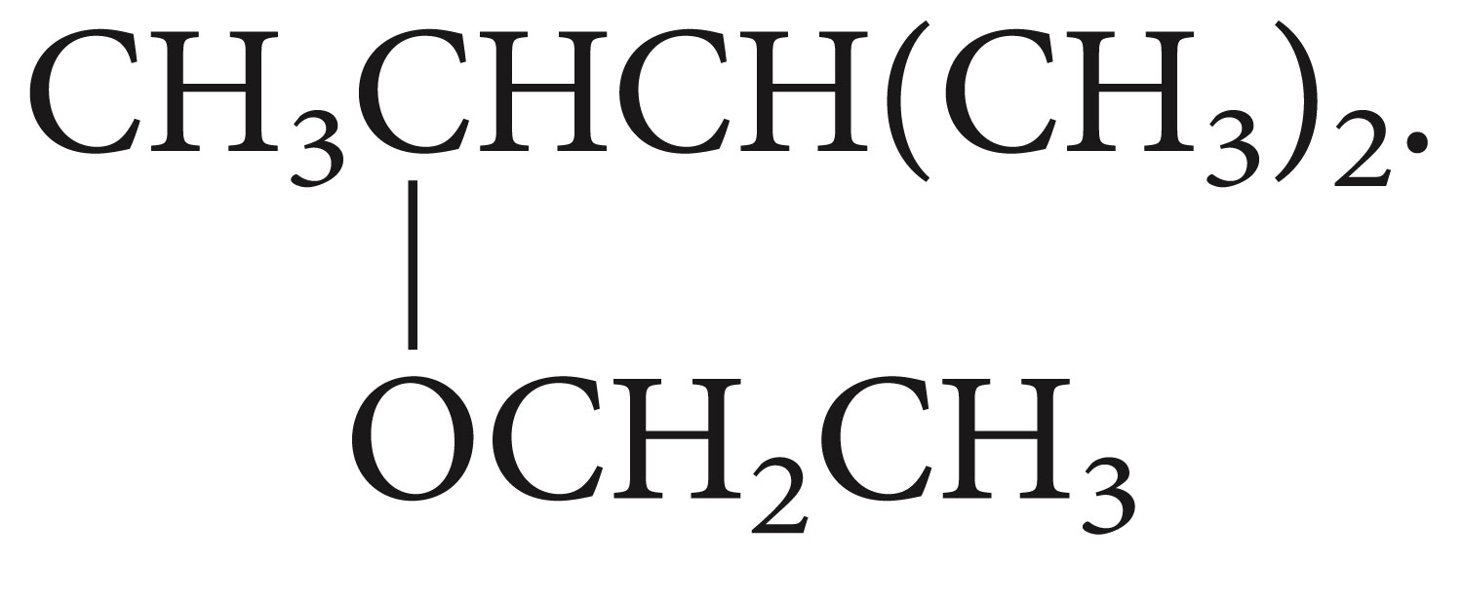
What are the correct names for the following ethers?

Slide 36
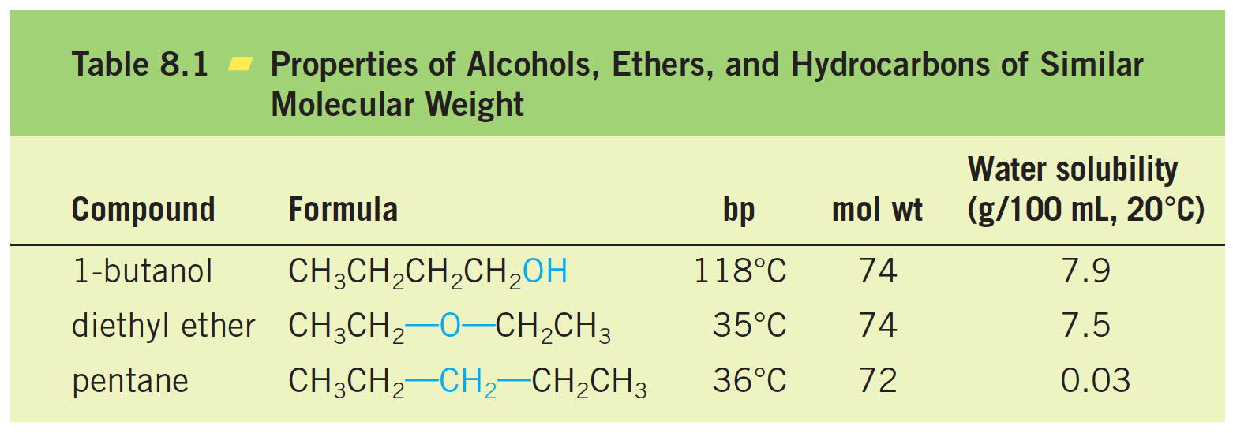
Physical Properties of Ethers

Slide 37
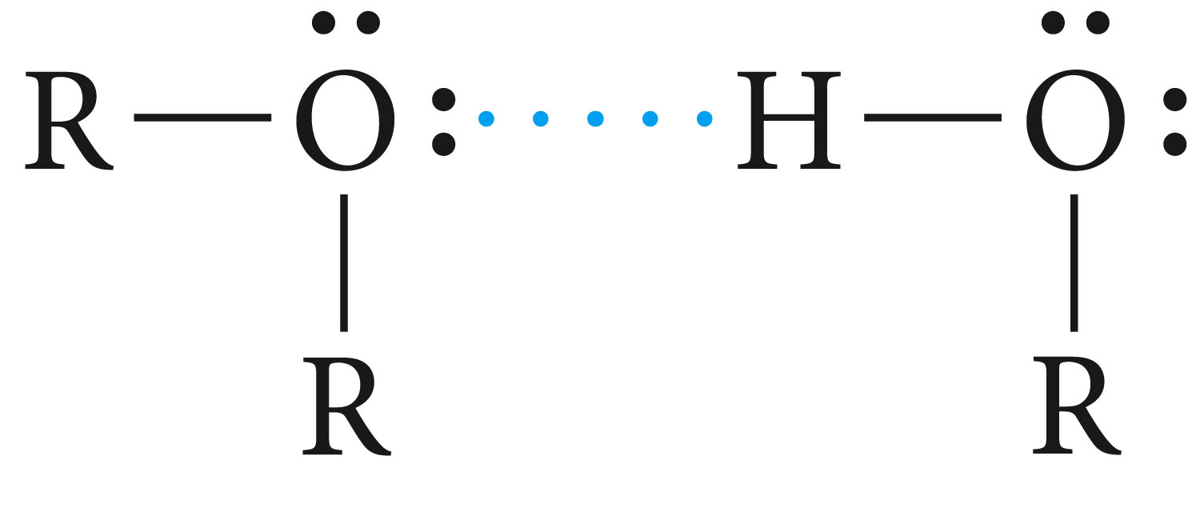
Although ethers cannot form hydrogen bonds with one another, they do form hydrogen bonds with alcohols. This explains why ethers and alcohols are mutually soluble.

Slide 38
Ethers as Solvents
Ethers are relatively inert compounds. They do no usually react with dilute acids or bases or common oxidizing and reducing agents.
They do not react with metallic sodium unlike alcohols.
Their inert nature and the fact that most organic compounds are ether-soluble makes them excellent solvents for organic reactions.
When ethers are exposed to air for a long time, they form peroxides and may result to explosives. FeSO₄ is usually added to destroy the peroxides.

Slide 39
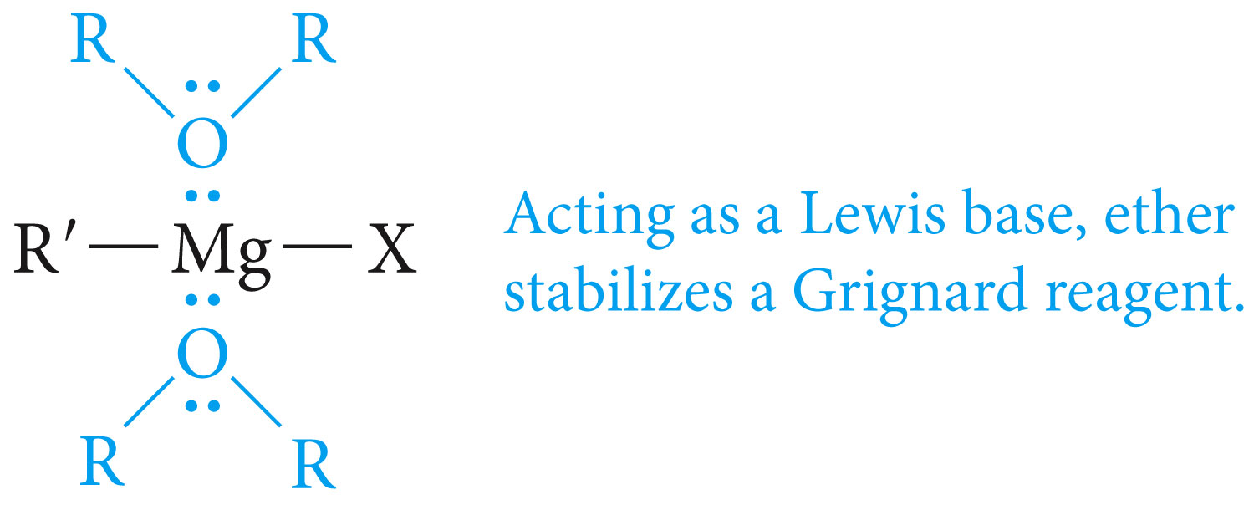
The Grignard Reagent : an Organometallic Compound
Pronounced greenyar(d)

Slide 40
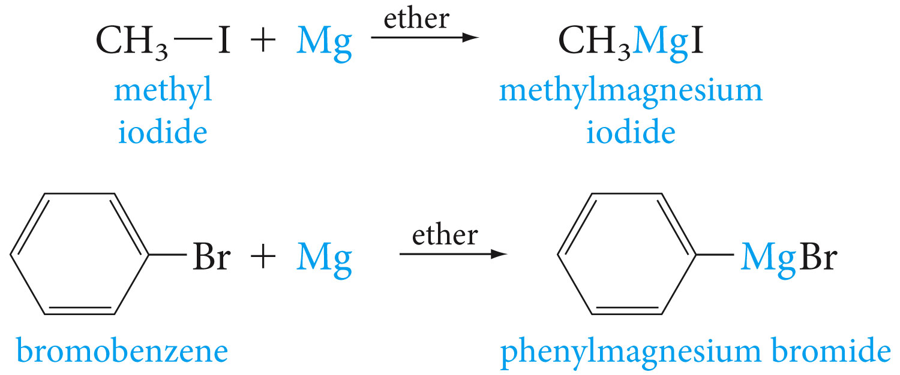

Slide 41
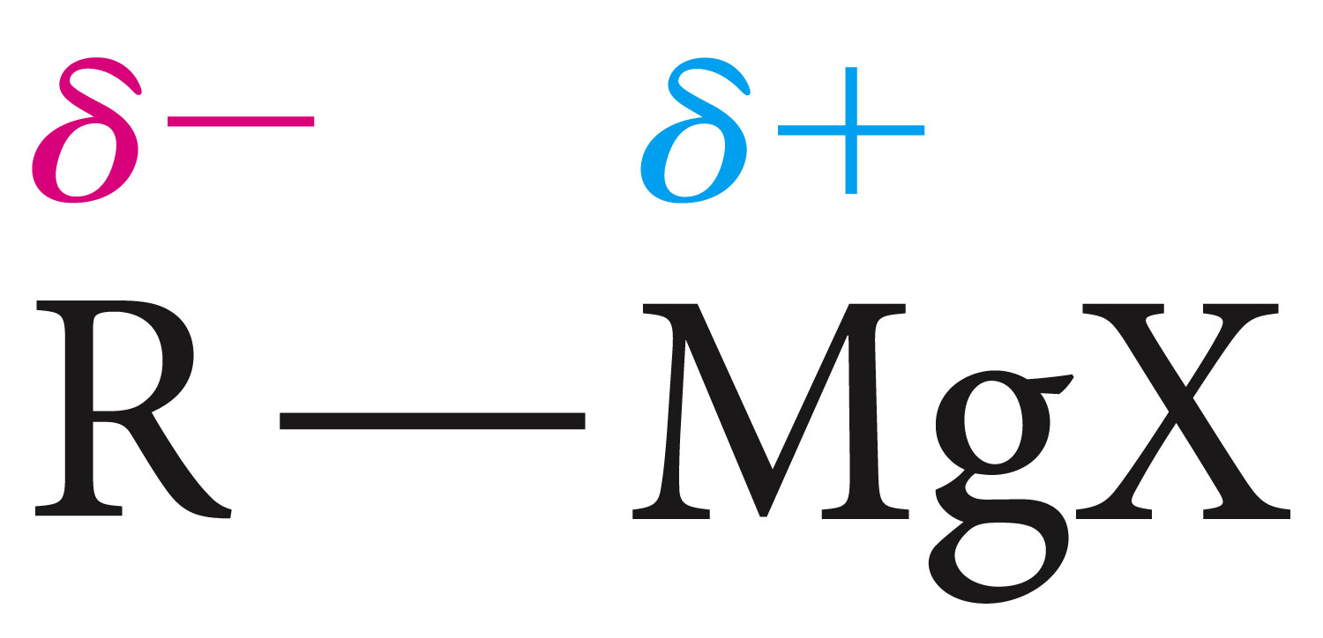
A carbanion is an alkyl or aryl group with a negatively charged carbon atom. Carbanions are strong bases

Slide 42
Grignard reagent reaction with water
Reaction of Grignard reagent with water can be used to place deuterium isotopes by reacting them with heavy water (D₂O), where the deuterium substitutes the halogen

Slide 43
Question: Show how to prepare CH₃CHDCH₃ from CH₂=CHCH₃

Slide 44
Organolithium compounds
These compounds contain carbon- metal (lithium) bond. They react in a similar manner to Grignard reagents, and are very useful in synthesis

Slide 45
Preparation of Ethers

Slide 46
Methyl tert Butyl Ether (MTBE) has a high octane value of about 110, it is used as an octane number enhancer in unleaded gasoline. It is prepared by the acid-catalyzed addition of methanol to 2-methylpropene

Slide 47
Williamson Synthesis

Slide 48
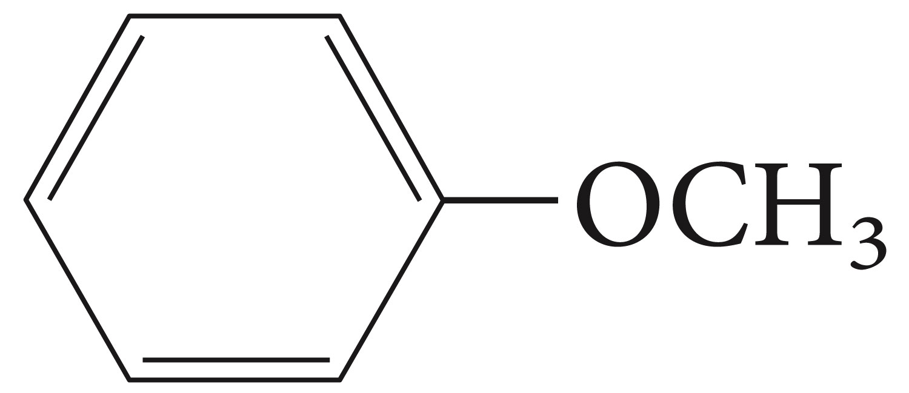
Show how this compound could be made

Slide 49
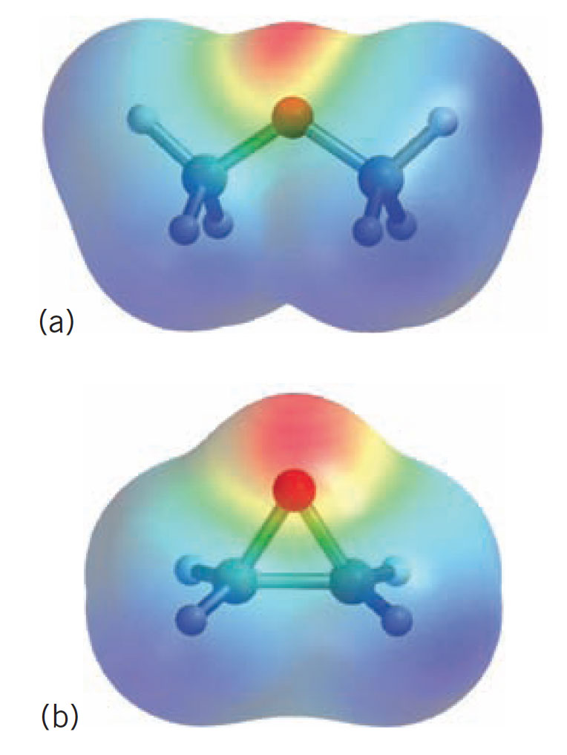
Cleavage of Ethers

Slide 53
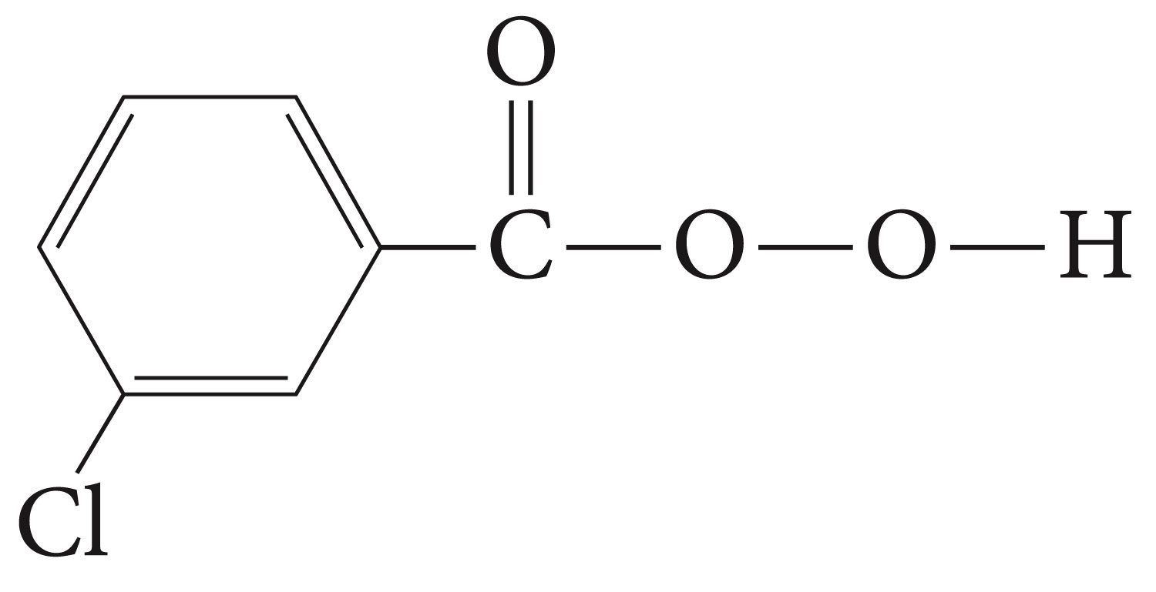
m-chloroperbenzoic acid (MCPBA) is an oxidizing agent frequently used in epoxidation reactions.

Slide 54
Reactions of Epoxides

Slide 56
Grignard reagents and organolithium compounds are strong nucleophiles capable of opening the ethylene oxide (epoxide) ring. The initial product is a magnesium alkoxide of lithium alkoxide, but after hydrolysis, we obtain a primary alcohol with two carbon atoms than the organometallic reagent.

Slide 57
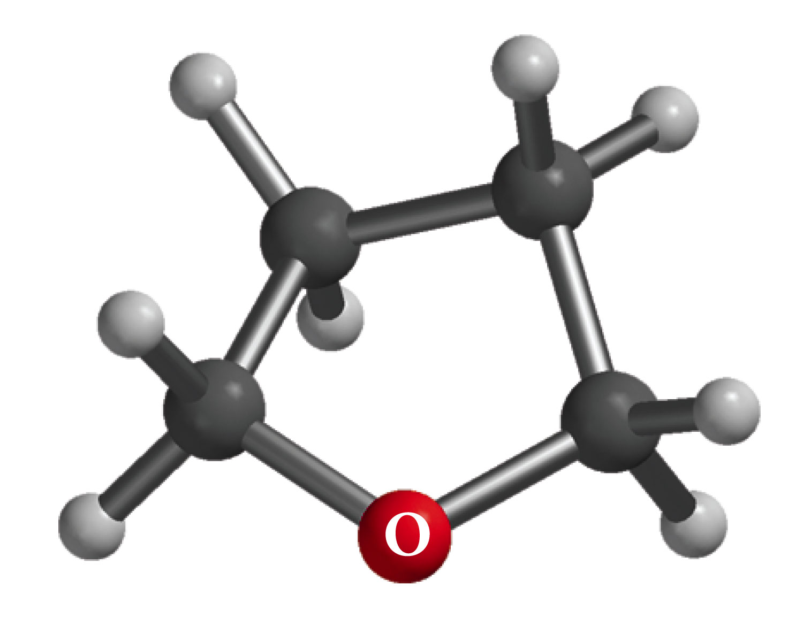
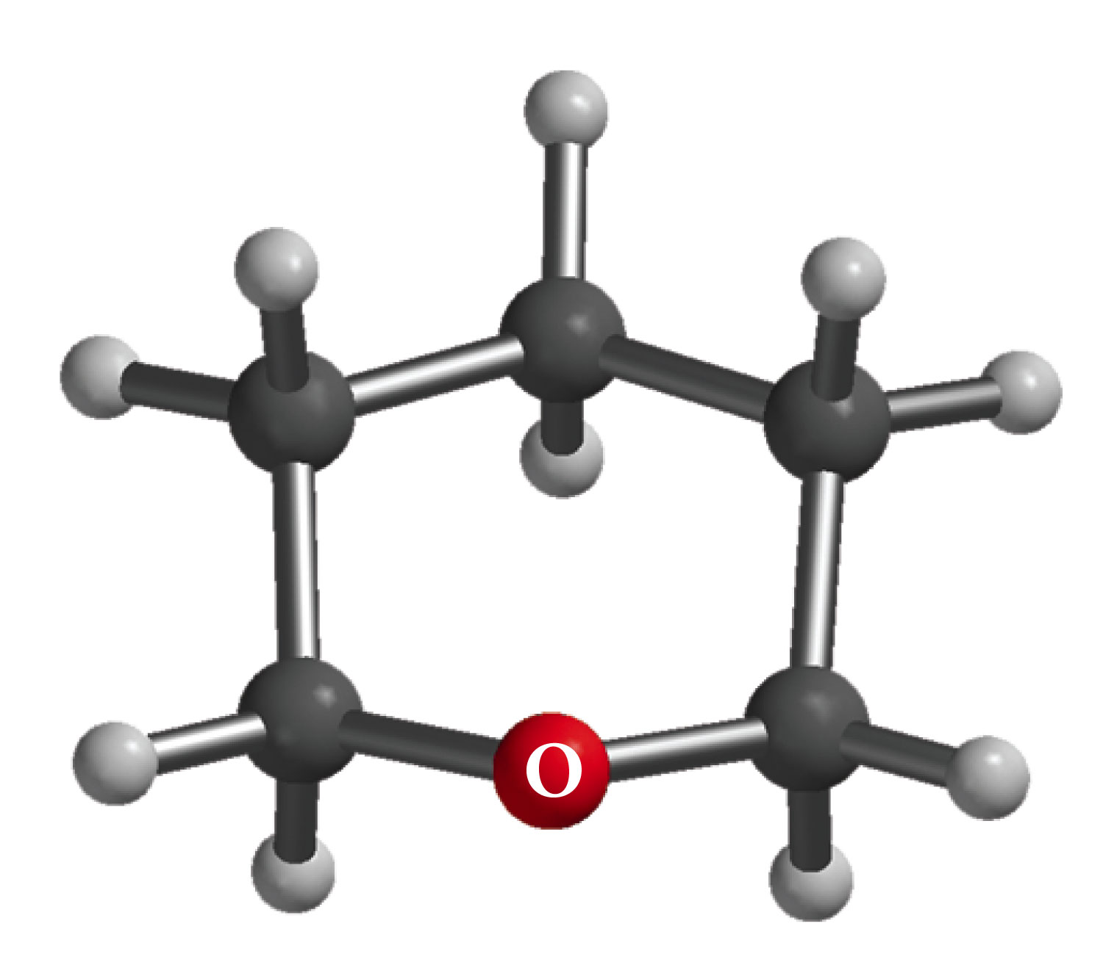
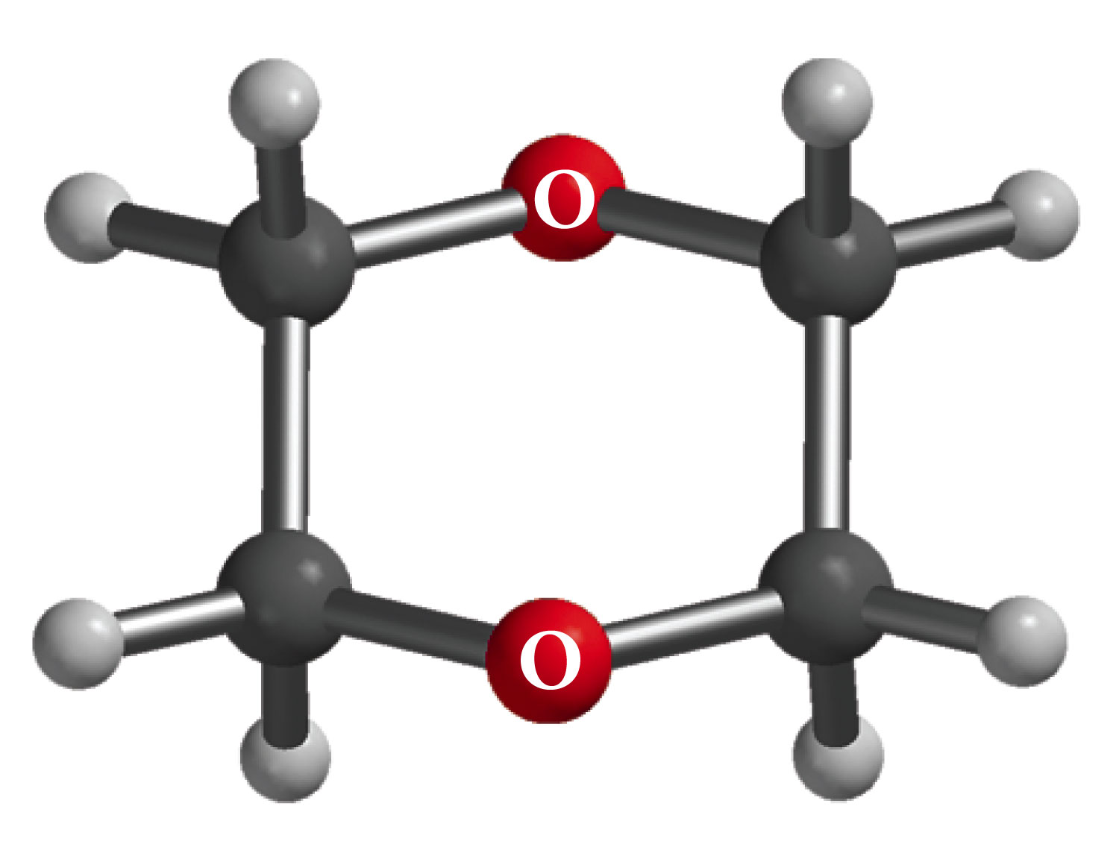
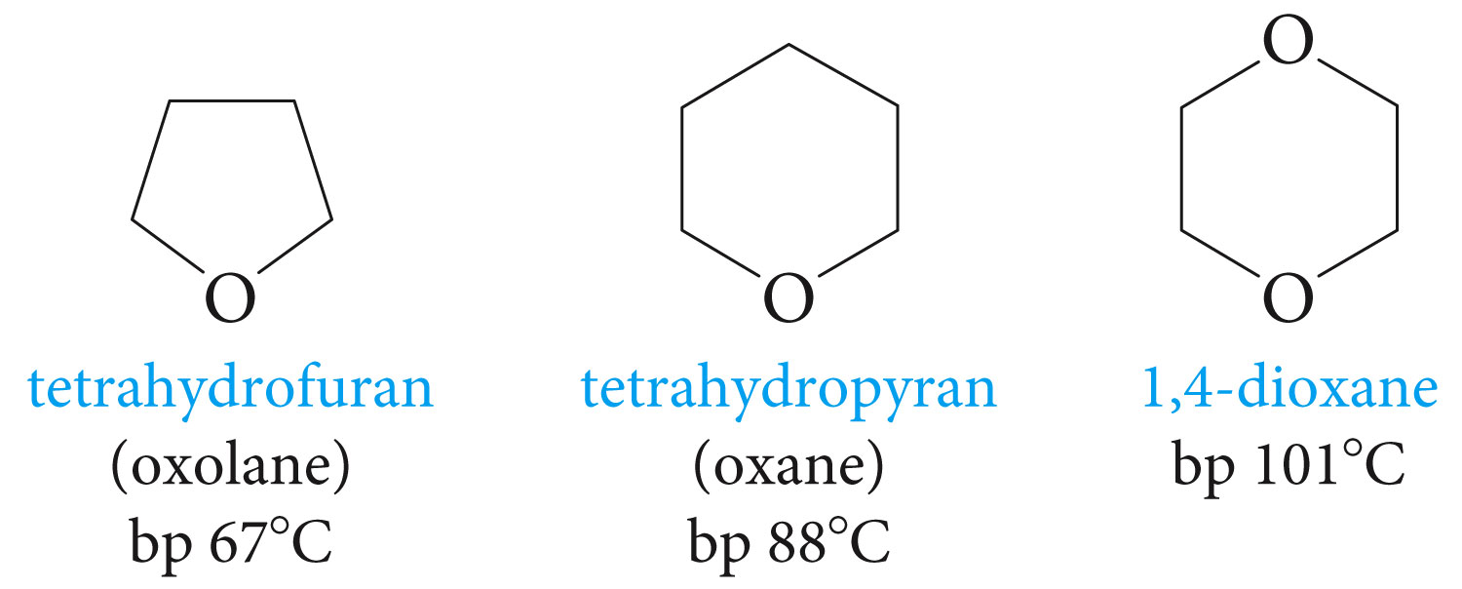
Cyclic Ethers

Slide 58
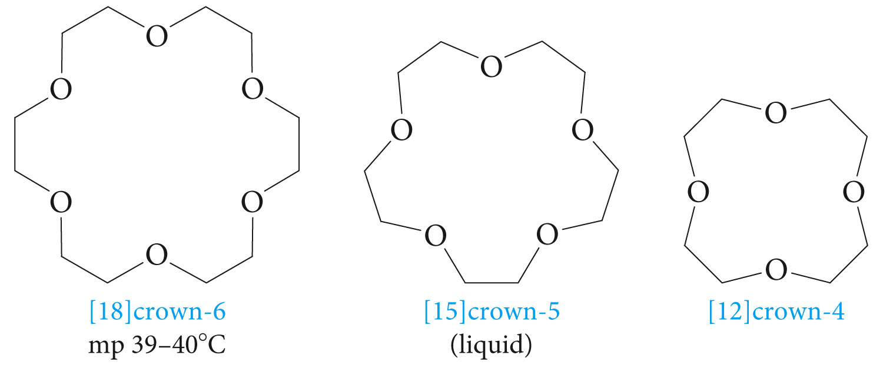
These compounds are called Crown ethers because their molecule have a crown-like shape. The bracket number represents the ring size and the terminal numbers gives the number of oxygens. The oxygens are usually separated by two carbons.

Slide 59
Crown ethers have the unique property of forming complexes with positive ions (Na⁺, K⁺ ) the positive ions fit within the macrocyclic rings selectively depending on the sizes. For example [18]crown-6 binds K⁺ more tightly than it does the smaller Na⁺ (too loose a fit) or the larger Cs⁺ (too large to fit in the hole). Similarly [15]crown-5 binds Na⁺ , and [12]crown-4 binds Li⁺. The crown ethers act as hosts for their anionic guests.

Slide 60
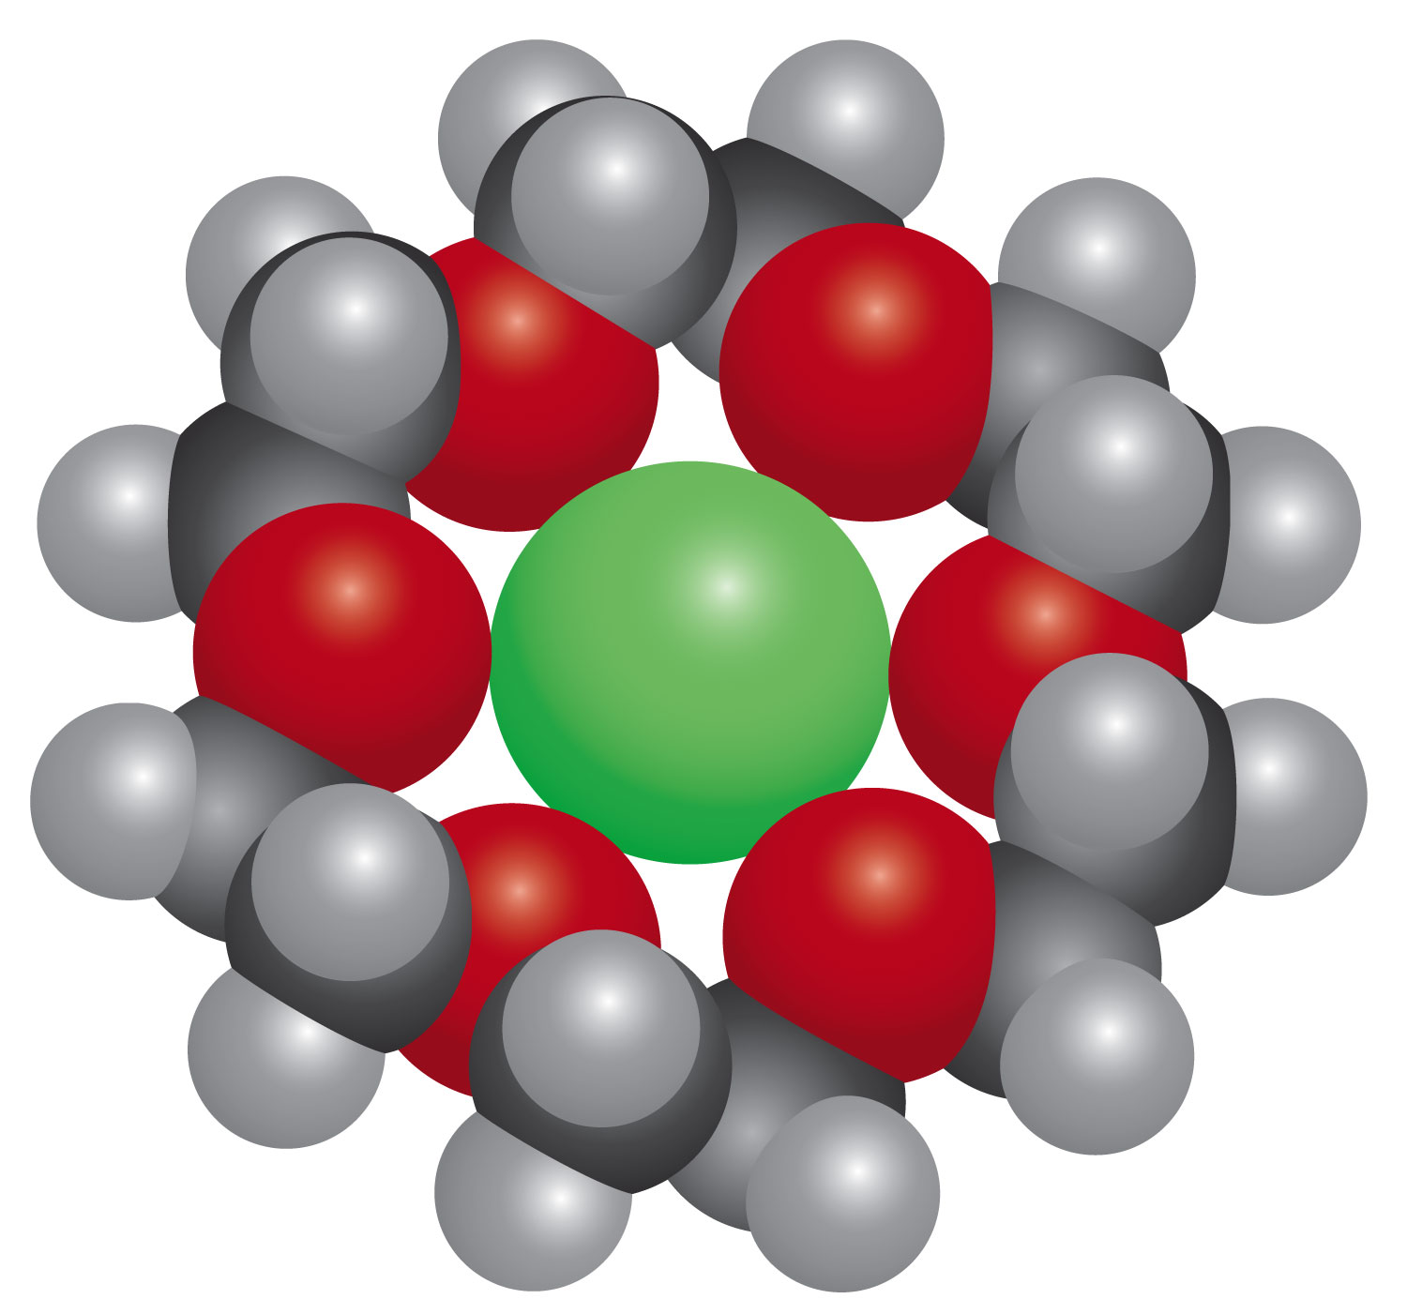
Model of [18]crown-6 complex with K⁺

Slide 61
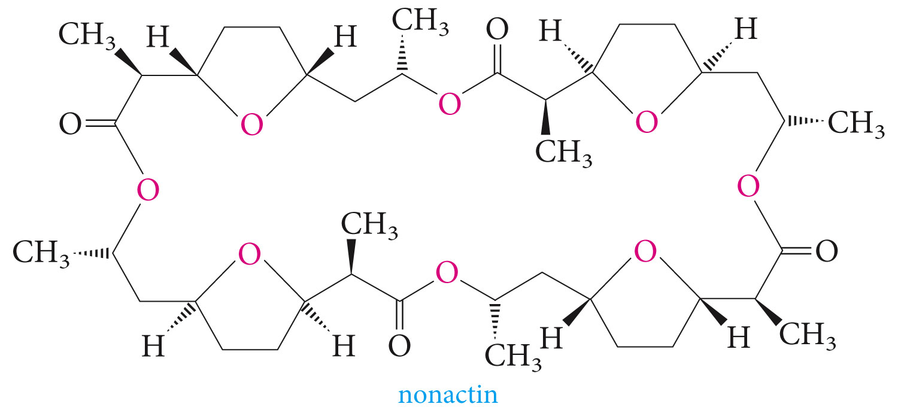
The selective binding of metallic ions by macrocyclic compounds is important in nature. Several antibiotics, such as nonactin, have large rings that contain regularly spaced oxygen atoms. Nonactin (which contains four tetrahydrofuran rings joined by four ester links) selectively binds K⁺ (in the presence of Na⁺) in aqueous media. Thus allowing selective transport of K⁺ (but not Na⁺) through the cell membranes

