Slide 1
Chapter 16
Acids and Bases

Slide 2
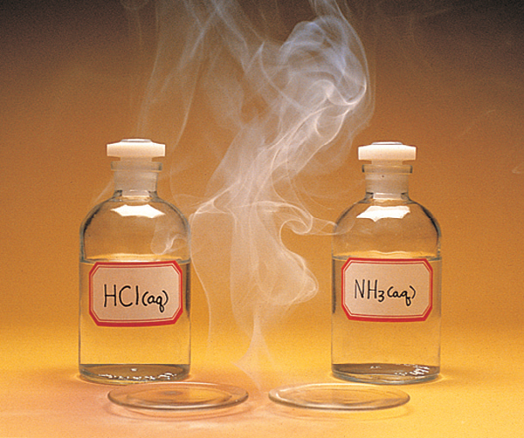

Slide 3
When gaseous hydrogen chloride meets gaseous ammonia, a smoke composed of ammonium chloride is formed.
HCl(g) + NH₃(g) → NH₄Cl(s)
This is an acid–base reaction.

Slide 4
We will examine three ways to explain acid–base behavior:
Arrhenius Concept
Brønsted–Lowry Concept
Lewis Concept
Note: H⁺ in water is H₃O⁺

Slide 5
Arrhenius Concept of Acids and Bases
An Arrhenius acid is a substance that, when dissolved in water, increases the concentration of hydronium ion, H₃O⁺(aq).
An Arrhenius base is a substance that, when dissolved in water, increases the concentration of hydroxide ion, OH⁻(aq).

Slide 6
The Arrhenius concept limits bases to compounds that contain a hydroxide ion.
The Brønsted–Lowry concept expands the compounds that can be considered acids and bases.

Slide 7
Brønsted–Lowry Concept of Acids and Bases
An acid–base reaction is considered a proton (H⁺) transfer reaction.
H⁺
H⁺
H⁺
H⁺

Slide 8
A Brønsted–Lowry acid is the species donating a proton in a proton-transfer reaction; it is a proton donor.
A Brønsted–Lowry base is the species accepting a proton in a proton-transfer reaction; it is a proton acceptor.

Slide 9
Substances in the acid–base reaction that differ by the gain or loss of a proton, H⁺, are called a conjugate acid–base pair. The acid is called the conjugate acid; the base is called a conjugate base.
Acid
Base
Conjugate base
Conjugate acid

Slide 10
What is the conjugate acid of H₂O?
What is the conjugate base of H₂O?
The conjugate acid of H₂O has gained a proton. It is H₃O⁺.
The conjugate base of H₂O has lost a proton. It is OH⁻.

Slide 11
Label each species as an acid or base. Identify the conjugate acid-base pairs.
a. HCO₃⁻(aq) + HF(aq) H₂CO₃(aq) + F⁻(aq)
b. HCO₃⁻(aq) + OH⁻(aq) O₃²⁻(aq) + H₂O(l)

Slide 12
Species that can act as both an acid and a base are called amphiprotic or amphoteric species.
Identify any amphiprotic species in the previous problem.
HCO₃⁻ was a base in the first reaction and an acid in the second reaction. It is amphiprotic.

Slide 13
Lewis Concept of Acids and Bases
A Lewis acid is a species that can form a covalent bond by accepting an electron pair from another species.
A Lewis base is a species that can form a covalent bond by donating an electron pair to another species.

Slide 14
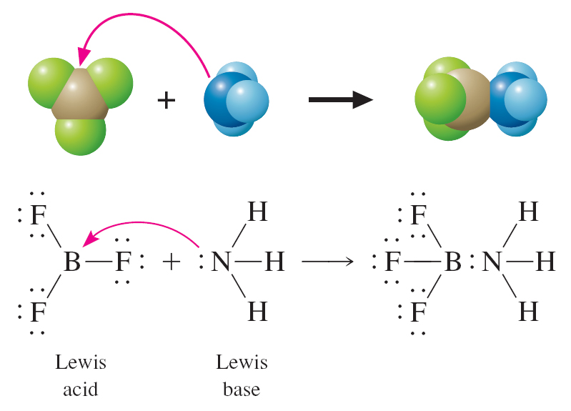

Slide 15
Relative Strengths of Acids and Bases
The stronger an acid, the weaker its conjugate base.
The weaker an acid, the stronger its conjugate base.

Slide 16
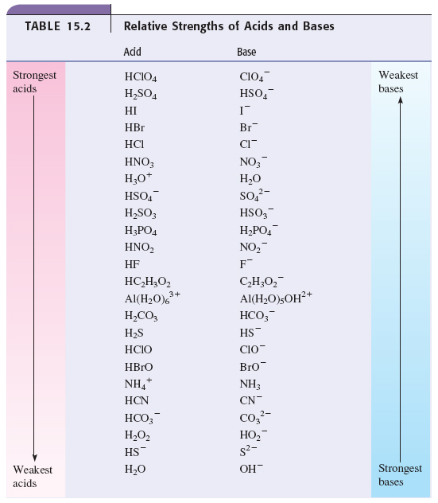

Slide 17
Formic acid, HCHO₂, is a stronger acid than acetic acid, HC₂H₃O₂. Which is the stronger base: formate ion, CHO₂⁻, or acetate ion, C₂H₃O₂⁻?
Because formic acid is stronger than acetic acid, formate ion (which is the conjugate base of formic acid) will be a weaker base than acetate ion (which is the conjugate base of acetic acid).
The acetate ion is a stronger base than the formate ion.

Slide 18
Molecular Structure and Acid Strength
The strength of an acid depends on how easily the proton, H⁺, is lost or removed. The more polarized the bond between H and the atom to which it is bonded, the more easily the H⁺ is lost or donated.
We will look now at factors that affect how easily the hydrogen can be lost and, therefore, acid strength.

Slide 19
For a binary acid, as the size of X in HX increases, going down a group, acid strength increases.
For a binary acid, going across a period, as the electronegativity increases, acid strength increases.

Slide 20
Which is a stronger acid: HF or HCl?
Which is a stronger acid: H₂O or H₂S?
Which is a stronger acid: HCl or H₂S?
HF and HCl
These are binary acids from the same group, so we compare the size of F and Cl. Because Cl is larger, HCl is the stronger acid.

Slide 21
H₂O and H₂S
These are binary acids from the same group, so we compare the size of O and S. Because S is larger, H₂S is the stronger acid.
HCl and H₂S
These are binary acids from the same period, but different groups, so we compare the electronegativity of Cl and S. Because Cl is more electronegative, HCl is the stronger acid.

Slide 22
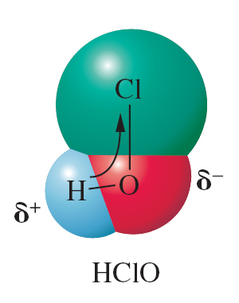
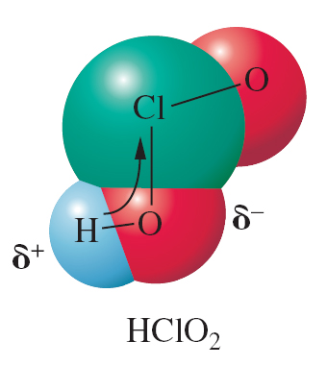
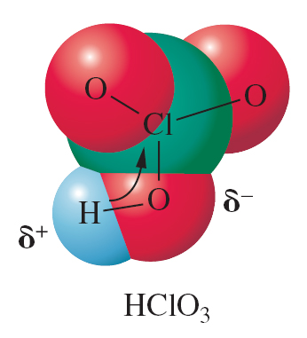
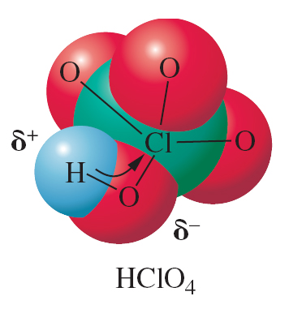
For oxoacids, several factors are relevant: the number and bonding of oxygens, the central element, and the charge on the species.
For a series of oxoacids, (OH)_{m}YO_{n}, acid strength increases as n increases.
(OH)ClO
n = 1
(OH)ClO₂
n = 2
(OH)ClO₃
n = 3
(OH)Cl
n = 0
Weakest
Strongest

Slide 23
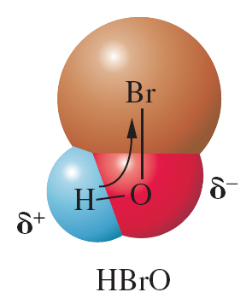
For a series of oxoacids differing only in the central atom Y, the acid strength increases with the electronegativity of Y.
Stronger
Weaker

Slide 24
The acid strength of a polyprotic acid and its anions decreases with increasing negative charge.
H₂CO₃ is a stronger acid than HCO₃⁻.
H₂SO₄ is a stronger acid than HSO₄⁻.
H₃PO₄ is a stronger acid than H₂PO₄⁻.
H₂PO₄⁻ is a stronger acid than HPO₄²⁻.

Slide 25
A reaction will always go in the direction from stronger acid to weaker acid, and from stronger base to weaker base.

Slide 26
Decide which species are favored at the completion of the following reaction:
HCN(aq) + HSO₃⁻(aq) CN⁻(aq) + H₂SO₃(aq)
We first identify the acid on each side of the reaction: HCN and H₂SO₃.
Next, we compare their acid strength: H₂SO₃ is stronger.
This reaction will go from right to left (←), and the reactants are favored.

Slide 27
Self-Ionization of Water
H₂O(l) + H₂O(l) H₃O⁺(aq) + OH⁻(aq)
Base
Acid
Conjugate acid
Conjugate base

Slide 28
H₂O(l) + H₂O(l) H₃O⁺(aq) + OH⁻(aq)
We call the equilibrium constant the ion-product constant, K_{w}.
K_{w} = [H₃O⁺][OH⁻]
At 25°C, K_{w} = 1.0 × 10⁻¹⁴
As temperature increases, the value of K_{w} increases.

Slide 29
Solutions of a Strong Acid or Strong Base
The concentration of hydronium or hydroxide in a solution of strong acid or base is related to the stoichiometry of the acid or base.

Slide 30
0.10 M HCl
b. 1.4 × 10⁻⁴ M Mg(OH)₂
Calculate the hydronium and hydroxide ion concentration at 25°C in
When HCl ionizes, it gives H⁺ and Cl⁻.
When Mg(OH)₂ ionizes, it gives Mg²⁺ and 2 OH⁻.

Slide 31
Solutions can be characterized as
Acidic: [H₃O⁺] > 1.0 × 10⁻⁷ M
Neutral:[H₃O⁺] = 1.0 × 10⁻⁷ M
Basic: [H₃O⁺] < 1.0 × 10⁻⁷ M

Slide 32
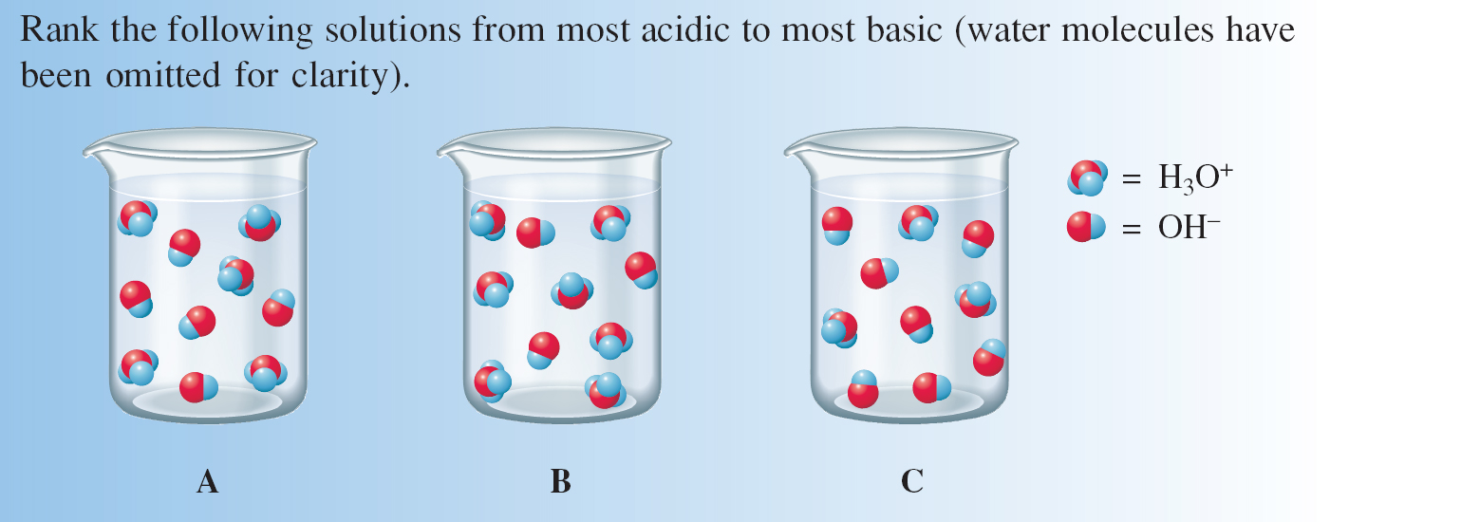

Slide 33
The pH of a Solution
pH = –log[H₃O⁺]
For a log, only the decimal part of the number has significant figures. The whole number part, called the characteristic, is not significant.

Slide 34
Calculate the pH of typical adult blood, which has a hydronium ion concentration of 4.0 × 10⁻⁸ M.

Slide 35
pOH = –log[OH⁻]
pH + pOH = 14.00 (at 25°C)
Also note that
[H₃O⁺] = 10^{-pH}
[OH⁻] = 10^{-pOH}

Slide 36
The pH of natural rain in 5.60. What is its hydronium ion concentration?

Slide 37
The next slide summarizes the conversions involving H₃O⁺, OH⁻, pH, and pOH.
Note that you can only go around the edges of the square; it takes two steps to go from one corner to the opposite corner.

Slide 38
[H₃O⁺] [OH⁻]
pH pOH
Notes:
In the top two equations (for [OH-] and [H3O+], when I edited them to replace the x’s with multiplication symbols, the font changed. I’m not sure how to change it back. Can you please revise them?
I reset the font as Arial for all the equations (the others appeared as if bolded).

Slide 39
Contents and Concepts
Acid–Base Concepts
Arrhenius Concept of Acids and Bases
Brønsted–Lowry Concept of Acids and Bases
Lewis Concept of Acids and Bases
Acid and Base Strengths
Relative Strengths of Acids and Bases
Molecular Structure and Acid Strength

Slide 40
Self-Ionization of Water and pH
Self-Ionization of Water
Solutions of a Strong Acid or Base
The pH of a Solution
Notes:
This slide should be followed by the set of Learning Objectives slides; please add them.
I was told not to use my time to do this.

