Slide 1
Chapter 1 Matter on the Atomic Scale

Slide 2
Why Care about Chemistry?
Chemistry
The science of matter and the transformations it can undergo.
Why should you study it?
It helps us understand our surroundings and the way we function.
It plays a central role in medicine, engineering and many sciences.
Consider the anticancer drug Taxol®.

Slide 3
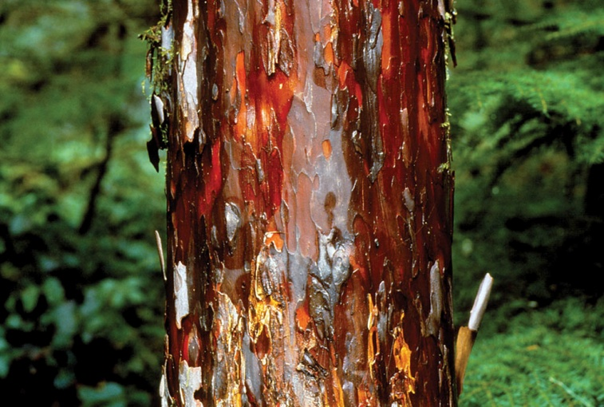
Molecular Medicine
Pacific yew bark extract has cancer-fighting properties.
Chemists:
Isolated the active chemical: Paclitaxel
Determined its formula: C₄₇H₅₁NO₁₄.
Determined its structure:
Smaller of two parts
of paclitaxel
(Taxol®)
Space-filling model Ball-and-stick model

Slide 4
Molecular Medicine
Pacific yew is a poor drug source.
Removing the bark kills the tree.
Six 100-year-old trees would be needed to treat one patient.
Another source was needed.
An English-yew needle extract can be converted into paclitaxel.
English yew is common and fast growing.
Needles can be harvested without killing the tree.

Slide 5
How Science is Done
Observations are made.
A hypothesis is proposed.
A tentative idea to explain the observations.
Suggests further experiments to check if correct.
A hypothesis: “Plant extracts treat cancer”.
Experiments generate:
Qualitative data – no numerical information, or
Quantitative data - contains “numbers”

Slide 6
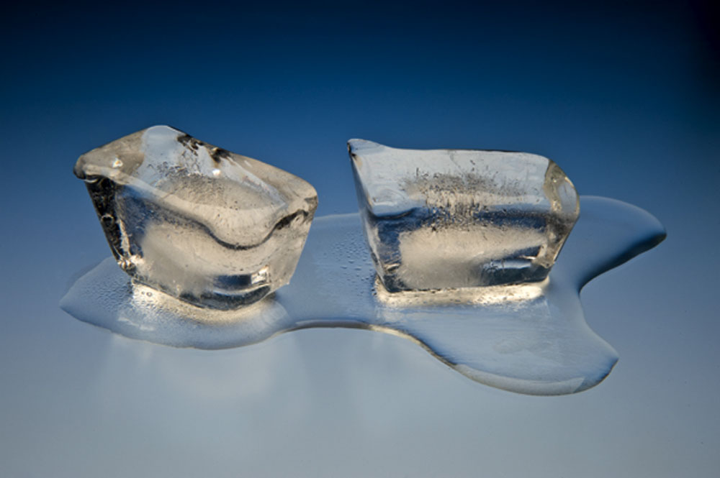
Identifying Matter: Physical Properties
Physical properties can be measured without changing the composition of a substance.
Temperature
Pressure
Mass
Volume
State (solid, liquid, or gas)
Melting point
Boiling point
Density
Color
Shape of crystals
Ice melting

Slide 7
Physical Change
The same substance is present before and after a physical change.
physical state may change.
e.g. ice melting (solid water → liquid water).
gross shape may change.
e.g. a lump of lead hammered into a sheet.
size may change.
e.g. a piece of wood is cut in two.

Slide 8
Physical Change
Temperature (T)
Measures relative energy (E) content of an object.
E transfers from high-T to low-T objects.
T is often given in degrees Fahrenheit (°F) in the U.S.
The rest of the world uses degrees Celsius (°C).
T (°F) T (°C)
Water freezes 32 0
Water boils 212 100
Normal body T 98 37

Slide 9
Temperature
water boils
T (°C) = [T (°F) – 32] x
100
180
100°C
212°F
or
T (°C) = [T (°F) – 32] x
and
T (°F) = [T (°C)] + 32
5
9
100
steps
180
steps
9
5
0°C
32°F
water freezes

Slide 10
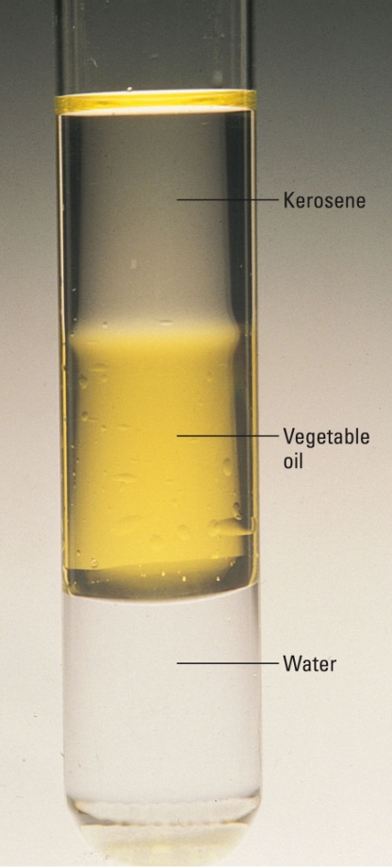
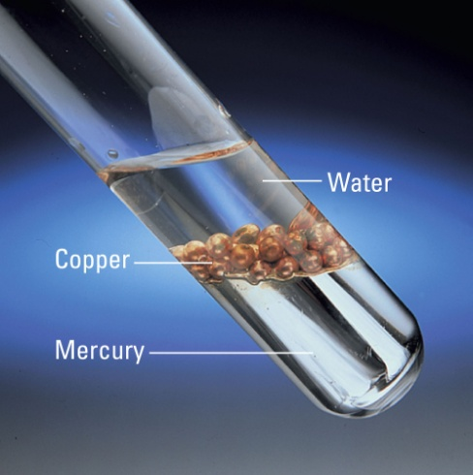
Density
mass
Volume
Physical property: density =
Density at 20°C
Substance d (g/mL)
ethanol 0.789
water 0.998
magnesium 1.74
aluminum 2.70
titanium 4.50
copper 8.93
lead 11.34
mercury 13.55
gold 19.32
m
V
d =
Kerosene, vegetable
oil and water
Water, copper and mercury

Slide 11
Density
A piece of metal has mass = 215.8 g. When placed into a measuring cylinder it displaces 19.1 mL of water. Identify the metal.
Density at 20°C
Substance d (g/mL)
magnesium 1.74
aluminum 2.70
titanium 4.50
copper 8.93
lead 11.34
mercury 13.55
gold 19.32
m
V
215.8 g
19.1 mL
= 11.3 g/mL
d=
=
Probably lead

Slide 12
Dimensional Analysis
Example
Determine the mass of 3274 mL of mercury.
m = V x d
= 3274 mL x
13.55 g
1 mL
= 4.436 x 10⁴ g
A proportionality factor was used.
known units x
desired units
known units
= desired units

Slide 13
Dimensional Analysis
Since 1 lb = 453.59 g we can write:
453.59 g
1 lb
1 lb
453.59 g
= 1
and
= 1
Example
Determine the mass (in grams) of a 2000. lb car.
2000. lb x
453.59 g
1 lb
= 9.072 x 10⁵ g
Multiplication by 1!
The quantity doesn’t change – just the units!

Slide 14
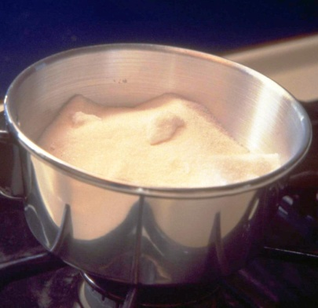
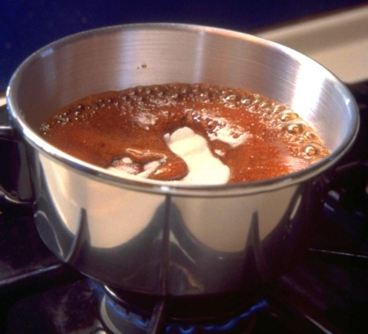
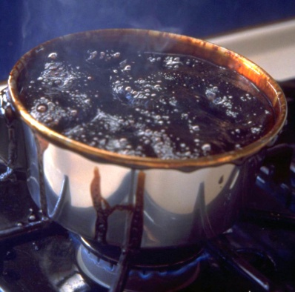
Chemical Properties
Chemical property
A chemical reaction that a substance can undergo.
Chemical Reaction?
Reactant atoms rearrange into different substances.
Sucrose caramelizes, then turns to carbon on heating.
sucrose carbon + water
heat
reactant products

Slide 15
Chemical Properties
Describe the change as chemical or physical:
(a) A cup of household bleach changes the color of your favorite T-shirt from purple to pink.
Chemical change
Fuels in the space shuttle (hydrogen and oxygen) combine to give water and provide energy to lift the shuttle into space.
Chemical change
(c) An ice cube in your glass of lemonade melts.
Physical change

Slide 16
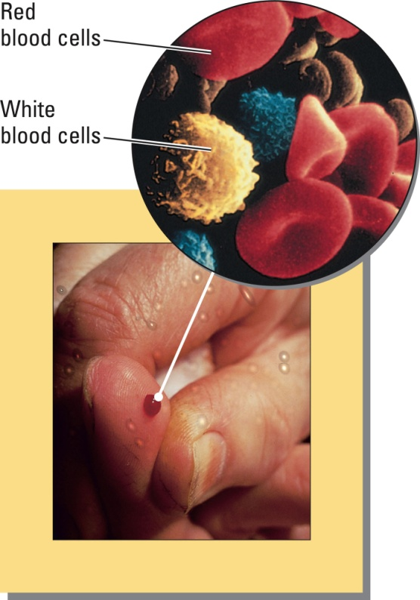
Classifying Matter
Mixtures of substances are either:
Homogeneous
two or more substances in the same phase.
completely uniform.
Heterogeneous
properties in one region differ from the properties in another region.
a microscope may be needed to see the variation.

Slide 17
Substances & Mixtures
Sample heterogeneous homogeneous
blood
air
apple
oil & vinegar dressing
milk
filtered ocean water
Blood appears homogeneous to the unaided eye, but not under a microscope.
“Homogenized” milk appears homogeneous, but not under a microscope.

Slide 18
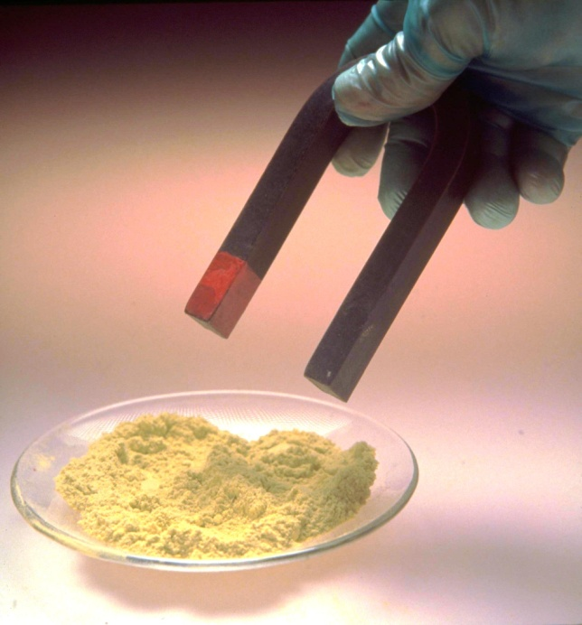
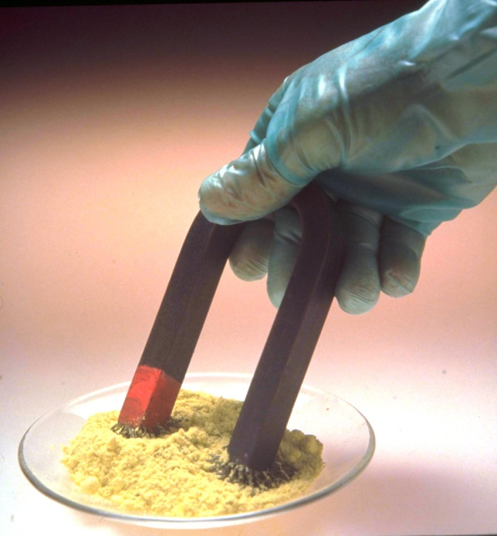
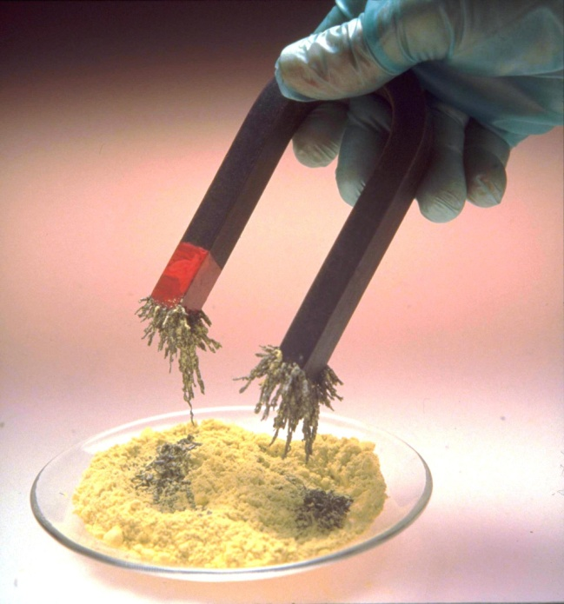
Separation & Purification
Mixtures can be separated by physical methods.
e.g. A magnet separating iron filings from sulfur powder.

Slide 19
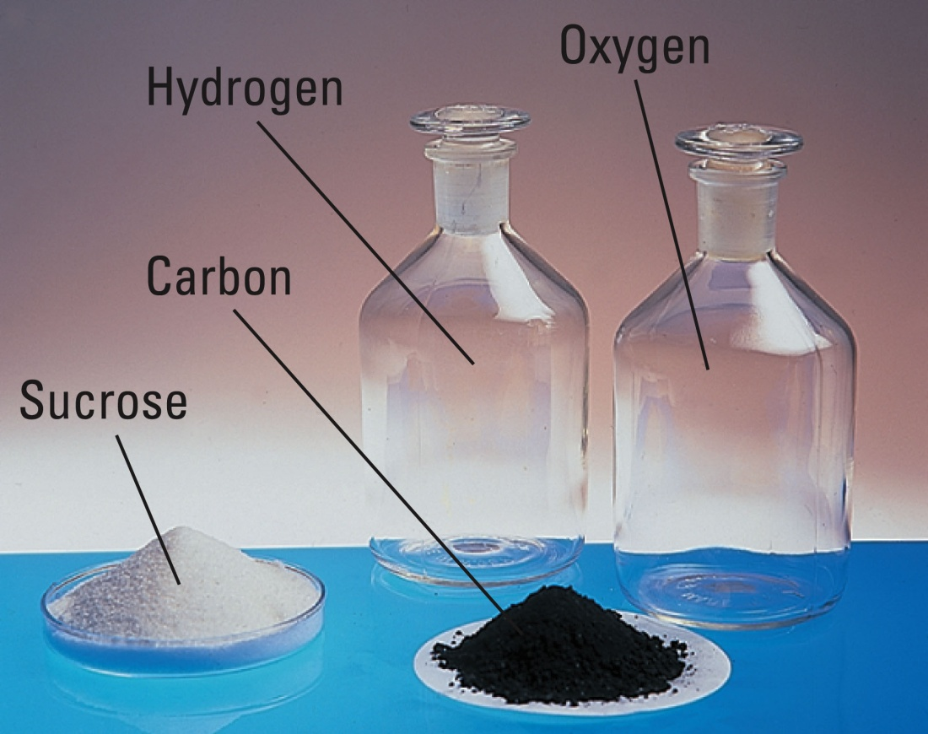
Classifying Matter: Compounds
Most substances are compounds:
They will decompose into simpler substances
Sucrose → carbon, hydrogen and oxygen.
O₂
(colorless gas)
H₂
(colorless gas)
carbon
(black solid)
sucrose
(white solid)

Slide 20
Classifying Matter: Elements
Compounds
Have specific composition
Sucrose is always 42.1% C, 6.5% H and 51.4% O by mass.
Have specific properties.
Water always melts at 0.0°C (1 atm).
Water always boils at 100.0°C (1 atm).
Elements
Cannot be decomposed into new substances

Slide 21
Types of Matter
Matter (may be solid, liquid, or
gas): anything that occupies
space and has mass
Physically
separable into
Heterogeneous matter:
nonuniform composition
Homogeneous matter:
uniform composition throughout
Physically
separable into
Substances: fixed
composition; cannot
be further purified
Solutions: homogeneous
mixtures; uniform compositions
that may vary widely
Chemically
separable into
Compounds: elements
united in fixed ratios
Elements: cannot be subdivided
by chemical or physical changes
Combine chemically
to form

Slide 22
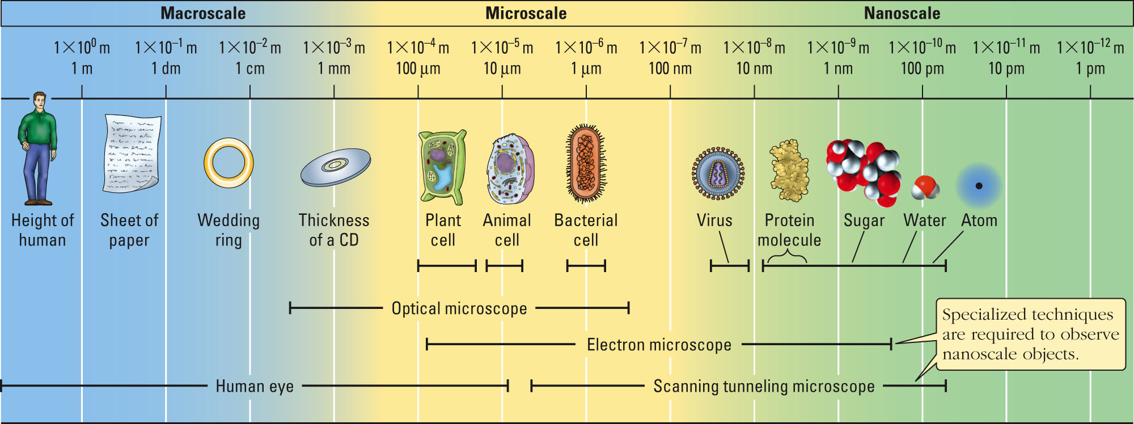
Nanoscale Theories & Models
macroscale objects can be seen, measured and handled without any aids.
microscale objects can be seen with a microscope.
nanoscale objects have dimensions ≈ an atom.
nano
SI prefix

Slide 23
Metric Units
Prefixes multiply or divide a unit by multiples of ten.
Prefix Factor
mega M 10⁶
kilo k 10³
deci d 10⁻¹
centi c 10⁻²
milli m 10⁻³
micro μ 10⁻⁶
nano n 10⁻⁹
pico p 10⁻¹²
Examples
1 kilometer = 1 km = 1 x 10³ meter
1 microgram = 1 μg = 1 x 10⁻⁶ gram

Slide 24
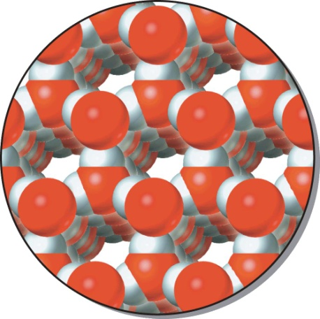
States of Matter: Solids, Liquids & Gases
Kinetic-Molecular Theory
Matter consists of tiny particles in constant motion.
Solid
Closely-packed particles often in regular arrays.
Fixed locations.
Vibrate back & forth.
Rigid materials.
Small fixed volume.
External shape often reflects inner structure.

Slide 25
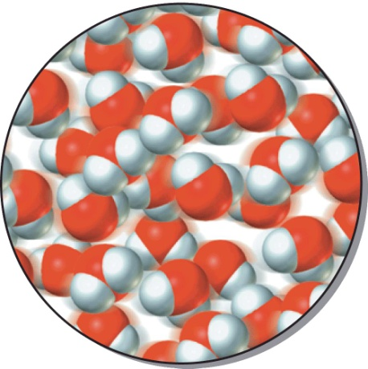
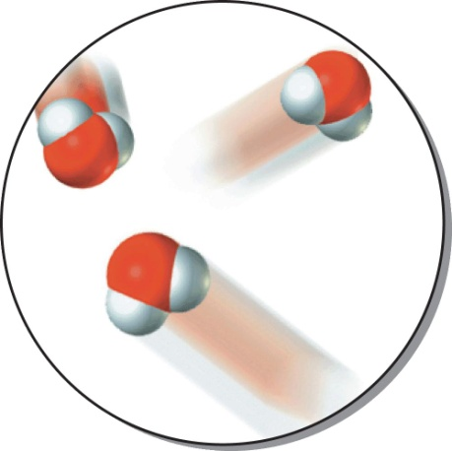
States of Matter: Solids, Liquids & Gases
Liquid
Closely spaced (similar to solids).
Slightly larger, fixed volume than a solid.
More randomly arranged than a solid.
Constant collisions with neighbors.
Less confined, can move past each other.
Gas
Continuous rapid motion
Particles are widely spaced.
Travel large distances before colliding.
No fixed volume or shape.

Slide 26
The Atomic Theory
All matter is made up of extremely small atoms.
All atoms of a given element are chemically identical.
Compounds form when atoms of two or more elements combine.
usually combine in the ratio of small whole numbers.
Chemical reactions join, separate, or rearrange atoms.
Atoms are not created, destroyed or converted into other kinds of atoms during a chemical reaction.

Slide 27
The Chemical Elements
Elements have unique names and symbols.
From people, places, mythology…
Symbols start with a capital letter.
Extra letters are lower-case.
Most symbols are obvious abbreviations
Helium = He Hydrogen = H
Americium = Am Zinc = Zn
“Old”-element symbols come from ancient names.
Gold = Au (aurum) Tin = Sn (stannum)
Silver = Ag (argentum) Lead = Pb (plumbum)

Slide 28
The Chemical Elements
Element Discovery Origin of Name
Carbon (C) Ancient L. carbo (charcoal)
Curium (Cm) Seaborg et al. In honor of Marie and Pierre Curie
1944 Nobel prize winners
Hydrogen (H) Cavendish Gr. hydro (water) + genes (maker)
1766
Mercury (Hg) Ancient Mythology: messenger of the gods
Gr. hydrargyrum (liquid silver)
Titanium (Ti) Gregor L. Titans (1st sons of the earth)
1791
Neon (Ne) Ramsay & Travers Gr. neos (new)
1898
Polonium (Po) M. & P. Curie In honor of Poland
1898

Slide 29
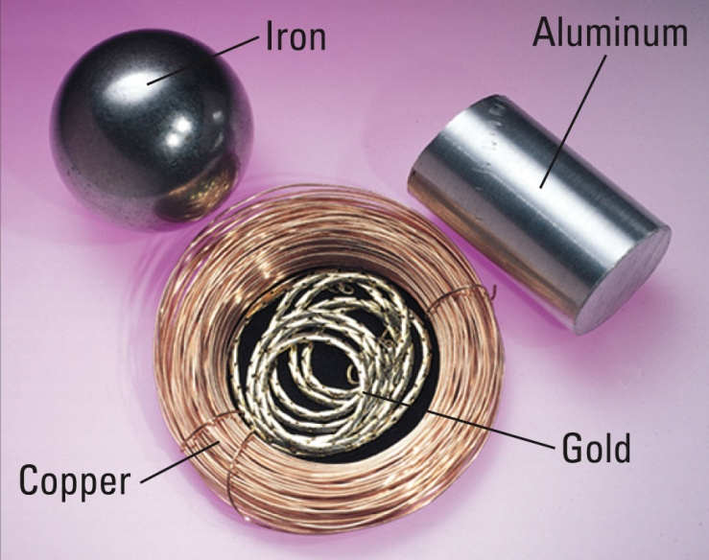
Types of Elements
More than 110 elements are currently known
90 occur naturally on earth.
the rest are man-made (synthetic).
most are metals (only 24 are not).
Metals
solids (except mercury – a liquid).
conduct electricity.
ductile (draw into wires).
malleable (roll into sheets).

Slide 30
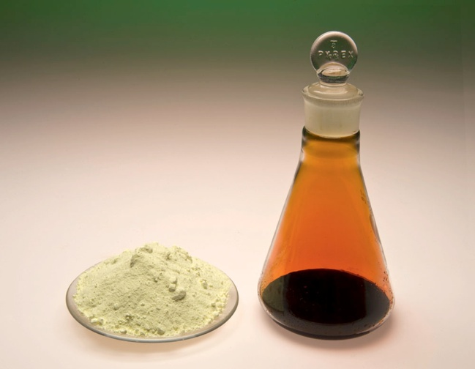
Types of Elements
Nonmetals
Occur in all physical states.
solids: sulfur, phosphorus, carbon.
liquid: bromine.
gases: oxygen, helium, nitrogen.
Do not conduct electricity.
graphite (a form of carbon) is one exception.
Sulfur and bromine

Slide 31
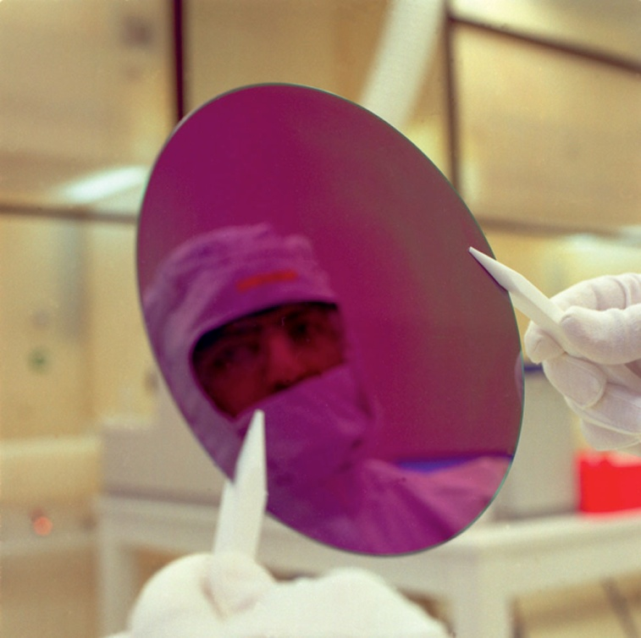
Types of Elements
Six are metalloids:
boron
silicon
germanium
arsenic
antimony
tellurium
Ultrapure silicon
They exhibit metallic and nonmetallic properties:
Look like metals (shiny).
Conduct electricity (not as well as metals).
they are semiconductors.

Slide 32
Elements that Consist of Molecules
Most non-metal elements form molecules.
A chemical formula shows the composition:
Diatomic examples:
Cl₂ O₂ N₂ F₂
Polyatomic examples:
O₃ P₄ S₈

Slide 33
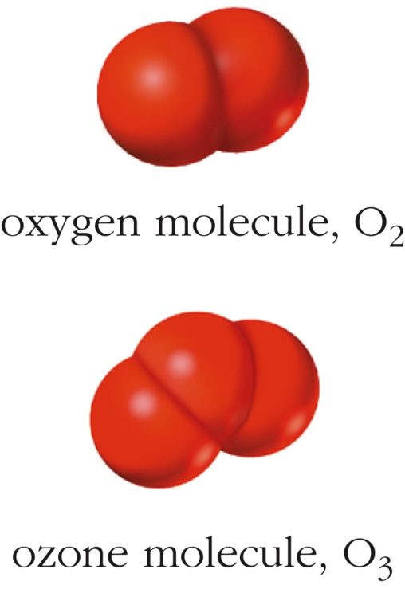
Allotropes
Different forms of an element (same T, P and phase)
Oxygen (gas):
O₂ (oxygen)
O₃ (ozone)
Carbon (solid):
C (diamond)
C (graphite)
C₆₀ (buckminsterfullerine) & other fullerines
C (nanotubes)

Slide 34
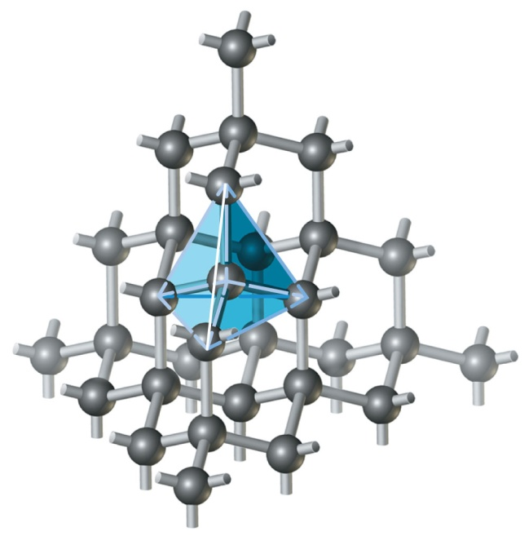
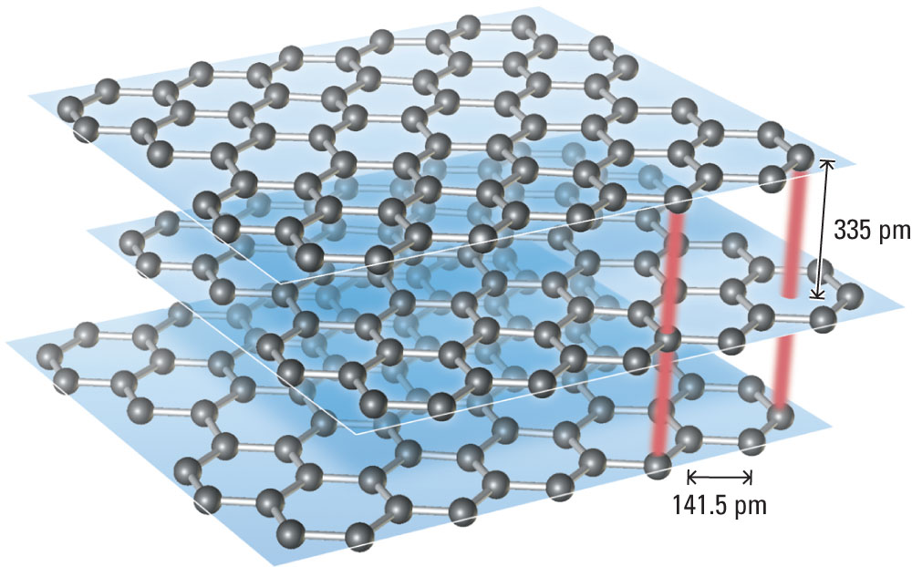
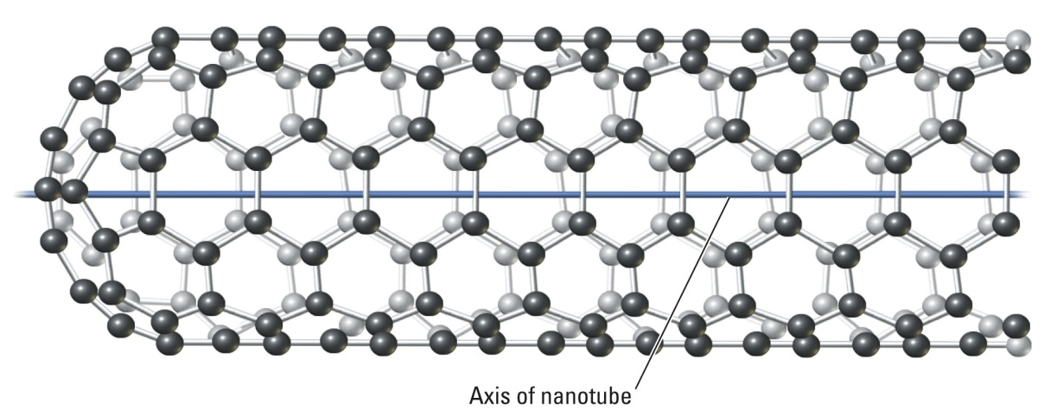
Allotropes
Diamond
Graphite
Buckminsterfullerene
Carbon nanotube

Slide 35
Communicating Chemistry: Symbolism
Chemical formulas show:
Number and type of atoms in the molecule.
Relative ratio of the atoms in a compound.
C₁₂H₂₂O₁₁(s) CH₃OH(ℓ) NaCl(s)
sucrose methanol table salt
Chemical equations show:
How reactants convert into products.
heat
C₁₂H₂₂O₁₁(s) 12 C(s) + 11 H₂O(g)
sucrose carbon + water

