Slide 1
Section 2.1 The Structure of the Atom

Slide 2
The Structure of the Atom
In this section…
The components of an atom
Atomic symbols
Isotopes and atomic weight

Slide 3
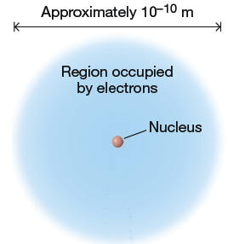
The Structure of the Atom
Components of an Atom:

Slide 4
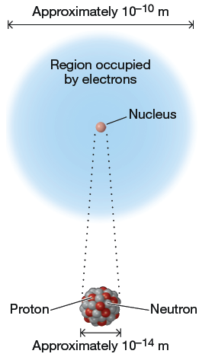
The Structure of the Atom
Components of an Atom:

Slide 5
The Structure of the Atom

Slide 6
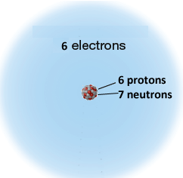
The Structure of the Atom
Atomic number and mass number:

Slide 7
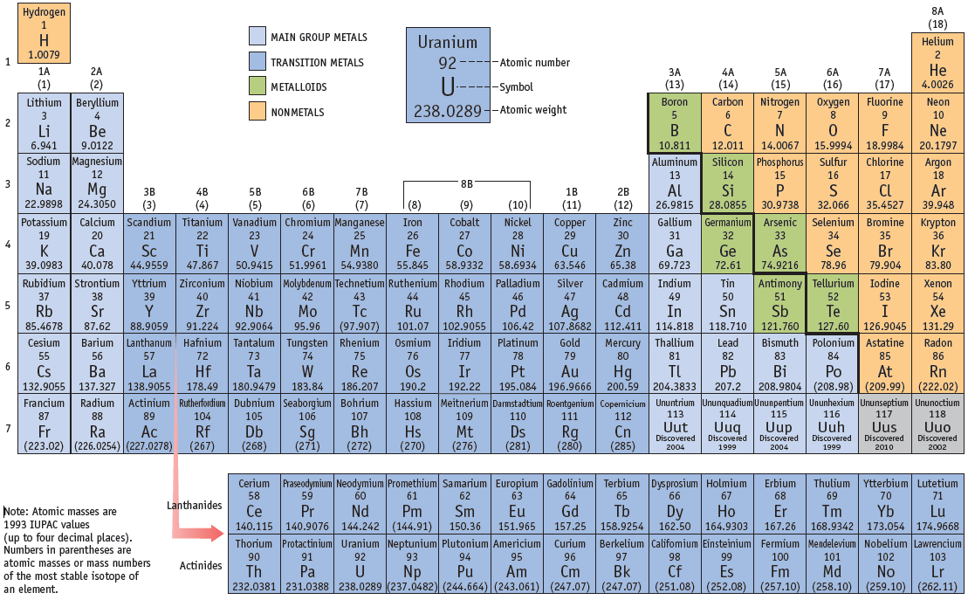
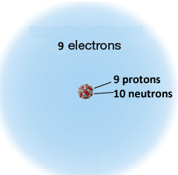
The Structure of the Atom
Atomic symbols:

Slide 8
The Structure of the Atom
Isotopes: atoms with the same number of protons
but different numbers of neutrons

Slide 9
The Structure of the Atom
Isotopes and average atomic weight:
The average atomic weight of an element depends
on the mass of the atoms but also on the relative
abundance of each isotope.

Slide 10
The Structure of the Atom
Average atomic weights are shown on periodic table:

Slide 11
Chiuaua: 4 lbs.
Mastif: 120 lbs.
What is the average weight of a collection of these dogs?

Slide 12
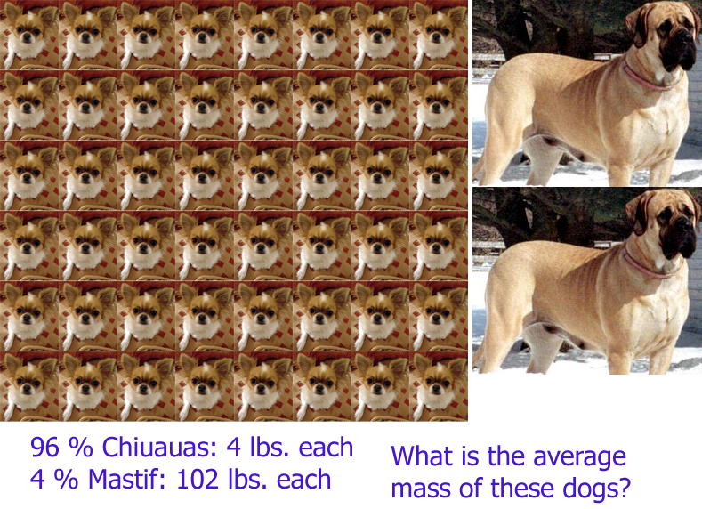

Slide 13
The Structure of the Atom
Isotopes and average atomic weight:
Average dog mass:
96 % Chiuauas @ 4 lbs.
4 % Mastifs @ 120 lbs.

Slide 14
The Structure of the Atom
Elements with a single isotope have
atomic weight = mass of that isotope
Can make rough estimate of relative abundance
from average atomic weight.

Slide 16
Isotope trends among the elements:

Slide 17
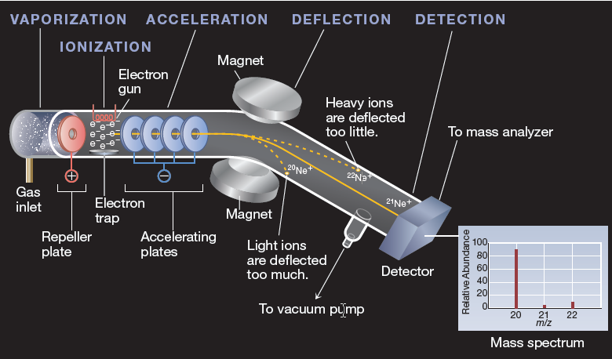
The Structure of the Atom
Isotopes and average atomic weight:
how do we know all this?
Mass spectrometry

Slide 18
Section 2.2 Elements and the Periodic Table

Slide 19
The Periodic Table
In this section…
Structure of the periodic table
Classifications of elements
Element structures (atomic arrangements)

Slide 21
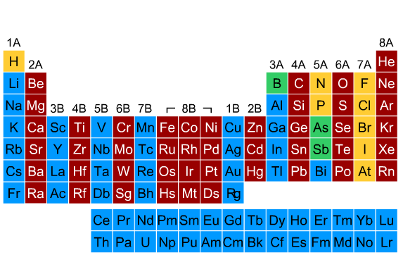
Periodic table structure: groups (columns)

Slide 23
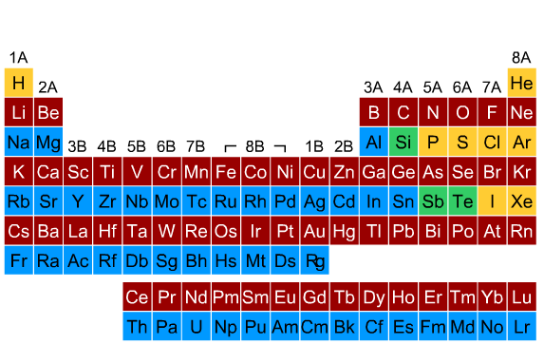
Periodic table structure: periods (rows)

Slide 24
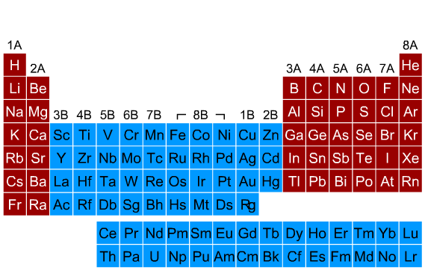
Periodic table structure: main group elements

Slide 25
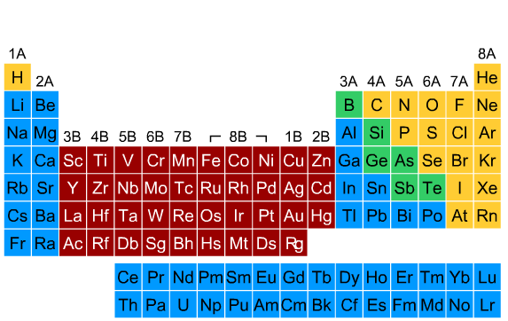
Periodic table structure: transition metals

Slide 26
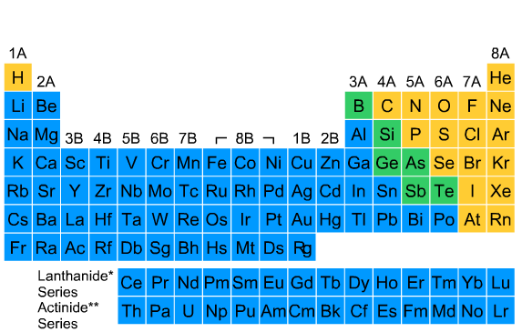
Periodic table structure: lanthanides and actinides

Slide 27
Periodic table structure: lanthanides and actinides

Slide 28
Periodic table structure: lanthanides and actinides

Slide 29
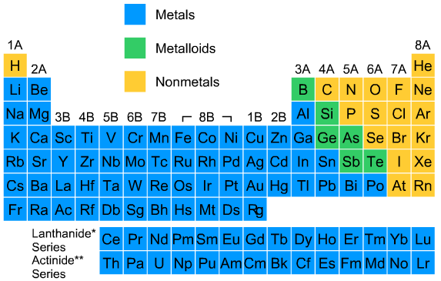
Classification of elements:

Slide 30
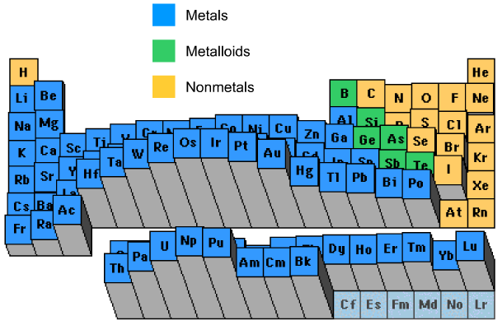
Periodic trends: density

Slide 31
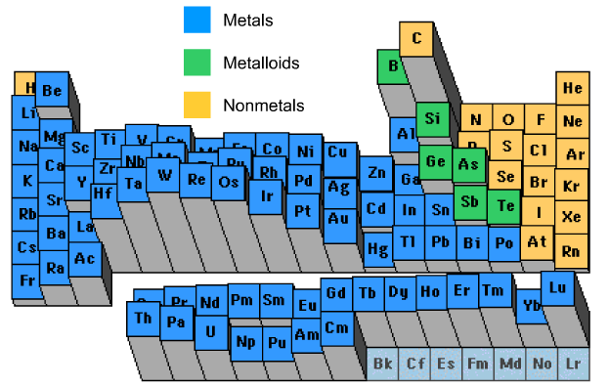
Periodic trends: melting point

Slide 32
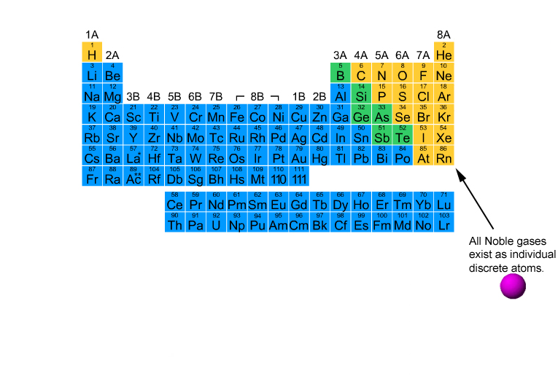
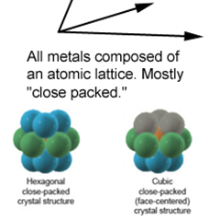
Element structures

Slide 33
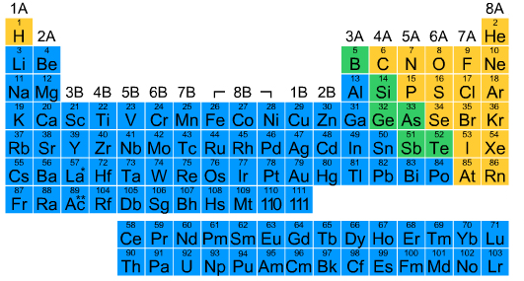
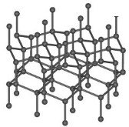
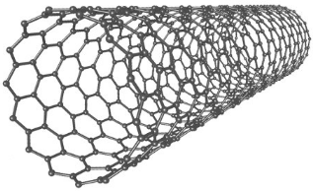
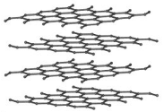
Element structures: extended structures

Slide 34
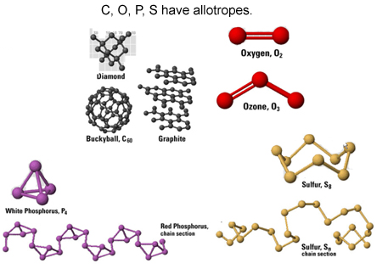
Element structures: allotropes (same element,
different structures)

Slide 35
Section 2.3 Covalent Compounds

Slide 36
Covalent Compounds
In this section…
The nature of covalent compounds
Ways of representing covalent compounds
Naming covalent compounds

Slide 37
Covalent Compounds
Covalent compounds are composed of atoms of
different elements that are bonded together by
sharing electrons.
Two types: -- molecular compounds
-- network covalent compounds

Slide 38
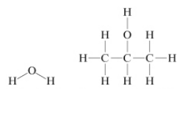
Covalent Compounds
Molecular compounds:
composed of individual molecules containing
the same number of atoms

Slide 39
Covalent Compounds
Molecular compounds:
composed of individual molecules containing
the same number of atoms

Slide 40
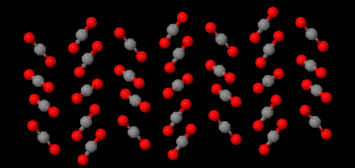
Molecular Compounds
Molecular compounds: carbondioxide

Slide 41
Covalent Compounds
Network covalent compounds:
A large number of atoms of different elements
bonded by shared electrons. Each sample
has molecules with different numbers of atoms.

Slide 42
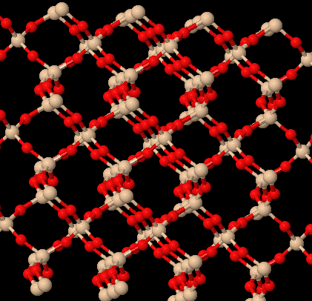
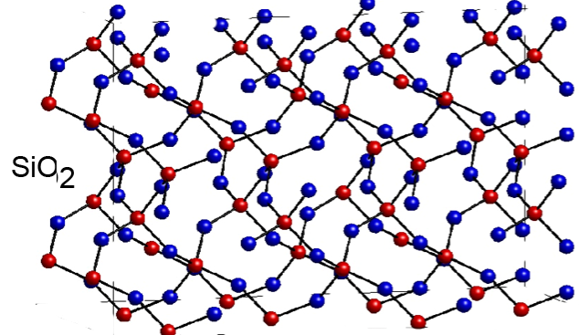
Covalent Compounds
Network covalent compounds: silicondioxide

Slide 43
Covalent Compounds
Representing compounds:
Molecular formula: depicts number of atoms
of each element
Empirical formula: shows simplest integer ratio
of atoms of each element
Structural formula: shows atomic linkages
Models: show 3-dimensional shape of molecule

Slide 44
Covalent Compounds
Molecular formula: depicts number of atoms
of each element

Slide 45
Covalent Compounds
Empirical formula: shows simplest integer ratio
of atoms of each element
molecular formula:
empirical formula:

Slide 46
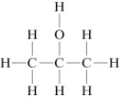
Covalent Compounds
Molecular and Empirical formulas
are often the same.

Slide 47
Covalent Compounds
Structural formula: shows connections
between atoms

Slide 48
Covalent Compounds
Condensed structural formula: mainly for organics.
CH₃CH₂CH₂CH₂OH

Slide 49
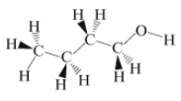
Covalent Compounds
Models: show 3-dimensional shape
wedge-and-dash
ball-and-stick

Slide 50
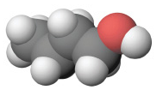
Covalent Compounds
Models: Ball-and-Stick vs. Space Filling

Slide 51
Nomenclature: Naming Binary Nonmetal Compounds
Going from formula to name.
Interactive Table 2.3.1

Slide 52
Interactive Table 2.3.1
1. The first word in the compound name is the name of the first element in the compound
formula. If the compound contains more than one atom of the first element, use a prefix
(Table 2.3.2) to indicate the number of atoms in the formula.
CS₂First word in compound name: carbon
N₂O₄First word in compound name: dinitrogen
2. The second word in the compound name is the name of the second element in the formula
that has been changed to end with -ide. In all cases, use a prefix (Table 2.3.2) to indicate
the number of atoms in the formula.
CS₂Second word in compound name: disulfide
N₂O₄Second word in compound name: tetraoxide
3. The compound is named by combining the first and second words of the compound
name.
CS₂carbon disulfide
N₂O₄dinitrogen tetraoxide

Slide 53
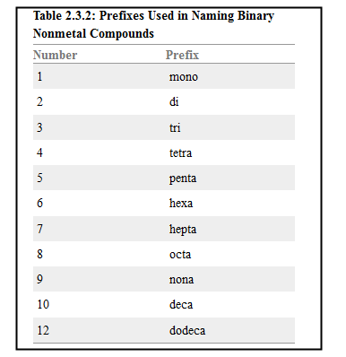

Slide 54
Some Examples:
SO₂
SO₃
ClO
S₂F₁₀
Some Common Compounds:
H₂O N₂H₄
H₂O₂ NO
NH₃

Slide 55
Important Simple Hydrocarbons
Alkanes: Table 2.3.4
Hydrocarbon Name
CH₄ Methane
C₂H₆ Ethane
C₃H₈ Propane
C₄H₁₀ Butane
C₅H₁₂ Pentane
C₆H₁₄ Hexane
C₇H₁₆ Heptane
C₈H₁₈ Octane
C₉H₂₀ Nonane
C₁₀H₂₂ Decane

Slide 56
Table 2.3.5: Names and Formulas of the Halogen Oxoacids
Name Formula Name Formula
HClO₄ Perchloric acid HBrO₄ Perbromic acid
HIO₄ Periodic acid HClO₃ Chloric acid
HBrO₃ Bromic acid HIO₃ Iodic acid
HClO₂ Chlorous acid HBrO₂ Bromous acid
HIO₂ Iodous acid HClO Hypochlorous acid
HBrO Hypobromous acid HIO Hypoiodous acid

Slide 57
Table 2.3.6: Names and Formulas of Some Inorganic Acids
Name Formula
Hydrogen chloride HCl (also hydrochloric acid)
Hydrogen bromide HBr (also hydrobromic acid)
Hydrogen iodide HI (also hydroiodic acid)
Nitric acid HNO₃
Nitrous acid HNO₂
Hydrogen sulfide H₂S
Sulfuric acid H₂SO₄
Sulfurous acid H₂SO₃
Phosphoric acid H₃PO₄

Slide 58
Section 2.4 Ionic Compounds

Slide 59
Ionic Compounds
In this section…
Monatomic and Polyatomic ions
Ionic compound formulas
Naming ionic compounds
Covalent vs. Ionic compounds

Slide 60
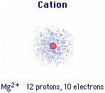
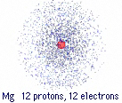
Formation of Ions
Cations: Positive ions form by loss of electrons.

Slide 61
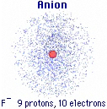
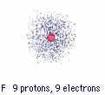
Formation of Ions
Anions: Negative ions form by gain of electrons.

Slide 62
Names of Monatomic Ions
monatomic cations: element name + “ion”
monatomic anions: element name with “ide” suffix + “ion”

Slide 63
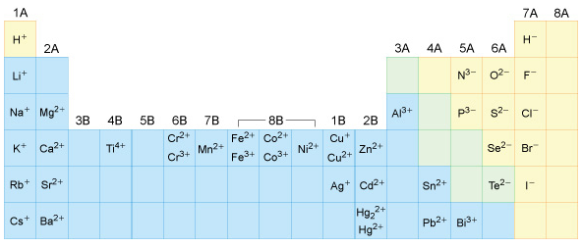
Common Monatomic Ions

Slide 64
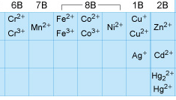
Naming Transition Metal Cations
The name of a transition metal cation is the element name
followed by the cation charge in Roman numerals
within parentheses and the word ion.
Cr²⁺
Co³⁺

Slide 65
Polyatomic Ions Groups of bonded atoms with a charge
Ammonium ion: NH₄⁺
Carbonate ion: CO₃²⁻

Slide 66
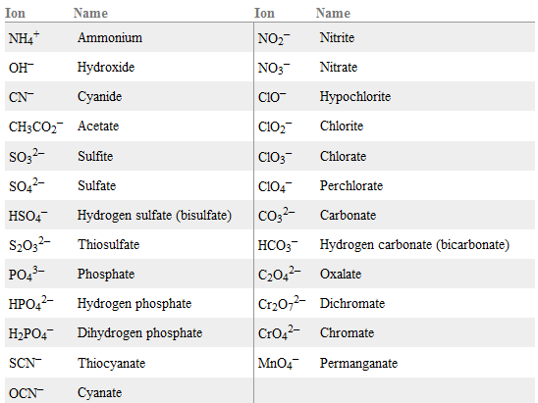
Table 2.4.1: Polyatomic Ions

Slide 67
Formulas of Ionic Compounds
Rule: Total charge on cations = Total charge on anions
So, ions combine in numbers so charges cancel.
Mg²⁺ and Cl⁻
Mg²⁺ and N³⁻
Na⁺ and O²⁻
Mg²⁺ and O²⁻

Slide 68
Formulas of Ionic Compounds
Rule: Total charge on cations = Total charge on anions
When multiple polyatomic ions are present, they are in
parentheses.
Mg²⁺ and PO₄³⁻
Parentheses are not used with a single polyatomic ion:
Mg²⁺ and SO₄²⁻

Slide 69
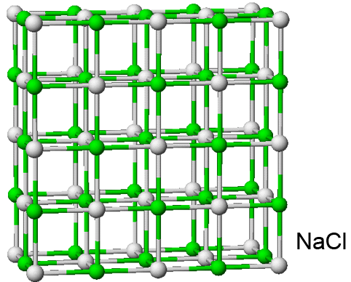
Formulas of Ionic Compounds
Ionic compounds are extended structures:
No molecules, so no “molecular formula.”

Slide 70
Naming Ionic Compounds
Ionic compound name = cation name + anion name
The word “ion” is dropped from the ion names.
The name does NOT reflect the number of ions.
NaCl
Na₂SO₄
MgCl₂
(NH₄)₃PO₄

Slide 71
Naming Ionic Compounds
Transition metals with variable charges?
The name of a transition metal cation is the element name
followed by the cation charge in Roman numerals
within parentheses and the word ion.
CrCl₂
CoPO₄

Slide 72
Identifying Covalent vs. Ionic Compounds
Ionic Compounds:
Metals + nonmetals
Metals + polyatomic anions
Two polyatomic ions
Covalent Compounds:
Two nonmetals,
but no polyatomic ions

