Slide 1
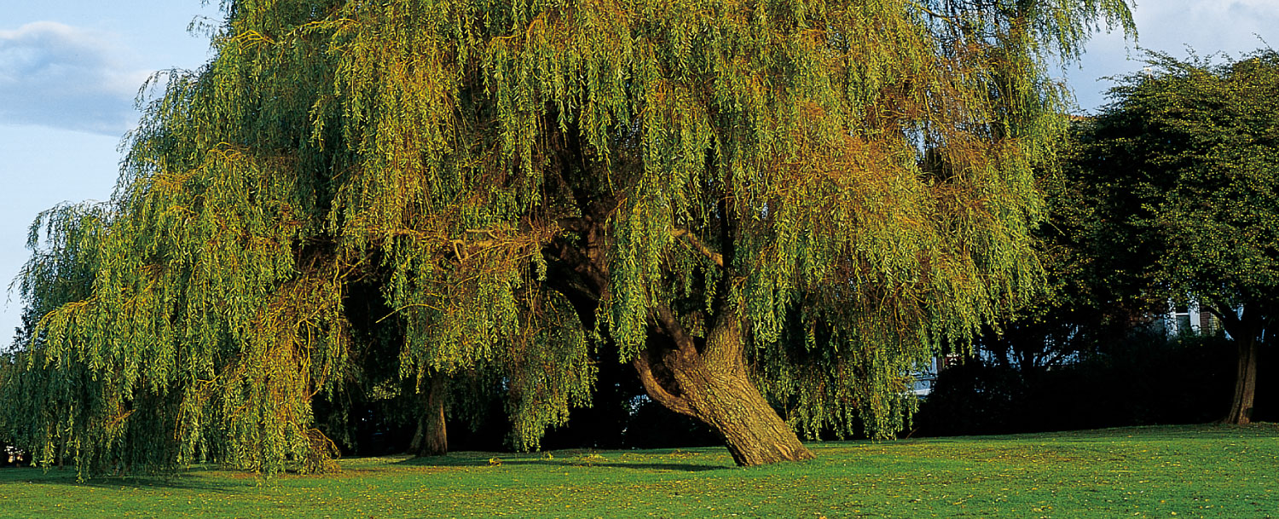
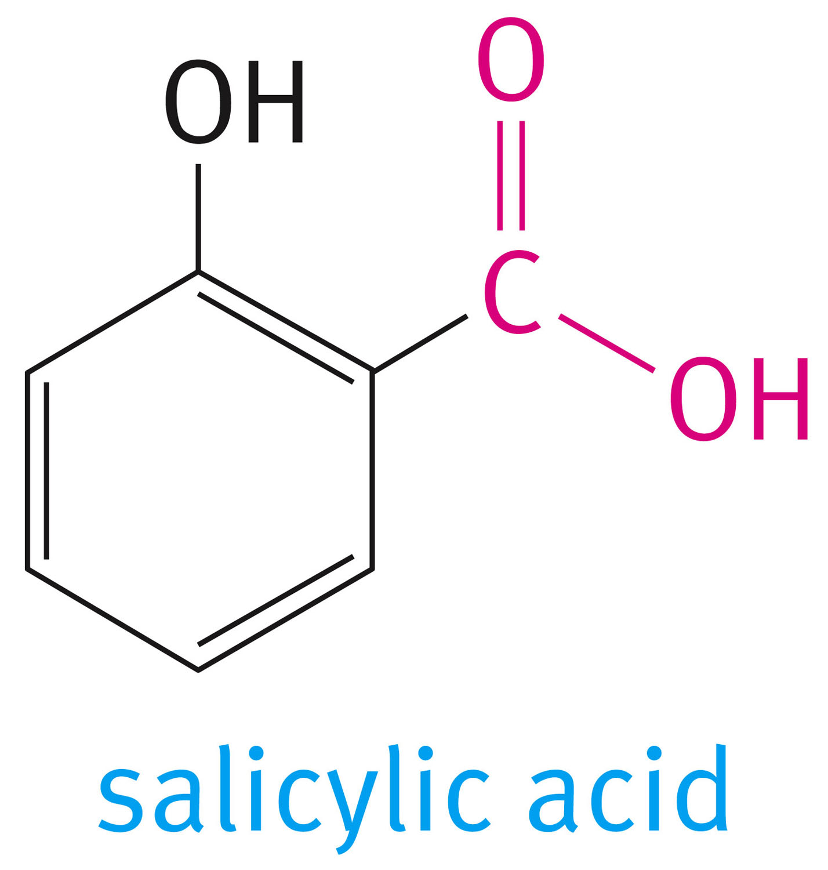
Chapter 10: Carboxylic Acids and Their Derivatives
The back of the white willow tree (Salix alba) is a source of salicylic acid which is used to make aspirin (acetylsalicylic acid)

Slide 2
Carboxylic acids and acid derivatives are represented generally as:

Slide 3
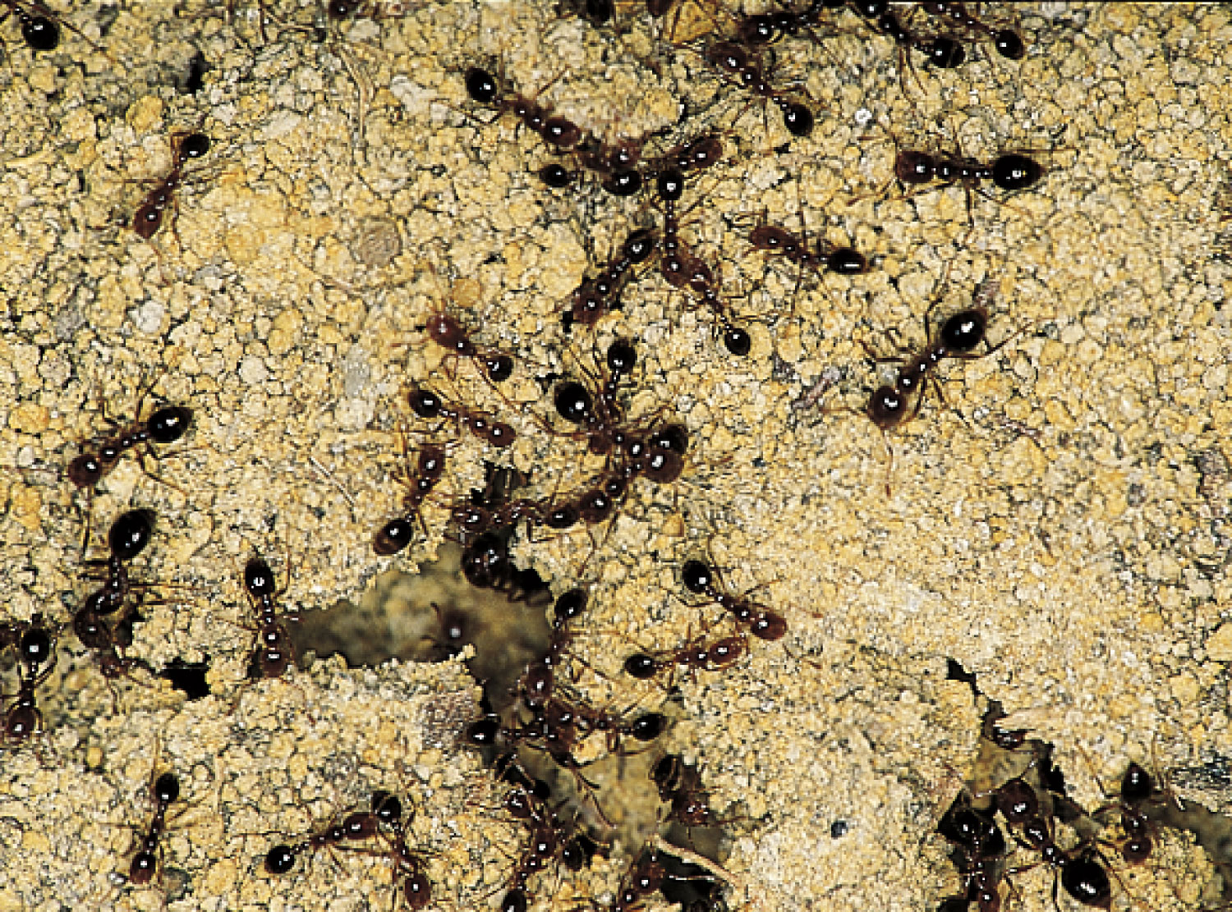
Nomenclature of Acids
Stinging ants, are a source of formic acid HCOOH

Slide 5
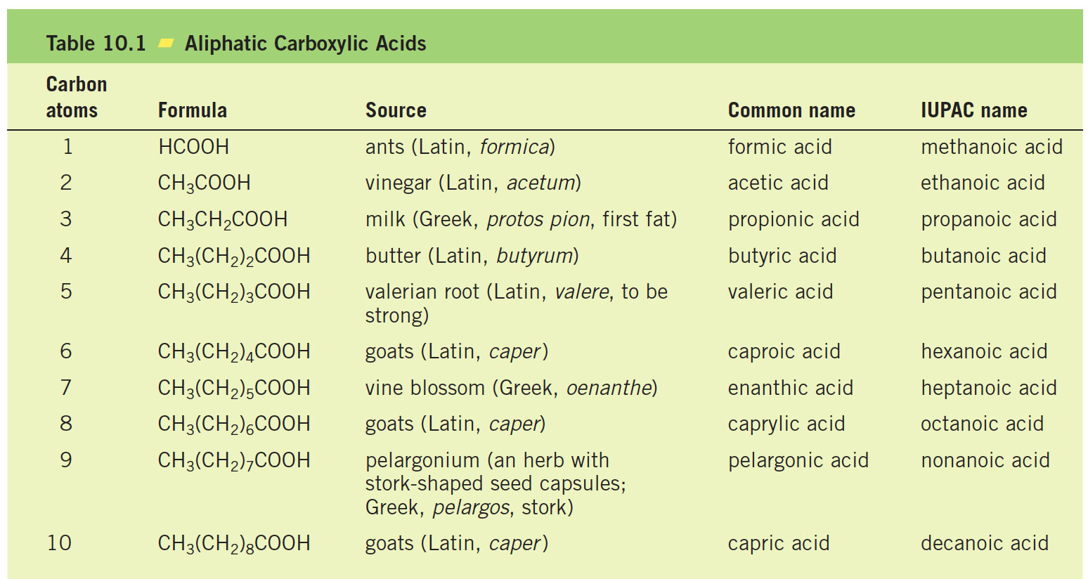

Slide 7
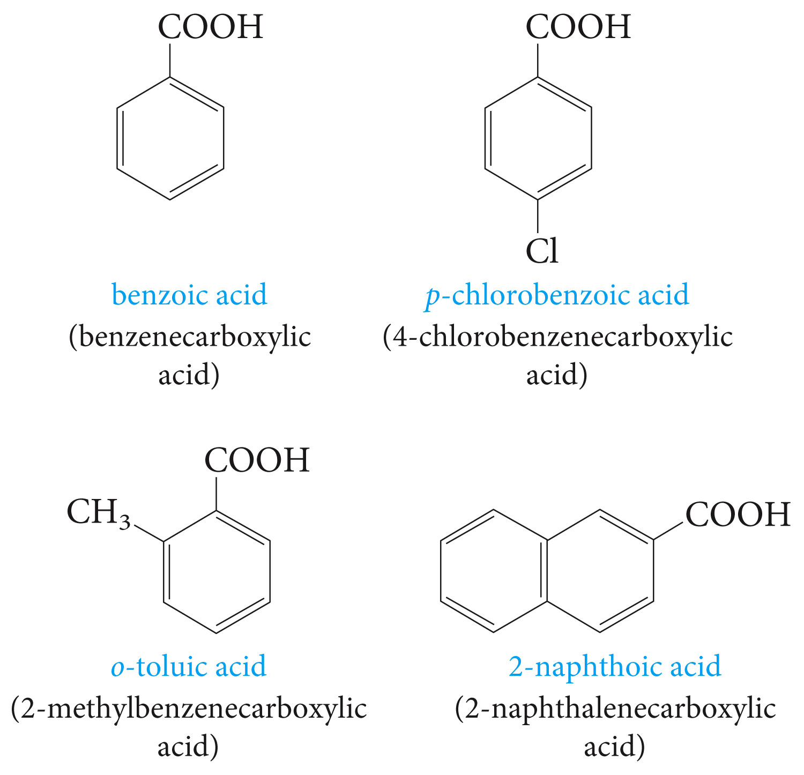

Slide 8
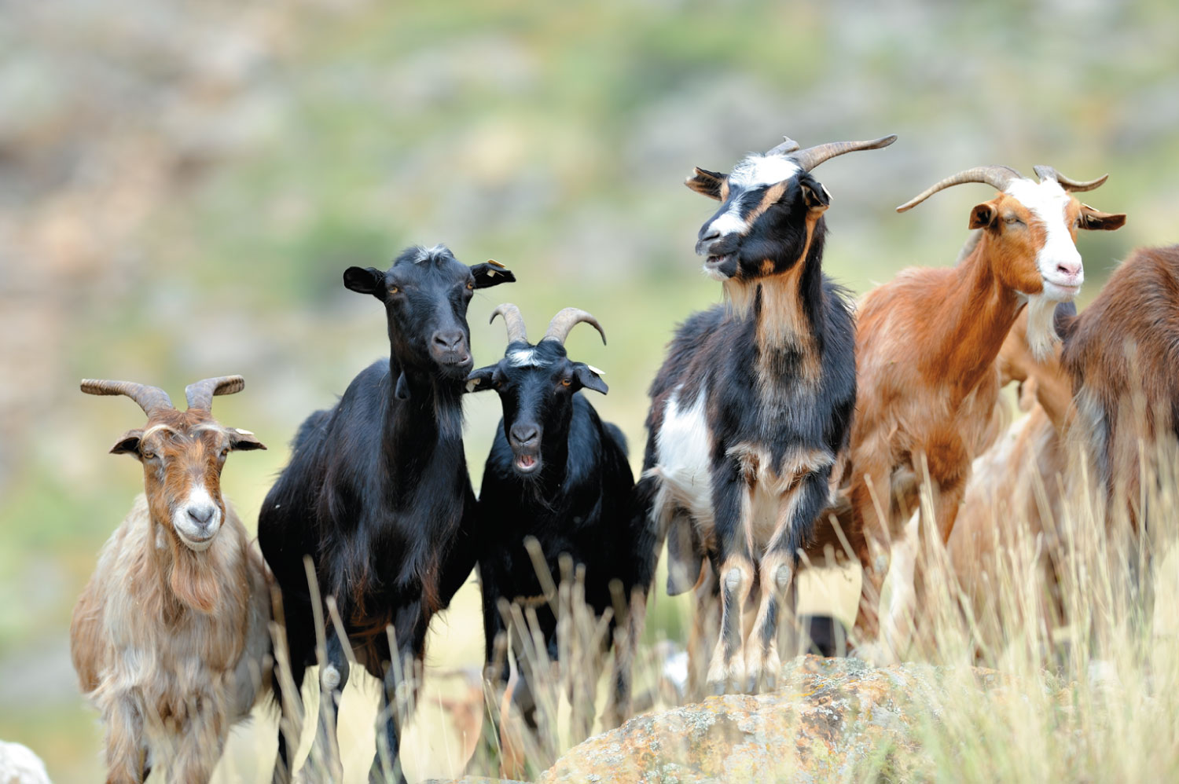
Good sources of carproic, caprylic and capric acids. CH₃(CH₂)_{n}COOH
n= 4, 6, 8

Slide 11
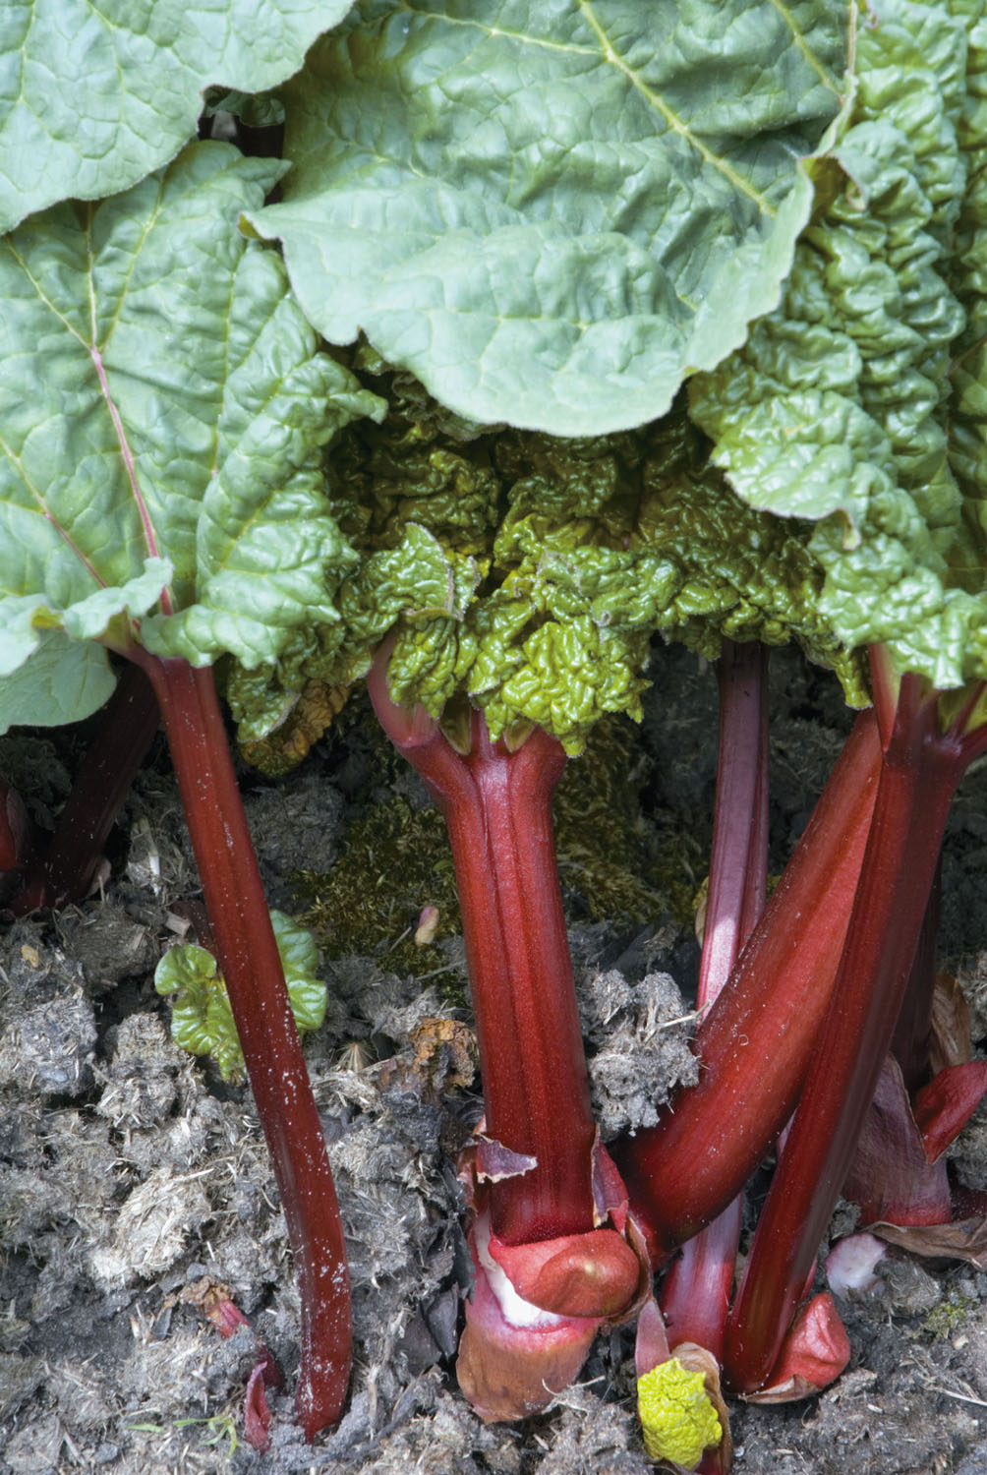
Rhubarb, a source of oxalic acid HOOCCOOH

Slide 12
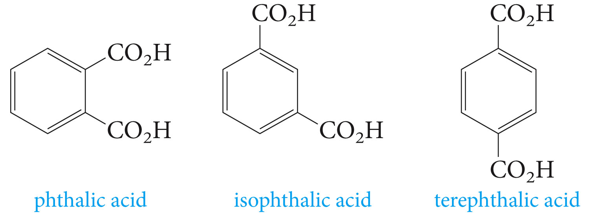

Slide 14
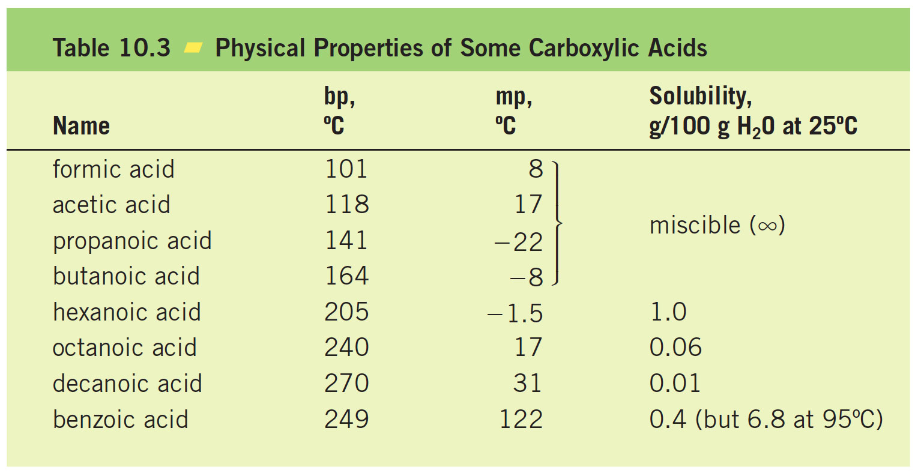
Physical Properties of Acids

Slide 15
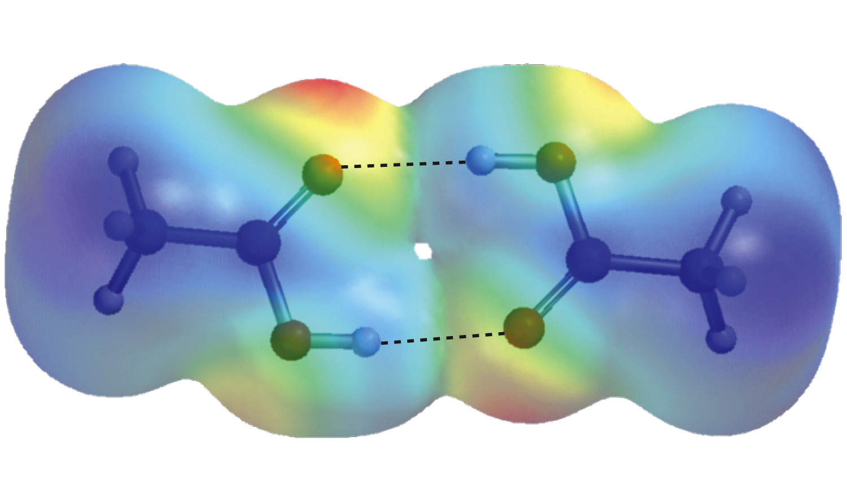
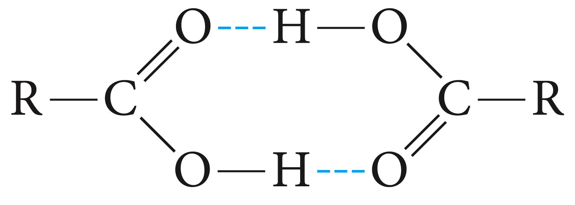

Slide 16
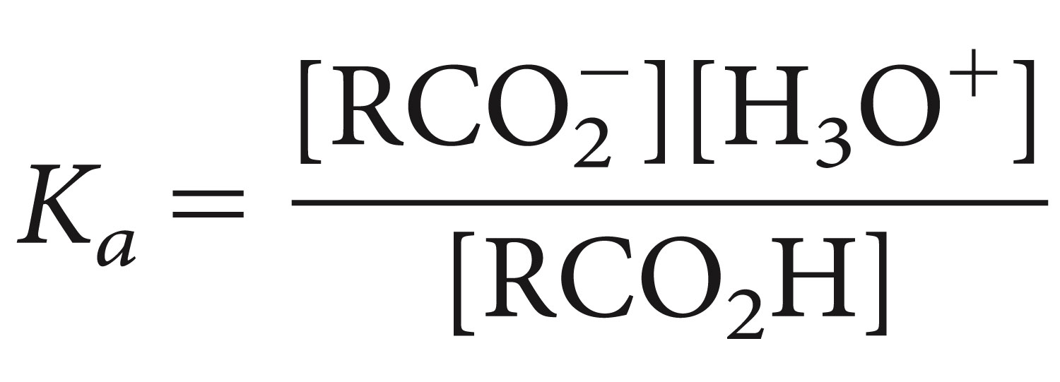
Acidity and Acidity Constants

Slide 17
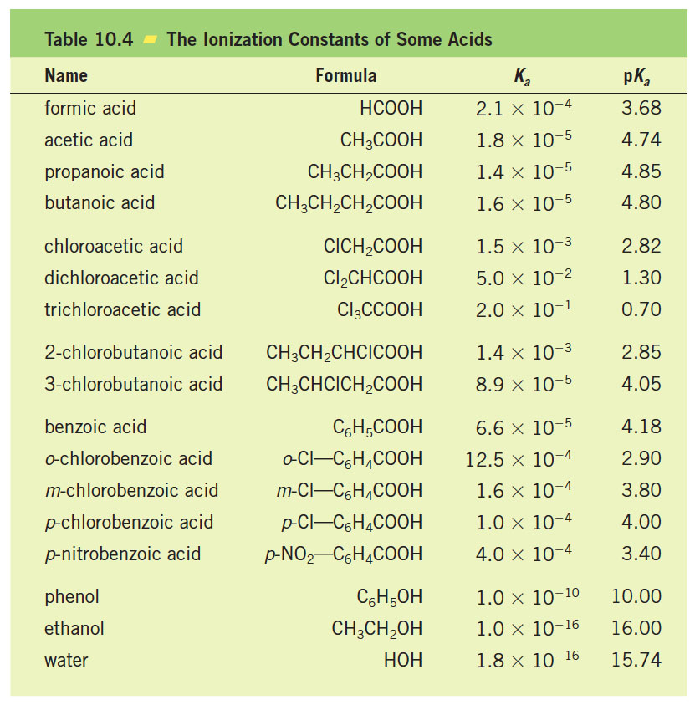

Slide 18
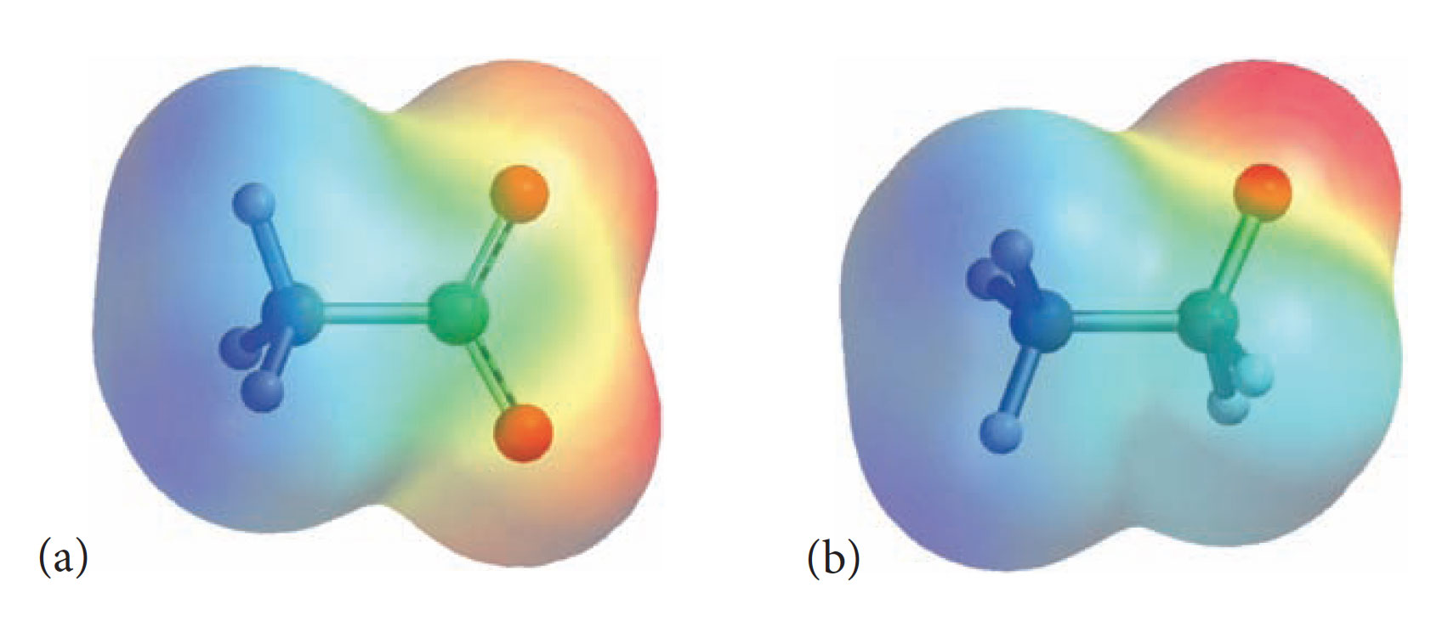

Slide 19
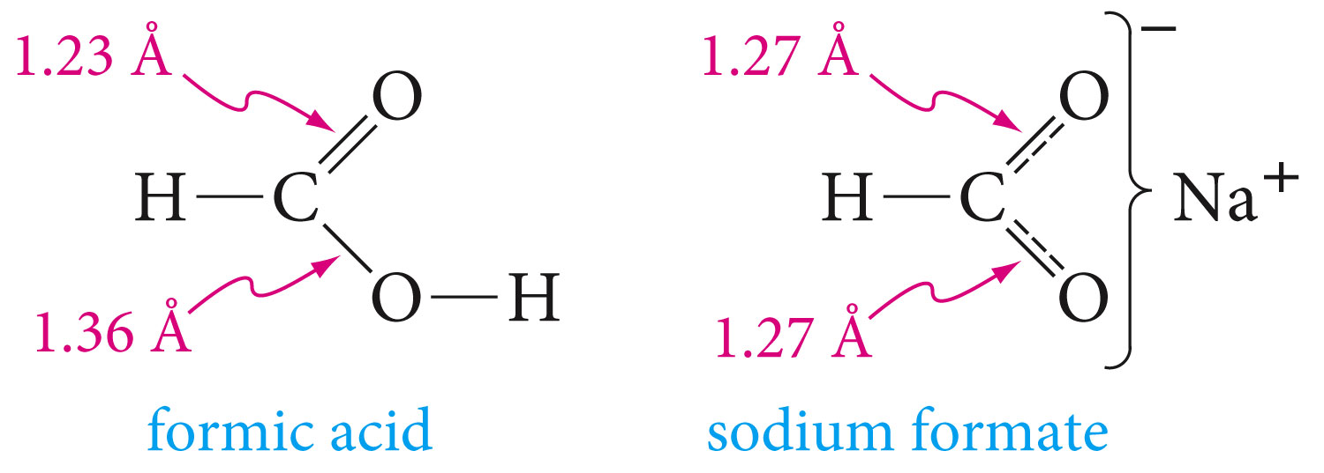

Slide 20
Effect of Structure on Acidity

Slide 21
Conversion of Acids to Salts

Slide 22
Preparation of Acids

Slide 23
Oxidation of Aromatic Side Chains

Slide 25
Reaction of Grignard Reagents with CarbonDioxide

Slide 26
Hydrolysis of Cyanides

Slide 27
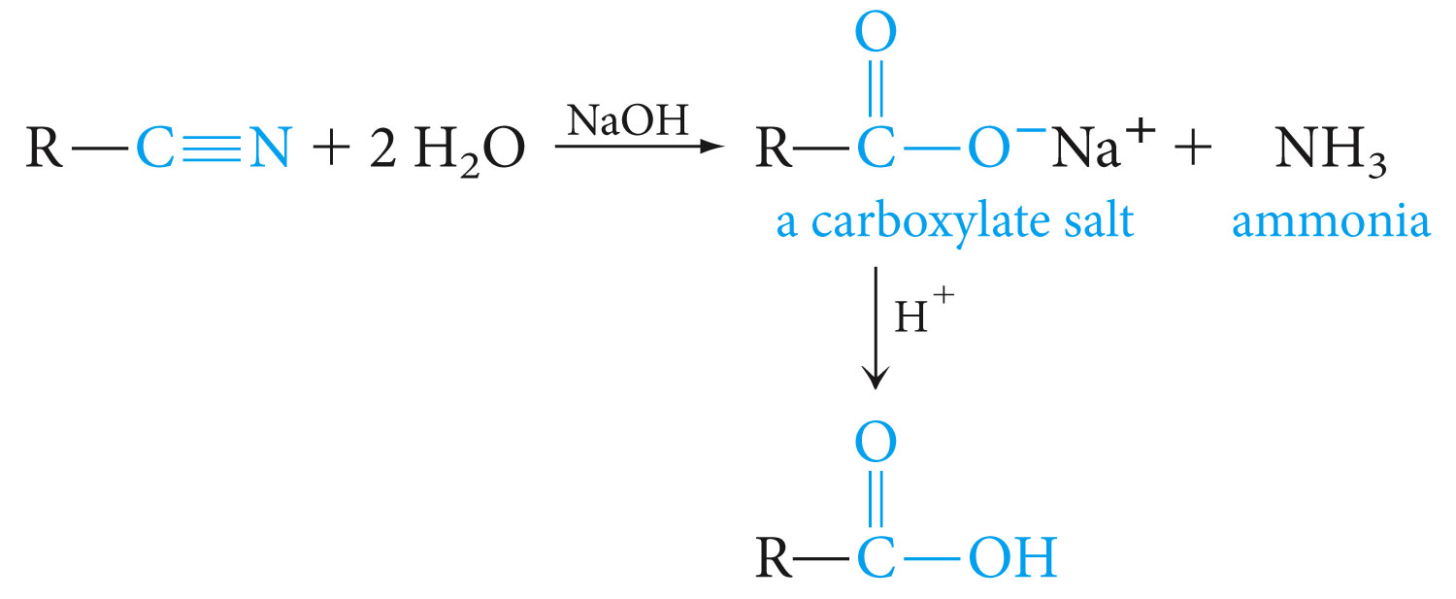

Slide 29
Carboxylic Acid Derivatives

Slide 30
Esters

Slide 31
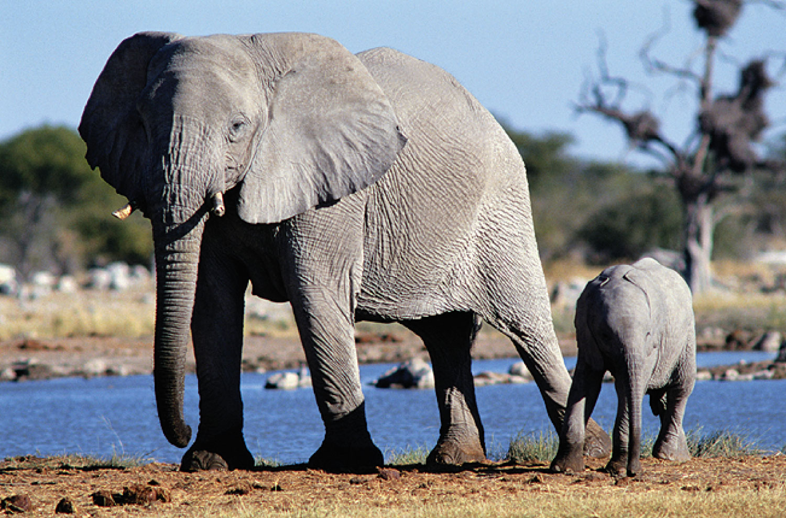
Female elephant releases the ester (Z)-7-dodecen-1-yl acetate to attract mates

Slide 32
Fischer Esterification

Slide 33
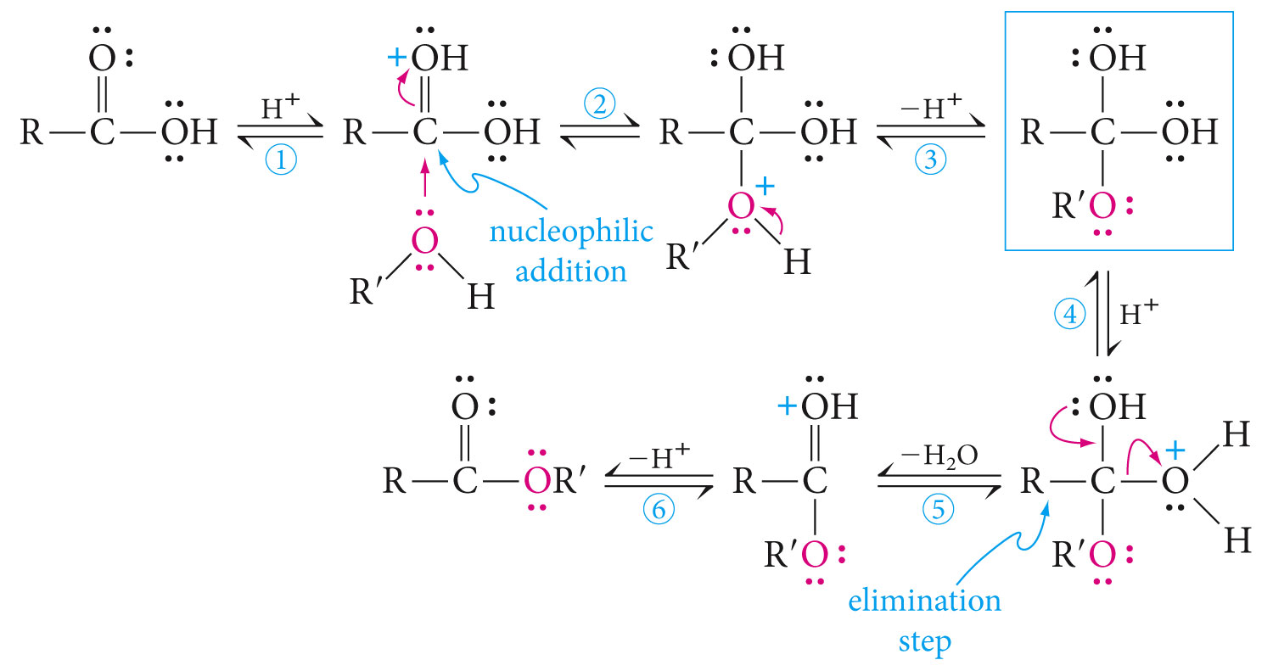
Mechanism of Acid Catalyzed Esterification

Slide 35
Lactones

Slide 36
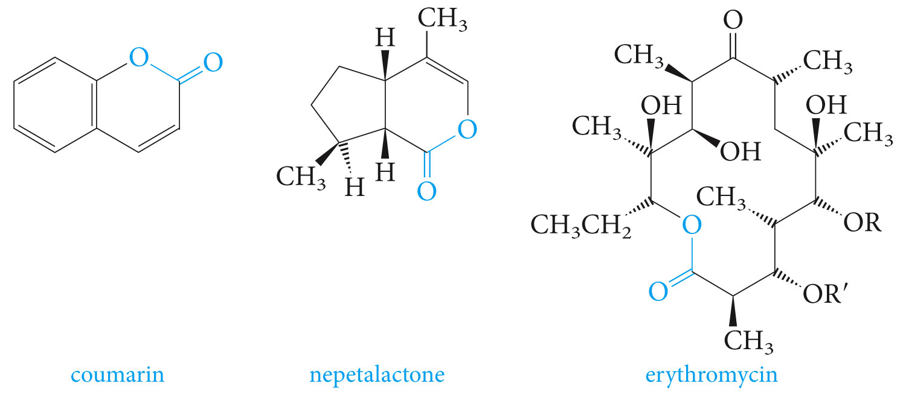

Slide 37
Saponification of Esters

Slide 38
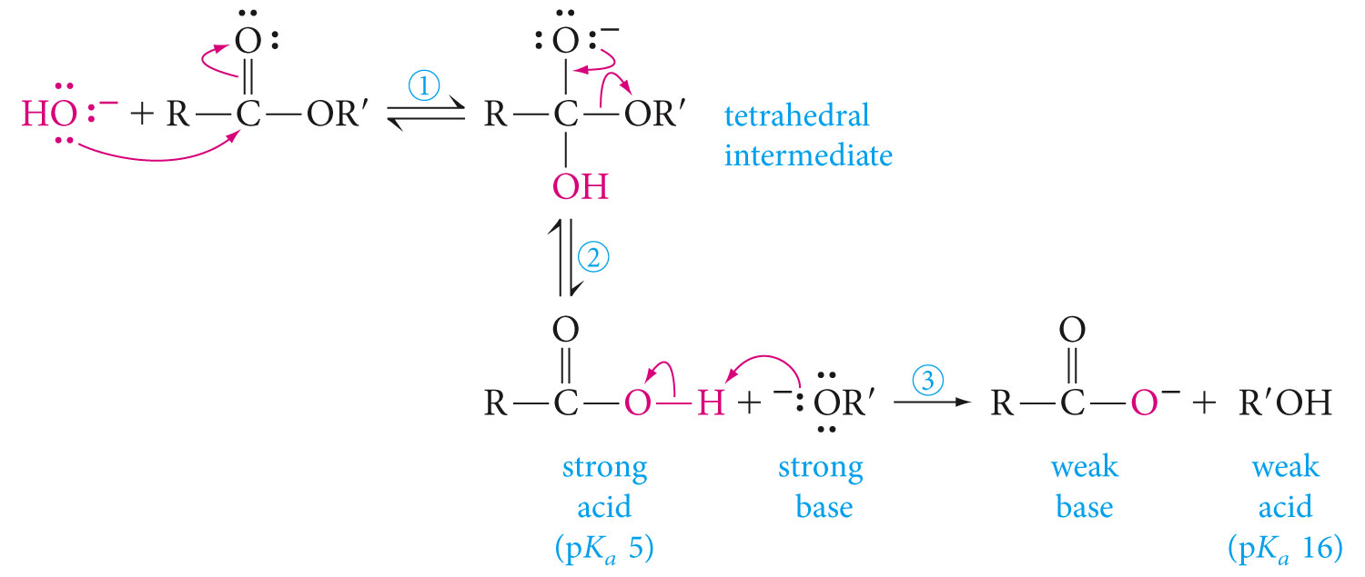

Slide 39
Ammonolysis of Esters

Slide 41
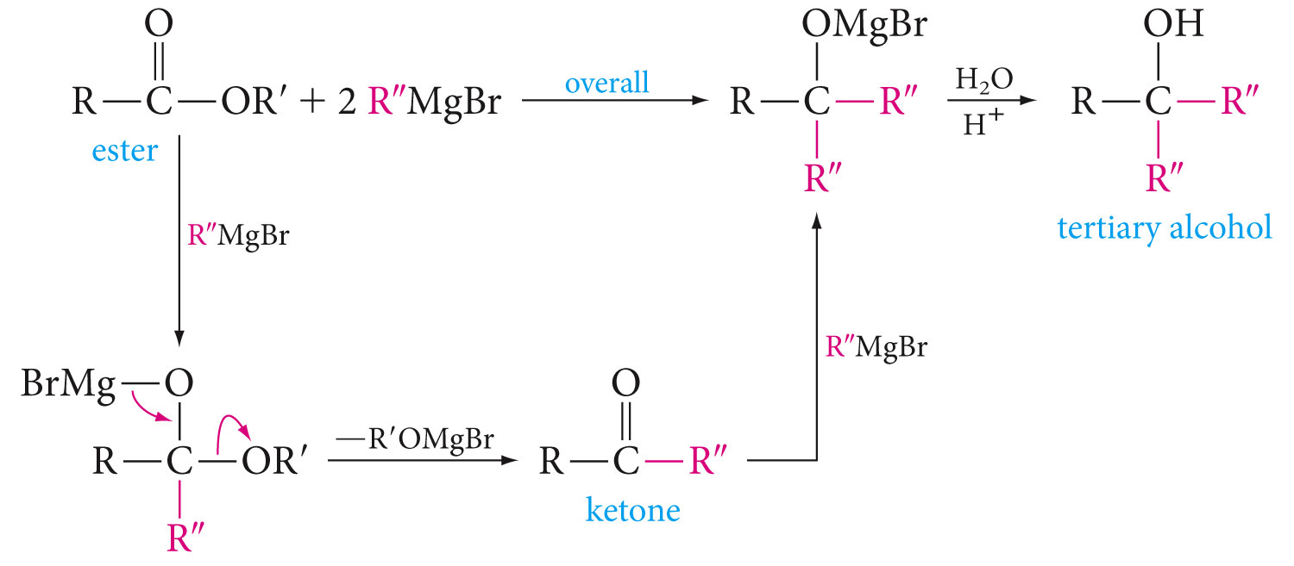
Reaction of Esters with Grignard Reagents

Slide 43
Reduction of Esters

Slide 46
Acyl Halides

Slide 47
Acyl chlorides react rapidly with most nucleophiles. In the above example it reacts with water to form a carboxylic acid.

Slide 48
Acyl halides react rapidly with alcohols to form esters

Slide 49
Acyl halides react with ammonia to form amides

Slide 50
Acid Anhydrides

Slide 51
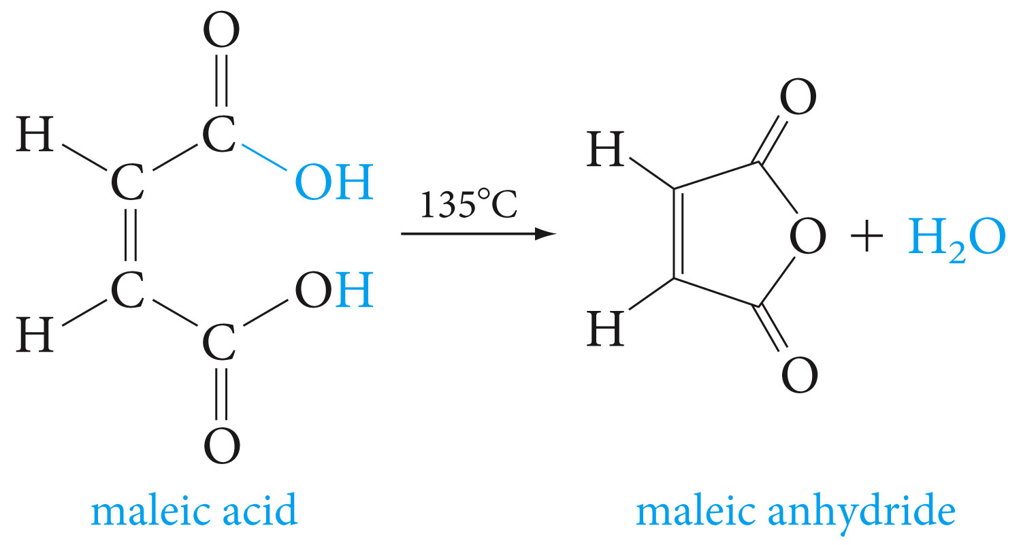
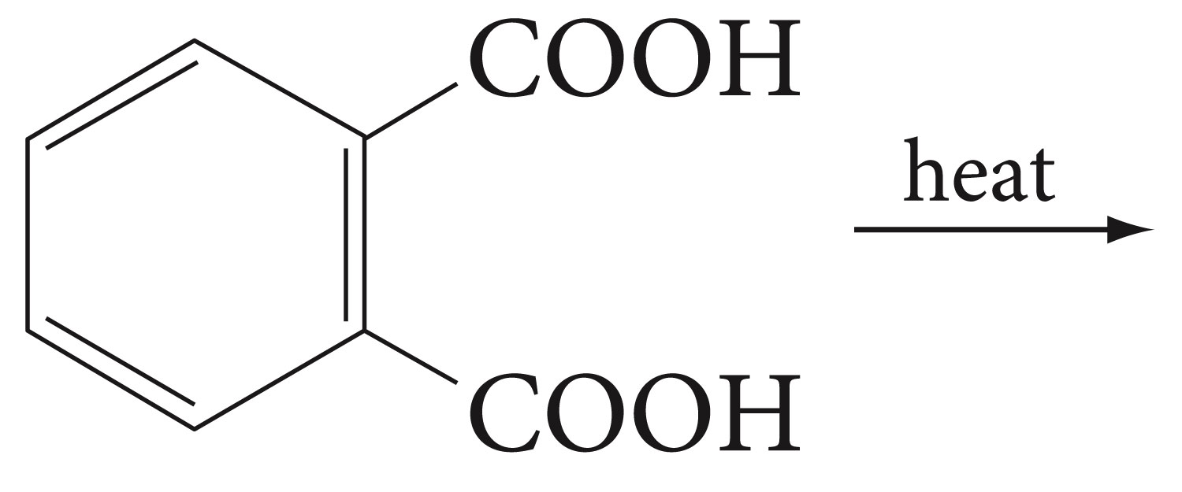
Anhydrides are prepared by dehydration of acids. Predict the structure of the anhydride product of the reaction below.

Slide 52
Anhydrides can also be prepared from acid chlorides and carboxylate salts.

Slide 53
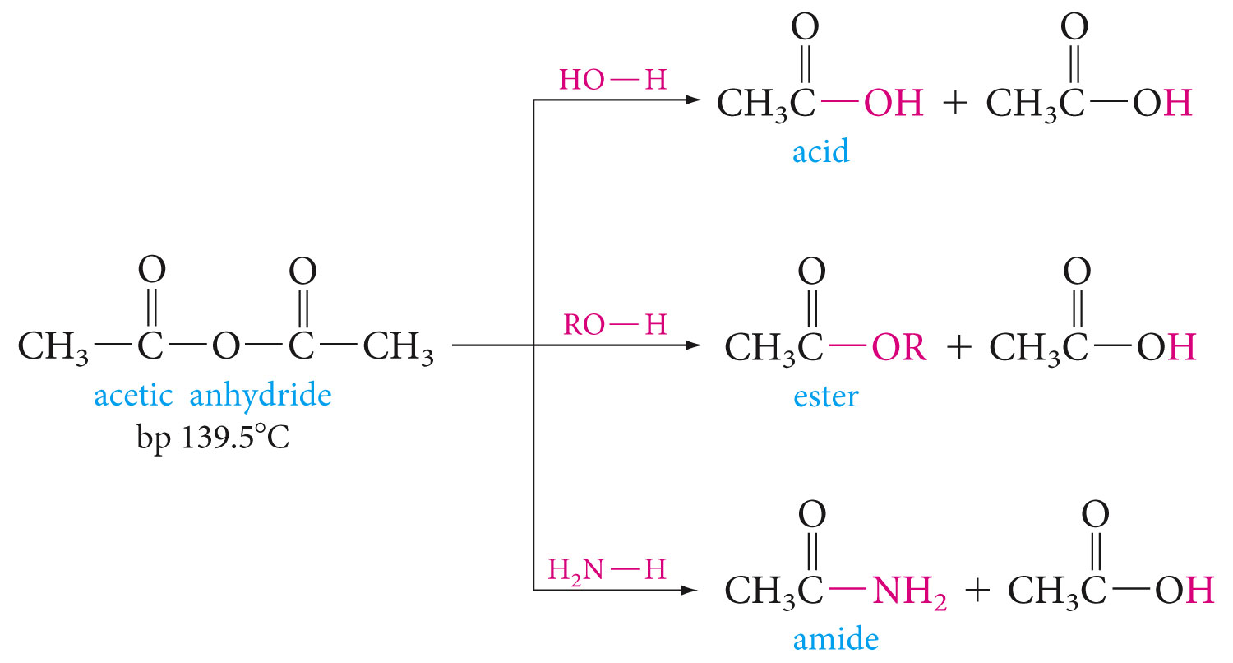
Anhydrides undergo nucleophilic acyl substitution reactions. They are more reactive than esters, but less reactive than acyl halides, toward nucleophiles. Below are some typical reactions with acetic anhydride

Slide 54
Aspirin can be prepared by the reaction of acetic anhydride with salicylic acid
(o-hydroxybenzoic acid).

Slide 55
Amides

Slide 56
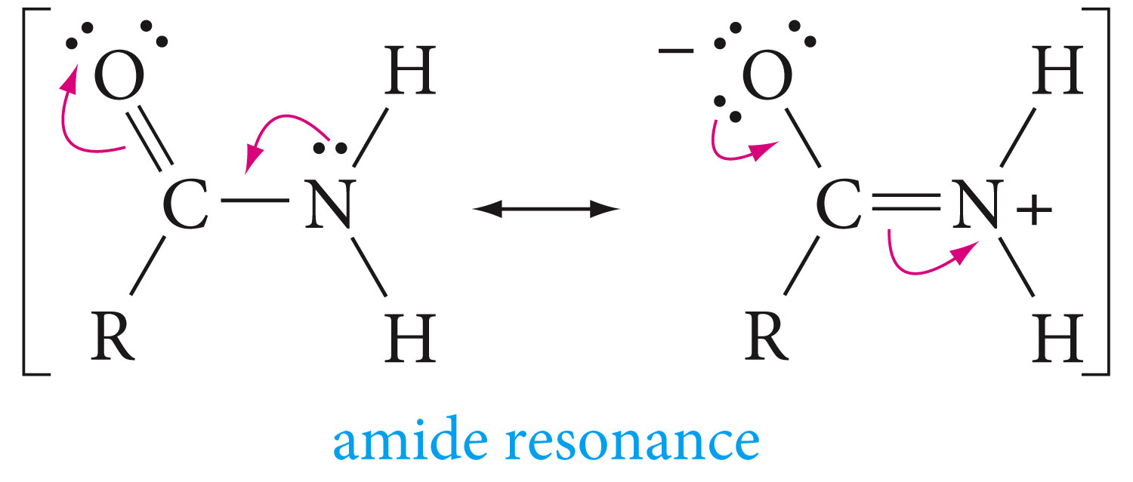
Amides have planar geometry, this is because of the C-N double bond character resulting from the resonance

Slide 57
Amides are dipolar contibutors for hydrogen bonding, lading to very high boiling points

Slide 59
Like other acid derivatives, amides react with nucleophiles. Above is an example of hydrolysis of an amide

Slide 60
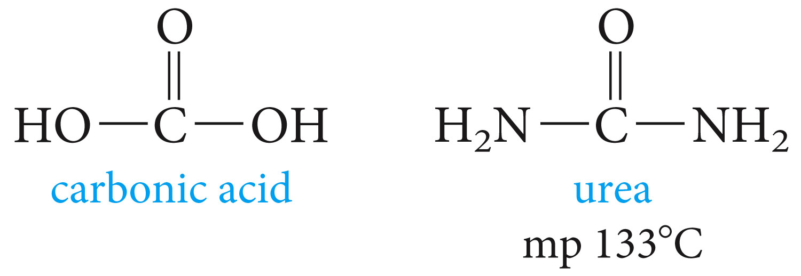
Amides can be reduced to primary amines by Lithium aluminum hydride

Slide 61
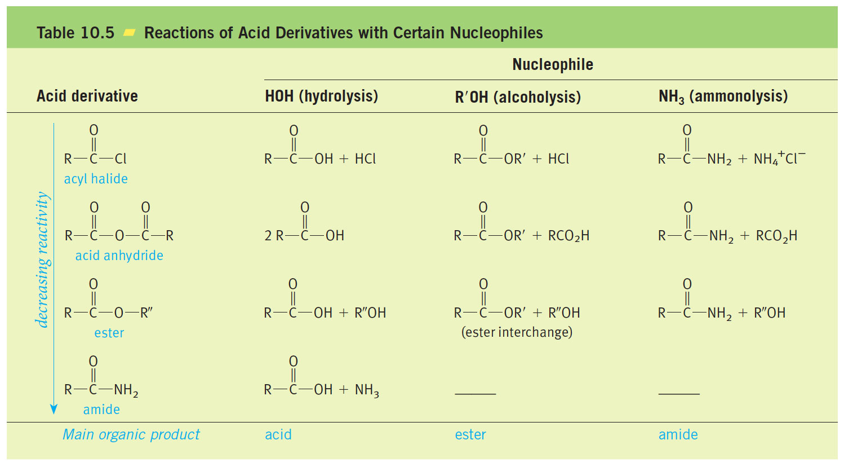

Slide 63
Claisen Condensation

