Slide 1
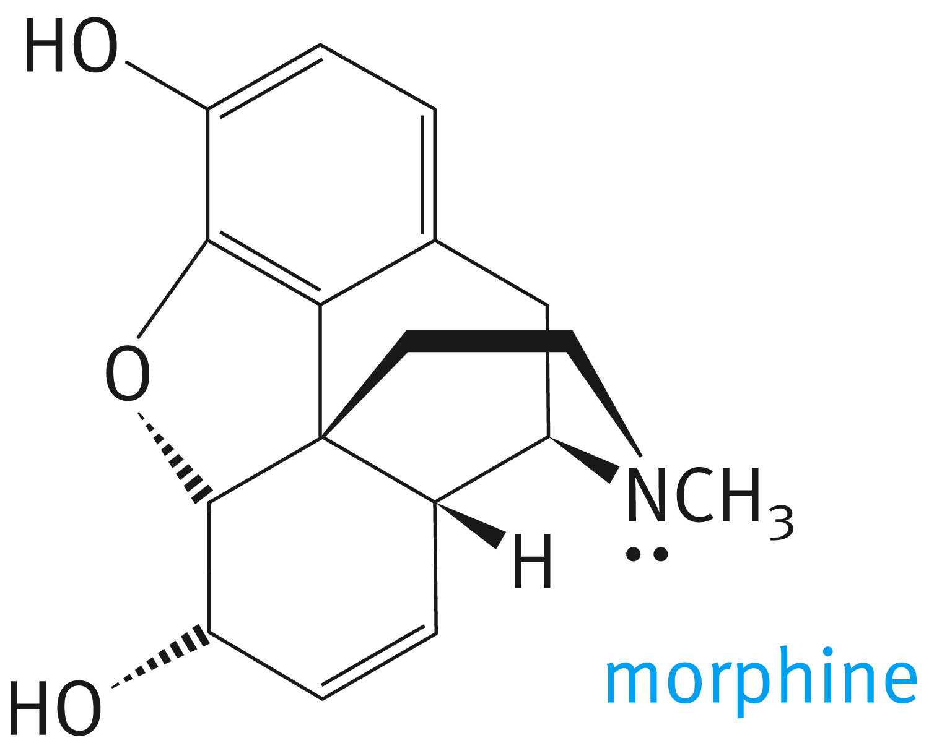
Chapter 11: Amines and Related Nitrogen Compounds
The painkiller morphine is obtained from opium, the dried sap of unripe seeps of the poppy Papaver somniferum
Amines are relatives of ammonia and are usually classified as primary, secondary or tertiary

Slide 3
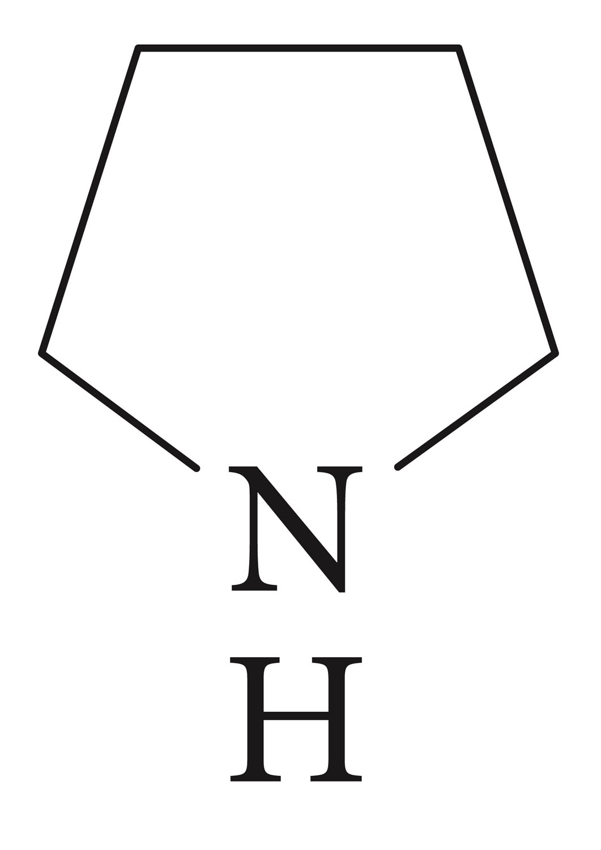
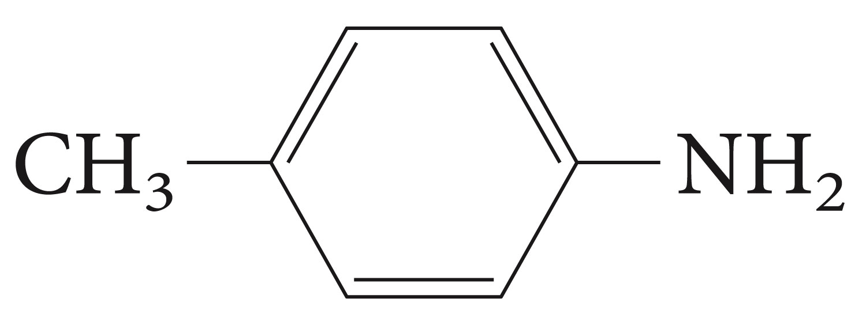
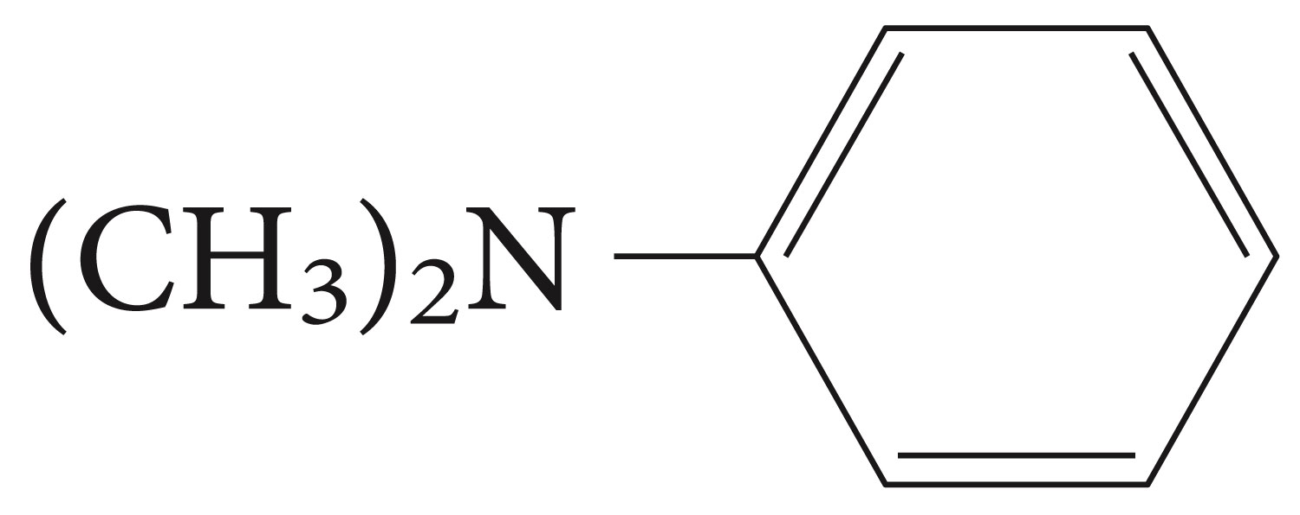
Classify the following amines as primary, secondary or tertiary

Slide 4
Structure of Amines

Slide 5
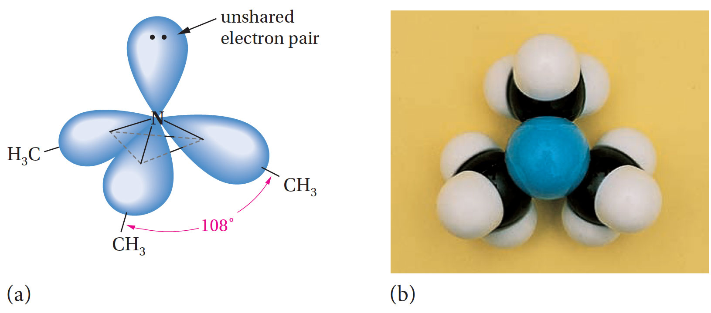

Slide 6
Nomenclature of Amines

Slide 8
When other functional groups are present, the amino group is named as a substituent

Slide 9
Aromatic amines are named as derivatives of aniline. In the CA system, aniline is called benzeneamine

Slide 10
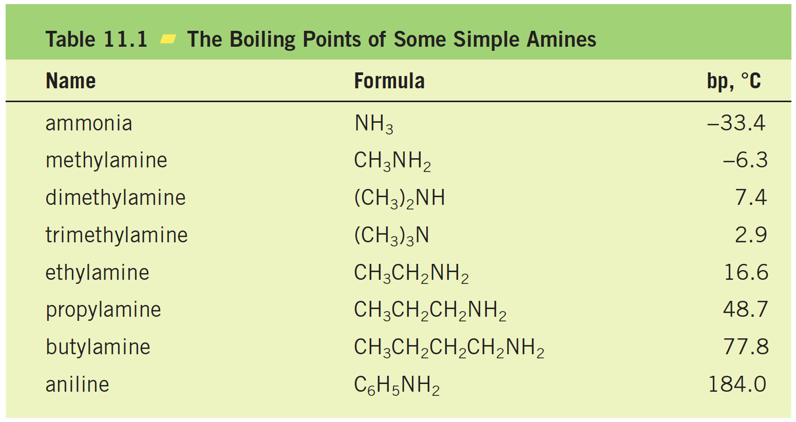
Physical Properties and Intermolecular Interactions of Amines

Slide 11
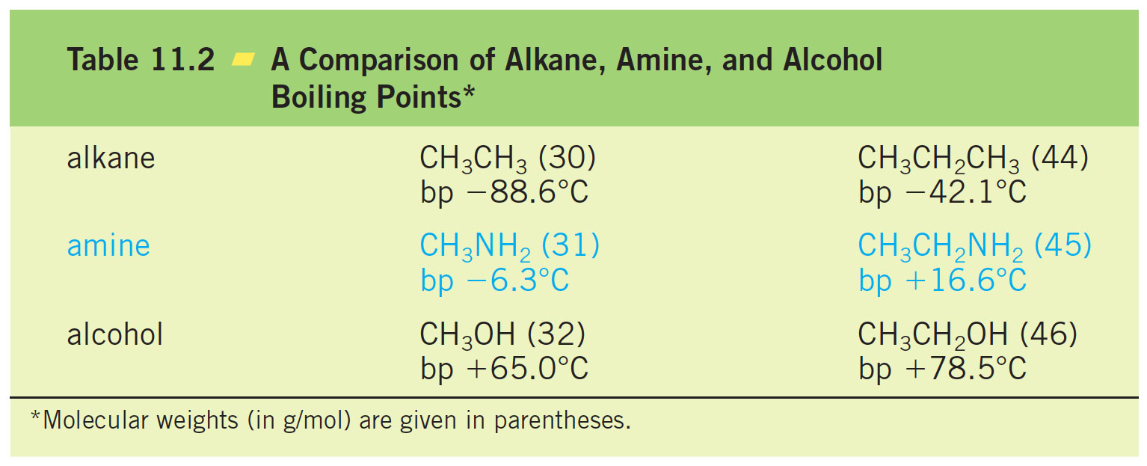

Slide 12
Preparation of Amines
This reactions proceed by the formation of an ammonium salt followed by the treatment of a strong base.

Slide 13
Similarly secondary amines and tertiary amines can be prepared by the same procedure

Slide 14
Reaction with tertiary amines leads to the formation of quaternary ammonium salts.

Slide 15
Alkylation of aromatic amines may be selective

Slide 16
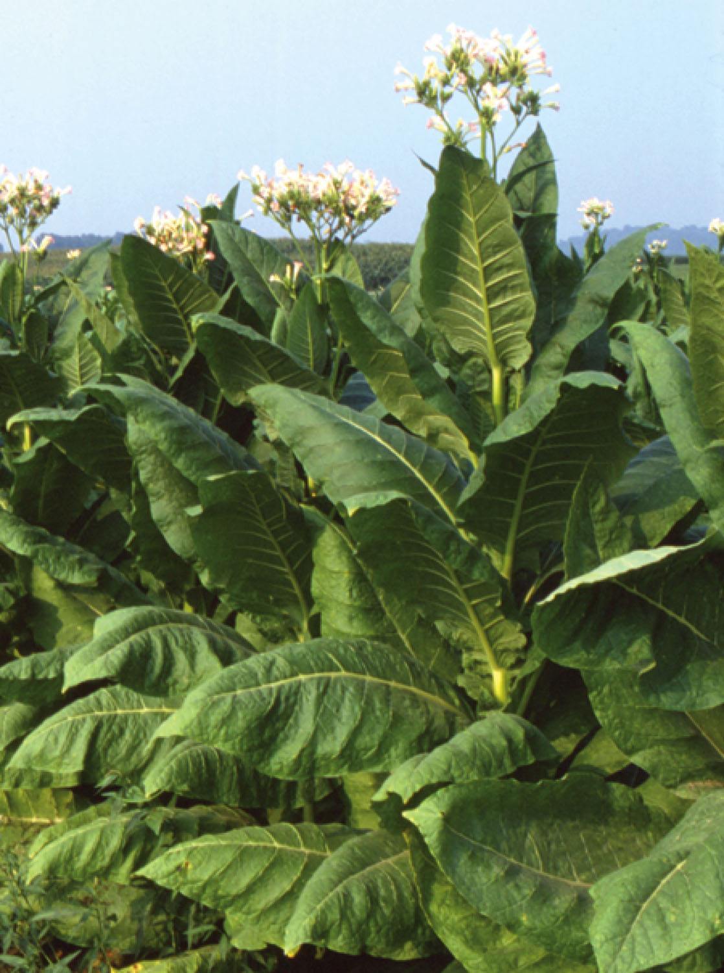
Alkylation may also be intramolecular an example is shown in the synthesis of nicotine
Tobacco plant, a natural source of nicotine

Slide 17
Reduction of the nitrobenzene always yields aniline.

Slide 18
Amides can be reduced to amines with lithium aluminum hydride

Slide 19
Reduction of nitriles (cyanides) gives primary amines

Slide 20
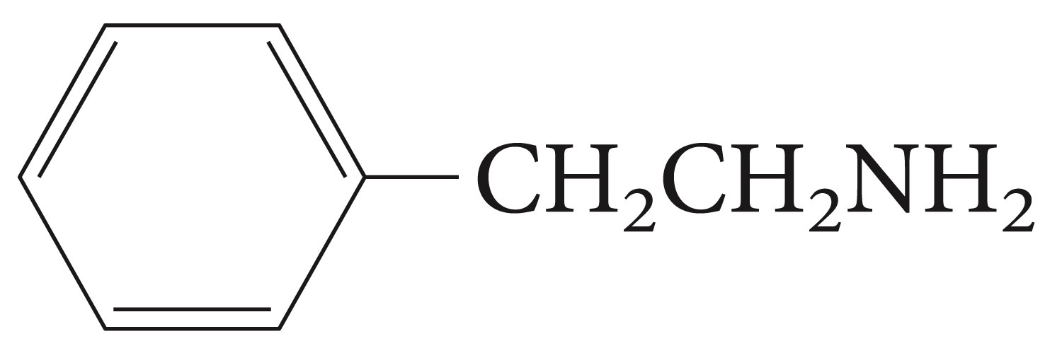
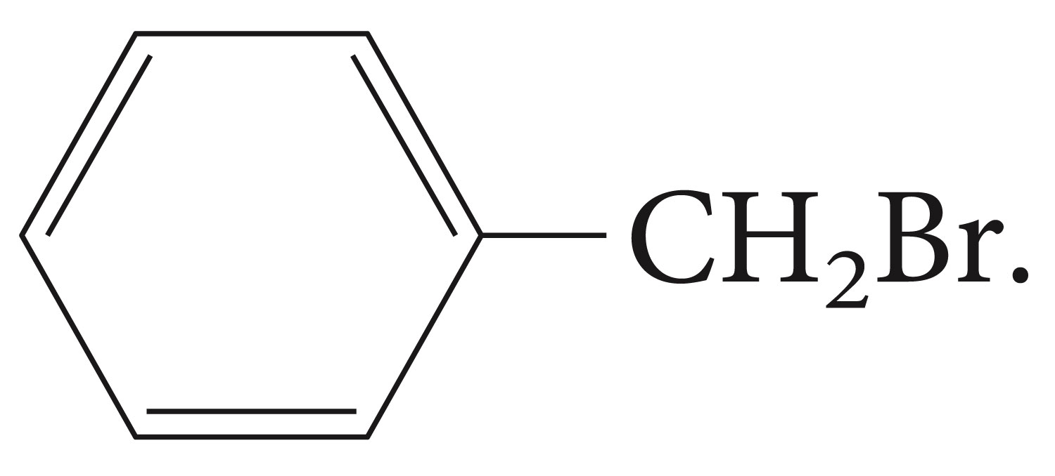
Device a synthesis of the compound on the left from the one on the right

Slide 21
Aldehydes and ketones undergo reductive amination when treated with ammonia, primary amine or secondary amines, to give primary, secondary, or tetiary amines respectively. The commonly used reducing agent for this purpose is metal hydride sodium cyanoborohydride, NaBH₃CN.

Slide 22
Basicity of Amines

Slide 23
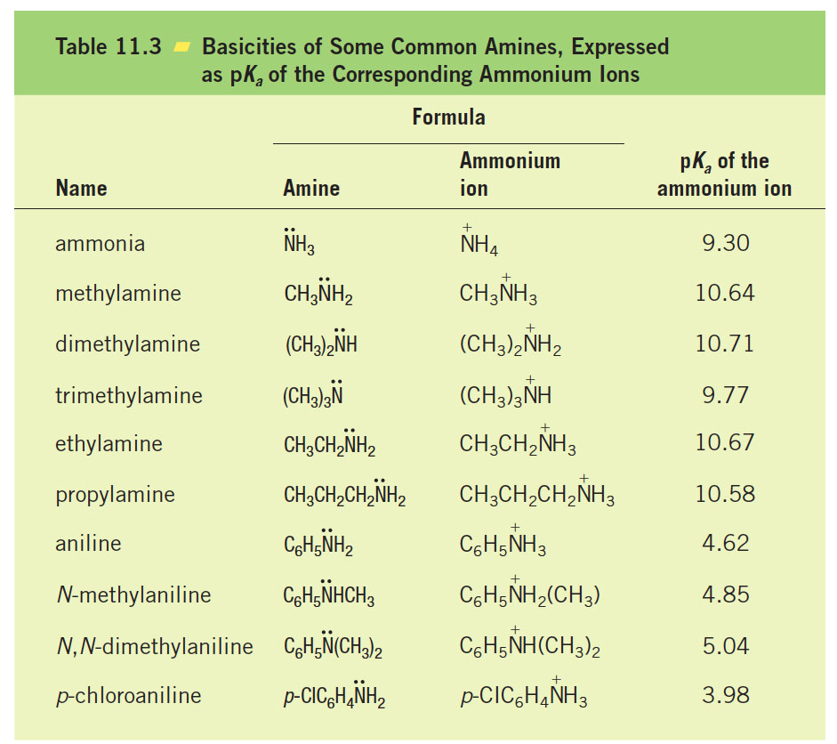

Slide 24
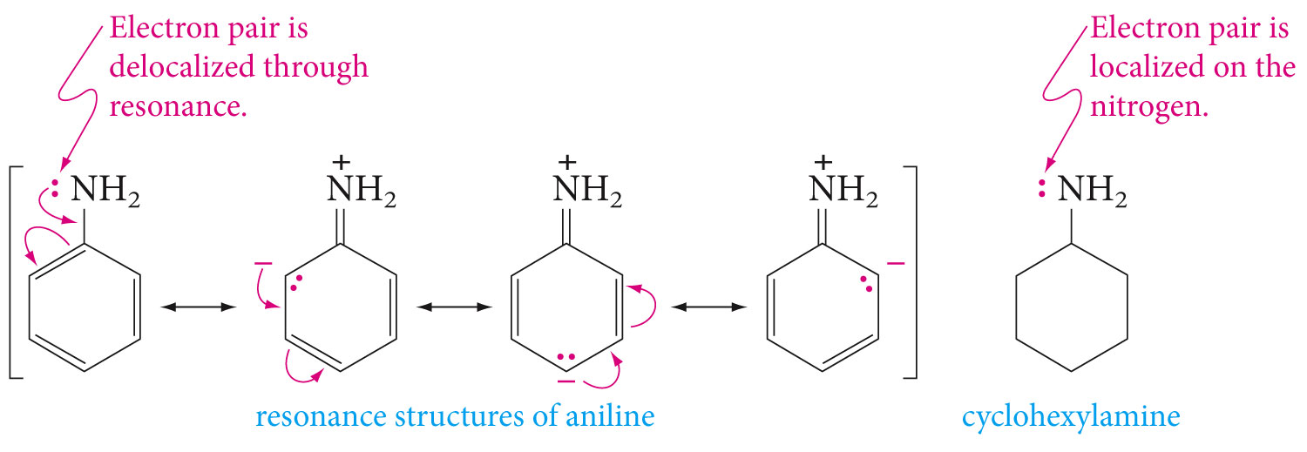
Aromatic amines are weaker bases than aliphatic amines or ammonia. This is mainly due to the resonance delocalization of the unshared electron pair in the aromatic amines.

Slide 25
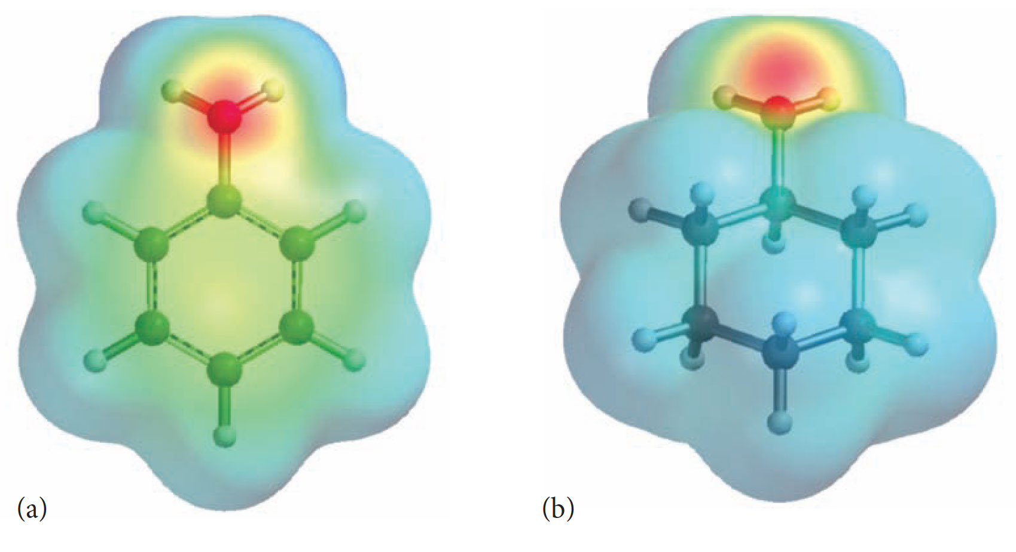

Slide 26
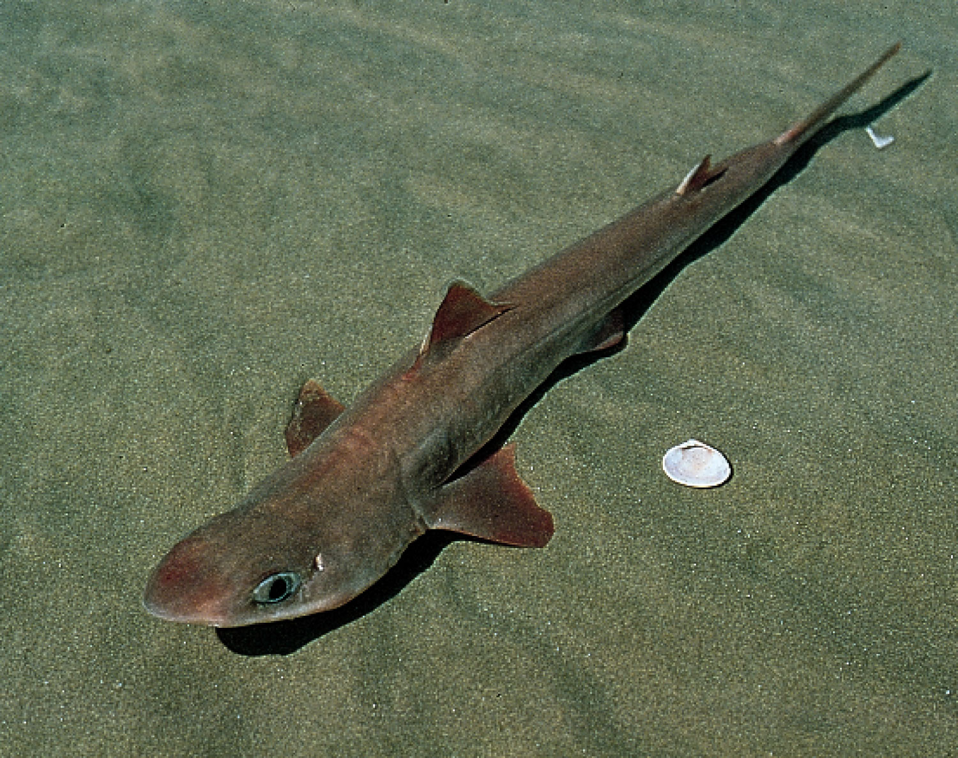
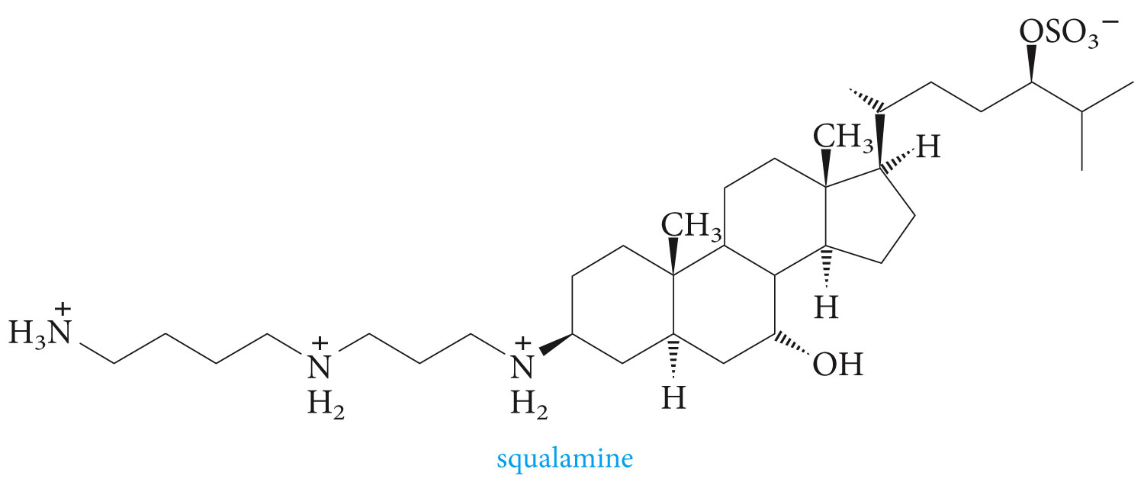
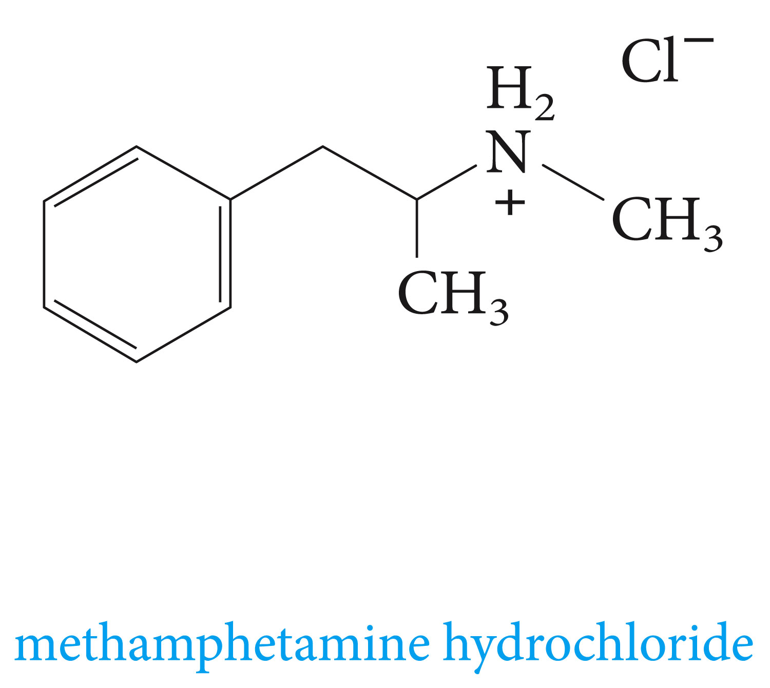

Slide 27
Quaternary Ammonium Compounds

Slide 28
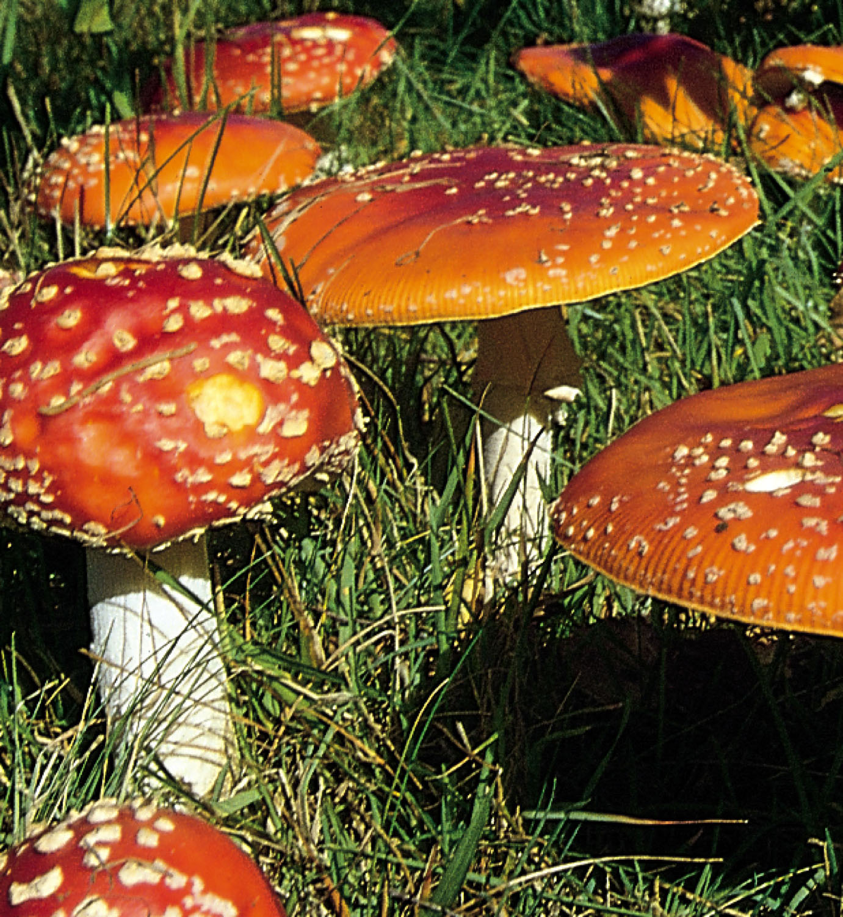

Slide 29
Aromatic Diazonium Compounds
Primary aromatic amines react with nitrous acid at 0 0C to yield aryldiazonium ions. The process is called diazotization

Slide 35
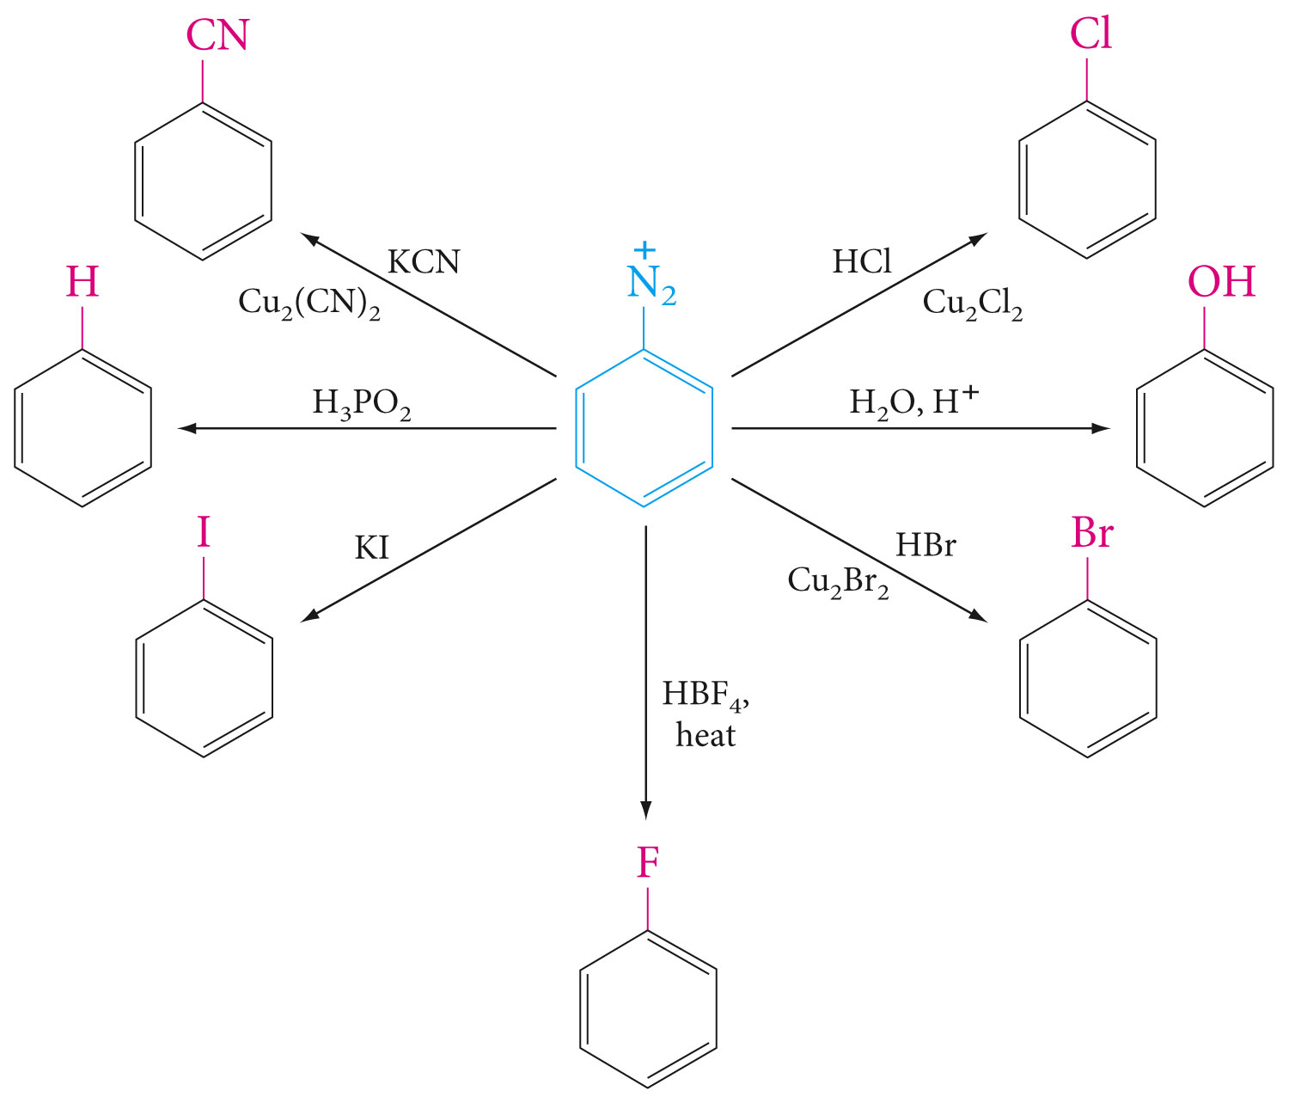
Examples of conversion of diazonio group to other groups

Slide 36
How can one prepare m-dibromobenzene?

Slide 37
Prepare o-methylbenzoic acid from o-toluidine (o-methylaniline)

Slide 38
Prepare 1,3,5-tribromobenzene from aniline?

Slide 39
Diazo Coupling; Azo Dyes

Slide 40
Aryldiazonium ions react with strongly activated aromatic rings like phenols and aryl amine to give azo compounds

Slide 41
