Slide 1
Chapter 12
Spectroscopy and Structure Determination
Principles of Spectroscopy
Nuclear Magnetic Resonance Spectroscopy
Infrared Spectroscopy
Mass Spectrometry
UV-Visible Spectroscopy

Slide 2
Important questions about the structure of an organic compound
How are the atom arranged?
The carbon skeleton-cyclic or acyclic?
Aromatic or not?
Saturated or unsaturated?
What functional group/s are present?
What elements are in a compound and in what proportions?

Slide 3
Attempts to provide answers to the questions
Chemists have used
  Elemental analysis
  Chemical tests for functional groups
  Chemical conversions and breakdowns
In modern times
  Spectroscopy has provided great advantages such as: rapid response, detailed structural information, small sample materials, and consistency of results.

Slide 4
Principles of Spectroscopy
The relationship between the energy of light and its frequency, speed and wavelength.
E = hν or E= hc/λ

Slide 5
Principles of Spectroscopy
E = hν or E= hc/λ
Type of spectroscopy | Radiation source | Energy (Kcal/mol) | Type of transition
NMR | Radio waves | 6-60 x 10⁻⁶ | Nuclear spin
IR | Infrared light | 2-12 | Molecular vibrations
UV-Visible | Visible or ultraviolet light | 37-150 | Electronic states

Slide 6
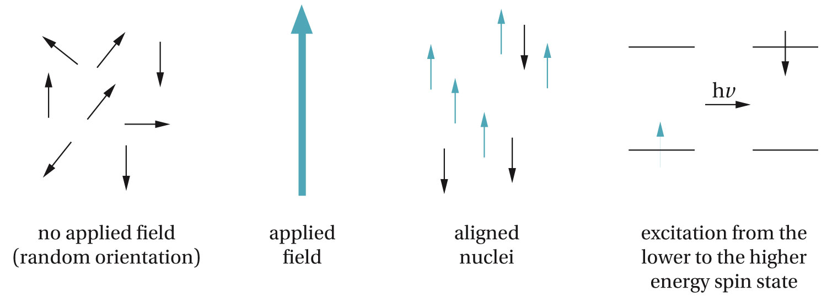
Nuclear Magnetic Resonance (NMR) Spectroscopy
Commonly used nuclei in NMR are ¹H and ¹³C

Slide 7
¹H NMR Spectrum of 1,4-Diethylbenzene

Slide 8
Chemical Shifts
¹H nuclei in a particular organic compound may differ in their electronic environments, therefore show peaks at different chemical shifts measured in δ (delta) units from the reference peak. Which is TMS (tetramethylsilane (CH₃)₄Si
The chemical shift is independent of the instrument on which it is measured.
Chemical shift = δ = distance of peak from TMS, in Hz _{ppm}
spectrometer frequency in MHz

Slide 9
Peak Areas
Different kinds of ¹H nuclei will give different peaks. The relative
number of equivalent ¹H nuclei are proportional to their peak area.
The relative ratios of peak areas is captured in the integration of the spectrum.

Slide 10
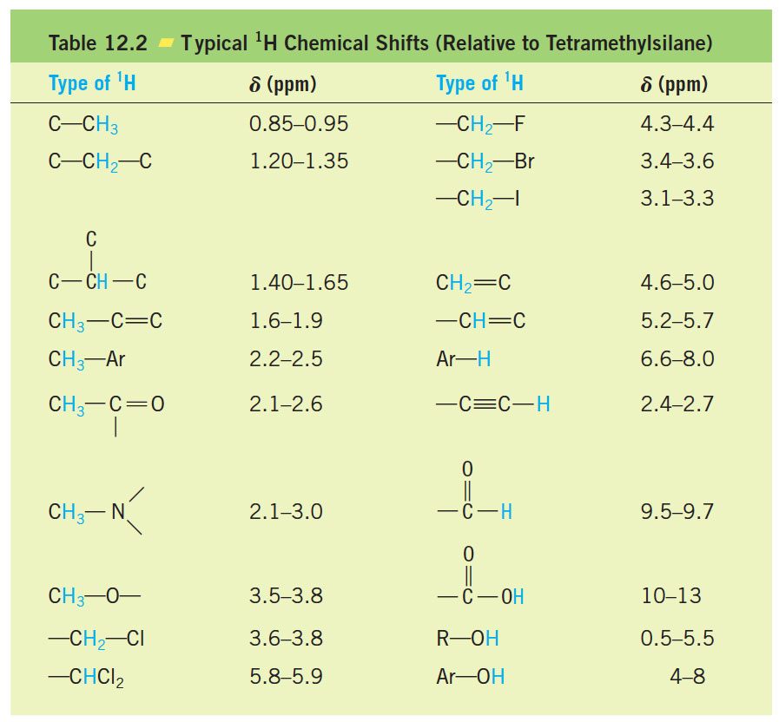
Typical Chemical Shifts

Slide 11
¹³C NMR Spectroscopy
¹³ C NMR spectroscopy provides information about the carbon
Skeleton of the compound.
The abundant ordinary ¹²C isotope does not have a nuclear spin
However the ¹³C, which has 1.1% natural abundance has a nuclear spin.
Typical chemical shift range for ¹³C is 0 ppm to 200 ppm downfield from TMS

Slide 12
¹³C NMR spectra of cyclohexane vs benzene

Slide 13
p-Xylene

Slide 14
Electronegativity effect

Slide 15
Splitting in ¹³C NMR
Due to low natural abundance of ¹³ C, the chance of finding two
adjacent ¹³C atoms in the same molecule is small. Hence ¹³C-¹³C splitting is ordinarily not seen.
However, ¹³C-¹H spin-spin splitting can occur, but the ¹³C spectrum is usually run such that this splitting do not appear (called a proton decoupled spectrum)

Slide 16
Infrared (IR) Spectroscopy
IR spectroscopy is very helpful in determining the type of bonds that are in a molecule and hence the functional groups

Slide 17
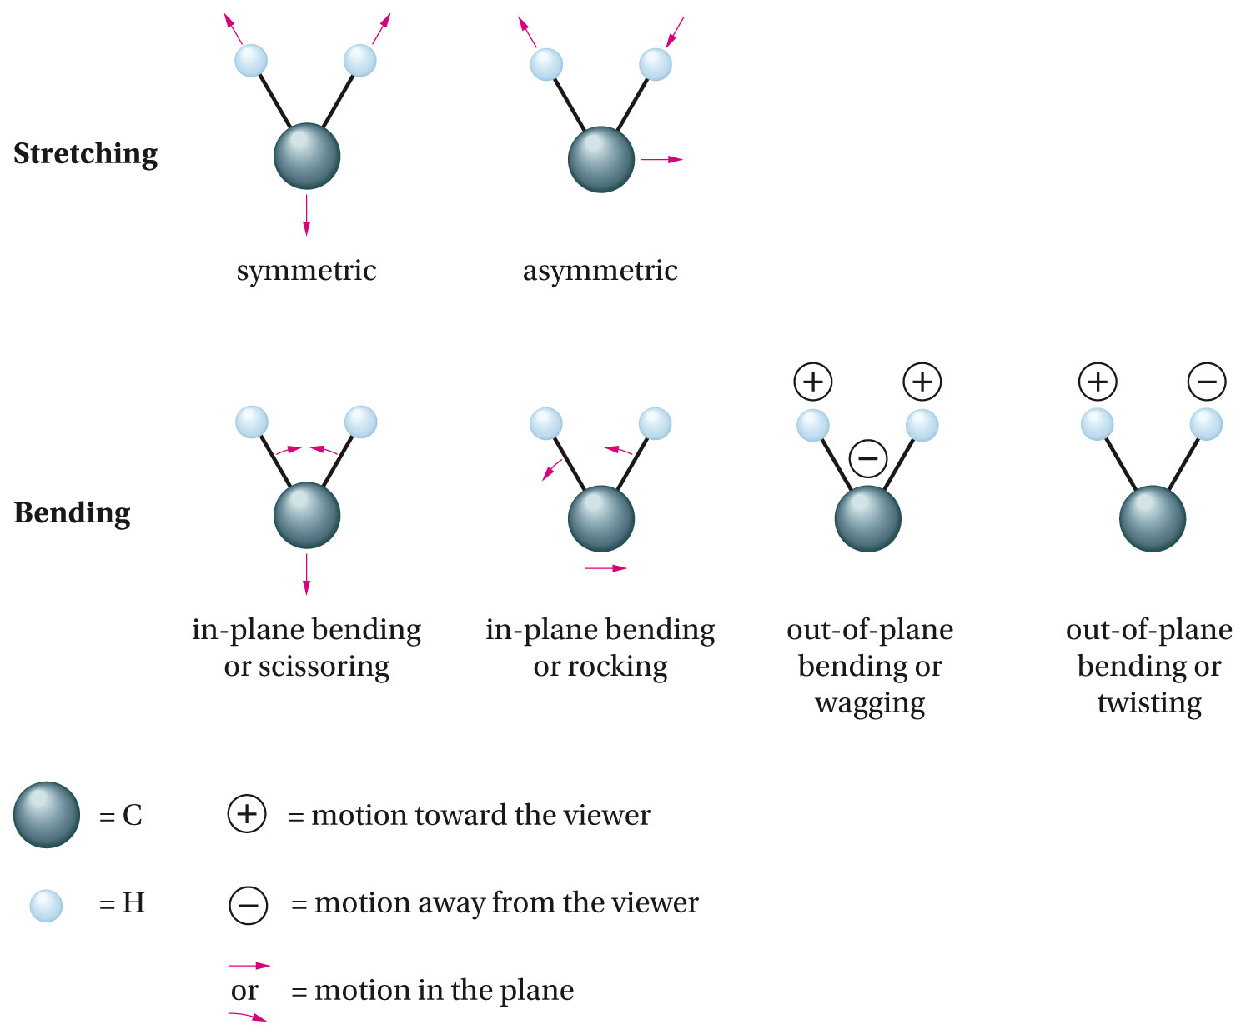

Slide 18
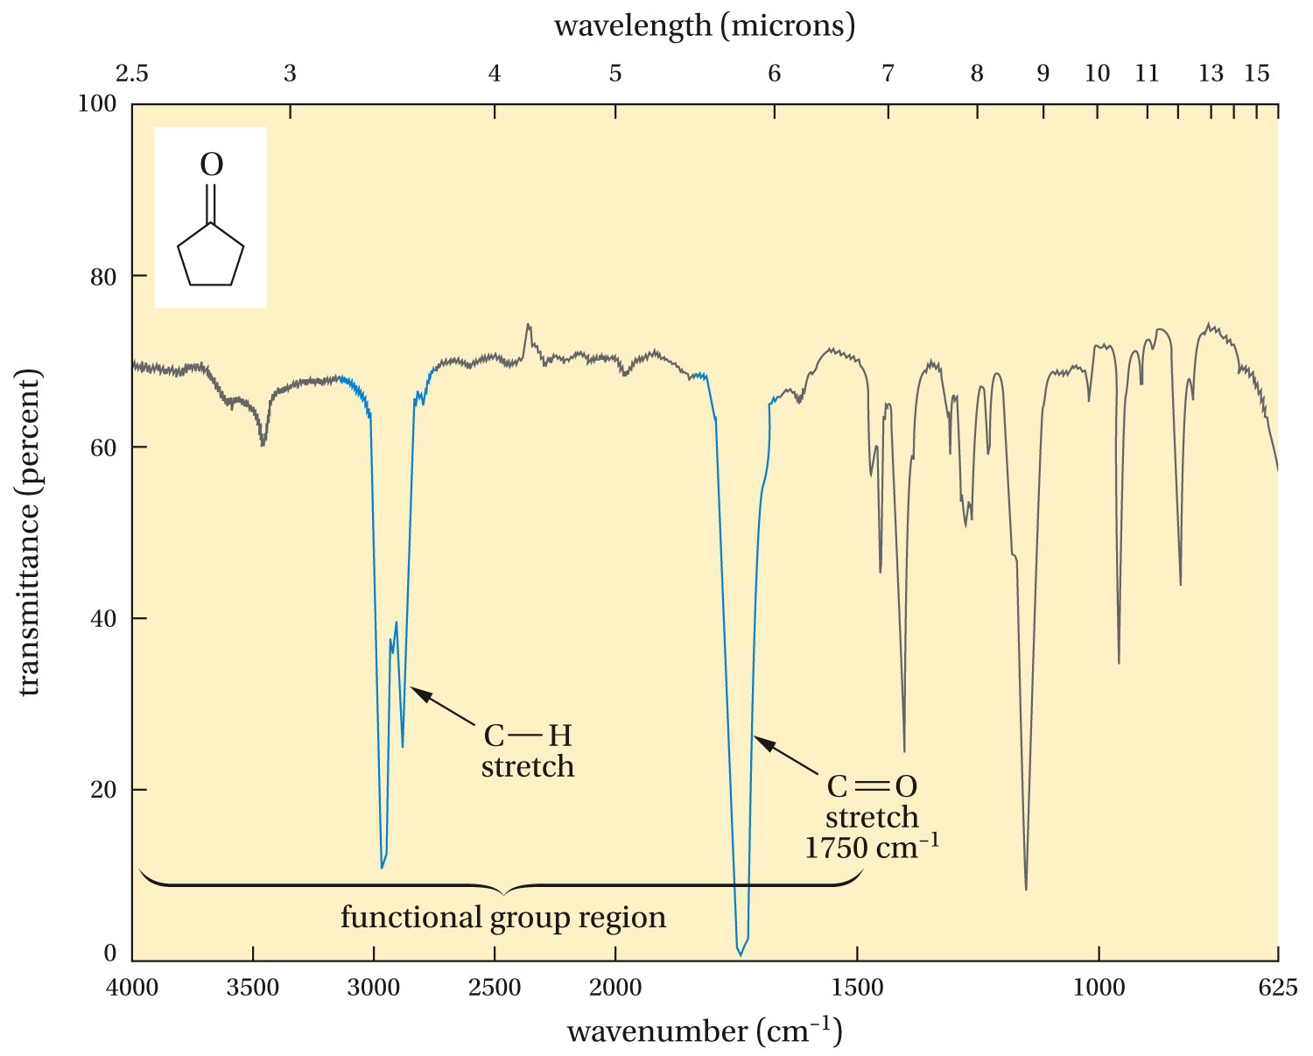
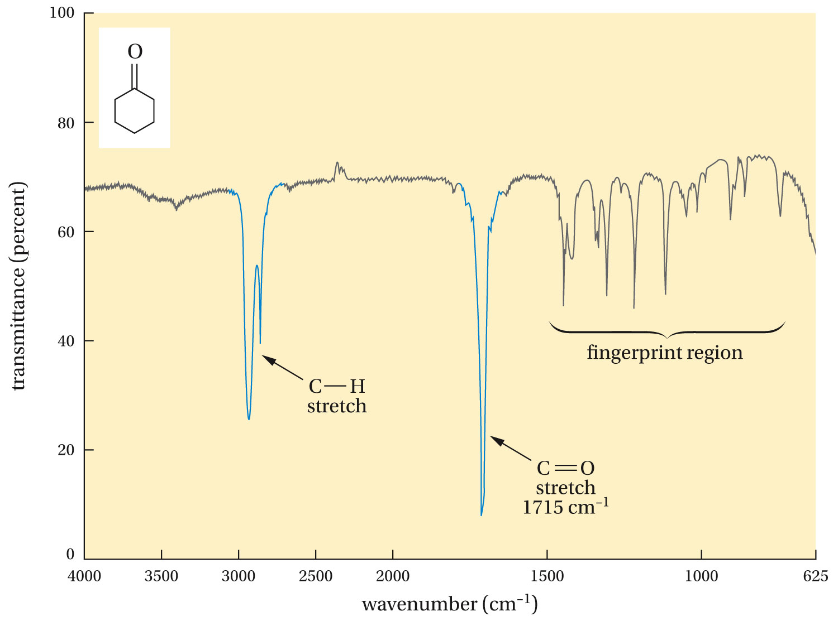

Slide 19
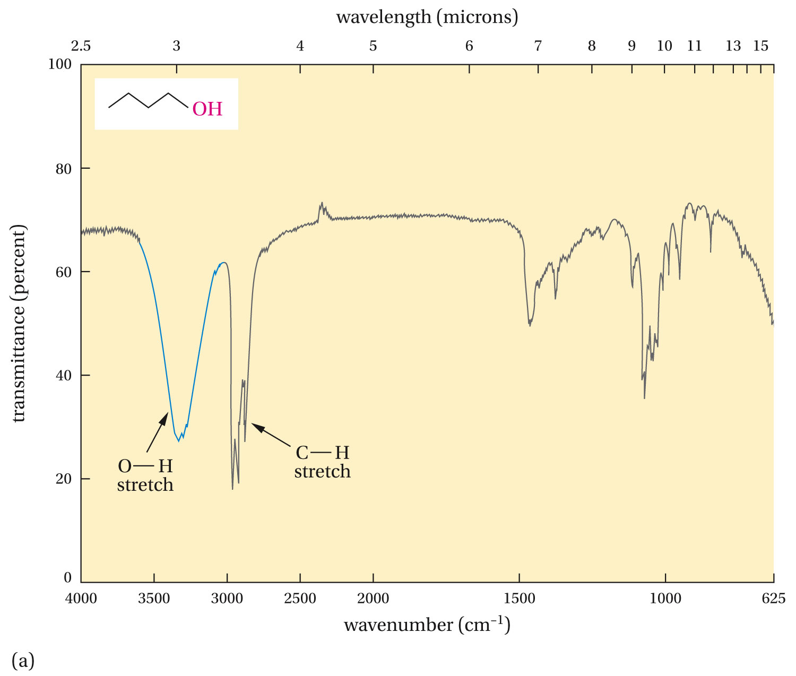

Slide 20
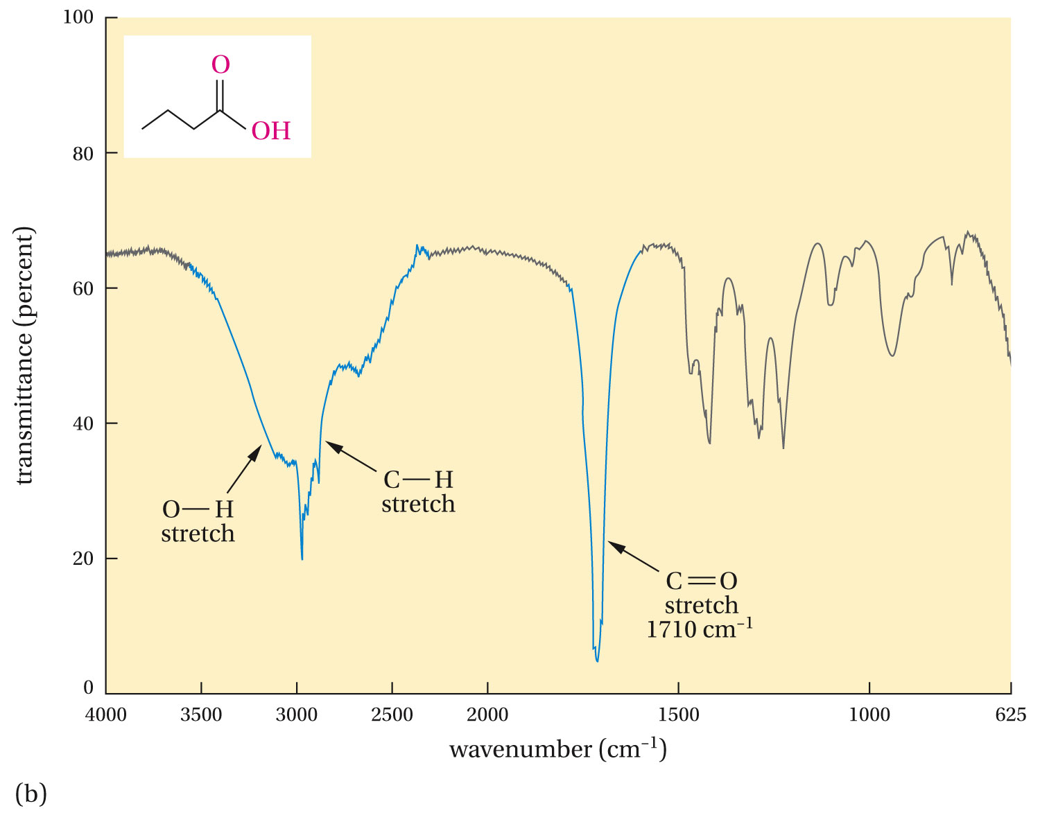

Slide 21
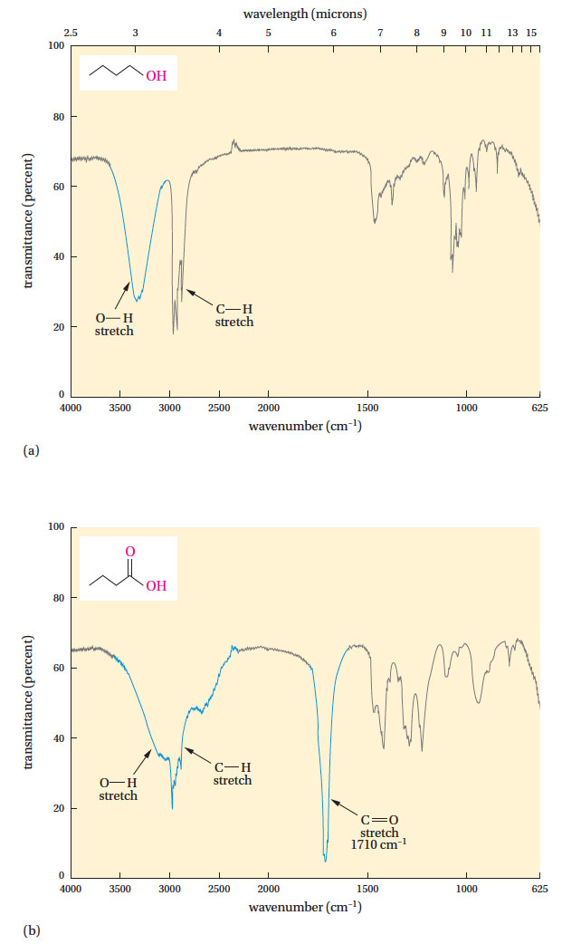

Slide 22
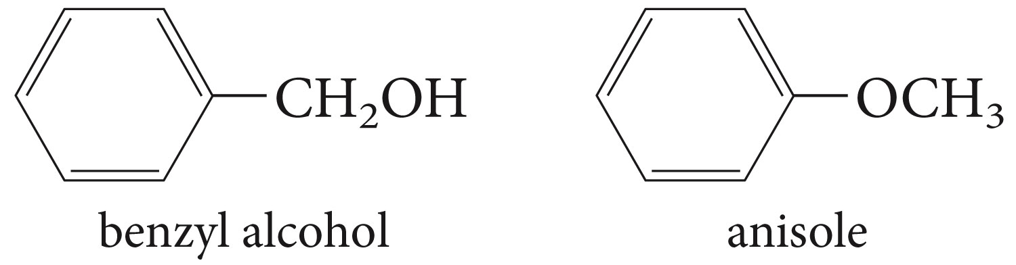
How can these isomeric compounds be distinguished using IR spectroscopy

Slide 23
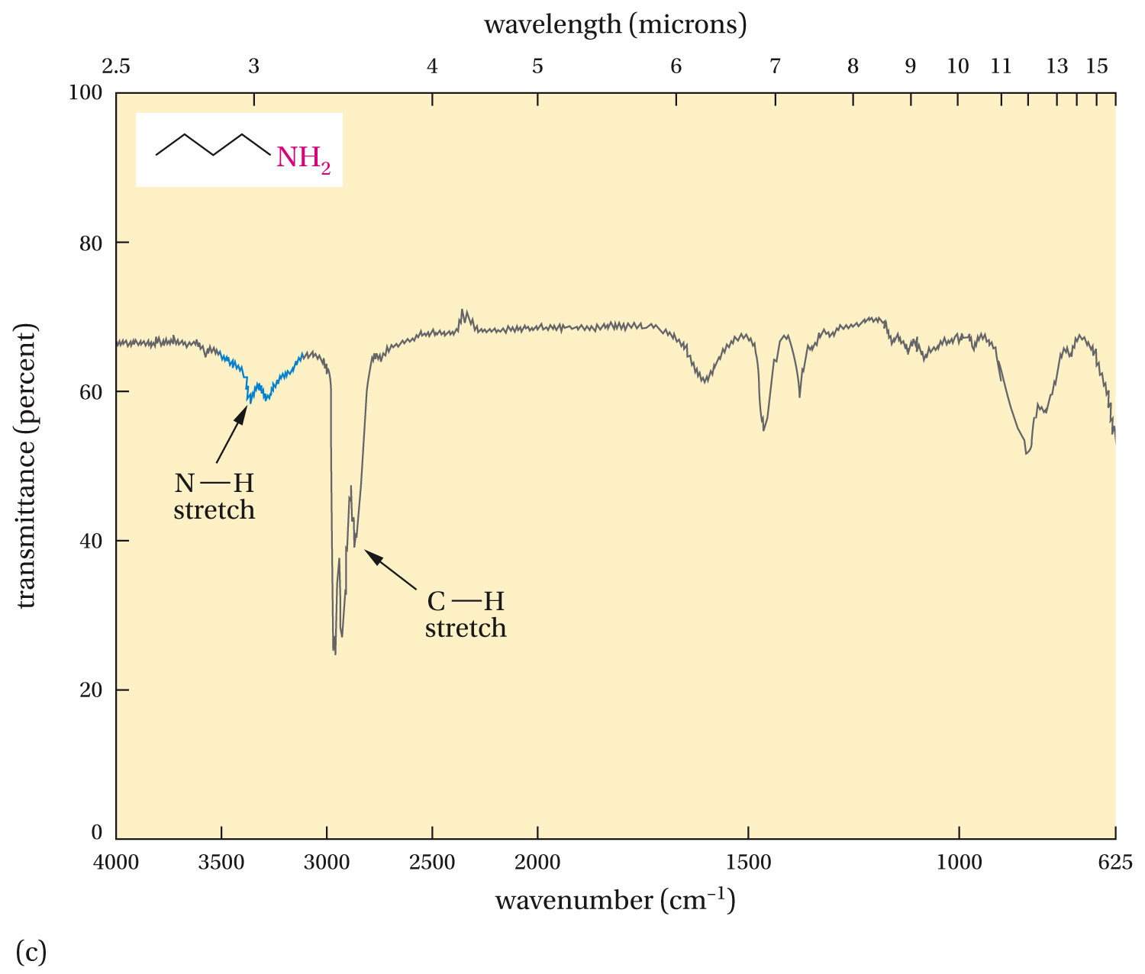

Slide 24
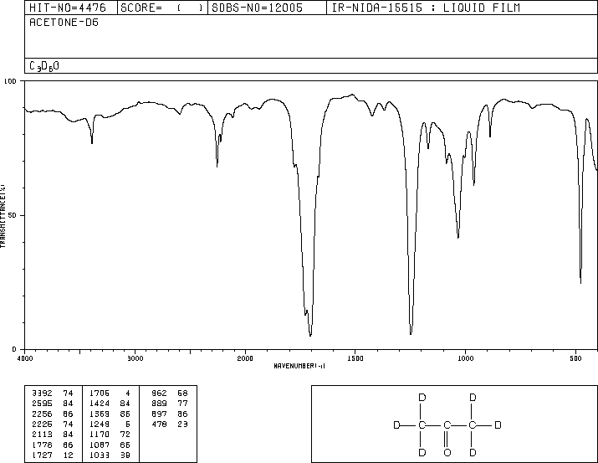
Clicker Question
In the IR the spectrum shown
Identify the peaks for the C=O stretch
A
D
B
C

Slide 25
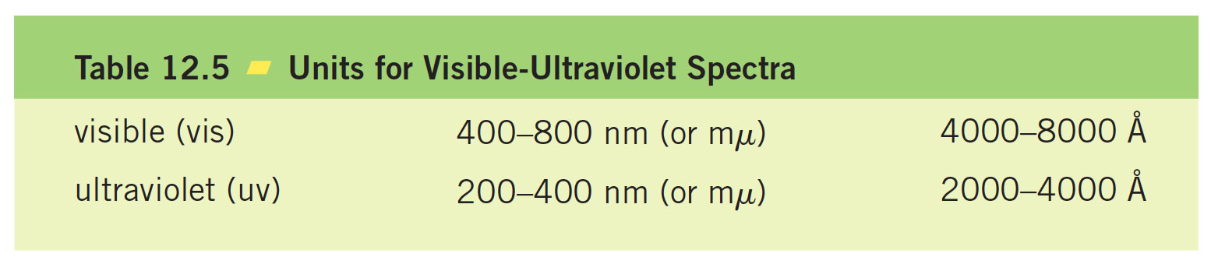
Visible and Ultraviolet Spectroscopy

Slide 26
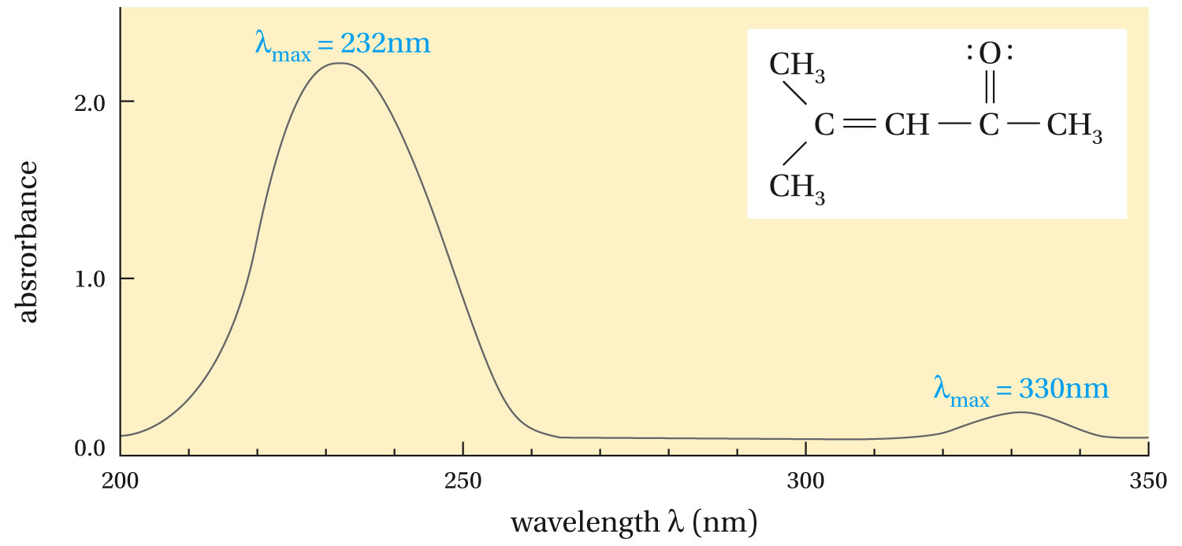

Slide 27
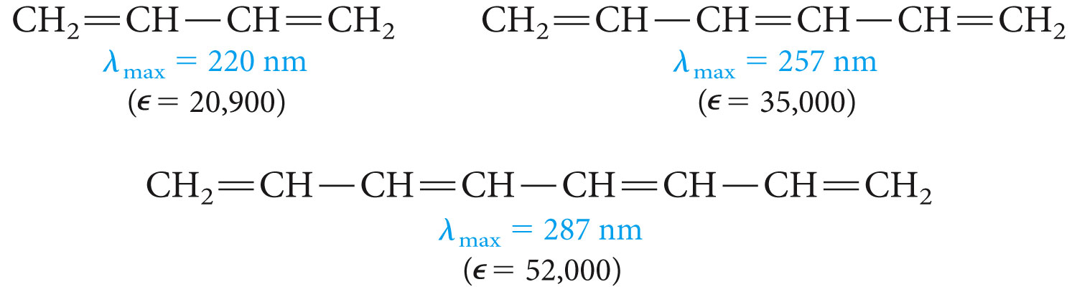
Conjugation

Slide 28
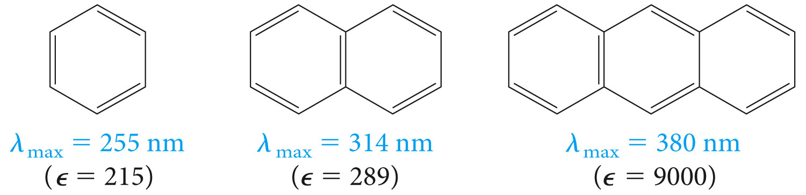

Slide 29
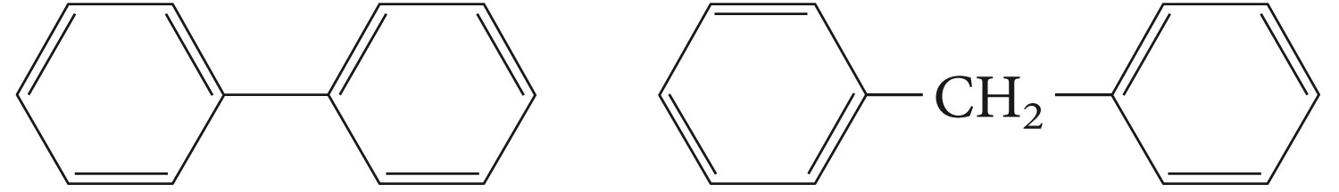
Clicker Question
Which of the following aromatic compounds do you expect
to absorb at longer wavelengths?
1
2

Slide 30
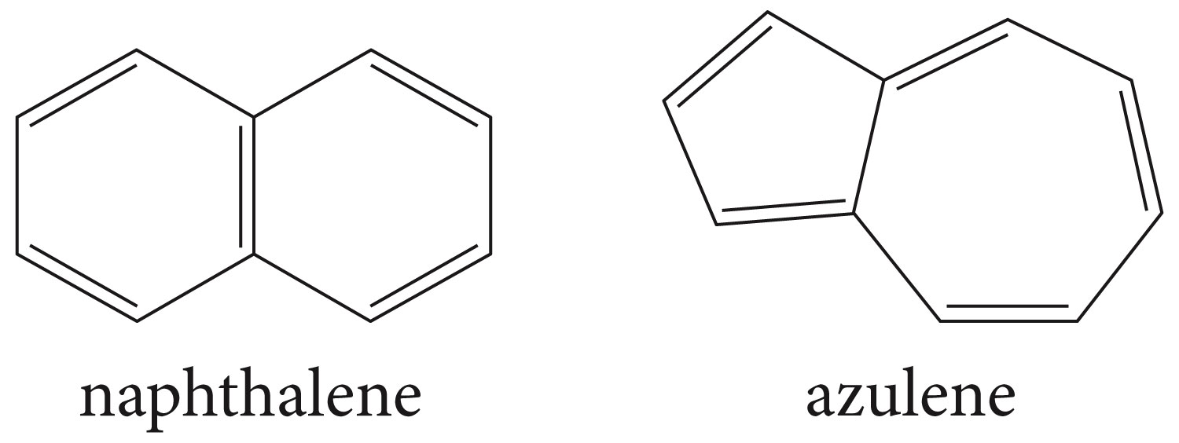
Problem 12.15
Naphthalene is colorless, but its isomer azulene is blue. Which compound has the lower energy pi-electron transition?

Slide 31
Clicker Question
An unsaturated aldehyde CH₃(CH=CH)_{n}CH=O have ultraviolet absorption spectra that depends on the number of n; the lamba max values are 220 nm, 270nm, 312 nm, and 334 nm as n changes. If n takes the values 1-4. what is the correct order of n in order of increasing lambda max (220 nm, 270nm, 312 nm, and 334 nm)
1, 2, 3, 4
4, 3, 2, 1

Slide 32
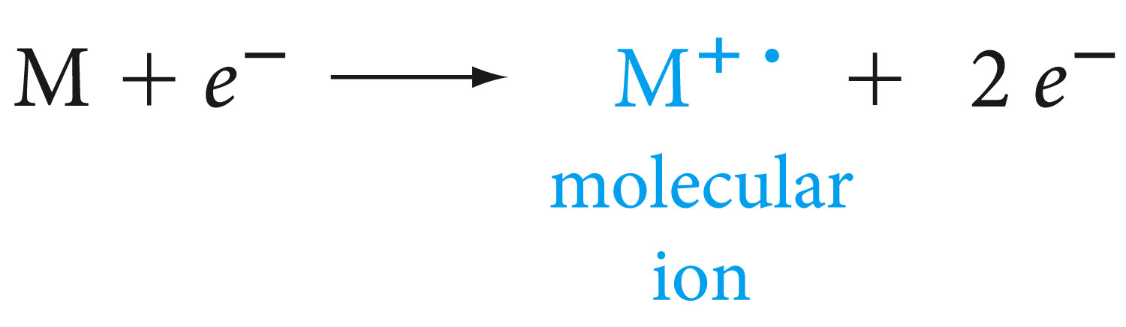
Mass Spectrometry

Slide 33
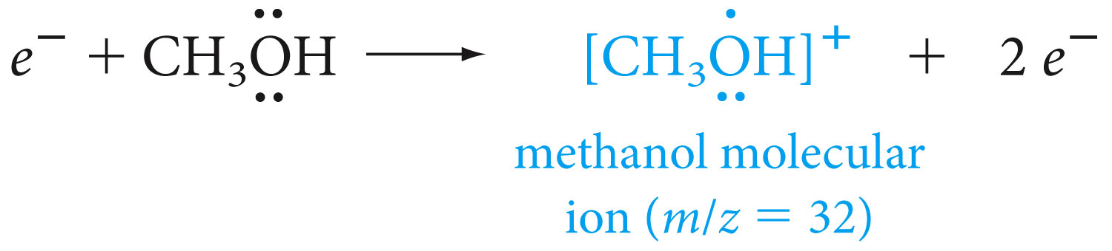

Slide 34
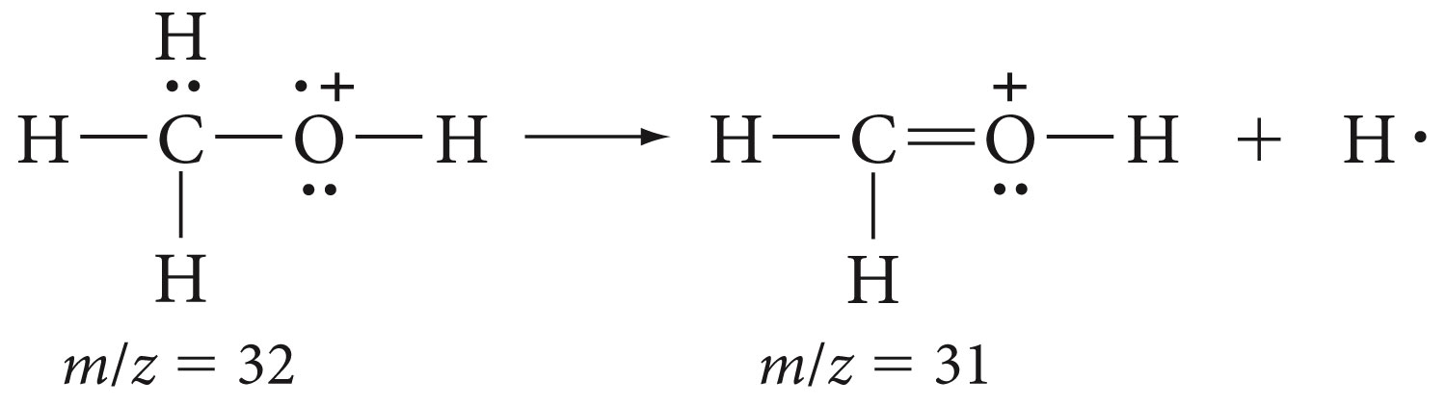
Daughter ions

Slide 35
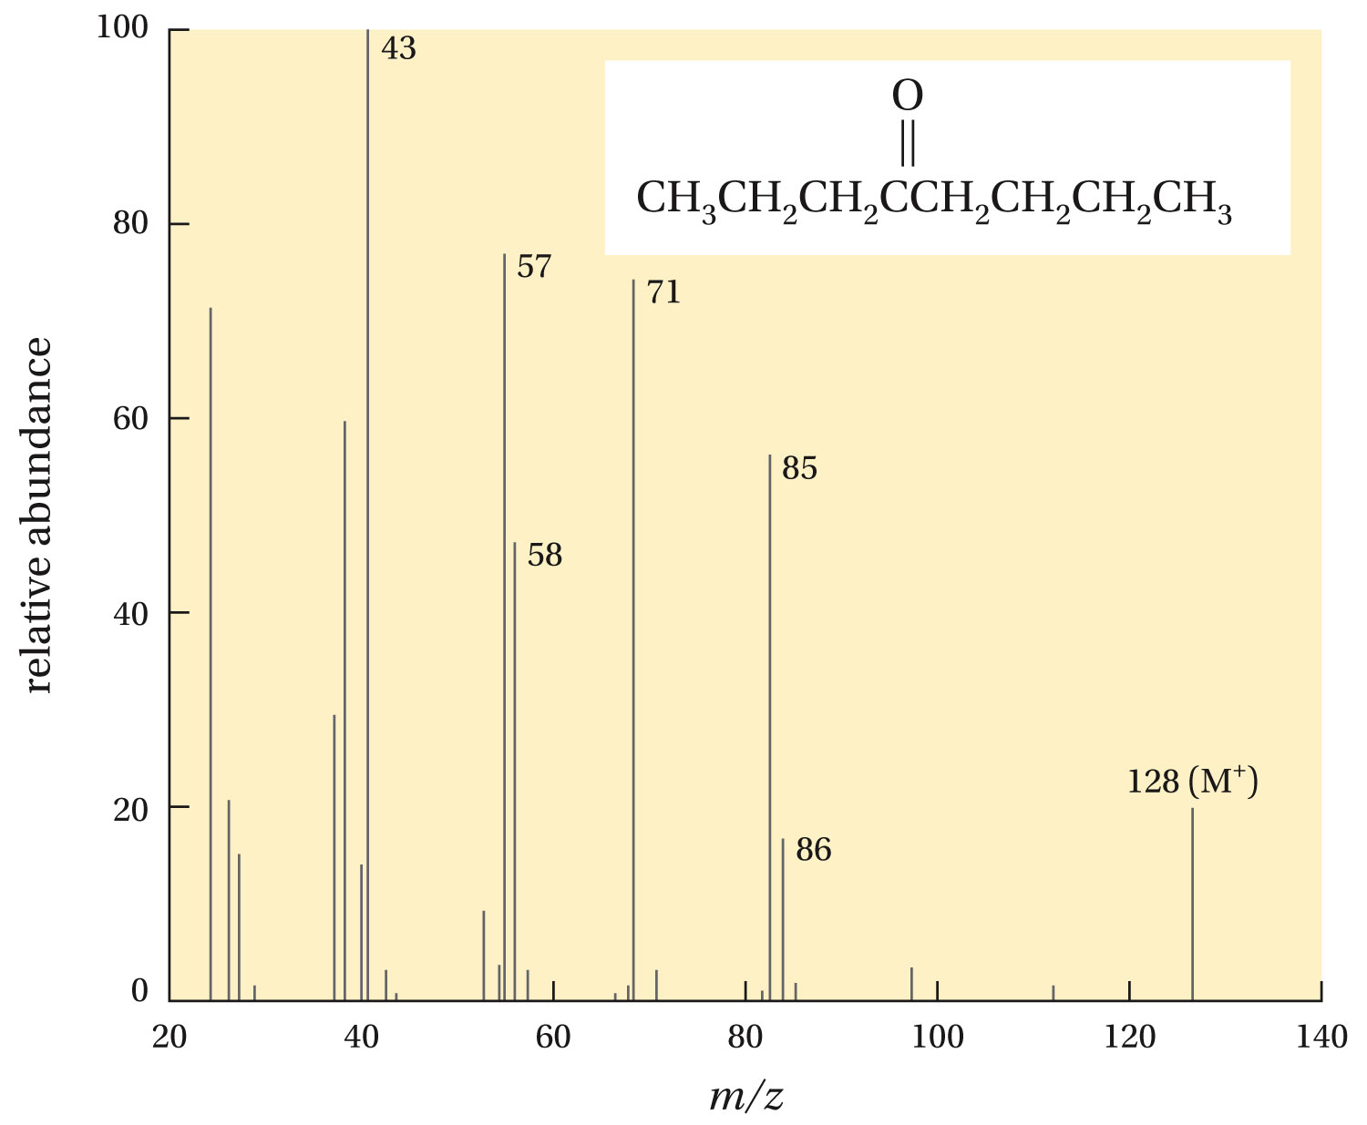

Slide 36
Problem
A bromoalkane shows two equal-intensity parent peaks at m/z 136
And m/z 138. deduce its molecular formula?

Slide 37
NMR question?
The 1H NMR spectrum of a compound, C₄H₉Br, consists of a single
sharp peak. What is is structure? The spectrum of an isomer of this compound consists of a doublet at delta=3.2 and a complex pattern at delta =1.9, and a doublet at delta =0.9, with relative areas 2:1:6. what is its structure

Slide 38
Combined
A compound, C₅H₁₀O, has an intense IR band at 1725 cm⁻¹. its
¹ H NMR spectrum consists of a quartet at 2.7 and a triplet at 0.9,
With relative areas of 2:3. What is its structure?

