Slide 1
Chapter 16 Carbohydrates
Classification
Nomenclature
Reactions
Notes:
1

Slide 2
Organic compounds in nature
Carbohydrates are among the major classes of organic compounds found in nature.
Others include: lipids, proteins and nucleic acids.

Slide 3
Functions of Carbohydrates
Components of genetic material; DNA and RNA

Slide 4
16.1 Classification of Carbohydrates
Many of this class of molecules have a common formula C_{x}(H₂O)_{y} which is carbon (carbo) and water (hydrate).
Carbohydrate compounds are also known as sugars or saccharides.
Carbohydrates are polyhydroxy aldehydes and ketones
Notes:
2

Slide 5
Classification of Carbohydrates
Monosaccharide
Oligosaccharide
Polysaccharide

Slide 6
Classification of Carbohydrates

Slide 7
Monosaccharides
Is not cleaved to a simpler carbohydrate on hydrolysis.
Glucose (C₆H₁₂O₆), for example, is a monosaccharide
Notes:
3

Slide 8
Monosaccharides
Classification is based on:
Number of carbon atoms present
Whether the carbonyl group is an aldehyde or ketone

Slide 9
Trioses

Slide 10
Some Classes of monosaccharides
No. of carbons Aldose Ketose
4 Aldotetrose Ketotetrose
5 Aldopentose Ketopentose
6 Aldohexose Ketopentose
7 Aldoheptose Ketoheptose
8 Aldooctose Ketooctose
Aldoses: Monosaccharides that are polyhydroxy aldehydes
Ketoses: Monosaccharides that are polyhydroxy ketones
Notes:
6

Slide 11
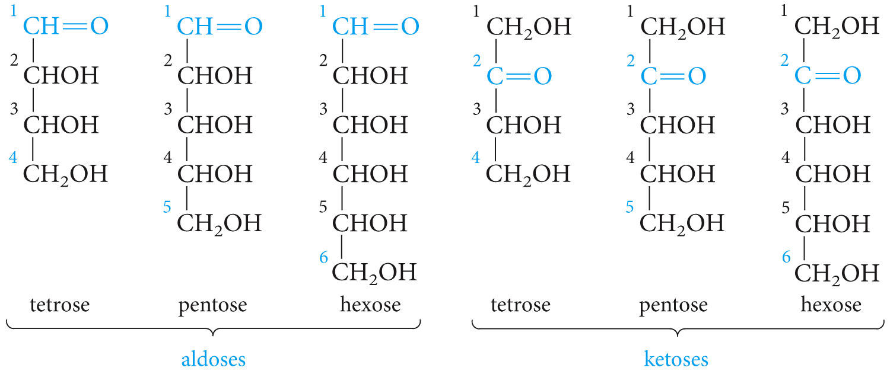
p. 462a

Slide 12
16.3 Chirality in Monosaccharides

Slide 13
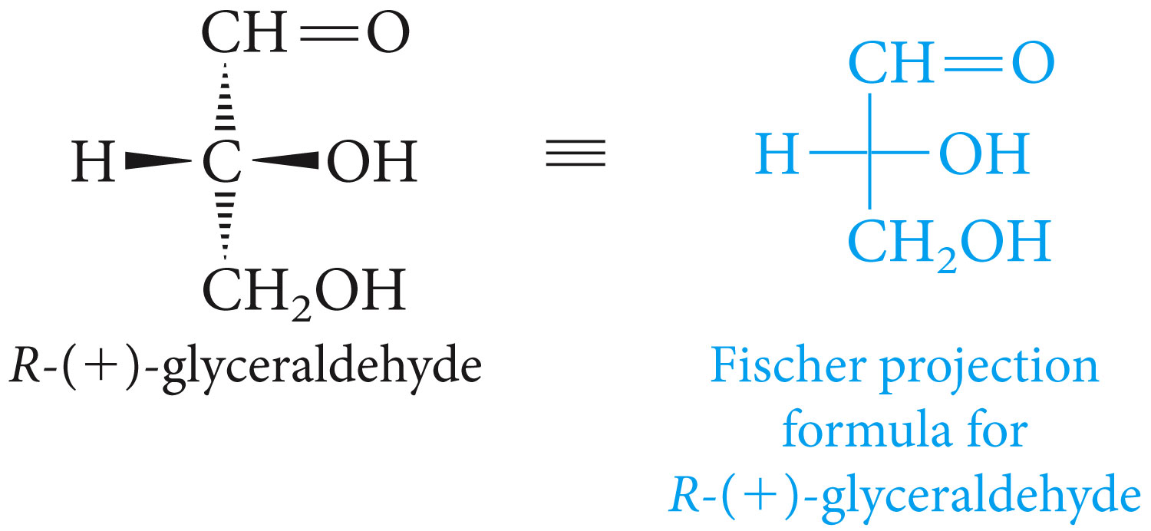
Fischer Projection
p. 462c

Slide 14
D and L Notation
p. 463a

Slide 15
D and L Notation
p. 463b

Slide 16
D and L Notation
D-L is fundamentally different from R-S notation
R-S is only used for single stereogenic center, while D-L is used for the whole molecule.
Stereochemistry is assigned on basis of whether configuration of highest-numbered stereogenic centeris analogous to D or L-glyceraldehyde.

Slide 17
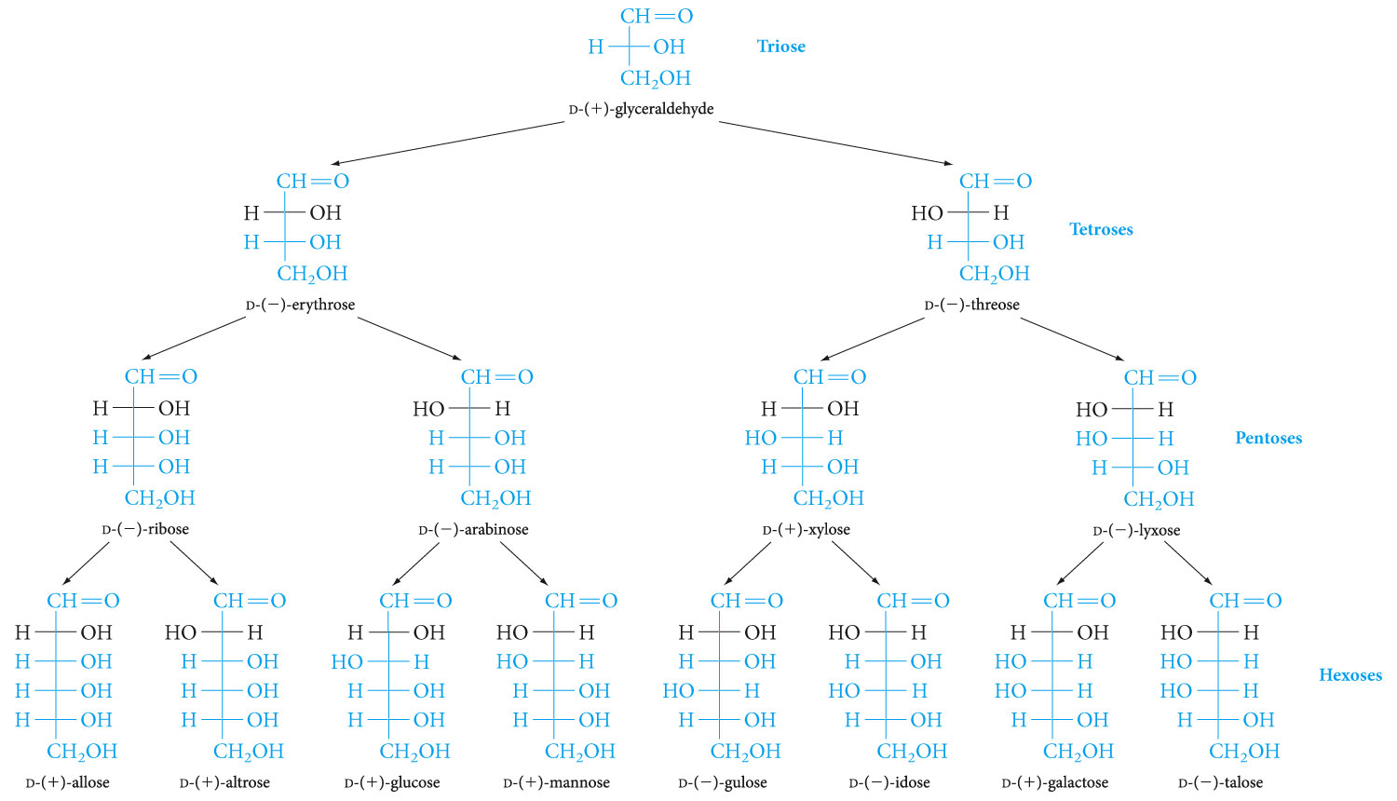
p. 464, Fig. 16-1

Slide 18
16.4
Cyclic Hemiacetal Structures
of Monosaccharides

Slide 19
Recall from Section 9.7
R
R
••
••
C
O
+
R"OH
R"O
C
O
H
••
• •
••
••
R'
R'
Product is a hemiacetal.
Notes:
5

Slide 20
Cyclic Hemiacetals
R
R
OH
C
O
C
OH
O
Aldehydes and ketones that contain an OH group elsewhere in the molecule can undergo intramolecular hemiacetal formation.
The equilibrium favors the cyclic hemiacetal if the ring is 5- or 6-membered.
Notes:
5

Slide 21
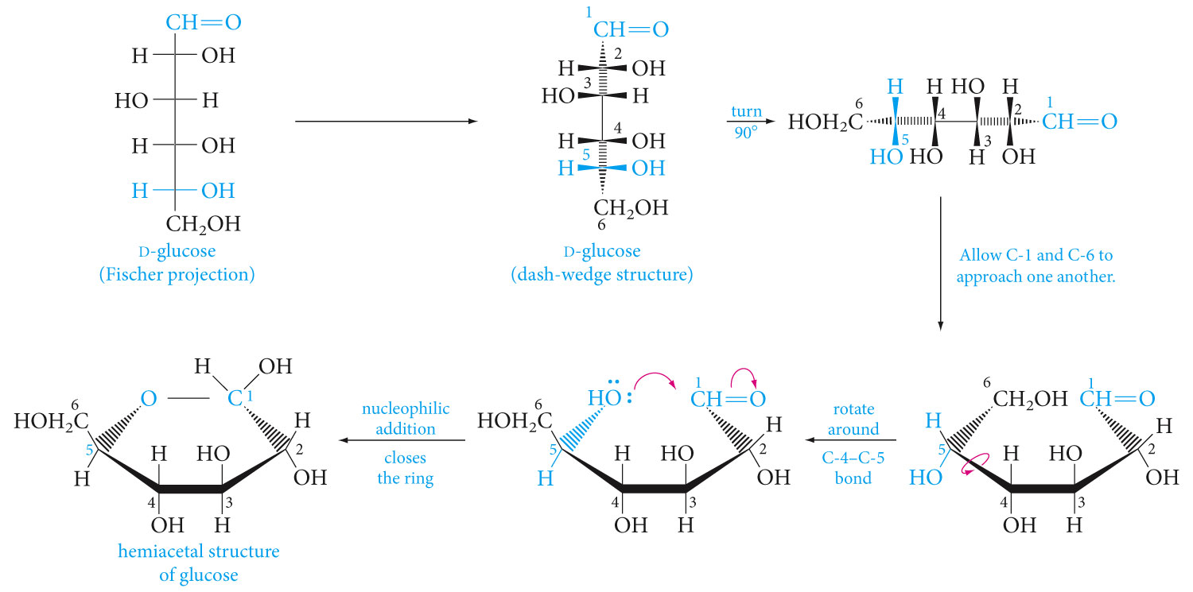
p. 466, Fig. 16-2

Slide 22
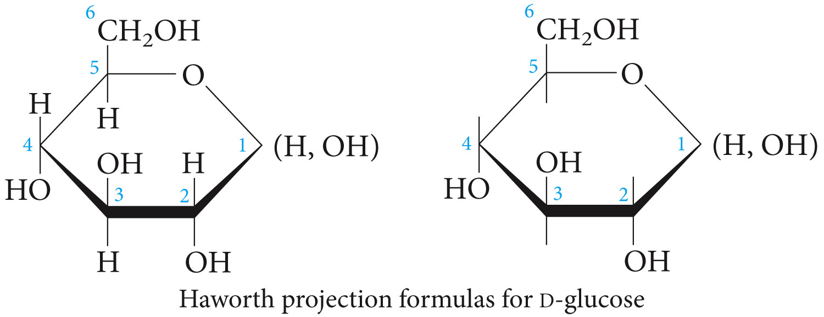
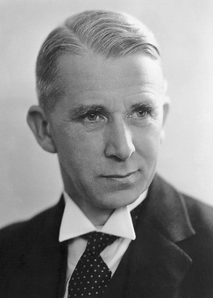
p. 467a

Slide 23
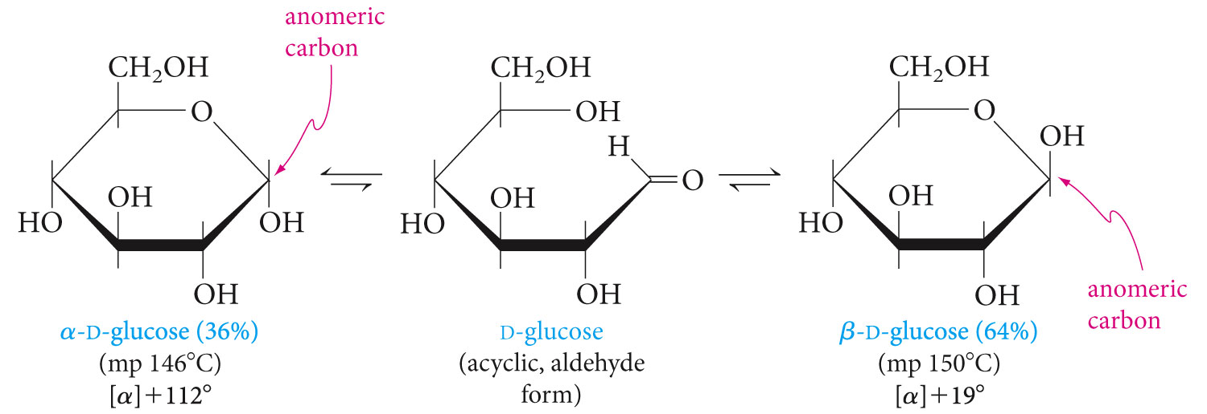
16.5
Anomeric Carbons
p. 468

Slide 24
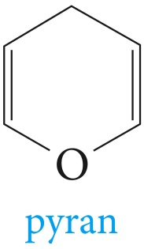
16.6
Pyranose Structures

Slide 25
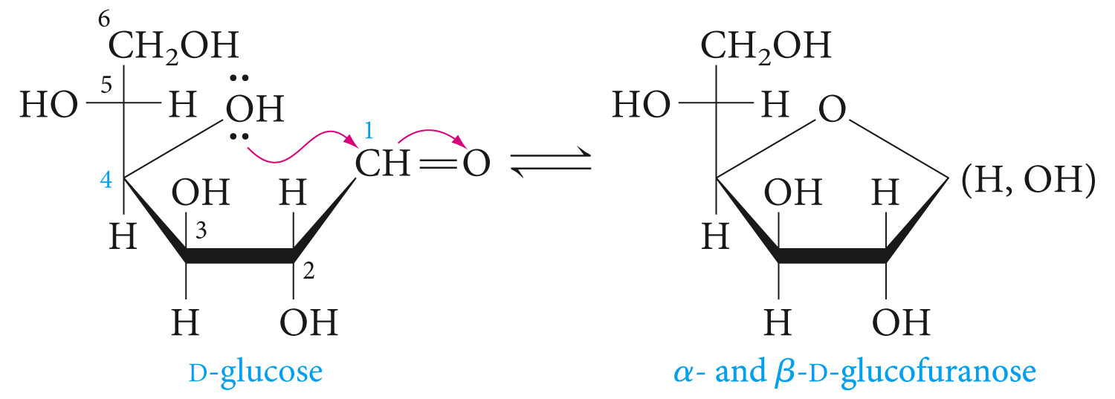
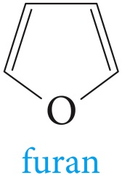
16.6
Furanose Structures

Slide 26
16.6
Furanose Structures
p. 470a

Slide 27
Conformation of Pyranoses

Slide 28
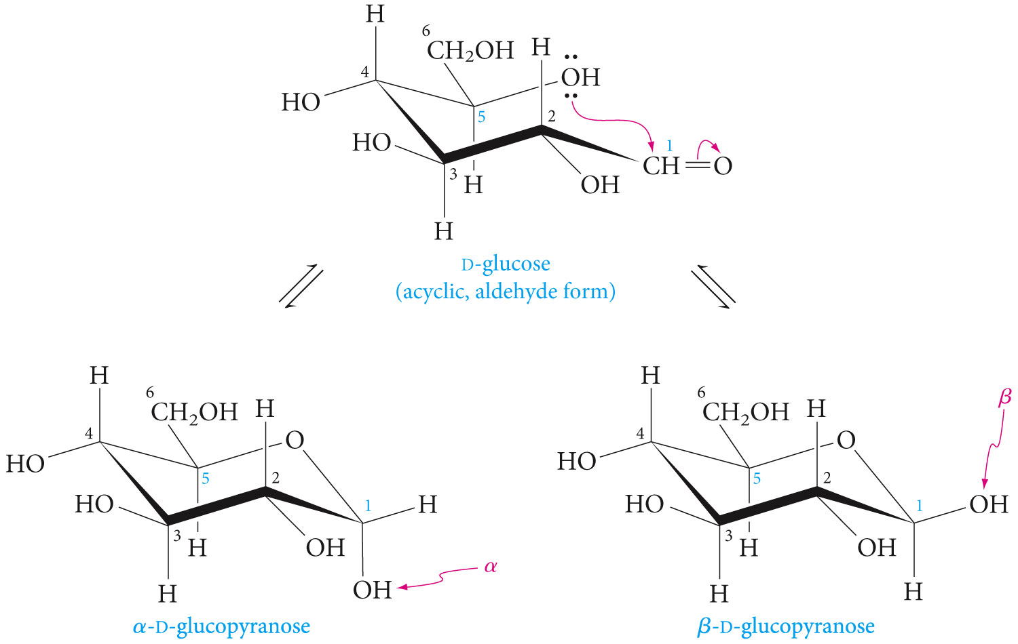
16.7
Conformation of Pyranoses
p. 470b

Slide 29
Reactions of Carbohydrates

Slide 30
Carbohydrate Reactivity
Reactions of carbohydrates are similar to other organic reactions already studied.
These reactions were once used extensively for structure determination.
Reactions of carbohydrates can involve either open-chain form, furanose, or pyranose forms.

Slide 31
16.8
Esters from monosaccharides
p. 471b

Slide 32
16.8
Ethers from monosaccharides
p. 471b

Slide 33
16.9
Reduction of monosaccharides
p. 471b

Slide 34
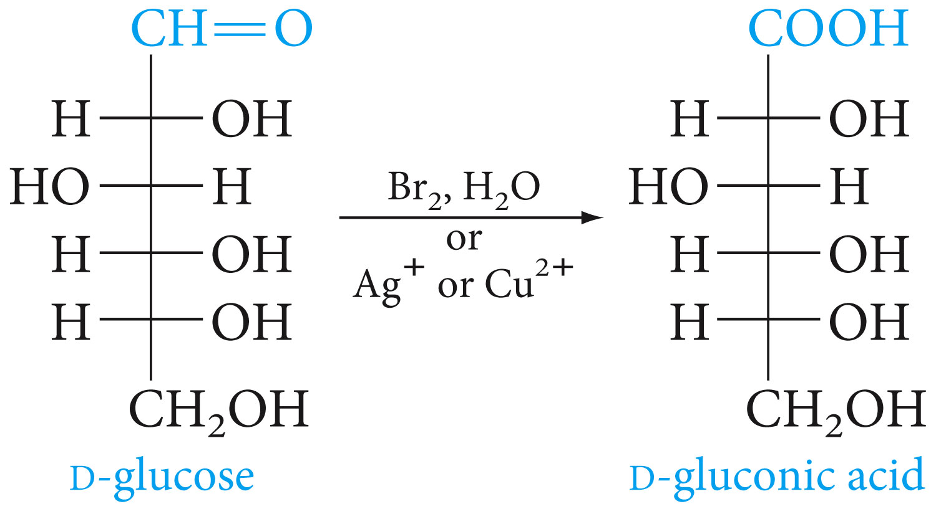
16.10
Oxidation of monosaccharides
p. 471b

Slide 35
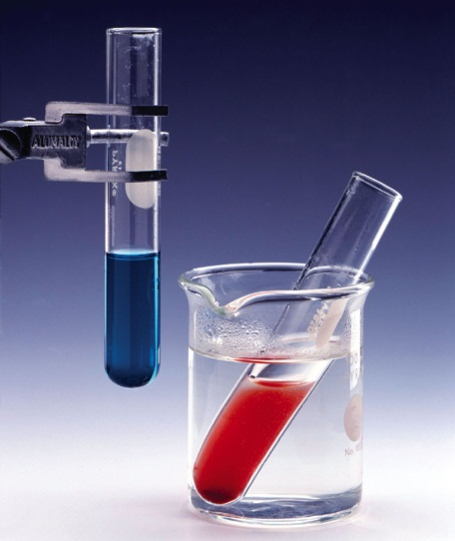
16.10
Oxidation of monosaccharides
p. 471b

Slide 36
16.10
Oxidation of monosaccharides
p. 471b

Slide 37
Oxidation Occurs at the Ends
Easiest to oxidize the aldehyde and the primary alcohol functions.
CH
O
CO₂H
CO₂H
CH₂OH
CH₂OH
CO₂H
Aldose
Aldonic acid
Aldaric acid

Slide 38
16.11 Formation of glycosides from monosaccharides

Slide 39
16.11 Formation of glycosides from monosaccharides

Slide 40
16.12 Disaccharides
Is cleaved to two monosaccharides on hydrolysis.
These two monosaccharides may be the same or different.
C₁₂H₂₂O₁₁ + H₂O
C₆H₁₂O₆ + C₆H₁₂O₆
glucose (a monosaccharide)
sucrose (a disaccharide)
fructose (a monosaccharide)
Notes:
4

Slide 41
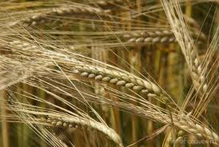
Maltose
Maltose is composed of two glucose units linked together by a glycosidic bond between C-1 of one glucose and C-4 of the other.
Beer is made from four basic building blocks: water, malted barley, and hops.

Slide 42
Cellobiose
Cellobiose is a stereoisomer of maltose.
The only difference between the two is that cellobiose has a β(1,4) glycosidic bond while that of maltose is α(1,4).
Obtained from hydrolysis of cellulose

Slide 43
Lactose(Milk Sugar)
Cellobiose and lactose are stereoisomeric disaccharides.
Both have β(1,4) glycosidic bonds.
The glycosidic bond unites two glucose units in cellobiose. It unites galactose and glucose in lactose.

Slide 44
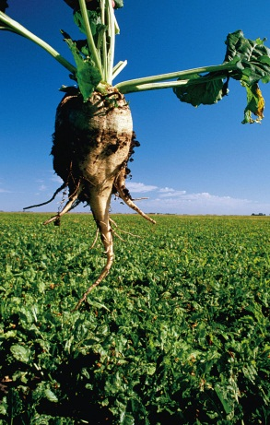
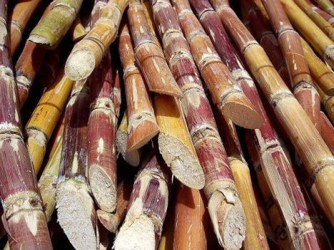
Sucrose(Table sugar)

Slide 45
16.13 Polysaccharides
Contain many linked monosaccharides
Vary in chain length and molecular weight
Most give a single monosaccharide on complete hydrolysis
Monosaccharide units may be linearly connected or may be branched

Slide 46
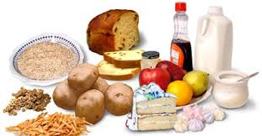
Starch
Starch- energy storing carbohydrate of plants
In cereals, rice, potatoes and corn
Starch is a mixture of amylose and amylopectin, which are both composed of thousands of D-glucose units joined by α(1,4)-glycosidic linkages.
Thus, they can be viewed as a repeating collection of maltose units

Slide 47
Starch

Slide 48
Starch

Slide 49
Glycogen
Glycogen- energy storing carbohydrate of animals
More branched than starch(amylopectin)
Produced from glucose that is absorbed from the intestines into the blood
Transported to the liver, muscles and then polymerized enzymatically

Slide 50
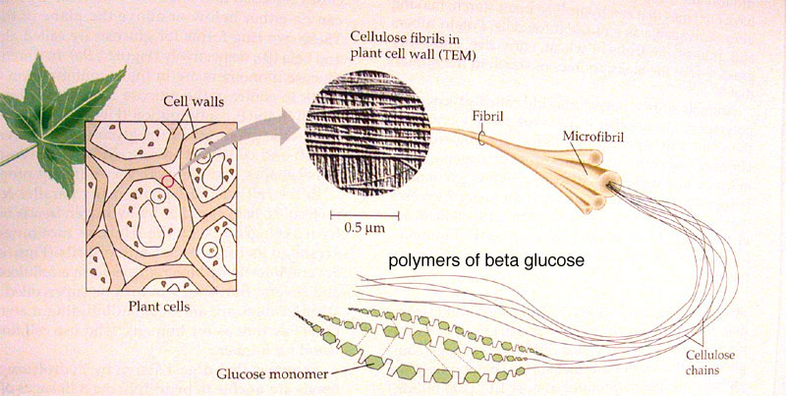
Cellulose

Slide 51
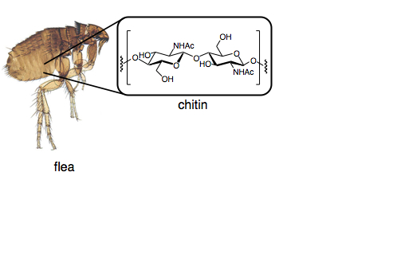
Chitin
A tough, protective, semitransparent substance, primarily a nitrogen-containing polysaccharide, forming the principal component of arthropod exoskeletons and the cell walls of certain fungi.

Slide 52
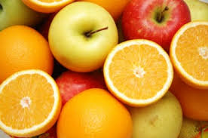
Pectin
structural heteropolysaccharide contained in the primary cell walls of terrestrial plants.
It is produced commercially as a white to light brown powder, mainly extracted from citrus fruits, and is used in food as a gelling agent particularly in jams and jellies.
It is also used in fillings, medicines, sweets, as a stabilizer in fruit juices and milk drinks, and as a source of dietary fiber.

