Slide 1
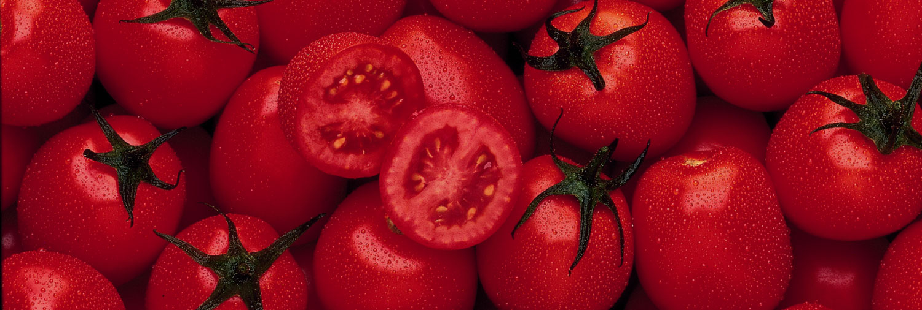
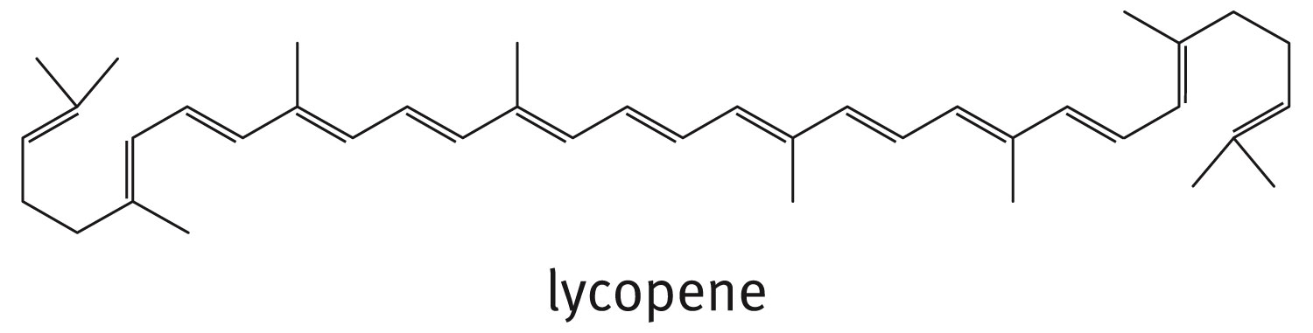
Chapter 3: Alkenes and Alkynes

Slide 2
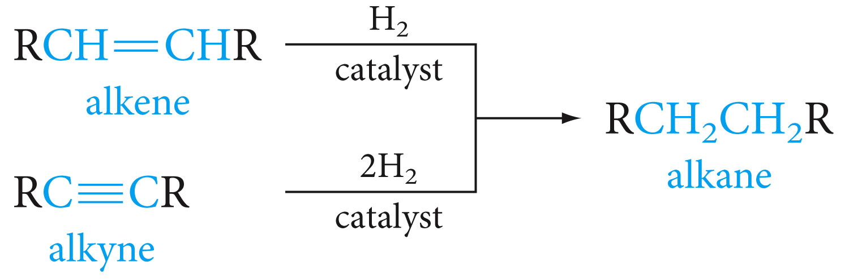
Hydrogenation of Alkenes and Alkynes
Hydrocarbons that have carbon-carbon double bond are called alkenes; those with a carbon-carbon triple bond are alkynes
Their general formulas are C_{n}H_{2n} alkenes and C_{n}H_{2n-2} alkynes
Both alkenes and alkynes are unsaturated hydrocarbons

Slide 3
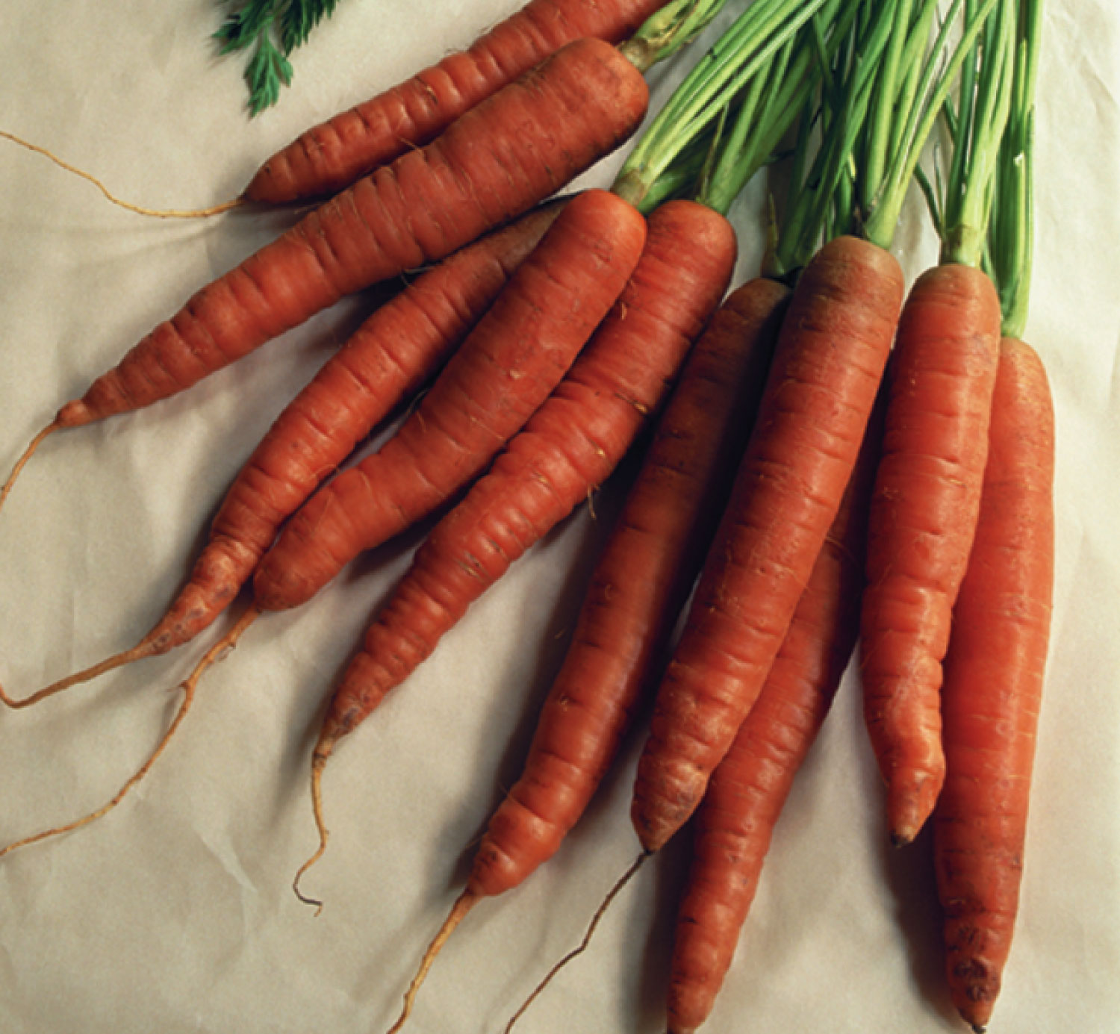
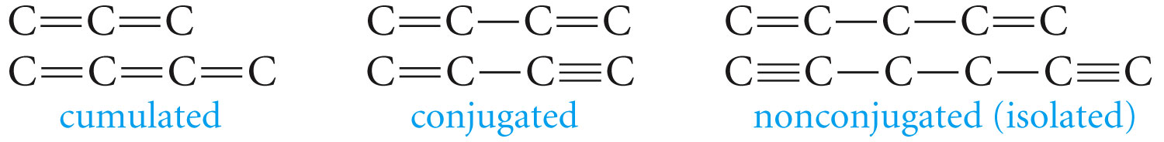
Compounds with more than one double or triple bonds exist. Multiple double bonds may lead to dienes, trienes, tetraenes and polyenes. β-carotene and lycopene are examples of polyenes
When two or more multiple bonds are present in a molecule, they can be classified depending on the relative positions of the bonds

Slide 4
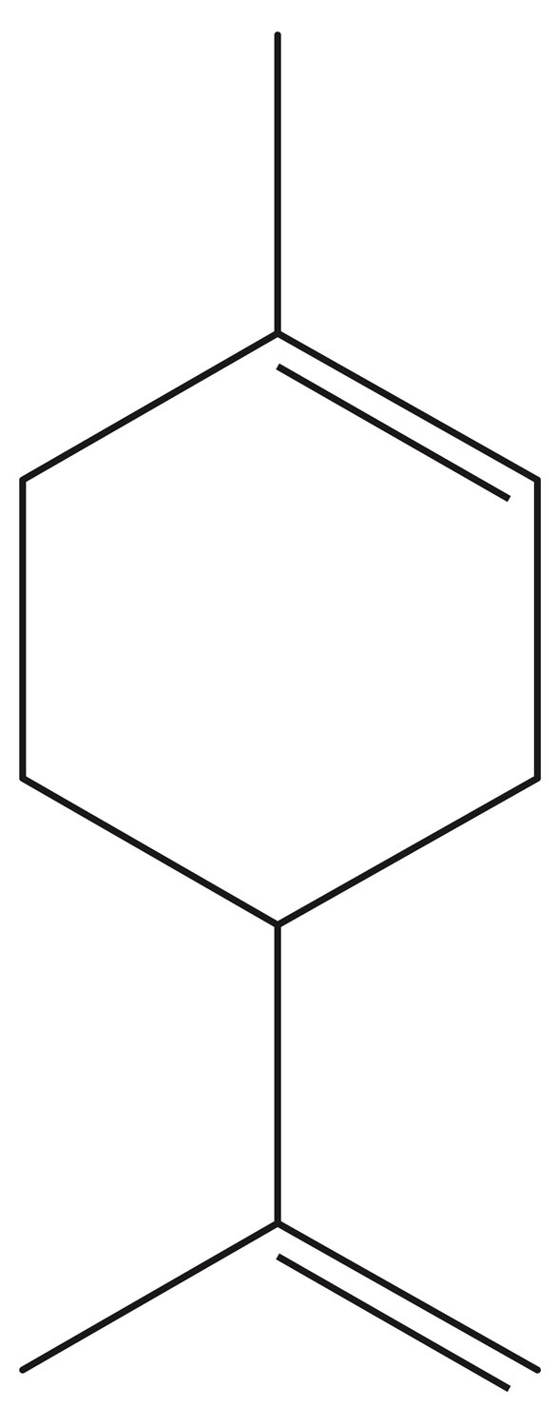
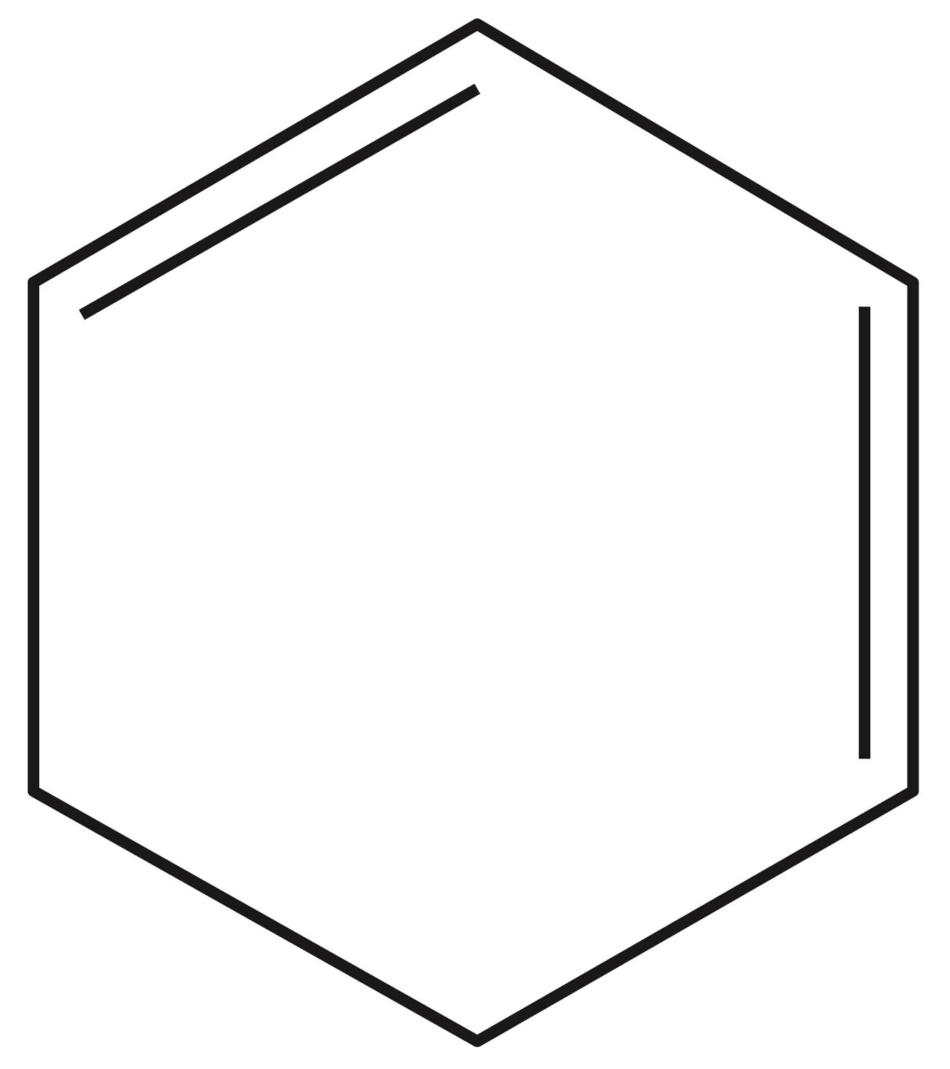
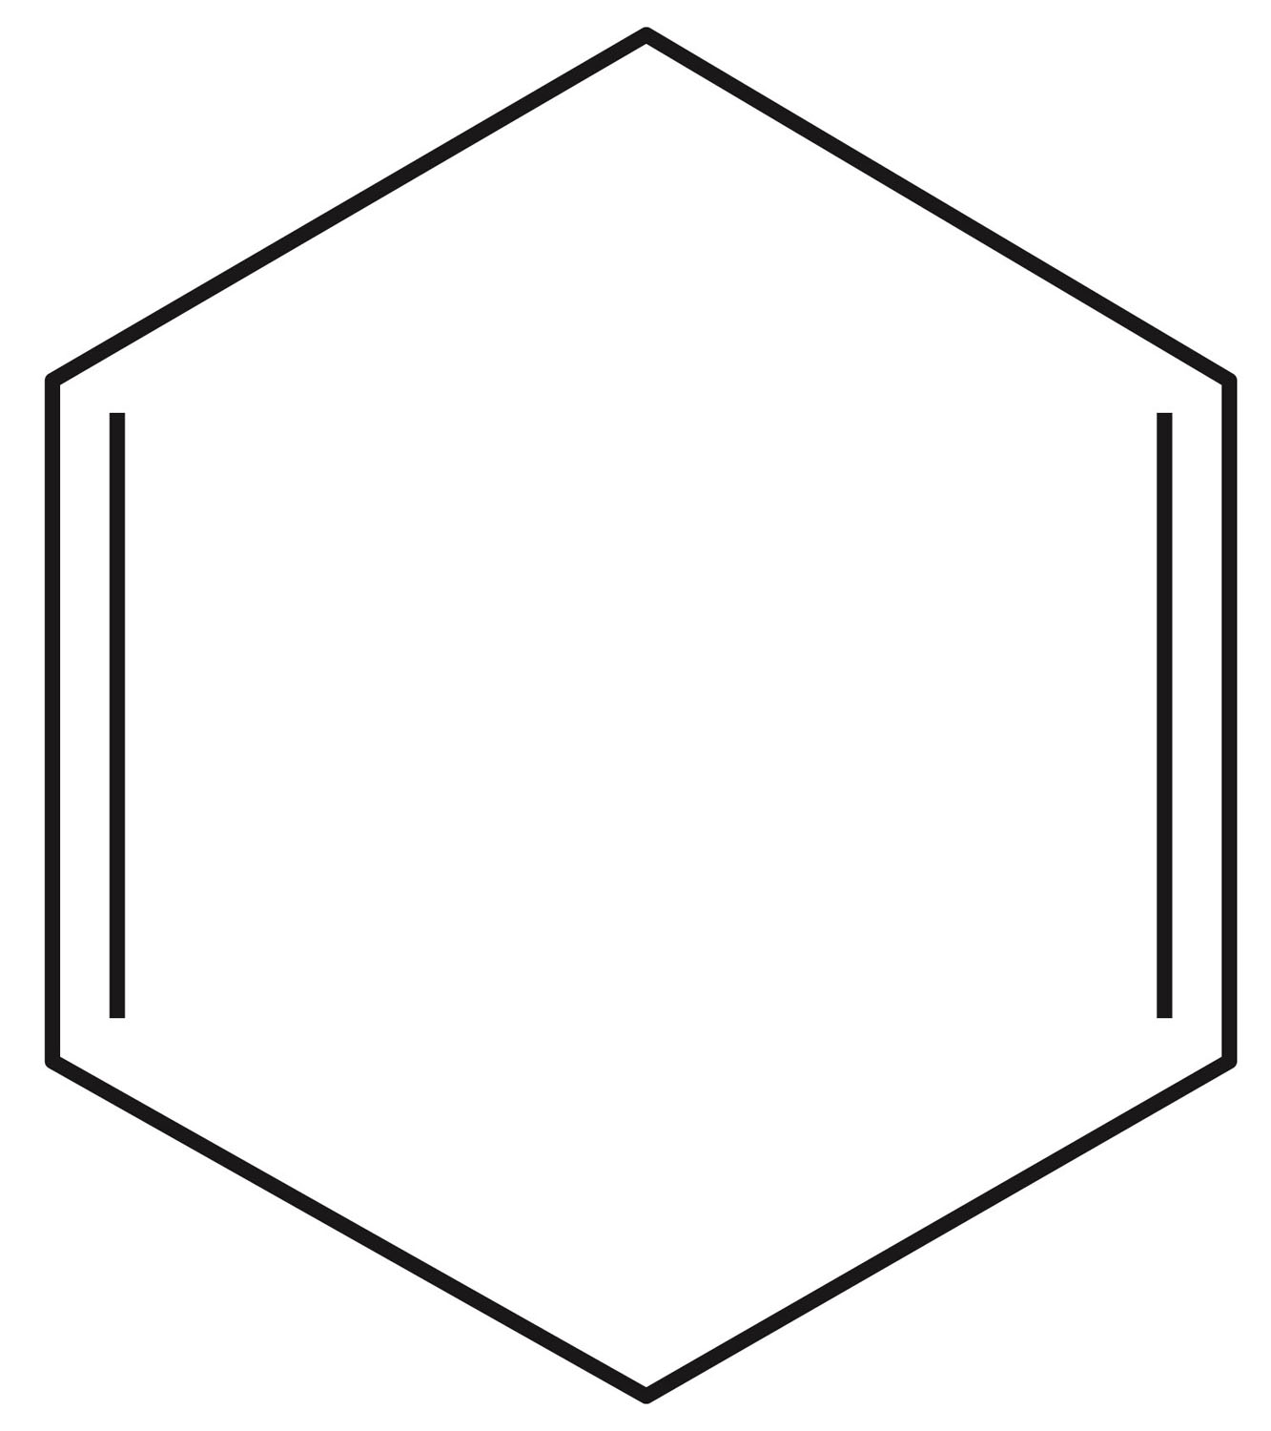
Clicker Question
Which of the following compounds have conjugated multiple bonds? (enter in order of numbers no comas)
1
3
4
2

Slide 5
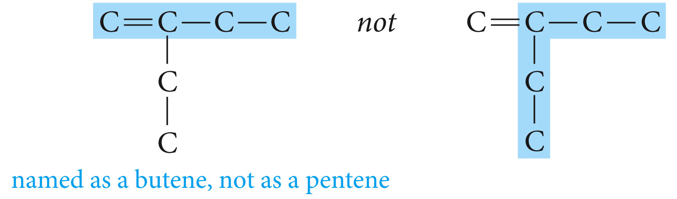
Nomenclature
The ending –ene is used to designate carbon-carbon double bond. When more than one double bond is present, the ending is –diene, triene, tetraene and so on. The ending –yne is used for triple carbon-carbon bond.
Select the longest chain that includes both carbons of the double bond or triple bond.

Slide 6
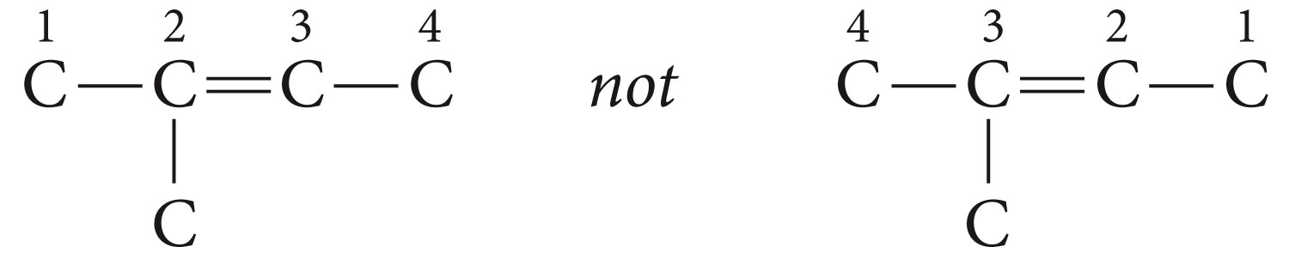
Number the chain from the end nearest the multiple bond so that the carbon atoms in that bond have the lowest possible numbers.
If the multiple bond is equidistant from both ends of the chain, number the chain from the end nearest the first branch point.

Slide 7
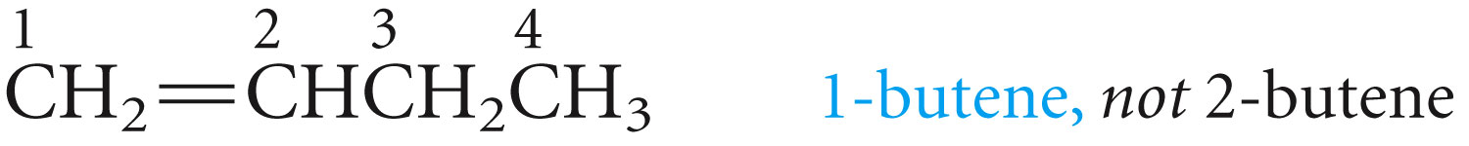
Indicate the position of the multiple bond using the lower numbered carbon atom of that bond.
If more than one multiple bond is present, number the chain from the end nearest the first multiple bond.

Slide 8
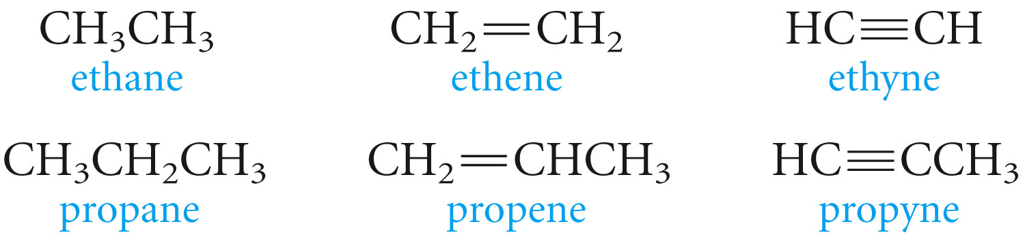
If the double bond and the triple bond are equidistant from the end of the chain, the double bond receives the lowest number.
The root name is from the longest carbon chain containing the multiple bond

Slide 9
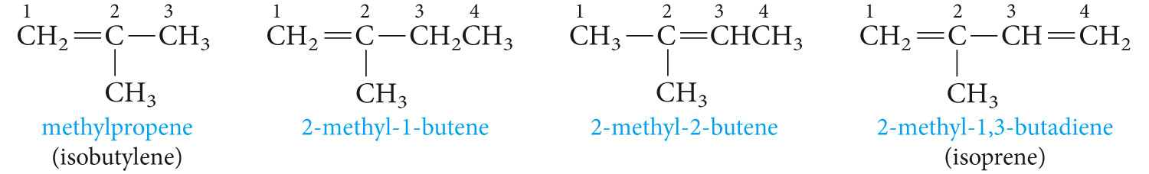

Slide 10
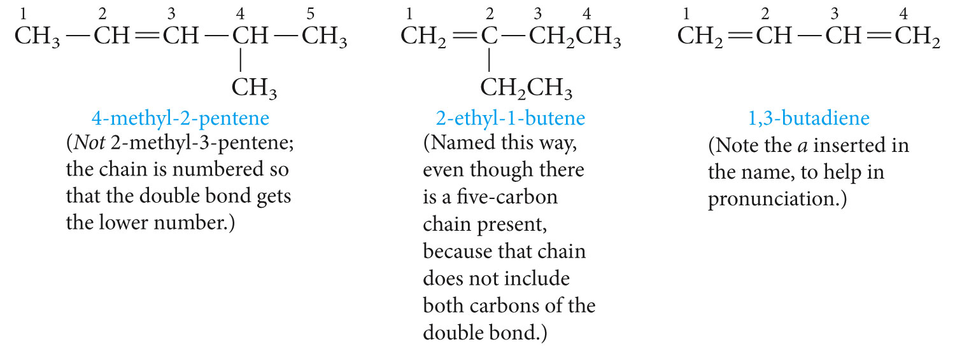
The numbering rules applied

Slide 11
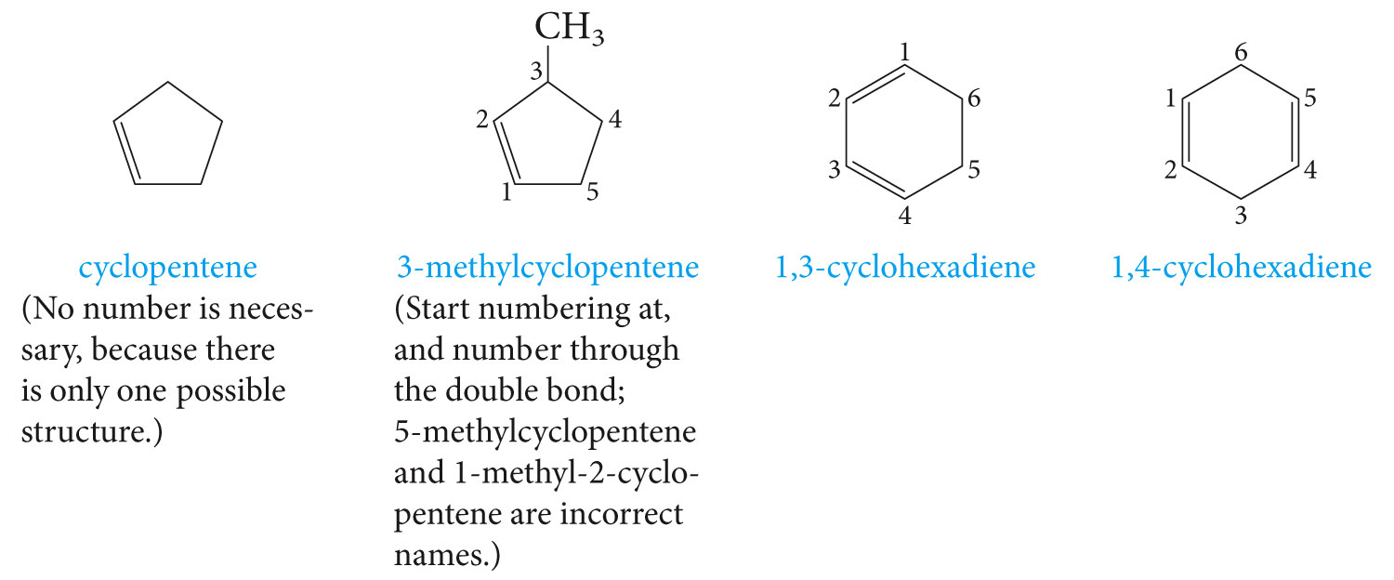
With the cyclic hydrocarbons, we start numbering the ring with the carbons of the multiple bond.

Slide 12
Write the structural formula for
3-methyl-2-pentene
1,4-dichloro-2-pentene
3-hexyne
1,2-dimethylcyclobutene
2-bromo-1,3-pentadiene

Slide 13
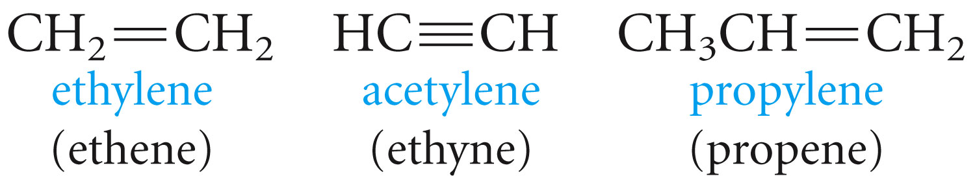
Some Common names

Slide 14
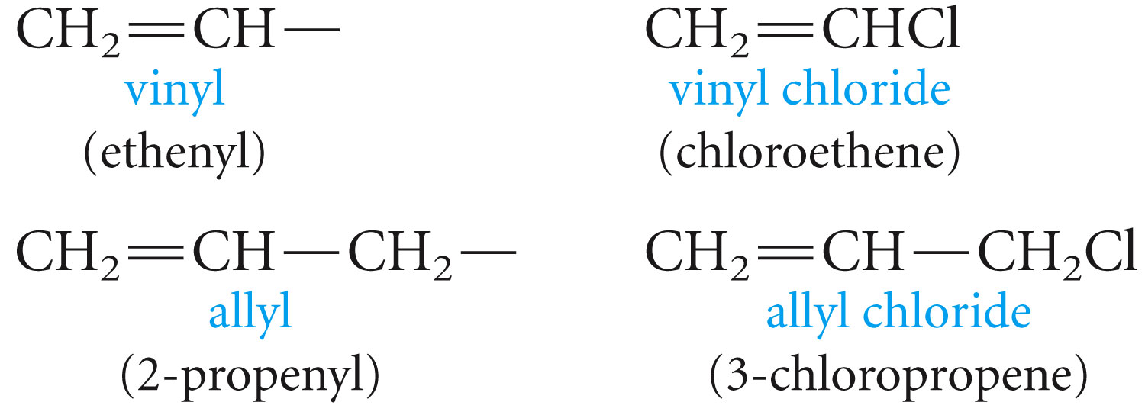

Slide 15
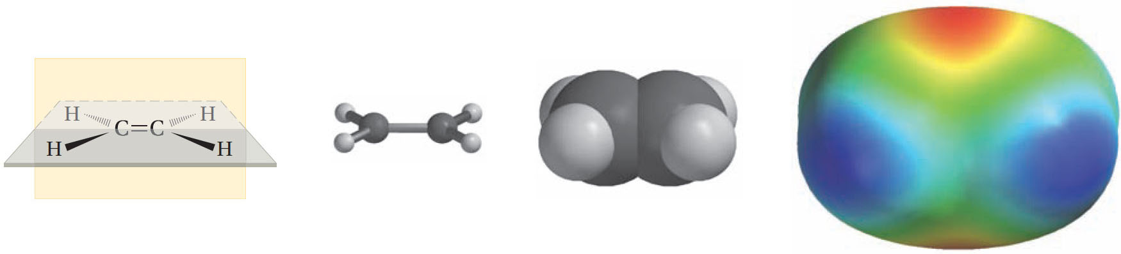
Some Facts about Double Bonds

Slide 16
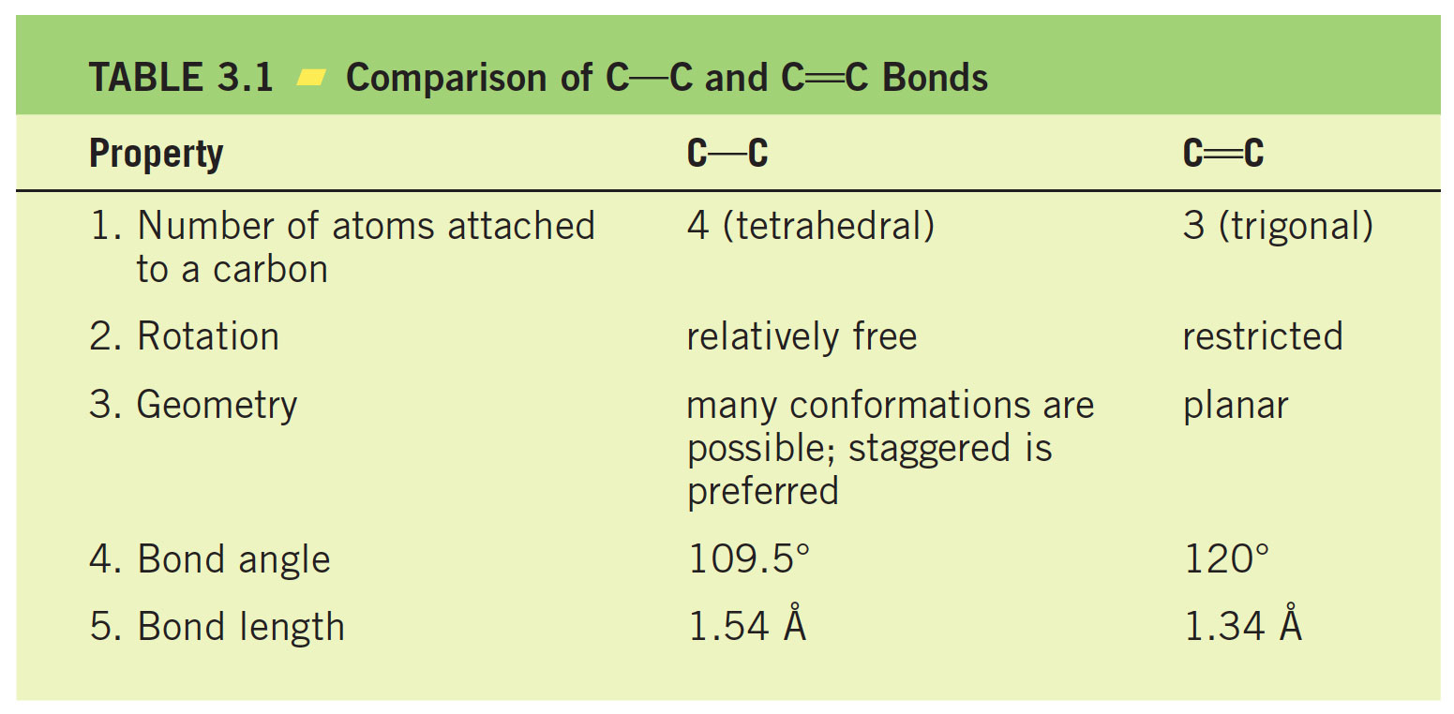

Slide 17
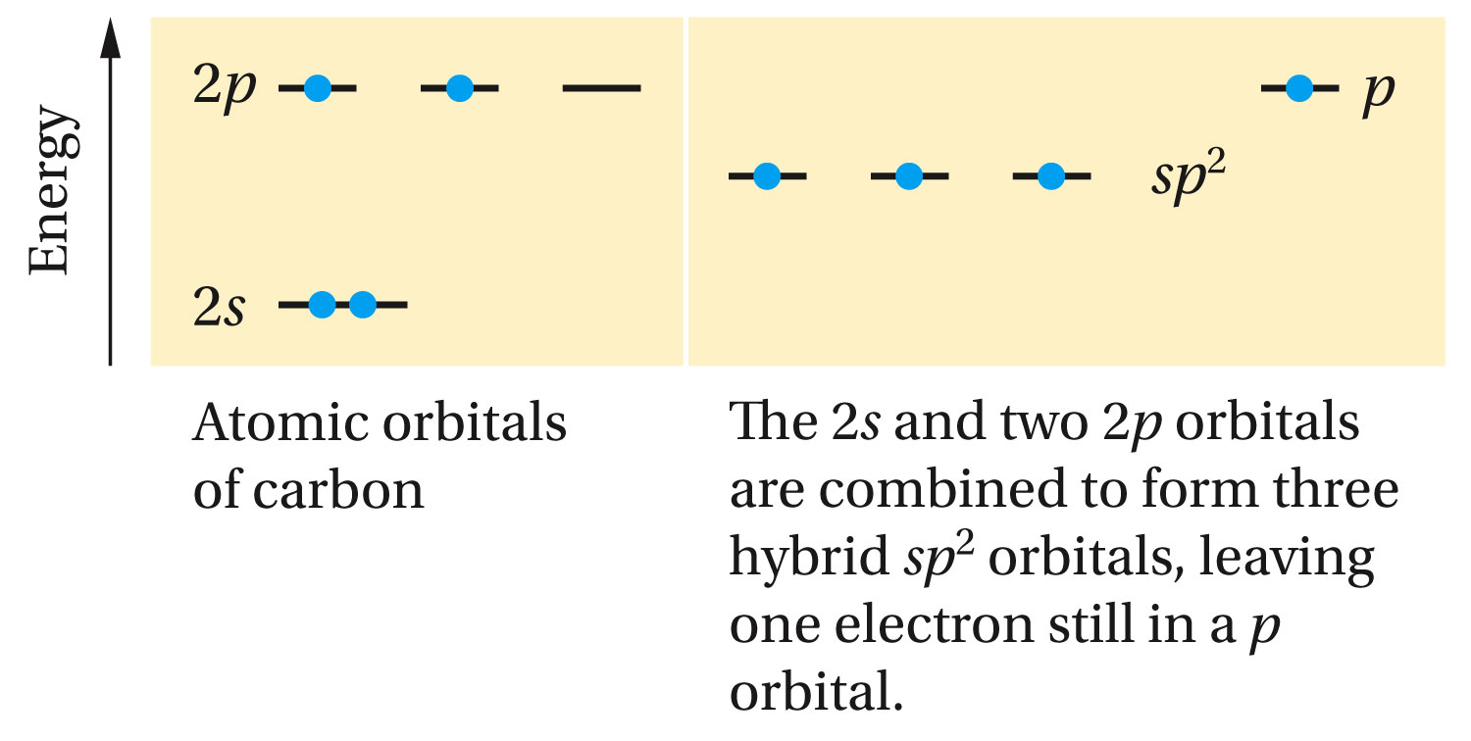
The Orbital Model of a Double Bond; the pi Bond

Slide 18
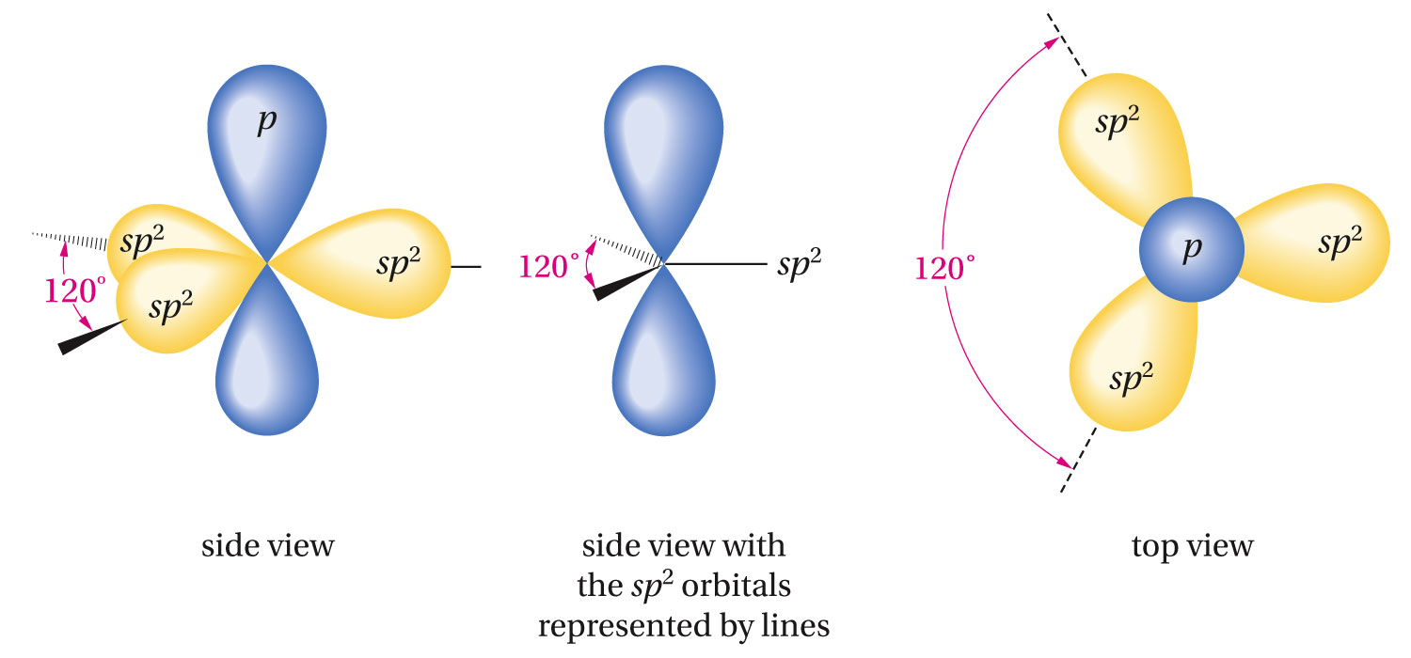

Slide 19
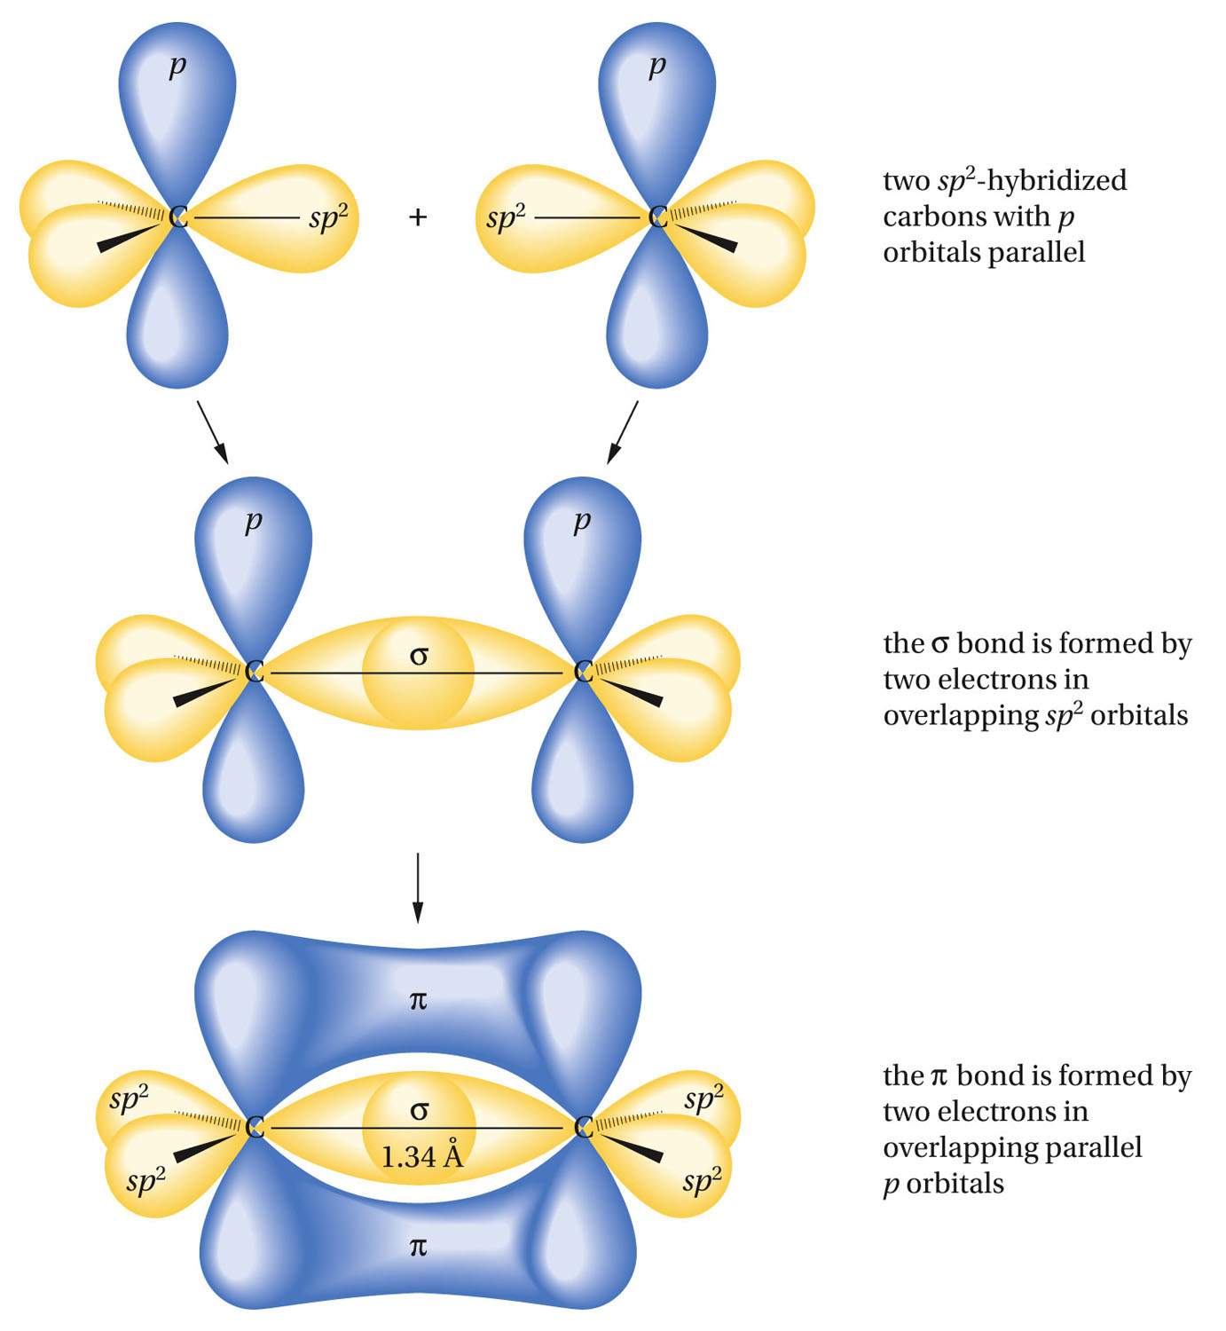

Slide 20
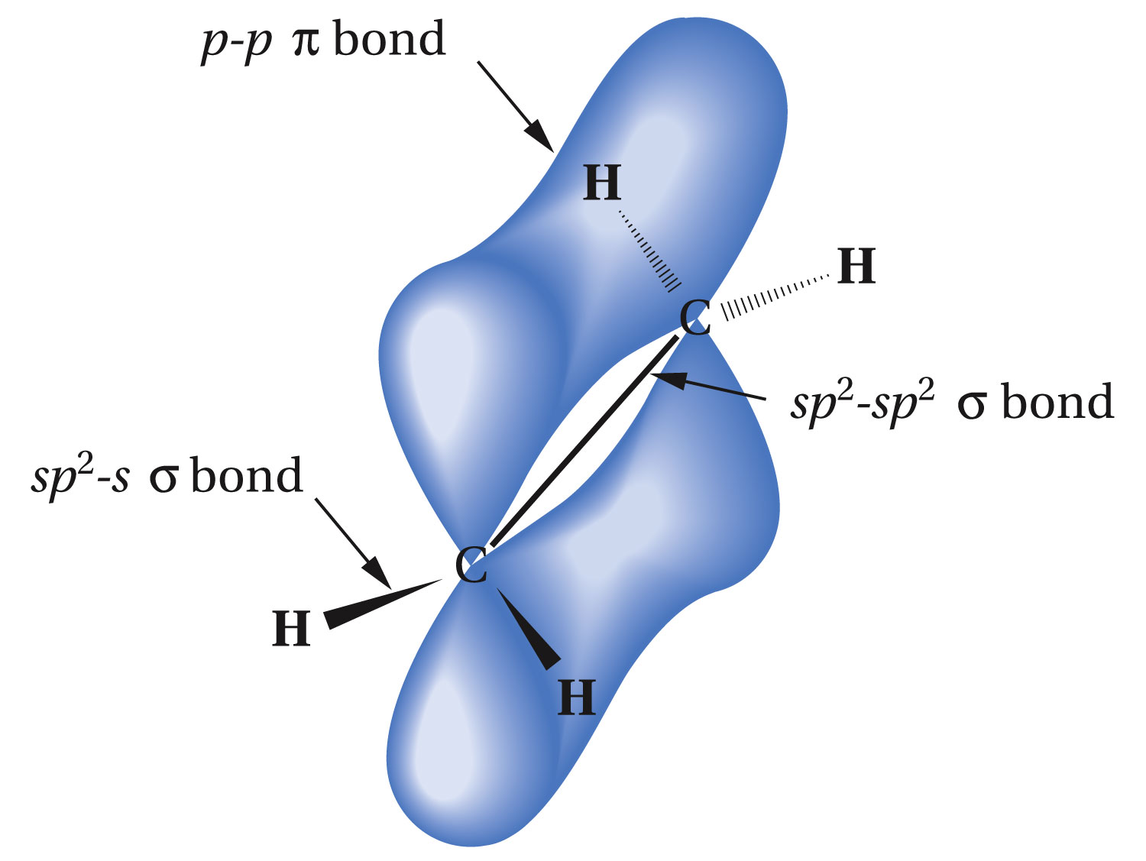

Slide 21
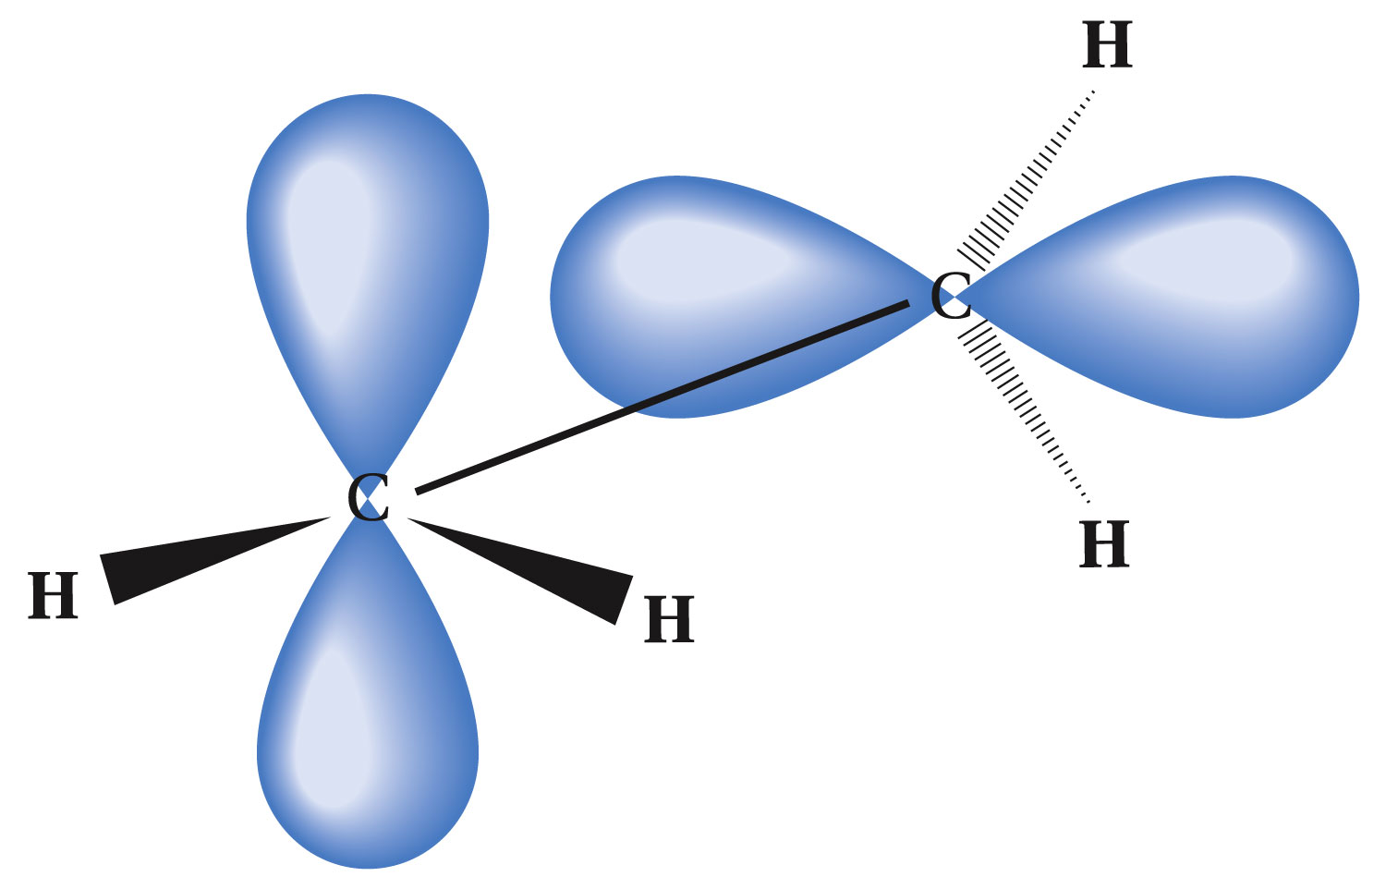

Slide 22
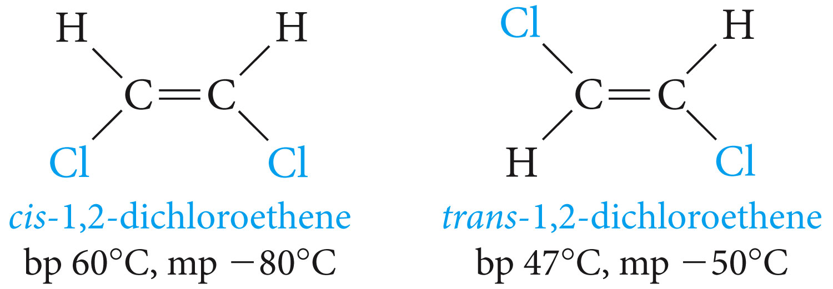
Cis-Trans Isomerism in Alkenes

Slide 23
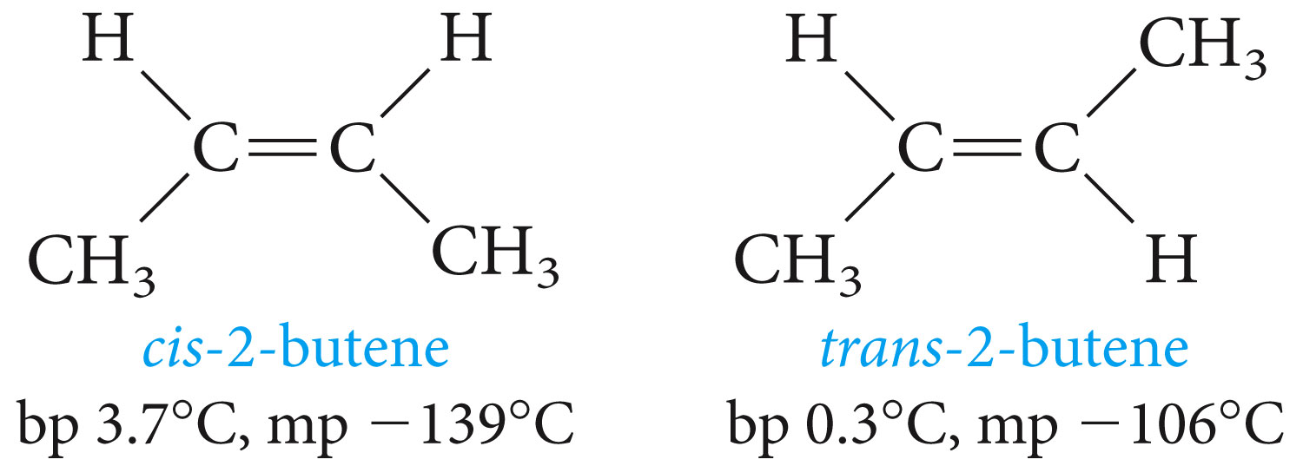
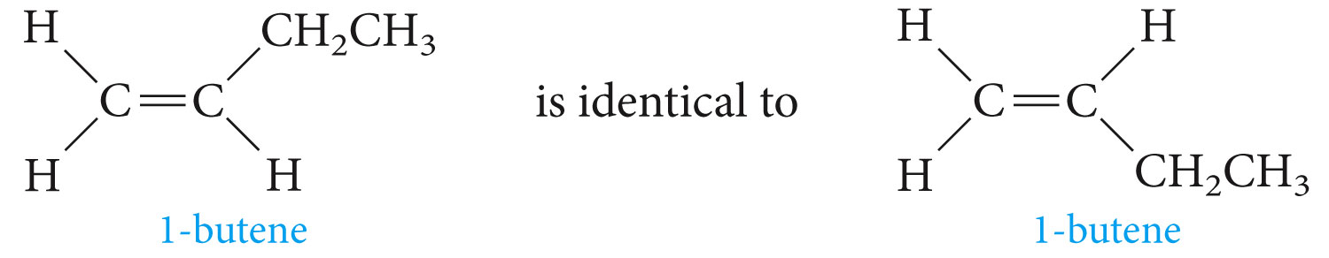
Are cis-trans isomers possible for 1-butene and 2-butene?

Slide 24
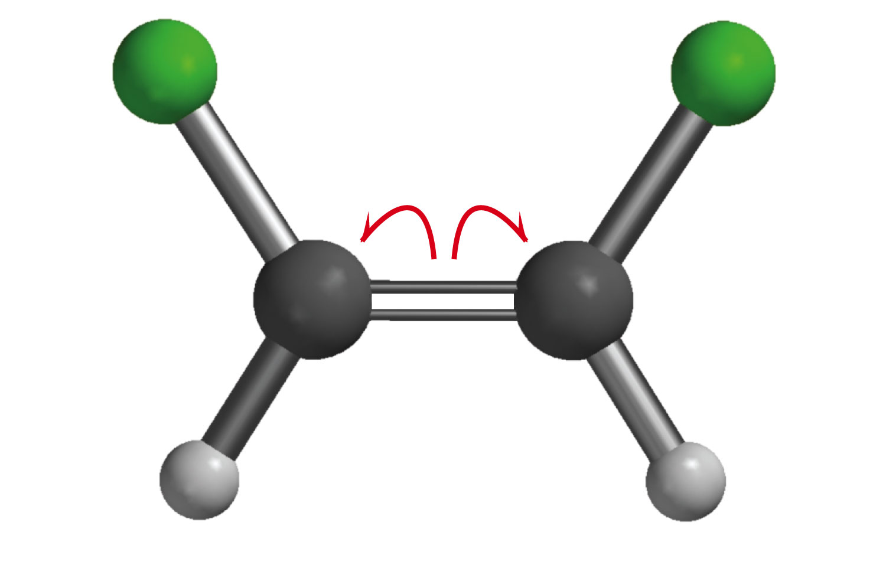
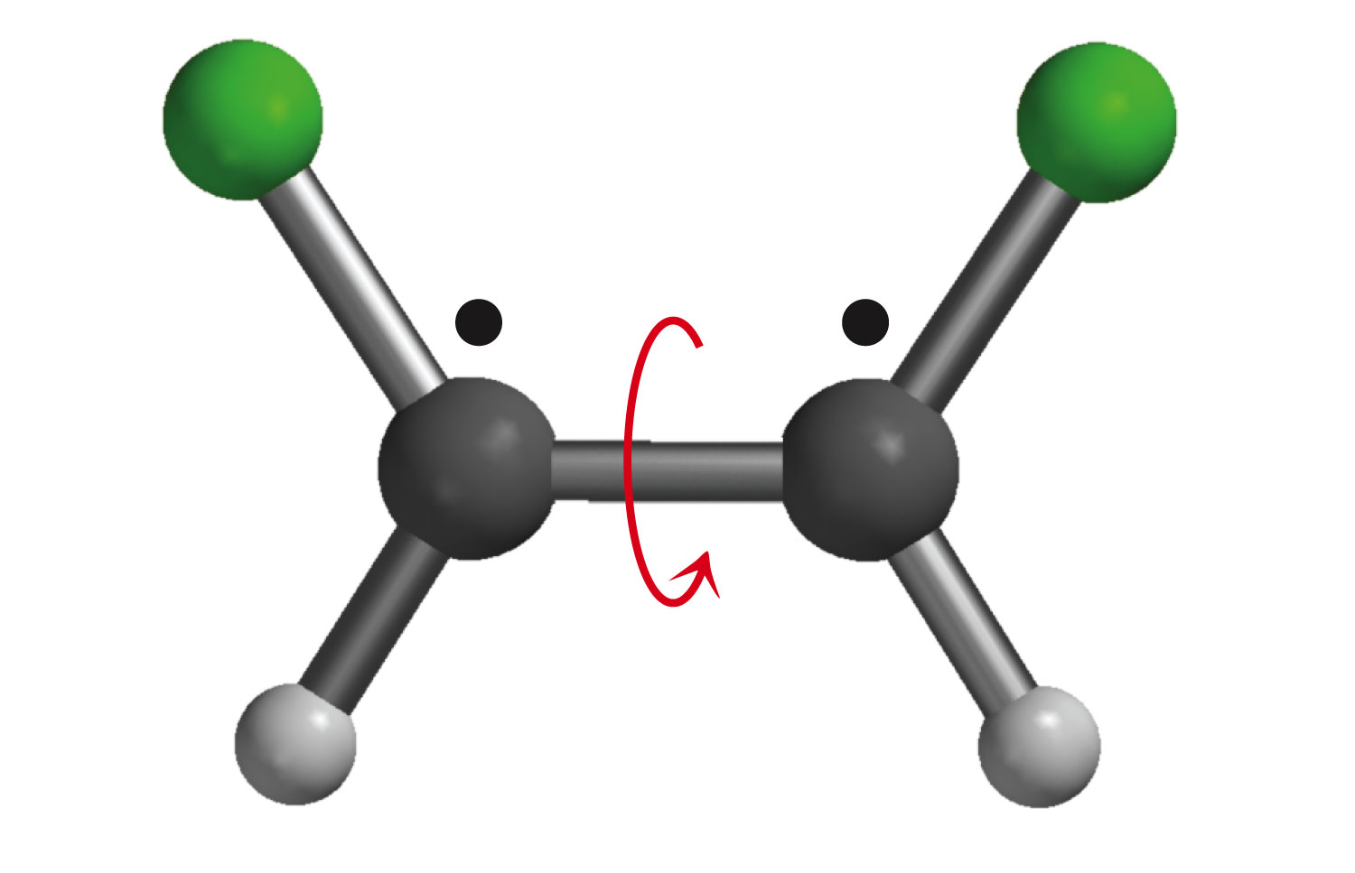
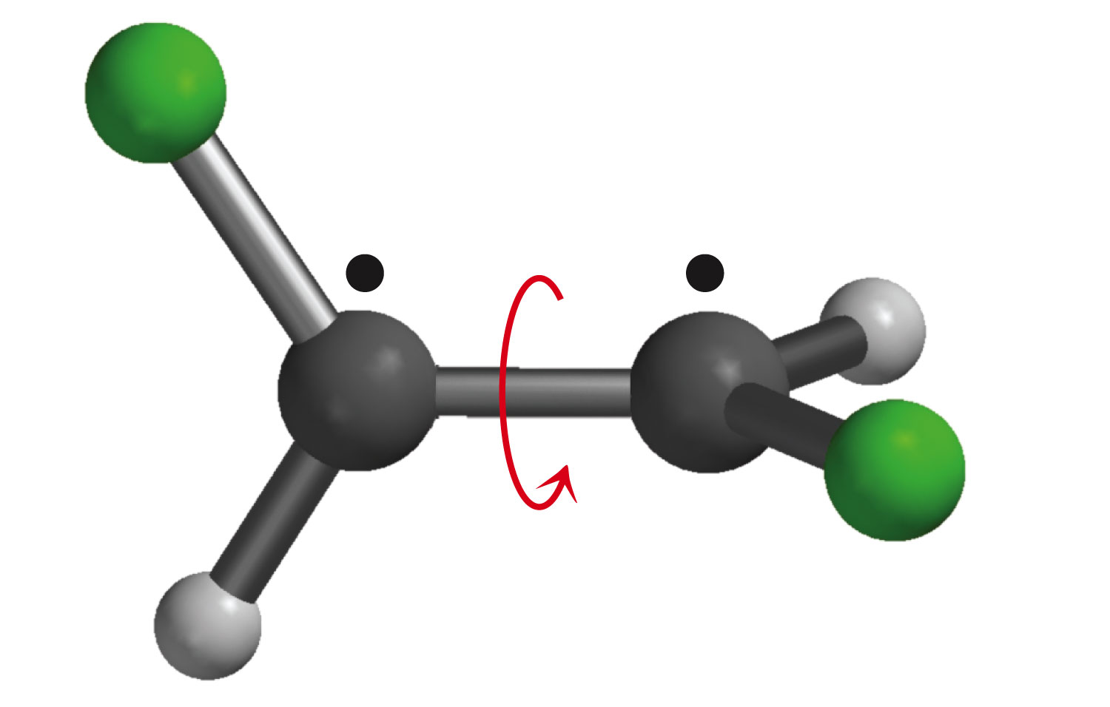
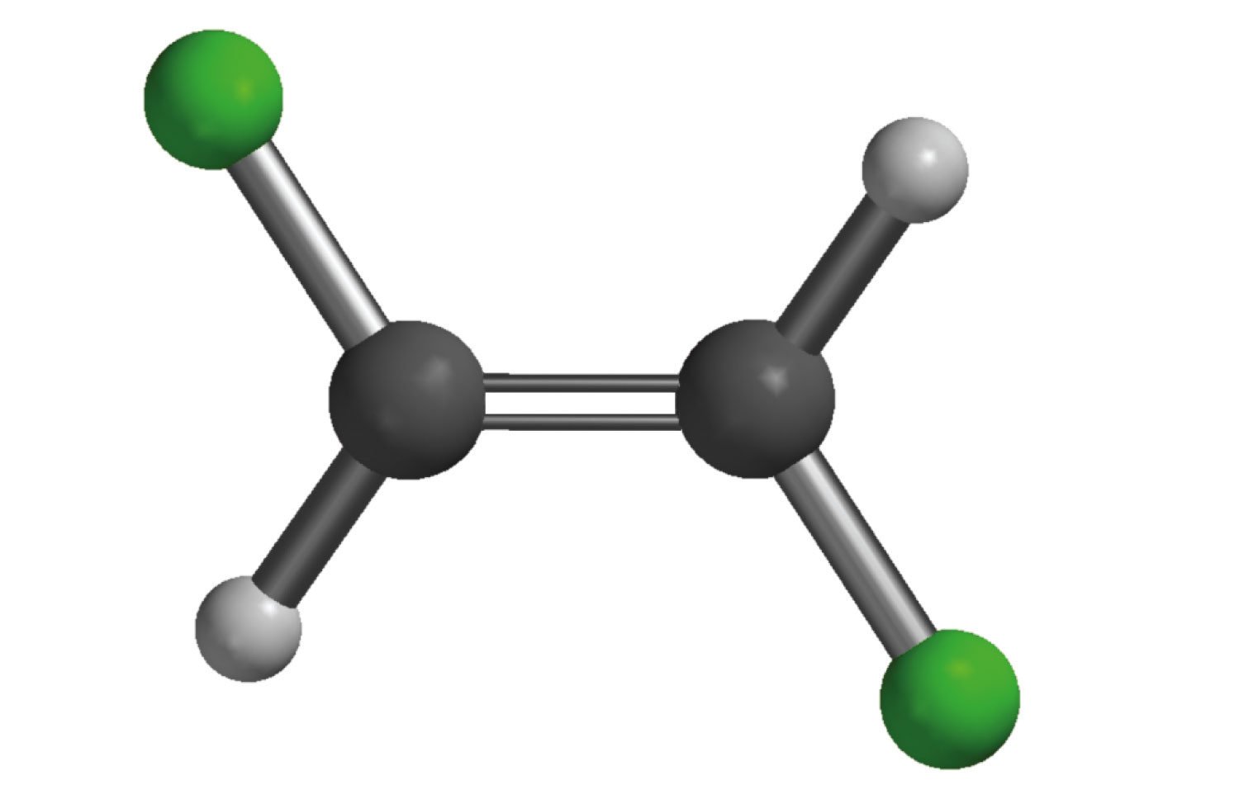
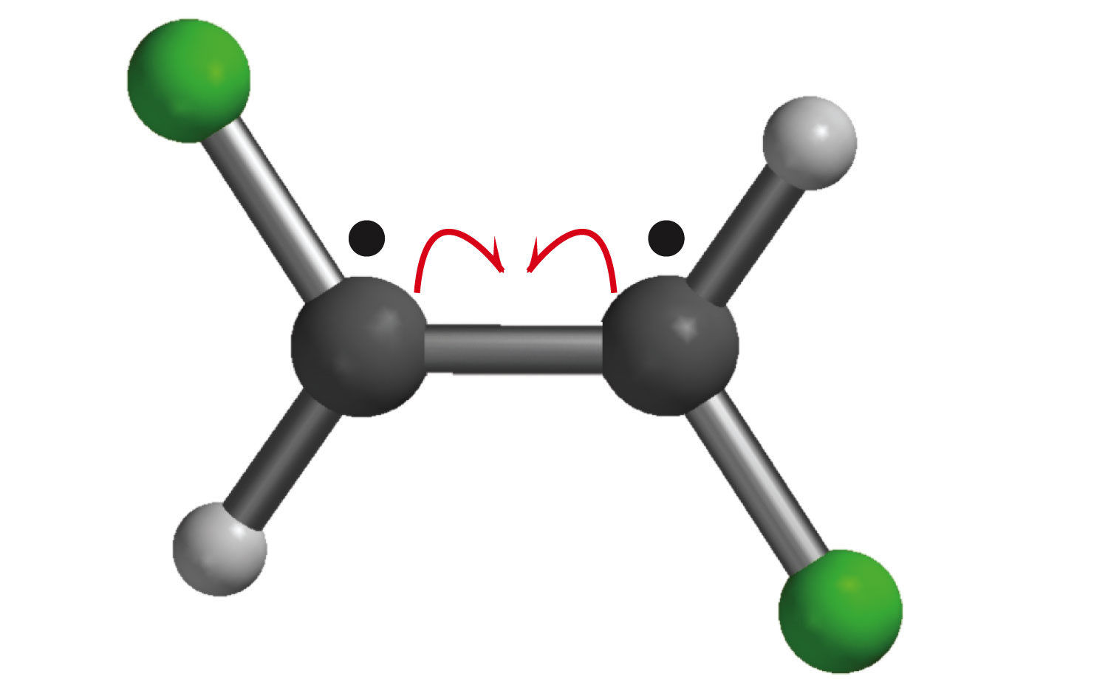
Geometric isomers of alkenes can be interconverted if sufficient energy is supplied to break the pi bond and allow rotation about the remaining sigma bond.

Slide 25
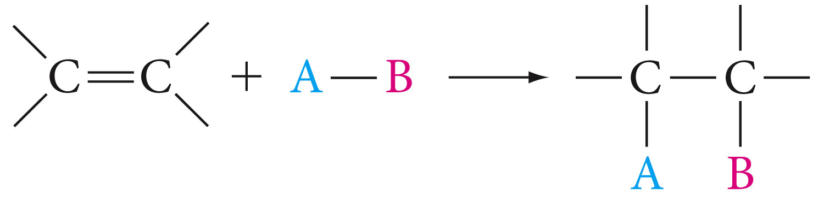
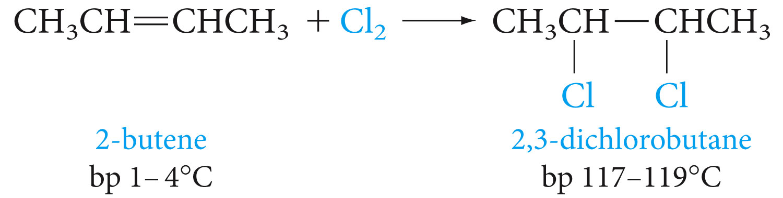
Addition Reactions
Addition of halogens X₂

Slide 26
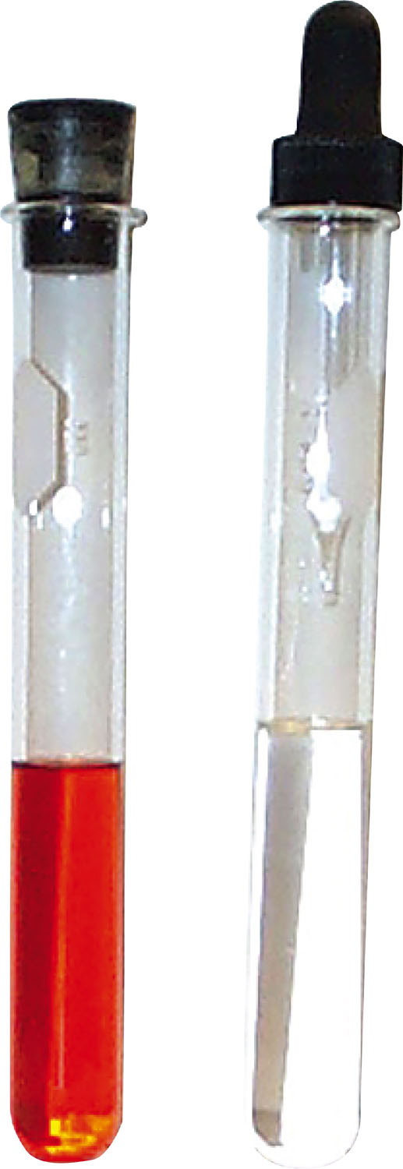

Slide 27
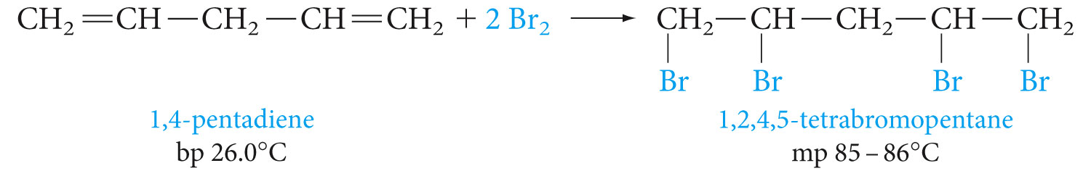
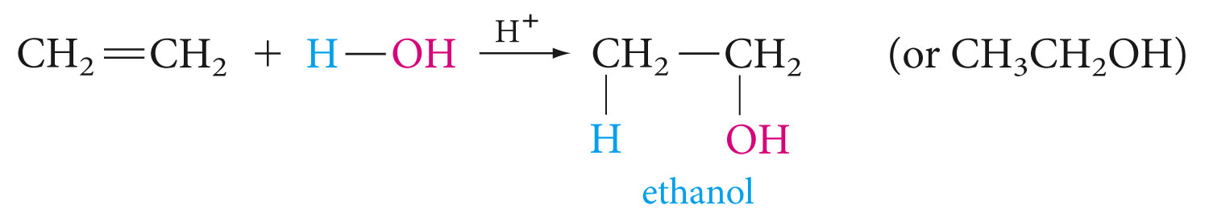
Addition of Water (Hydration)

Slide 28
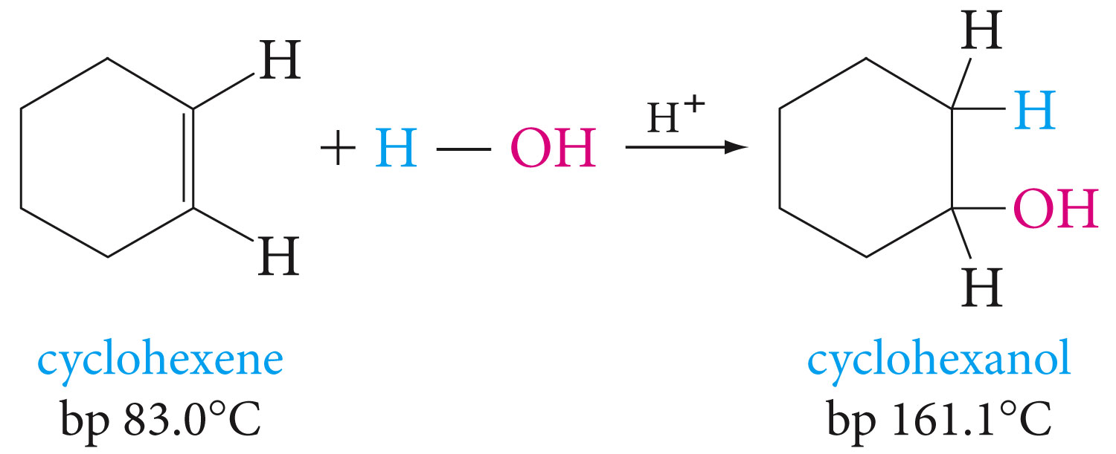

Slide 29
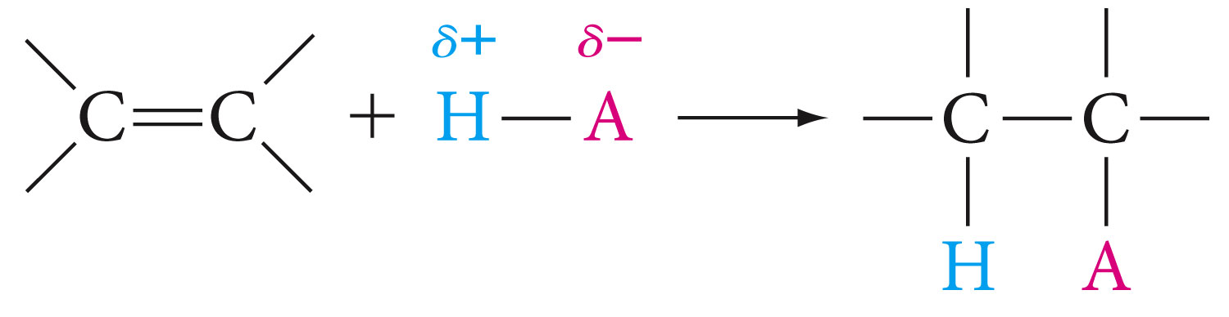
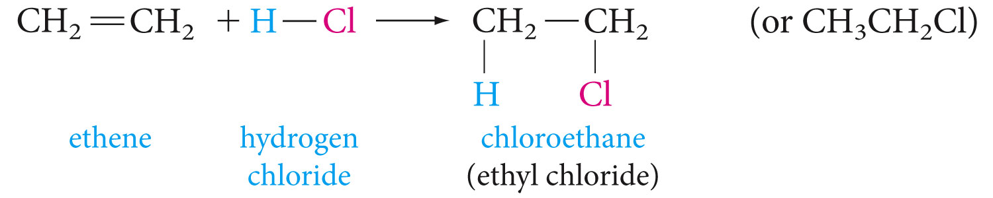
Addition of Acids
Acids that add this way are the hydrogen halides (H-F, H-Cl, H-Br, H-I) and sulfuric acid (H-OSO₃H)

Slide 30
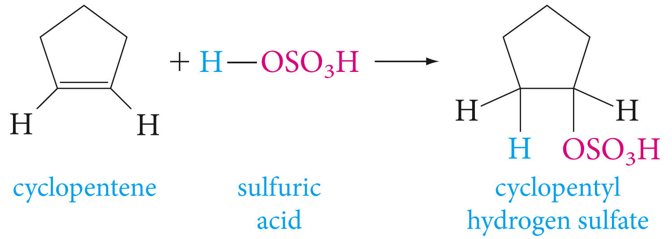
Write the equation for each of the following reactions
2-butene + HCl
3-Hexene + HI
4-methylcyclopentene + HBr

Slide 31
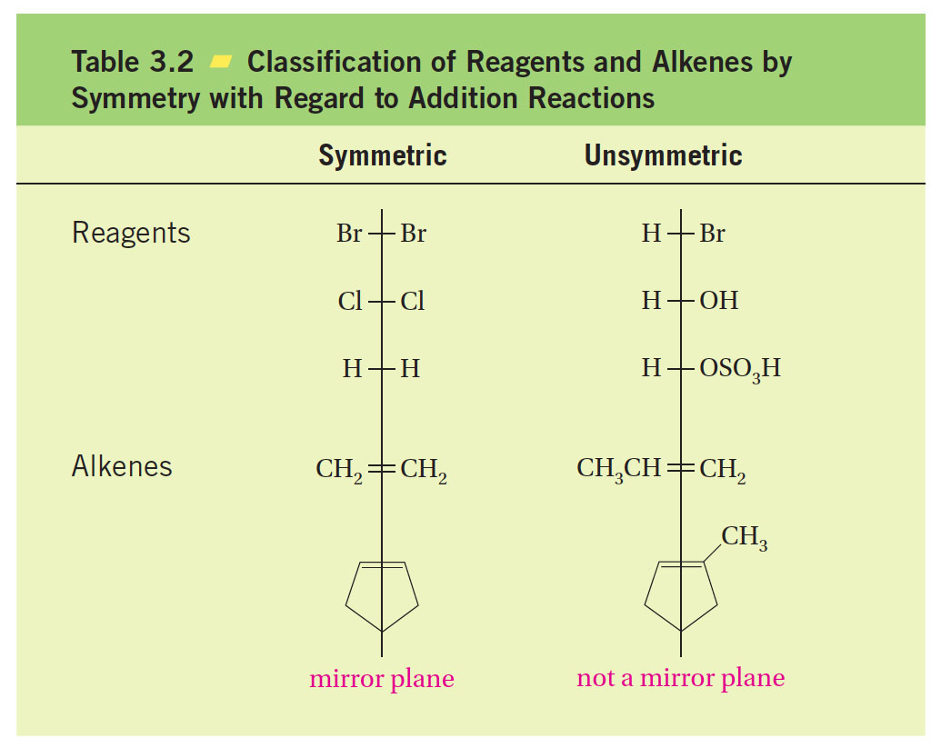

Slide 32
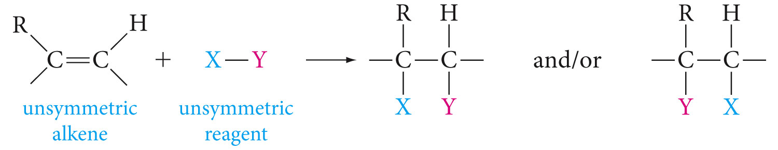
Addition of Unsymmetric Reagents to Unsymmetric Alkenes; Markovnikov’s Rule

Slide 33
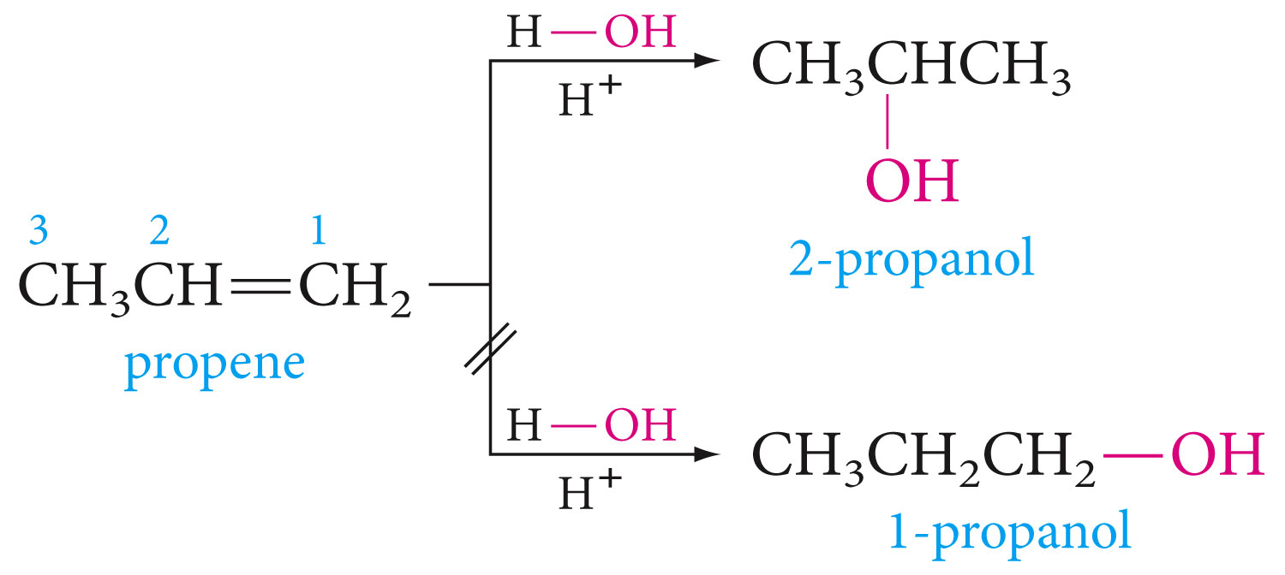

Slide 34
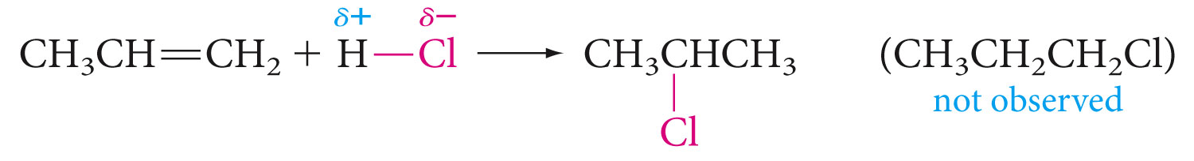
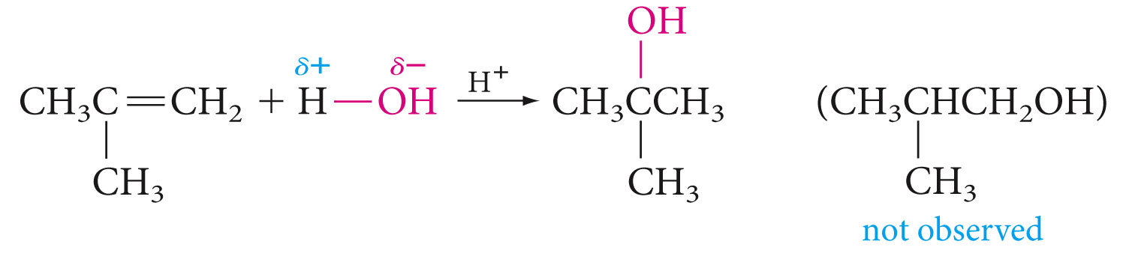

Slide 35
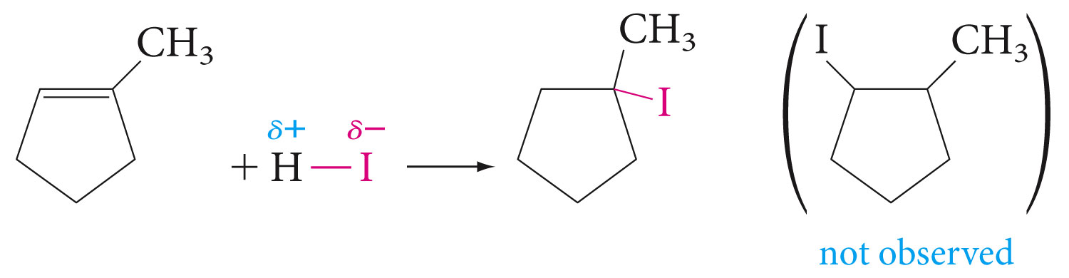

Slide 36
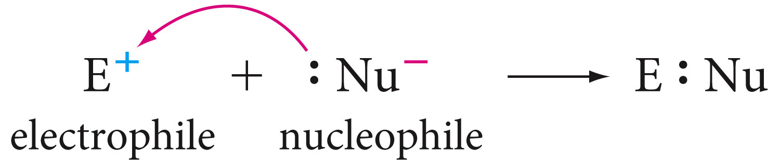
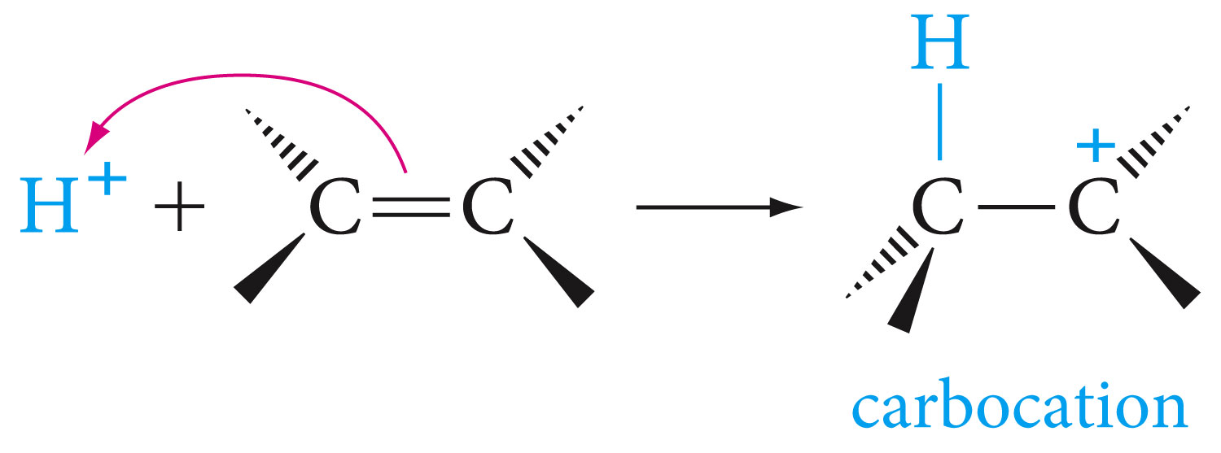
Mechanism of Electrophilic Addition to Alkenes

Slide 37
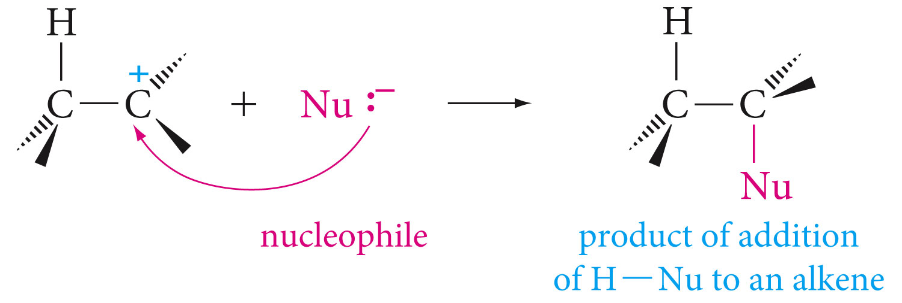

Slide 38


Slide 39

Markovnokov’s Rule Explained

Slide 40


Slide 41
Clicker Question
Classify the following carbocation and primary (1) secondary (2)
or tertiary (3)

Slide 42


Slide 43

Reaction Equilibrium

Slide 44


Slide 45


Slide 46


Slide 47


Hydroboration of Alkenes

Slide 48


Slide 49



Slide 50


Slide 51


Slide 52


Slide 53

What alkene is needed to obtain the alcohol below via hydroboration-oxidation sequence, what product would this alkene give with acid-catalyzed hydration.

Slide 54

Addition of Hydrogen

Slide 55


Slide 56

Addition to Conjugated Systems

Slide 58


Slide 59



Slide 60


Slide 61

Cycloaddition to Conjugated Dienes: Diels-Alder Reaction

Slide 62


Slide 63


Slide 64


Slide 65


Slide 66


Slide 67


Free-Radical Additions; Polyethene

Slide 68


Slide 69



Slide 70



Slide 71


Oxidation with permanganate; a Chemical Test

Slide 72

Ozonolysis of Alkenes

Slide 73


Slide 74


Slide 75

Other Alkene Oxidations

Slide 76


Slide 77


Slide 78


Slide 79


Slide 80


Slide 81


Slide 82


Slide 83



Slide 84



Slide 85


Slide 86


REACTIONS SUMMARY

Slide 87


Slide 88



Slide 89



Slide 90



Slide 91



Slide 92



Slide 93


Slide 94



Slide 95



Slide 96


