Slide 1
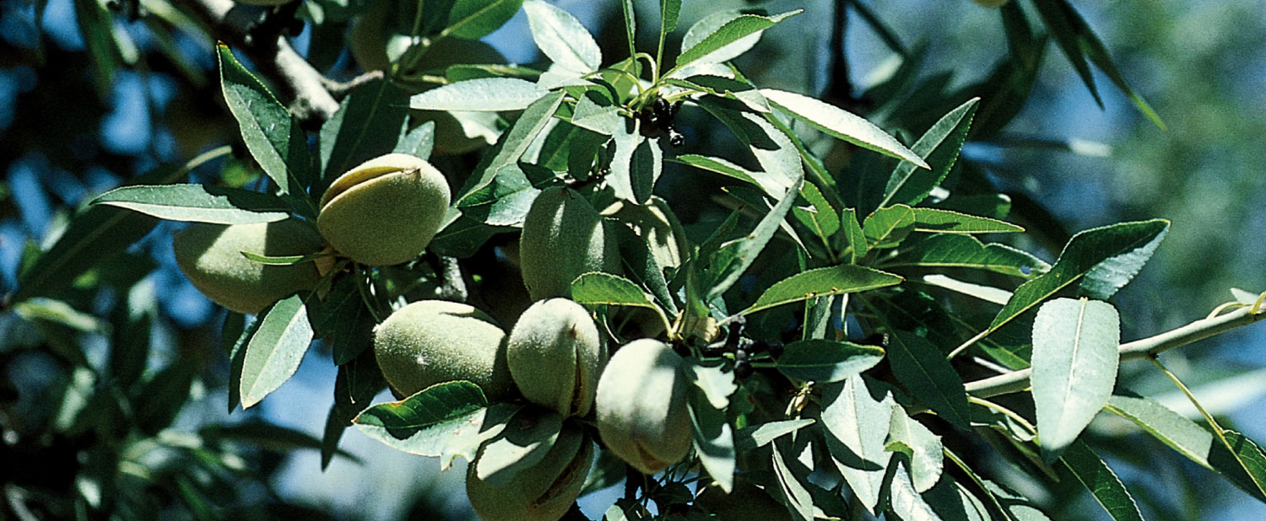
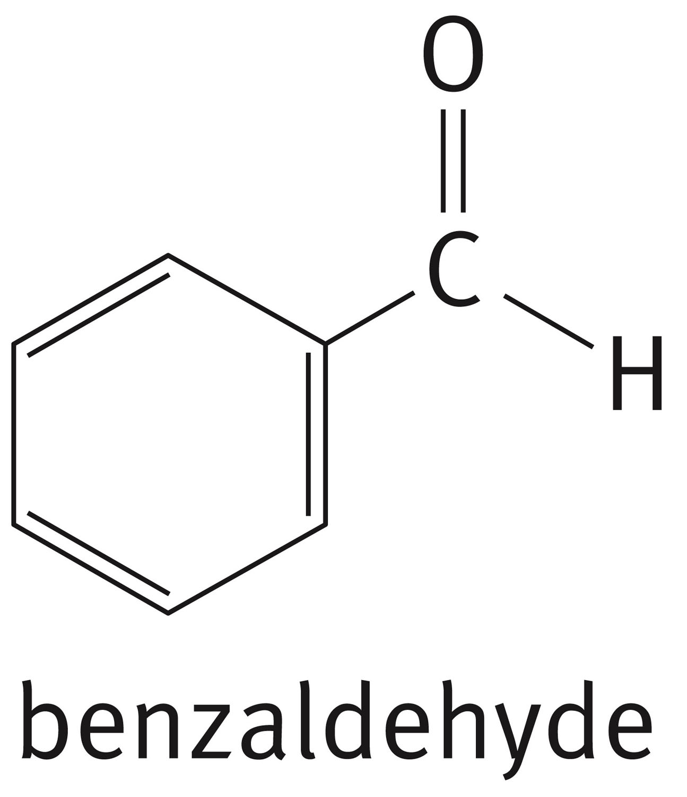
Chapter 4: Aromatic Compounds
Bitter almonds are the source of the aromatic compound benzaldehyde

Slide 2
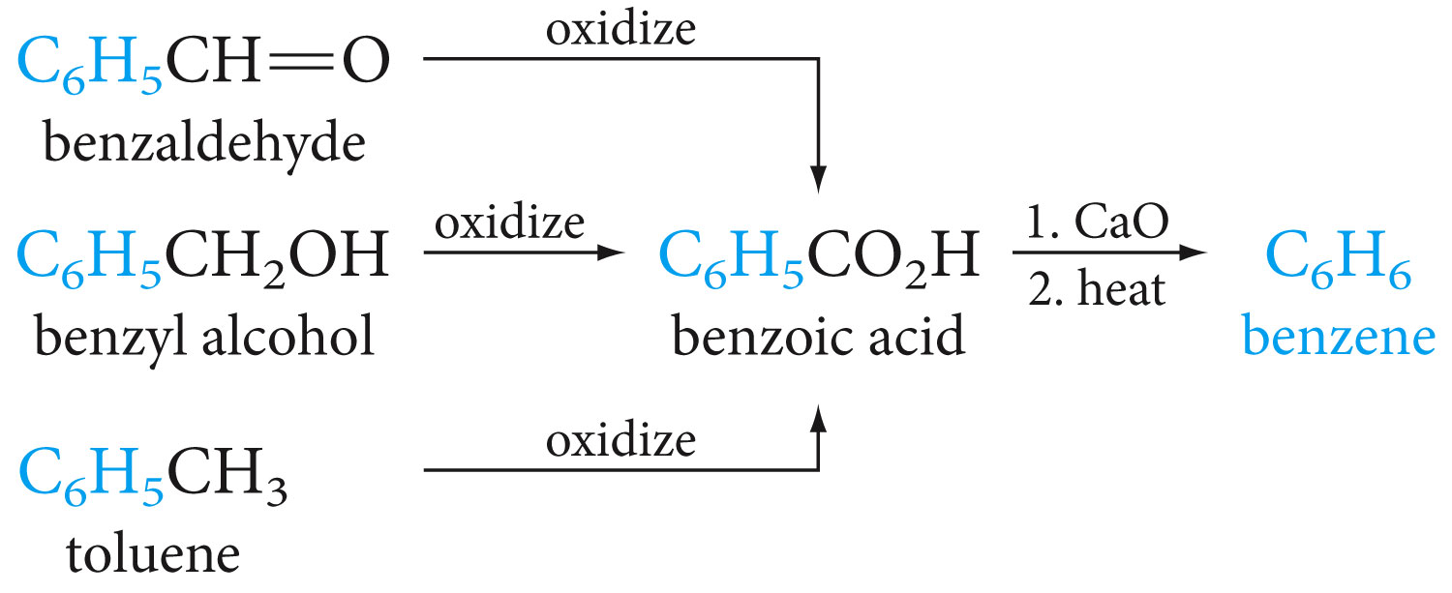
Sources of Benzene

Slide 3
Some Facts About Benzene
Reacts mainly by substitution

Slide 4
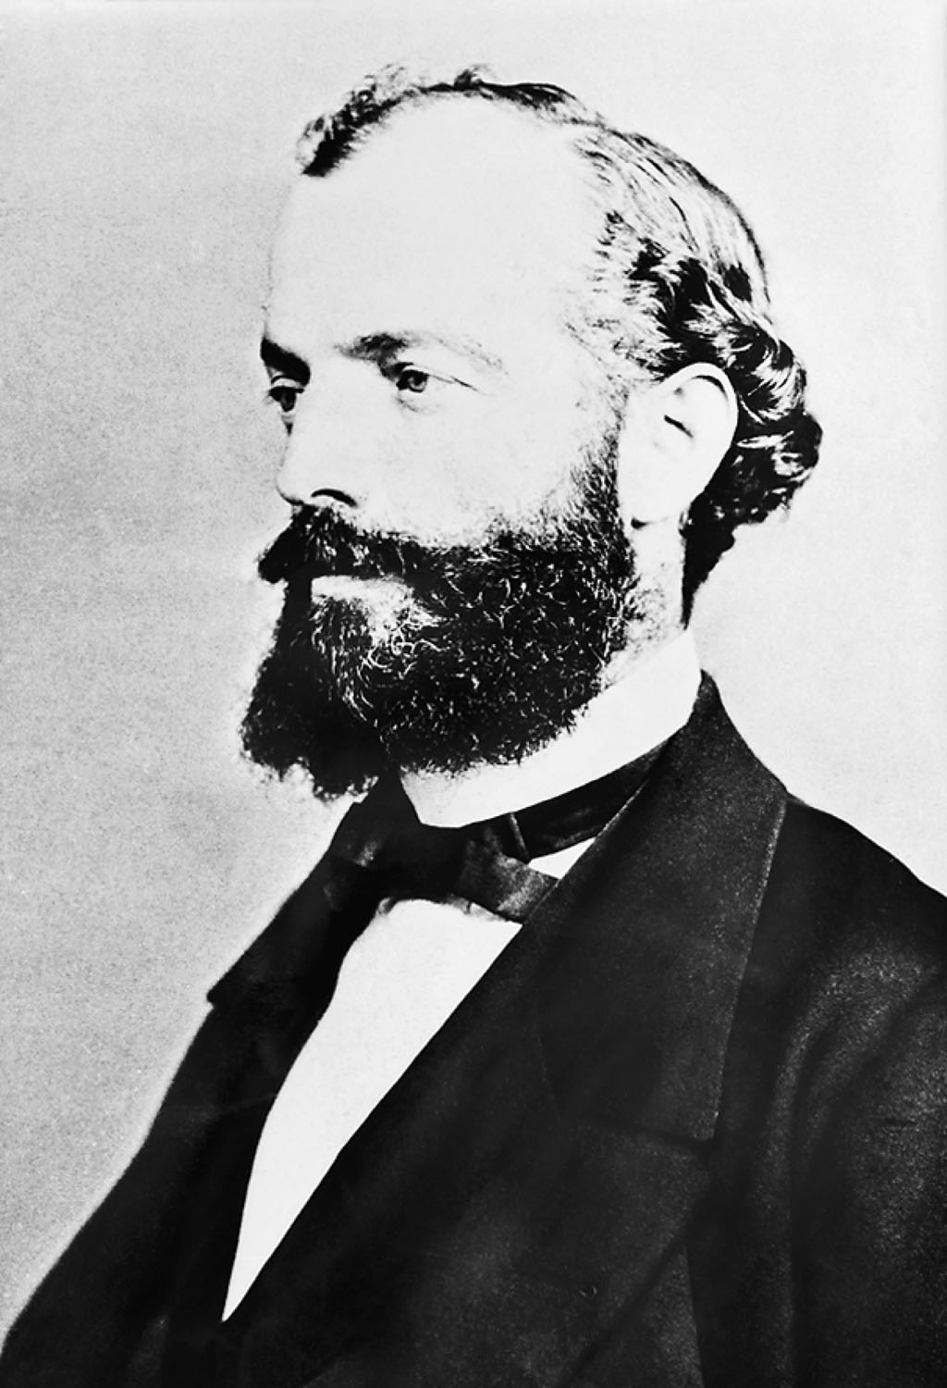
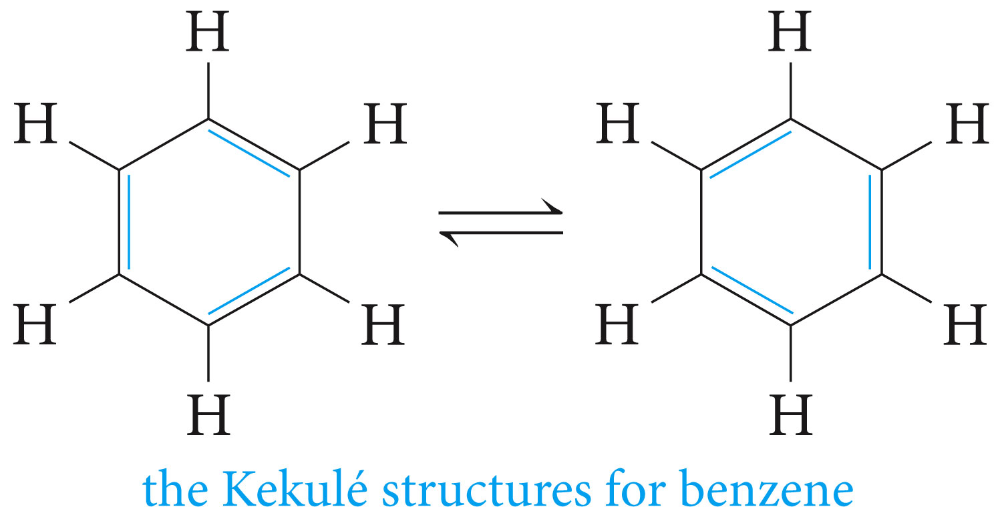
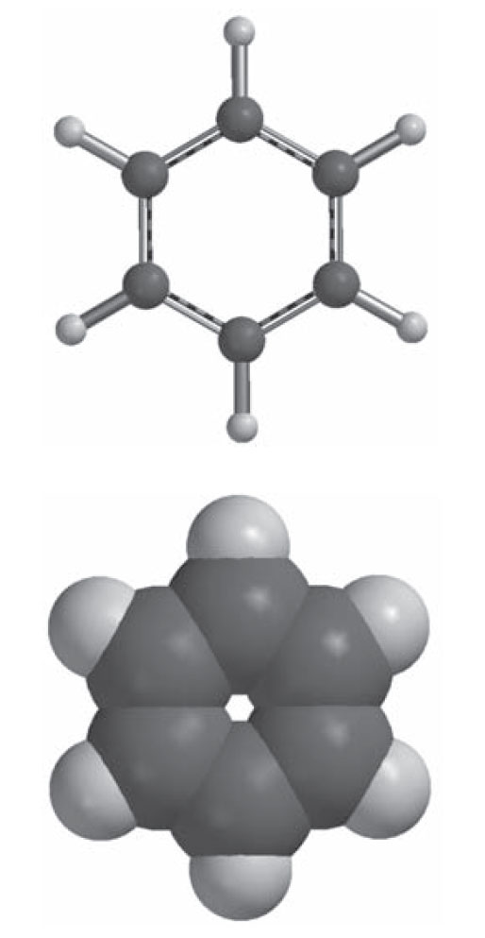
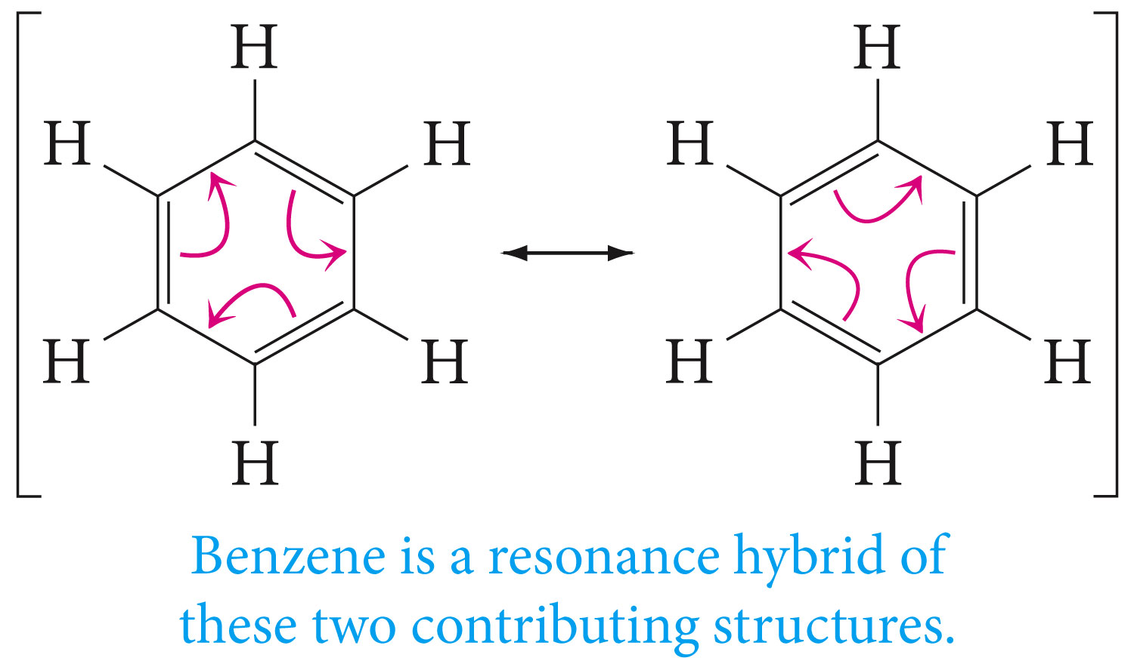
Friedrich August Kekule’

Slide 5
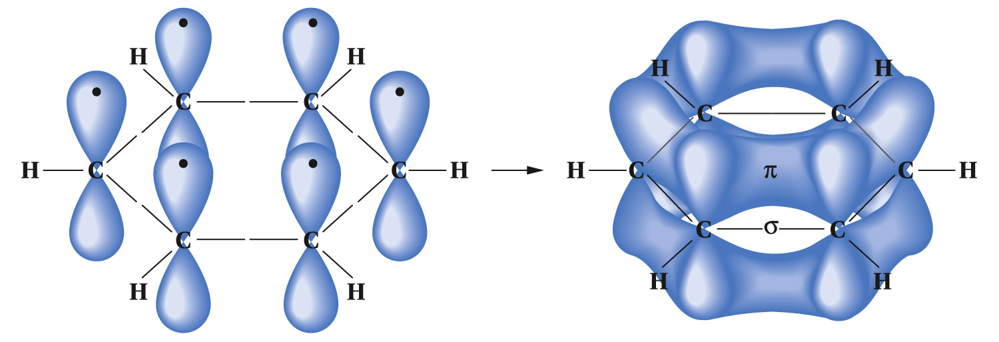
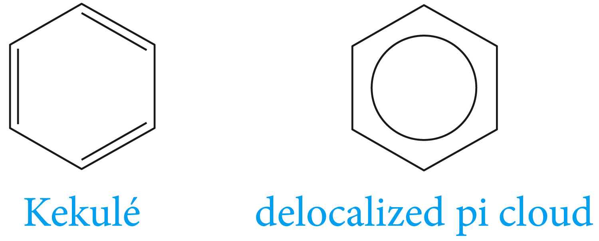
The Orbital Model for Benzene
Symbols for Benzene

Slide 6
Nomenclature of Aromatic Compounds
Monosubstituted benzenes with common names

Slide 7
Monosubstituted benzenes that do not have common names

Slide 8
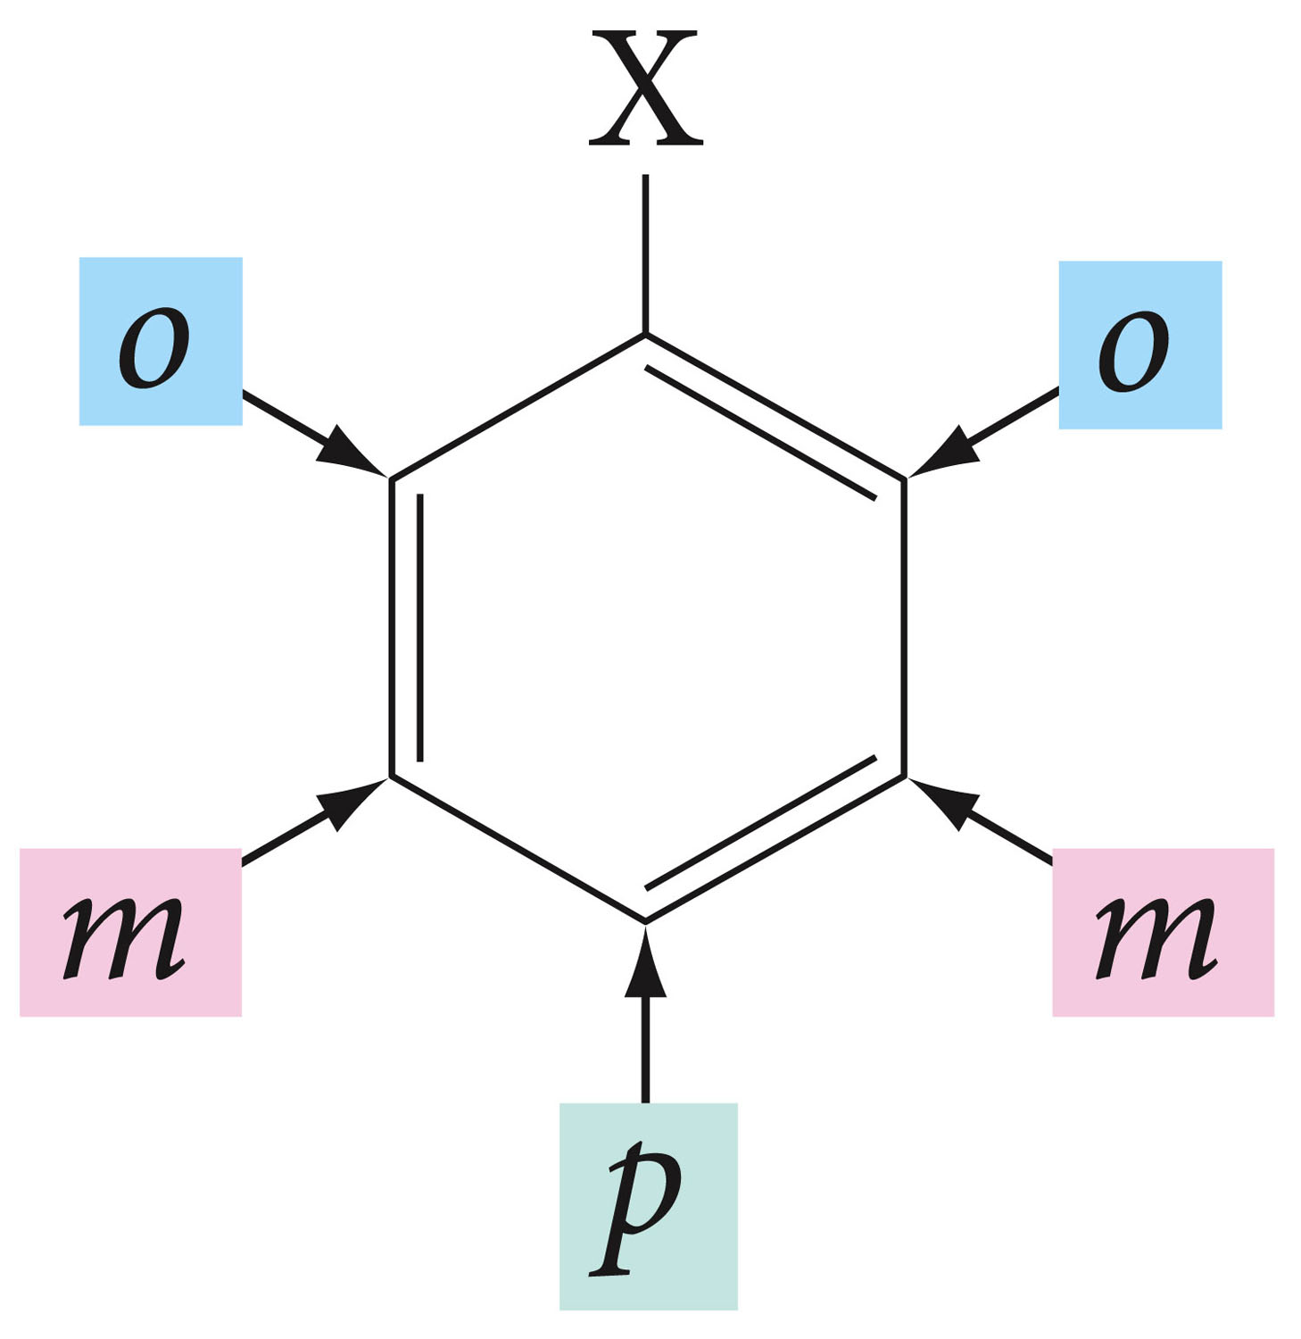
When two substituents are present, we use prefixes ortho-, meta-, and para-, usually abbreviated as o-, m-, and p-, respectively.

Slide 10
For more than two substituents, their positions are designated by numbering the ring.

Slide 11
Aromatic hydrocarbons, as a class called Arenes (Ar) the aryl groups are therefore aromatic substituents.

Slide 12
The symbol Ph is sometimes used as an abbreviation for phenyl group

Slide 13
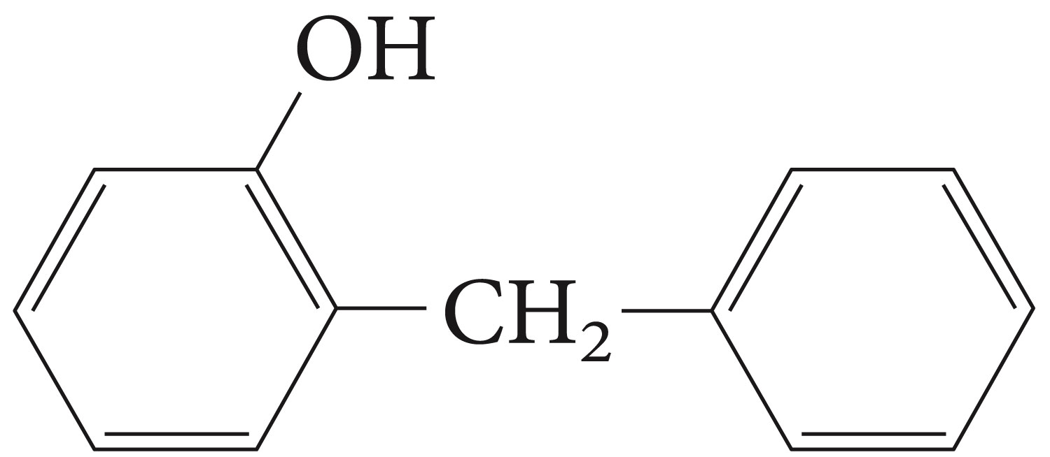
Name the following structures

Slide 14
Electrophilic Aromatic Substitution

Slide 16
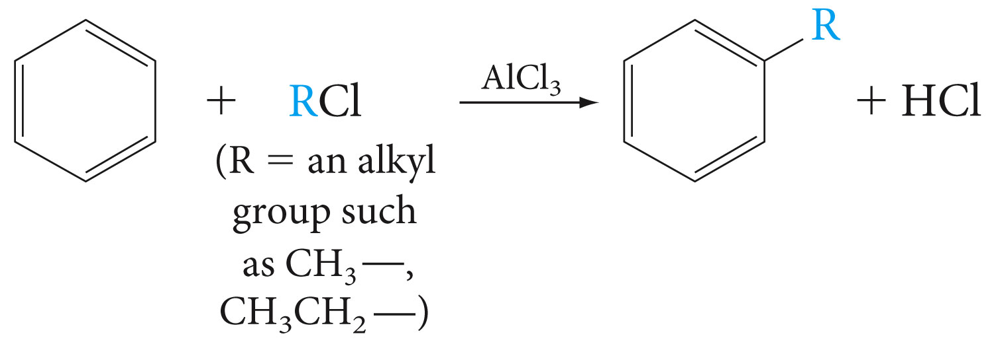

Slide 18
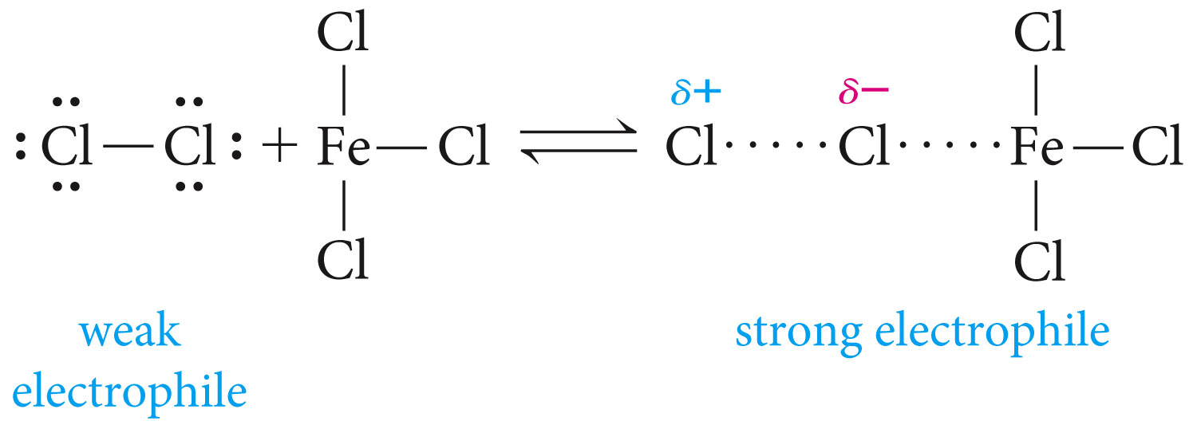
The Mechanisms of Electrophilic Substitutions

Slide 19
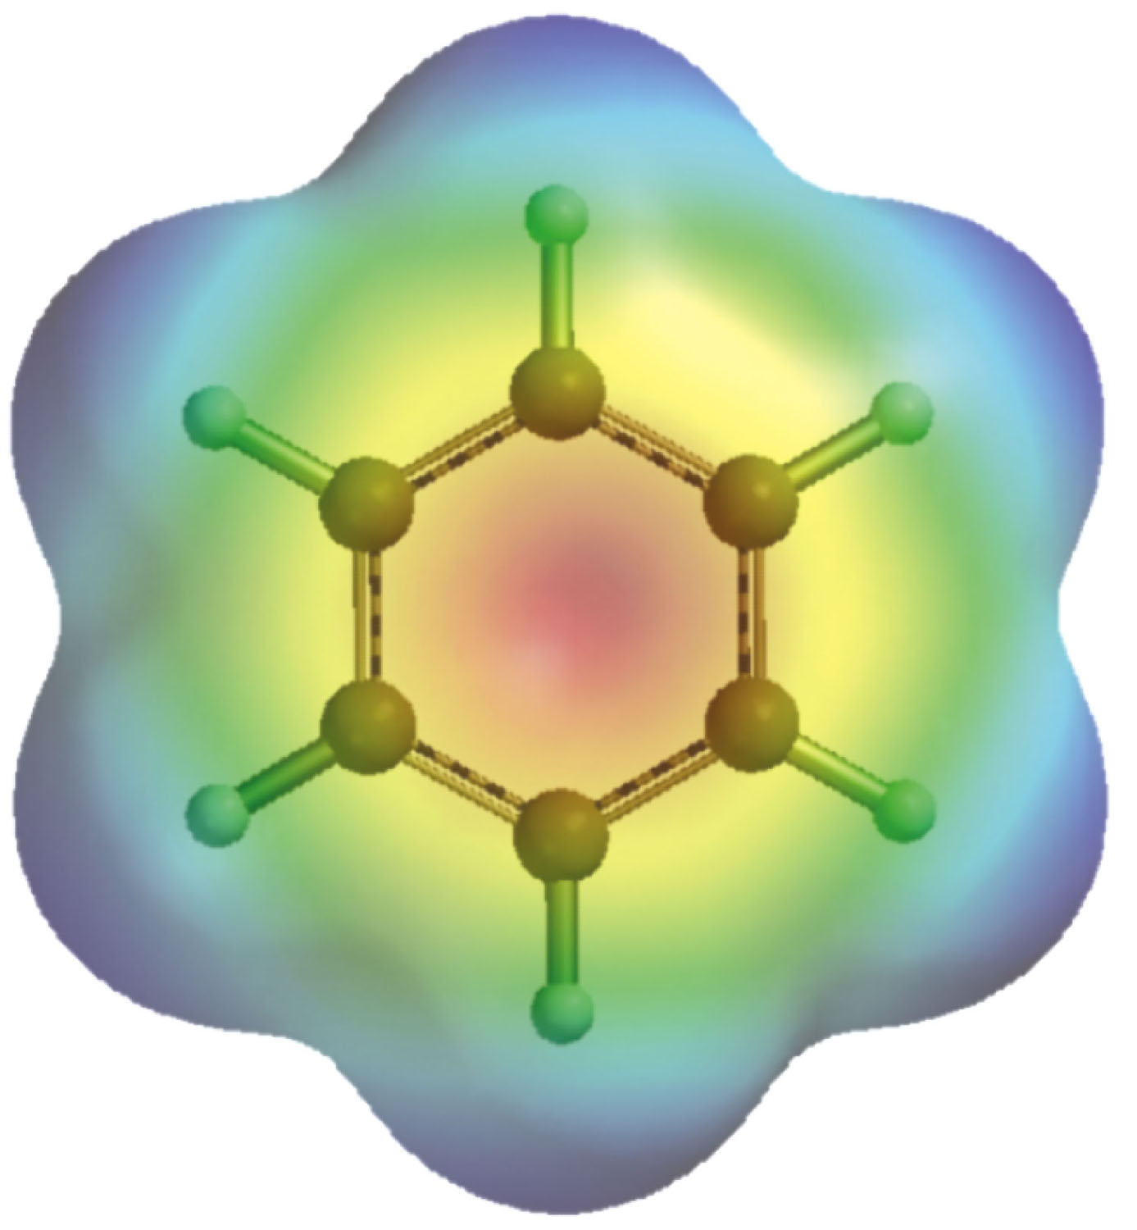
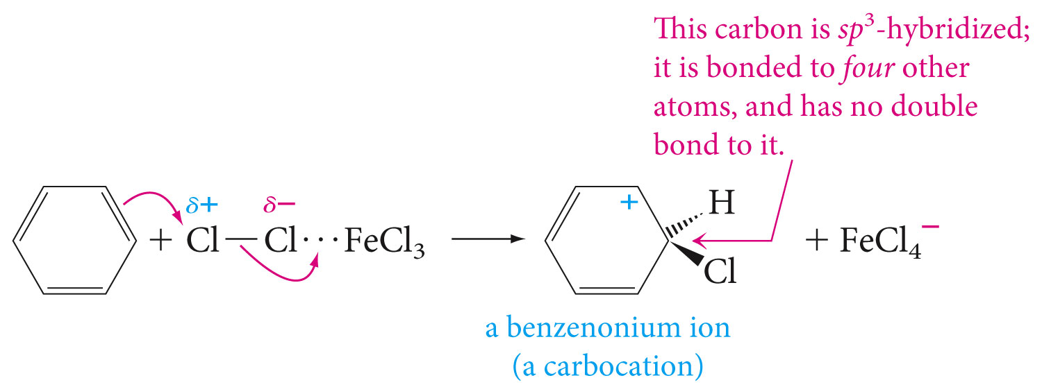

Slide 22
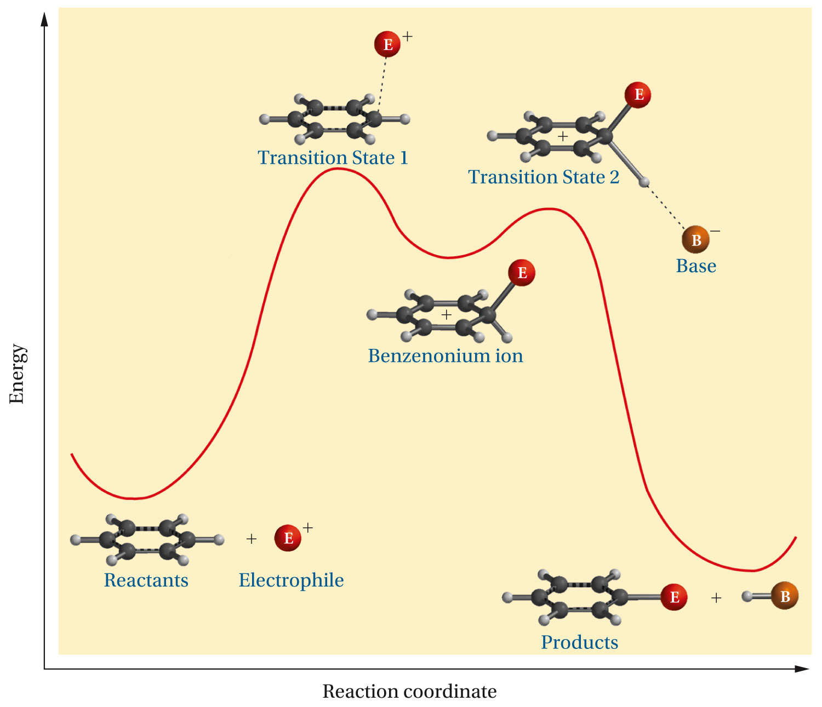

Slide 23
Nitration

Slide 24
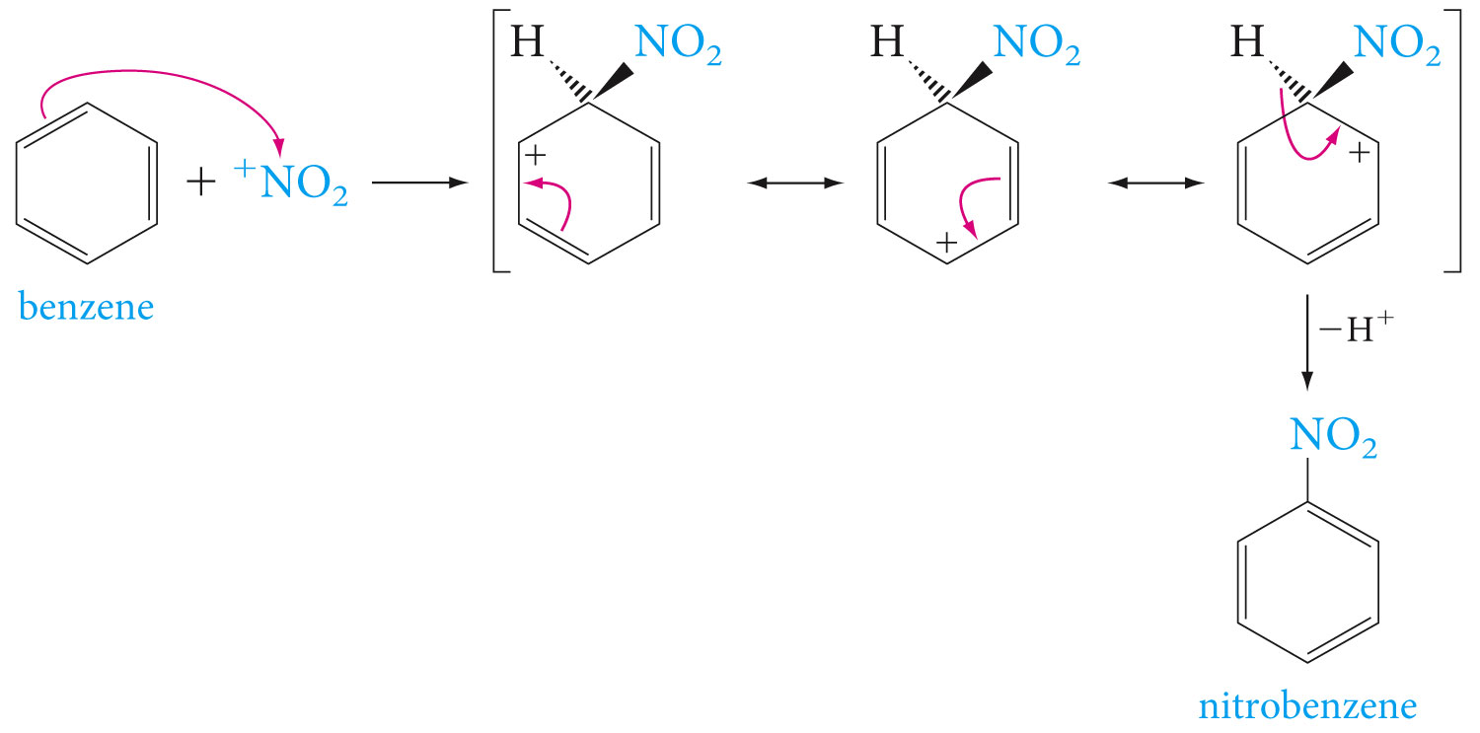

Slide 25
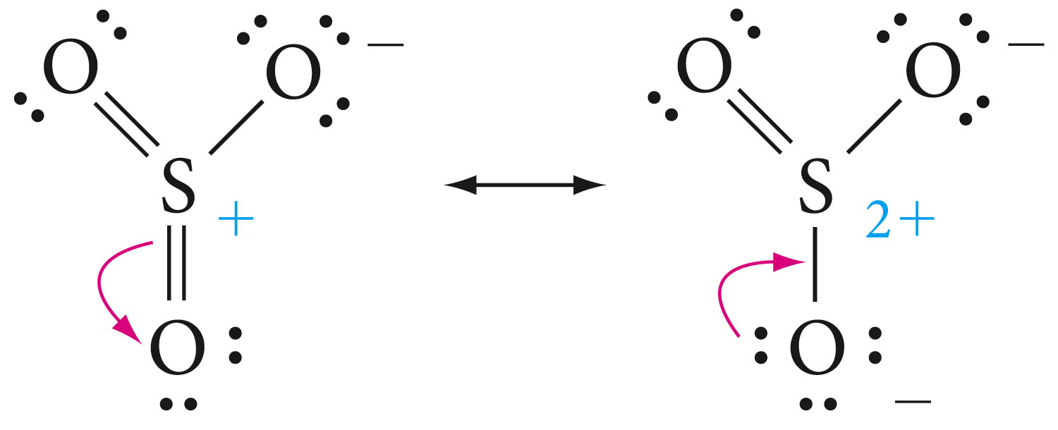
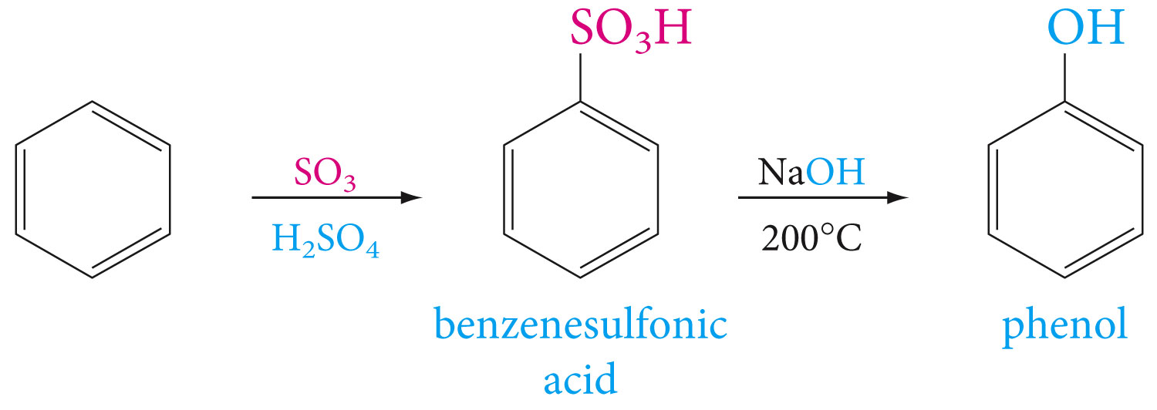
sulfonation

Slide 26
Alkylation and Acylation (Friedel-Crafts reaction)

Slide 28
Ring-Activating and ring-Deactivating Substituents

Slide 29
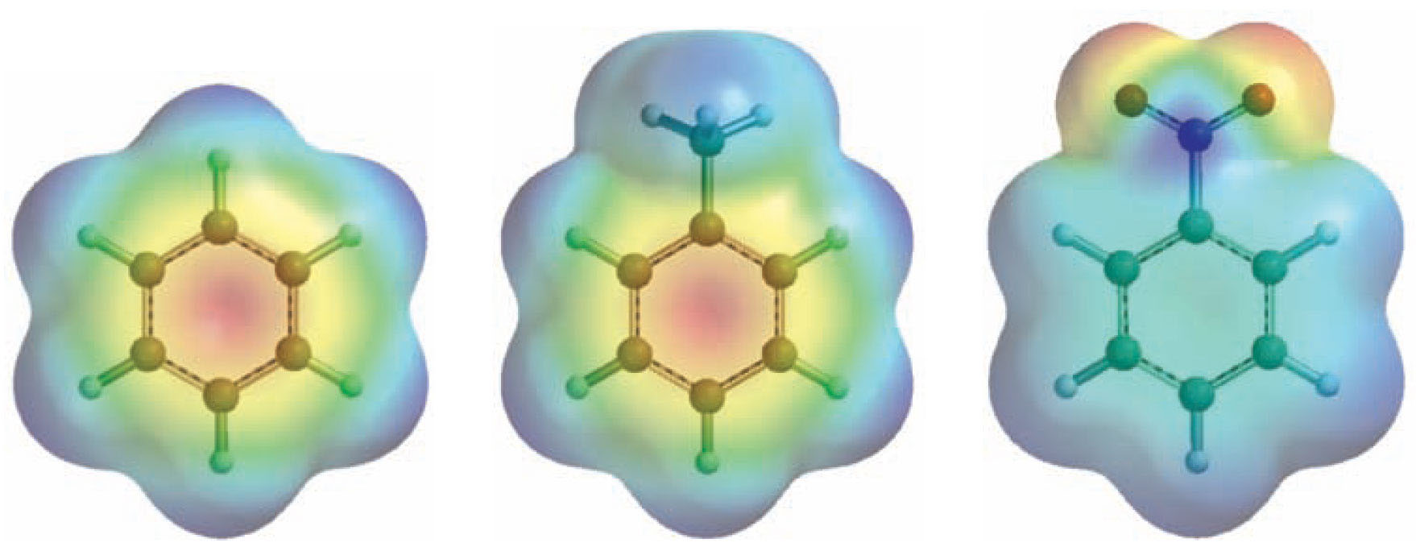

Slide 30
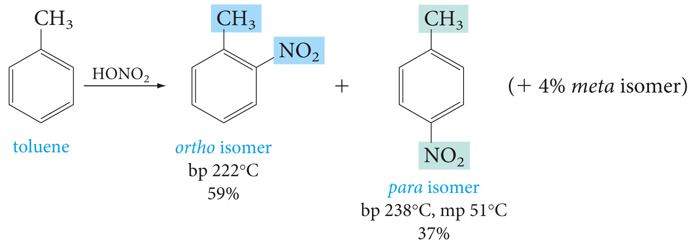
Ortho, Para-Directing and Meta-Directing Groups

Slide 31
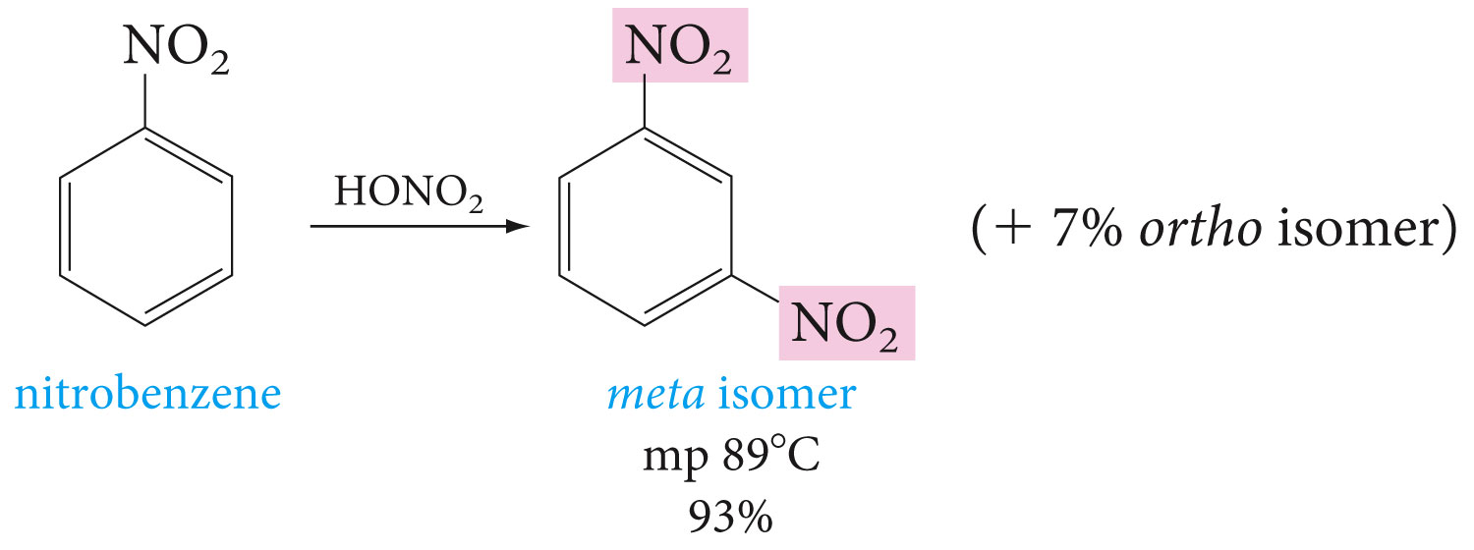

Slide 32
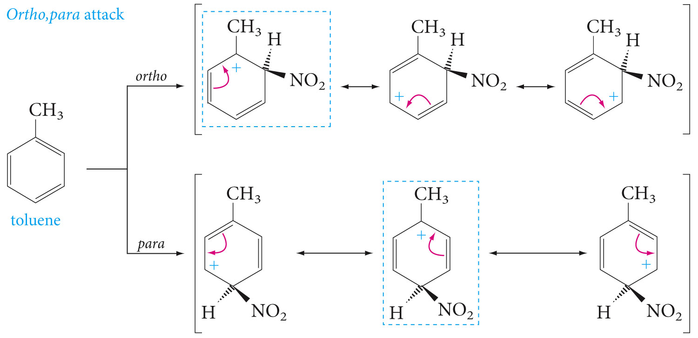
Ortho, Para-Directing Groups

Slide 34
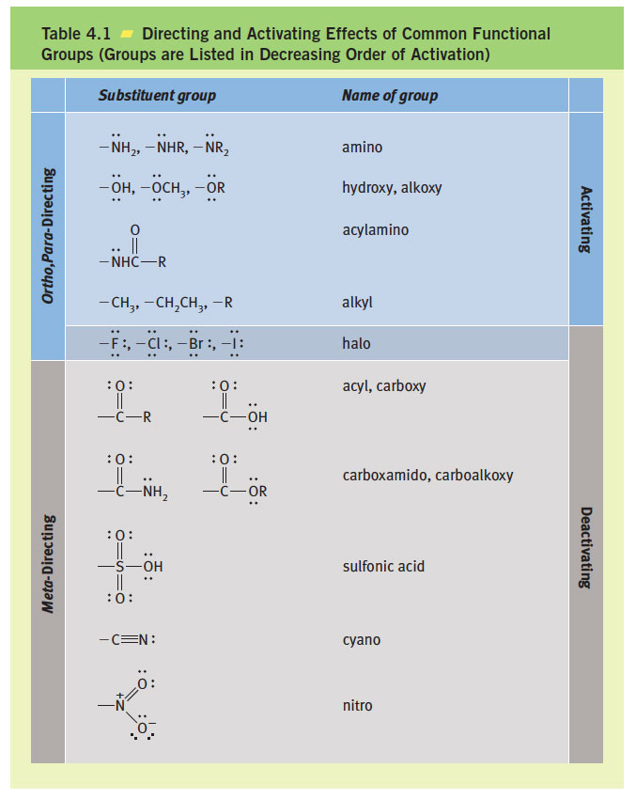

Slide 35
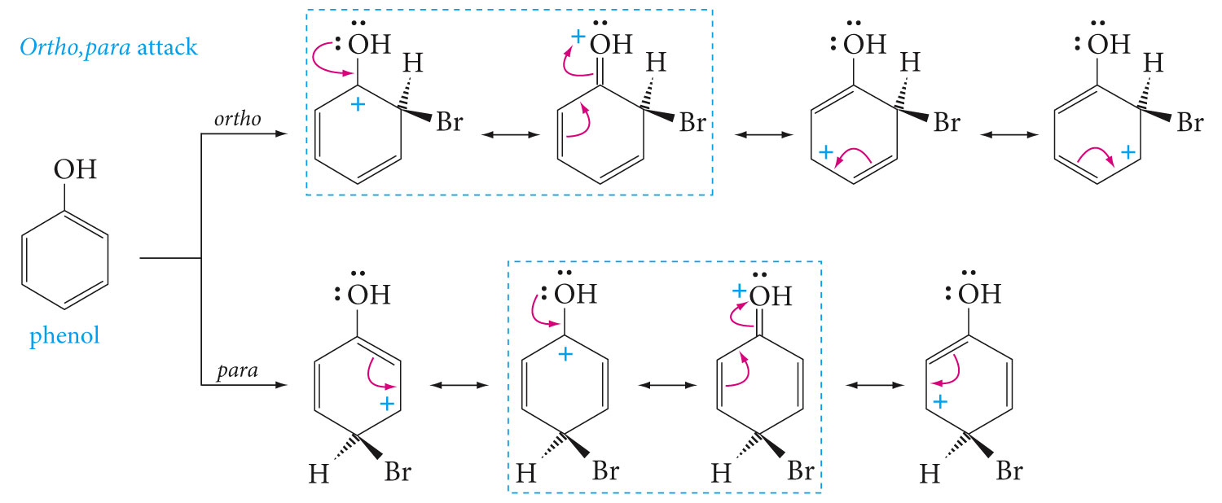

Slide 37
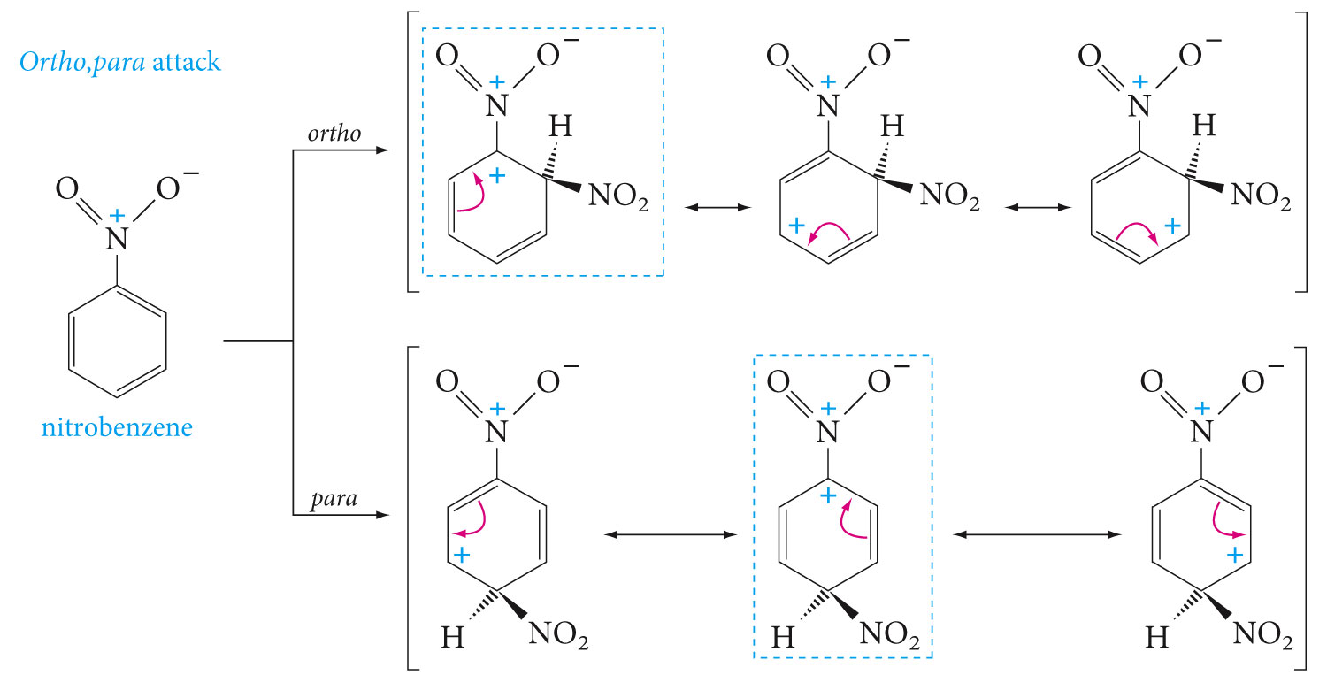

Slide 40
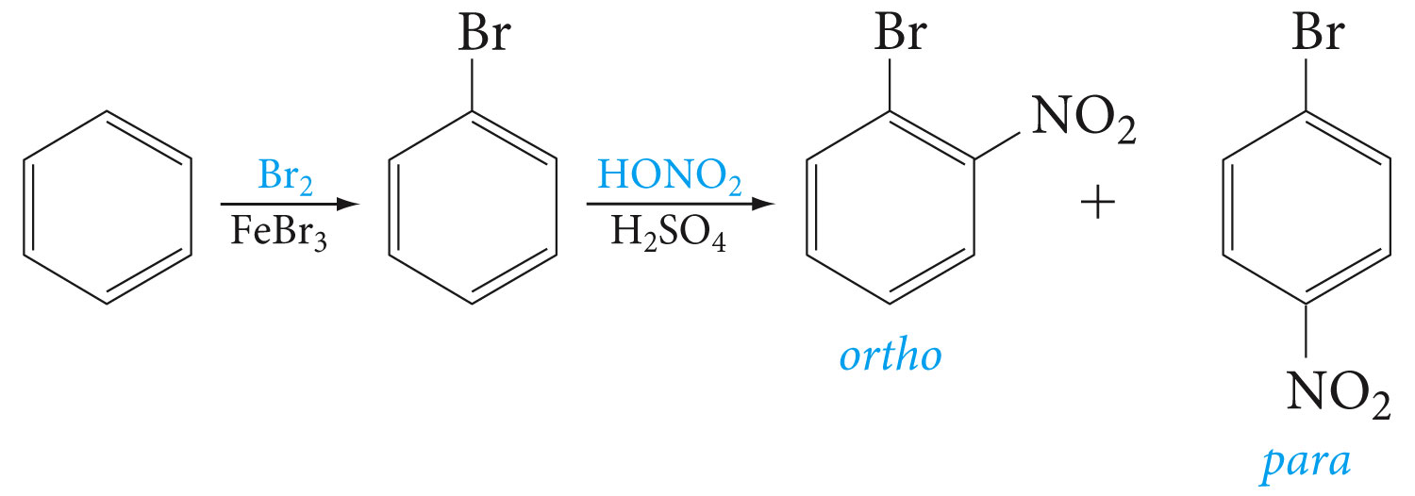
Importance of Directing Effects in Synthesis

Slide 41
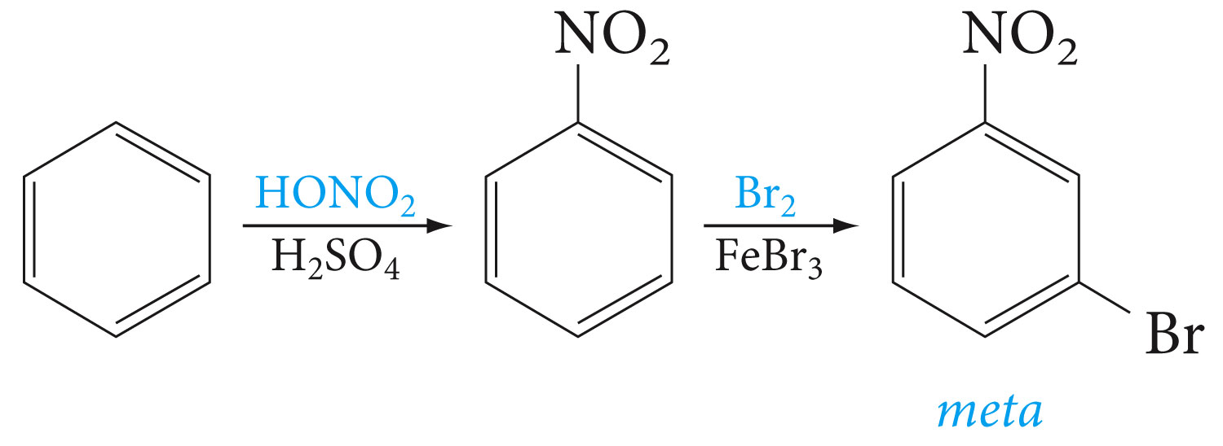

Slide 42
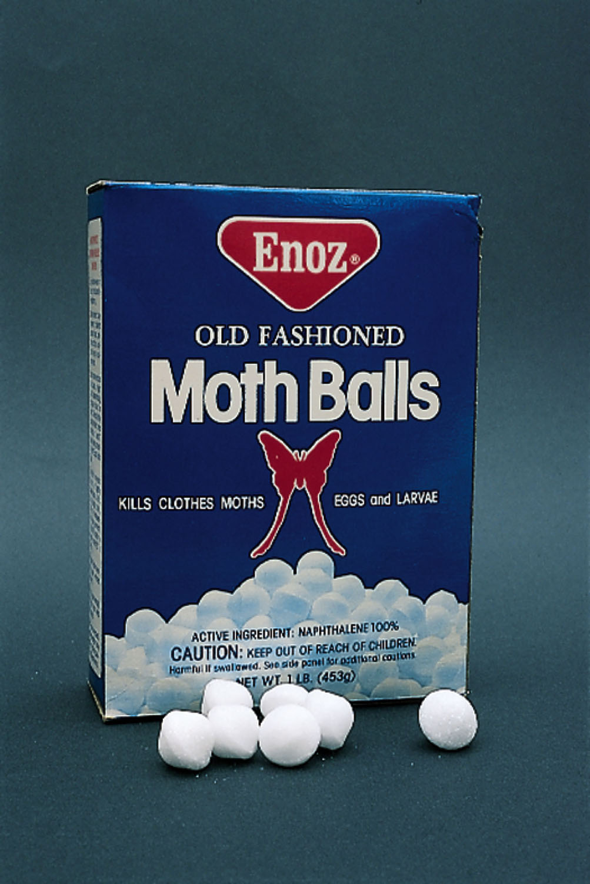
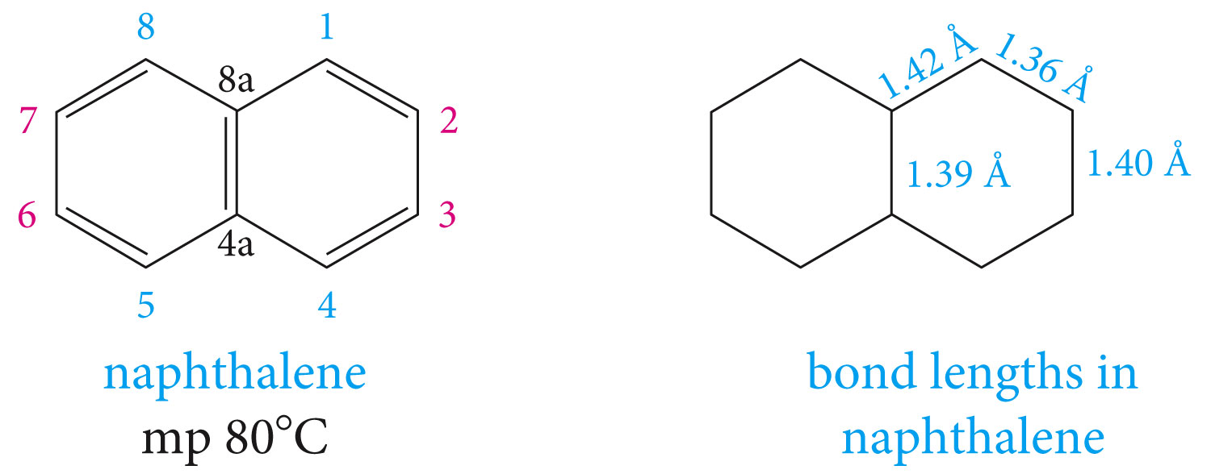
Polycyclic Aromatic Hydrocarbons

Slide 44
Fused polycyclic hydrocarbons

Slide 45
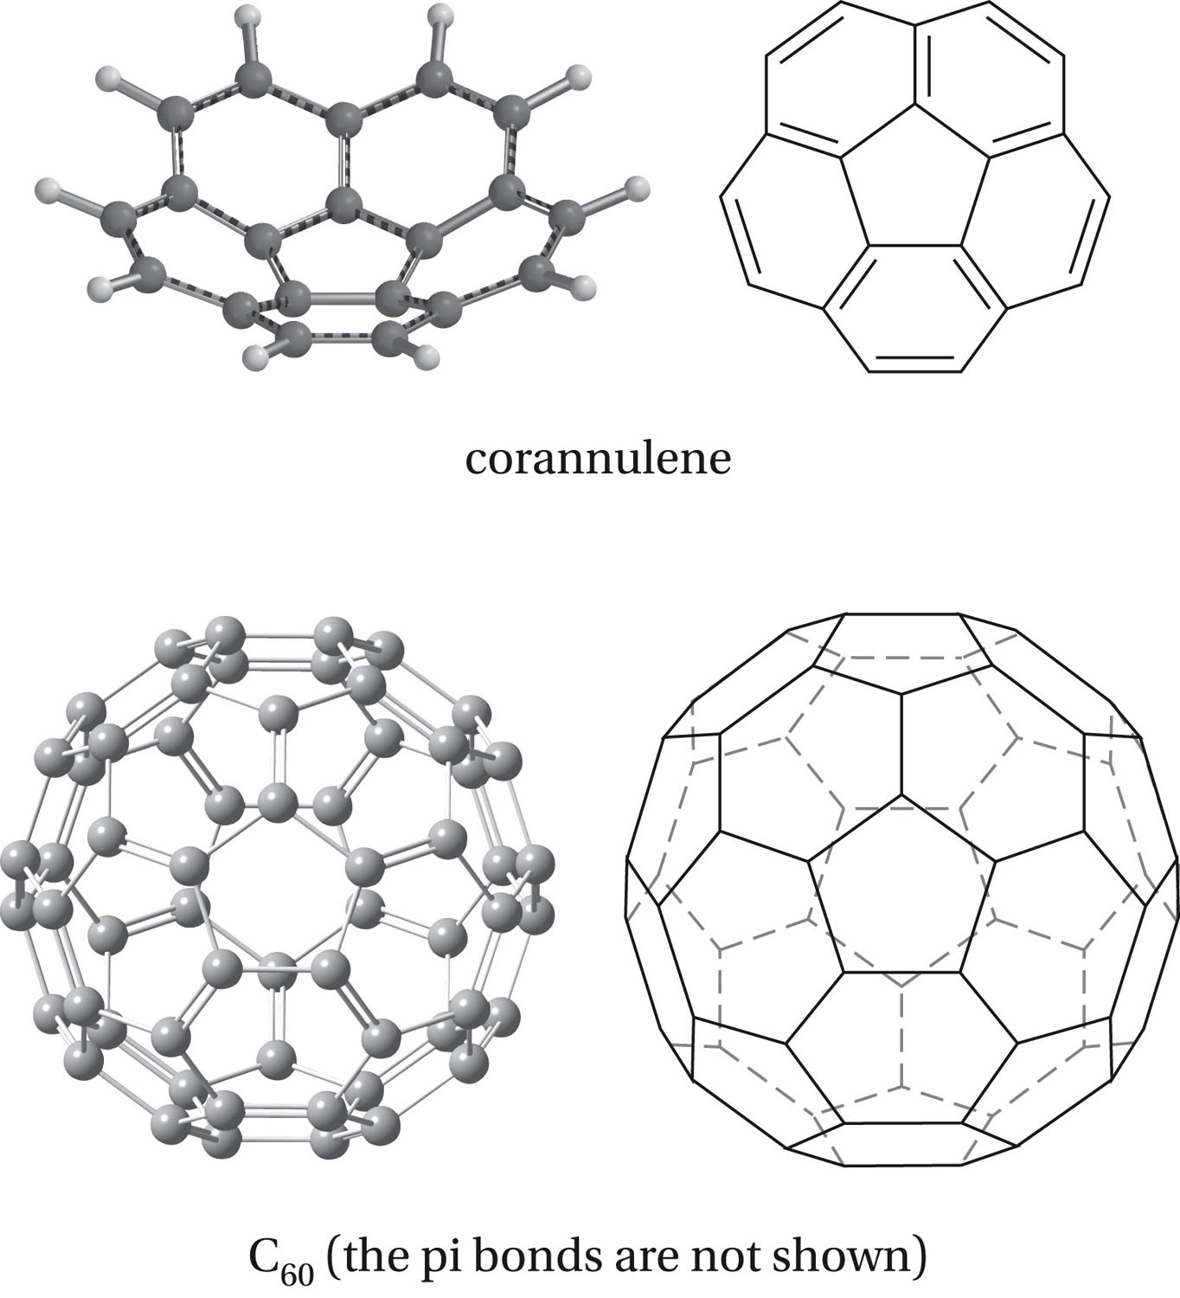

Slide 46
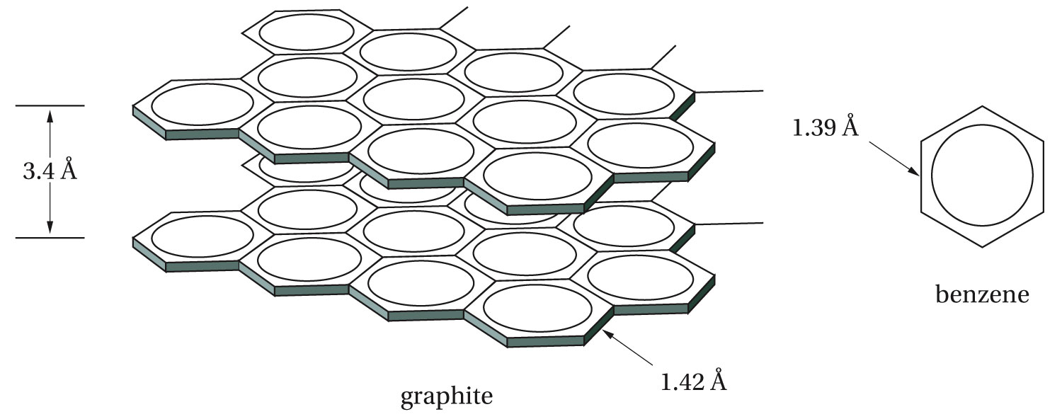

Slide 47
