Slide 1
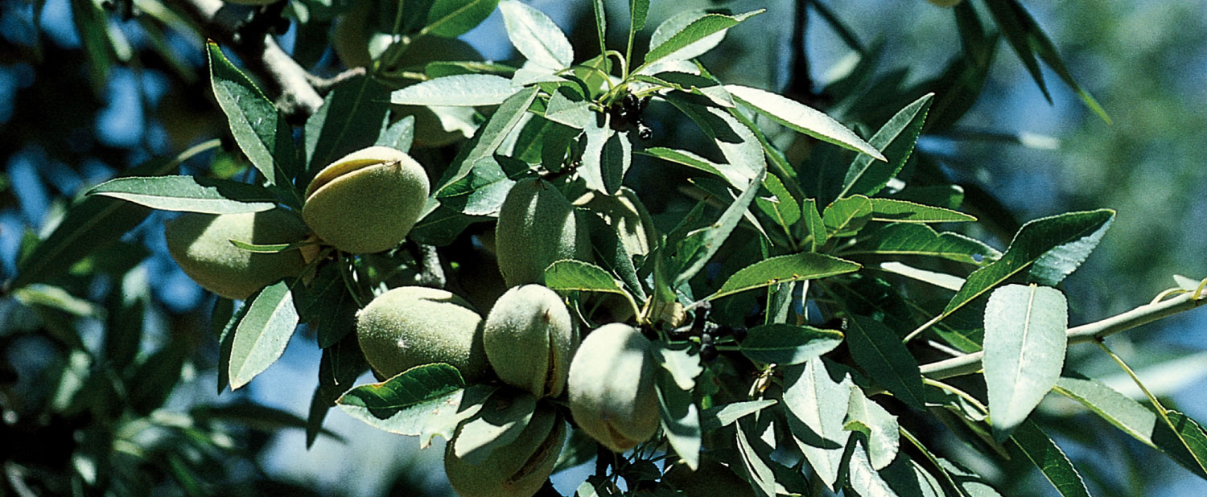
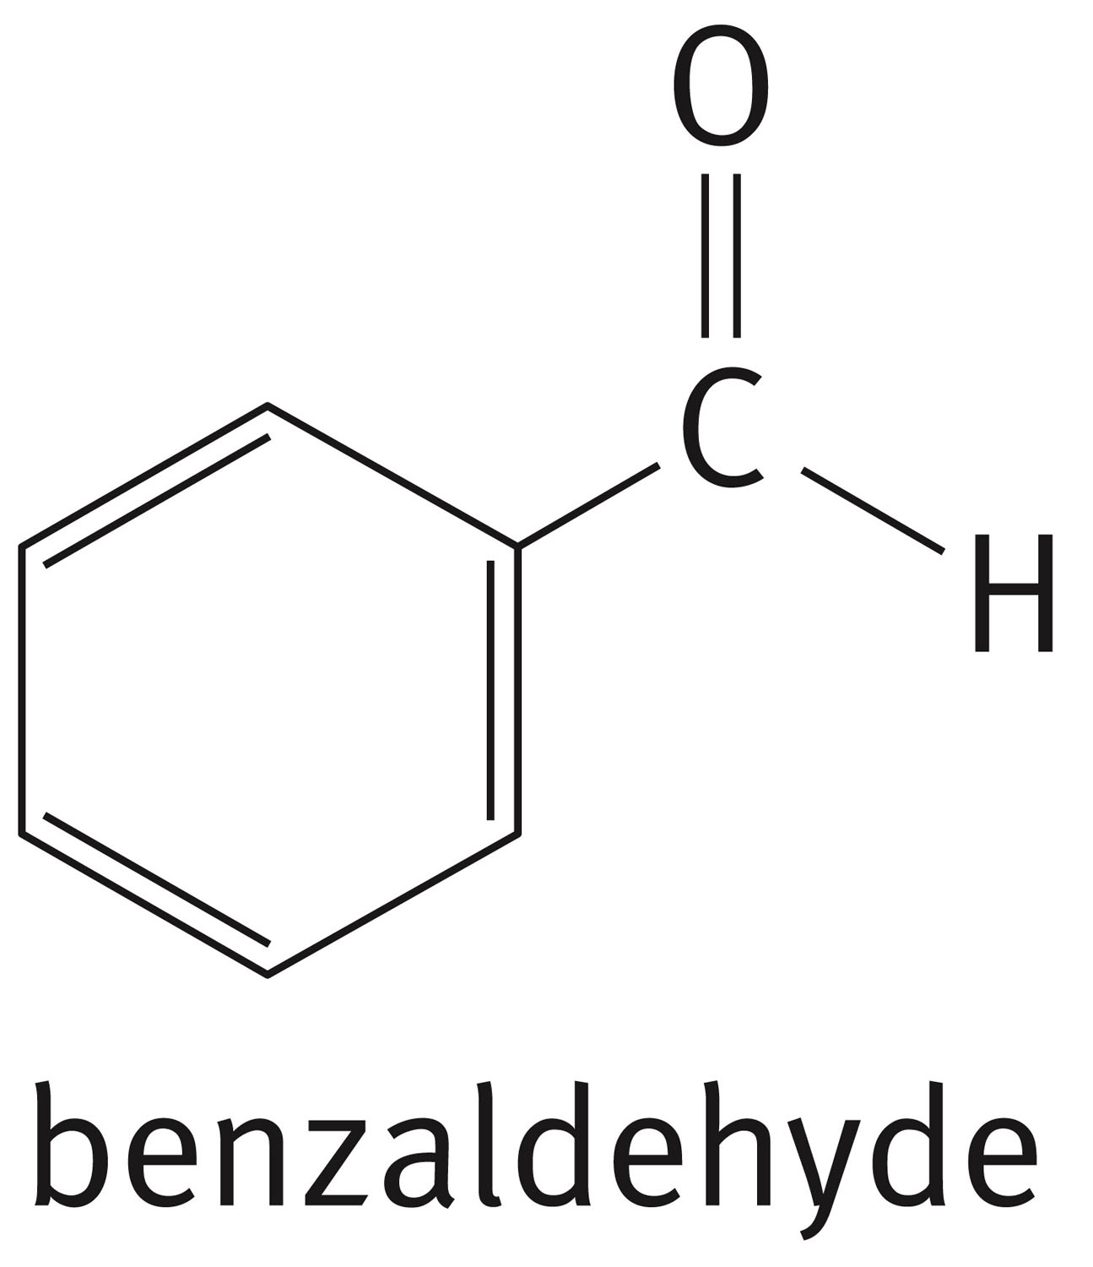
Chapter 4: Aromatic Compounds
Bitter almonds are the source of the aromatic compound benzaldehyde

Slide 2
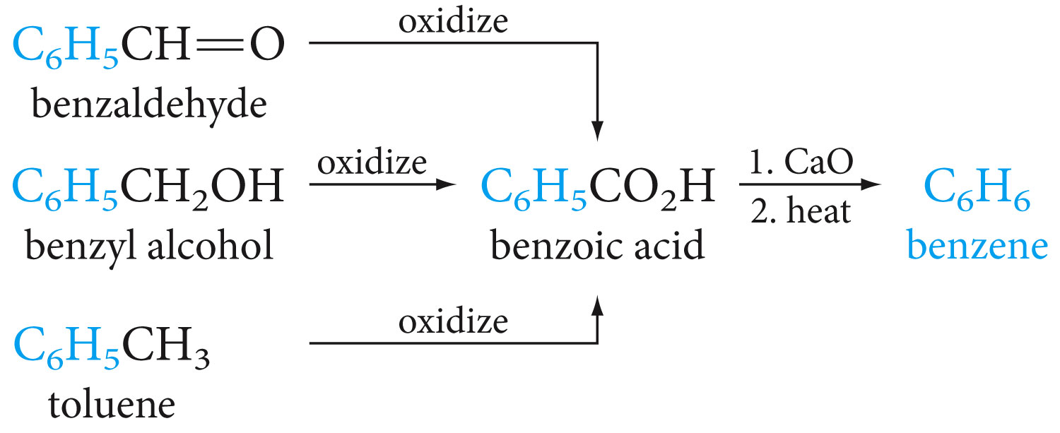
Sources of Benzene

Slide 3
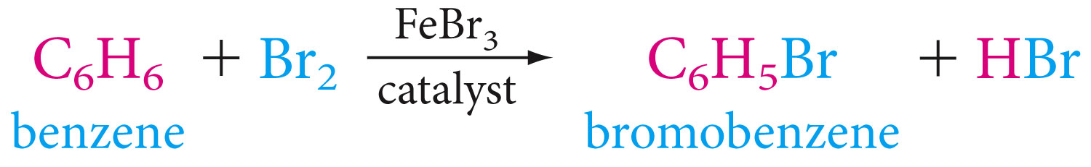

Some Facts About Benzene
Reacts mainly by substitution

Slide 4
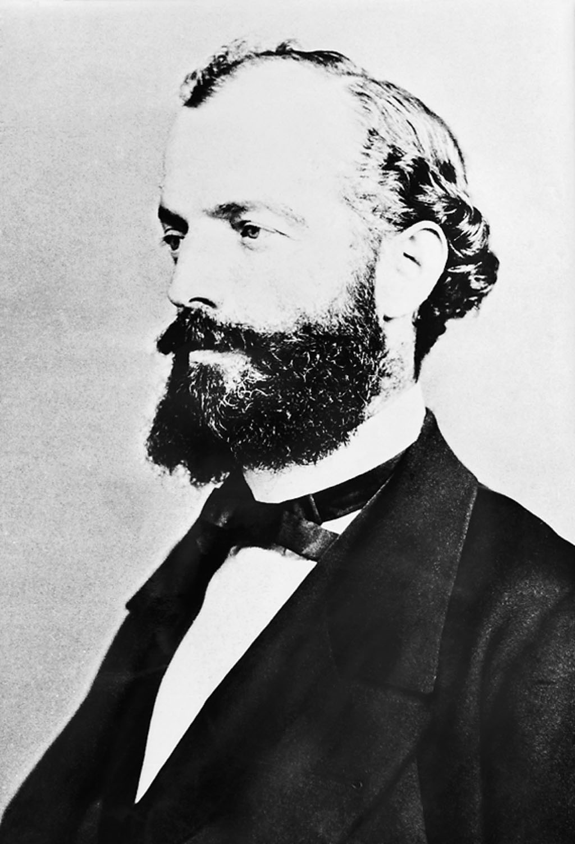
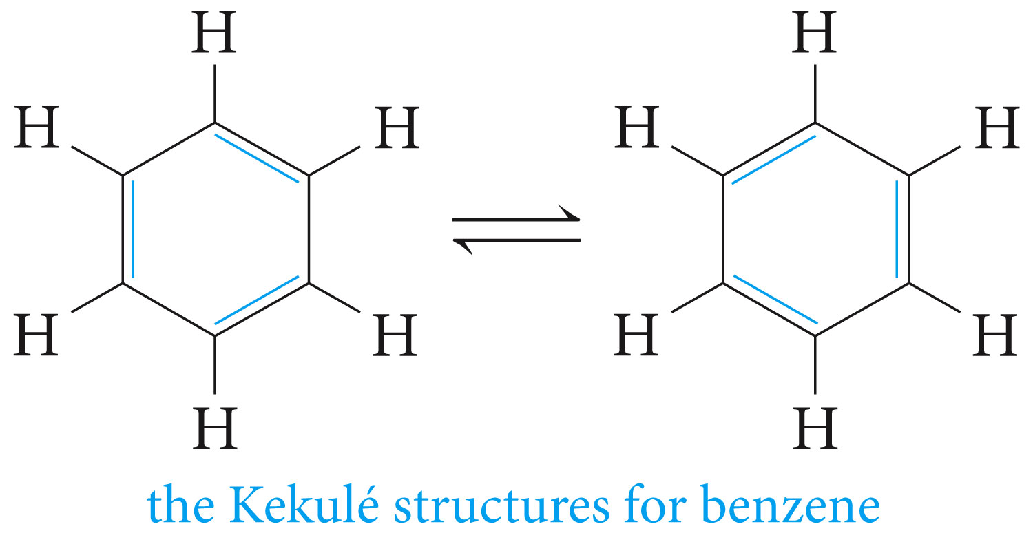
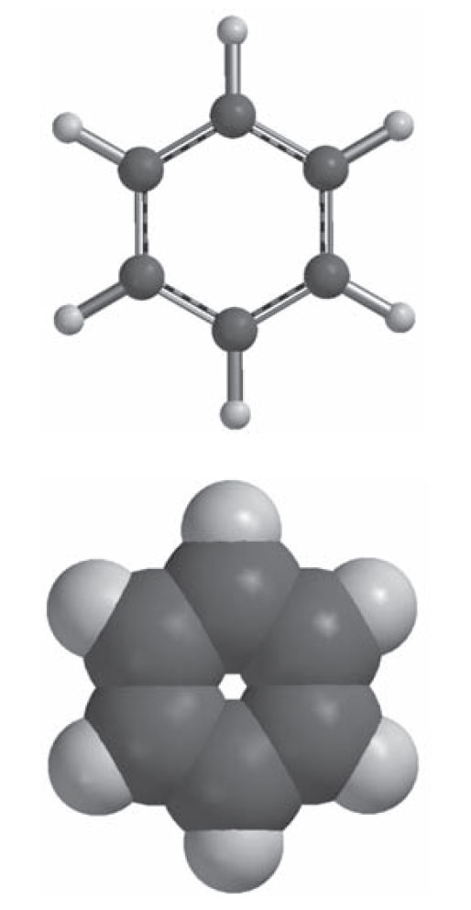
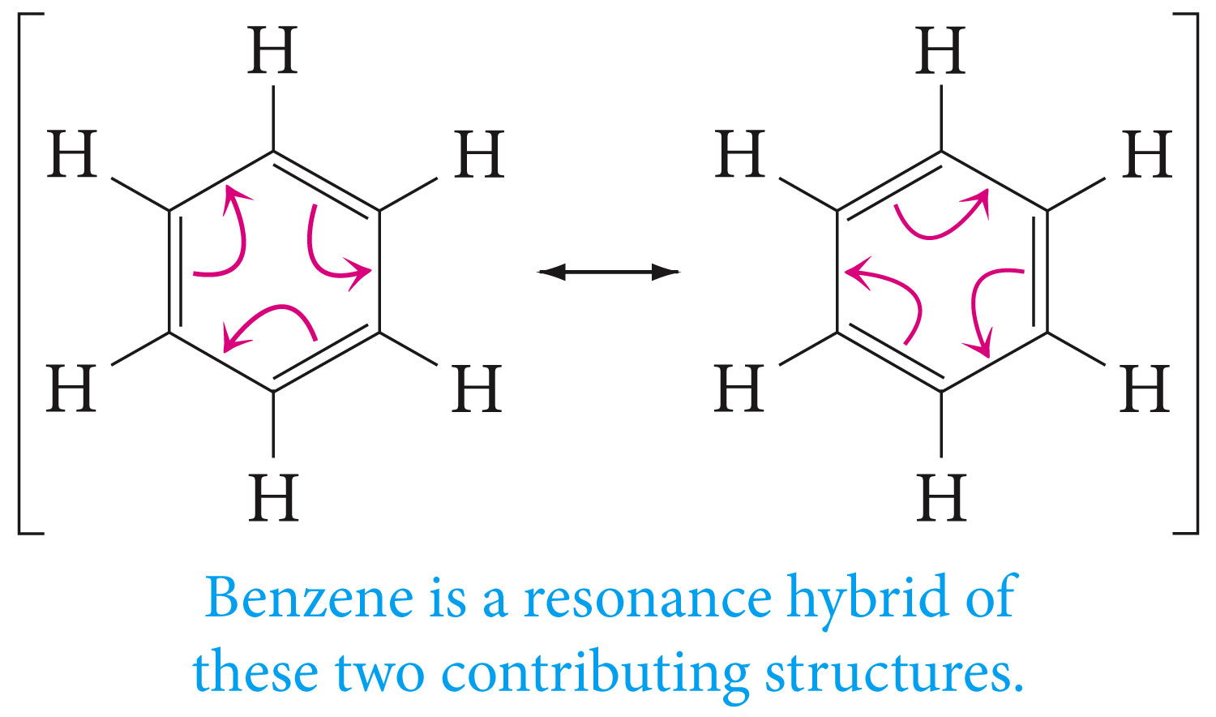
Friedrich August Kekule’

Slide 5
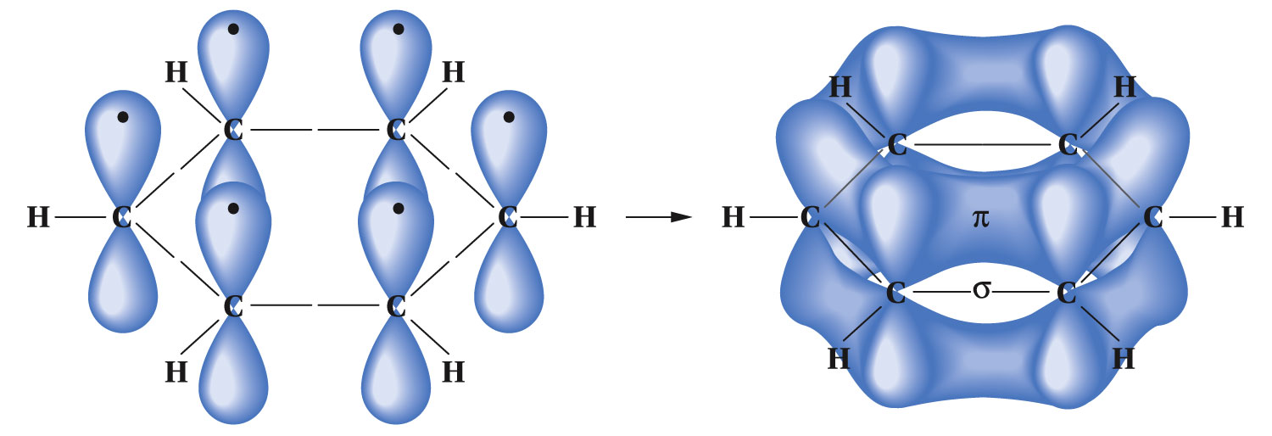
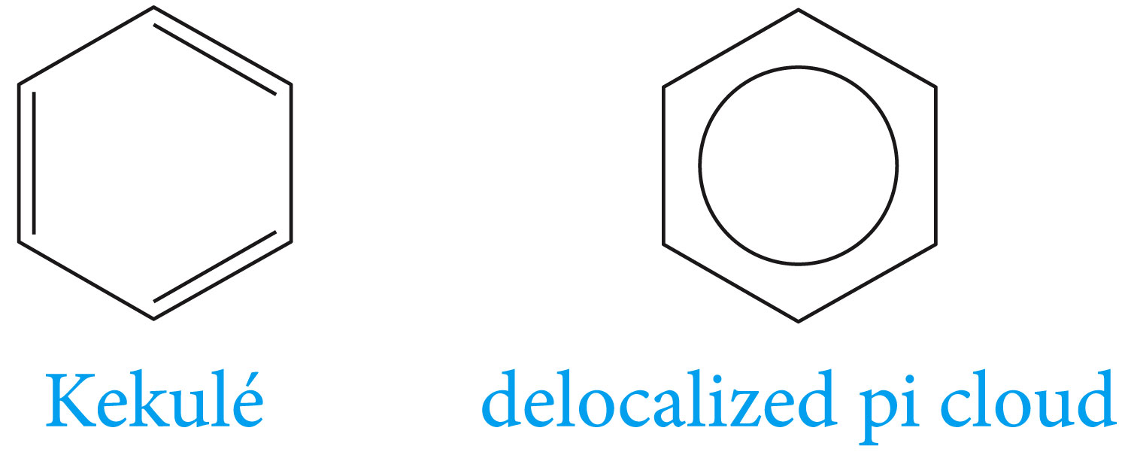
The Orbital Model for Benzene
Symbols for Benzene

Slide 6
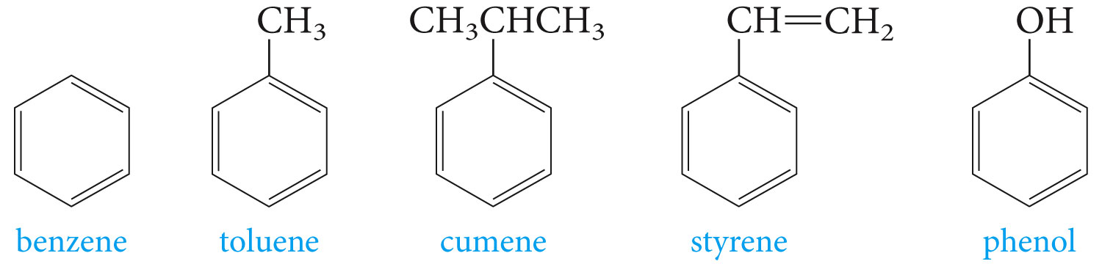
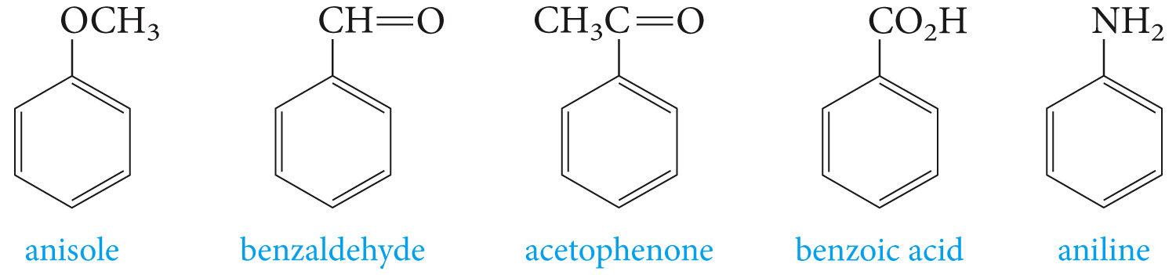
Nomenclature of Aromatic Compounds
Monosubstituted benzenes with common names

Slide 7
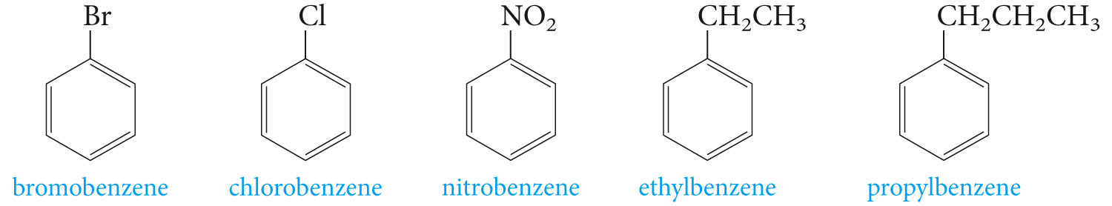
Monosubstituted benzenes that do not have common names

Slide 8
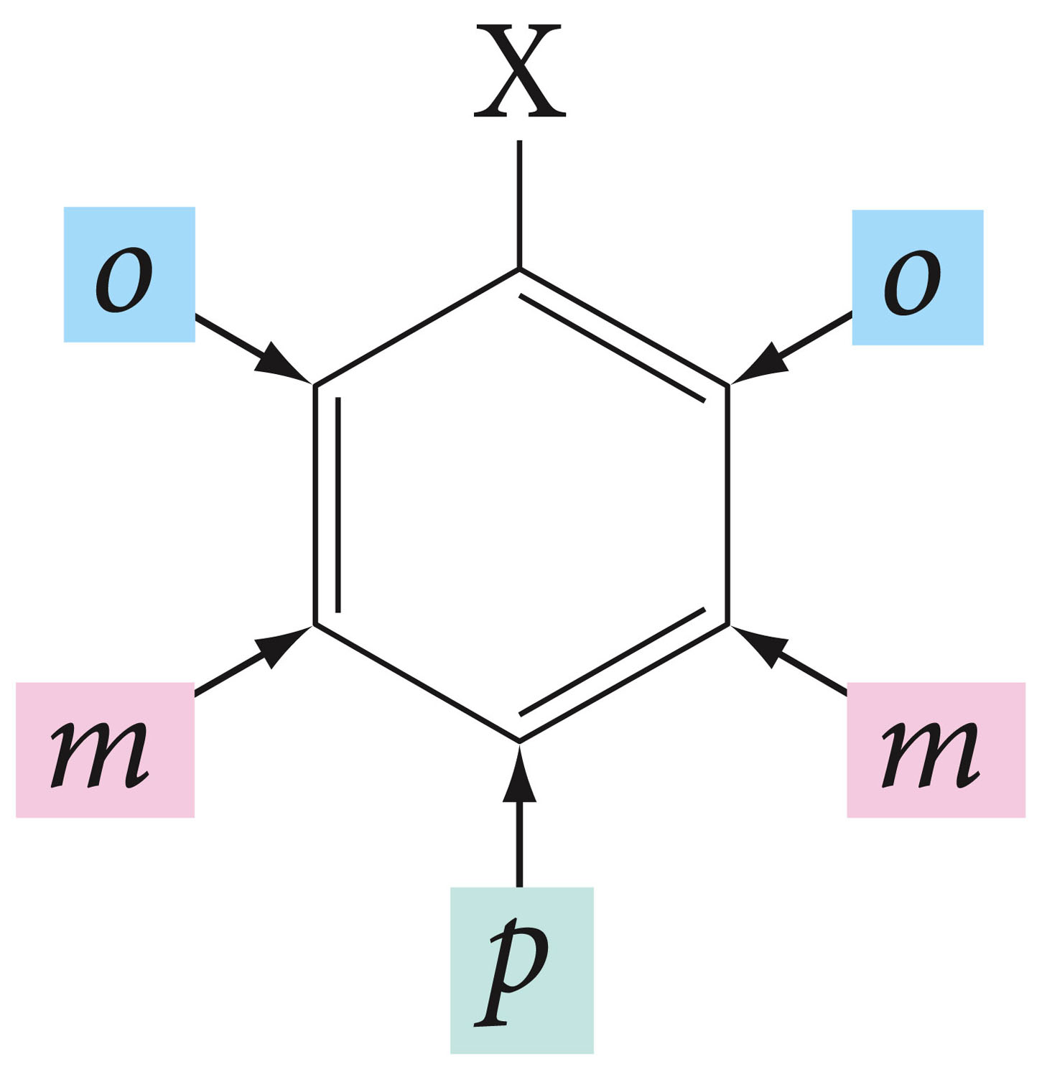
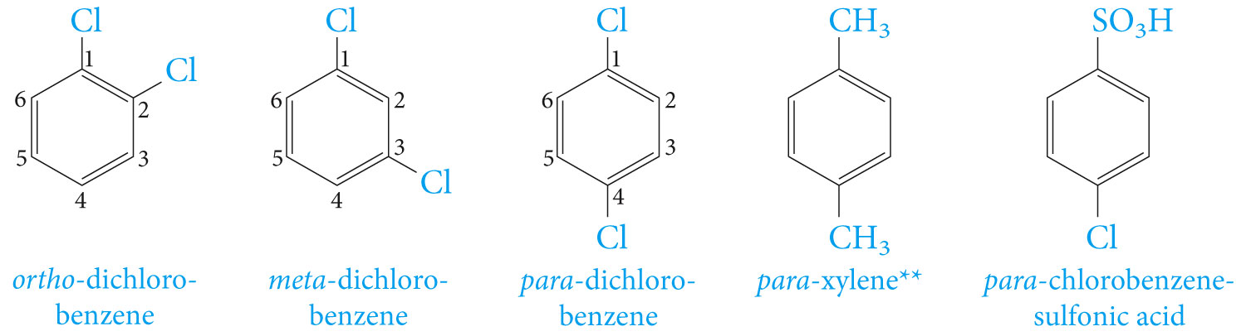
When two substituents are present, we use prefixes ortho-, meta-, and para-, usually abbreviated as o-, m-, and p-, respectively.

Slide 9
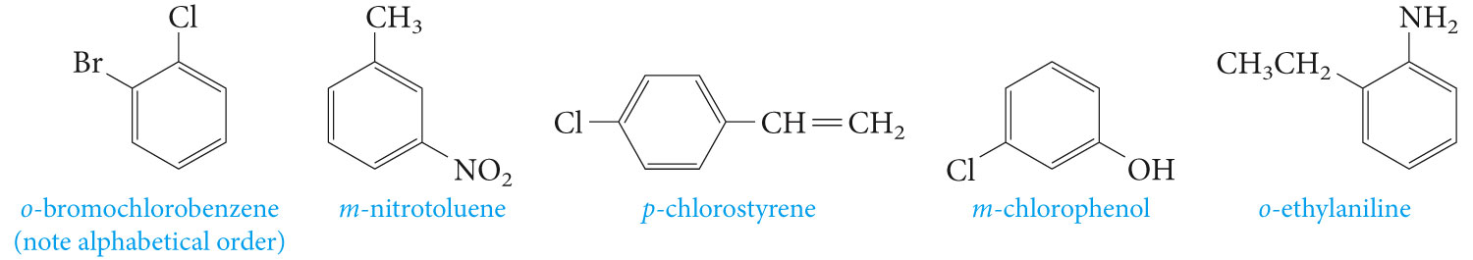

Slide 10
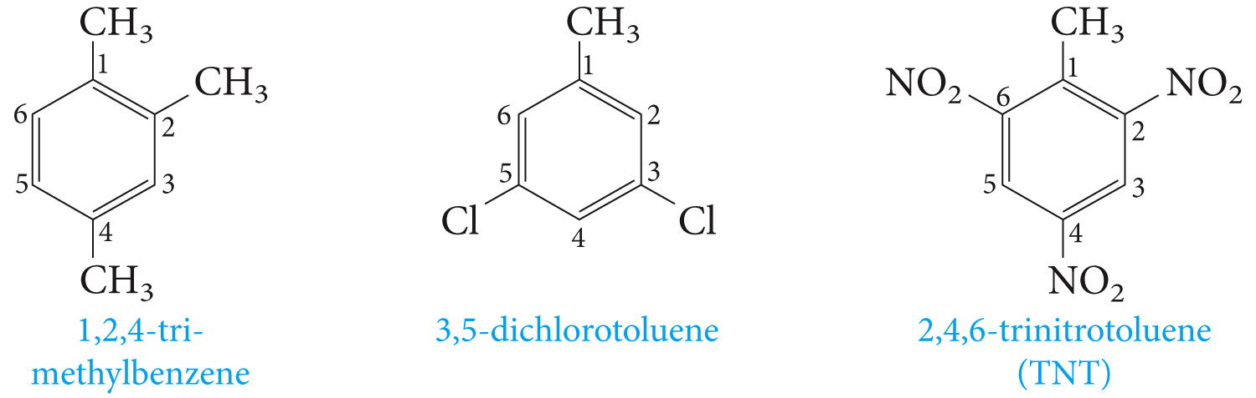
For more than two substituents, their positions are designated by numbering the ring.

Slide 11
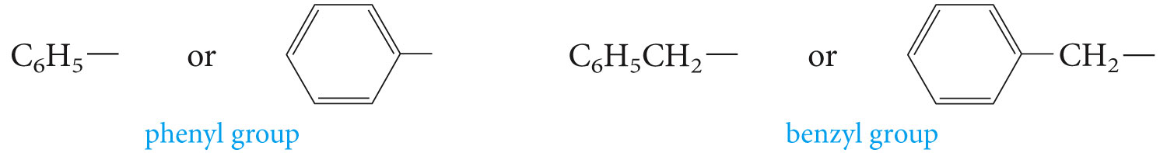
Aromatic hydrocarbons, as a class called Arenes (Ar) the aryl groups are therefore aromatic substituents.

Slide 12
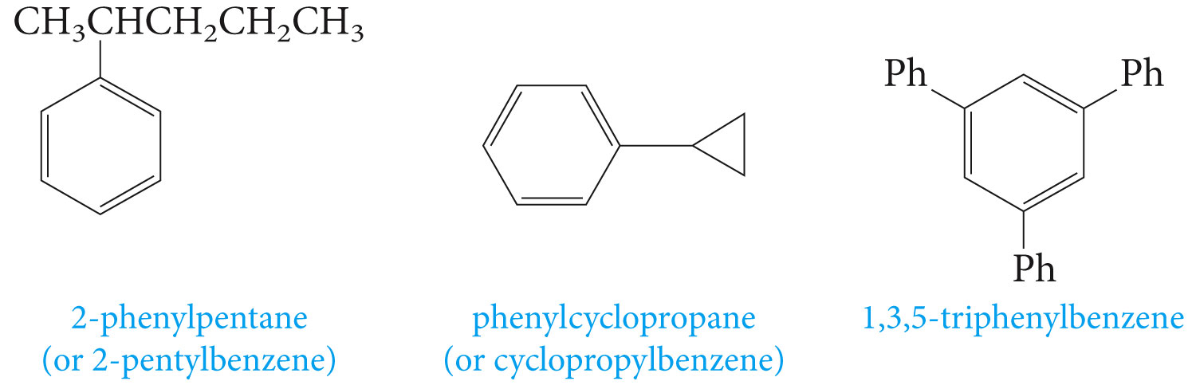
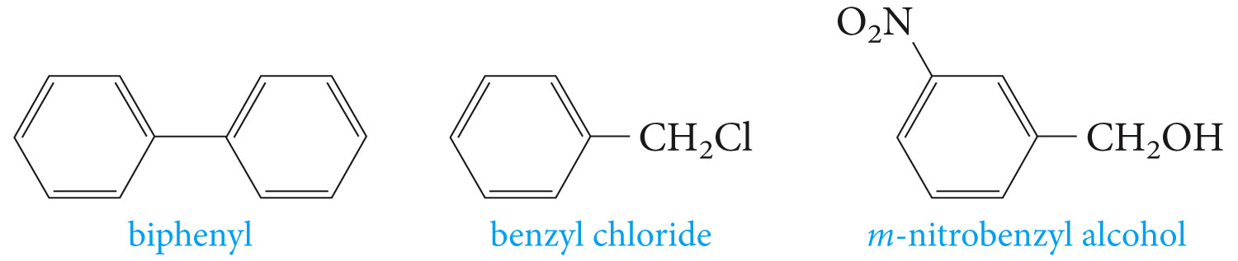
The symbol Ph is sometimes used as an abbreviation for phenyl group

Slide 13

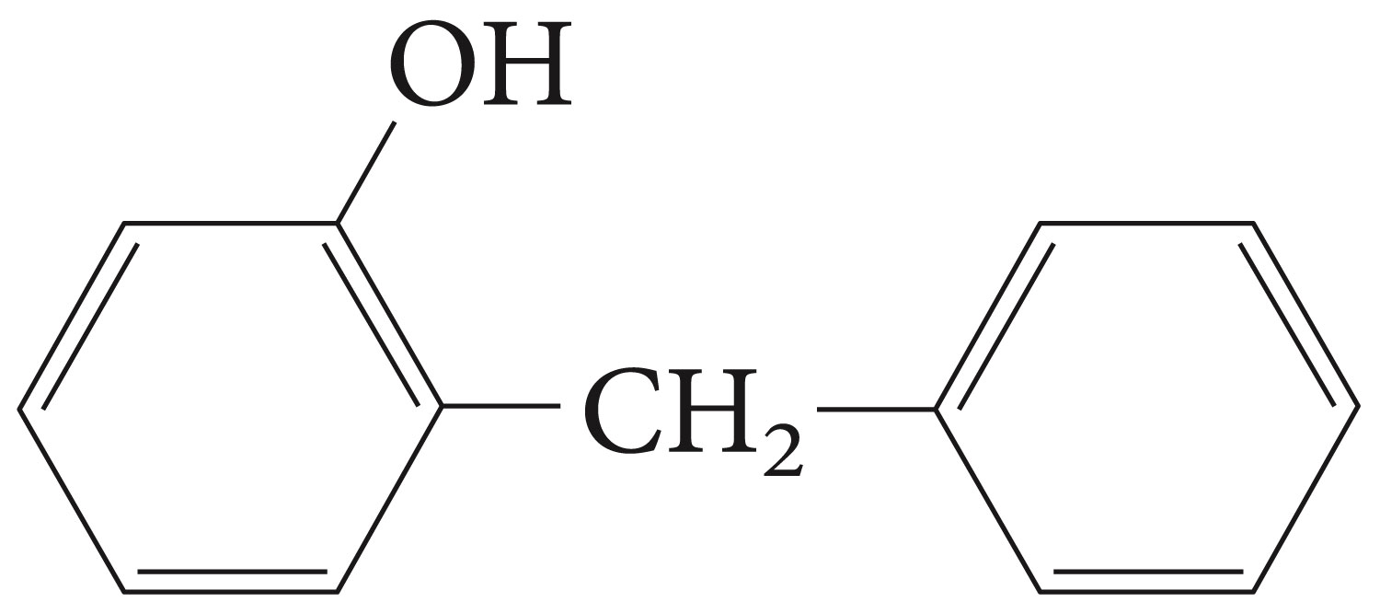
Name the following structures

Slide 14
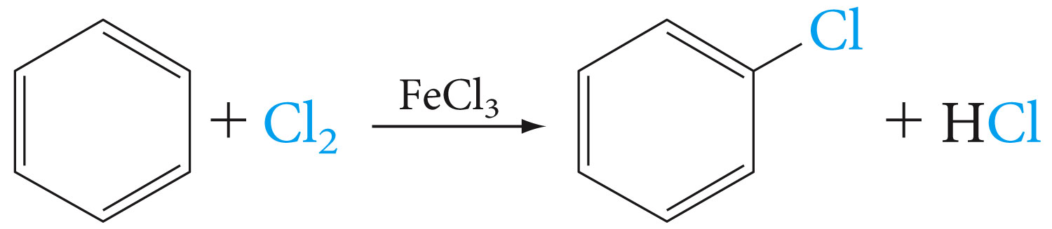
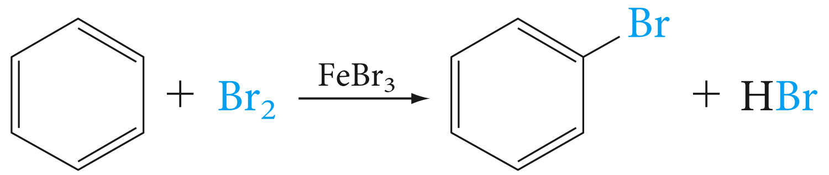
Electrophilic Aromatic Substitution

Slide 15
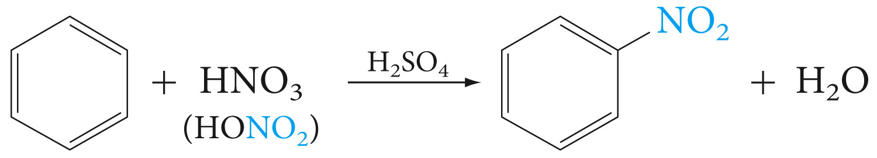
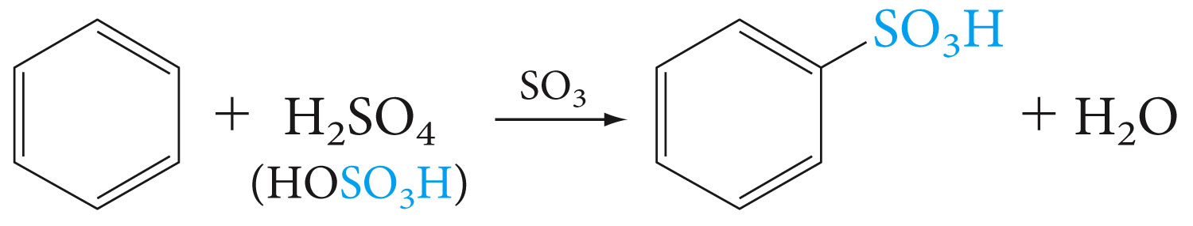

Slide 16
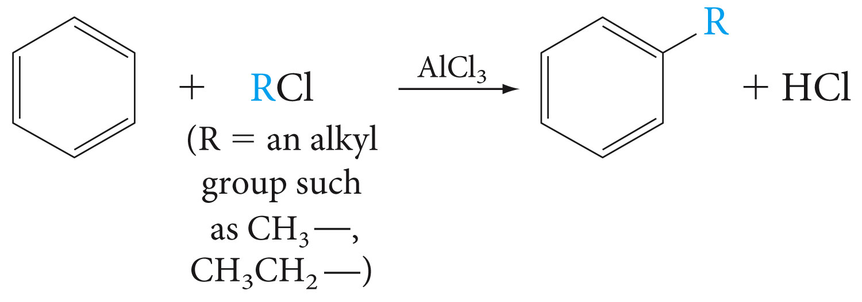
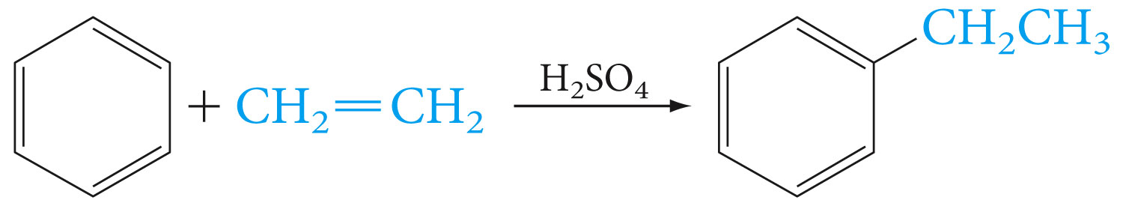

Slide 17
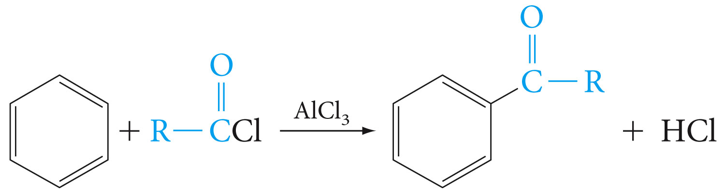

Slide 18
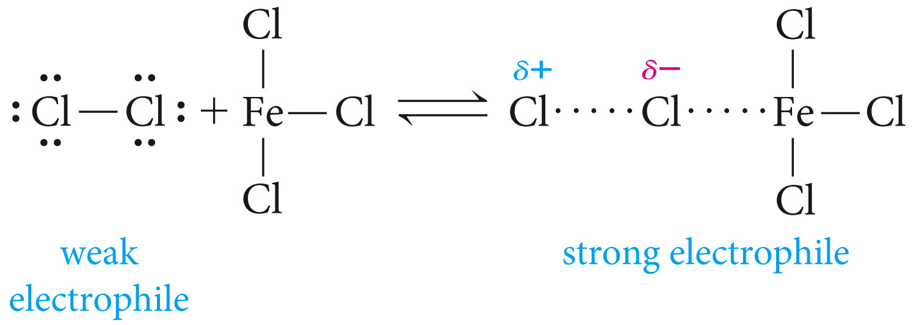
The Mechanisms of Electrophilic Substitutions

Slide 19
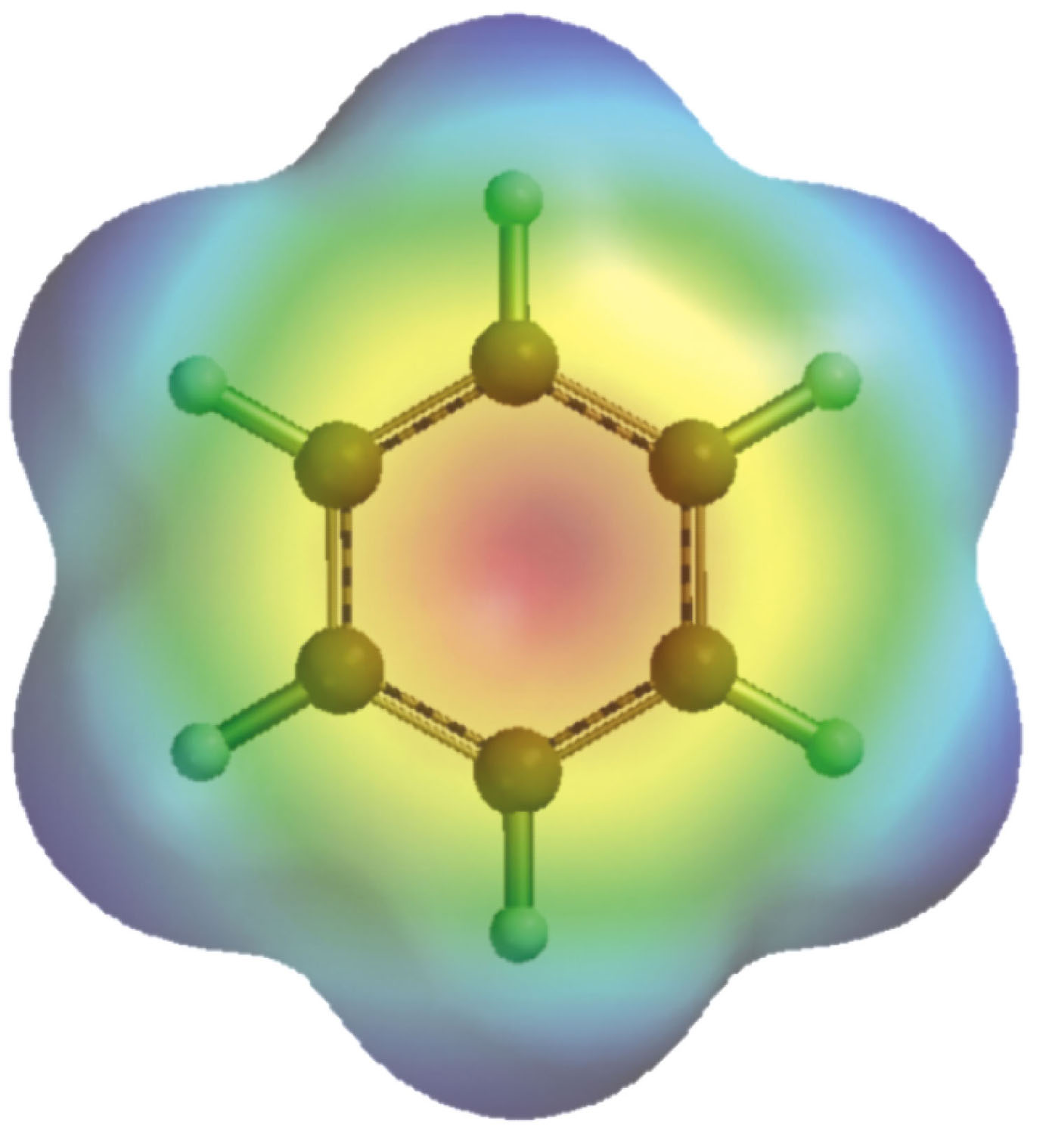
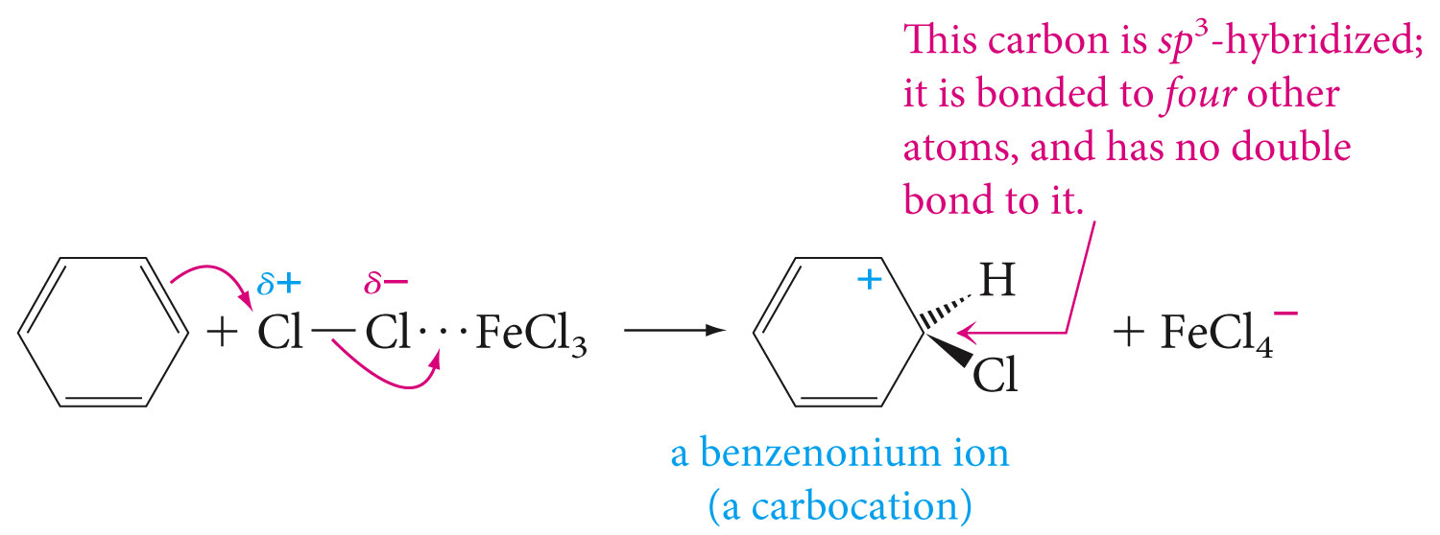

Slide 20
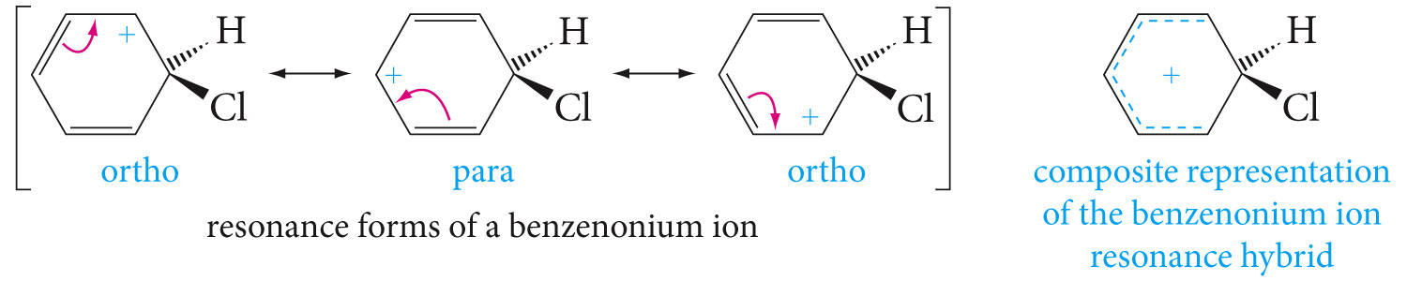
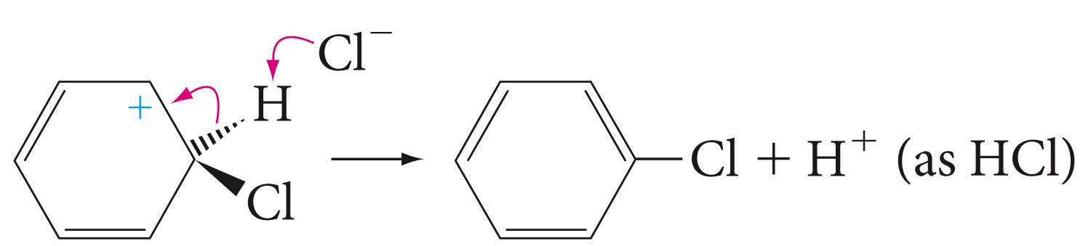

Slide 21
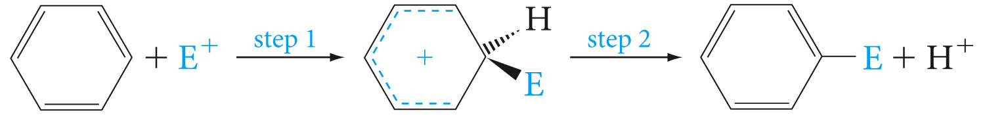
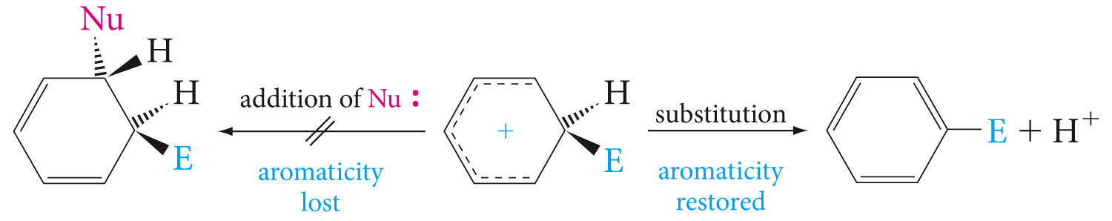

Slide 22
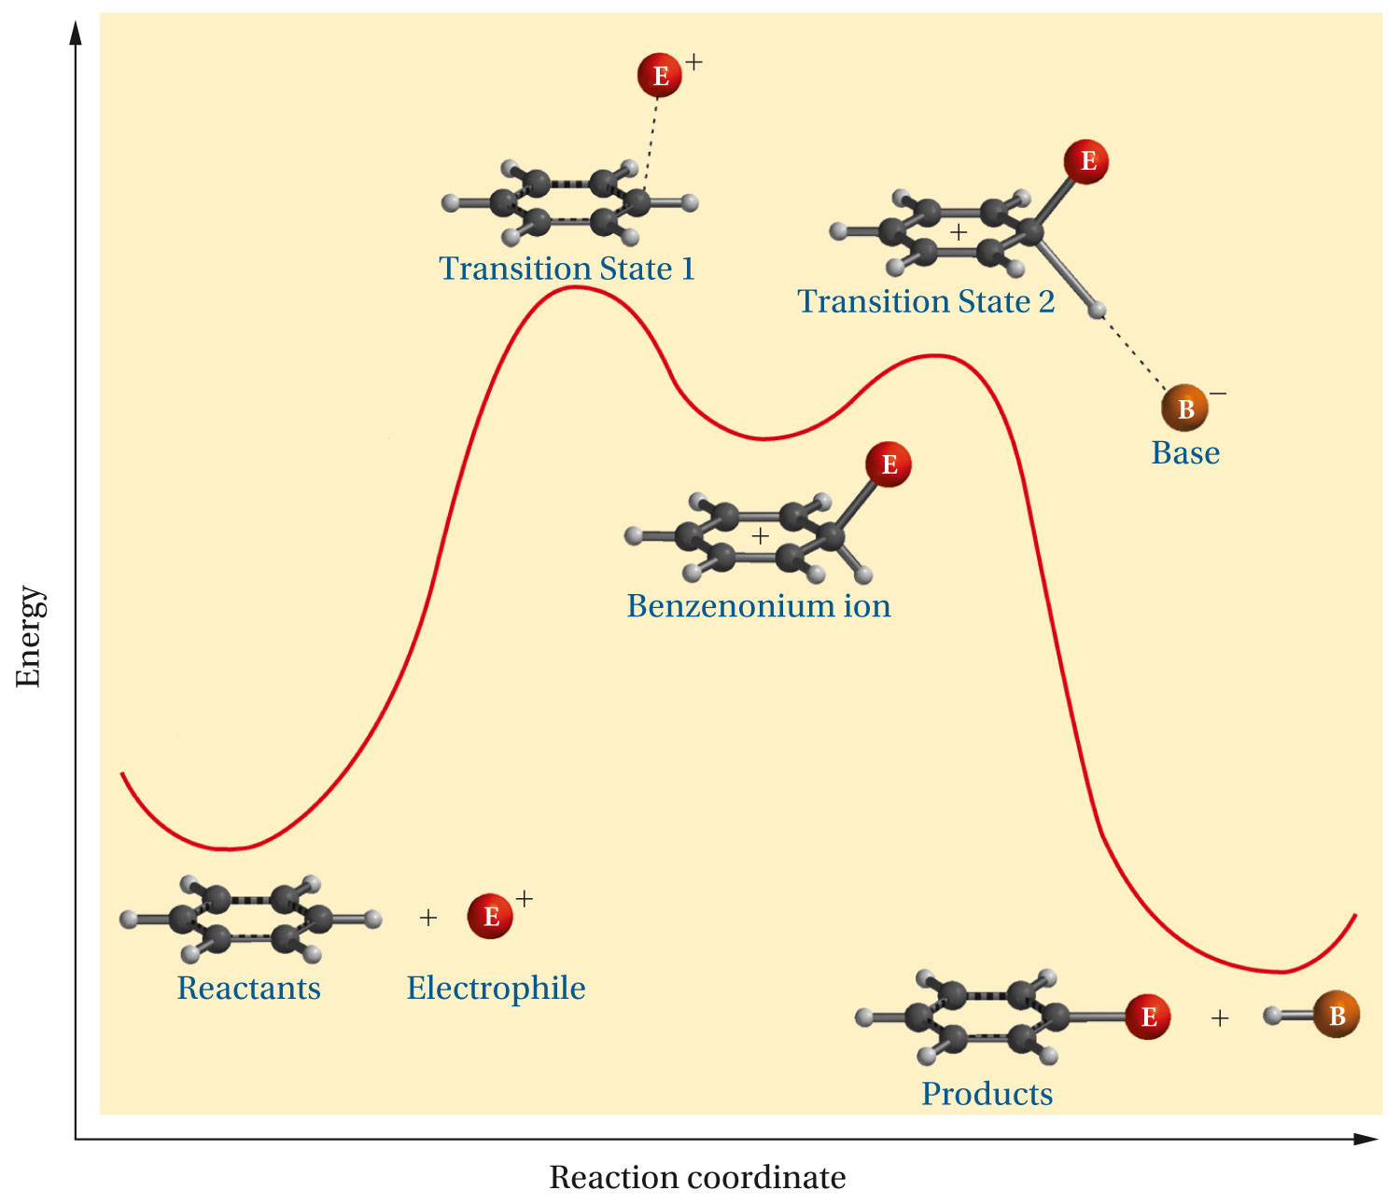

Slide 23
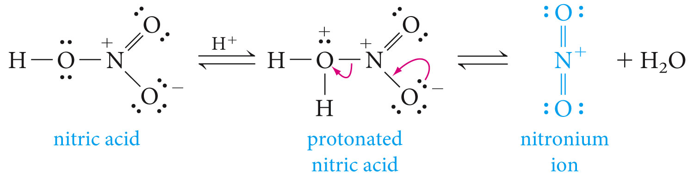
Nitration

Slide 24
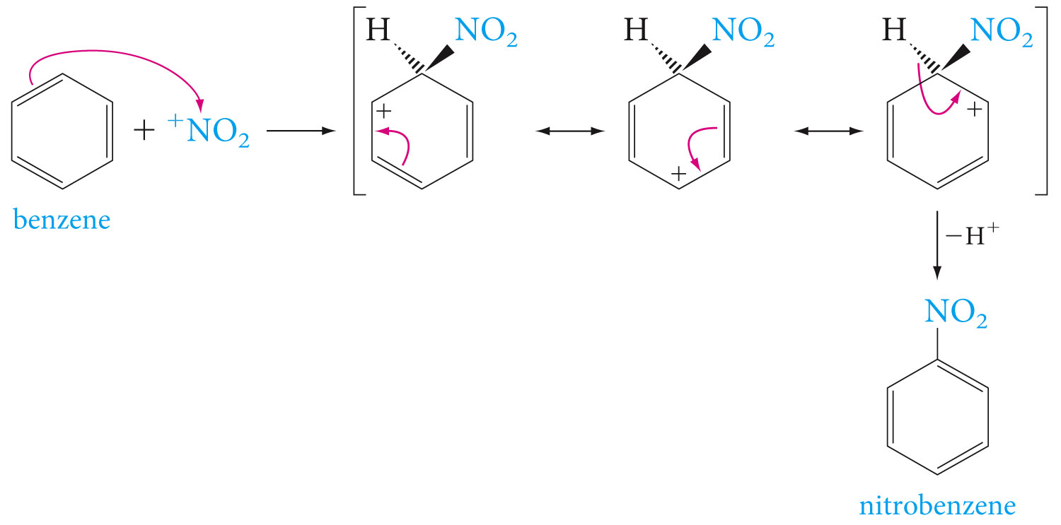

Slide 25
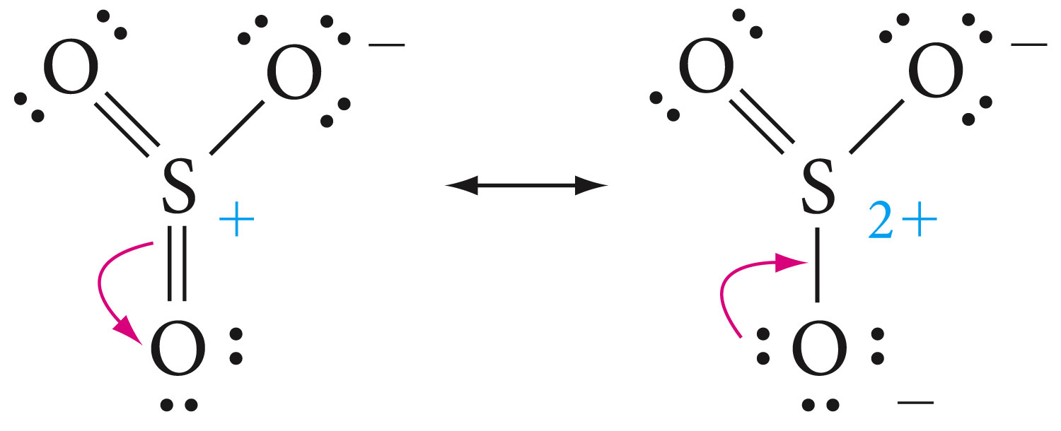
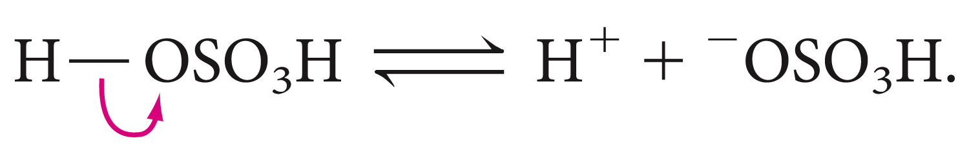
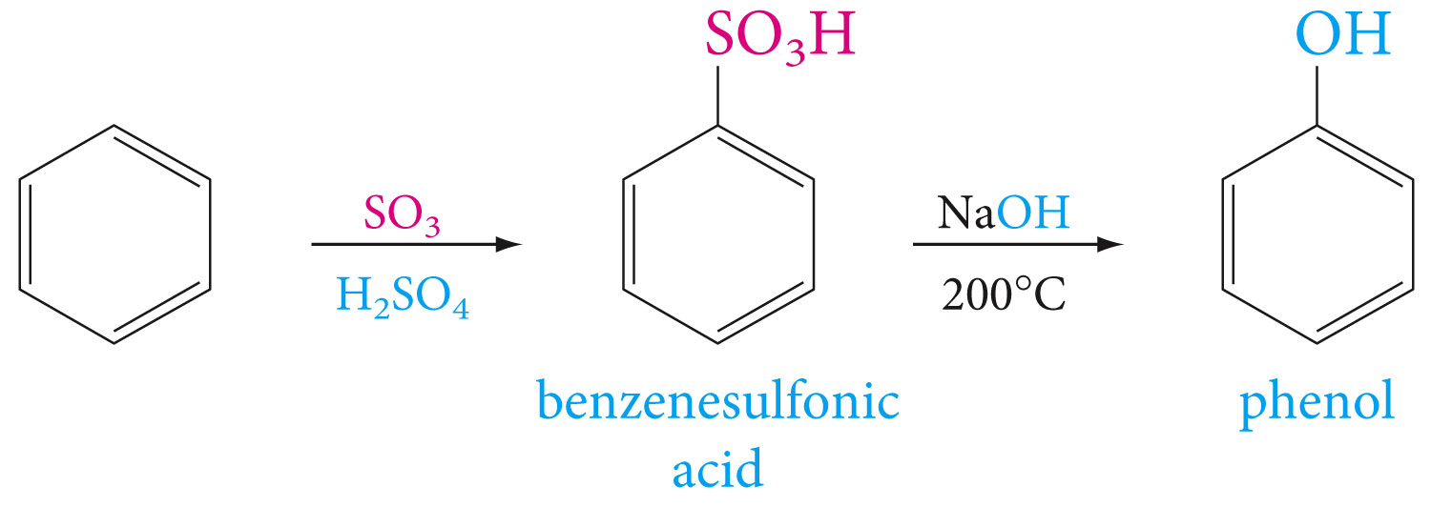
sulfonation

Slide 26
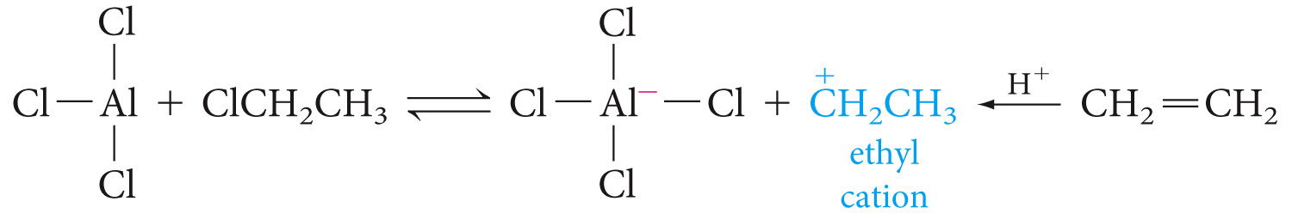
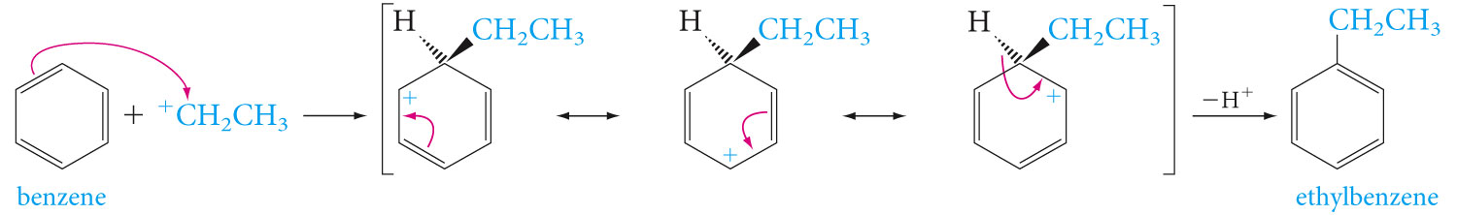
Alkylation and Acylation (Friedel-Crafts reaction)

Slide 27
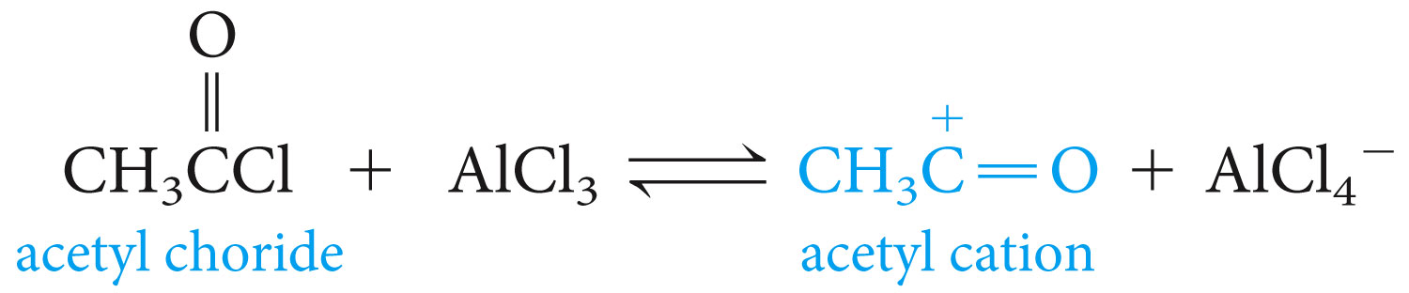
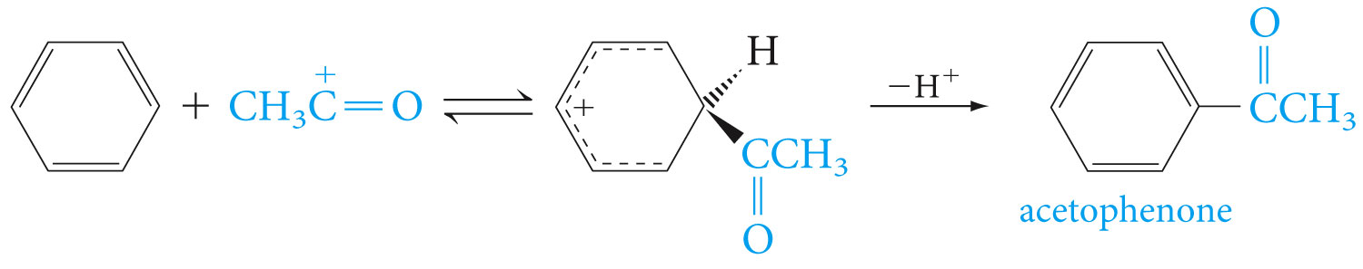

Slide 28
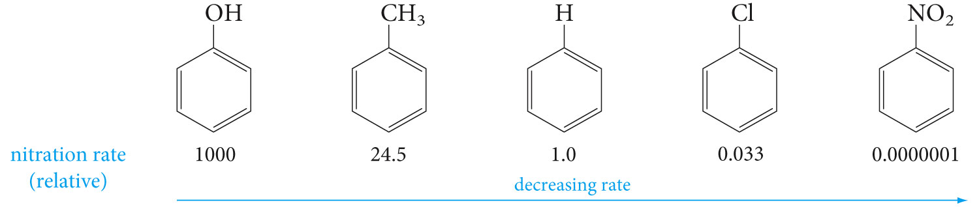
Ring-Activating and ring-Deactivating Substituents

Slide 29
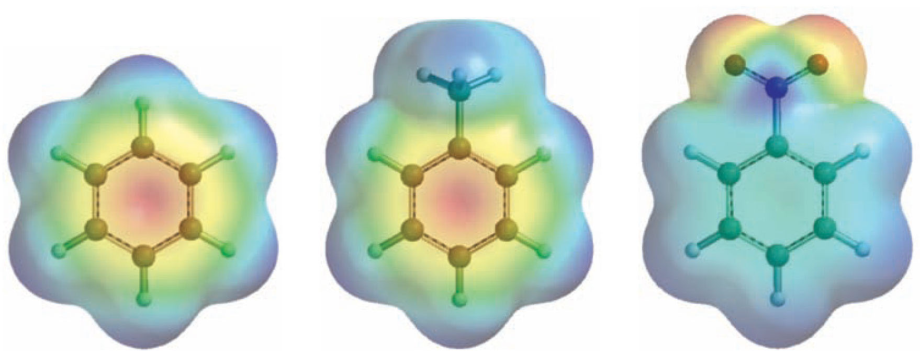

Slide 30
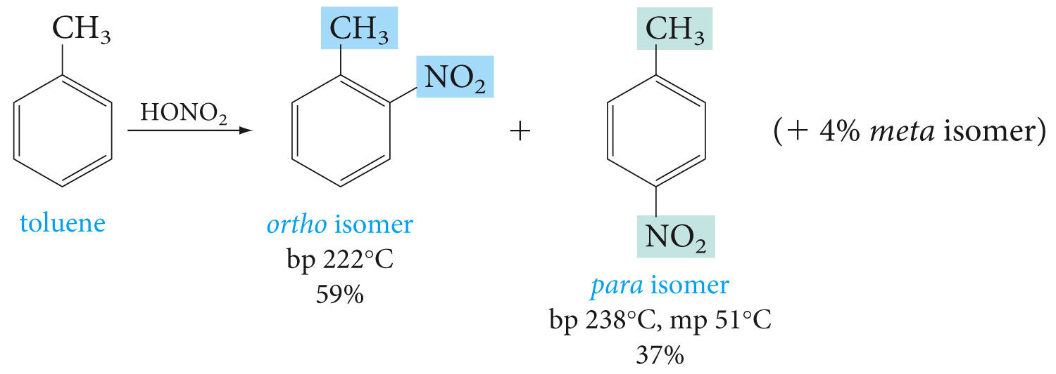
Ortho, Para-Directing and Meta-Directing Groups

Slide 31
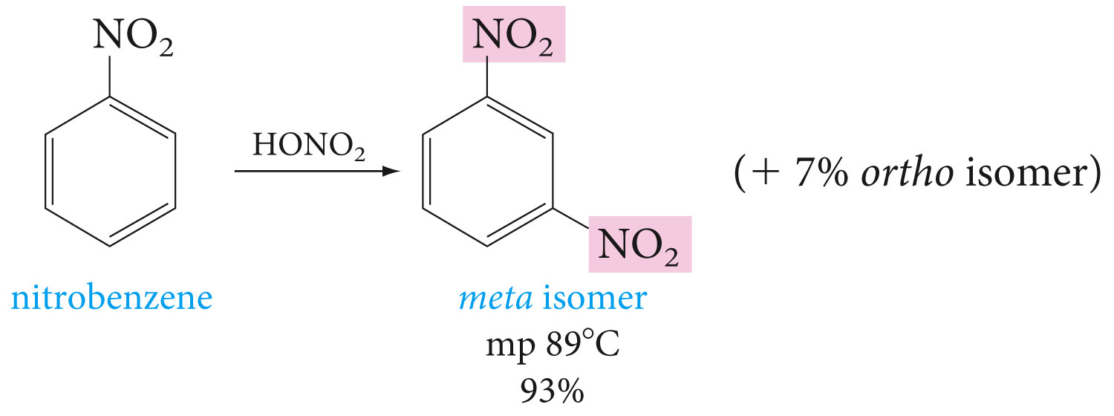

Slide 32
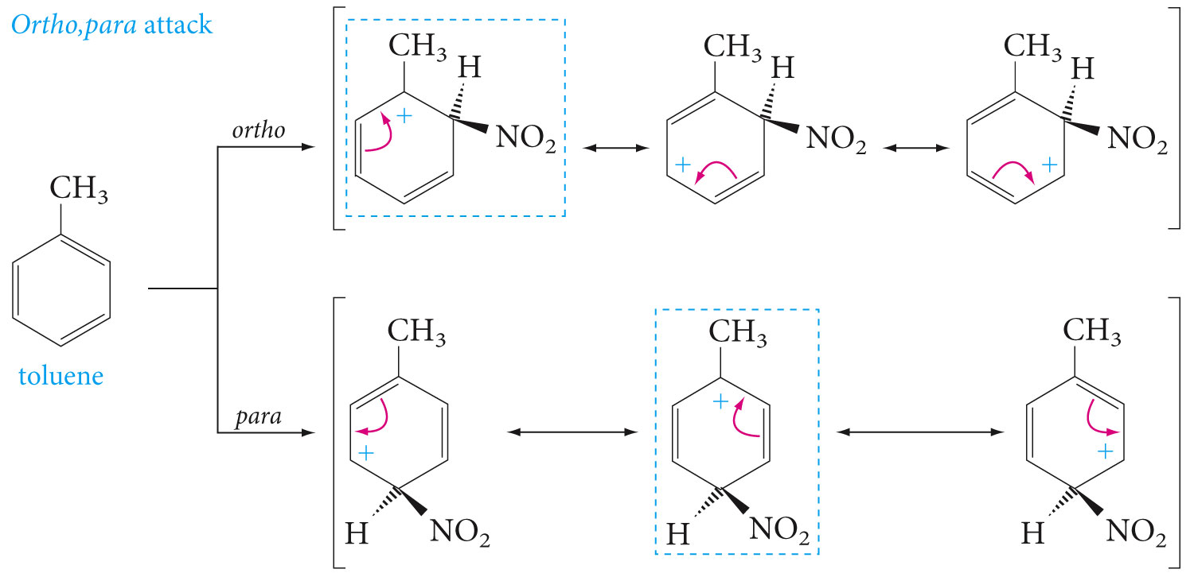
Ortho, Para-Directing Groups

Slide 33


Slide 34



Slide 35


Slide 36


Slide 37


Slide 38


Slide 39


Slide 40

Importance of Directing Effects in Synthesis

Slide 41


Slide 42


Polycyclic Aromatic Hydrocarbons

Slide 43


Slide 44

Fused polycyclic hydrocarbons

Slide 45


Slide 46


Slide 47


