Slide 1
Sections 11.1 – 11.3 Properties of Liquids

Slide 2
Properties of Liquids
In these sections…
Phases of Matter
Phase Changes
Properties of Liquids:
Enthalpy of Vaporization
Boiling Point
Relating Vapor Pressure, Boiling Point and Enthalpy of Vaporization
Surface Tension, Viscosity and Capillary Action

Slide 3
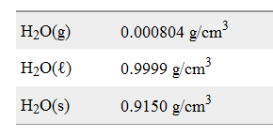
Phases of Matter on the Bulk Scale
Densities of H₂O:

Slide 4
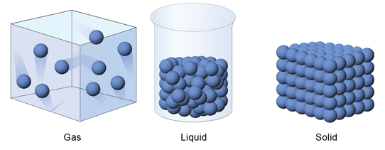
Phases of Matter on the Molecular Scale
All have molecules in motion.
Gases and Liquids have molecules that can move freely.
Liquid and Solids have molecules in close proximity.
Only Solids have molecules that cannot change positions with one another.
Solids and Liquids have molecules held near one another
by Intermolecular Forces (IMFs)

Slide 5
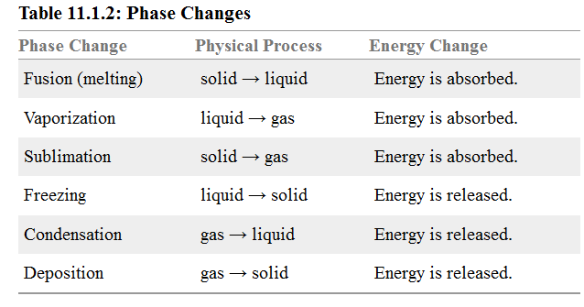
Phase Changes on the Bulk Scale

Slide 6
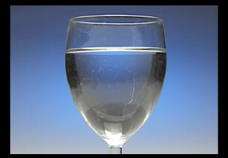
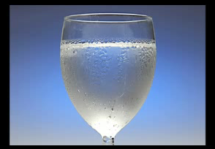
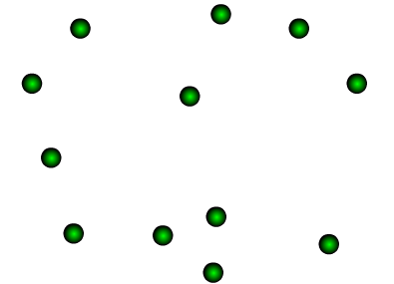
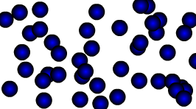
Phase Changes on the Molecular Scale

Slide 7
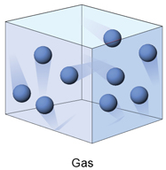
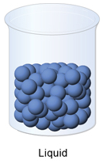
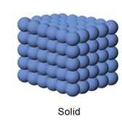
Phase Changes on the Molecular Scale

Slide 8
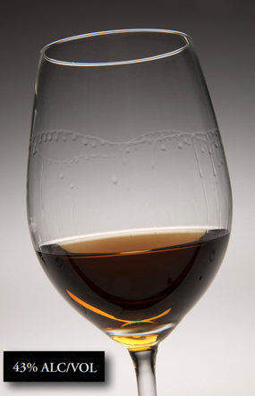
Different Liquids have Different Properties
CH₃CH₂OH
H₂O
In this case: ethanol has higher vapor pressure

Slide 9
Properties of Liquids
Enthalpy of Vaporization: Energy required to vaporize a liquid.
Vapor Pressure: The gas pressure of a vapor
(a vapor is a gas that comes from a liquid vaporizing.)
Boiling Point: Temperature at which vapor pressure reaches
external atmospheric pressure.
Surface Tension: The tendency of a liquid surface to resist change.
Viscosity: The resistance of a liquid to flowing.

Slide 10
Enthalpy of Vaporization
Also called heat of vaporization, ΔH_{vap}.
Energy required to vaporize a liquid to form a gas.
1 mol H₂O(l) → 1 mol H₂O(g) ΔH = 40.7 kJ
So,
ΔH_{vap}(H₂O) = 40.7 kJ/mol

Slide 11
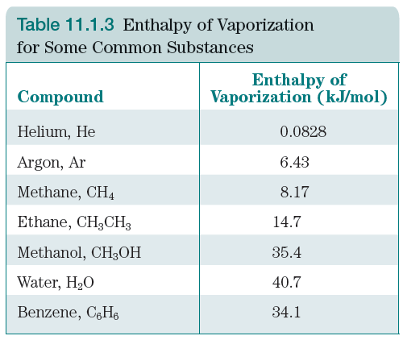
Enthalpy of Vaporization: Trends
Stronger IMFs lead to larger enthalpy of vaporization.

Slide 12
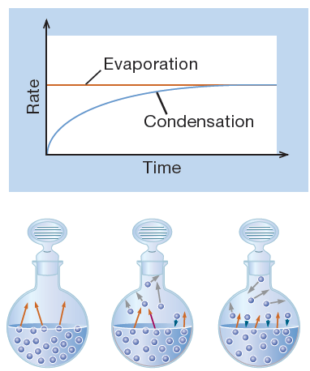
Vapor Pressure
The pressure exerted by a vapor in equilibrium with the liquid from which it vaporizes.
Vapor pressure represents a
“dynamic equilibrium.”

Slide 13
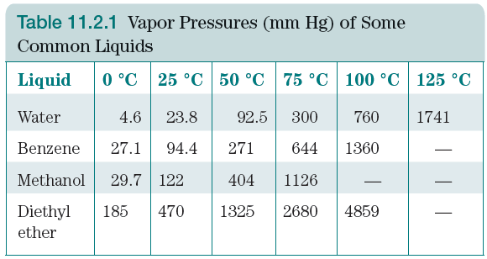
Vapor Pressure: Trends
Vapor pressure increases with increasing temperature.
Strong IMFs lead to low vapor pressure.
simulation

Slide 14
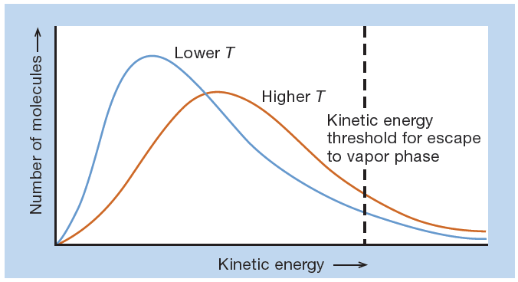
Vapor Pressure: Trends on the Molecular Scale
Vapor pressure increases with increasing temperature.

Slide 15
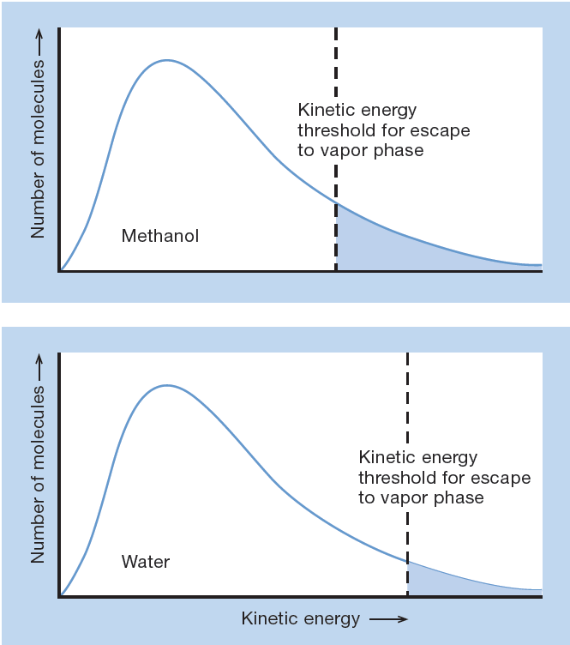
Vapor Pressure: Trends on the Molecular Scale
Strong IMFs lead to
low vapor pressure.

Slide 16
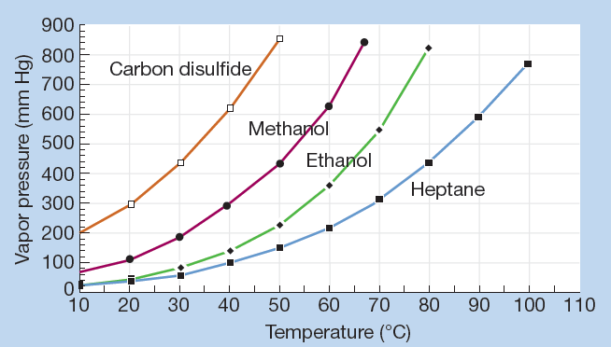
Vapor Pressure and Temperature

Slide 17
Vapor Pressure and Boiling Point
Boiling Point: The temperature at which the vapor pressure
of a liquid reaches the external atmospheric pressure.

Slide 18
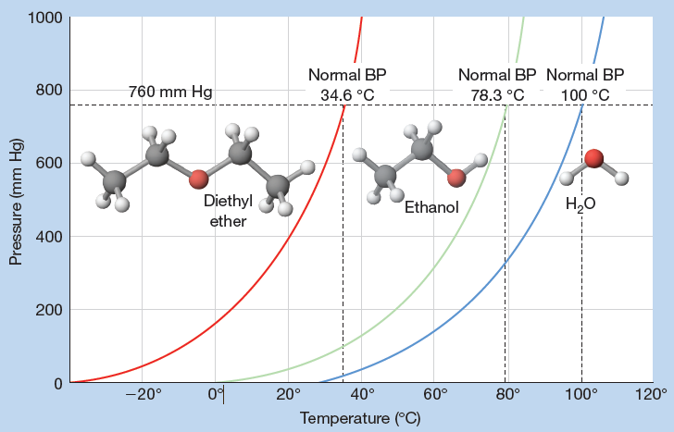
Normal Boiling Point
Normal Boiling Point: The temperature at which the vapor
pressure of a liquid reaches 1 atm (760 mm Hg).

Slide 19
Normal Boiling Point: Trends
Normal Boiling Point increases with increasing IMF strength.

Slide 20
Trends Summary
As IMF Strength

Slide 21
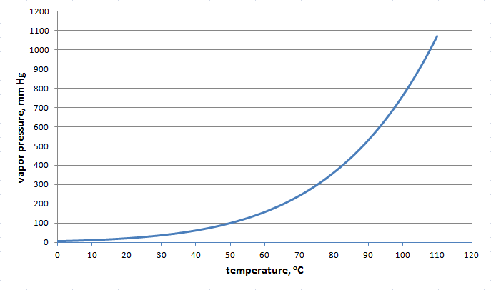
Vapor Pressure Curves: Will it rain?
If the partial pressure of a vapor > vapor pressure, gas will
condense to liquid until pressure drops to vapor pressure.

Slide 22
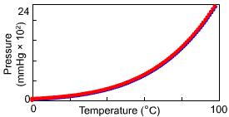
Vapor Pressure, Temperature and ΔH_{vap}
Vapor pressure of
CH₃OH.

Slide 23
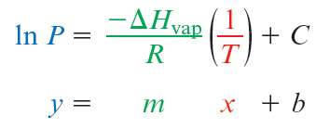
The Clausius-Clapeyron Equation:
Vapor Pressure, Temperature and ΔH_{vap}
Relationship:
R = 8.3145 J/K⋅mol
Straight line version:
Two point version:

Slide 24
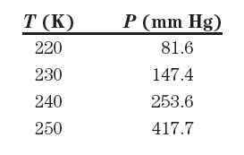
Determining ΔH_{vap} Using Vapor Pressure Data
Straight line version:
Vapor Pressure date for SO₂:
Make a plot of ln(P) vs. 1/T.
Slope = -ΔH_{vap}/R

Slide 25
Using the Two-Point Version of the Clausius-Clapeyron Equation
Two point version:

Slide 26
The vapor pressure of liquid aluminum is 400. mm Hg at 2590 K. Assuming that ΔH_{vap} for Al (296 kJ/mol) does not change significantly with temperature, calculate the vapor pressure of liquid Al at 2560 K.

Slide 27
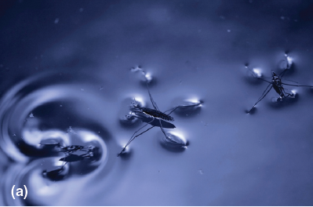
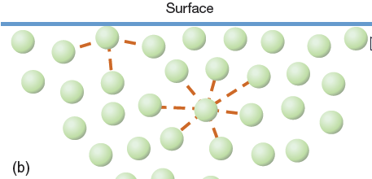
Surface Tension
Surface tension is a measure of force required to "break" the surface of a liquid. Surface tension tries to minimize the amount of surface area.

Slide 28
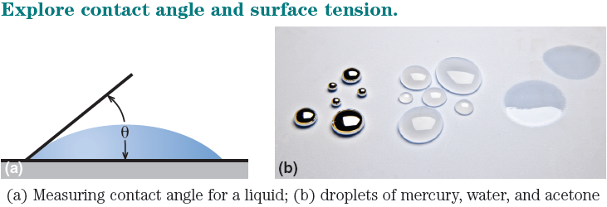
Surface Tension: Drops!
A sphere has the smallest surface area per volume, so liquids want to be spheres.
A drop is a contest between surface tension and gravity.

Slide 29
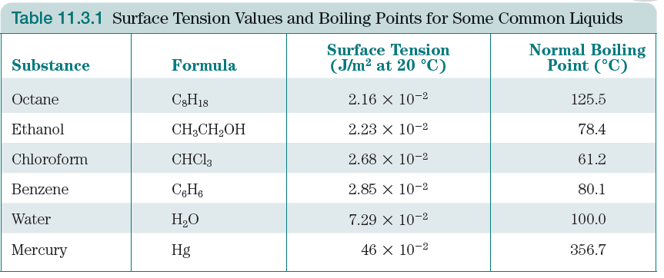
Surface Tension: Trends, such as they are

Slide 30
Viscosity
Viscosity is a measure of a liquid’s resistance to flow.
Water vs. Honey
Corn starch
Mercury
Trends:
Long molecules have high viscosity.
No good correlation with IMF strength.

Slide 31
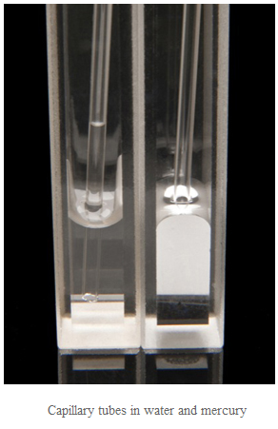
Capillary Action
Movement of a liquid up a capillary tube or up a paper towel are examples of capillary action.
Capillary action represent an
adhesive force.

