Slide 1
Section 13.1 Quantitative Expressions of Concentration

Slide 2
Concentration Units
In this section…
Review of solubility
Concentration units
molarity
weight percent
ppm
ppb
molality
mole fraction

Slide 3
Classifications of Solubility
Solubility = how much solute can dissolve in a solution at a given temperature
Saturated solution:
the solute concentration is at the solubility
limit at a given temperature
Unsaturated solution:
the solute concentration of a solute is less than the solubility
limit at a given temperature

Slide 4
Classifications of Solubility
Supersaturated solution:
the solute concentration exceeds the solubility limit at
a given temperature
Miscible mixture: two liquids that mix completely, forming a single phase
Immiscible mixture: two liquids that do not intermix, forming two phases

Slide 5
Concentration units.
The following examples all describe the
very same solution.
26.0 g NaCl (0.445 mol NaCl)
100. g H₂O (5.55 mol H₂O)
Total volume = 121 mL

Slide 6
Molarity: M or mol solute/L solution
26.0 g NaCl (0.445 mol NaCl)
100. g H₂O (5.55 mol H₂O)
Total volume = 121 mL

Slide 7
Weight percent: %
26.0 g NaCl (0.445 mol NaCl)
100. g H₂O (5.55 mol H₂O)
Total volume = 121 mL

Slide 8
Molality: m or mol solute/kg solvent
26.0 g NaCl (0.445 mol NaCl)
100. g H₂O (5.55 mol H₂O)
Total volume = 121 mL

Slide 9
Mole fraction: χ
26.0 g NaCl (0.445 mol NaCl)
100. g H₂O (5.55 mol H₂O)
Total volume = 121 mL

Slide 10
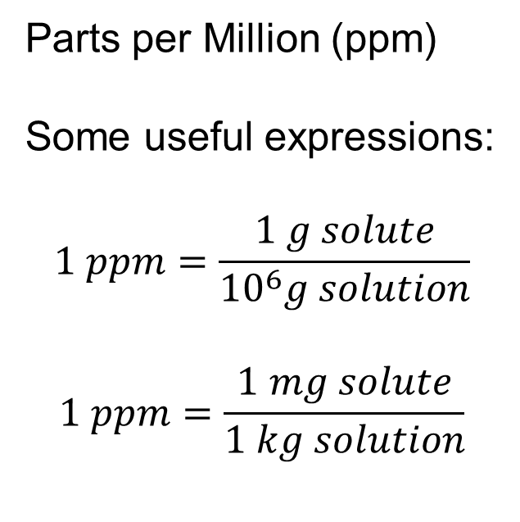
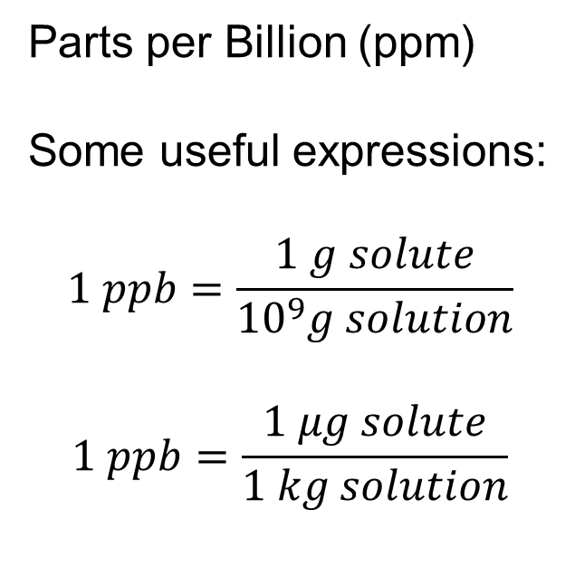
Parts per Million and Parts per Billion: Used for dilute solutions
Parts per Million (ppm)
Some useful expressions:
$$1 ppm=\frac{1 g solute}{{10}^{6}g solution}$$
$$1 ppm=\frac{1 mg solute}{1 kg solution}$$
Parts per Billion (ppm)
Some useful expressions:
$$1 ppb=\frac{1 g solute}{{10}^{9}g solution}$$
$$1 ppb=\frac{1 μg solute}{1 kg solution}$$

Slide 11
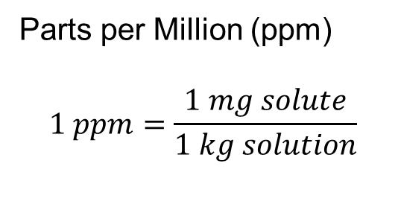
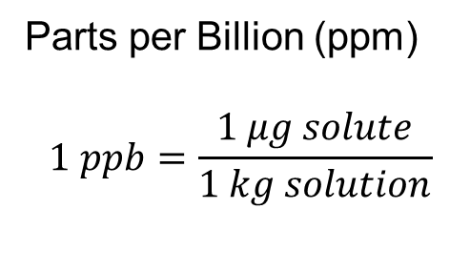
22 mL of a 5% solution of NaOCl is added to a washing machine
that contains 8.6 gal water (= 32.7 L). What is the concentration
NaOCl in ppm and ppb? Assume solution densities = 1 g/mL.
Parts per Million (ppm)
$$1 ppm=\frac{1 mg solute}{1 kg solution}$$
Parts per Billion (ppm)
$$1 ppb=\frac{1 μg solute}{1 kg solution}$$

