Slide 1
Section 13.4 Colligative Properties

Slide 2
Colligative Properties
In this section…
Osmotic pressure
Vapor pressure lowering
Distillation
Boiling point elevation
Freezing Point depression

Slide 3
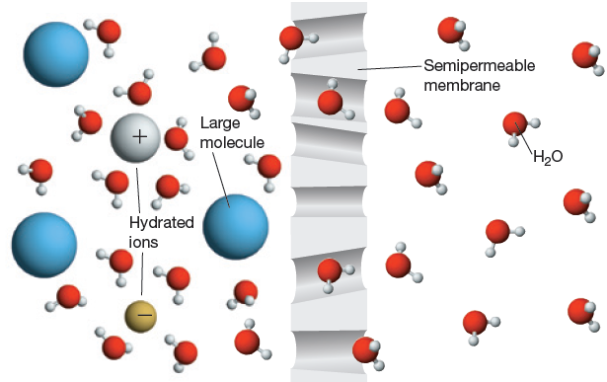
Colligative Properties:
Properties of the solvent that change upon dissolution of a solute
Key #1: This all involves solute particles “blocking” molecules from
leaving the liquid state:
Key# 2: It does not matter what the solute is, just how many particles
(molecules or ions are present)

Slide 4
Osmotic pressure
Osmotic pressure is the amount of
pressure required to prevent the flow of a
solvent across a semipermeable membrane.

Slide 5
Osmotic pressure: Example

Slide 6
Effect of Ions: i = van’t Hoff factor
Ideal Van’t Hoff factors:
NH₃
KCl
CaCl₂
FeBr₃

Slide 7
Osmotic pressure: the van’t Hoff Factor
What is the osmotic pressure of a solution containing 0.249 g CaCl₂ dissolved
In 151 mL of an aqueous solution at 298 K?
The van’t Hoff factor in this solution is 2.8.

Slide 8
Osmotic pressure: the van’t Hoff Factor
What is the osmotic pressure of a solution containing 0.249 g CaCl₂ dissolved
In 151 mL of an aqueous solution at 298 K?
What does a van’t Hoff factor of 2.8 really mean?

Slide 9
Using osmotic pressure to determine molar mass
In a laboratory experiment, a student found that a 229.5-mL aqueous solution
containing 11.34 g of a compound had an osmotic pressure of 15.4 mm Hg at 298 K.
The compound was also found to be nonvolatile and a nonelectrolyte. What is the
molar mass of this compound?

Slide 10
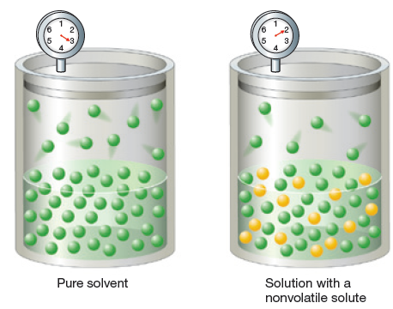
Vapor Pressure Lowering: The Concept
The presence of a nonvolatile solute blocks solvent
molecules from escaping to the gas phase.
P_{solution} α χ_{solvent}

Slide 11
Vapor Pressure Lowering: Raoult’s Law Example
P_{solution} = Pº_{solvent} x χ_{solvent} x i
The vapor pressure of hexane (C₆H₁₄) at 50 °C is 399 mm Hg.
What is the vapor pressure of a solution consisting of 70.0 g hexane
and 0.100 mol of a solute that is a nonvolatile nonelectrolyte?

Slide 12
Distillation: Changing the composition of a mixture of volatile liquids
Vapor Pressures at 50 ºC
Water 99 mm Hg
Ethanol 232 mmHg
Distill a 10% alcohol solution.

Slide 13
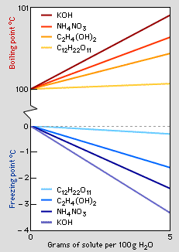
Freezing and Boiling Point Changes:
The presence of a solute
keeps molecules in the liquid
phase and therefore extends
the temperature range the
substance exists as a liquid.

Slide 14
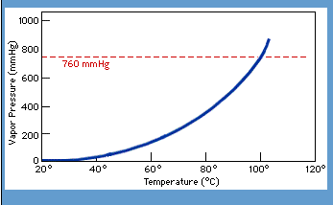
Boiling Point Elevation: An extension of Vapor Pressure Lowering
The presence of a solute lowers the vapor pressure,
meaning a higher temperature must be reached for
the vapor pressure to reach 1 atm.

Slide 15
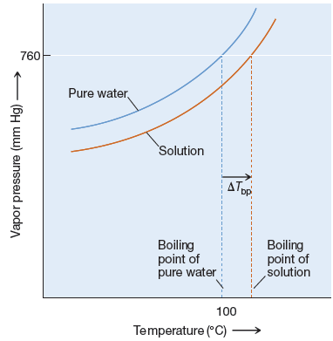
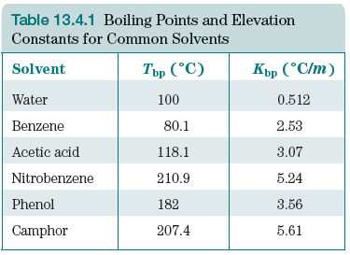
Boiling Point Elevation

Slide 16
Boiling Point Elevation: Example
What is the boiling point of a solution
containing 40.0 g I₂ and 250 g
benzene (C₆H₆)?

Slide 17
Use Boiling Point Elevation to Determine Molar Mass
0.315 g of an unknown compound (a
nonvolatile nonelectrolyte) and 25 g of
CHCl₃ has a boiling point of 62.09 °C.
The normal boiling point of CHCl₃ is
61.70 °C. What is the molar mass of
the compound?
(K_{bp} = 3.63 °C/m for CHCl₃)

Slide 18
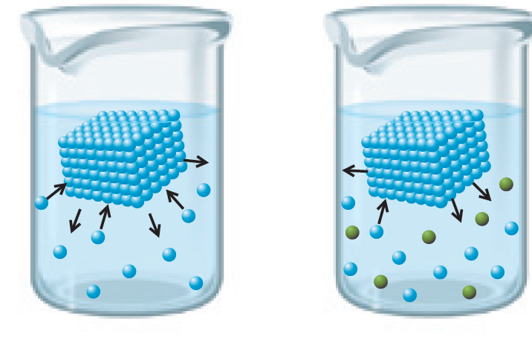
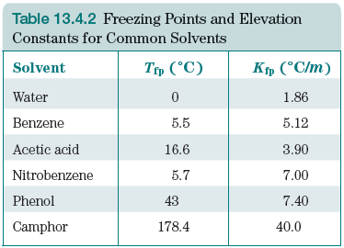
Freezing Point Depression

Slide 19
Freezing Point Depression
What is the freezing point of a solution
containing 40.0 g I₂, a nonelectrolyte,
and 250 g benzene (C₆H₆)?

Slide 20
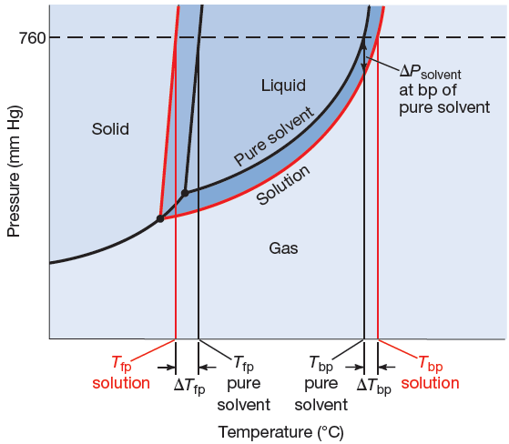
Freezing and Boiling Point Changes & Phase Diagrams

