Slide 1
Section 4.1 and 4.2 Types of Chemical Reactions and Aqueous Solutions

Slide 2
In this section: a. Types of Chemical reactions 1. Combination reactions 2. Decomposition reactions 3. Displacement reactions b. Aqueous Solutions 1. Compounds in aqueous solution 2. Electrolytes 3. Solubility of ionic compounds

Slide 3
Combination Reactions
Two or more reactants form a single product

Slide 4
Decomposition Reactions
A single reactant breaks up to form two or more products

Slide 5
Single Displacement Reactions
One “part” of a compound is replaced by another

Slide 6
Double Displacement Reactions Metathesis Reactions
Two atoms or ions exchange.

Slide 7
Two atoms or ions exchange.
Precipitation reactions:

Slide 8
Two atoms or ions exchange.
Acid-base (neutralization) reactions:

Slide 9
Two atoms or ions exchange.
Gas-forming reactions:

Slide 10
Aqueous Solutions
Solutes dissolved in the solvent water.
Categorized by the nature
of the dissolved species.

Slide 11
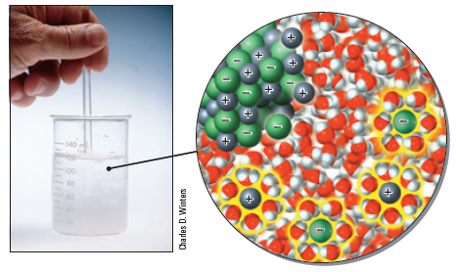
Aqueous Solutions: Electrolytes
Solutes dissolved in the solvent water.

Slide 12
Aqueous Solutions: Electrolytes
Strong Electrolytes:
all solute dissociates to form ions in solution.

Slide 13
Aqueous Solutions: Electrolytes
Weak Electrolytes:
A small fraction of solute dissociates to form ions in solution.
HF(aq) H⁺(aq) + F⁻(aq)

Slide 14
Aqueous Solutions: Electrolytes
Nonelectrolytes:
Solute molecules do not form ions in solution.
Example: CH₃OH

Slide 15
Aqueous Solutions: Electrolytes
Strong electrolytes: conduct electricity well
soluble ionic compounds
strong acids
Weak electrolyte: conduct electricity poorly
weak acids and the weak base NH3
Nonelectrolytes: do not conduct electricity
most molecular, covalent compounds

Slide 16
Solubility of Ionic Compounds
Basic Idea:
for ionic compound MX (M⁺ cation and X⁻ anion)
When added to water, does:
MX(s) M⁺(aq) + X⁻(aq)
happen?
Yes: compound is soluble in water
No: compound is insoluble in water

Slide 17
Solubility of Ionic Compounds
A little more complicated: how soluble is soluble?
1 g solute per 100 g water.

Slide 18
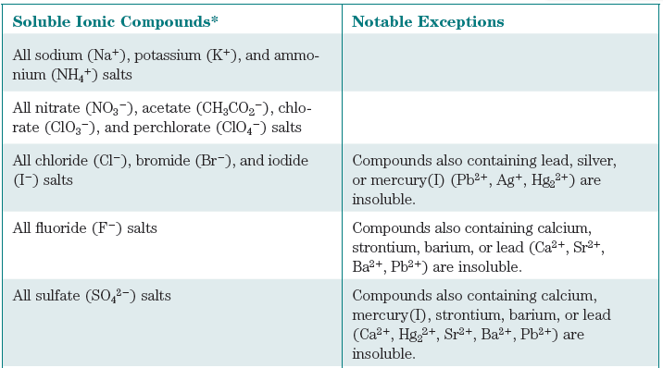
Solubility Rules
Part 1: things that are generally soluble

Slide 19
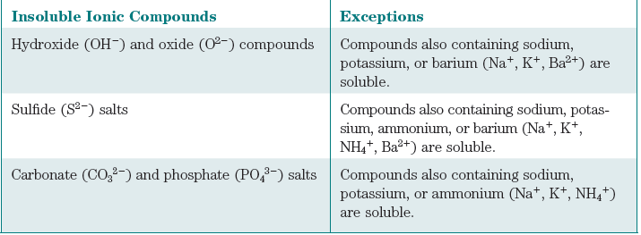
Solubility Rules
Part 1: things that are generally insoluble

Slide 20
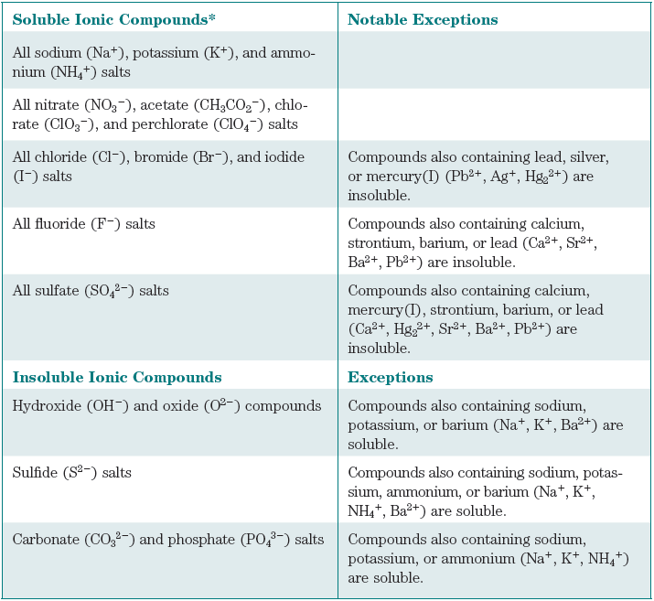

Slide 23
Section 4.4 Oxidation Reduction Reactions
Redox Reactions
Electron-Transfer Reactions

Slide 24
In this section:
oxidation and reduction
oxidation numbers
recognizing redox reactions
predicting redox reactions
Not from this section:
a. Organic reactions

Slide 25
Oxidation-Reduction Reactions
Oxidation = loss of electrons
Reduction = gain of electrons
Zn(s) + Cu²⁺(aq) → Zn²⁺(aq) + Cu(s)
Oxidation Half-Reaction: Zn(s) → Zn²⁺(aq) + 2 e⁻
Reduction Half-Reaction: Cu²⁺(aq) + 2 e⁻ → Cu(s)

Slide 26
Oxidation-Reduction Reactions
Oxidation = loss of electrons
Reduction = gain of electrons
Zn(s) + Cu²⁺(aq) → Zn²⁺(aq) + Cu(s)
Oxidizing agent = oxidant = gains electrons
Reducing agent = reductant = loses electrons

Slide 27
Balancing Simple Redox Reactions
Cu(s) + Ag⁺(aq) → Cu²⁺(aq) + 2 Ag(s)

Slide 28
Oxidation Numbers
Electron tracking method.
Oxidation numbers do not imply charges.

Slide 29
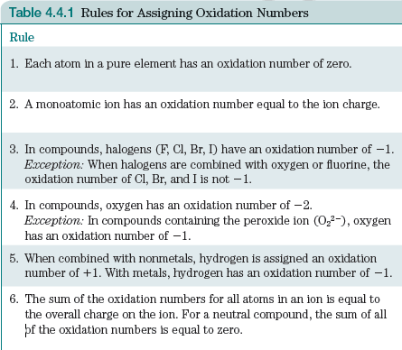

Slide 30
Examples:
N in N₂
Fe in Fe³⁺
N in NO₂⁻
O in H₂O
Cl in NaOCl
Mn in MnO₄⁻

Slide 31
Recognizing Oxidation-Reduction Reactions
Oxidation = loss of electrons = increase in ox #
Reduction = gain of electrons = decrease in ox #
4 Fe + 3 O₂ → 2 Fe₂O₃

Slide 32
CuO(s) + H₂(g) → Cu(s) + H₂O()
CaCO₃(s) → CaO(s) + CO₂(g)

Slide 33
MnO₄⁻(aq) + 5 Fe²⁺(aq) + 8 H⁺(aq) → Mn²⁺(aq) + 4 H₂O() + 5 Fe³⁺(aq)

Slide 34
Predicting Redox Reactions

Slide 35
Organic Reactions
A. Combustion Reactions
Reaction with oxygen gas to form CO₂ and H₂O.
C₃H₈(g) + 5 O₂(g) → 3 CO₂(g) + 4 H₂O(l)
B. Substitution Reactions
Exchange of one atom or molecular fragment.

Slide 36
C. Addition Reactions
Addition of two molecules together.
D. Elimination Reactions
Ejection of a small molecule from a larger one.

Slide 37
E. Isomerization (Rearrangement) Reactions
Change of shape of a molecule without gain or loss of any atoms.

